Slide 1
Brand Protection and eCommerce Case Law Update
PRESENTED BY
Laura Erdman
Partner Vorys, Sater, Seymour and Pease LLP
Adam Sherman
Partner Vorys, Sater, Seymour and Pease LLP

Slide 2
9th Circuit Clarifies Personal Jurisdiction Test for Online Sellers
Herbal Brands Inc. v. Photoplaza Inc., No. 21-17001 (9th Cir. 2023)
Online seller defendants can be sued in brand’s state if:
(1) the seller is selling products online that allegedly infringe the brand’s trademarks;
(2) the seller learns that its sales are allegedly harming the brand where the brand is located;
(3) after learning this, the seller continues to sell products into the brand’s state “as part of the seller’s regular course of business,” and
(4) the seller has “some level of control” over where its products are sold.

Slide 3
9th Circuit Clarifies Personal Jurisdiction Test for Online Sellers
Herbal Brands Inc. v. Photoplaza Inc., No. 21-17001 (9th Cir. 2023)
The 9th Circuit
rejected the common argument than an online seller must “specifically target” the brand’s state over other states
held that an online seller’s use of Fulfillment by Amazon does not alter the analysis
What to remember:
Decision gives brands/trademark owners additional flexibility and power in protecting their trademarks against unauthorized sellers
Decision is likely to be persuasive in other jurisdictions because few courts have examined personal jurisdiction in the online marketplace context
If a brand wants to sue unauthorized sellers in the brand’s home state, the brand should notify the seller explicitly that the unauthorized sales are causing harm in the brand’s home state

Slide 4
U.S. Supreme Court Cabins Extraterritorial Reach of the Lanham Act
Abitron Austria GmbH, et al. v. Hetronic Inter’l, Inc., No. 21-1043 (2023)
A U.S.-based manufacturer sued German/Austrian-based resellers in the U.S. based on unauthorized sales, seeking damages worldwide. The vast majority of the defendant’s sales occurred in Europe.
Held: The Lanham Act does not apply extraterritorially, and that the Lanham Act is designed to target the infringing “use in commerce” of a trademark that occurs in the U.S.
What to remember:
Brands should be vigilant in seeking trademark protection in foreign jurisdictions where they do business. While relying on U.S. rights for enforcement outside the U.S. was never a great strategy, this decision further limits that possibility.
The critical inquiry is where the “use” of the trademark occurred, not where the resulting confusion or lost profits occurred. Where “use” occurs may provide some leeway in the analysis.

Slide 5
INFORM Act
Integrity, Notification, and Fairness in Online Retail Marketplaces for Consumers Act – H.R. 2617
Federal law - effective June 27, 2023
Requires online marketplaces to collect and verify contact information from high-volume sellers: 200 or more sales transactions and $5,000 or more in revenue in a consecutive 12-month period.
Requires sellers who have $20,000 or more in annual revenue to disclose this contact information to consumers.
Online marketplaces must suspend seller accounts violating the Act until compliance, and must provide reporting mechanism for consumers to report bad behavior by sellers.
“Contact information” includes names and government/tax ID information, and current working email addresses and phone numbers.
No private right of action.

Slide 6
INFORM Act
Integrity, Notification, and Fairness in Online Retail Marketplaces for Consumers Act – H.R. 2617
Impacts of the INFORM Act (so far):
Since it became effective, we have not noticed any differences in the contact information disclosed on the vast majority of third-party storefronts, and certainly no decrease in the amount of false, fake, and incomplete contact information displayed on storefronts.
It will likely be several months before we start to see further action by the marketplaces to comply or any action taken by the FTC and state attorneys’ general under the Act.

Slide 7
Amazon Increases Efforts to Combat Fake Product Reviews
Amazon has filed lawsuits against companies that
solicit or create fake reviews of products sold on Amazon
entice fraudulent positive reviews about sellers or false negative reviews about competing sellers
Through May 2023, Amazon had filed 94 lawsuits targeting the “fake review broker” industry – and has filed more since
But Amazon has said it also recognizes that the keys to combatting fake reviews are information-sharing among industry leaders and law enforcement, vigilance by online service providers, and better legislation.
It is unclear whether these lawsuits are having a deterrent effect, or merely pushing these schemes to other social media platforms.

Slide 8
Declaratory Judgment Actions by Online Sellers
Impetus is often an inaccurate or improper Amazon Brand Registry IP infringement complaint
Recent uptick in lawsuits filed by online sellers against brands for declaratory judgment of non-infringement
Often arise after the brand has submitted a notice through Amazon Brand Registry notifying Amazon that a product listing infringes the brand’s trademarks.
Brand Registry notices that draw legal action are often inaccurate or improper. But when done right, these notices are legitimate and defensible, and these cases are often dismissed.
It is critical for brands to carefully submit these notices and use experts knowledgeable in trademark law, online sales, and Amazon to advise on or submit them for the brand.

Slide 9
Online Marketplaces 101

Slide 10






Two Types of Online Marketplace Models
Shared Listing Model
Separate Listing Model

Slide 11

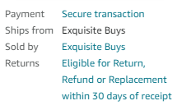
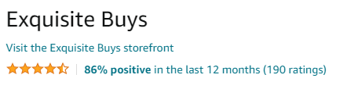
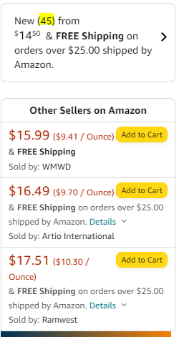
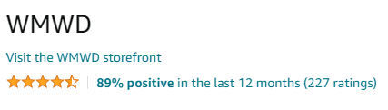
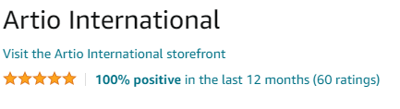
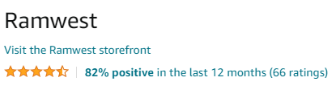
Multiple Sellers on Identical Product Listings

Slide 12
Selling Models on Online Marketplaces
1P
3P
(unrelated)
3P (brand-operated)
Brand wholesales product to Amazon. Amazon sells the product to the consumer.
Brand wholesales product to a third-party seller. Third-party seller sells the product to the consumer via the seller’s storefront on marketplace.
Brand sells the product to the consumer via a brand-operated third-party storefront on marketplace.

Slide 13
Rogues Defined
Amazon
Defined
Rogue ASIN – unauthorized/unofficial client branded product listing on Amazon.
Rogue Seller – Amazon based seller that has not been authorized to sell on any of your branded product listings.
OFFICIAL ASINS
ROGUE SELLERS
ROGUE
ASINS
Why monitor Rogues?
Rogue sellers can take significant portions of revenue share by creating & selling under both Rogue and official ASINs. Rogue ASINs are more likely to be selling counterfeit, expired, or outdated versions of your product which will result in a diminished brand reputation. It is critical to monitor Rogue activities as well as authorized activity to achieve comprehensive coverage on Amazon.

Slide 14
How Online Marketplaces Cause Omnichannel Disruption in the Age of eCommerce

Slide 15


Transformation of 21st Century Commerce: The Old World
Open distribution models
Decades-old distribution contracts
Geographies operating in silos
No transparency
Minimal disruption from unauthorized sellers
15

Slide 16
Transformation of 21st Century Commerce: The New World
Transparency regionally, nationally, and globally
Highly-disruptive marketplace algorithms and scraping technology
Anonymous, unauthorized sellers
New capabilities required to win
Brands must limit intrabrand competition on marketplaces to succeed – tightly control marketplace distribution
16

Slide 17
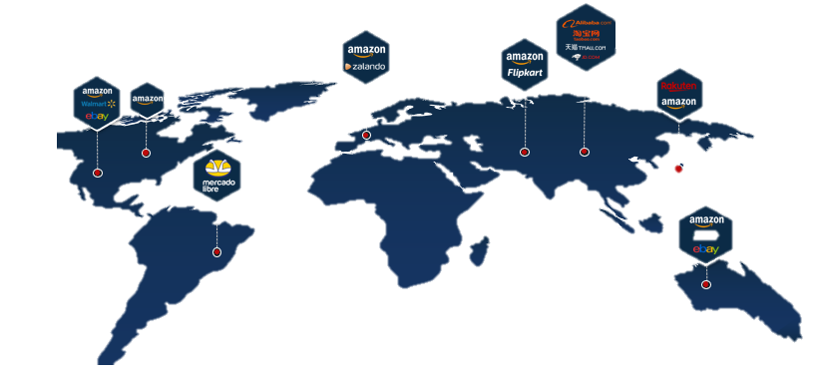
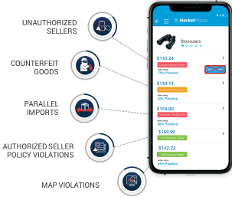

Marketplace Channels Are Easily Disrupted
Online Marketplaces Are Rapidly Expanding Globally
Uncontrolled Distribution
Many Disruptors
Distributors
Dealers
Co-ops
Unauthorized
Online
Sellers
Retailers
$5T+ GMV
24% of Global Online Retail Sales
1M+ New Amazon Sellers Per Year
END CUSTOMERS

Slide 18



Omnichannel Disruption Soon Follows
Threatens to no longer carry products
CRaP
Moves products to bottom shelves
Google Search Results
National D2C Seller
Amazon
Walmart
Counterfeit on marketplace in Google Shopping at $18.00
$30
$30
$30
$29.99
$27.99
Wish.com Unauthorized Seller Product Listing $22.00
$
AMZ $28.99
SUPPRESSED
WMZ $27
AMZ $27
WMZ $25
25% Promotion $22.50
$26.99
WMZ $22.50
Brand
AMZ $25.99
Marketplaces, Domains & Websites, Paid Search, Social, Apps.
Counterfeit, IP Infringement, Fraud
$20
MSRP/MAP Policy $30
$24.99
AMZ $22.50
Suppressed from counterfeit
Poor Quality
1 Star “Helpful” Tags by Others
Diverter
Amazon
Walmart
ABC Regional Seller on Walmart
Anonymous (Distributor) on Amazon
Anonymous (Diverter) on Walmart
Distributor
$30
$15 Volume Pricing/Incentives
Regional D2C Seller

Slide 19

Lack of Marketplace Control Triggers a Profitability Death Spiral
Across All Channels
1
eCommerce Booms
3P sellers flock to marketplaces
2
3
Intrabrand competition drives down brand value
Lost buy box
4
5
Brick & mortar match online prices
Retail profits decline
6
7
eCommerce profits decline
All channels less profitable
8

Slide 20




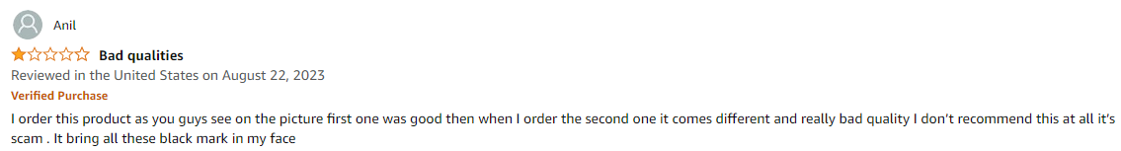
Lack of Marketplace Control Leads to a Poor Consumer Experience

Slide 21
Expanding Impact of Uncontrolled Marketplaces
Revenue/ Margin Impacts | Annual Estimated Value
Impact of Amazon Average Selling Prices below MAP | Units Sold*(MAP ASP – below MAP ASP)
Amazon listing suppression | Units*(1P or 3P Price)
Buy box loss value | Units*Retail Price (or BB Price)
Amazon margin chargebacks | Units*(Target PPM - Actual PPM)
Amazon price negotiations | Units*(Old PPU – New PPU)
Retailer price match chargebacks | Units*(Desired ASP – Price Match)
Retailer/Distributor price negotiations | Units*(Old PPU – New PPU)
Value of products retailers/distributors refuse to carry | Units*Retailer Price
Value of Amazon CRaPed out products | Units*Amazon Price
Shift product sales from low margin diverters to high margin authorized | Units*(HM Price-LM Price)
Competitors take share opportunity | $ value of target % of competitor share take
Price Concessions, Other Financial Considerations | Total Cost of Concessions
Total Business Impact | $$$$$$$$

Slide 22



Control Creates Exponential Impact For Brands Across Channels
OMNICHANNEL PERFORMANCE
Better Business @ Brick & Mortar
MARKETPLACE CHANNEL PERFORMANCE
Sales Growth
Better Leverage
on Platforms
Marketplace
Control
Improved Ad Performance
LISTING PERFORMANCE
Improved Margins
Better Consumer Experience
Buy Box Ownership
Improved Inventory Management
Stabilized Advertised Pricing
Improved Reviews
Stronger Brand Equity
Improved Product Quality
Improved Ranking

Slide 23
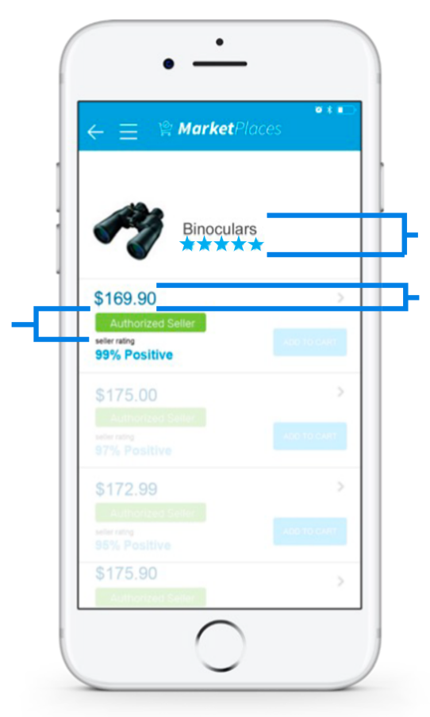







Making Optimal Marketplace Growth a Reality
Increased
Sales
Increased
Sales
Lost Sales
No Brand Control
Brand Control
Authorized Seller 50% of Sales
Authorized Seller
95% of Sales
MAP Compliant
Protect Brand Value
Brand Equity Erosion
No MAP Compliance
Other Sellers 50% of Sales
Eliminate Channel Conflict
Other Sellers 50% of Sales
Upset Channels
Negative Reviews
Improve Brand Representation

Slide 24
Control Requires a Holistic Solution
Optimize Online Marketplace Distribution
Investigation, Enforcement & Root Cause Mitigation
Authorized Reseller Program
GROW SALES
Technology & Data Insights
Unauthorized Seller Legal Foundation
Minimum Advertised Price Policy
(if applicable)

Slide 25



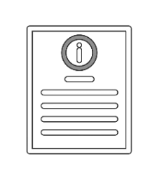

Control Requires Buy-in and Support from Cross-Functional Team
Sales
Compliance
eCommerce
Marketing
Customer
Care
Legal

