Slide 1
Partnering Between Established Companies and Startups
Joe Pennell, Mayer brown stephanie wilkins, rush street interactive drew Wojciechowski, awardco Scott young, Mayer brown

Slide 2


Slide 3
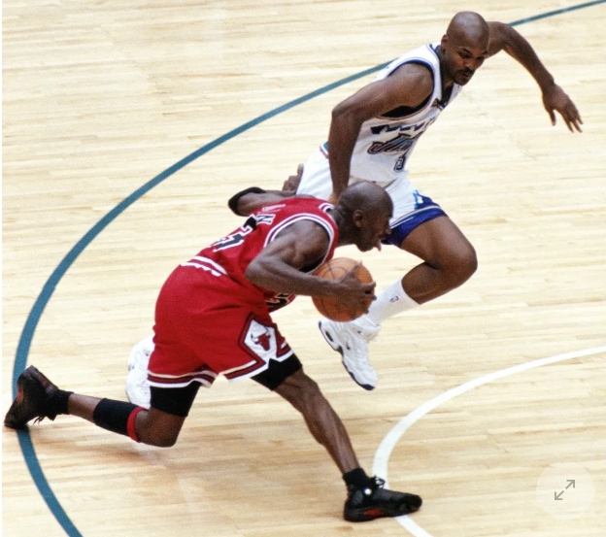
1998: Jordan’s Last Shot

Slide 4
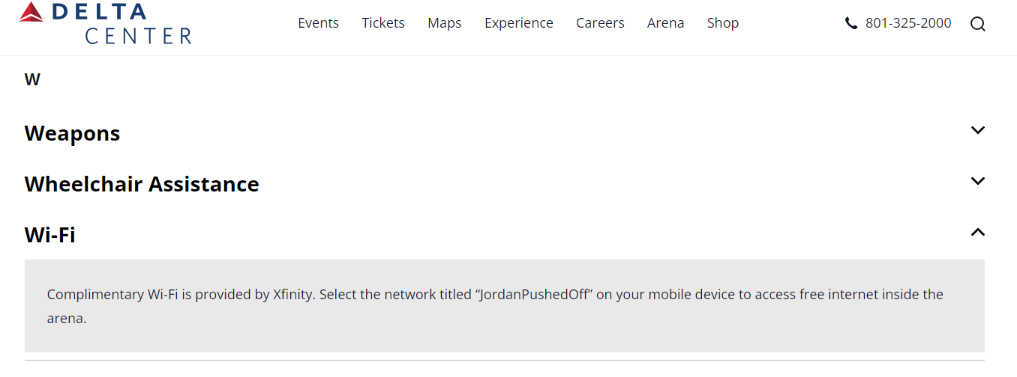

Slide 5

What is an Established Company?
What is a Startup?
What is a Partnering Deal?

Slide 6

DEAL process
1.
Evaluation
2.
Preparation
3.
Negotiation

Slide 7
PHASE 1
EVALUATION

Slide 8
Established Company Tip:
Understand the Value Proposition and the Startup’s Plans
Startup Company Tip:
Develop Relationships of Trust

Slide 9

QUESTION #1
Does your company have a formal process for evaluating a potential partnering deal or counterparty pre-negotiation?

Slide 10
Does your company have a formal process for evaluating a potential PARTNERING DEAL OR counterparty pre-negotiation?
A.
Yes.
B.
Yes, but only for deals over a certain size.
C.
No.
D.
We don’t do deals. I’m just here for the food and the CLE credit.

Slide 11
QUESTION #2
How broadly is your company’s unique value proposition understood?

Slide 12
How broadly is your company’s unique value proposition understood?
A.
Understood by everyone. This is a big emphasis.
B.
Only understood by sales and marketing.
C.
Only understood by sales and upper management.
D.
My company is in trouble. Articulating the value proposition has been left entirely to the legal department.

Slide 13
PHASE 2
PREPARATION
Phase 1
EVALUATION

Slide 14
Established Company Tip:
Conduct Due Diligence
Startup Company Tip:
Open and Honest Communication

Slide 15

QUESTION #1
For established companies, do you conduct due diligence on startups for Partnering Deals?

Slide 16
For established companies, do you conduct due diligence on startups for Partnering Deals?
A.
Yes.
B.
Yes, but only on deals over a certain size.
C.
Yes, but the process is informal.
D.
What is due diligence again?

Slide 17
QUESTION #2
By a show of hands, how many people have seen a Partnering Deal:

Slide 18
By a show of hands, how many people have seen a Partnering Deal:
A.
Die as a result of a show-stopper discovered before negotiations.
B.
That went to negotiations, but should not have, because of failure to discover a show-stopper.
C.
Survive with a creative solution to a perceived show-stopper before negotiations started.

Slide 19
Phase 2
PREPARATION
PHASE 3
NEGOTIATION
Phase 1
EVALUATION

Slide 20
Established Company Tip:
Use Term Sheets
Startup Company Tip:
Less is More
Established Company Tip:
Take Advantage of Approval Process
Startup Company Tip:
Unique Approaches to Accomplish Clear Objectives

Slide 21





Specific Contract Provisions
TERMINATION FOR
CONVENIENCE
COMPLIANCE WITH LAWS
ABILITY TO SUBCONTRACT
CONTROL OVER THE PLATFORM

Slide 22

What (other) strategies do you use when negotiating with an established company or a startup?
What things have you seen go wrong in a deal between a startup and established company that could have been prevented?

Slide 23
Mayer Brown is a global services provider comprising associated legal practices that are separate entities, including Mayer Brown LLP (Illinois, USA), Mayer Brown International LLP (England), Mayer Brown (a Hong Kong partnership) and Tauil & Chequer Advogados (a Brazilian law partnership) (collectively the “Mayer Brown Practices”) and non-legal service providers, which provide consultancy services (the “Mayer Brown Consultancies”). The Mayer Brown Practices and Mayer Brown Consultancies are established in various jurisdictions and may be a legal person or a partnership. Details of the individual Mayer Brown Practices and Mayer Brown Consultancies can be found in the Legal Notices section of our website. “Mayer Brown” and the Mayer Brown logo are the trademarks of Mayer Brown. © Mayer Brown. All rights reserved.

