Slide 1
ACC Spring Training 2025
Understanding Climate Litigation
Jessica Priselac, Duane Morris LLP

Slide 2
Overview
Background
Evolution of Claims
Litigation Trends

Slide 3
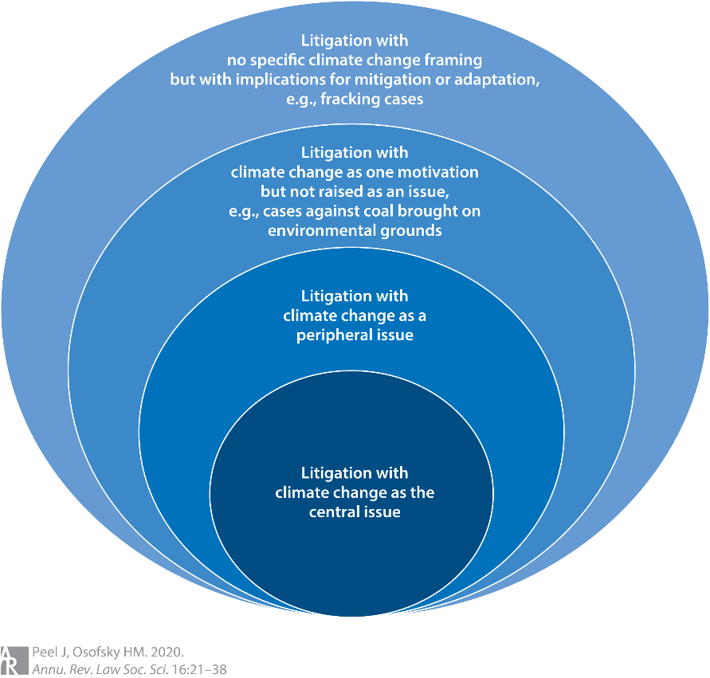
Defining the Universe of Cases

Slide 4
Defining the Universe of Cases
Sabin Center for Climate Change Law at Columbia University
  Database of Cases Filed
    Cases brought before a judicial body where climate change law, policy, or science is a material issue of law or fact.

Slide 5
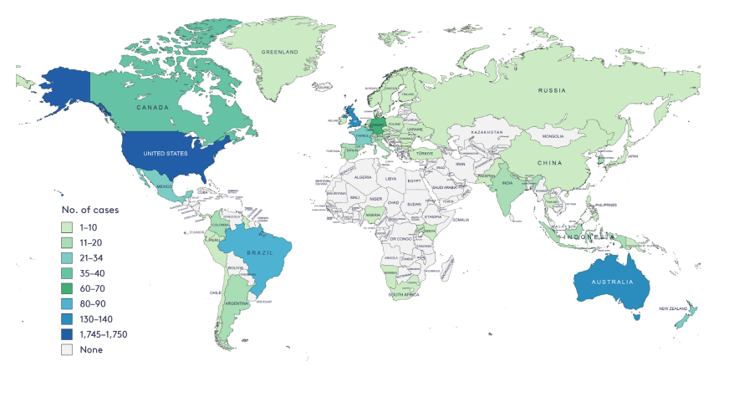
Climate Litigation Worldwide - 2024

Slide 6
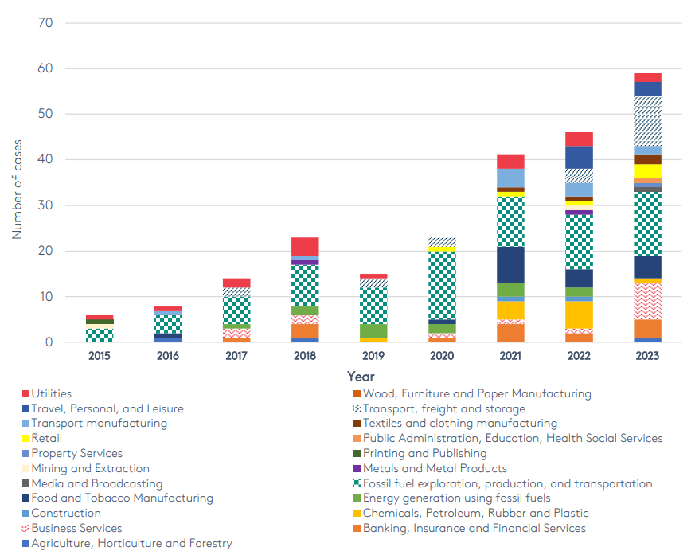
Number of Companies Targeted by Sector

Slide 7
Evolution of Claims in the U.S.
Administrative Challenges
Federal Common Law Claims

Slide 8

Evolution of Claims in the U.S.
Municipal Torts
  Public Nuisance
  Adaptation
State Attorneys General
  Fraud
  Consumer Deception
Securities Litigation
  Disclosures
  Directors’ Duties

Slide 9
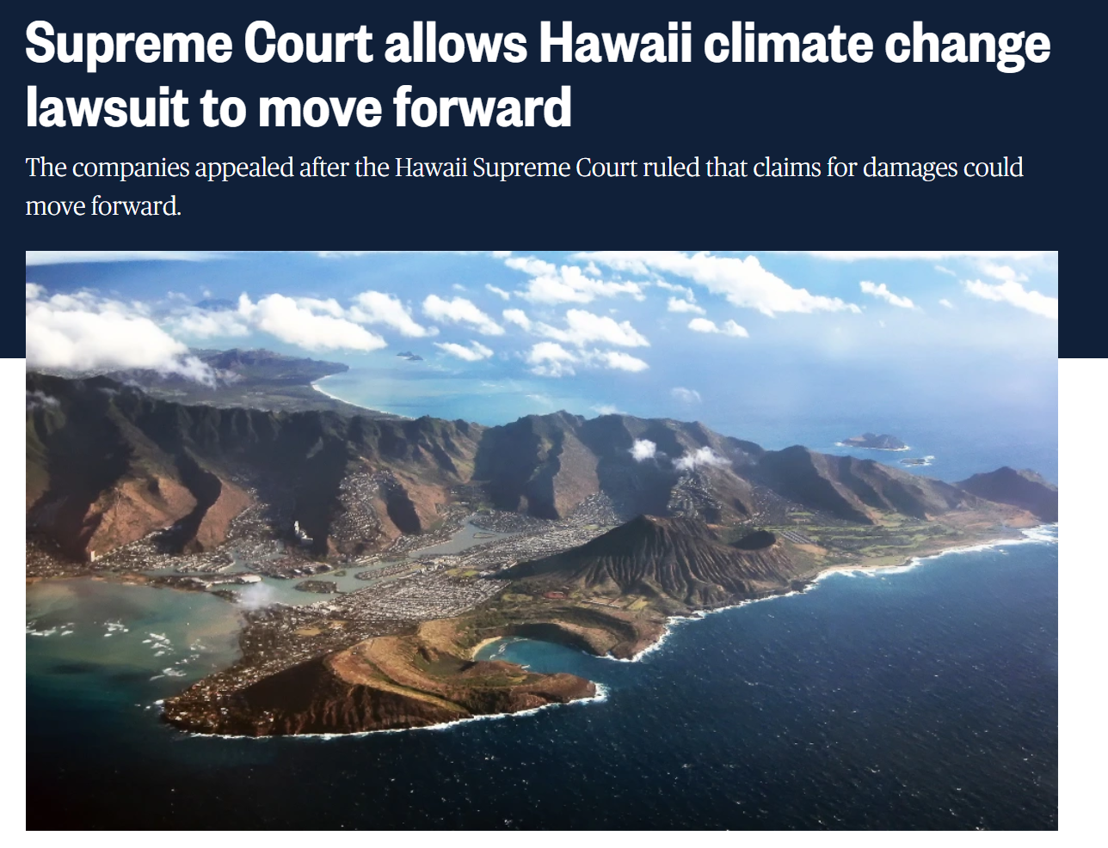
Litigation Trends
Shift to state courts
  January 2025 SCOTUS Ruling

Slide 10
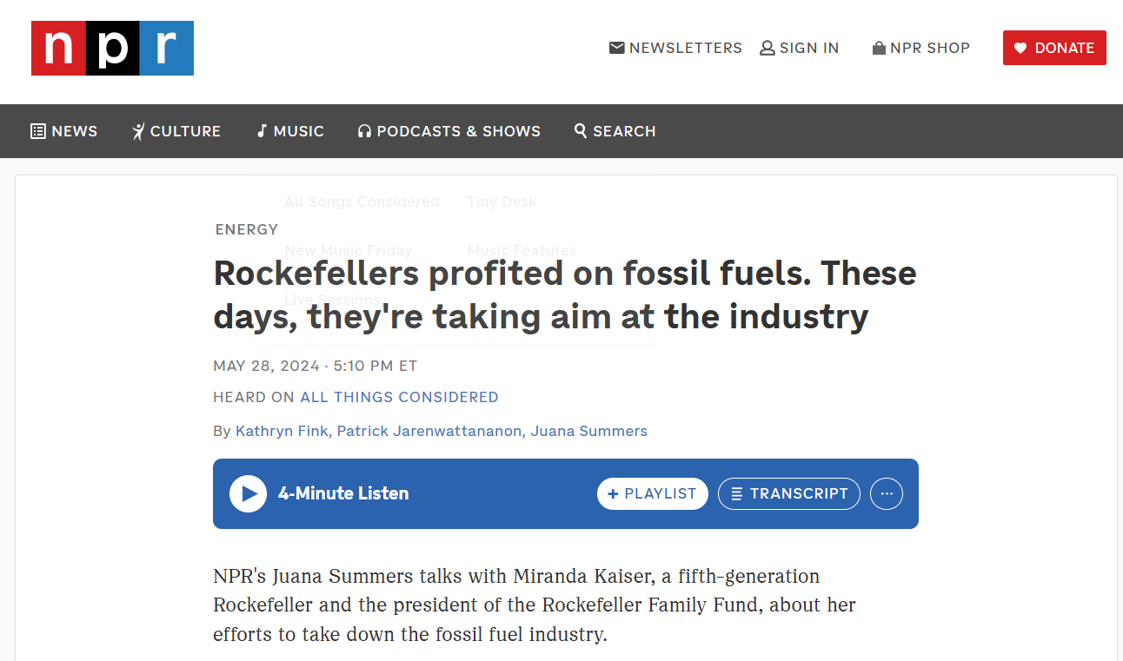
Litigation Trends
Outside Funding

Slide 11
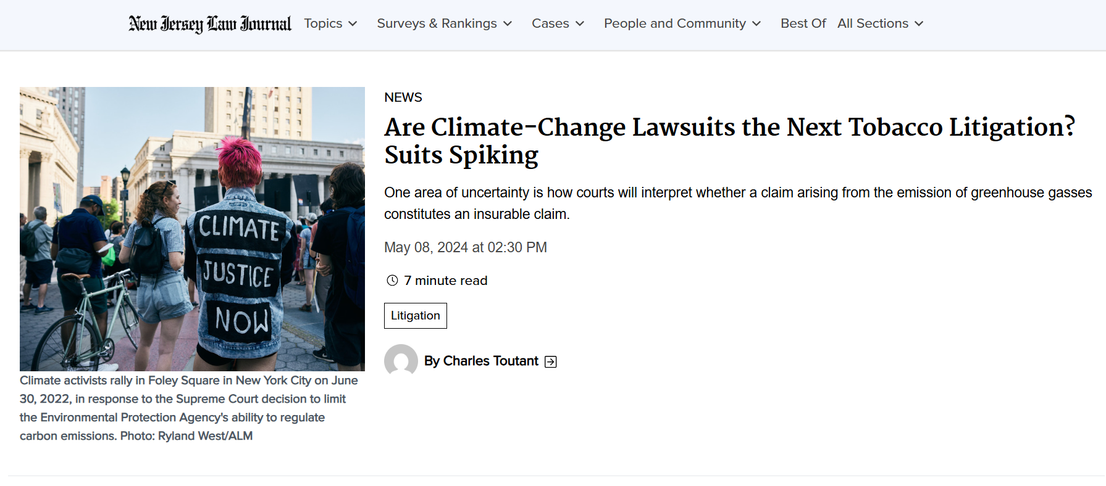
Litigation Trends
Plaintiffs using other “bet the company” litigation as a playbook

Slide 12
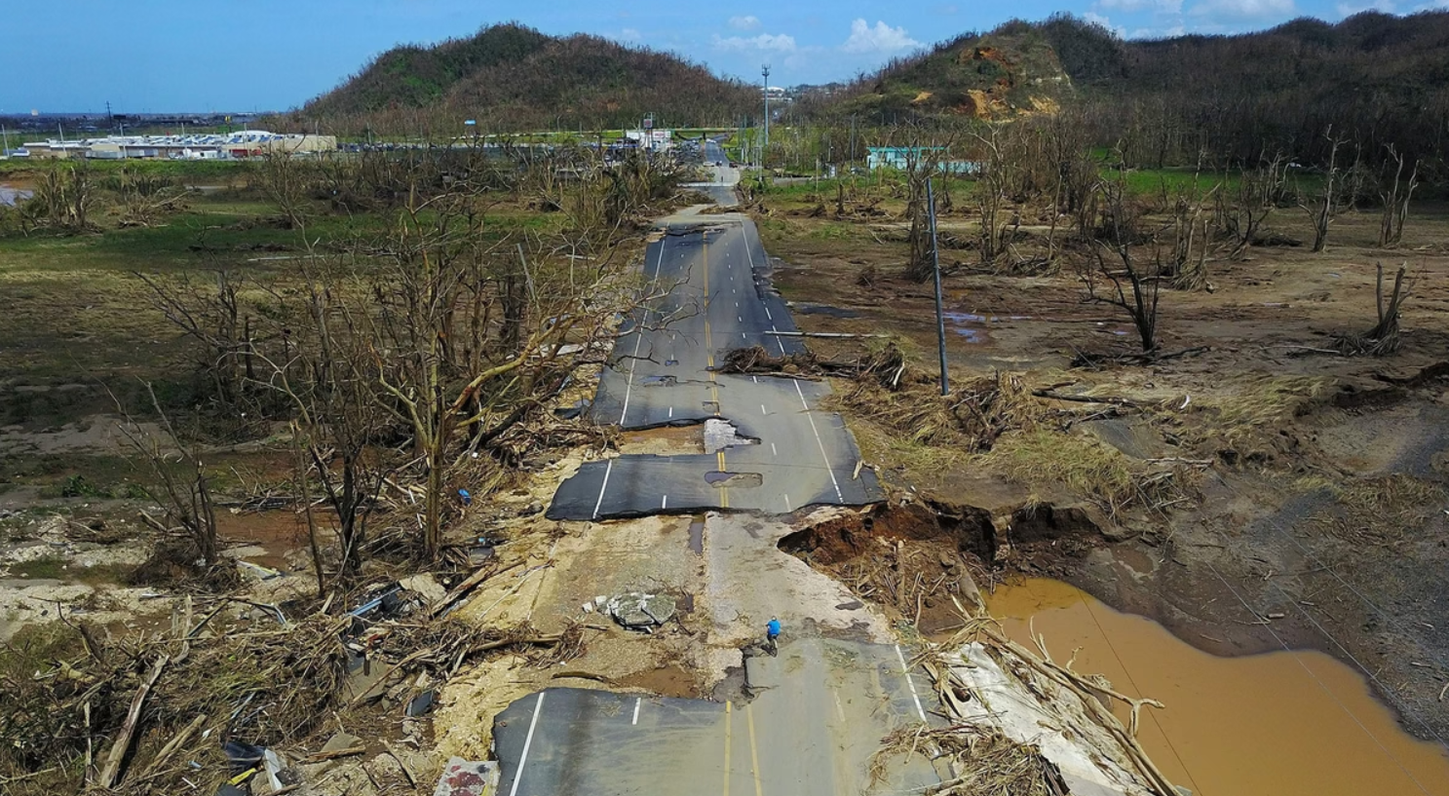
Future Directions
Puerto Rico Municipalities
  RICO Act and federal antitrust claims
  Damages related to the 2017 hurricane season

Slide 13
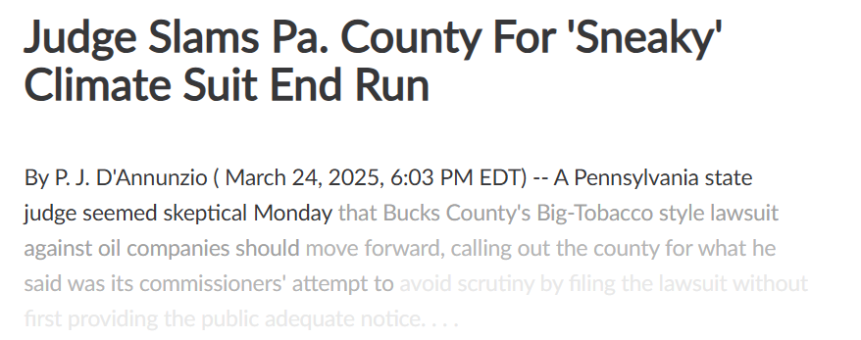
Closer to Home . . .
Bucks County Litigation

Slide 14
Questions?
Jessica Priselac
Duane Morris LLP
jpriselac@duanemorris.com
Thank you!

