Slide 1

The Halo Effect
Litigation and Regulation of Feel-Good Marketing Claims in 2023

Slide 2

Halo Claims – Marketing Positive Societal Impacts.
87% of consumers would buy a product with a social benefit if given the opportunity (Forbes)
88% will be more loyal to a company that supports social or environmental issues (Forbes)
80% of consumers aged 18-34 claim they are willing to pay more for environmentally-friendly products (National Retail Federation)

Slide 3


Scenario 1
Your company focuses on advanced nutrition and the CEO has been studying non-for-profits that align with this goal. She wants the next product release to include a statement on the packaging that “Proceeds from Every Product Sold goes to Cultivating Community a 501(c)(3) helping build food gardens in under-served communities across the U.S.” The CFO has calculated that the company can afford $1 dollar from every sale during the initial release.
Everyone is excited, and they have turned it over to you . . .

Slide 4
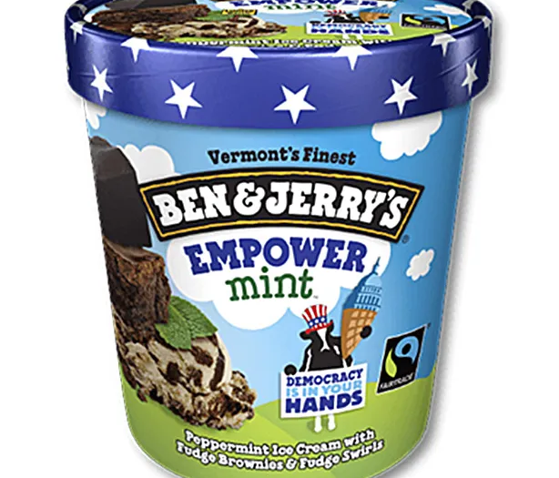

(Be)cause Marketing
Collaboration between a for-profit business and a nonprofit organization.
The business promotes their product by pledging proceeds to the nonprofit.
Demonstrates social ethos, while benefitting aligned nonprofits.

Slide 5
Cause Marketing (Commercial Co-Venturer) Laws
25 states expressly regulate CCVs including Utah
Common CCV requirements include:
  Written agreement with charity
  Advertising disclosures of the type of donation, any cap on donations, and start/end of campaign.
  Pre- and post-campaign filings (~12 states)
  Company registered as a CCV and bonded (2-3 states)
  Charity registered to solicit in state where campaign is conducted
  Regular accounting and turnover of funds to the charity (at least every 90 days)
  Recordkeeping for 3 years

Slide 6
Your CEO wants the next product release to include a statement on the packaging that “Proceeds from Every Product Sold goes to Cultivating Community helping build food gardens in under-served communities across the U.S.” The CFO has calculated that the company can afford one dollar from every sale during the initial release.
Does the charity even know we intend to run this campaign?
Is the charity a registered 501(c)(3)?
Is there a contract with the charity? Does it contain the cap we intend?
Can we use more specific language than “proceeds from” – specifying it is one dollar from every sale.
How do we disclose to consumers the financial commitment – e.g., the cap
Can we ensure the financial commitment mirrors the number of units released and or the length of the advertising campaign

Slide 7

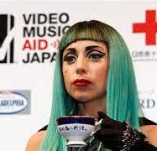
Cause Marketing Failures Leading to Court
“All Proceeds” Claims
  Demetsenare v. Germanotta, aka Lady Gaga, House of Gaga et al, 2011 WL 2520285 (E.D.Mich.)
  Not “all proceeds” went to Japan tsunami relief
  $200K class settlement.
Undisclosed Donation Limits
  50 cents per lid returned to company donated to breast cancer charity
  Undisclosed cap on underside of lid and viewable only after purchase
  $63K settlement

Slide 8

Scenario 2
The new scientist in your product development team discovered a study from a University in Sweden, where participants were given identical cups of coffee. They were told that one of the cups contained “eco-friendly” coffee, but the other did not. The study found that participants preferred the taste of, and were willing to pay more for, the “eco-friendly” coffee. (Sörqvist, Langeborg, Nöstl & Kågströmet 2013). Researching further, your product development team discover similar research findings reported for wine (Wiedmann, Hennigs, Behrens, & Klarmann, 2014) as well as for potato chips and yoghurt (Lee, Shimizu, Kniffin, & Wansink, 2013).
The development team want to know - can we make a vague “eco-friendly” claim on the product to take advantage of this unconscious bias?

Slide 9
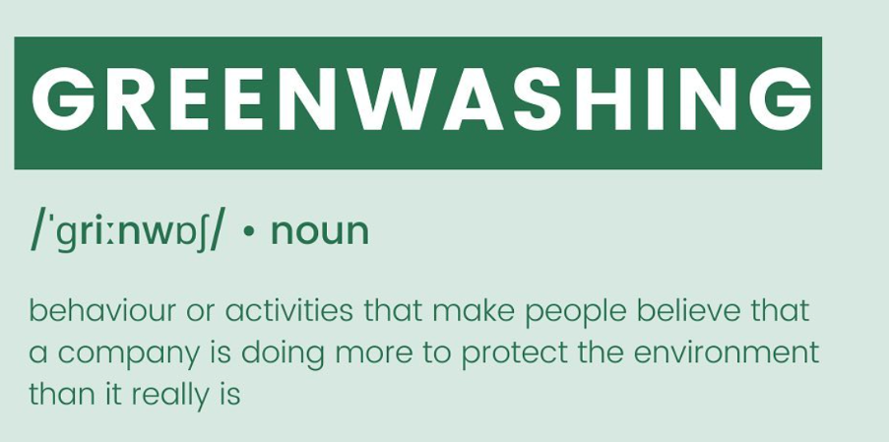
FTC Green Guides
State Specific Laws
International Laws
FTC Enforcement
Class Action Lawsuits
Lanham Act Claims
Shareholder Lawsuits

Slide 10
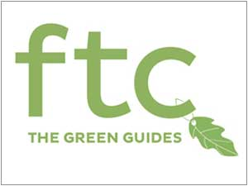
Topics covered by the Green Guides:
General environmental benefit claims (16 C.F.R. § 260.4)
Carbon offsets (§ 260.5)
Certifications and seals of approval (§ 260.6)
Compostable, Degradable claims (§§ 260.7 – 260.8)
Free-of, Non-toxic claims (§§ 260.9 – 260.10)
Ozone-safe and ozone-friendly claims (§ 260.11)
Recyclable, recycled content, refillable claims (§§ 260.12 – 260.14)
Renewable energy, materials (§§ 260.15 – 260.16)
Source reduction (§ 260.17)

Slide 11

Broad Unqualified Eco-Friendly Claims are Rarely Justified.
Marketers should not state or imply environmental benefits if the benefits are negligible. (16 C.F.R. § 260.3(c)).
Because it is highly unlikely that marketers can substantiate all reasonable interpretations of [general environmental claims], marketers should not make unqualified general environmental benefit claims. (16 C.F.R. § 260.4(b)).
To avoid deception, marketers should use clear and prominent qualifying language that limits the claim to a specific benefit or benefits. Marketers should not imply that any specific benefit is significant if it is, in fact, negligible. (16 C.F.R. § 260.4(c)).

Slide 12
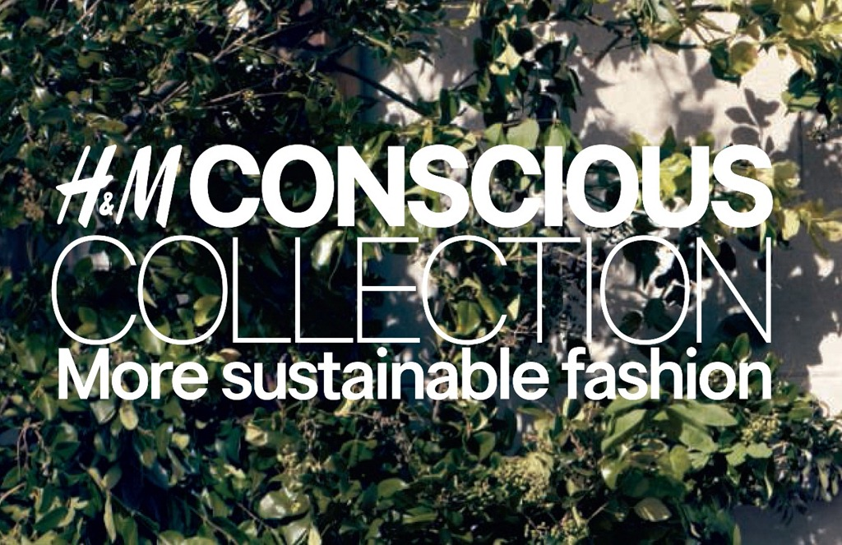
Broad Green Claims Should Be Qualified:
Lizama v. H&M Hennes & Mauritz LP, 2023 WL 3433957, at *6 (E.D. Mo. May 12, 2023)
“More sustainable fashion” and “more sustainable shopping” qualified by:
  “Each Conscious choice product contains at least 50% of more sustainable materials – like organic cotton or recycled polyester – but many contain a lot more than that.”
The language also reasonably meant the fashion line was more sustainable than its regular line of products – not more sustainable than other companies or all other alternatives.
Takeaway: explain why product has an environmental attribute and what it is.

Slide 13
Green Claims Should be Capable of Being Substantiated:
16 C.F.R. § 260.2: “Marketers must ensure that all reasonable interpretations of their claims are truthful, not misleading, and supported by a reasonable basis before they make the claims . . . In the context of environmental marketing claims, a reasonable basis often requires competent and reliable scientific evidence. Such evidence consists of tests, analyses, research, or studies that have been conducted and evaluated in an objective manner by qualified persons and are generally accepted in the profession to yield accurate and reliable results.”
Substantiate Before Disseminating
Look at all Reasonable Interpretations of the Claim
Don’t forget Implied Claims
The level of substantiation must match the claim “Studies show . . . “
“Competent and Reliable” Evidence – no pseudoscience.

Slide 14


Scenario 3
The Product Development team gets to work. But does not find anything particularly environmentally friendly they can substantiate. Unperturbed, they come up with an idea: without changing the formulation, packaging, etc., let’s change the brand – call it the company’s “eco” line of products and change the imaging on the package accordingly.
They don’t make any environmentally friendly claims – the word “eco” is only the brand name and the images are all generic. What could go wrong!

Slide 15
16 C.F.R. § 260.4(d) Ex. 1:
“The brand name “Eco-friendly” likely conveys that the product has far reaching environmental benefits and may convey that the product has no negative environmental impact. Because it is highly unlikely that the marketer can substantiate these claims, the use of such a brand name is deceptive.”
16 C.F.R. § 260.4(d) Ex. 3:
“Although the advertisement does not expressly claim that the product has environmental benefits, the featured images, in combination with the text, likely convey that the product has far-reaching environmental benefits and may convey that the product has no negative environmental impact. Because it is highly unlikely that the marketer can substantiate these claims, this advertisement is deceptive.”

Slide 16

Scenario 4
Your marketing team has returned from a global pharmaceutical conference – where the CEOs of the big pharma companies announced joint action to achieve net zero greenhouse gas emissions. Your marketing team has been otherwise inundated with marketing from other global companies like Nestlé touting their own net zero plans. If these large companies can do it – surely, we can!
What can we advertise about our carbon plans and what we have accomplished so far in terms of footprint?.

Slide 17
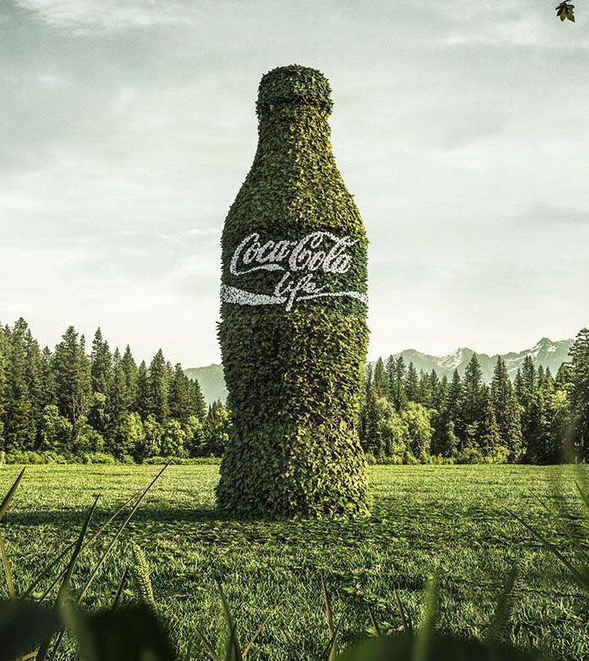
What About Forward-Looking Sustainability Plans?
Earth Island Institute v. The Coca-Cola Co. 2022 WL 18492133, at *1 (D.C. Super. Nov. 10, 2022)
“We’re using our leadership to achieve positive change in the world and build a more sustainable future for our communities and our planet”
Forward looking, general aspirational and vague corporate ethos statements and not specifically actionable:
  “It is clear that the language of the defendants does not convey a promise.” citing Nat. Consumers League v. Wal-Mart Stores, Inc., No. 2015 CA 007731 B, 2016 WL 4080541, at *6 (D.C.Super. July 22, 2016)

Slide 18
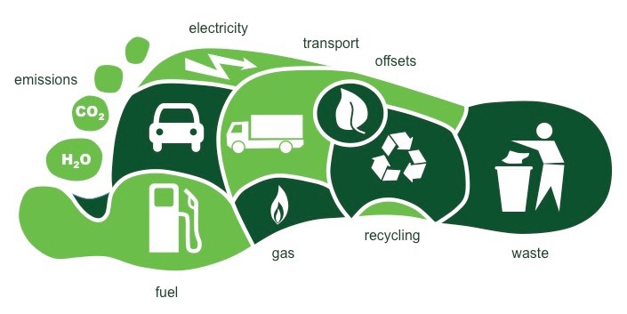
Carbon Footprint Claims – Not So Easy
What is a Carbon Footprint
Typically calculated as [kgCO₂e]
One unit roughly the same Green House Gas emissions from driving a car 2 1/2 miles.
What is a carbon offset?
Purchasing equivalent “credits” from projects that prevent or remove the same level of GHG emissions elsewhere
What are the problems in calculating footprint?
What are the problems in calculating offsets?
Rampant off-set fraud - project may never happen, may not have the promised benefits, may have happened anyway (mooting the value of the offset), or may be simply re-sold credits.
Relevancy of the data, ability to capture all activities, understanding the interaction between natural processes of CO₂.

Slide 19
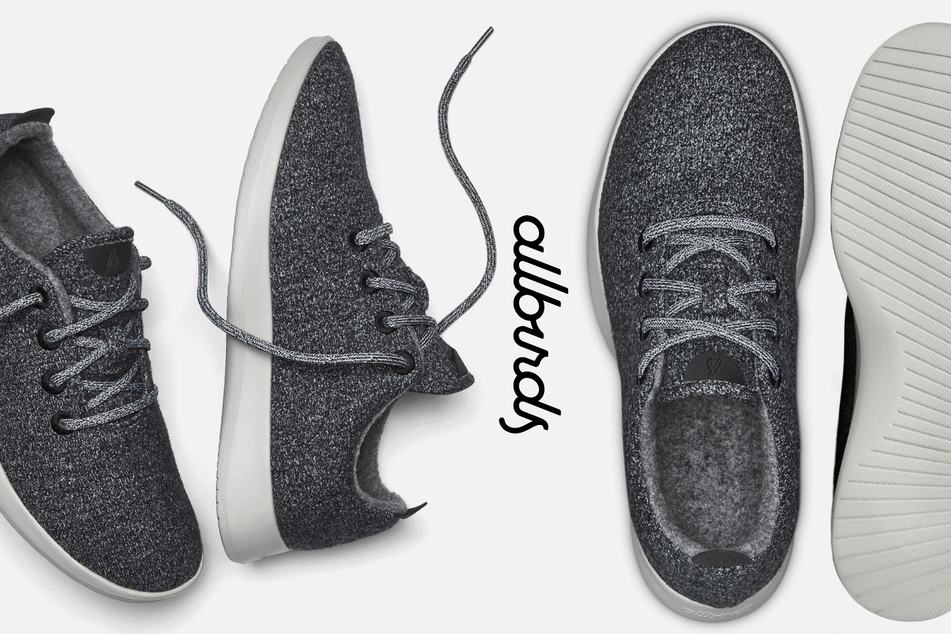
Dwyer v. Allbirds, Inc., 598 F. Supp. 3d 137 (S.D.N.Y. 2022)
The company advertised its carbon footprint and published its methodology for calculating it.
Plaintiff critiqued the methodology – accusing it of not counting certain animal supply- chain inputs.
Court ruled that Defendant did not claim it did count that input. Its calculation was not misleading.
Takeaway: with such methods without a consensus on how they are done, transparency is key

Slide 20

Berrin v. Delta Airlines, Inc., 2:23-CV-04150 (C.D. Cal. May 30, 2023)
Delta’s representations that it was a “carbon neutral” airline (based on its purchase of voluntary carbon offsets) are alleged to be false and misleading — because, as the complaint asserted, Delta’s offset transactions are “replete” with “inaccurate accounting” and “speculative emissions reductions.

Slide 21
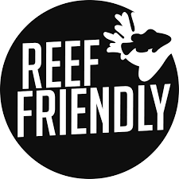
Scenario 5
While on an offsite in Hawaii with your legal department, you read about dangers to sensitive marine environments from chemicals in makeup and sunscreen. You read that state legislators in Hawaii have banned the use of two chemicals (oxybenzone and octinoxate) in sunscreens, based on its determination that they were harmful to coral reefs. You make an urgent call from the hotel to your formulation team stateside and are relieved to learn from them that they removed oxybenzone and octinoxate from products like sunscreen several years ago. Later sitting by the pool, thankful that your company was a friend to the reefs, you come up with an idea — let’s put a new logo on the product “Reef Friendly.” You call it into the marketing team, they are surprised that legal can produce any good ideas, they draw it up, it looks great. What could go wrong?

Slide 22
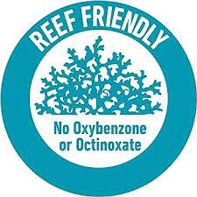
Blue-washing
Anderberg v. Hain Celestial Grp., Inc., 2023 WL 419268, at *6 (S.D. Cal. Jan. 26, 2023) (denying motion to dismiss); Moran v. Bondi Sands (USA) Inc., 2022 WL 1288984, at *3 (N.D. Cal. Apr. 29, 2022) (same, in part)
Richardson v. Edgewell Pers. Care, LLC, 2023 WL 1109646, at *5 (S.D.N.Y. Jan. 30, 2023); Moran v. Edgewell Pers. Care, LLC, No. 21-CV-07669-RS, 2022 WL 3046906, at *6 (N.D. Cal. Aug. 2, 2022) (same, in part)
Takeaway: don’t assume that non-banned chemicals are not harmful enough to make an unqualified “friendly” claim non-actionable.

Slide 23
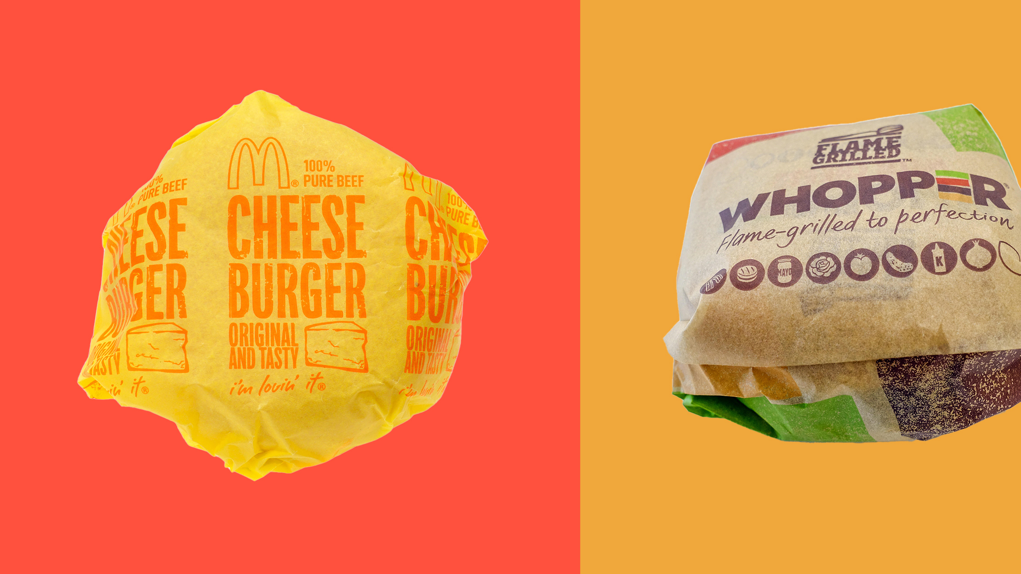
Feel Bad Chemicals
Per- and polyfluoroalkyl substance (PFAS) -- “forever chemicals”
Little v. NatureStar, LLC, Target Corporation, 1:22-cv-00232-JLT-EPG (E.D. Cal)
  PFAS in “compositable” products misleading
McDowell v. McDonald's Corporation, 1:22-cv-01688 (N.D. Ill)
  PFAS in food packaging “unsafe”
Takeaway: use of legal chemicals, for the purpose FDA approved them, can still make your company a greenwashing target.

Slide 24
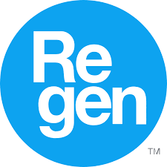
Scenario 6
One of your competitor’s latest product line includes a prominent certification logo Regen on its supplements. Other information about the product on the competitor’s website tout that the products contain only accredited “regeneratively farmed ingredients” which are “optimized for your benefit”. The competitor’s new product is selling through the roof, and your marketing team suspects this new accreditation is driving sales.
You have been tasked to investigate this accreditation to see if your competitor is acting lawfully.

Slide 25

Certification & Accreditation Claims
See FTC’s Guides Concerning Use of Endorsements and Testimonials in Advertising.
New version 2023 (first published in 1975, and revised versions were issued in 1980 and 2009).
16 C.F.R. § 255.3 - § 255.5
See also Certifications & Seals of Approval section added to the Green Guides in 2012 version.
16 C.F.R. § 260.6

Slide 26
What to Look for in FTC’s Guides:
§ 260.6 (a): it is deceptive to misrepresent certification by an independent third party
§ 255.3(c): the testing organization must have conducted valid scientific testing to support endorsement; see also § 255.4(c)
§ 255.3(a): any connection between the endorser and the advertised product must be disclosed clearly, conspicuously
§ 260.6 (c) advertiser must have its own substantiation for the claims reasonably communicated by the certification
§ 260.6 (e) To avoid deception, marketers should use clear and prominent qualifying language that clearly conveys that the certification or seal refers only to specific and limited benefits.

Slide 27

Example from 16 C.F.R. § 260.6: “An advertisement for paint features a ‘GreenLogo’ seal . . . This advertisement likely conveys that: (1) the GreenLogo seal is awarded by an independent, third-party certifier with appropriate expertise in evaluating the environmental attributes of paint; and (2) the product has far-reaching environmental benefits . . . The claim would not be deceptive if the marketer accompanied the seal with clear and prominent language: (1) indicating that the marketer awarded the GreenLogo seal to its own product; and (2) clearly conveying that the award refers only to specific and limited benefits.
See In the Matter of Benjamin Moore & Co., Inc., 2017 WL 3049127, at *1 (FTC Consent Order); Poole v. Benjamin Moore & Co., 2018 WL 2716806, at *1 (W.D. Wash. June 6, 2018) (denying motion to dismiss consumer class action)

Slide 28
Is the Certification Legitimate?
Is it a broad, vague certification?
Has the product been tested?
Is it an undisclosed “selfie” certification mark?
Is it displayed in a non-misleading manner?

Slide 29
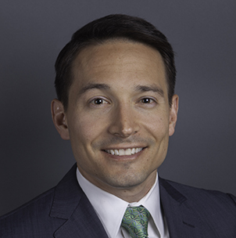

Any Questions?
Joseph M. Paunovich
Partner
joepaunovich@quinnemanuel.com
+1 213 443 3257
Nathan Archibald
Associate
nathanarchibald@quinnemanuel.com
+1 801 515 7310

