Slide 1
Open-Source Software: Legal Risks 101

Slide 2
Why is Open Source Software a Legal Issue?
Copyright and Open Source Software Licensing Obligations: Failure to comply → Copyright infringement
Loss of Intellectual Property Rights
Cybersecurity Risk

Slide 3
What is “FOSS” or “F/OSS”?
Free and Open Source Software (“FOSS” or “F/OSS”) is an umbrella term, which generally means software governed by an OSS License, whose source code is available to copy, modify and redistribute, free of royalty charge.
Free Software by FSF
Open Source Software by OSI
The freedom to run the program as you wish, for any purpose (freedom 0).
The freedom to study how the program works, and change it so it does your computing as you wish (freedom 1). Access to the source code is a precondition for this.
The freedom to redistribute copies so you can help your neighbor (freedom 2).
The freedom to distribute copies of your modified versions to others (freedom 3). By doing this you can give the whole community a chance to benefit from your changes. Access to the source code is a precondition for this.
Free Redistribution of Code
Source Code Available
Allow Derived Works
Allow Integrity of The Author's Source Code
No Discrimination Against Persons or Groups
No Discrimination Against Fields of Endeavor
No Additional Licenses
License Must Not Be Specific to a Product
License Must Not Restrict Other Software
License Must Be Technology-Neutral

Slide 5
FOSS offers user “Freedoms”, not “Free Lunches”
NOT FREE in the sense of NO $$$
  Substantially reduces development costs, but FOSS is not necessarily offered “gratis”
  Cost of Compliance
FREE in the sense of Freedom to run, copy, modify and distribute
  Results in accelerated/flexible product development and predictable rights
NOT FREE in the sense of Free Support/Maintenance
  While active FOSS projects mean more eyes to catch and fix bugs, users of FOSS must invest in internal resources to track and update code AND often pay others (e.g., Red Hat Enterprise Linux) to maintain it
FREE also means Open
  OSS implements open standards → Better product interoperability
  OSS enables community engagement for improvement, bug fixing, vulnerability updates

Slide 6
FOSS Licensing – Legal Risks
Open-source software licenses can typically be placed into two high-level categories, based on the conditions, restrictions, and/or obligations included in the license:
- Permissive: License and copyright notice must be included with source code
- Strong Copyleft: Source code must be disclosed if software is distributed (e.g., sell of on-prem software)

Slide 7
Costs/Risks of FOSS
Obligations Associated with the Use of FOSS Code in Proprietary Products
Proprietary Code
3rd-Party OSS
Product
EULA Terms
Proprietary Code
3rd-Party OSS
OSS License Terms
OSS License Terms
EULA Terms
EULA Terms
OSS License Terms
End Users
Tainting/Viral/Copyleft Effects of Certain OSS Licenses: As result of its combination with OSS code, proprietary code is required to be licensed under OSS license terms, including the obligation to release the proprietary source code as OSS

Slide 8
Software Licenses – Spectrum of Obligations
WEAK COPYLEFT
LICENSES
STRONG COPYLEFT
LICENSES
PERMISSIVE LICENSES
BSD License
MIT License
Apache License 2.0
MPL, CDDL, EPL, CDL
GPL + Linking Exception
GPL
LGPL
(static linking →)
VIRAL
Attribution Obligations
Tainting Modifications to the OSS
Tainting Proprietary Code
Obligations Triggered by Distributions

Slide 9
Copyleft in Non-Distributed Components
WEAK COPYLEFT
LICENSES
STRONG COPYLEFT
LICENSES
PERMISSIVE LICENSES
BSD License
MIT License
Apache License 2.0
MPL, CDDL, EPL, CDL
GPL + Linking Exception
GPL
AGPL
SSPL
LGPL
(static linking →)
VIRAL
Attribution Obligations
Tainting Modifications to the OSS
Tainting Proprietary Code
Obligations Triggered by Distributions

Slide 10
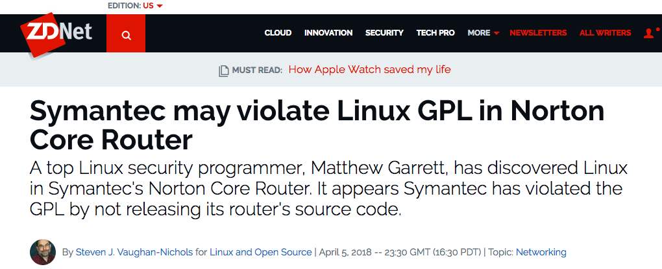
Copyleft Risk
Obligations Associated with the Use of FOSS Code in Proprietary Products

Slide 11
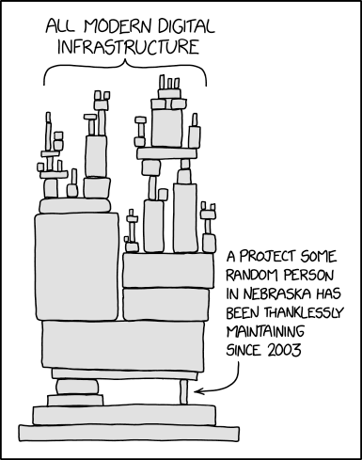
Risks of FOSS: Security Vulnerabilities
https://xkcd.com/ Comic, licensed under a Creative Commons Attribution-NonCommercial 2.5 License

Slide 12
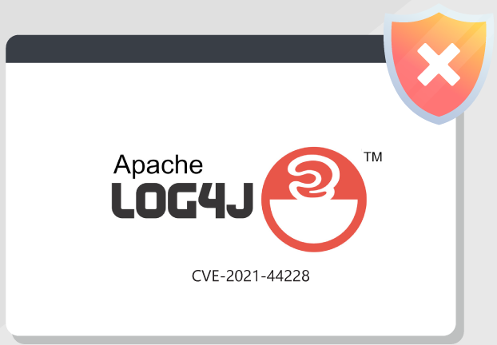
Risks of FOSS: Security Vulnerabilities
Notes:
The log4j security vulnerability allows attackers to execute malicious code remotely on a target. One of the most widespread vulnerabilities in history.
As of January 2021, nearly half of all corporations had been targeted by an attempted Log4J attack.

Slide 13
Risks of FOSS: Security Vulnerabilities
Notes:
Attackers exploited a vulnerability in Apache Struts, an open source development framework for creating enterprise Java applications that Equifax, along with thousands of other websites, uses. If attackers sent HTTP requests with malicious code tucked into the content-type header, Struts could be tricked into executing that code, and potentially opening up the system Struts was running on to further intrusion.
Equifax ended up facing legal action for losing the records of at least 147 million people to an unknown attacker. The breach stemmed from a known vulnerability that the company had failed to patch. On that basis, the FTC ended up settling with Equifax on a fine of $700 million dollars.

Slide 14
Why Open Source?

Slide 15
Open Source is Smart Software Development:
Modern apps are estimated to be built with upwards of 90% Open Source code. Here’s why:
  Free (!) or very low cost
  Immediately available
  Flexible – not locked into a vendor or existing solution
  Helps attract, develop, and retain industry talent
  Allows entities to utilize the distributed benefits of shared resources
    Shared security and bug fixes
Notes:
build your own code internally, purchase a software solution from a vendor, or open source

Slide 16
How Smart is your Open Source Program?
Given that your technologists are going to want to use Open Source, it’s essential to have a widespread Open Source compliance program.
A good Open Source compliance program should exist as a component of an overall software governance program
  Identify and Educate other Key Stakeholders:
    Security
    Legal
    Business
    Tech teams
Notes:
build your own code internally, purchase a software solution from a vendor, or o

Slide 17



How Smart is your Open Source Program cont.?
  Maintain a Software Bill of Materials (SBOM) that allows you to monitor what code exists in your ecosystem.
    Track licensing and security compliance along with version controls
  Provide automated controls that prevent unauthorized use of code in your codebase
    Control the download or release of code on Github
  Perform periodic audits
    Snyk, Blackduck (Synopsys) all perform license and security scanning tools
  Provide software developers with a transparent and clear written policy that is predictable and enforceable
  Consider forming a cross-functional committee with stake holders to consider inbound and outbound projects
Notes:
build your own code internally, purchase a software solution from a vendor, or o

Slide 18

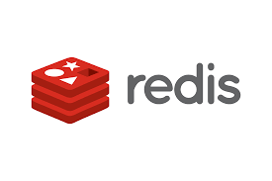



License Shifting
Recently, Open Source projects maintained by commercial companies have changed their license conditions from permissive licenses to more restrictive licenses in newer versions of the software.
Notable examples
  Elastic: real-time search server based on Apache Lucene
  Redis: an in-memory database
  Mongo DB: database
  Grafana: graphical representation of data
  Java: computing platform for developing code
Typically, these entities use a dual licensing model where users are required to chose between a restrictive OS license and a paid commercial license
Consequently, it is essential to know what resides in your code base, its version, and have a remediation plan in place, if necessary
Notes:
Con

Slide 19
Open Source Approval
Inbound Code
  Have a list of green, yellow, and red light licenses.
    Green light or permissive licenses are permitted to be used with little or no preauthorization required
      For example, some permissive licenses such as the BSD and MIT licenses are often approved for all use cases
    Yellow light licenses depend some level of approval based on how or where the code is used
      For example, MPL 2.0, is lower risk if it is only used internally without external distribution
    Red light licenses are not permitted and require remediation such as finding another open source solution under a more permissive license, obtaining a commercial license, or developing our own internal solution
      AGPL, SSPL, Grafana, Elastic 2.0
Notes:
build your own code internally, purchase a software solution from a vendor, or o

Slide 20
Open Source Approval
Outbound Code – releasing a new project
  Know your licenses – what do you want to release and check for license compatibility in any dependencies
  Code Review
      Check for code quality
      Check for security vulnerabilities
      Check for proprietary and confidential information
      Include a README file that describes what the project does in plain, easy to read language, and provide documentation where appropriate
      Include a LICENSE file that contains a verbatim copy of the approved license
  Consider whether you are going to devote substantial efforts to maintaining the project?
Notes:
build your own code internally, purchase a software solution from a vendor, or o

Slide 21
Open Source Approval
Outbound Code – contributing to an existing project
  Simple “bug fix” or significant contribution?
    For a significant contribution, a Contributor License Agreement “CLA” will likely need to be signed to define the rights and obligations of the contributor.
      For example, the CLA may require the contributor to grant a copyright license in the contribution to the project, its maintainer, and/or downstream recipients.
        Well known projects that require CLAs:
        Apache Software Foundation
        Django Software Foundation
        Eclipse Foundation
Notes:
build your own code internally, purchase a software solution from a vendor, or o

Slide 22
M&A Due Diligence – 3rd Party Code Review
Most buyers of software companies will require a detailed listing of all 3rd party code (both commercial and FOSS)
Many buyers will conduct a detailed code scan (e.g., Blackduck, Snyk, Flexera/Revenera)
  Require target to provide details of OSS usage (e.g., distribution, link models, maintenance/updates of OSS, etc.)
  Detailed comparison of list provided by target to scan results
Target can’t produce record of 3rd party code usage → Immature dev ops → Risky Target
Closing can be contingent on remediation of OSS/3rd party code issues

Slide 23

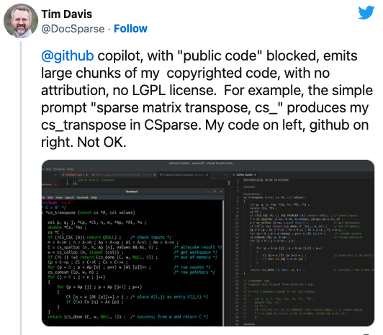
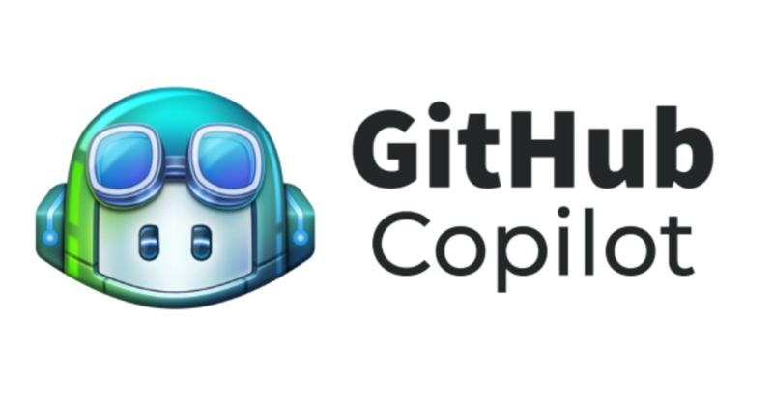
AI-Generated Code
Generative AI is now used by developers to create source code
Training models are often created using copyrighted source code subject to OSS licenses
Do AI tools need permission from the code copyright owner to train their models?
If the tools violate OSS licenses, do the end users violate them as well?
If AI-generated code suggestions are based on code covered by strong copyleft licenses, is a derivative work created?

