Slide 1

Privacy in a Ready Stance

Slide 2


Slide 3

Enforcement
GDPR’s Unfinished Work

Slide 4

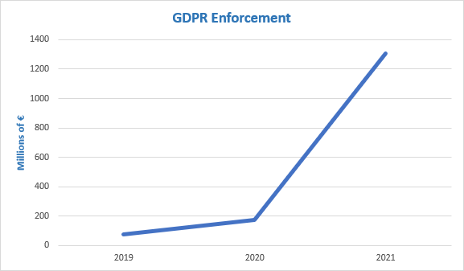

Slide 5
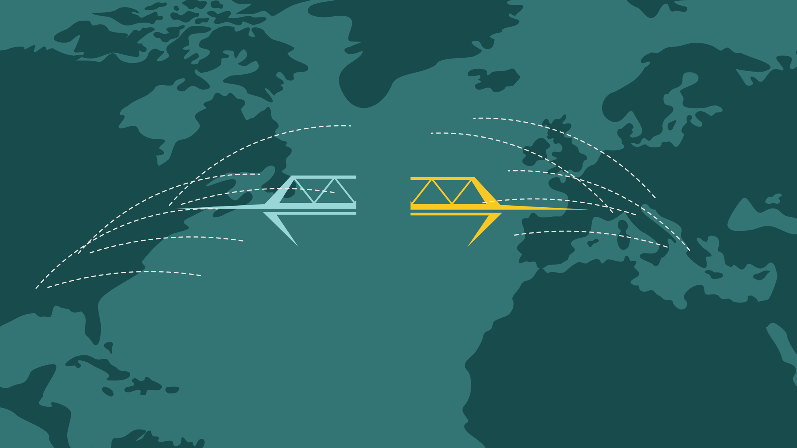
Data Transfers

Slide 6
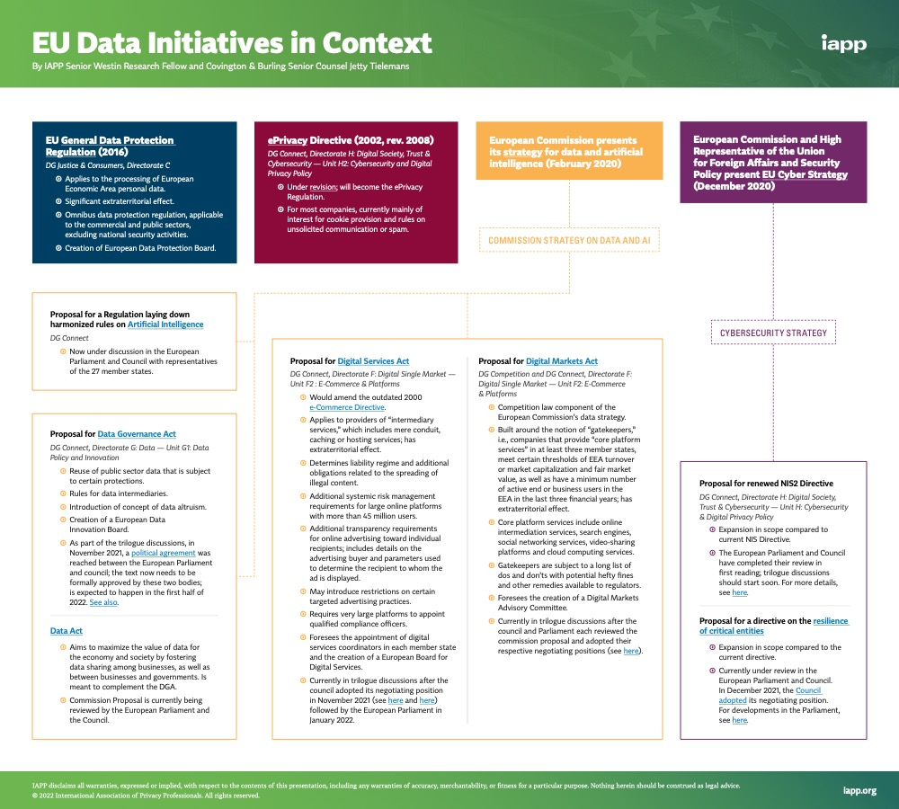

Slide 7
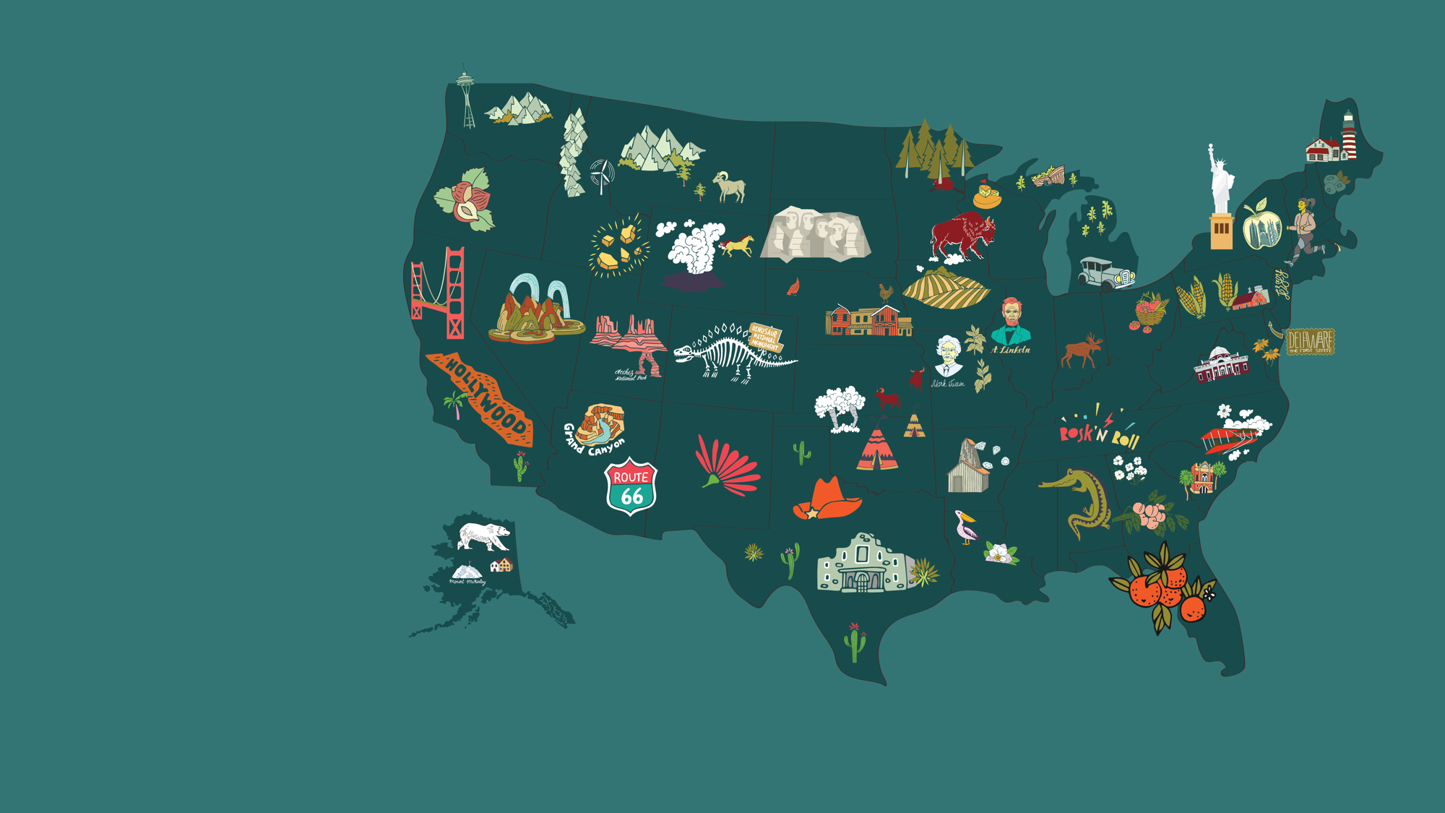

State Law
Federal Law
FTC

Slide 8
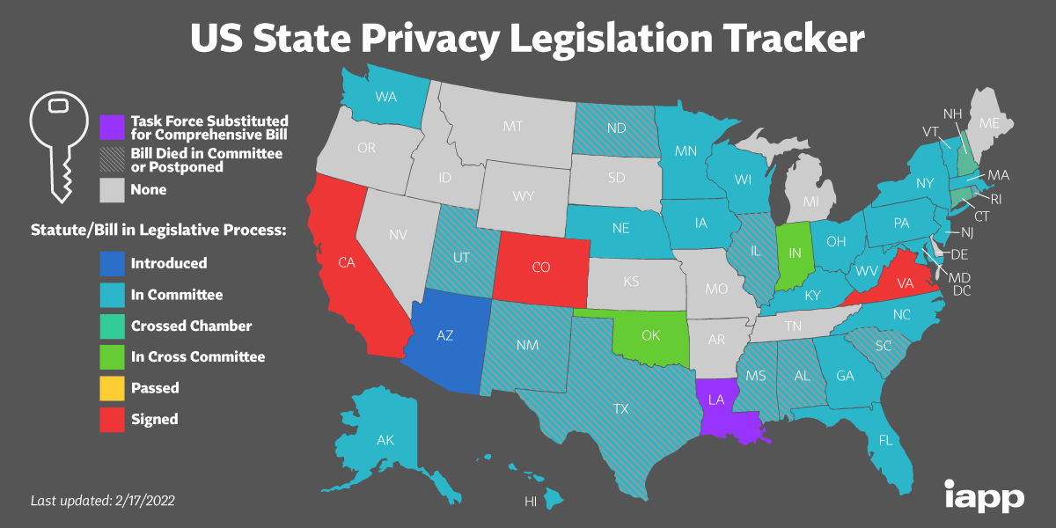

Slide 9
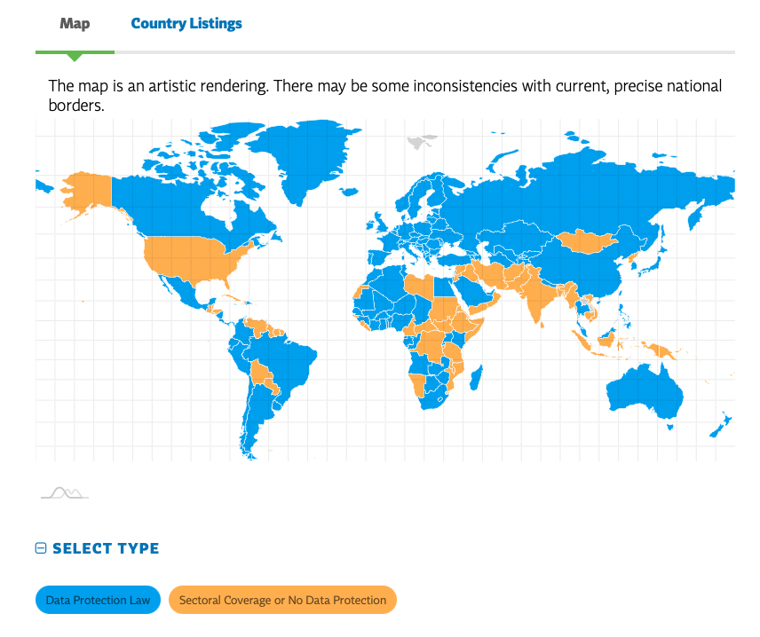

Slide 10


Slide 11

10%

Slide 12

75%

Slide 13

Notes:
Political unrest
demonstrators
COVID 19
AI
Education
Pharmacy
Thinking about this as a city scape. Smart car. Smart traffic light. Person walking speaking on phone. Folks demonstrating. Police officer. Pharmacy.

Slide 14
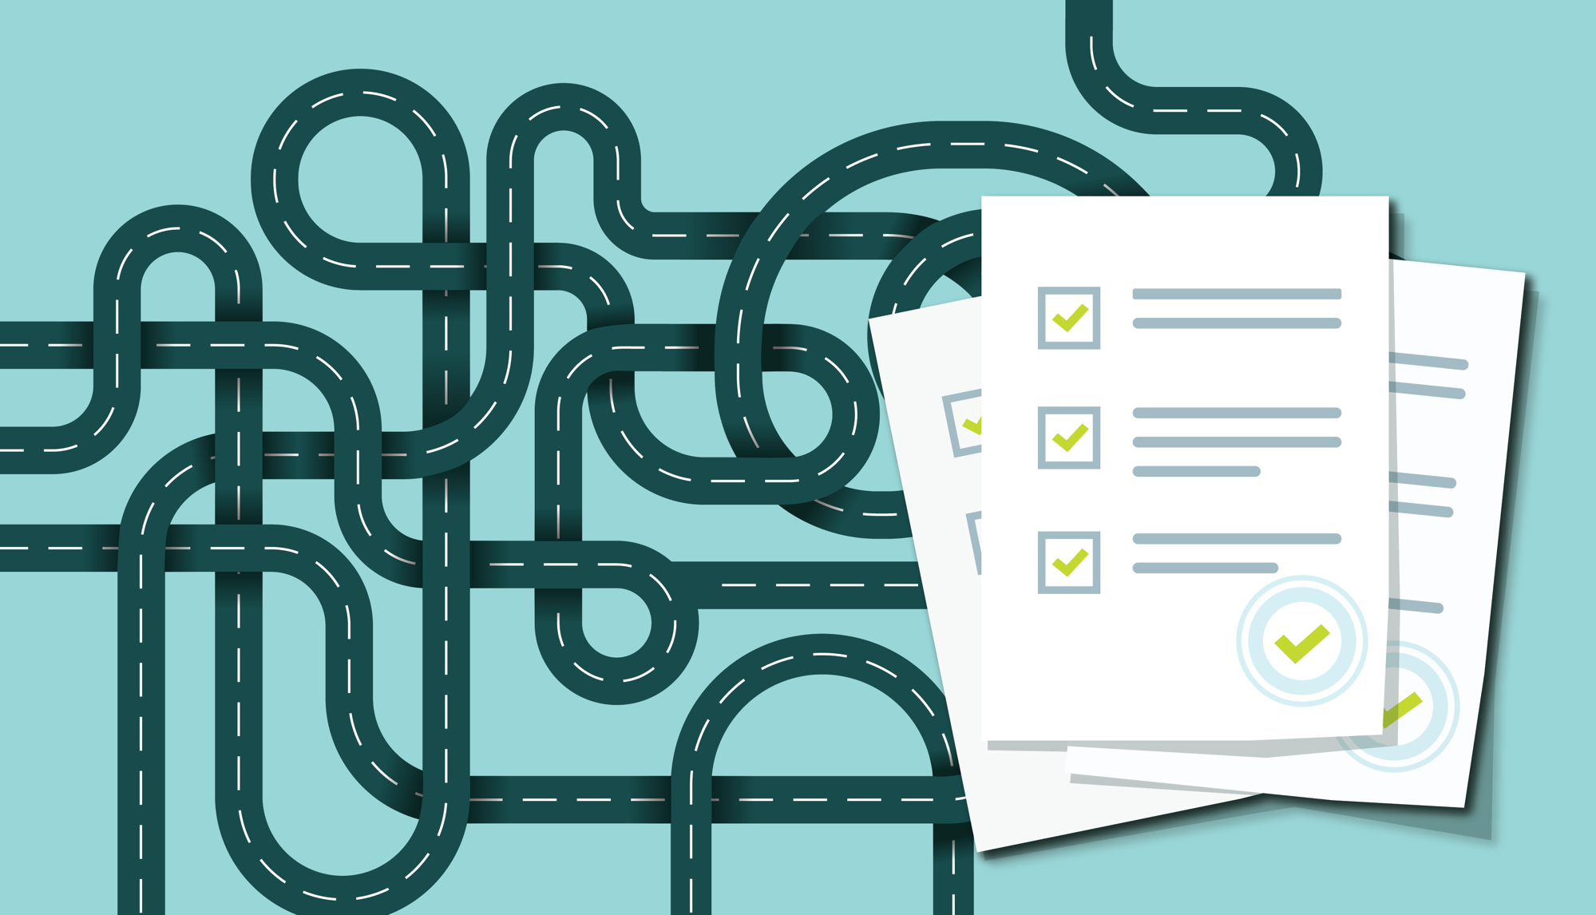

Slide 15
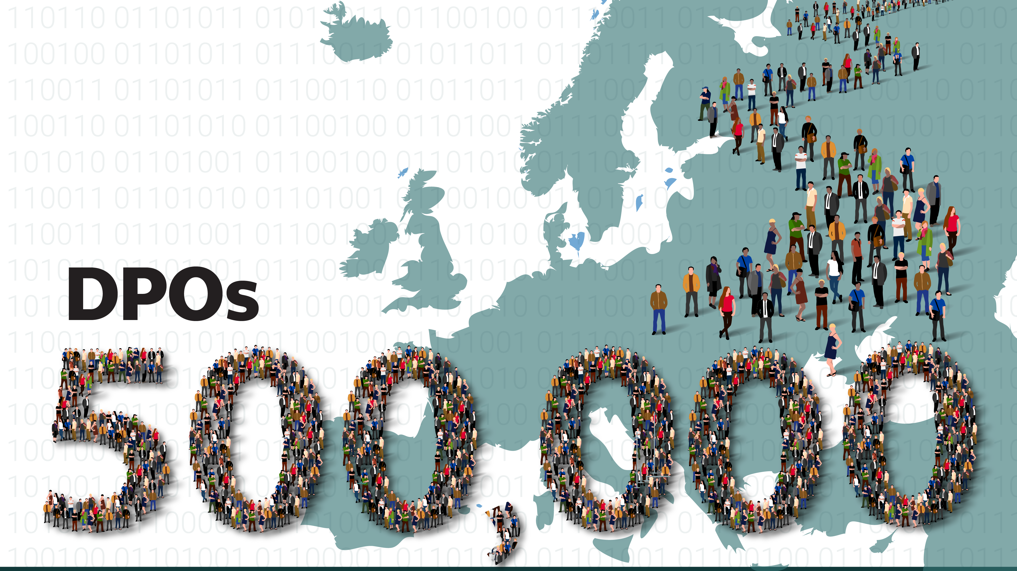

Slide 16
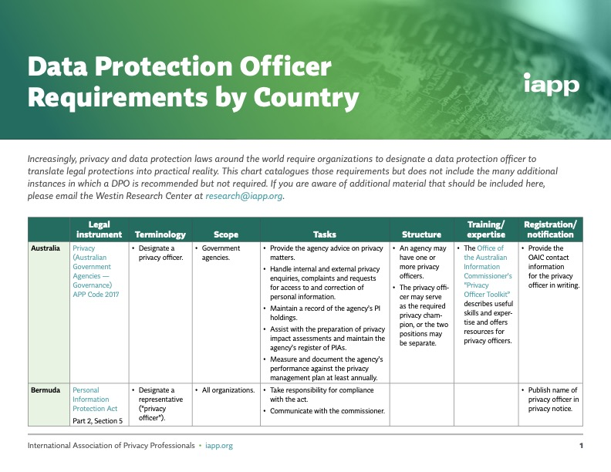

Slide 17


Slide 18
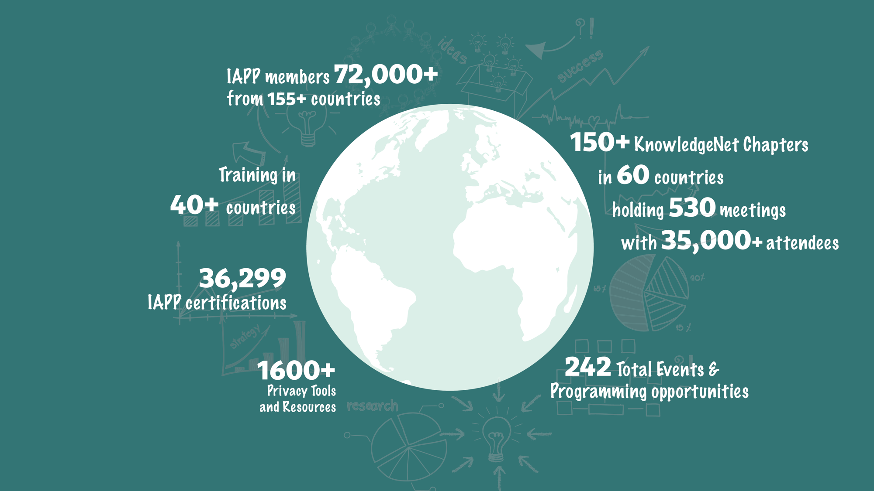

Slide 19

Notes:
44 in 2016
356 this year

Slide 20


Slide 21
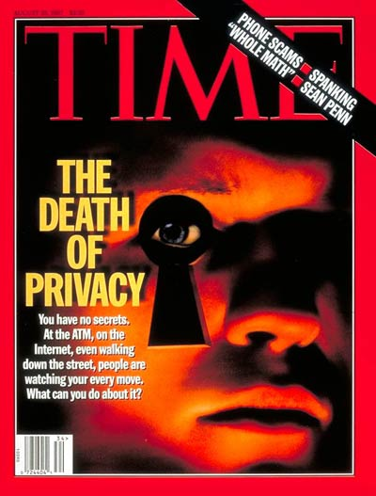
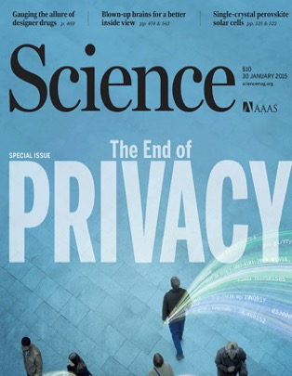


Slide 22


