Slide 1


Building the Car While Driving – Corporate IP Policies as a Vehicle for Business Success
PRESENTATION FOR
ACC Mountain West
Tech Law Symposium
March 1, 2024

Slide 2
Meet Our Panel

Slide 3
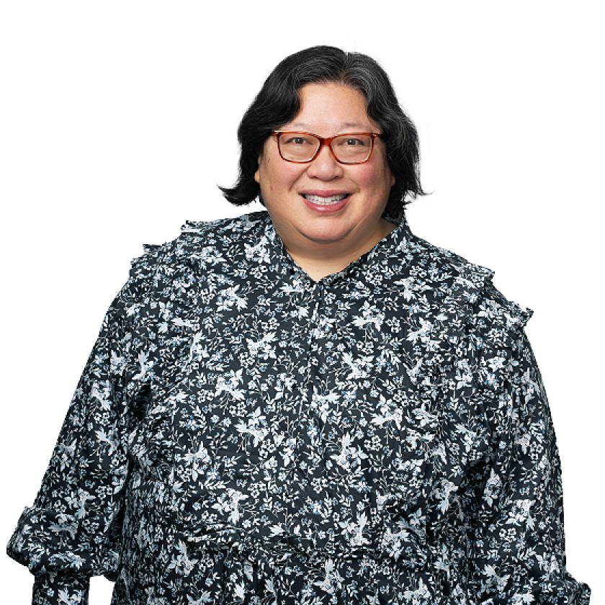
Moderator – Elaine Lee
Registered Patent Attorney at Maschoff Brennan
Elaine has 20+ years of experience working as a patent and intellectual property attorney for major technology companies as well as major international law firms. Her experience includes handling:
Complex Technology Transactions
Preparing and Prosecuting Patent Applications
Open Source Product Counseling and Compliance
U.S. and International Patent Portfolio Management
Due Diligence in Mergers and Acquisitions
Intellectual Property Counseling
Formulating Pre-Litigation and Litigation Strategies for Third-Party Patent Matters
education
J.D., University of Wisconsin Law School
B.S., Computer Science & Engineering, Cornell University
admissions
California State Bar
Illinois State Bar
State Bar of Wisconsin
U.S. Patent and Trademark Office
© 2024 Maschoff Brennan
3

Slide 4
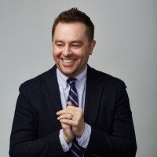
Panelist – James Larson
Deputy General Counsel of IP at Purple, Of Counsel at Dentons Durham Jones Pingar
James is Deputy General Counsel of IP at Purple. He has been with Purple for 6 years.
James is also Of Counsel at Dentons and has spent most of his career as a patent preparation and prosecution practitioner.
James is also very active in the world of soft IP and manages all of Purple’s soft IP in-house.
For anyone who is tempted to ask, James will tell you his favorite color is purple
education
J.D., Lewis & Clark Law School
B.S., Microbiology, Brigham Young University
admissions
Utah State Bar
U.S. Patent and Trademark Office
© 2024 Maschoff Brennan
4

Slide 5
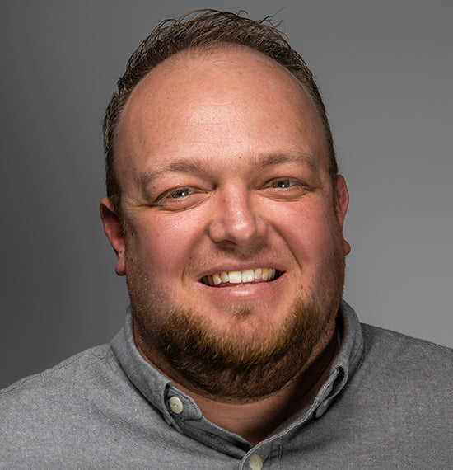
Panelist – Hadley Moss
General Counsel, Goal Zero
Hadley Moss is General Counsel of Goal Zero. and is responsible for all things legal. He likes to think of himself as a professional problem solver and enjoys getting to work with each of the teams at Goal Zero to prevent or solve the difficult problems that are always a part of doing business in a global economy.
Hadley has spent his whole professional career representing companies that make stuff. From the early days at one of Utah’s largest consumer products companies, to helping strike deals to build utility scale solar power projects, to his current role with Goal Zero, his approach to the legal world has been driven by helping good companies bring products to market that have a positive impact on the world.
Hadley’s favorite Goal Zero Product is the Sherpa 100AC Power Bank
education
J.D., University of Kansas
B.A., Political Science, University of Utah
admissions
Utah State Bar
© 2024 Maschoff Brennan
5

Slide 6
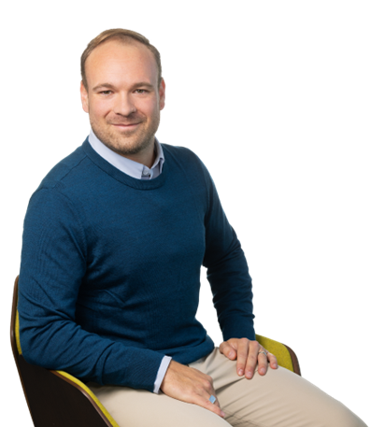
Panelist – Timothy Nielsen
Attorney at Law, Maschoff Brennan
Tim focuses his practice on intellectual property and complex litigation. He advises clients in a wide range of industries and has a particular interest in emerging technologies and biosciences.
He has spoken and moderated panels at events focused on blockchain technology, artificial intelligence, and machine learning. His experience includes:
Matters involving contract enforcement, business governance, patent and trademark disputes, and fraud
Working as a corporate attorney for emerging technology companies
Working on three startup teams as a co-founder
education
J.D., University of Utah, S.J. Quinney College of Law
M.B.C., University of Utah, David Eccles School of Business
B.S., University of Utah, Economics
professional admissions & associations
Utah State Bar
U.S. District Court, Utah
Certified Information Privacy Professional/United States (CIPP/US – IAPP)
© 2024 Maschoff Brennan
6

Slide 7
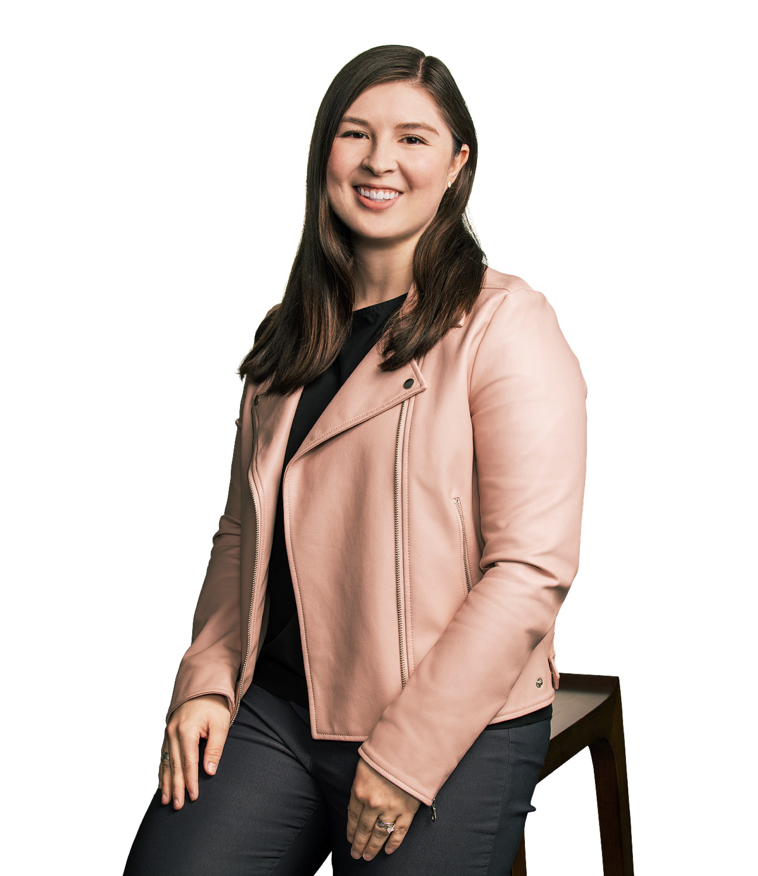
Speaker – Victoria Tomoko Carrington
Attorney at Law, Maschoff Brennan
Victoria helps clients protect and promote innovation through patent and trademark prosecution. She cares deeply about supporting scientists, engineers, and inventors.
Her experience includes:
Quinney Research Fellow for Professor Jorge L. Contreras and Law and Biomedical Sciences (LABS) Scholar
2023 publication in Nature Biotechnology on the patent landscape around assisted reproductive technologies (ARTs), including IVF and in vitro gametogenesis (IVG)
education
J.D., high honors, University of Utah, S.J. Quinney College of Law
B.S., Biochemistry, Brigham Young University
admissions
Utah State Bar
Passed Patent Bar Jan. 2024 (reg. no. pending)
© 2024 Maschoff Brennan
7

Slide 8
Corporate IP Policy - Human Resources and AI
Trade Secret
Secret
Valuable
Protected by Reasonable Measures
Does not require human involvement to create
Artificial Intelligence can be protected by trade secret law
Employee Onboarding/Offboarding
NDA/Invention Assignment Forms
Non-Compete Clauses
Enforceable in some states, banned in California
Federal rulemaking: FTC Proposed Rule to Ban Non-Compete Clauses
Incentive Programs for Employee Inventions – Trade secret protection
© 2024 Maschoff Brennan
8

Slide 9
AI and Marketing and Sales
Generative AI and Trademarks
Types of trademarks
Words or letters
Designs and symbols
Non-Traditional – Product Configuration, Sounds, Motions, Color
Trademark Protection
Fanciful/Coined, Arbitrary, Suggestive
Descriptive – must prove acquired distinctiveness
Generic- cannot function as a trademark
Use of AI to develop new trademarks
Generative AI and Copyrights
Copyright in inputs of large language and machine learning models
© 2024 Maschoff Brennan
9

Slide 10



Marketing & Sales
Social Media Policies
What are the things you want your marketing team to consider before they post to social media?
How much do the various terms of service of different social media sites impact your analysis of the risk/benefit of using social media marketing?
Social media best practices:
No undisclosed IP (especially trade secrets) should ever be featured on social media.
Disclose all paid-for endorsements upfront. Make sure any influencers you work with do the same.
Monitor competitors’ IP use on social media. If any of their material is substantially like your own, act by filing at least a cease-and-desist letter.
Enforce the same respect for other organizations’ and individuals’ IP rights that you expect for your own.
© 2024 Maschoff Brennan
10

Slide 11
Marketing & Sales
IP Legal Review of Marketing
Trademark Clearance and Registration
What resources are you using to make sure a mark you want to register is not already in use?
When it comes to marketing collateral, what policies does your company have in place to allow creatives to be creative while also avoiding infringement?
© 2024 Maschoff Brennan
11

Slide 12
AI and Research and Development
Generative AI and Patents
Inventorship requires a human being
Legislative efforts to reform patentable subject matter
Patent Eligibility Restoration Action of 2023 (PERA)
Patent Practitioner Use of Generative Ai
Generative AI and Copyrights
Human authorship required
Original works of authorship fixed in any tangible medium of expression
Input to large language and machine learning models may be protected by copyright
Inputs may be also protected by privacy laws
© 2024 Maschoff Brennan
12

Slide 13
Research and Development
IP Legal Review of Product Releases
Who has the decision-making authority for IP Protection Strategies (Trade Secret/Patent/Copyright/TM)
R&D
Legal
Marketing
Corporate/Business Development (e.g., Licensing, M&A)
Does your company have a patent committee (or committees) to identify which inventions the company should protect and how?
If so, who are the members of the patent committee?
How does the patent committee meet? (face-to-face, remote/real-time, email or online chat/tool)
How often does the patent committee meet?
© 2024 Maschoff Brennan
13

Slide 14
Research and Development
Invention Harvesting
What strategies have you developed to identify innovative R&D within your organization?
Who are the specific individuals/roles within the R&D organizations that you establish relationships with to identify potential new inventions?
Product Management
Engineering/Development team leads
Are there specific points in the product development and release cycle where you plug into the R&D organization to identify potentially patentable inventions?
If so, what are those timeline points?
© 2024 Maschoff Brennan
14

Slide 15
Research and Development
Patent Clearances
Does your company perform patent clearance reviews for new inventions and/or products?
What is the level of patent clearance reviews that are performed?
Informal patent search
Formal patent search
Informal opinion
Formal signed opinion
What are the criteria/determining factors for performing each level of patent clearance review that your business performs?
© 2024 Maschoff Brennan
15

Slide 16
Thank You!

