Slide 1
Mandatory Product Listing for Dietary Supplements
September 9, 2022
Krista Hekking

Slide 2
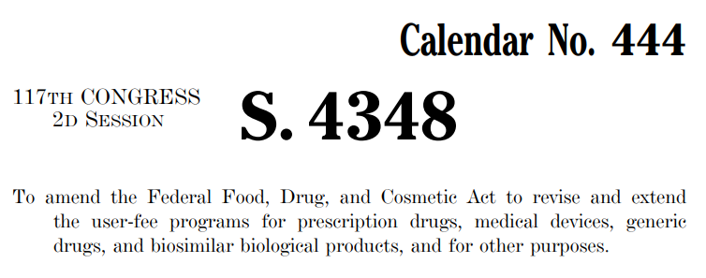
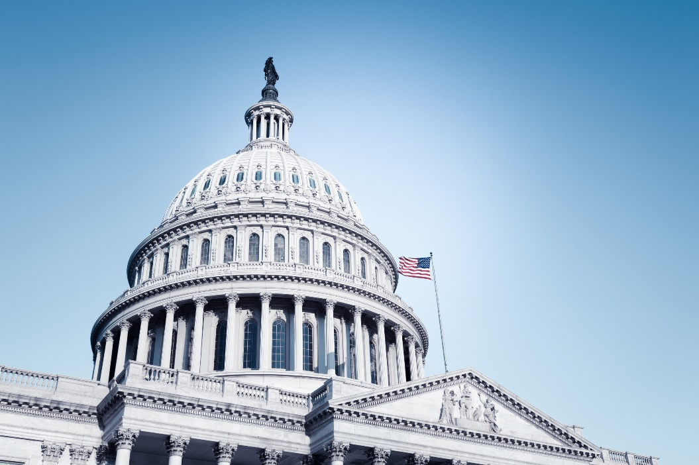

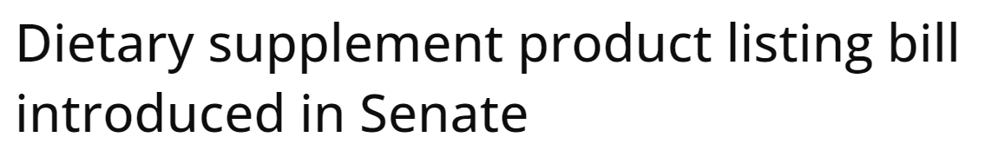


Slide 3
Agenda for Presentation
Background on product listing
Recent product listing legislative proposals
Outlook for product listing proposals
Bottom line for supplement companies

Slide 4
Background on Product Listing

Slide 5
What is Product Listing?
Submit list of FDA-regulated products the firm markets
Provide certain information about those products
Database of listing information

Slide 6


Existing Product Listing Requirements
Drugs
Medical Devices

Slide 7

Existing Product Listing Requirements
Human and animal drugs
  Proprietary, established name
  Name and quantity of active ingredients
  Name of inactive ingredients
  General product information (package, type, route of admin.)
  Facility information
  Labeling
  National Drug Code

Slide 8

Existing Product Listing Requirements
Medical devices for human use
  Proprietary/brand name
  Pre-market clearance, approval, or exemption info
  Activity conducted to device at establishment

Slide 9

Existing Product Listing Requirements
(Non-drug) Cosmetics - Voluntary
Cosmetic Product Ingredient Statements
  Business information
  Product name, website, label
  Ingredients

Slide 10
Why Product Listing?
FDA knows what is on the market
  Prioritize inspections
  Conduct post-market surveillance
  Oversee recalls
  Monitor product availability
  Identify violative products

Slide 11
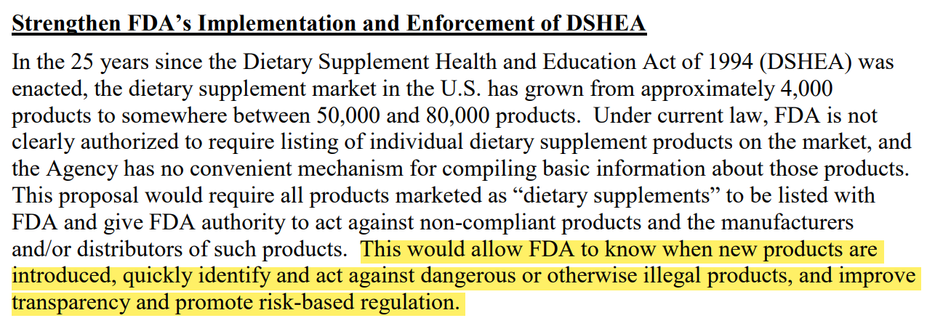
Why Product Listing for Dietary Supplements?

Slide 12
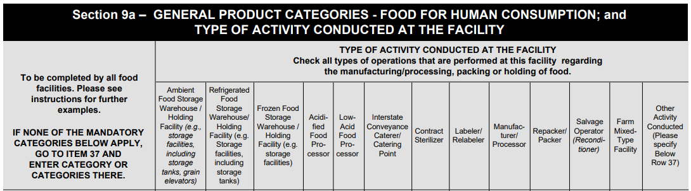
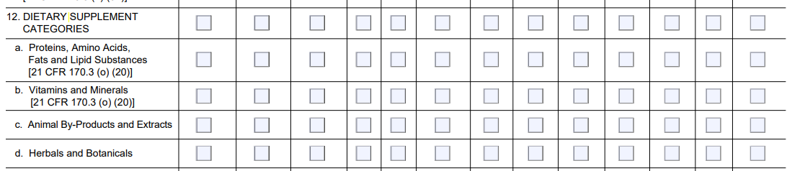
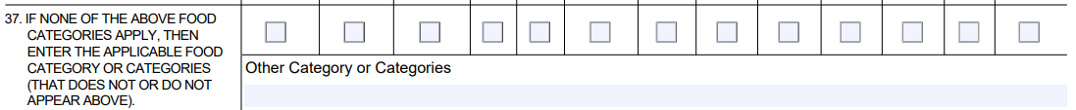
Product Information for Supplements

Slide 13
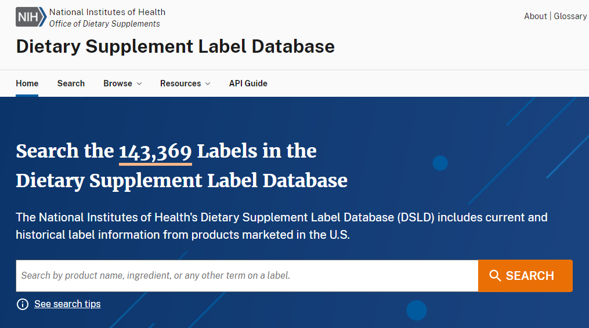
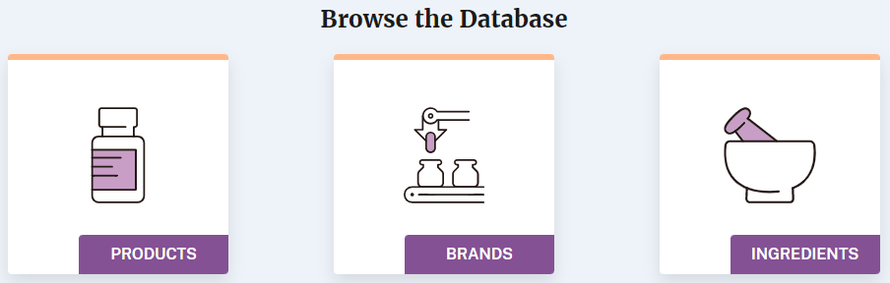
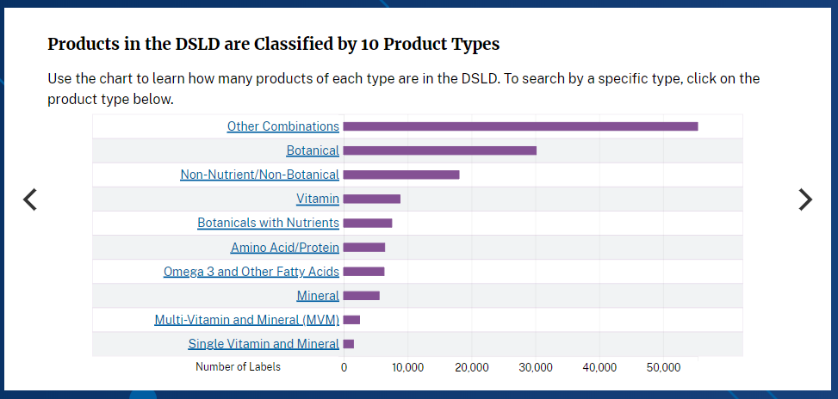
Product Information for Supplements

Slide 14

Product Information for Supplements

Slide 15
Product Information for Supplements
  Facility
  Registration
  NIH Database
  OWL Database
Why is listing needed?
  Reporting
  Internet Searches
  30-Day Notices, NDI Notifications

Slide 16
Recent Legislative Proposals

Slide 17
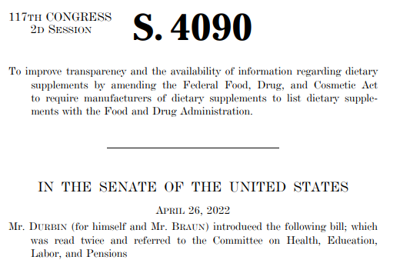
Dietary Supplement Listing Act
Introduced April 26, 2022, by Senators Durbin (D-IL) and Braun (R-IN)

Slide 18
Dietary Supplement Listing Act
Brand, proprietary name of supplement
Label and package insert
List of ingredients and amounts, if req’d to appear on label
Conditions of use
Warnings and precautions
Presence of any major food allergens
Dosage form
Health claims and structure/function claims

Slide 19
Dietary Supplement Listing Act
“Responsible persons” must list
  Foreign: U.S. agent
  Domestic: not defined, but potentially named company on label
Enactment
18 Months
Within 18 months after enactment
60 days to list after 18-month period expires
More than 18 months after enactment
Listed before distribution

Slide 20
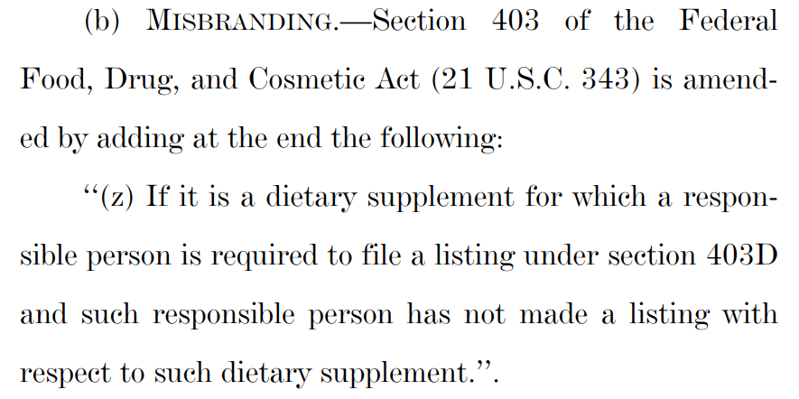
Dietary Supplement Listing Act

Slide 21
Dietary Supplement Listing Act
Stakeholder concerns
  Does listing amount to pre-market approval?
  Redundancies
  Restrict access to supplements?

Slide 22
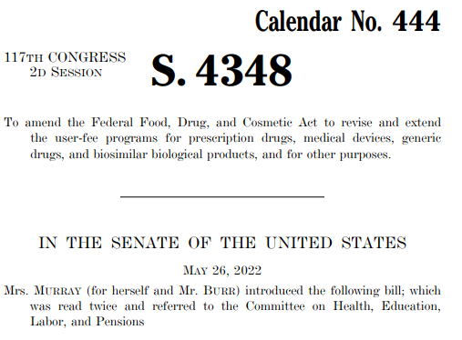
FDASLA
Introduced May 26, 2022, by Senators Murray (D-WA) and Burr (R-NC)

Slide 23
FDASLA
Largely mirrors the DSLA
  Makes explicit lack of pre-market approval authority
    “Nothing in this section shall be construed to grant the Secretary authority to require the approval of a dietary supplement prior to marketing.”
  Clarifies “responsible person”
    “The manufacturer, packer, or distributor of a dietary supplement whose name…appears on the label of a dietary supplement”
  Labels not required to be submitted

Slide 24
FDASLA
Requires information about quantity of ingredients in proprietary blends
Confidentiality protections
  Rule of construction
    “Nothing in this section shall be construed to authorize the disclosure of information that is prohibited from disclosure”
  Carve-out from database
    Shall contain listing information “except for information submitted under [the provisions requiring submission of the amount per serving of dietary ingredients within a proprietary blend]”

Slide 25
FDASLA
Requires information about quantity of ingredients in proprietary blends
Confidentiality protections
  Confidentiality provision
    “In response to a [FOIA request], [amount per serving of dietary ingredients within a proprietary blend] shall be withheld”

Slide 26
FDASLA
Marketed after Jan. 1, 2024
List before product enters the market
Sept. 30, 2022
Jan. 1, 2024
Potential date of enactment
Marketed on or before Jan. 1, 2024
List by Mar. 30, 2024

Slide 27
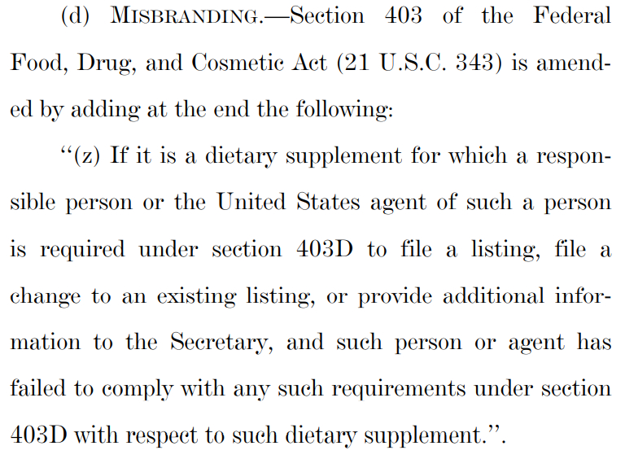
FDASLA

Slide 28
Outlook for Legislative Proposals
and Potential Impact

Slide 29
Outlook for Legislative Proposals
Dietary Supplement Listing Act on pause
Uncertain whether FDASLA will pass with supplement provisions
  House version does not have supplement provisions
  Limited time to pass fee package
  Controversial “prohibited act” provision
If FDASLA passes without supplement provisions
  Low likelihood of short-term passage for DSLA
  Likely will be further negotiation given lessons learned

Slide 30
Potential Impacts of a Listing Requirement
Administrative effort
Increased consumer confidence
Increased visibility
  Ingredients
  Structure/function and health claims
Inform FDA activity
  Enforcement
  Inspection
  Post-market
Precondition to partnering with retailers
Visibility for plaintiff’s attorneys

Slide 31
Questions?
Krista Hekking
KHekking@cov.com

