Slide 1

FTC Developments Regarding Advertising for Dietary Supplements
Riëtte van Laack
rvanlaack@hpm.com
www.FDAlawblog.net
18th Annual Nutrition Law Symposium
Sept. 8, 2023

Slide 2
Outline
FTC Jurisdiction Related to Dietary Supplement Advertising
Updated Health Claims Guidance
Updated Endorsement Guides
FTC Enforcement Actions
Notice of Penalty Offenses as Enforcement Tool

Slide 3
Federal Trade Commission
FTC shares authority with FDA over the advertising of over-the-counter products, including dietary supplements.
The FTC’s Division of Advertising Practices “protects consumers from unfair or deceptive advertising and marketing practices that raise health and safety concerns, as well as those that cause economic injury.”
The Federal Trade Commission Act (the “FTC Act”) prohibits “[u]nfair methods of competition in or affecting commerce, and unfair or deceptive acts or practices in or affecting commerce.” 15 U.S.C. § 45(a)(2).
Prohibits the dissemination of “any false advertisement . . . [b]y any means, for the purpose of inducing, or which is likely to induce, directly or indirectly, the purchase in or having an effect upon commerce, of food, drugs, devices, services, or cosmetics.” Id. § 52(a)(2).

Slide 4

Health Claims Guidance
Issued in Dec. 2022; no request for input or comments.
Expanded guidance applies to all OTC products, including cosmetics, OTC drugs, OTC devices, and other consumer products with health claims.
Sweeping overhaul of the 1998 guidance which was limited to advertising for dietary supplements.
FTC claims that guidance recaps FTC’s position(s) decisions of the past decades in matters related to “health claims.”
Although FTC says no change of the standard it has applied for decades, it does appear that the guidance moved away from the “flexible” approach.

Slide 5
Key Changes
Applies to advertising practices for “any health-related product.”
Expands the type of claims.
More stringent “competent and reliable scientific evidence standard.”
Includes “requirements” for design of randomized clinical trials (RCT).
Includes FTC “thoughts” on analysis of RCT data (no post hoc analysis).

Slide 6
Ingredient Claims
Can you rely on ingredient studies? Query whether scientific experts would require whole product testing.
Essentially equivalent standard.
Negative ingredient interaction is rare.

Slide 7
Traditional Use Claims
1998 Guidance: Present claim in a way that consumers will understand that the (sole) basis for the claim is history of use.
2022 Guidance: Include a disclaimer that there is “no scientific basis” (or support) for the claim.

Slide 8
Claims Based on Preliminary Research
1998: Discuss limitation of the research rather than rely on the meaning of the term preliminary (or promising).
2022: Consumers are likely to interpret terms such as preliminary or prominent as positive attributes; must have strong disclaimers.

Slide 9
Disclosures
Must be clear and conspicuous.
Ideally in the same size and type of font.
Disclosure must be understandable to target audience.

Slide 10
Some Thoughts
The document is guidance and not legally binding.
Some of FTC statements/positions are not consistent with the case law.
Future cases may contradict the guidance.
FDA’s current guidance on substantiation relies on FTC’s previous guidance. As a result there is a discrepancy. According to FDA, dietary supplement companies may rely on various types of scientific information, no requirements for drug-level trials for dietary supplement claims. Other valid sources may include observational, open-label, animal and laboratory studies.

Slide 11
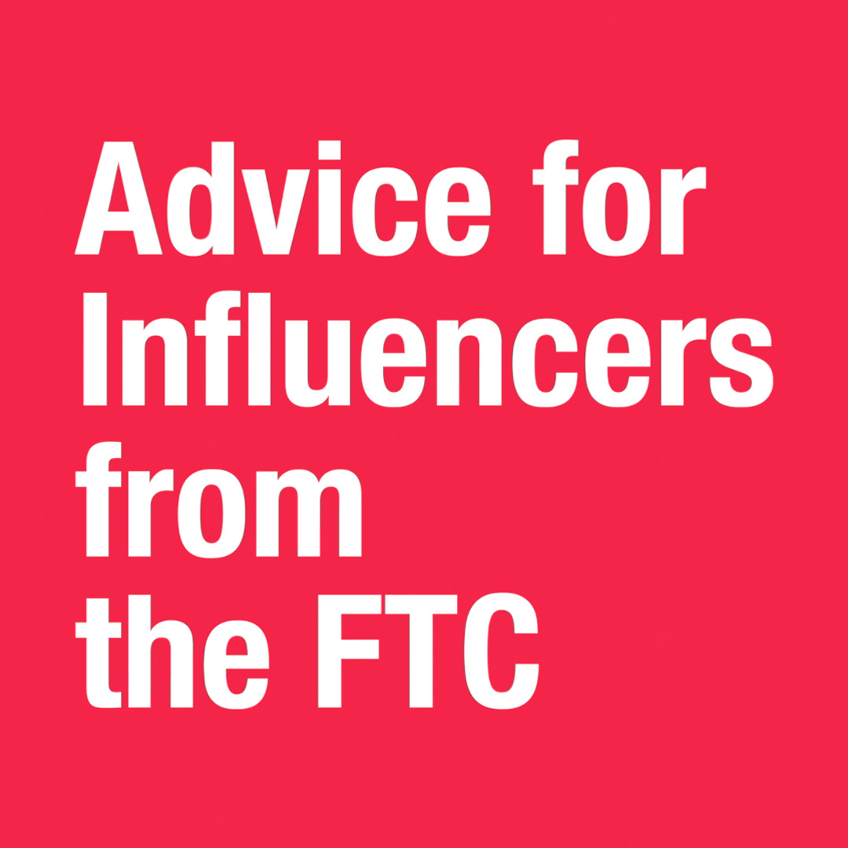
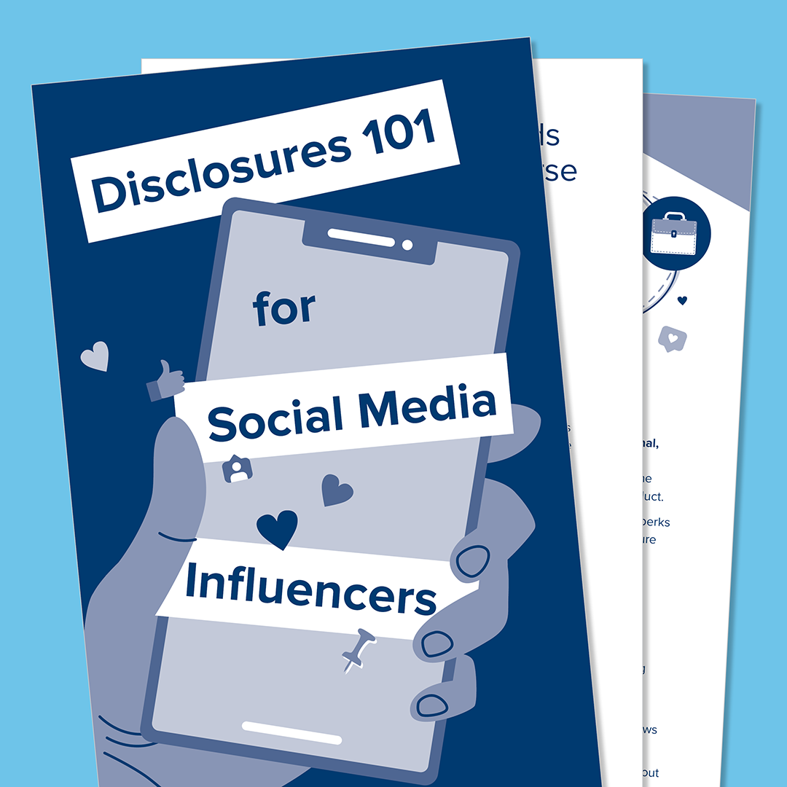
Updated Endorsement Guides
On June 29, 2023, FTC announced updates to guidance concerning endorsements and testimonials in advertising and FAQ: What People are Asking.

Slide 12
Updated Endorsement Guides: What’s New?
Definition of Endorser broad(ened).
Broadens when a disclosure is required by expanding material connection.
Revised definition of clear and conspicuous.
Broader liability for advertisers and endorser as well as intermediaries.

Slide 13
Definitions
Definition of Endorser broadened:
Simply tagging a brand in social media would be an endorsement.
Simply posting a picture of a product.
One that appears to be endorser.
Material Connection: Material connection need not be a payment or other reward; family relationship and free products and prizes may be material connection.

Slide 14
Clear and Conspicuous Standard
Must be difficult to miss.
The Disclosure must be UNAVOIDABLE.
Use the same font, type size, etc.
Use the same “format” as used for the endorsement, e.g., spoken endorsement requires spoken disclosure; written endorsement requires written disclosure.
Also, disclaimer must be understandable.

Slide 15
Manage Influencer Campaign
Agreement with influencers must include requirement related to disclosures about relationship: Instruct the influencer about the disclosure requirements, e.g., clear and conspicuous and actual language.
Consider training of influencers as to the requirements.
Best to preapprove posts, and review actual posts.
Monitor influencers; Company must ensure that influencers do what they are expected to do (stick to the “rules”).
Document efforts to fix problem posts.

Slide 16
FTC Proposed Rule on Use of Consumer Reviews and Testimonials
Addresses consumer reviews and companies’ use of such reviews. Describes what conduct in the context of consumer reviews constitutes unfair or deceptive acts.
Proposed rule prohibits:
Use of reviews/testimonial by people who do not exist, do not use or test product, misrepresent experience.
Review hijacking (use review for one product for other product(s).
Offering consumers compensation or other incentive for (good) review.
Company
from writing reviews w/o disclosure, and
Soliciting review from employees or relatives w/o disclosures.
Fake independent websites.
Suppressing negative reviews.

Slide 17
FTC Enforcement Actions
FTC continues to take actions against dietary supplements with unsupported claims.
Influencers and endorsers have been scrutinized.

Slide 18
Traditionally, the FTC Has Used Two Options for Enforcement
Investigation --- Action is warranted.
An administrative complaint to institute a case before an administrative law judge (ALJ), See FTC Act § 45(b). --- FTC has the authority to order the company to cease and desist violative conduct, and may also include so-called “fencing-in” provisions that go beyond the scope of the behavior declared unlawful. Id. No civil penalties. If a company violates the FTC’s order, the FTC can institute a civil action seeking an injunction, civil penalties, and consumer redress.

Slide 19

Options for Enforcement, cont’d
A complaint in federal court. Id. §§ 53(b), 57b. --- Compared to administrative proceeding FTC can more quickly obtain injunctive relief and asset freezes. For decades FTC has been able to attain civil penalties, consumer redress, and disgorgement.
--- April 2021, Fatal blow to FTC enforcement authority: In AMG Capital Management, LLC, et al. v. Federal Trade Commission, the U.S. Supreme Court decided that FTC cannot obtain monetary relief under section 13(b) of the FTC Act to obtain equitable monetary relief.

Slide 20
FTC Option for Civil Penalties Post AMG
Develop a rule: Under 15 U.S.C. 45(m): FTC may commence a civil action to recover a civil penalty against any party which violates any rule related to unfair or deceptive acts or practices: FTC issued a rule regarding Made in USA claims.

Slide 21
Another Option for Civil Penalties: FTC Notice of Penalty Offences
A Notice of Penalty Offenses is intended to put firms on clear notice about deceptive or unfair acts or practices the FTC has fully litigated.
A Notice of Penalty Offenses, also referred to as a “Section 205 Synopsis,” lists certain types of conduct that the FTC has determined, in prior administrative orders, violate the FTC Act. Once a company receives the NPO, it presumably “knows” about the conduct the FTC prohibits and if the company subsequently engages in the prohibited conduct, it can be subject to civil penalties.
FTC revitalized this tool in 2021, when it sent out several NPOs.
In 2023, the maximum penalty is 50,120 dollars per violation.

Slide 22
Requirements for NPO
Penalty Offense Authority, authorizes the FTC to seek civil penalties against other parties if the following specific circumstances are met:
a final cease and desist order has been entered against a party in an administrative proceeding under section 5(b) of the FTC Act;
there is a Commission determination that a specific practice is unfair or deceptive, as part of that order; and
a party with actual knowledge that the practice is unfair or deceptive has engaged in that practice after the order became final.

Slide 23
NPOs
Benefit?
The FTC can substantially increase deterrence and reduce litigation risk by noticing whole industries of Penalty Offenses, exposing violators to significant civil penalties, while helping to ensure fairness for honest firms.
Possible Issues
Lack of due process afforded a party.
FTC case decisions are not written like a rule, and facts are contested and often complex, ----- do decisions provide a clear and unambiguous framework?
Subsequent defendants may be able to distinguish the underlying case and claim, and argue that the decision did not give them adequate notice that their activity was also unlawful.

Slide 24
NPOs in 2021
Oct. 6, 2021: NPO to 70 for profit educational institutions.
Oct. 13, 2021: NPO to 700 companies, including many consumer product, pharmaceutical, and food manufacturer focused on misleading use of endorsements and testimonials.
Oct. 26, 2021: NPO to 1,100 businesses re false money-making claims.
NPOs notes that a notice is not an indication that the recipient has violated the law.
So what is the purpose?
Ensure that the recipient understands the law.
Know the consequences of a violation.

Slide 25
NPO on Misleading Endorsements and Testimonials
Lists seven practices that have been found to violate the FTC Act
claiming that a third party has endorsed a product or its performance when that is not the case (this includes fake reviews);
misrepresenting that an endorsement reflects the experience, views, or opinions of users or purported users;
misrepresenting an endorser as an actual, current, or recent user of a product;
continuing to advertise an endorsement without reason to believe the endorser continues to subscribe to the views presented in the endorsement;

Slide 26
Endorsement Practices that Violate FTC Act, cont’d
using testimonials to make unsubstantiated or otherwise deceptive performance claims – even if the testimonial is genuine;
failing to disclose a material connection that may affect the weight or credibility of the endorsement or review; and
misrepresenting that the experience of an endorser represents the typical or ordinary experience of users of the product.

Slide 27
2023 FTC NPO Re Substantiation
Letters to 670 companies that are making or likely to make health claims.
Under the advertising substantiation doctrine, “companies must have a reasonable basis to support their advertising claims before those claims are disseminated.” The FTC suggested that companies review the Health Products Compliance Guidance as the starting point to ensure compliance.

Slide 28
NPO Lists Five Practices
Making an objective product claim without relying on competent and reliable evidence to support it;
Misrepresenting the level or type of substantiation for a claim;
Making a health or safety claim without relying on competent and reliable scientific evidence conducted and evaluated in an objective manner by qualified persons and that is generally accepted in the profession to yield accurate and reliable results;
Representing that a claim has been scientifically or clinically proven unless the advertiser relies upon evidence sufficient to satisfy the relevant scientific community of the claim’s truth.

Slide 29
Practices, Cont’d
Representing expressly or by implication that a product is effective in the cure, mitigation, or treatment of any serious disease without relying on at least one human clinical trial of the product that:
1) is randomized,
2) is well controlled,
3) is double-blinded (unless the marketer can prove blinding cannot be effectively implemented);
4) is conducted by qualified people;
5) measures disease end points or validated surrogate markers; and
6) yields statistically significant results.
Only this last practice is somewhat specific.

Slide 30
NPO Re Substantiation
Will this NPO be effective?
Substantiation is a complex issue. Determination of reasonable basis and competent and reliable evidence requires a complex nuanced fact based evaluation.
Conduct must be sufficiently similar to conduct of litigated cased cited in the NPO: For substantiation far more complex and uncertain than for some other issues.
Litigated cases complex and nuanced issues often with dueling experts.
Prohibited practices described are very general and appear to reiterate FTC guidance.

Slide 31
What To Do If You Have Received A Notice?
Do an internal compliance check including review of internal substantiation policies and files.
No policy? Create one!
Know what claims you are using: create a list!
Prepare internal records.
Where necessary, take corrective actions.
What not to do:
Contact FTC.
Ignore the NPO

Slide 32
Conclusion
FTC continues to scrutinize advertising practices.
FTC has a toolbox full of enforcement option; violation of FTC Act can be costly.
Everyone involved in advertising, including intermediaries, can be held liable.
Companies benefit from developing internal procedures for advertising including endorsements, testimonials, influencers, and substantiation.
Substantiation is a complicated issue; monitor FTC guidance and enforcement actions.
FTC guidance is not the law but do not ignore it.

Slide 33


Questions

