Slide 1
Best Practices for Addressing a Potential Recall Issue
Justin J. Prochnow

Slide 2
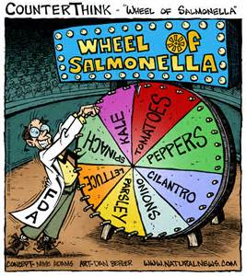
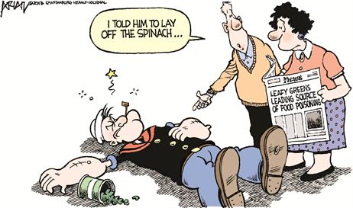
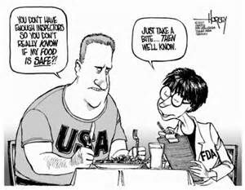
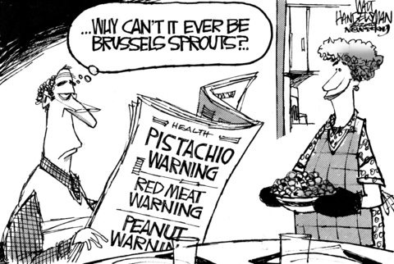
Food Safety

Slide 3
Discovery of F00d Safety and other Potential Recall Issues
Company discovers a problem internally
Customer and/or consumer reports an issue
FDA inspects a manufacturing facility and discovers issues
FDA investigates based on receiving complaints and discovers issues
FDA is contacted by CDC about illness outbreaks

Slide 4
We’ve heard there’s an issue. What do we do next?
Convene the Food Safety/Recall Team
Discuss the issue with your experienced and knowledgeable attorney!
Evaluate the issues and determine whether a recall is warranted and/or necessary
Actually, while we are on the subject, what is a recall?

Slide 5
What is a Recall?
21 CFR 7.40
Recall is an effective method of removing or correcting consumer products that are in violation of laws administered by the FDA. Recalls are an alternative to a FDA-initiated court action for removing or correcting violative products
Recall notices posted on FDA website for food, beverage and supplement products
Regulations regarding recalls found at 21 CFR 7.40-7.59

Slide 6
Bases for Recalls
Food contamination
Salmonella, Listeria, E. Coli, other
Failure to Identify Food Allergens pursuant to FALCPA
Milk, eggs, wheat, peanuts, soybeans
Crustacean shellfish, tree nuts, fish
Undeclared Ingredients
Drug ingredients (Tadalafil, Sibutramine, Steroids)
Sulfites
Foreign Objects
Glass
Metal Objects
Improper Labeling
Amounts in product don’t correspond to labeling information
Inadequate or incorrect directions (kid’s multivitamin)

Slide 7
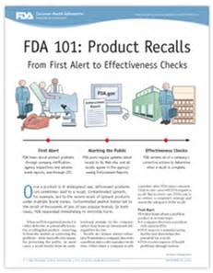
Classes of Recalls
Class I Recall
Reasonable probability that product will cause serious adverse health consequences or death
Examples: Salmonella, Listeria, undisclosed ingredients, food allergens
Class II Recall
Temporary or medically reversible adverse health consequences or where the probability of serious adverse health consequences is remote
Examples: failure to specify source of ingredients, insanitary conditions, trace foreign objects
Class III Recall
Not likely to cause adverse health consequences
Examples: container issues, spoiled products, exceeded impurity specifications, label misspellings
Market Withdrawal

Slide 8
“Voluntary” Recalls
Most recalls are considered voluntary; these are recalls initiated by a Company pursuant to 21 CFR 7.40(b)
Company may end up “voluntarily” recalling product as a result of pressure from FDA and/or customers
FDA Safety Alerts / Warning Letters
Refusal to initiate recall may result in seizure or other court action; seizure may also happen when a recall would not be effective or there is a continuing violation

Slide 9
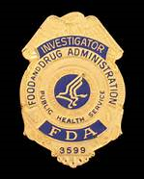
FDA Statutory Recall
FDA is authorized by law to order recalls in certain situations
Mandatory Device Recalls
Mandatory Recall of Biologics
Mandatory Recall of Human Tissue Intended for Transplantation
Infant Formula
Interstate Milk Shipments
FSMA

Slide 10
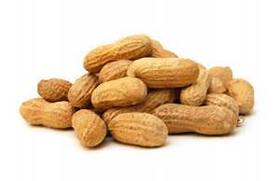
FDA Requested or Mandated Recall
FDA may also request that a Company initiate a recall pursuant to 21 CFR 7.40(b) when a Company does not undertake a recall on its own initiative
Requests are generally reserved for urgent situations and are most often classified as Class I
Example: Westco Fruit and Nuts Inc.
Under the FSMA, FDA may also go into court and seek mandatory recall authority but only for situations in which there is the potential for serious adverse health consequences or death

Slide 11
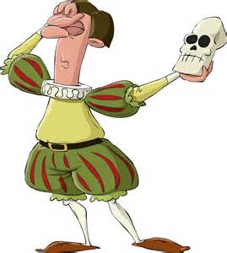
To Recall or Not to Recall – That is the Question
Evaluating the Necessity of a Recall
Is there a safety issue?
If it is a contamination issue, an undeclared food allergen, or some other potential health risk, you must evaluate the potential health risk
Often utilize a toxicologist to evaluate safety
Highly recommended if the ultimate decision is to not recall
What are the business costs?
Recalls are expensive
Not just replacement of product – other costs include restocking fees, attorneys fees, commissions, other business costs
What are the PR consequences?
Does Issuing a Recall Shine a Spotlight on the Issue?

Slide 12
Who Initiates the Recall?
Responsible Company can “voluntarily” recall product
FDA can request a Company to recall product
FDA can mandate recall pursuant to certain statutes and laws
FDA has mandatory recall authority under FSMA for products with a reasonable probability of serious adverse health consequences or death

Slide 13
Notifying FDA
Once a Company determines that a recall is necessary, it must contact the FDA and the District Recall Coordinator
Notice must be given to consumers; this usually means a press release
FDA will recommend that a Company issue a press release and the District Recall Coordinator will ask to review
Model press releases on FDA website
No requirement to have FDA approve, but if FDA doesn’t like press release or a Company doesn’t issue press release, FDA may do so

Slide 14
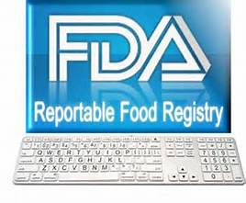
Reportable Food Registry
Requirements of Reportable Food Registry are separate from recalls
RFR database was initiated by FDA in 2009 to track patterns of adulterated food
Covers all food regulated by FDA except dietary supplements and infant formula
Must file with RFR when there is a reasonable probability that the use of, or exposure to, food will cause serious adverse health consequences or death to humans or animals
Report must be made no later than 24 hours after a food is determined to be a reportable food
Failure to report is prohibited act under the FDCA

Slide 15
Submission and Evaluation by FDA
Once a recall is initiated and notice is given, a Company must submit information to the FDA pursuant to 21 CFR 7.46(a)
District Recall Coordinator will send an outline of the necessary information needed by FDA
FDA will take information and classify the recall as a Class I, Class II, or Class III recall

Slide 16
Information to Submit to FDA
Guidance for Industry: Product Recalls
21 CFR 7.46(a)
Identity of product
Reason for removal
Evaluation of risk
Total amount of products produced & distributed
Distribution information
Copies of recall communications
Recall plan/strategy
Contact information

Slide 17
Communications with FDA
FDA District Recall Coordinator will be contact
Recommended to have outside counsel designated as primary contact with FDA to ensure all correspondence and communications with FDA are appropriate
Company will need to submit recall status reports and supplement information provided to FDA
Company may need to expand recall (PCA)
Company may need to answer additional questions from FDA
Once recall plan is completed, notify FDA and request termination pursuant to 21 CFR 7.55(b)

Slide 18
Inspections
FDA very likely will conduct inspection of facilities
FDA has the authority to inspect facilities at which food is manufactured, processed, packed or held pursuant to 21 USC §§ 372-374
Refusal to allow FDA to inspect is a criminal offense
Right to inspect is not unfettered; it is critical that companies understand their own rights and the FDA’s rights and scope to inspect

Slide 19
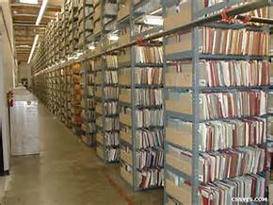
Documentation of Recall
DOCUMENT EVERYTHING!!!!
FDA will want documentation of communications with distributors, retailers, customers, etc.
FDA will want records regarding disposition of recalled product
Relabeling/reconstitution
Destruction
Professional service (Certificate of Destruction)
Self (video, photos)

Slide 20
Are you Prepared?
Some recalls are simply beyond control of company if other company in food supply chain has issues (Salmonella in tea, eggs, peanuts)
Sometimes the best offense is a good defense

Slide 21
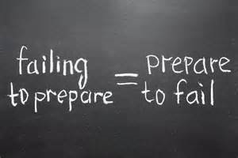
Preemptory Recall Planning
Take steps to lessen impact of potential recall
Recall Team/Management
SOPs
Manufacturing, Supply, Distribution Agreements
Insurance

Slide 22
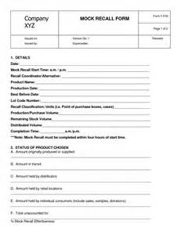
Recall Team/Management
Once a recall is underway, it is important to manage the recall effectively and efficiently
Have a “Recall Team” designated in advance
Key Personnel (Internal Recall Coordinator)
Legal
Public Relations
Perform a mock recall

Slide 23
Recall Team/Management
Balancing the Equities
Safety should be #1 priority
Assess risks of action vs. inaction
Costs
Media portrayal
Good corporate citizen
Know your Rights and Obligations
Companies have certain obligatory responsibilities but FDA does not have carte blanche to demand anything and everything

Slide 24
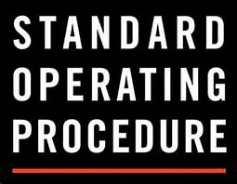
Standard Operating Procedures
Especially with larger companies, important to have SOPs in place for recalls so that all employees know what to do when a recall occurs
Helps to avoid premature destruction of product or records
Streamlines recall and interaction with FDA

Slide 25
Insurance
Check current insurance coverage for extent of recall coverage
Many policies have exclusions for recalls
Low limits for recall issues
Costs for recalls include lost product, recall fees from retailers, manpower hours, destruction costs, attorneys’ fees
More insurance companies are offering recall coverage, although it is expensive
Once recall issues surface, MUST PUT CARRIER ON NOTICE!!
Must cooperate with insurance investigation

Slide 26
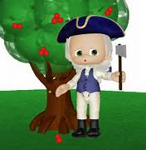
Final Recall Tips
Be Truthful and Forthcoming – Don’t Lie!
Lying or providing materially misleading information to any federal government agent performing their official duties is a felony - 18 U.S.C.§ 1001 (False Statement)
Making false or misleading statements to shareholders is also a felony – 18 U.S.C.§ 1348 (Sarbanes-Oxley Act of 2002)
Age of media proliferation; your lies will get disseminated rapidly – Twitter, Facebook, YouTube

Slide 27
Greenberg Traurig LLP An International Firm of 2100+ Attorneys & Government Law & Policy Professionals in 40+ Cities

Slide 28
Legal Disclaimer
This presentation consists of general legal information. It is not intended to give legal advice about a specific legal problem, nor does it create an attorney-client relationship.
Due to the importance of individual facts of every situation, the generalization in this presentation may not necessarily be applicable to all situations. Changes in the law could make parts of this presentation obsolete in the future.
This area of law is, in particular, an area of great flux and change. The discussion of law and regulations may be out of date soon after this presentation.
This information is provided with the understanding that if specific legal advice is required, the services of the presenter or another competent attorney should be sought.

Slide 29
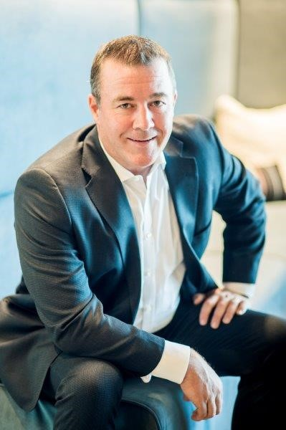
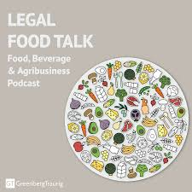
QUESTIONS AND ANSWERS
Justin J. Prochnow
Greenberg Traurig LLP
1144 15th Street, Suite 3300
Denver, Colorado 80202
(303) 572-6562
prochnowjj@gtlaw.com
Twitter: @LawguyJP
Podcast: Greenberg Traurig’s Legal Food Talk

