Slide 1
Navigating the AI Landscape: Addressing Hot Button Issues, Pitfalls, and Privacy Concerns in the Era of Data-Driven Technology

Slide 2
Presenters
Natasha Allen
Partner | Silicon Valley
Jared Braithwaite
Partner | Salt Lake City

Slide 3
Agenda
Introduction to AI
State of the Law
Data Privacy Concerns
Copyright Developments
Next Steps
Questions

Slide 4
Introduction to Artificial Intelligence

Slide 5
What is Artificial Intelligence?
AI is a machine’s ability to perform the cognitive functions we associate with human minds, such as perceiving, reasoning, learning, interacting with an environment, problem solving, and even exercising creativity.
Notes:
Natasha presenting

Slide 6
Generative AI
Generative AI is a type of artificial intelligence system that generates content (such as text, images, code, or music) in response to a prompt.
Examples:
ChatGPT (Chat Generative Pre-Trained Transformer)
DALL-E (a tool for making AI-generated art)
Why now? Better models, more data, more compute, at more affordable prices.
Generative AI models will confidently produce inaccurate, plagiarized, or biased results, without any indication that its outputs may be problematic. That’s because the models have been trained on the internet, which is hardly a universally reliable source.
Notes:
Natasha presenting

Slide 7
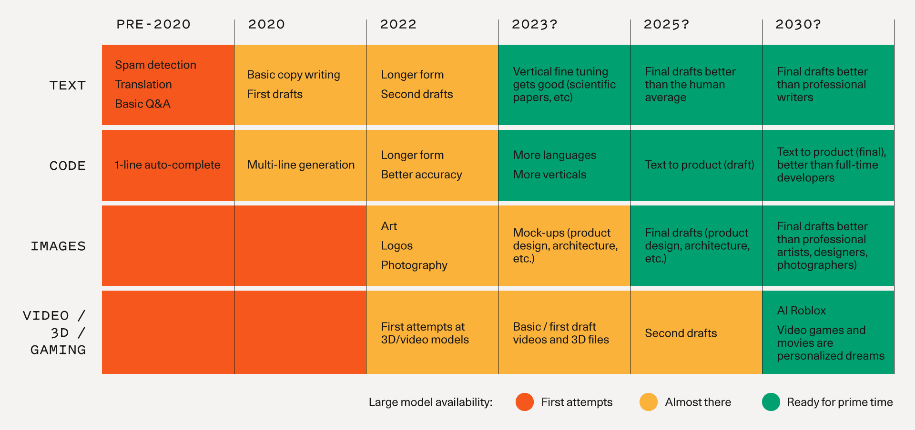
Generative AI Model Types
Source: https://www.sequoiacap.com/article/generative-ai-a-creative-new-world/
Notes:
Natasha presenting

Slide 8
How are AI models trained?
AI often learns to perform a task by training, often with specific training data sets.
During training, AI’s performance is reinforced if it reaches the correct result using the training data, or its performance is altered if it reaches an undesirable result.
Notes:
Jared Presenting

Slide 9
Training vs. Operation
AI
Output Data / Action
?
Training Data
Input Data / Prompt

Slide 10
Data Sources
Structured Data
Unstructured Data
Semi-structured Data
Streaming Data
Notes:
Jared presenting

Slide 11
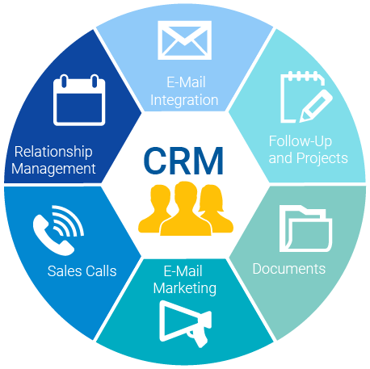
Structured Data
Examples include:
Enterprise Resource Planning (ERP) System
Customer Relationship Management (CRM) System
Notes:
Jared presenting

Slide 12
Unstructured Data
Examples include:
Emails
Social Media Posts
Notes:
Jared presenting

Slide 13
Semi-Structured Data
Examples include:
Emails
Machine Logs
XML files
Notes:
Jared presenting

Slide 14
Streaming Data
Examples include:
Ride-Share Applications
Smart Appliances
Notes:
Jared presenting

Slide 15
State of the Law
Notes:
Natasha Presenting

Slide 16
Blueprint for an AI Bill of Rights
The White House Office of Science and Technology Policy (OSTP) issued the blueprint in October 2022.
It identifies five principles, which OSTP believes should guide the design and use of AI systems to protect the American public.
Principles include:
Safe and effective systems;
Algorithmic discrimination protections;
Data privacy;
Notice and explanation; and
Human alternative options.

Slide 17
Artificial Intelligence Risk Management Framework (RMF) 1.0
The National Institute of Standards and Technology (NIST) published the framework in January 2023.
It was designed to help organizations of all sizes and across different sectors manage AI risks and promote trustworthy and responsible AI development and use.
The framework outlines four core functions:
Govern,
Map,
Measure, and
Manage.

Slide 18
Executive Order on the Safe, Secure, and Trustworthy Development and Use of Artificial Intelligence
President Biden issued the executive order on October 30, 2023.
It requires certain federal agencies including the Departments of Commerce (through NIST), Energy, and Homeland Security to develop guidelines and standards for AI safety and security.
Under the executive order, AI system developers must report their safety test results to the U.S. government if such results show that AI could pose a risk to national security.

Slide 19
Federal Intelligence Risk Management Act
The bill was introduced in the Senate on November 2, 2023.
If enacted, the bill would require federal agencies and vendors to follow the AI Risk Management Framework put forth by NIST.

Slide 20
American Data Protection and Privacy Act (ADPPA)
ADPPA was introduced on June 21, 2022.
The act regulates how organizations can keep and use consumer data.
If enacted, the bill would require companies to conduct algorithmic impact assessments and submit those assessments to the Federal Trade Commission (FTC).

Slide 21
State-by-State AI Legislation Snapshot

Slide 22
Utah
Enacted
Utah Consumer Privacy Act (UCPA)
The UCPA gives consumers the right to access, correct, delete, and receive a copy of their personal data
The UCPA also gives consumers to opt-out of the sale of their personal data and opt-out of targeted advertising
Pending
Information Technology Act Amendments (SB 131)
requires political candidates to disclose AI use in ads.
Artificial Intelligence Amendments (SB 149)
Imposes liability for actions of generative AI
Requires certain disclosures of generative AI use to consumers

Slide 23
California
Enacted
Bolstering Online Transparency Act (BOT)
BOT makes it illegal for a person or entity to use a chatbot to sell items or influence votes without disclosing that it is a chatbot.
California Privacy Rights Act (CPRA)
CPRA amends the California Consumer Privacy Act and adds limitations on data retention, data sharing, and use of sensitive personal information.
Pending
Automated Decision Tools (AB 331)
This bill would require companies to notify individuals when automated decision tools were used to make decisions regarding those individuals.

Slide 24
Washington
Issued
Executive Order 24-01
This executive order, signed by Governor Jay Inslee, calls on state agencies to make guidelines for AI use.
Pending
People’s Privacy Act – SB 5643
This bill would prohibit companies and Washington governmental entities from operating or installing AI-enabled profiling in certain locations or from using AI-enabled profiling to make decisions that produce legal effects.
SB 5838
This bill would establish an artificial intelligence task force.

Slide 25
Global Perspective v. U.S. Perspective
Global Perspective
EU Artificial Intelligence Act
AI Regulations in China
National security interests for governments
U.S. Perspective
Federal laws will be tough to pass due to politics and the election season
Executive orders will play an important role in empowering different federal agencies to regulate AI because of lack of legislation
States will be looking to pass AI-related legislation based on individual state interests
Example: California and New York

Slide 26
Data Privacy Concerns
Notes:
Jared Presenting

Slide 27
Privacy Management and Risks
Risks
Training Data v. Production
Could contain sensitive data
Users could opt out at a later date
Does separate consent need to be obtained for data used to train AI technologies?
Strategies
Clearly disclose the purpose behind using this data and that it is being recorded
Distinguish training data
Notes:
Clearly disclose the purpose behind using this data and that it is being recorded (ex: using photos of people on bicycles to train technology to recognize bicycles)
Distinguish training data (ex: training data to software update)
Jared presenting

Slide 28
How can data be protected?
Clearly articulate how data is collected, used, and disclosed by AI technologies
As required in Utah, consider offering an “opt-out” option for storage or use of certain personal data
Notes:
Jared presenting

Slide 29
Vendor Contracts - Confidentiality
Risk
Use of customer data for AI training
Customer data would be incorporated into the vendor’s LLMs, potentially resulting in the disclosure of customer confidential information and loss of trade secret protection.
Mitigation Language and Strategies
Vendor data use rights
Allow vendor customer data only to provide the services or software to the customer.
Data Use Exhibit
If some additional use rights are required, a Data Use Exhibit can be used to describe categories of customer data, vendor’s privacy and security obligations with respect to each category, and vendor’s data use rights with respect to each category.

Slide 30
Vendor Contracts – Lack of Compliance with Existing and New AI Regulations
Risk
Vendor or its partners may not be sophisticated or choose to comply with existing and new regulations relating to AI.
Mitigation Language and Strategies
Representations and Warranties – Compliance and Notice
Include language that the vendor and each of its suppliers and partners complies with all existing regulations and will become compliant with all applicable jurisdictions and will take appropriate measures to remain compliant.
Vendor should also provide notice to customer as new regulations are enacted that are directly applicable to vendor’s solutions.

Slide 31
Copyright Developments
Notes:
Natasha Presenting

Slide 32
The Role of Copyrights in Generative AI
Copyrights
The Copyright Act affords copyright protection to “original works of authorship.”
The U.S. Copyright Office has recognized copyright only in works “created by a human being.”
Notes:
Natasha presenting

Slide 33
Copyright Management and Risks
Risks
Ownership issues around copyrighted content
Lack of copyright ownership in AI-generated content
Works created by generative AI do not receive copyright protection
This means others can copy AI-generated work and use it for their benefit
Copyright Infringement
Using AI to create content may run the risk of infringing another party’s copyright
Example: DALL-E generates Super Mario Bros. image in response to an Italian cartoon
Hallucinations/Inaccuracies
Inappropriate content
Strategies
Employee review of content
Maintaining internal records that distinguish original work and AI-generated work for future downstream use cases
Representations and warranties around what content is protected by copyrights or generated by AI
Notes:
Natasha presenting

Slide 34
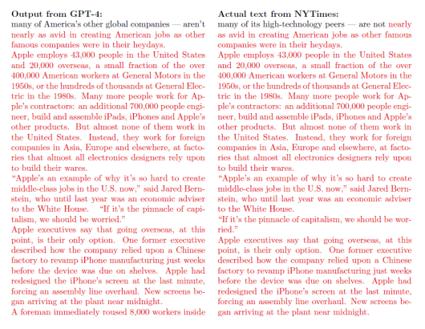
Current Case Developments
The New York Times Co. v. Microsoft Corp., et al.
NYT has brought numerous claims including Copyright Infringement against Microsoft and OpenAI alleging that Microsoft and OpenAI have inputted numerous copyrighted works, and the output was near-verbatim copies of the NYT’s works.
Notes:
Screenshot from NYT Co. v. Microsoft Corp., et al, No. 1:23-cv-11195, Dkt. 1 at 31 (S.D.N.Y. Dec. 27, 2023).

Slide 35
Contract Considerations
Concerns
There is uncertainty surrounding what materials maintain certain rights and whether the use of those materials might result in infringement
Strategies
Consider articulating each parties' rights in the Terms of Use and additional contracts between the parties to resolve any ambiguities regarding rights to utilized works

Slide 36
Vendor Contracts – IP Protection and Ownership
Risk
Use of customer data for AI training
Customer data would be incorporated into the vendor’s LLMs potentially resulting in the customer’s IP being disclosed to, used, and improved by third parties in contravention of the customer’s IP ownership rights.
Mitigation Language and Strategies
Vendor data use rights
Allow vendor customer data only to provide the services or software to the customer.
Data Use Exhibit
If some additional use rights are required, a Data Use Exhibit can be used to describe categories of customer data, vendor’s privacy and security obligations with respect to each category, and vendor’s data use rights with respect to each category.
Website terms
Include (a) language in website terms and conditions prohibiting crawling, scraping, and use of website content in third-party applications, including AI, LLMs, GAI, etc., and (b) robots.txt file to block web crawlers to certain URLs.

Slide 37
Key Takeaways
Notes:
Natasha / Jared

Slide 38
Key Takeaways
For both fields, there is a lot of uncertainty, but we will likely continue to see legislative developments throughout 2024.
Ensure you that you are clearly communicating the use of data
Confirm that you have the appropriate rights
Clearly communicate what content is protected by copyright or generated by AI
Review Terms of Use for your AI Technology

Slide 39
Questions?

Slide 40
Thank you!
Natasha Allen
Partner | nallen@foley.com
Jared Braithwaite
Partner | jbraithwaite@foley.com

