Slide 1
Navigating Global Trends in Nutritional Supplements
Presented by:
Troy Keller, Partner Dorsey & Whitney
Nathan Brower, General Counsel, Nature’s Sunshine
September 2022

Slide 2
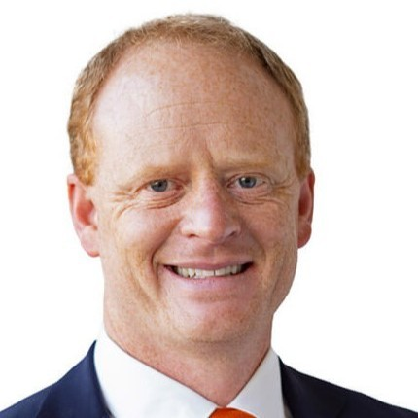
Troy Keller
Partner, Dorsey & Whitney LLP
Troy is a partner in the Salt Lake City Office of Dorsey & Whitney LLP. Before joining Dorsey, Troy was Vice President of Corporate Law and Global Government Relations at Huntsman Corporation. Previous to Huntsman, he was Securities & M&A counsel at Qwest Communications, and he began his career as an attorney at the New York office of Sidley Austin.
Troy currently serves as World Trade Center Utah’s International Trade and Commercial Policy Advisor and is a member of the Salt Lake Chamber Board of Governors. He is a frequent commentator in business and media publications. He is admitted to practice law in New York, Colorado and Utah.
Nathan Brower
Executive Vice President, General Counsel, Nature’s Sunshine
Nathan joined Nature’s Sunshine in May 2015, and was promoted to Executive Vice President, General Counsel in December of 2017.
Prior to joining the company, Nathan worked as an attorney at the law firms Strong & Hanni and Dorsey & Whitney, where he focused on mergers & acquisitions, securities law, corporate governance and capital market transactions.
Nathan received a Doctor of Jurisprudence from The University of Idaho, and a B.A. in Economics from Weber State University.

Slide 3
Preliminary Thoughts
Wellness or Survival? | U.S. Leadership? | Geopolitics & Trade
Globally, supplements often serve a critical nutritional role. Their importance drives regulation and growth. The supplements industry will continue to grow, and this creates significant opportunity. | In terms of market-size, yes, with over 30% of the global revenue. However, China is by far the largest manufacturer. Asia Pacific predicted to be largest market in 2030. | Supply chain challenges and trade protectionism continue to bias new investment toward on-shoring and nearshoring. Political risk, particularly for investing in China, higher than it has been in a decade.

Slide 4
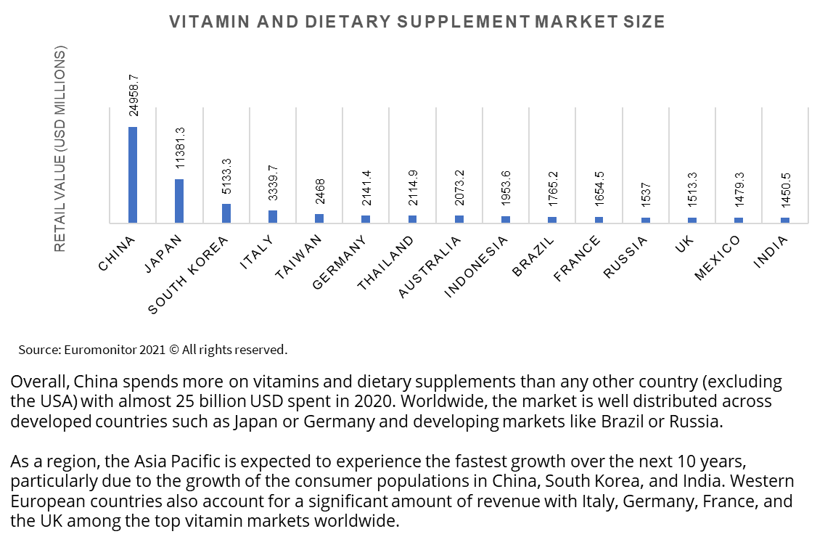
Industry Market Sizes
Global market estimated at $164 billion in 2022 and to reach $327 billion in 2030.*
Source: Grandview Research

Slide 5
Manufacturing
China is by far the world’s largest manufacturer of vitamins at almost $120 billion catering to both its domestic market and the global market. USA is a net exporter at about $37 billion.
Behind China and USA, Western European nations such as France, Germany, and the UK are major manufacturers.

Slide 6
Global Regulatory Inconsistency
Dietary supplements have become a global industry with manufacturing supply chains distributed around the world (dominated by U.S. and China). But there are not consistent standards or even definitions. As a result, a product that is regulated as a food in one country may be regulated as a drug in another jurisdiction. The rubber most hits the road when it comes to new products. Jurisdictions like the EU and Australia default to harmonized lists that facilitate sales of existing products. New compounds can take years to be approved. Sliver lining: The attention regulators are now giving supplements and the quickly evolving regulatory frameworks are evidence of the industry’s staying power.

Slide 7
Evolving Jurisdictions to Consider
India. New regulations (finally) have become effective with a promise to facilitate introductions of supplements and remove bottlenecks. Will continue to be a complicated jurisdiction for entrants.
China. Regulatory structure remains reasonable on paper, but implementation is unpredictable. Only two overseas firms received approval on a new health food application in 2022. (Spoiler: neither was a US company).
Singapore. Revised Health Supplements Guidelines launched this year provide additional clarity for the rules of the road in a growing market.

Slide 8
Geopolitical Trends and Disruption Risks
US-China Trajectory
Tariffs and trade
Russia – Ukraine
Supply Chains of the Future

Slide 9
Structures for Going Overseas
Distributor Approach | Joint Venture / Acquisition | Build from Ground Up
License of trademarks (and perhaps formulations) to distributor who is responsible for local sales and regulatory compliance. Easiest of approaches but downsides include poorer economics and lack of control. Complicated to unwind if you change your strategy. | Partner with (or acquire) a local industry player to springboard from their existing platform and leverage off their relationships. Most expensive of options up front, and so economic risk/reward is high in early years. | Generally a slower route and can be (very) expensive over time, but carries best economics if it works out. Risky in some jurisdictions to go in without a pre-existing presence.

Slide 10
Going Global Help for Utah Companies:
WTC Utah’s Global Business Services team consults Utah companies across a variety of industries and sizes, from aerospace & defense giants to protein bar start-ups, in all areas of their international growth. Services include:
Pathfinding Service
International business assessment to understand export readiness
Creation of an international customer/buyer profile
“Explore Report” international market research to select priority markets
“Focus Report” international market research to deep dive on selected priority markets
Global Compliance and Regulatory Advisory Service
Global regulatory and compliance “health check” in current export markets
Market specific regulatory and compliance consultations
Introductions of vetted regulatory agents and other service providers
Executive recommendations on priority markets and associated market entry strategies
Global Supply Chain Service
Analysis of key data points in key global sourcing markets, including
Operational advisory on integrating new suppliers into existing chain in a cost efficient manner
Supplier mapping and identification in key sourcing markets
Matchmaking and communication facilitation with potential suppliers in target locations

Slide 11
Questions?

