Slide 1
Digital Rules & Data Drama: 2025 EU and UK Law Recap + Your 2026 Survival Guide
3 and 4 December, 2025
Presenters: Alexander Brown, Christopher Götz, Emily Jones, and Olivia Ward

Slide 2
Session Overview
Key topics to be covered
1 | 2025 – A Year in Review
2 | EU Regulatory Milestones in 2025
3 | UK Regulatory Milestones in 2025
4 | Focus on 2026 - EU AI Act
5 | Focus on 2026 - EU Data Act
6 | Focus on 2026 - Cybersecurity & Vulnerability Reporting
7 | The Future of AI & Data Regulation in the UK
8 | 2026 Compliance Checklist
9 | Practical Guidance & Resources
10 | Q&A

Slide 3

2025 – A year in review
2025 – A year in review
Brief summary of the digital and data regulatory landscape in the EU and UK
Key themes and drivers:
Increase in laws addressing security and cyber issues
No one stop shop across the EU
Extra-territorial effect of new laws
Greater vendor due diligence required
Combination of EU Directives and EU Regulations making harmonisation more challenging
Higher 'GDPR style' fines
UK divergence
3

Slide 4
EU Regulatory Milestones in 2025
EU Regulatory Milestones in 2025
EU AI Act: Phased implementation timeline and scope
EU Data Act: Data sharing, portability, and cloud implications
EU Digital Operational Resilience Act (DORA): Key obligations
NIS2 Directive: Expanded cybersecurity requirements
EU Digital Omnibus: Overview and impact
4

Slide 5

EU AI Act: phased implementation
EU Regulatory Milestones in 2025
August 2024
Feb 2025
August 2025
August 2026
August 2027
Initial Application
Provisions on banned AI systems & AI Literacy
come into force
Most provisions
High Risk AI Systems & other provisions
Entry into force
GPAI - Models
Provisions applicable to General Purpose AI Models come into force
Harmonised products
Provisions applicable to products already regulated by other EU laws (Annex I)
5

Slide 6
EU AI Act: Scope
EU Regulatory Milestones in 2025
EUR
35M /
7%
Banned AI
AI systems used for certain biometric identification (exceptions Annex II), emotion
recognition in workplace and education, social scoring,
subliminal manipulation (→ class action against X and TikTok)
High Risk
Obligations for Providers & Deployers
High Risk AI Systems (HRAIS)
Significant harmful impact on health, safety and fundamental rights of individuals in the EU
→ Annex I: e.g. Safety component of a med. device / car
→ Annex III: e.g. AI system intended to be used to filter job applications, employee management
EUR 15 million or 3% of global annual turnover
General Purpose AI Models (with & without systemic risk)
Obligations on providers of GPAI models
(“capable of competently performing a wide range of distinct tasks”)
AI systems intended to interact with natural persons
AI systems intended to interact with natural persons, e.g. chatbots, are subject to transparency requirements
Comply with general principles (AI Literacy)
Additionally/instead codes of conduct may be introduced for all low risk AI systems
Low Risk
Other AI Systems
6

Slide 7
EU Data Act
Connected Products
Data processing services
Overview
B2B DATA ACCESS
B2C DATA ACCESS
B2G DATA ACCESS
DATA INFRASTRUCTURES
Right of “users” to access data generated by connected product (incl. metadata) & allow 3rd parties to access data
Specific rules for data requests by national and EU bodies towards private companies in “exceptional situations”
Switchability requirements (contractual) for providers of cloud services
“Connected Product” : e.g. autonomous cars, smart factory, robot, medical device
Interoperability requirements
Exclusion: data that is subject to IP rights (processed data)
Trade secrets? → NDA!
Requirements set out to facilitate B2G data sharing + “once-only principle”
Requirements to prevent unlawful 3rd country data access
Model contract terms and unfairness test
Contractual transparency:
Information obligation
Prior consent
General access rules
BETTER CROSS-SECTORAL STANDARDISATION: LEGAL BASIS FOR DELEGATED ACTS
Source: EU Commission, SWD/2022/34 final, p. 66
7

Slide 8
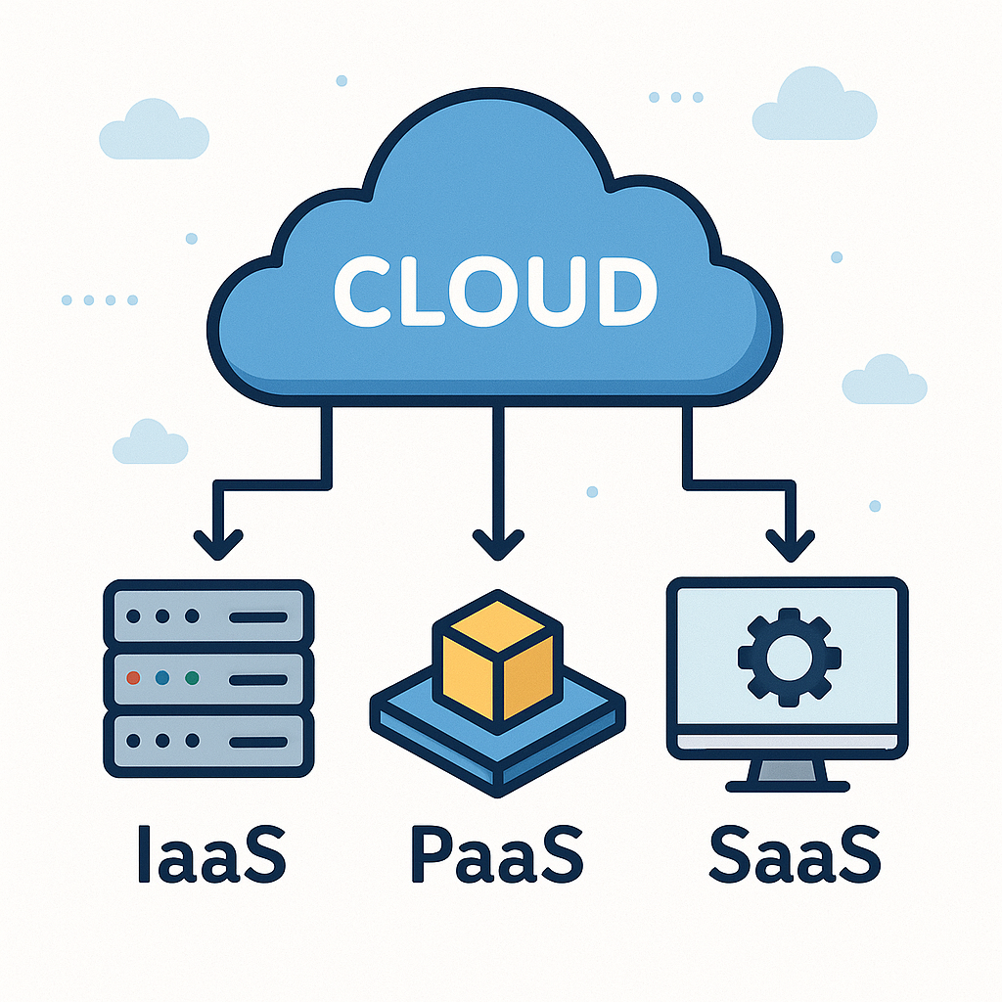
Data Processing Services
EU Regulatory Milestones in 2025
Typical examples
Infrastructure-as-a-Service (e.g. Hosting)
Software-as-a-Service
- Companies across all sectors in-scope!
New types of cloud services
- (e.g. AI-as-a-Service)
Intention of law:
Avoid “lock-in”-effect!
Enable easy switching!

Slide 9
UK Regulatory Milestones in 2025
UK Regulatory Milestones in 2025
Data (Use and Access) Act – Status & Key Provisions
Expected commencement phases throughout 2025 Framework for trusted data access, particularly in health, finance and public-sector datasets New duties on data holders to enable secure, permissioned access Stronger oversight of data intermediaries Complementary to UK GDPR but separate governance regime
Online Safety Act – Scope & 2025 Compliance Focus
Applies to user-to-user services and search services with UK links
Digital Markets, Competition and Consumers Act (DMCCA)
New Consumer Rules (2025 rollout)
2025 emphasis:
Illegal harms duties
Enforcement of age assurance requirements
Transparency reporting for larger platforms
Expansion of Ofcom codes of practice
High-risk areas: user uploads, algorithmic recommendation systems, and content moderation governance
Broad overhaul of UK consumer protection law
Stronger bans on subscription traps (pre-contract clarity, reminder notices, simple cancellation)
Enhanced rules on dark patterns and misleading UX
More prescriptive information requirements for online traders
Digital Competition Regime
Targeted at firms with Strategic Market Status (SMS)
Obligations around data access, interoperability, and fair conduct
CMA empowered to impose GDPR-level fines (up to 10% global turnover)
9

Slide 10
EU vs UK Digital Reg
Comparative Table – EU vs UK Digital Regulation
Regulatory Area | EU Approach | UK Approach
Data Protection | EU GDPR: Harmonised law across all member states with a maximum fine of €20 million or 4% of global annual turnover. The valid age of consent is generally 16. | UK GDPR: Retained EU law with minor domestic changes (via the Data (Use and Access) Act 2025). Fines capped at £17.5 million or 4% of global annual turnover. The age of consent is 13.
Digital Markets | Digital Markets Act (DMA): Sets out uniform, prescriptive "dos and don'ts" for all designated "gatekeeper" firms across the EU. | Digital Markets, Competition and Consumers (DMCC) Act: Gives the regulator (CMA) flexibility to create bespoke, individual codes of conduct for firms with "strategic market status" after an investigation.
Online Content Regulation | Digital Services Act (DSA): Establishes a comprehensive framework for online platforms regarding content moderation, user rights, and systemic risk assessments. | Online Safety Act (OSA): Focuses primarily on tackling illegal and harmful content, especially regarding child safety, with many specific rules still to be detailed by the regulator (Ofcom) in secondary legislation.
AI Regulation | EU AI Act: Adopted a comprehensive, risk-based horizontal law. High-risk AI systems face stringent requirements. | Pro-innovation Approach: A light-touch, sector-specific approach regulated by existing bodies, though the government plans to regulate powerful AI models in the future.
Enforcement Body | National supervisory authorities in each member state, coordinated by EU-level boards (e.g., EDPB for data protection). | A single national regulator for each area, e.g., the Information Commissioner's Office (ICO) for data, the CMA for digital markets, and Ofcom for online safety.
10

Slide 11
Focus on 2026
11

Slide 12
Focus on 2026 – EU AI Act
EU AI Act 2026 Actions: High Risk AI System
Banned AI
AI systems used for certain biometric identification (exceptions Annex II), emotion
recognition in workplace and education, social scoring,
subliminal manipulation (→ class action against X and TikTok)
High Risk
Obligations for Providers & Deployers
High Risk AI Systems (HRAIS)
Significant harmful impact on health, safety and fundamental rights of individuals in the EU
General Purpose AI Models (with & without systemic risk)
Obligations on providers of GPAI models
(“capable of competently performing a wide range of distinct tasks”)
AI systems intended to interact with natural persons
AI systems intended to interact with natural persons, e.g. chatbots, are subject to transparency requirements
Low Risk
Other AI Systems
Comply with general principles (AI Literacy)
Additionally/instead codes of conduct may be introduced for all low risk AI systems
12

Slide 13
Focus on 2026 – EU AI Act
EU AI Act: High Risk AI Systems
High Risk AI Systems
AI systems that have a significant harmful impact on health, safety and fundamental rights of persons in the EU Annex I and/or Annex III
Annex I | Annex III (AI system intended to be used…, e.g.)
AI system is a product or used as safety component of product covered by pre-existing product safety regulation listed in Annex I (e.g. Medical devices, in vitro, automotive) AND required to undergo 3rd party-conformity assessment (CE-declaration) | Employment, workers management (e.g.): → for recruitment / selection, e.g. to place targeted job advertisements, analyse / filter job applications / evaluate candidates, making decisions affecting terms of work-related relationships, promotion or termination Critical infrastructure: safety component in the management / operation of critical digital infrastructure, road traffic, or in the supply of water, gas, heating or electricity Remote biometric identification Access to and enjoyment of essential private services and essential public services and benefits (e.g.): Creditworthiness checks, establishing credit scores
UNLESS does not pose significant risk of harm to health, safety, fundamental rights of persons (Art. 6 (3)), e.g. only preparatory task, improve previously completed human activity.
13

Slide 14
EU AI Act: Stakeholders – Obligations
Focus on 2026 – EU AI Act
Provider
(developer of an AI system- a natural or legal person, authority, institution or other body)
Deployer
(natural or legal person, etc., under whose responsibility AI system is used)

Slide 15
EU AI Act: Provider obligations re high-risk AI systems
Focus on 2026 – EU AI Act
Technical Documentation
Drafting comprehensive "manual" for HRAIS which contains, at a minimum the Annex IV information
Article 11
"Record-keeping"
HRAIS must be designed to ensure automatic logging of events eg period of use and input data reviewed (Article 12) and providers must keep these logs
Article 12
Transparency / Explainability
HRAIS must be accompanied by instructions for use which include detailed information including their characteristics, capabilities and limitations Article 13
Risk management
Implementing process for entire lifecycle of HRAIS to identify, analyse and mitigate risks
Article 9
Data quality / Data Governance
Training and testing of HRAIS using data shall be undertaken in accordance with
Article 10
Conformity assessment
HRAIS provider shall follow conformity assessment procedure
Article 43/20
"Human oversight"
HRAIS must be designed so they can be overseen by humans, who should meet various requirements eg being able to understand the HRAIS and to stop its use
Article 14
Post-market monitoring
HRAIS providers must document a system to collect and analyse data provided by users on the performance of the HRAIS throughout its lifetime
Article 72
Accuracy, resilience and cyber security
HEAIS must be accurate (with accuracy metrics included in instructions for use), resilient to errors or inconsistencies (eg through fail-safe plans) and resilient to cyber-attacks
Article 15
Quality - Management Systems
HRAIS providers must put in place a comprehensive quality management system which includes at least the extensive information requirements
Article 17

Slide 16
EU AI Act: Obligations for Deployers of high-risk AI systems
Focus on 2026 – EU AI Act
Use in accordance with operating instructions
Human oversight is only delegated to natural persons who have the necessary competence, training, and authority and receive the necessary support
Ensure that input data is appropriate for the intended purpose of the high-risk AI system and is sufficiently representative
Monitor the operation of the system and inform the provider & suspend use (in the event of a serious incident: additionally inform the market surveillance authority)
Logging and event recording (obligation to retain for 6 months, unless contrary to GDPR)
Before commissioning/use at the workplace: Employers inform employee representatives and affected employees

Slide 17
Focus on 2026 – EU AI Act
EU AI Act: Practical Steps for 2026
1 | Comprehensive inventory of AI applications.
2 | Clear understanding of usage of AI in organisation.
3 | Perform risk assessment to determine obligation levels.
4 | Assess whether AI system is High Risk or not.
5 | Assess whether you are Provider or Deployer (or both).
6 | Ensure compliance with your obligations under AI Act.
7 | Register High Risk AI system in database.
8 | Ensure AI Literacy*.
17

Slide 18
EU Data Act
Connected Products
Data processing services
Overview
B2B DATA ACCESS
B2C DATA ACCESS
B2G DATA ACCESS
DATA INFRASTRUCTURES
Right of “users” to access data generated by connected product (incl. metadata) & allow 3rd parties to access data
Specific rules for data requests by national and EU bodies towards private companies in “exceptional situations”
Switchability requirements (contractual) for providers of cloud services
“Connected Product” : e.g. autonomous cars, smart factory, robot, medical device
Interoperability requirements
Exclusion: data that is subject to IP rights (processed data)
Trade secrets? → NDA!
Requirements set out to facilitate B2G data sharing + “once-only principle”
Requirements to prevent unlawful 3rd country data access
Model contract terms and unfairness test
Contractual transparency:
Information obligation
Prior consent
General access rules
BETTER CROSS-SECTORAL STANDARDISATION: LEGAL BASIS FOR DELEGATED ACTS
Source: EU Commission, SWD/2022/34 final, p. 66
18

Slide 19
EU Data Act: Switching data processing services - Obligations
Focus on 2026 – EU Data Act
Key Contractual Provisions:
Initiation of cloud switching by customer (B2B & B2C): notice period of only 2 months
Mandatory transitional period of max 30 days, extendable to max 7 months by provider if technically not feasible
Exhaustive specification of data and applications included in (and excluded from) the switch
Minimum data retrieval period of 30 days from end of transitional period
Disclosure of all data, including metadata, upon termination
“Guarantee” of full erasure
Cooperation, Information and Transparency obligations:
Good faith cooperation
Information on switching and porting procedures, methods and formats, as well as restrictions and technical limitations
Online register of all data structures and formats, as well relevant standards and open interoperability specifications, in which exportable data are available

Slide 20
EU Data Act: Switching data processing services – Interoperability obligations
Focus on 2026 – EU Data Act
Technical requirements:
Infrastructure providers (including IaaS):
Facilitate the transition process by providing functions, appropriate information, documentation, technical support and, where necessary, tools.
Other providers (including PaaS and SaaS):
provide open interfaces free of charge to facilitate switching process, and enable portability and interoperability.
adhere to published open interoperability standards or enable data export in common, machine-readable formats.
European Commission: Development of standards and specifications for interoperability
Switching charges:
From 12 Jan 2027: switching charges completely removed.
From 11 Jan 2024 to 12 Jan 2027: providers may impose reduced switching charges.
“Termination fees” affected?

Slide 21
EU Data Act – Actions for 2026
Focus on 2026 – EU Data Act
Manufacturer / Data Holder
Implement design requirements in time (Manufacturer / Provider)
Get to know your data
Start developing price book for data
Classify non-personal – personal data (tricky in large data sets / machine data)
Draft proper license terms
Data Recipient
Assess where / whether you may profit as Data Recipient (aftermarket services!)
User
Assess where you are a User and may profit from access to data
Cloud Provider / Cloud Switching
Legally assess applicability of EU Data Act (see Digital Omnibus)
Structure contracts appropriately
Be aware of interoperability requirements
WATCH OUT FOR
interoperability standardisation being published by the Commission regarding data spaces, cloud services
member state legislation regarding
- penalties for non-
compliance with Data Act
- responsible authorities!

Slide 22
Focus on 2026 – Preparing for EU Laws on Cybersecurity & Vulnerability Reporting
Focus on 2026 – Cybersecurity
Aspect | Cyber Resilience Act (CRA) | AI Act | NIS2 Directive
Primary Focus | Ensure cybersecurity of products with digital elements (hardware/software) across the EU. | Create a harmonised legal framework for AI systems in the EU that ensures they are safe, ethical, and trustworthy, whilst fostering innovation. | Enhance cybersecurity for essential and important entities across critical sectors.
Effective Date | Entered into force 10 Dec 2024; phased compliance obligations for manufacturers with full compliance required by December 2027. | Entered into force 1 August 2024 with phased implementation. Most provisions in force by August 2026. | Adopted Nov 2022. Member States must transpose by 17 Oct 2024 but many are delayed.
Scope | All products with digital elements marketed in the EU (IoT, software, hardware). | Introduces a tiered, risk-based approach with rules for placing AI systems on the market, obligations for providers and deployers. | Broad: 18 sectors, including energy, transport, healthcare, banking, digital infrastructure.

Slide 23
Focus on 2026 – Preparing for EU laws on Cybersecurity & Vulnerability Reporting
Focus on 2026 – Cybersecurity
Aspect | Cyber Resilience Act (CRA) | AI Act | NIS2 Directive
Key security requirements | Secure design & development Vulnerability handling Incident reporting Compliance before market release. Security obligations throughout product lifecycle (updates, support, end-of-life). | Requirements for high-risk AI systems, including that ensuring robustness and resilience against attacks, measures to prevent unauthorised access or tampering, maintaining accuracy and reliability. Monitoring and reporting obligations for providers and deployers of high-risk AI systems. GPAI providers with systemic risk also have reporting duties. | Incident reporting Risk management & governance Incident reporting within 24h Supply chain security Multifactor authentication & monitoring. Cooperation among Member States.
Incident Reporting | Report exploited vulnerabilities & major incidents without undue delay and within 24 hours. | Various timelines depending on severity of impact and category of AI. | Report significant cybersecurity incidents within 24 hours to national authorities.
Enforcement bodies & Penalties | Market surveillance authorities. Penalties for non-compliance (market withdrawal/recall of products, fines). | Multi-level governance and enforcement structure, combining EU-level bodies with national authorities. Up to €35 million or 7% of global annual turnover for the most severe breaches, such as non-compliance with prohibited AI practices. | National authorities. Fines up to €10M or 2% of global turnover; executive liability possible.

Slide 24
Focus on 2026 - UK Cyber Security Legislation
Focus on 2026 – UK Cyber Security Legislation
Cyber Security and Resilience (Network Information Systems) Bill
Addresses the shortfalls of the Network and Information Systems Regulations (NISR) 2018 owing to the heightened risks posed to the provision of essential services due to the exploitation of supply chain vulnerabilities.
Bill is progressing through second reading.
Key amendments proposed to the Network and Information Systems Regulations (NISR) 2018 :
1. Expansion of the scope of the NISR 2018:
Data centres, managed service providers, and large load controllers brought into scope.
Authorities may also designate “critical suppliers” at which a disruption would significantly impact the economy or society.
2. Reform of incident reporting obligations:
Businesses will have to report cyber breaches that have the potential to cause significant impacts. Data centres and digital and managed service providers will need to inform their customers if they are likely to have been impacted.
3. Sector-specific regulation and regulator duties:
12 regulators will regulate implementation, who will be duty bound to seek specified priority outcomes.
4. More severe enforcement penalties:
Substantially greater “standard” penalty capped at the greater of £10,000,000 or 2% of global turnover. More serious failings can attract the greater of £17,000,000 or 4% of global turnover.
24

Slide 25
Focus on 2026 - The Future of AI & Data Regulation in the UK
Focus on 2026 - The Future of AI & Data Regulation in the UK
Data (Use and Access) Act 2025
First major Post-Brexit reform of UK data protection regime - staged 12-month implementation following June 2025 Royal Assent.
Key amendments to UK GDPR:
Introduction of “Recognised Legitimate Interests.”
Relaxation of the prohibition on using personal data in Automated Decision Making for ‘significant’ decision-making.
“Legitimate interest” lawful basis available for ADM.
Codification of “reasonable and proportionate” DSAR searches.
New “stop the clock” mechanism for DSAR searches.
New formal requirements for data subject complaints.
Introduction of an “assumption of compatibility” for certain re-uses of personal data.
Cookies consent not required for specific purposes.
Implications for businesses:
Impacts are highly contingent on the UK’s EU adequacy status being formally renewed on 27 December 2025, which is expected to take place.
The European Commission has proposed to extend the current adequacy arrangements for six years to December 2031.
If the UK retains EU adequacy, businesses will benefit from continued seamless UK-EU data flows and opportunities for compliance simplification and enhanced business flexibility.
25

Slide 26
Focus on 2026 –
EU Digital Omnibus
EU Digital Omnibus – Impact on GDPR & Privacy
1 | “Personal data”: identification must reasonably be possible for the data holding entity (e.g. dynamic IP address = personal data?)
2 | AI training on personal data based on legitimate interests allowed.
3 | Processing of biometric data for identity verification in AI systems allowed, if the data or verification means remain under the sole control of the data subject.
4 | Data breach notification to DPA limited to “high risk for individual”; via single entry point.
26

Slide 27
Focus on 2026 –
EU Digital Omnibus
EU Digital Omnibus – Impact on AI Act
Proposal to simplify & streamline various digital laws
1 | Delayed obligations regarding high-risk AI and transparency of AI systems generating synthetic content.
2 | Reduced compliance: AI literacy only to be “encouraged”, no obligation.
3 | Processing of special categories of data for bias detection and correction allowed for all AI systems (with safeguards).
4 | Public database registration for certain high-risk AI systems to be removed.
5 | AI Office gains exclusive authority for AI systems based on GPAI models.
27

Slide 28
Focus on 2026 –
EU Digital Omnibus
EU Digital Omnibus – Impact on Data Act
Proposal to streamline & clarify
1 | Key data laws (Free Flow of Non-Personal Data Regulation, Data Governance Act, Open Data Directive) repealed (almost) entirely and merged into the Data Act.
2 | Some definitions clarified.
3 | Data holders may refuse disclosure of trade secrets if there is a high risk of unlawful acquisition, use, or disclosure to countries with weaker protections.
4 | B2G data requests limited to public emergencies, e.g. a cybersecurity incident with serious, lasting effects on people or economic/financial stability in the EU or a Member State, officially recognised under EU or national law.
5 | Exempted from cloud switching rules: contracts concluded before 12 Sep 2025 in relation to custom-made services, SMEs and/or SMCs.
28

Slide 29
2026 Compliance Checklist
2026 Compliance Checklist
AI & Digital Systems Governance
Map AI use cases; identify high-risk systems under EU AI Act Update risk assessments, DPIAs, and model documentation Implement human oversight frameworks, testing, and red-teaming
Data Access, Interoperability & Vendor Controls
Data Act-readiness: contractual updates, cloud portability, data sharing pathways Strengthen vendor due diligence (security, data location, subcontracting) Create a group-wide data transfer and access matrix
Content, Consumer & Competition Compliance
Review Online Safety Act/DSA alignment (moderation, transparency, reporting) DMCCA subscription compliance: reminders, “one-click” cancellation, renewal flows UX assessments to remove dark patterns
Security & Incident Reporting
Assess application of relevant security/cyber laws
Organisational Readiness
Update internal policies: AI, data governance, cybersecurity, consumer transparency Establish cross-functional governance board (legal, security, data, product) Build a 2026 regulatory roadmap with owners, deadlines, KPIs
Gap analysis of existing policies and procedures against new requirements Implement enhanced incident escalation timelines Prepare for audit files and regulator evidence requirements
29

Slide 30
Practical Guidance
& Resources
Practical Guidance & Resources
Further Reading from Simmons & Simmons
The EU Digital Omnibus Update
Simmons & Simmons AI Hub
Newsletter: AI View
Webinar Series: EU Data Act
Digital Regulation Tracker
Article: Introducing the UK Data (Use and Access) Act 2025 (DUAA)
30

Slide 31

Q&A

Slide 32




Thank you
Contacts
Alexander Brown
Christopher Götz
Partner
Partner
Digital Business
Corporate & Commercial
+44 20 7825 4954
+49 89-20 80 77 63-32
alexander.brown
@simmons-simmons.com
christopher.goetz
@simmons-simmons.com
Emily Jones
Olivia Ward
Partner
Supervising Associate
Corporate & Commercial
Corporate & Commercial
+1 628 466 0180
+1 628 466 0182
emily.jones
@simmons-simmons.com
olivia.ward
@simmons-simmons.com

