Slide 1
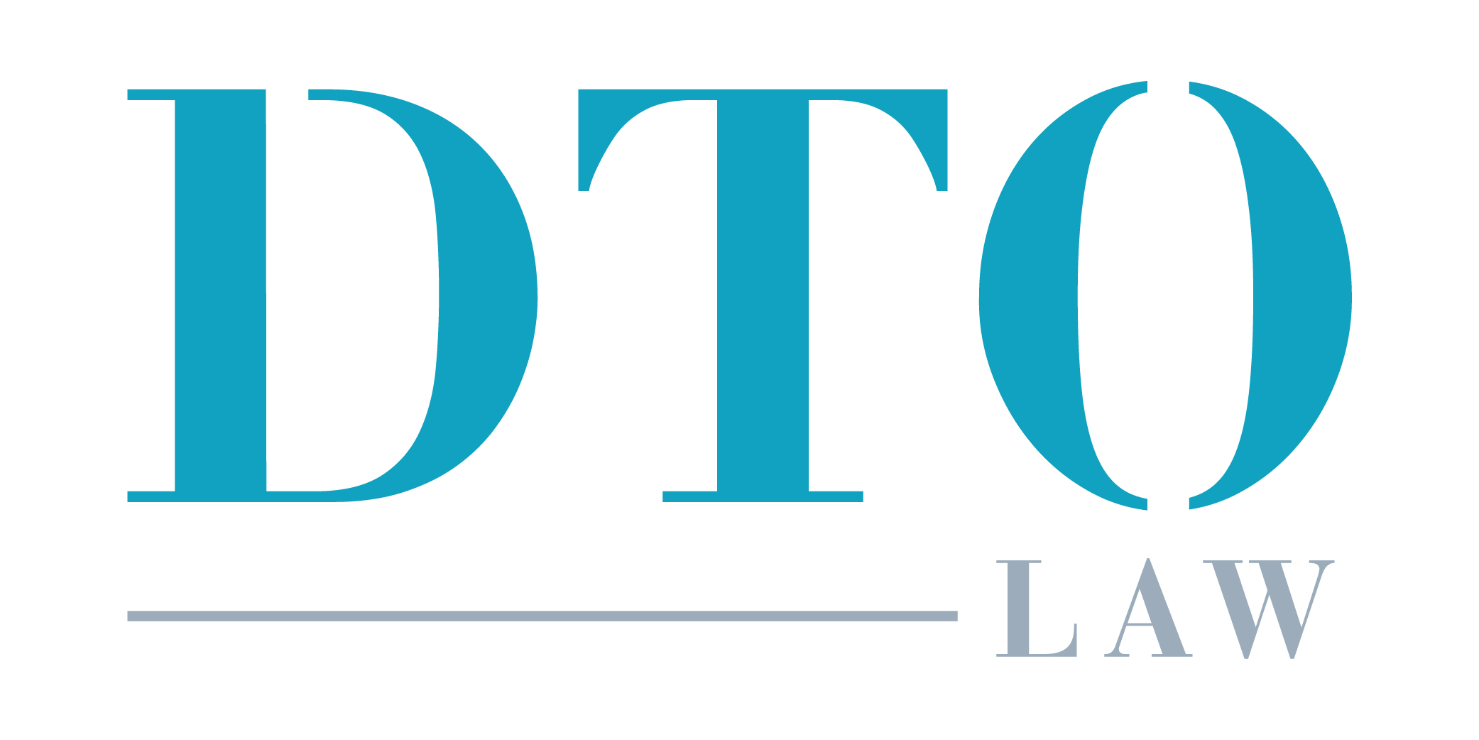
The Class Action Trial Is Not Mythical After All
An in-depth look at Montera v. Premier
Los Angeles
601 S. Figueroa Street, Suite 2130
Los Angeles, CA 90017
Silicon Valley
2400 Broadway, Suite 200
Redwood City, CA 94063
New York
27 East 28th Street, Suite 208
New York, NY 10016

Slide 2
WILLIAM DELGADO
PARTNER
MEGAN O’NEILL
PARTNER
JUSTIN GOODWIN
PARTNER

Slide 3
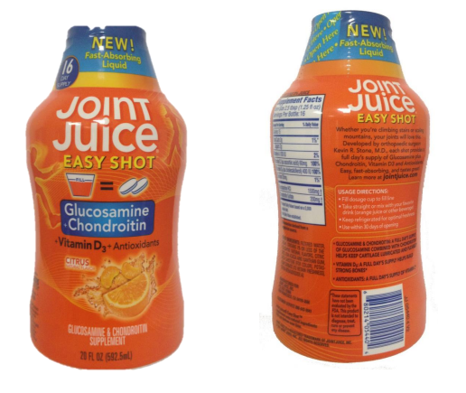
Case Basics
Plaintiff: Eric Fishon --> Mary Beth Montera (both New York residents)
Defendant: Premier Nutrition (CA-based)
Product: Joint Juice

Slide 4
Case Basics
Label Claims: "Helps keep cartilage lubricated and flexible" and consumer should "drink daily for healthy, flexible joints."
Key Ingredient: 1500 mg per serving of glucosamine hydrochloride and chondroitin sulfate.
Allegation: "All of the meta-analysis studies conclude glucosamine and chondroitin do nothing."
Class: All persons who purchased any Joint Juice Product in New York.
Claims Alleged: NY GBL § 349; NY GBL § 350

Slide 5
Who Remembers the Erie Doctrine?
Erie Recap: A federal court sitting in diversity applies federal procedural law but must apply state substantive law.
Background: NY GBL § 349 provides for statutory damages ($50 per violation) as does NY GBL § 350 ($500 per violation). But NY CPLPR § 901 prohibits recovery of penalties and statutory damages in a state court class action.
Issue: Can statutory damages be recovered in a federal court class action?

Slide 6
Who Remembers the Erie Doctrine?
Case: Shady Grove v. Allstate, 559 U.S. 393 (2010) (at issue, statutory interest as a penalty)
Result: Four justices hold that, in federal court, Rule 23 trumps NY CPLR § 901 because § 901 is procedural. Four justices dissent and say § 901 reflects a substantive policy choice.
Steven's Concurrence: In this case, § 901(b) is procedural. But there may be other cases where a "procedural" rule is really substantive in nature.

Slide 7
The legislative history makes clear that the only reason these statutes contain statutory damages is because the Legislature believed they would be unavailable in the class action context.
In other words, the substantive right to recover statutory damages depends on the unavailability of a class action vehicle.
Most district courts do not appreciate this question and have held that statutory damages are available in federal court.
Open Question Remains....
What, exactly, does the Stevens Concurrence mean?
Does it close the door on any future argument related to § 901(b)?
If not, is the specific combination of GBL § 349/GBL § 350 and § 901(b) procedural or substantive?

Slide 8
The legislative history makes clear that the only reason these statutes contain statutory damages is because the Legislature believed they would be unavailable in the class action context.
In other words, the substantive right to recover statutory damages depends on the unavailability of a class action vehicle.
Most district courts do not appreciate this question and have held that statutory damages are available in federal court.
Open Question Remains....
The legislative history makes clear that the only reason these statutes contain statutory damages is because the Legislature believed they would be unavailable in the class action context.
In other words, the substantive right to recover statutory damages depends on the unavailability of a class action vehicle.
Most district courts do not appreciate this question and have held that statutory damages are available in federal court.

Slide 9
On the way to trial....
Motion for Judgment on the Pleadings denied.
Defendant argued preemption defense (Dachauer v. NBTY)
Court ruled "no mismatch" here.
No real fight about certification because a class had already been certified in Mullins v. Premier Nutrition.
Only real issue: statute of limitations and tolling.
Court ruled plaintiffs could only go back as far as each state's statute of limitations.

Slide 10
On the way to trial....
Montera replaced Fishon because Fishon was found to be an unsuitable class rep in a different class action against Peloton.
Motion to decertify (individualized issues related to the NY causes of action) denied.

Slide 11
Defendant's Daubert Motions
Farshid Guilak, Ph. D. (Plaintiff's Science Expert)
Excluded. No testimony on his studies of pig cartilage.
J. Michael Dennis, Ph.D. (Plaintiff's Survey Expert)
Permitted. Critiques re: survey go to weight not admissibility.

Slide 12
Defendant's Daubert Motions
Derek Rucker, Ph.D. (Plaintiff's Marketing Expert)
Permitted, w/r/t general marketing principles, marketing strategies, intended message, target audience, etc.
Excluded, w/r/t how consumers would interpret the intended message.
Colin Weir (Plaintiff's Damages Expert)
Permitted. "Per unit" damages permissible.

Slide 13
Plaintiff's Daubert Motions
Stuart Silverman, M.D. (Defendant's Science Expert-rheumatologist)
Permitted w/r/t to benefits of Joint Juice.
Excluded w/r/t to the microbiome and bioavailability; regulatory approval; personal observations; safety of osteoarthritis treatments.
Daniel A. Grande, Ph.D. (Plaintiff’s Damages Expert-cartilage repair)
Permitted w/r/t to benefits of Joint Juice.
Excluded w/r/t to the microbiome and bioavailability

Slide 14
Plaintiff's Daubert Motions
William Choi, Ph.D. (Defendant’s Damages Expert)
Permitted. Actual damages (price premium) is relevant.
Hal Poret (Defendant’s Survey Expert)
Permitted.
Joel Steckel, Ph.D. (Defendant’s Rebuttal Survey Expert)
Permitted

Slide 15
Plaintiff's Daubert Motions
Kevin Stone, M.D. (Orthopedic Surgeon, Creator of Joint Juice, and Founder of Premier Nutrition)
Excluded. Failed to provide written report.
Lance Palumbo (Joint Juice Brand Director)
Excluded. Failed to provide adequate disclosure

Slide 16
Plaintiff’s Proposed Voir Dire

Slide 17
Plaintiff’s Proposed Voir Dire

Slide 18
Defendant’s Proposed Voir Dire

Slide 19
Defendant’s Proposed Voir Dire

Slide 20
Defendant’s Proposed Voir Dire

Slide 21
Key Pretrial Ruling
Plaintiff must prove actual damages, but statutory damages is a legal question for the court.

Slide 22
The Jury Trial
Jury Trial began on May 23, 2022.
Defendant filed Rule 50 Motion on June 2, 2022.
Trial concluded on June 7, 2022.
Jury verdict on June 7, 2022.
Jury finds: (i) violation of NY GBL § 349, (ii) violation of NY GBL § 350, (iii) sale of 166,249 units, and (iv) $1,488,078.49 in actual damages.
$8.95 per unit.

Slide 23
Post-Trial Questions
Are damages available under both NY GBL § 349 and NY GBL § 350 so that total, per unit, damages are $550?
Is prejudgment interest when plaintiff is asking for statutory damages?
Is a statutory damages award of $550 constitutional?
Plaintiff answered all of these questions with “yes” and asked for $91MM in statutory damages and $48MM in prejudgment interest, seeking to convert a $1.5MM award into a $139MM award.

Slide 24
Post-Trial Answers
A statutory award of $500 per unit is unconstitutionally excessive. An award of $50 per unit is okay.
The trial court recognized there is presently very little guidance on this.
Prejudgment interest is available under statutory damages.
No need to determine whether § 349 and § 350 can be combined.
Final judgment: $8.5MM in statutory damages and $4.6MM in prejudgment interest.
Remaining question: What will the claims process look like?

Slide 25
Motion for Attorneys’ Fees
Three different methods of calculation:
Percentage of fund
Lodestar
Hybrid (when there is a fee-shifting statute)
Defendant pays lodestar. Class pays the overage on % of fund.

Slide 26
Motion for Attorneys’ Fees
Plaintiff’s counsel is seeking $6.8MM in fees and $1MM in costs.
Gross benefit to class: $12M judgment, $1.1MM costs, and $6.8MM fee award.
1.06x Lodestar

Slide 27
www.dtolaw.com

