Slide 1
Guiding the Employee Evaluation Process
In the New Workplace
Eric Nichols, Amanda Taylor, and Chris Cowan
(512) 708-1000
enichols@beckredden.com
ataylor@beckredden.com
ccowan@beckredden.com

Slide 2
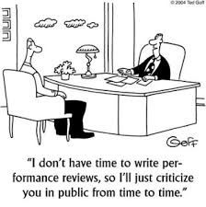
Employee Evaluations
Five questions for you:
1. Who among you provides performance evaluations as part of your job?

Slide 3
Employee Evaluations
2. Who among you serves in part an internal HR function?
3. Who among you helps to advise HR within company?
4. Who among you likes dealing with employee evaluations?

Slide 4
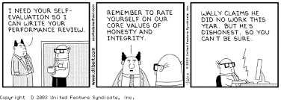
Employee Evaluations
5. Who among you has dealt with or helped to advise HR or managers with respect to evaluating an employee whose performance may be lagging?

Slide 5
Lagging Performance: Overlay of Potential Litigation
Federal and Texas law prohibits employers from:
Discriminating against any individual with respect to [his or her] compensation, terms, conditions or privileges of employment because of such individual’s race, color, religion, sex, or national origin.”
    42 U.S.C § 2000e-2(a); AutoZone v. Reyes, 272 S.W.3d 588, 592 (Tex. 2008)
  Retaliating against an employee because the employee has made a complaint or has filed a charge of discrimination.
    42 U.S.C § 2000e-3(a); Tex. Labor Code Ann. § 21.055

Slide 6
Lagging Performance: How Cases Play Out
Establishing discrimination/retaliation (burden shifting analysis):
Plaintiff must first establish prima facie case:
    Discrimination: Plaintiff (a) is member of protected class, (b) qualified for position, (c) suffered an adverse employment action, and (d) was replaced by or treated less fairly than someone outside of her protected class.
    Retaliation: Plaintiff (a) participated in a protected activity and (b) suffered an adverse employment action, and (c) there was a causal connection between the activity and action.
Burden then shifts to Defendant to proffer legitimate, non-discriminatory reason for its action.
Burden then shifts back to Plaintiff to demonstrate that the proffered reason is pretext.

Slide 7
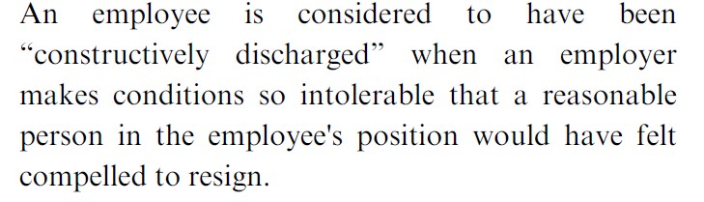
Lagging Performance: How Cases Play Out
Adverse Employment Action / Constructive Discharge:
Question Put to a Jury:

Slide 8
Lagging Performance: How Cases Play Out
Adverse Employment Action/Constructive Discharge:
Question in Litigation: How Were You Exposed to Hostile Work Environment?
Plaintiff’s Answer:
Retaliatory actions, increased unwarranted focus on my job performance, extra pressure on me, additional punitive weekly reviews, unwarranted and baseless reprimands . . .
The sub-par review I received . . . after [co-employee’s] complaint against me and on-going, which written report thereof omitted all of the positive peer feedback I received during the course of this review. . . . This review was endorsed and supported by [chain of managers].

Slide 9
Lagging Performance: How Cases Play Out
Hostile Work Environment:
Trial Exhibits 3-10: All performance reviews.

Slide 10
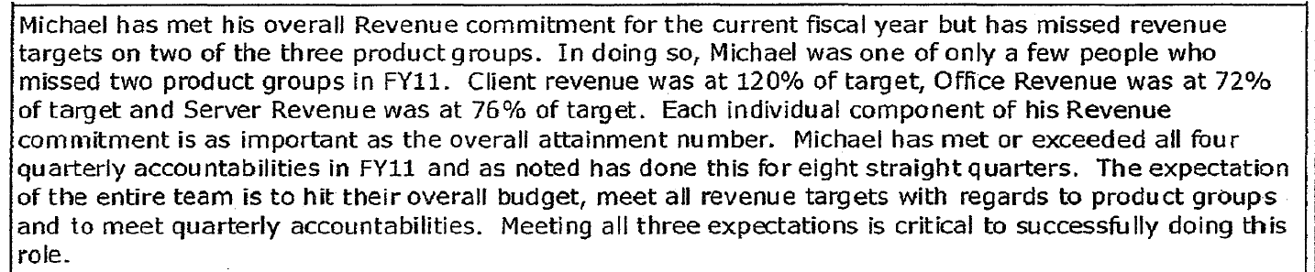
Lagging Performance: How Cases Play Out
Hostile Work Environment:
Trial Exhibits 3-10: All performance reviews.

Slide 11
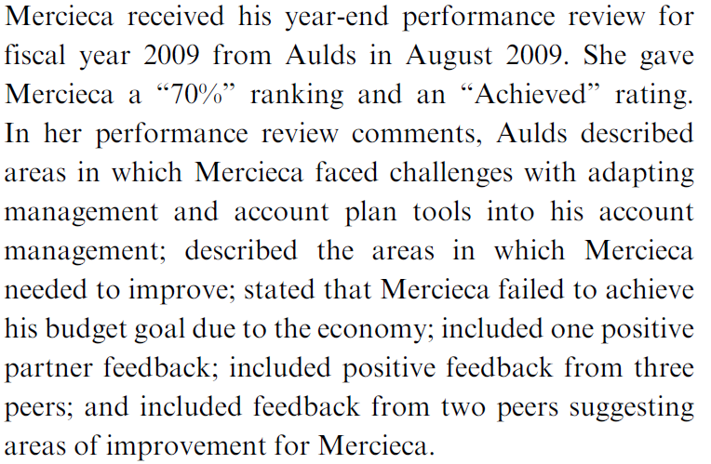
Lagging Performance: How Cases Play Out
Court decision:

Slide 12
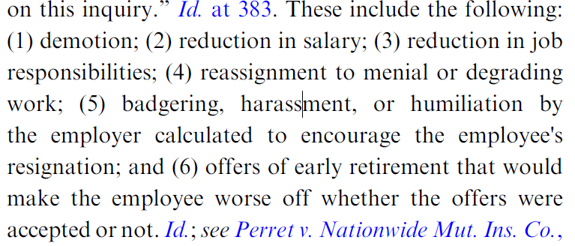
Lagging Performance: How Cases Play Out
Court decision:

Slide 13
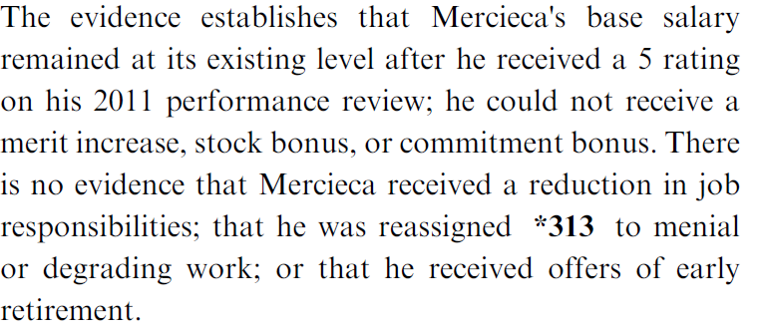
Lagging Performance: How Cases Play Out
Court decision:

Slide 14
Employee Evaluations: Potential Liability
“Adverse Action”
A negative employee evaluation is likely not an “adverse action” supporting a federal or Texas discrimination claim.
  See Navy v. Coll. of the Mainland, 407 S.W.3d 893, 899 (Tex. App.—Houston [14th Dist.] 2013)
However, an improvement plan given on the basis of that evaluation may be considered an “adverse action” “depending on the nature of the plan and the consequences for not completing it,” such as termination.
  Alamo Heights ISD v. Clark, 544 S.W.3d 755, (Tex. 2018)

Slide 15
Employee Evaluations: Potential Liability
“Retaliation”
Negative evaluations preceding a protected activity cannot be “retaliation.”
Negative evaluations following a protected activity might be evidence of a state or federal retaliation claim, depending on the circumstances.
  See Metropolitan Transit Authority of Harris County v. Douglas, 544 S.W.3d 486 (Tex. App.—Houston [14th Dist.] 2018)
The Texas Supreme Court recently gave broad protection to employers: “An employer is not forbidden from addressing performance issues [after] employees have engaged in protected activity,” whether those issues were “pre-existing” or were not discovered until the investigation resulting from the employee’s complaint.
  Alamo Heights ISD v. Clark, 544 S.W.3d 755, 791-92 (Tex. 2018)

Slide 16
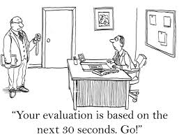
Crafting an Employee Evaluation Process
Regularity:
  Ensuring that regular (quarterly) reviews are done
  Interim reviews should be held when necessary

Slide 17
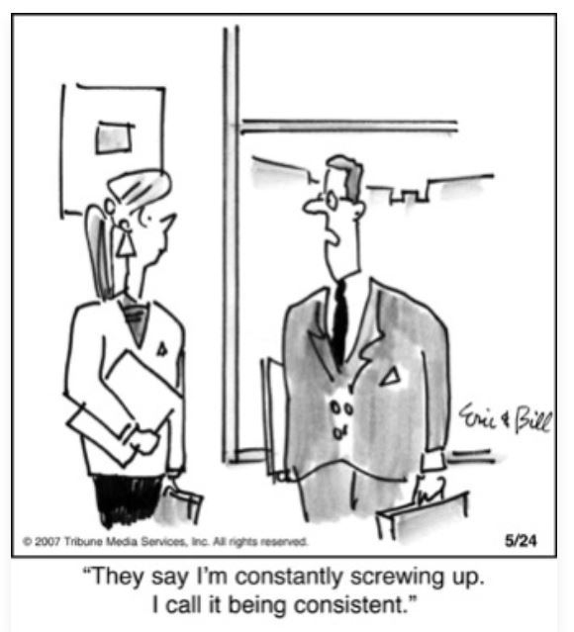
Crafting an Employee Evaluation Process
Consistency:
  Ensure that consistent job performance criteria applied to those in similar positions
  Consequences:
    Consistent for those similarly situated
    Consistent with established policy
  “Stacked ranking”/curve situations

Slide 18
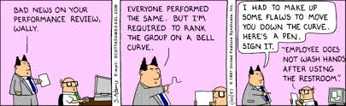
Crafting an Employee Evaluation Process
Clarity / Objectivity:
  Speak directly and don’t mince words
  Score job performance on an objective scale

Slide 19
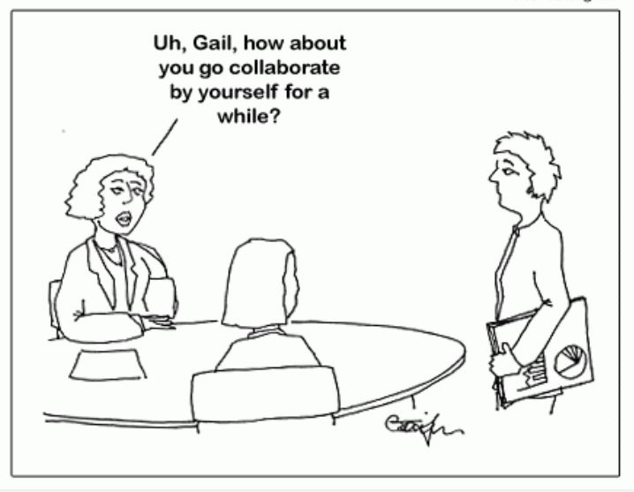
Crafting an Employee Evaluation Process
Collaborative:
  Solicit feedback on performance from multiple sources
  Involve employee in the process:
    Provide employee opportunity to respond in writing to negative review
    Meaningful opportunity for employee self-evaluation

Slide 20
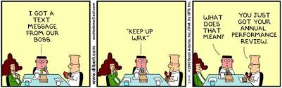
Crafting an Employee Evaluation Process
Document, document, and then document again!

Slide 21
Evaluations Done Right
Objectivity and Consistency:
Alkhabwaldeh v. Dow Chemical Comp., 851 F. 3d 422 (5th Cir. 2017)
  Court upheld dismissal of race/nationality discrimination and retaliation claims. Plaintiff failed to rebut employer’s non-discriminatory reason in retaliation claim because plaintiff’s supervisor rated plaintiff “a 1 – the lowed possible rating on Dow’s 1-5 scale” and placed plaintiff on a “Performance Improvement Plan.”
  For the same reason, court upheld summary judgment on discrimination claim because Plaintiff was unable to identify any other employee similarly situated (i.e. received a 1 employment rating).
  Court also noted that prior to termination plaintiff’s performance was also evaluated by committee – consistent with “corporate policy.”

Slide 22
Evaluations Done Right
Regularity / Collaborative / Objectivity:
Noel v. Shell Oil Comp., 261 F. Supp. 3d 752 (S.D. Tex. 2017)
  Dismissed gender discrimination and retaliation claims because plaintiff failed to show that employer’s proffered non-discriminatory reasons for terminating were pretextual because Plaintiff had consistently low “performance ratings” in her evaluations by multiple supervisors
  In doing so, Court also repeatedly stated that Plaintiff was given multiple opportunities to dispute the poor performance ratings, including self-evaluations, and “did not mention gender discrimination, retaliation, or any other illegal bias.”
Lopez v. Exxon Mobil Dev. Co., 2017 WL 4018359, at *2 (Tex. App.-Houston [14th Dist.] Sept. 12, 2017, pet. denied).
  Court upheld dismissal of age discrimination and retaliation claims. Plaintiff established prima facie case but could not rebut employer’s proffered non-discriminatory reason by showing pretext because “the undisputed evidence indicates that, from 2009 to 2014, Lopez was ranked below at least 87% of his peers.”

Slide 23
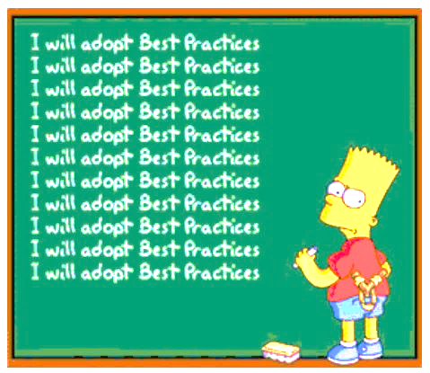
Employee Evaluations: Potential Liability
Retaliation
BEST PRACTICE: If an employee has lodged a complaint, further employee evaluations should be conducted by committee and by management unrelated to the allegations.

Slide 24
Employee Evaluations: Potential Liability
Defamation
Statements in an evaluation cannot support a defamation claim when self-published by the employee, even if the publication was “compelled.”
To hold otherwise would improperly “chill honest evaluation and communication about employee performance,” and would “induce self-censorship by employers.”
  Exxon Mobil Corp. v. Rincones, 520 S.W.3d 572, 582 (Tex. 2018).

Slide 25

TCPA Implications
Application
Texas Citizens Participation Act (“anti-SLAPP”)
Employee’s claim against employer, which is based on statements made by the employer in an evaluation,
  may implicate the employer’s right to “speak freely” or “associate,”
  thereby allowing the employer to use the TCPA as a tool to dismiss the claim and seek monetary awards against the employee.
    ExxonMobil Pipeline Co. v. Coleman, 512 S.W.3d 895 (Tex. 2017)
    Budri v. Humphreys, No. 02-18-00070-CV, 2018 Tex. App. LEXIS 6294 (Tex. App.—Fort Worth Aug. 9, 2018, no pet.)
    CLEAT v. Sheffield, No. 03-13-00105-CV, 2014 Tex. App. LEXIS 1098 (Tex. App.—Austin Jan. 31, 2014, pet. denied)

Slide 26
TCPA Implications
“No Exemption”
Not “commercial speech” because the statements are made (1) as part of an employment decision, not a commercial transaction; and the (2) intended audience is the employee and other managers, not an actual or potential customer.
  Castleman v. Internet Money, Ltd., 546 S.W.3d 684, 686-90 (Tex. 2018)
Not an “insurance action” unless “brought under the Insurance Code or arising out of an insurance contract.” Worker’s compensation claims arise under the Labor Code, not the Insurance Code, and therefore are not exempt.
  Tervita LLC v. Sutterfield, 482 S.W.3d 280, 286 (Tex. App.—Dallas 2015, pet. denied).

Slide 27
Take-Aways
Just because we and our colleagues don’t like doing evaluations, doesn’t make them not important.
In-house counsel can play a role in avoiding litigation in which a plaintiff seeks to use employment evaluations as part of a discrimination/retaliation case, but need to establish relations with business clients to ensure issues brought forward early.
Courts will generally not allow employment evaluations that result from an organized, regularly conducted system applicable to all employees to be used as evidence of hostile work environment or adverse employment action.

Slide 28

Q&A Time

