Slide 1

Coronavirus and Your
Mental Health:
A Lawyer’s Guide to Coping with Isolation, Anxiety and Fear In Uncertain times

Slide 2
Coronavirus and Your Mental Health: A Lawyer’s Guide to Coping with Isolation, Anxiety and Fear in Uncertain Times Presented by -Brian S. Quinn, Esq. – Education and Outreach Coordinator, LCL of PA, Inc. Brian S. Quinn, Esquire is a licensed attorney in Pennsylvania who currently serves as the Education and Outreach Coordinator for Lawyers Concerned for Lawyers of Pennsylvania, Inc., a Lawyers Assistance Program established in 1988 for the purpose of helping lawyers, judges and law students recover from alcoholism, drug addiction and mental health disorders. Mr. Quinn obtained his undergraduate degree in 1970, his law degree in 1973 and a certificate in Drug and Alcohol counselling in 2012, from Villanova University. Prior to his work with Lawyers Concerned for Lawyers, he was a private practitioner for over 40 years and has also worked in the field of Alcohol and Drug Counseling in suburban Philadelphia. Mr. Quinn is a past member of the Board of Directors of Lawyers Concerned for Lawyers of Pennsylvania and served as a peer volunteer for over six years prior to accepting his current role as the organization's Educator in 2017. He has written and presented on lawyer wellness topics to law firms, Bar Associations and legal education providers for state, national and international groups as well.

Slide 3
Lawyers Concerned​ for Lawyers of
Pennsylvania
Free information and literature ​​
Free evaluation by a healthcare professional​​
Free assistance with interventions ​​
Peer support​​
Lawyer/Judge/Law Student-only
support group meetings
​​ LCL staff support
FULLY OPERATIONAL during COVID-19​
Our services are free, confidential,​​non-judgmental and non-obligatory​
CONFIDENTIAL Helpline​
1-888-999-1941​
24 hrs./day, 7 days/week,
365 days/year​​
www.lclpa.org

Slide 4
What Is LCL ?
​Our mission:​
​To provide a caring peer assistance program to save the lives and restore the health and professional competence of Pennsylvania’s judges and lawyers, members of their families, and law students who are at risk as a result of alcohol and drug use, gambling, depression or other serious mental illness. We carry out this mission through a combination of confidential helpline services, volunteer support and education. ​

Slide 5
What Is LCL ?
​a provider of FREE non-clinical services to Pennsylvania lawyers, judges, their family members and law students
a 24 hour, CONFIDENTIAL, no strings attached Helpline and peer assistance program. LCL received 644 calls in 2019, 65% of which were self –referrals, representing a 33% increase over the past two years.
an organization that in 2019 provided 101 LCL funded mental health and substance abuse evaluations by 146 independent healthcare providers

Slide 6
What Is LCL ?
​a source for interventions. LCL assisted with 224 interventions in 2019, with 45% of those approached agreeing to an initial evaluation and 79% engaging in some form of LCL services.
an Educational source that reached over 30,000 lawyers, judges and law students in 2019
a paid staff of 6 and 293 unpaid peer volunteers who provide encouragement and support to PA lawyers, judges, their family members and law students in a safe, non - judgmental environment

Slide 7

What Is LCL ?
LCL Is Not
a reporting agency or affiliated with the PA Disciplinary Board as it relates to attorney or judicial misconduct cases.
judgmental !!

Slide 8
We Protect Your Identity and Information
LCL does not report or disclose any identifying information to the Supreme Court, the Judicial Conduct Board, the Disciplinary Board, the Board of Law Examiners or any other agency of the Supreme Court; nor do we report or disclose any identifying information to the Conference of State Trial Judges, Pennsylvania Bar Association, local bar associations or any judicial or law related organization. We do not report any identifying information to anyone without your prior consent.
You may remain anonymous and still receive LCL services.

Slide 9
GUIDANCE FROM THE SUPREME COURT
Rule 8.3 (c) of the Rules of Professional Conduct addresses that concern by providing an exception to the duty to report: “The Rule does not require disclosure of information otherwise protected by Rule 1.6 or information gained by a lawyer or judge while participating in an approved lawyers assistance program.”
Comment 7 explains: “… providing for an exception … encourages lawyers and judges to seek treatment through such a program. Conversely, without such an exception, lawyers and judges may hesitate to seek assistance from these programs, which may then result in additional harm to their professional careers and additional injury to the welfare of clients and to the public.” (emphasis added)

Slide 10

ABA / Hazelden- Betty Ford Study (Published February, 2016 Journal of Addiction Medicine)
Problematic Drinking*​
- 6.4% of entire U.S. population​
- 21% of all licensed attorneys​
- 32% of all attorneys under 30 yrs. old​
* Problematic drinking defined as hazardous, possible dependence

Slide 11

ABA / Hazelden- Betty Ford Study (Published February, 2016 Journal of Addiction Medicine)
Depression, Anxiety and Stress Scale​
- Depression – 28% of all attorneys​
- Stress – 23% of all attorneys
- Anxiety – 19% of all attorneys​
- Higher rates among younger lawyers

Slide 12
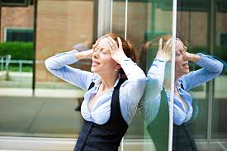
Mental Health By The Numbers
A recent survey conducted by ALM Intelligence and Law.Com revealed:
74% feel the profession has had a negative impact on their mental health
44% use alcohol to deal with stress
64% feel they suffer from anxiety
31% feel they are depressed
74% feel their work environment contributes
18% have contemplated suicide at some point in their careers
By the Numbers: the State of Mental health in The Legal Industry –www.law.com ;Feb.19,2020

Slide 13

Mental Health By The Numbers
A recent survey conducted by ALM Intelligence and Law.Com revealed:
36% use all of their vacation time
35% do not feel safe discussing their mental health at work
36% feel the billable hour has a major effect on stress level
62% know a colleague who is depressed and
50% know a colleague with an alcohol problem
By the Numbers: the State of Mental health in The Legal Industry –www.law.com ;Feb.19,2020

Slide 14
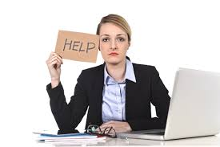
Mental Health By The Numbers
A recent survey conducted by ALM Intelligence and Law.Com revealed:
65% feel they could NOT take an extended leave from employment to tend to mental health issues
78% felt an extended leave would hurt career trajectory
77% were fearful of what the firm would think
56% felt they had too much work to take an extended leave
By the Numbers: the State of Mental health in The Legal Industry –www.law.com ;Feb.19,2020

Slide 15

THE VIRTUAL WORLD
“Workers today are ‘never turned off’. Like our mobile phones, we only go on standby at the end of the day as we crawl into bed, exhausted. Technology was supposed to liberate us from much daily slog…in 2002 fewer than 10% checked work email outside of work, today it is 50% often before we get out of bed…”
www.theguardian.com/lifeandstyle2018/jan/15

Slide 16

What is Depression ?
To qualify for major depressive disorder you need to have been experiencing your symptoms almost every day for at least two weeks, and they are more intense than the normal fluctuations in mood that all of us experience in our daily lives.
It’s not enough to experience just one of the symptoms over the two week period; you need to have at least five of them to qualify, and one of these five has to be either depressed mood or loss of interest or pleasure in activities.

Slide 17

What Causes Depression ?
Depression has many possible causes, including faulty mood regulation by the brain, genetic vulnerability, stressful life events, medications, and medical problems. It's believed that several of these forces interact to bring on depression.
Harvard Health Publications, 2009

Slide 18
“AM I DEPRESSED ?”
Symptoms of Depression
Flat, apathetic, sad, and/or irritable mood most days
Decreased pleasure and/or loss of interest
Feelings of worthlessness, excessive/inappropriate guilt
Feelings of helplessness, hopelessness

Slide 19
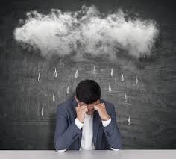
“AM I DEPRESSED ?”
Symptoms of Depression
Recurrent thoughts of death or suicide
Increased use of substances to cope (i.e., alcohol,
marijuana, opiates, stimulants, etc.)
Insomnia or hypersomnia
Social or occupational distress/isolation

Slide 20
WHAT IS STRESS ?
STIMULUS
THOUGHT
EMOTION
BEHAVIOR
Psychological stress is composed of the following sequence of elements:

Slide 21
WHAT IS STRESS ?
The central nervous system perceives a dangerous situation (stimulus) and then immediately begins to appraise it. Those initial appraisals are unconscious and internal.
Once we become aware of our thoughts, we make conscious judgments in other sensory forms (visual, auditory) which are external.
As the central nervous system recognizes the dangerous situation we immediately begin to experience “sympathetic” bodily responses – increase heart rate, sweating, faster breathing.
The internal and external appraisals combine to produce an emotion (fear in this case)
The emotion pushes the body to react (behave) externally

Slide 22


The thoughts and emotions are internal and subjective – part of the way we habitually respond to things – and are changeable, otherwise everyone would react in the same manner to a situation.
If we cannot interrupt or change the stimulus which produces the stress, then we must interrupt or change our appraisal of it.

Slide 23
HOW STRESSED ARE YOU ?
My work requires me to do too much in too little time.
I don’t have enough time to spend with my family and friends or to pursue recreational and social activities.
Competition is making it difficult to make a living.
The people at my law firm or department lack collegiality – e.g., are cold, unfriendly or rude.
My firm or department is mismanaged – e.g., not enough good clerical help, compensation or procedures are unfair.

Slide 24
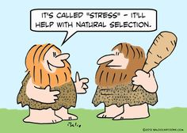
HOW STRESSED ARE YOU ?
My firm or department is too focused on profit.
The physical environment is unpleasant.
My work bores me.
I’m not good at what I do.
I’m not making a positive contribution to society or the lives of others.
What I am doing doesn’t deserve respect /get enough respect.
I deal with too many unreasonable and difficult people.

Slide 25
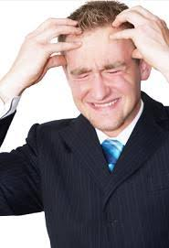
HOW STRESSED ARE YOU ?
I feel overly responsible for everything and everyone.
I overanalyze things and am too cautious.
I often feel depressed, defeated or hopeless.
I often rely on alcohol or drugs to help me feel good.
I think about quitting at least once a month.
Occasionally, I think about suicide.

Slide 26

STRESS or DISTRESS ?
Some stress is healthy. Positive stressors can energize and motivate us to be productive and creative problem solvers.
A totally stress free life is not only unrealistic, it can actually be a harmful form of denial.
We need to eliminate distress. Distress is harmful both physically and psychologically.
Being “strong” or having “courage” and enduring distress is a sign of poor judgment or fear of change.

Slide 27
STRESS or DISTRESS ?
Gradual, incremental increases in responsibilities, duties, pressures and demands at home and work combined with long work days and weeks is risky.
We become unaware that we have lost balance in our lives.
We stay busy and “stuff” our feelings.
Even relaxing can cause us to feel distress.
REMEMBER, DISTRESSED LAWYERS and PROFESSIONALS EVENTUALLY LOSE THEIR EFFICIENCY AND EFFECTIVENESS !!

Slide 28
QUICK STRESS-BUSTERS
Pause – lean back- give your eyes a rest for a couple minutes.
Take three deep breaths and imagine your muscles relaxing from head to toe
Be mindful. Focus on the immediate present. Enjoy the moment.
Stretch. Walk around your office or go outside.
Maintain a sense of humor about yourself.
Vary your routine. Don’t get trapped in a rut.
Prioritize at work and home and manage your time effectively.
ASK FOR HELP. Talk it out with someone you trust.

Slide 29

QUICK STRESS-BUSTERS
Meditate and/or pray. CONSISTENT stress reduction occurs with only 10 minutes of daily meditation.
Unplug from social media when acutely stressed.
Exercise.
Eat a healthy diet.
Cultivate a positive attitude.
Sleep 8 hours/ night when possible.
Avoid overuse of alcohol or prescription drugs. These short term “fixes” just mask the problem and can lead to negative health and social consequences.

Slide 30

Aloneness Solitude vs. Loneliness
Solitude
The physical state of being alone
Need not be a permanent experience
Balance between solitude & togetherness
Develop an “I’m not alone” mentality

Slide 31

Aloneness Solitude vs. Loneliness
Loneliness
The emotional state of being alone
Response to perceived isolation
Belief that no one understands our
circumstances, thoughts or emotions
More importantly, a belief that no one cares

Slide 32

Social Isolation
Social isolation is the combination of solitude
and loneliness, experienced by an individual for
an extended period. Both the emotional and
physical state feed off of one another and can
create an inability to reengage with society in a
meaningful way.

Slide 33

Social Isolation
IMPACT OF COVID-19 ISOLATION
Even perceived social isolation can be
linked with adverse health conditions
such as depression, poor sleep quality,
and accelerated cognitive decline.
The issues only become more substantial
when the isolation is no longer just
perceived, but immediate and ongoing.

Slide 34
What is Anxiety ?
Anxiety, noun
A feeling of worry, nervousness, or unease, typically about an imminent event or something with an uncertain outcome

Slide 35
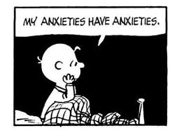
What is Anxiety ?
Anxiety disorders are characterized by a variety of symptoms.
Excessive and intrusive worrying that disrupts daily functioning
Agitation and irritability
Restlessness and fatigue
Difficulty concentrating
Tense muscles
Trouble sleeping

Slide 36

What is Worry ?
Worry is a habit.
Nearly everyone worries occasionally – it’s a normal response to problems and the unknown
A thought escalates into a story – “our” story in which we play out hypothetical scenarios in our imagination.
These thoughts are often in the form of a “What if” question.

Slide 37


Productive worry vs. Unproductive worry
Productive – Identifying problems and using effective problem solving strategies.
vs.
Unproductive - Worrying as a way of coping with problems we can’t change. It adds worry and anxiety to an already unpleasant experience.

Slide 38

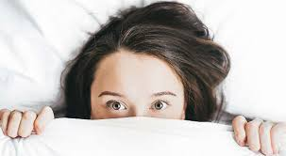
COVID-19 : How do we calm our anxiety ?
We are feeling:
Uncertain
Helpless
Scared
Unsure
Paralyzed
What are we going to do ??

Slide 39
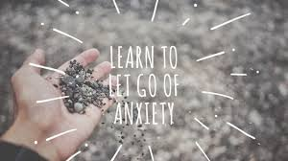
COVID-19: How do we calm our anxiety ?
While Anxiety makes entry into the future a thing to be dreaded, it also eradicates any memory of the bounty of the present.

Slide 40
Tips For Dealing With COVID -19 Fear
Stay away from social media and up-to-the-minute news, especially if you begin to feel overwhelmed.
Know the facts – “Pandemic” doesn’t describe the deadliness of an illness, but how widespread it is.
Actively remind yourself of reasons not to worry
Create a new routine – occupy your mind with relaxing hobbies, not your phone or computer.
Call a friend if you live alone. Isolation is already a warning sign for lawyers. Stay connected !
SEEK HELP – call a medical professional or LCL

Slide 41

Connect and Debrief
Debriefing is telling someone about what has happened, or going over an experience or set of actions, to achieve some sort of order or meaning concerning them.

Slide 42

SET BOUNDARIES

Slide 43





Disconnect

Slide 44

Tips For Dealing With COVID -19 Fear
Focus on things you CAN control
Lawyers already have control issues. As long as we’re focusing on questions with unknowable answers and circumstances outside of our personal control, this strategy will get us nowhere other than drained, anxious and overwhelmed !

Slide 45


Slide 46

Tips For Dealing With COVID -19 Fear
Keeping the under control
Mindfulness
Relinquishing our desire for certainty in these times is difficult. Ground yourself in the present moment. Bring attention to your breath and your body. Focus all your attention on the here and now: the sights, sounds, smells and what you are feeling.
Gently bring your mind back to your body and breath until calm.

Slide 47



ETHICAL DILEMMAS and COVID-19

Slide 48
ETHICAL DILEMMAS and COVID-19
There are significant connections between anxiety and work.
Job-related stress is likely to lead to negative coping behaviors.
Anxiety has been shown to lead to worse outcome in negotiations.
Anxiety negatively impacts creativity and productivity.
Anxiety triggers feelings of self-threat, which may increase unethical behavior.

Slide 49
ETHICAL DILEMMAS and COVID-19
Experienced anxiety
Perceived self-threat
Defensive coping
Unethical acts

Slide 50

ETHICAL DILEMMAS and COVID-19
Anxious individuals are more willing to participate in unethical actions.
Anxiety increases threat perception.
Acquiring resources from unethical acts
is used to “overcome” threat
Falsifying time sheets, records
Accessing client funds and misuse IOLTA
Gambling on line is now legal in many states
Anxiety increases risk of developing alcohol
and substance use disorder

Slide 51


ETHICAL DILEMMAS and COVID-19
Challenges to working from home for lawyers, their staffs AND clients
Data protection must be discussed with staff and clients – confidentiality still exists at the kitchen table or living room sofa.
Supervision is still a must !! Rules of Professional Conduct provide that lawyers must supervise subordinate attorneys and staff.

Slide 52
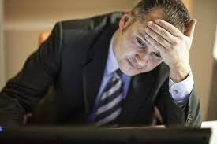
Why Are Legal Professionals at High Risk of Mental Health & Substance Use Disorders?
High expectations and accountability
Lack of work-life balance
Always on call to solve others problems
High stress level are consistent predictors
of SUD’s and their severity.
67% of attorneys work more than 40 hours/week.
Inherent pessimism

Slide 53

Why Are Legal Professionals at High Risk of Mental Health & Substance Use Disorders?
Conflict driven and adversarial profession
Emotional detachment
Win-lose, black-white, often rigid thinking
Perfectionism
Excessive self-reliance
These traits are great for a successful career but not so
great for mental health.

Slide 54
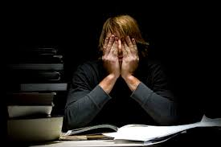
Lawyers who do not appropriately address their personal issues can harm their clients,
destroy their own careers, damage the reputation and viability of their law firms, and sometimes even lose their lives.

Slide 55
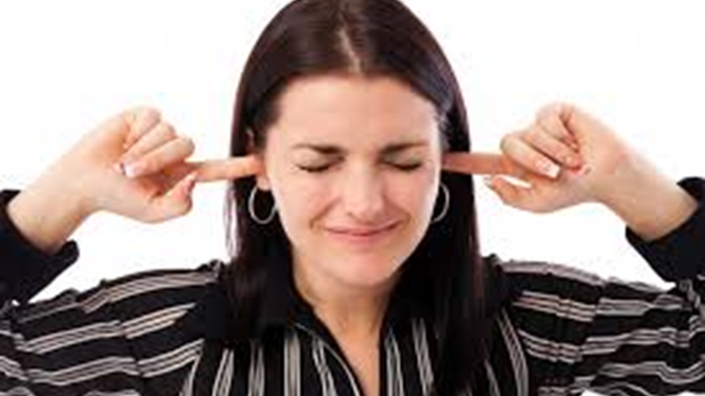
What keeps many professionals from seeking or accepting the help they so desperately need ?
Shame and Embarrassment- STIGMA
Denial
Cunning ,insidious diseases
Enabling

Slide 56
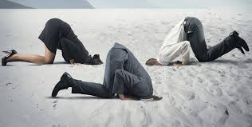
Dealing with Denial
The most potent barrier
Psychological defense mechanism
Rationalize and minimize behavior
Honestly believe they are under control
I’m not one of “them” mentality

Slide 57

ENABLING The Conspiracy of Silence
Removes motivation to change
Provides evidence that fuels denial
Allows cons of treatment to outweigh pros
PREVENTS treatment of a progressive disease
Greater harm to career, family and well being
Not good for YOU either !!

Slide 58

What can YOU do ??
Although it is difficult, remember that your end goal is to help motivate the impaired lawyer to seek professional help they so desperately need.

Slide 59
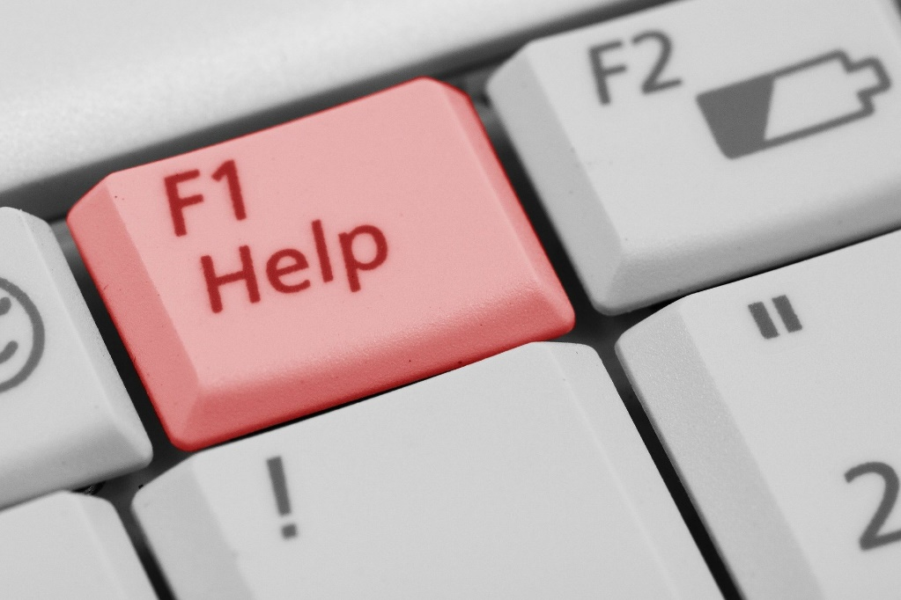
A Reminder to Us All
reaching out for support = strength
we aren't immune/recovery isn't a shield
LAP's are here to support all of us
we are all in this together
directly or indirectly, COVID-19 will impact all of us

Slide 60
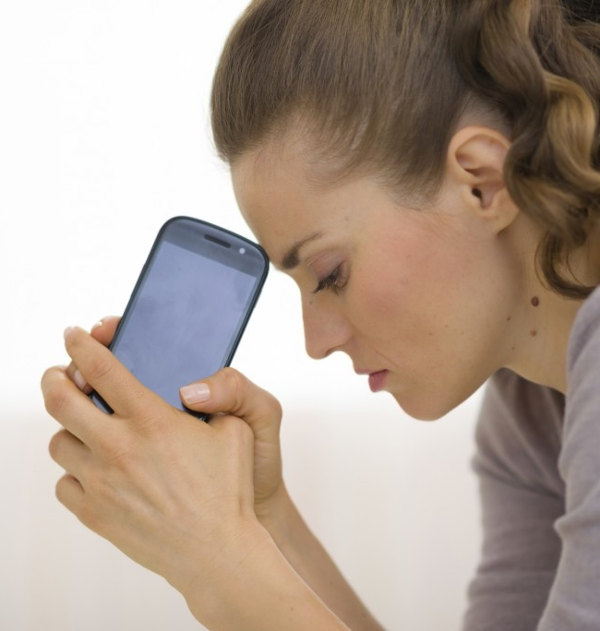
To Call LCL…or Not to Call
I’m ok. I can work this out for myself.
I’m not like a “real” alcoholic anyway.
I want help but I don’t want anyone to know.
Will I be reported to Discipline?
I already tried to get help and it didn’t work.
I don’t have the money to pay for treatment.
What will people say about me if I ask for help ?
It’s no use – nobody will understand – I give up !

Slide 61
To Call LCL…or Not to Call
Is this really any of my business?
I want to help but I don’t want to get involved.
Will I harm his/her or the firm’s reputation?
Must I report him or her to Discipline?
I already tried to help and it didn’t work.
Let’s wait and see. Maybe it will get better.
I really don’t have time for someone else’s problems.

Slide 62
Five Core Steps for a Sustainable Culture in the Legal Profession:
Identify stakeholders and their roles.
Diminish stigma associated with seeking help.
Emphasize that well-being is a part of competence.
Educate on well-being/mental health/substance use disorders.
Make health and well-being a top priority throughout the profession.

Slide 63

THE SUN WILL RISE TOMMOROW !!!

Slide 64
Coronavirus and Your Mental Health: A Lawyer’s Guide to Coping with Isolation, Anxiety and Fear In Uncertain times
Thank you all for attending today’s Continuing Legal Education program.
If you have any questions that were not answered or would like to contact me for any reason, please call or email me at the following:
Brian S. Quinn, Esq., Education and Outreach Coordinator
LAWYERS CONCERNED FOR LAWYERS of PA, INC.
(717) 460-3385 brian@lclpa.org

Slide 65
Additional Resources - COVID -19
Pandemic Preparedness Resources from the National Association of Bar Executives
Contains extensive information on the following:
· Webinar script examples
· Various platforms available for teleconferencing, electronic meetings and video conferencing
· Advice and tips for working remotely
· Articles on how to take care of yourself and your team
· Government Agency Resources
· Information about the CARES Act (Coronavirus Aid, Relief and Economic Security Act) ; ABA Summary of 10 Highlights of the CARES Act; US Chamber of Commerce CARES Guide: What Small Businesses Need to Know o ASAE Summary of Provisions of the CARES Act Applicable to Associations and Foundations

Slide 66
Additional Resources - COVID -19
CORONAVIRUS (COVID-19) INFORMATION AND UPDATES Centers for Disease Control and Prevention
The CDC site is likely to offer the most up to date information on the COVID-19 virus.
LAWYER SPECIFIC RESOURCES
ABA COVID-19 Mental Health Resources – a comprehensive compilation of lawyer-specific practice and mental health resources ABA Commission on Lawyer Assistance Programs – list of state lawyer assistance programs and additional resources ABA's Lawyer Well-Being Week (May 4-8, 2020)- brought to you by the National Task Force on Lawyer Well-being - Free webinars, online activities, and other events. Check out the website lawyerwell-being.net for a wealth ff information and activities you can pursue at any time
NEW CLE produced by the ABA Commission on Lawyer Assistance Programs (CoLAP) - Staying Mentally Safe, Sound and Sober During COVID-19 debuts as a webinar at 1pm on April 6, 2020 (free to membership, $50 to non-members). Laurie Besden, Esq., LCLPA’s Executive Director, leads the presentation.

Slide 67
Additional Resources - COVID -19
SOCIAL DISTANCING & STAYING BUSY
“Stigma and Resilience” published by the CDC
“Tips for Social Distancing, Quarantine, And Isolation During an Infectious Disease Outbreak” published by SAMHSA – see this documents pp.
“Dealing with Social Isolation” by Brian Cuban, author of “The Addicted Lawyer”
“100 things to do while stuck inside due to a pandemic” published by USA TODAY
Free Online Courses from Ivy League schools
STRESS, ANXIETY AND GRIEF
“That Discomfort You’re Feeling is Grief” by Scott Berinato March 23, 2020 (Harvard Business Review)
“Mental Health and Coping During COVID-19” published by the CDC
“7 science-based strategies to cope with coronavirus anxiety” by Jelena Kecmanovic
“[Lawyer] Anxiety, Self-Protective Behavior, Ethical Sinkholes, and Professional Responsibility” by Dan Defoe
“Coronavirus and your mental health: Two experts explain why we panic and how to cope” by By Joanna Chi

Slide 68
National Task Force on Lawyer Well-Being Recommendations
"The Path to Lawyer Well-Being:
Practical Recommendations For Positive Change"
http://lawyerwellbeing.net/wp-content/uploads/2017/11/Lawyer-Wellbeing-Report.pdf

Slide 69
Additional Resources - COVID -19
The National Suicide Prevention Lifeline provides 24/7, free and confidential support for people in distress, prevention and crisis resources for you or your loved ones, and best practices for professionals.
1-800-273-TALK www.suicidepreventionlifeline.org
Crisis Text Line serves anyone, in any type of crisis, providing access to free, 24/7 support and information via a medium people already use and trust: text.
Text “HOME” to 741741 www.crisistextline.org

Slide 70
How to Join the National Well-Being MOVEMENT
“WELL-BEING TOOLKIT FOR LAWYERS AND LEGAL EMPLOYERS”
Created By Anne M. Brafford For Use By The American Bar Association
https://www.americanbar.org/content/dam/aba/administrative/lawyer_assistance/ls_colap_well-being_toolkit_for_lawyers_legal_employers.authcheckdam.pdf
“Well-Being Toolkit Nutshell: 80 Tips For Lawyer Thriving”
https://www.americanbar.org/content/dam/aba/administrative/lawyer_assistance/ls_colap_Well-Being_Toolkit_Flier_Nutshell.authcheckdam.pdf

