Slide 1

18th Annual Nutrition Law Symposium
Class Action Litigation Roundup:
Trending Cases and Legal Strategies
Matthew Orr
Partner
Amin Talati Wasserman LLP
William Cole
Partner
Amin Talati Wasserman LLP
Kim R. Pearson
General Counsel
Thorne HealthTech, Inc.

Slide 2
Agenda
Class Action Landscape
Trends
  Legal Trends
    Structure/Function
    Implied Preemption
  Class Action Trends
    Microcontamination
    ESG & Green Claims
    Food, Beverage & Supplements
    Pricing, Subscriptions, Privacy, & Accessibility
Looking into the Crystal Ball

Slide 3
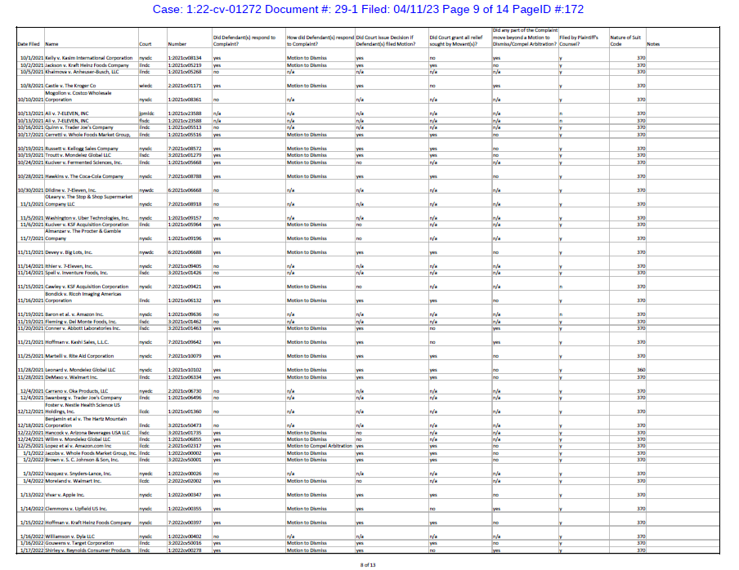
Class Actions Are Booming

Slide 4
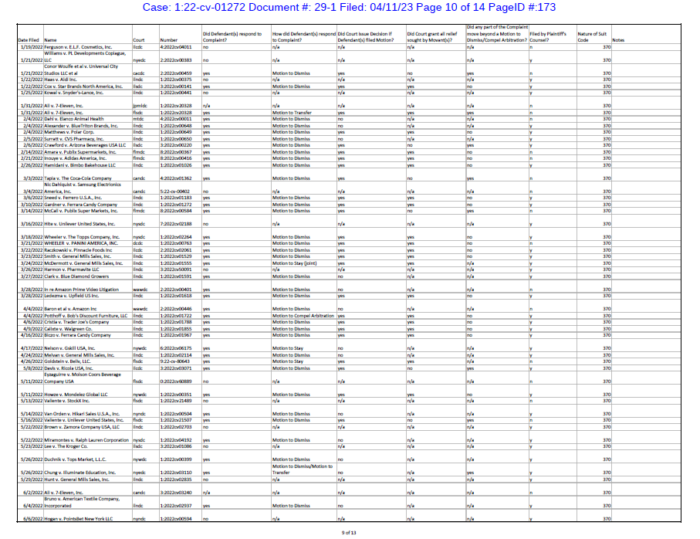
Class Actions Are Booming

Slide 5
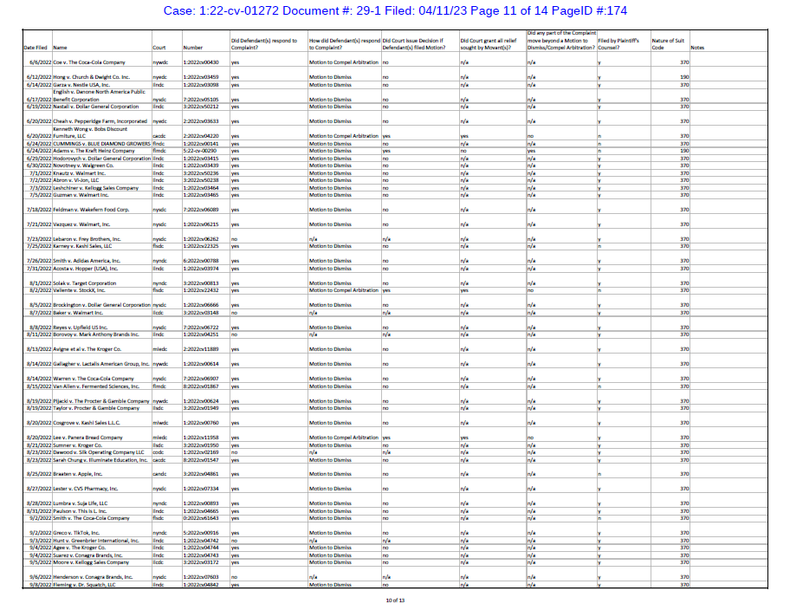
Class Actions Are Booming

Slide 6
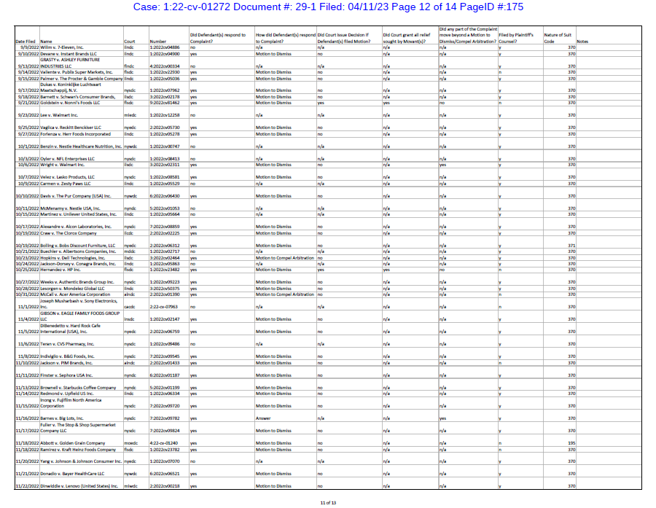
Class Actions Are Booming

Slide 7
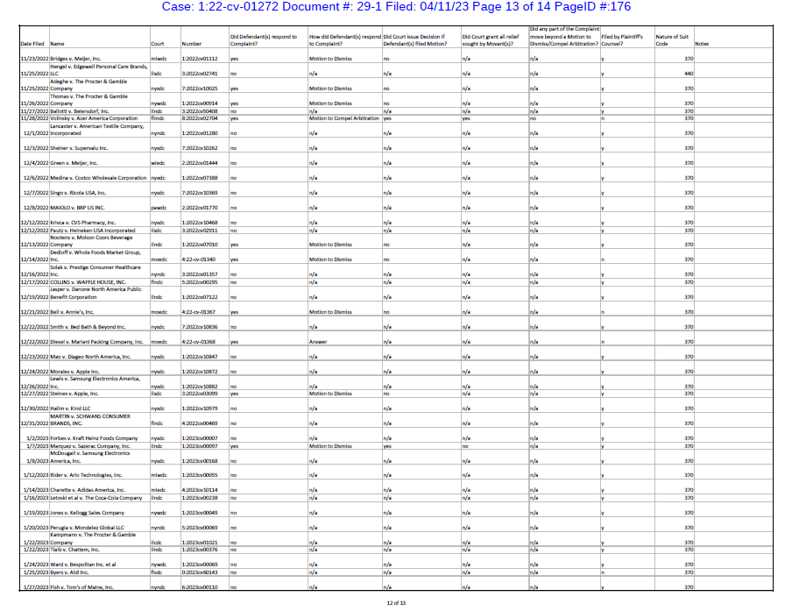
Class Actions Are Booming

Slide 8
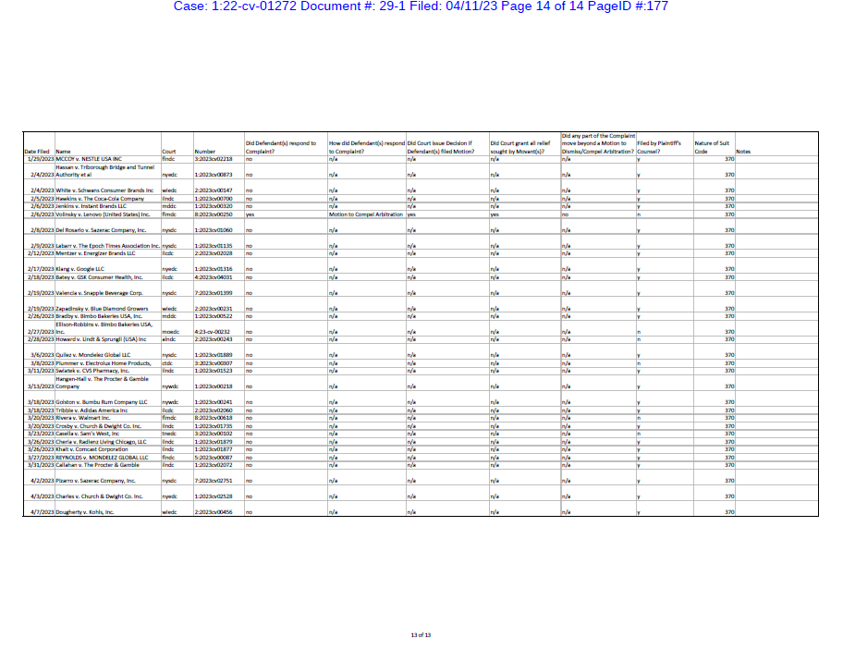
Class Actions Are Booming

Slide 9
Plaintiffs’ Lawyers are Growing in Number, Power and Sophistication (If not Competence)
Growing number of smaller firms (2-10 lawyer) bringing cases regularly.
Entrepreneurial model: Lawyers find a case and then solicit consumer plaintiffs.
Consumer protection cases are easier to plead, and offer big paydays.
Plaintiffs’ lawyers share information and work across state lines, creating a virtual network.
Plaintiffs copy prior filings and sue in states where the original filer did not allege a class.
Litigation Funding??

Slide 10





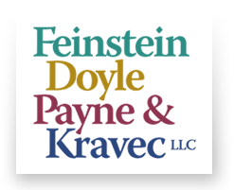


KEY PLAYERS
BURSOR & FISHER, P.A.
EDELSON
10

Slide 11
How to Prepare?
Demand Letter: Shot Across the Bow
Proactively assess risk of getting sued, winning on a motion to dismiss, costs of defense, and settlements.
  “What is the strongest argument a plaintiff could make that the claim is misleading to a reasonable consumer?”
Monitor state and federal developments, consumer complaints, news stories, citizen petitions; watch for emerging trends in filings and court decisions.

Slide 12
So You Have Been Sued. What Now?
  Document Retention
  Communication Embargo
  Insurance Coverage
  Arbitration
  Venue/Jurisdiction
  Removal/Transfer/First Filed Doctrine
  Procedural Defenses/Motion to strike class
  Substantive Defenses/Motion for Summary Judgment
  Experts
  Settlement v Litigation

Slide 13
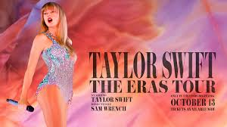

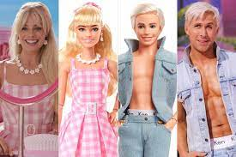


TRENDS
13

Slide 14
Legal Trends
Structure/Function Claims
Greenberg v. Target Corp., 985 F.3d 650 (9th Cir. 2021)
  Allegation: “helps support healthy hair and skin” claim for biotin supplement misleading, because majority of population obtains enough biotin from diet
  Ninth Circuit affirmed summary judgment in favor of defendant
  Plaintiff did not dispute biotin supports healthy hair and skin
  Plaintiff cannot impose a higher standard on s/f claims
  “Simply put, manufacturers may make structure/function claims about a nutrient’s general role on the human body without disclosing whether the product will provide a health benefit to each consumer”
14

Slide 15
Legal Trends
Structure/Function Claims
Ferrari v. Vitamin Shoppe, Inc., USDC Mass
  Plaintiffs did not contest that glutamine has been shown to produce the claimed benefits, but alleged that the dose of glutamine was insufficient to deliver the claimed benefits.
  The Court held that a structure/function claim must be substantiated by evidence of the ingredient’s function in the body, and that it does not require evidence that the product produces the claimed benefits. Thus, Plaintiffs were preempted from claiming that the glutamine structure/function label claims were false and misleading.
  Very Recently Upheld by First Circuit.
15

Slide 16
Legal Trends
Implied Preemption(Buckman)
Chong v. Kind
Failure to provide %DV for Protein
  Bootstrapped UCL claim based on violation of Sherman Act
    FDCA preempts state-law claims (including UCL) that ultimately are dependent on the existence of violations of federal law.
    To navigate the “narrow gap” for non-preempted claims, plaintiffs must “rely[] on traditional state tort law which had predated the federal enactments in question.”
Bubak v. Golo
Implied disease claims
  Bootstrapped UCL claim based on violation of Sherman Act
    FDCA’s absence of a private remedy evidences Congress’s determination “that widely available state rights of action,” including California’s Sherman Law, “provided appropriate relief for injured consumers.”
16

Slide 17
Litigation Trends
Microcontamination
“Microcontaminant” is any chemical, element, or ingredient, that may, even in incredibly small quantities (e.g. ppt) pose a “risk” of harm.
Typically asserted as omission, affirmative misrepresentation, and/or breach of warranty claims.
Generally tied to a failure to disclose the presence of the microcontaminant based on safety issue, or that “natural,” “healthy,” “safe,” “clean” or similar representations are deceptive and misleading
Brought by a handful of plaintiffs’ firms, typically filed in California, Illinois, or New York federal courts.

Slide 18

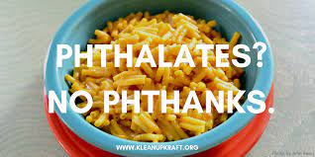
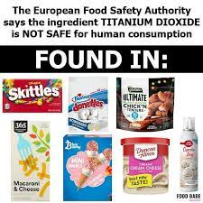

Litigation Trends
Microcontamination
Benzene
  Generally tied to propellants in aerosol products
Heavy Metals
  Dark Chocolate
  Pre-Natal Vitamins
  Baby Food
Phthalates
  Macaroni & Cheese
PFAS
  Feminine Hygiene Products
  Cosmetics
  Beverages
Titanium Dioxide
  Candies
  Cosmetics

Slide 19
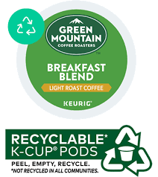
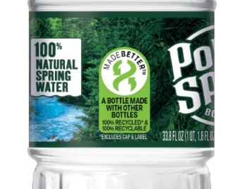
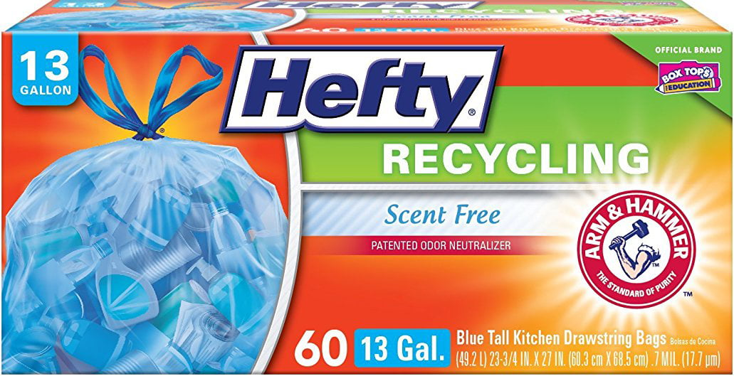
Litigation Trends
ESG & Green Claims
RECYCLABILITY
K-Cup Pods
  Alleged the “recyclable” pods are not accepted for recycling in many areas
  Settled March 2022 for $10 Million
  Smith v. Keurig Green Mountain, 18-cv-6690 (N.D. Cal. Sept. 2018)
Bottled Water, Soda, and Other Beverages
  Alleged “100% Recyclable” is deceptive where parts of the bottle are not recyclable & certain plastic types (PET #1 & HDPE #2) are not actually recycled
    Duchimaza v. Niagara Bottling, LLC, 21-cv-6434 (S.D.N.Y. July 2021) – Dismissed with prejudice
    Haggerty v. Bluetriton Brands, Inc., 21-cv-13904 (D.N.J. July 2021) – Dismissed, terminated
    Swartz v. The Coca-Cola Co., 21-cv-4643 (N.D. Cal. June 2021) – Dismissed once, second MTD pending
Recycling Bags
  Alleges bags are not suitable for recycling because waste haulers deliver them to solid waste disposal facilities
    Gudgel v. Reynolds Consumer Products, Inc., 22-cv-1149 (M.D. Fla. July 2022)
    Millam v. Walmart Inc., 22-cv-1090 (C.D. Cal. July 2022)
    Woodlard v. Reynolds Consumer Products, Inc., 22-cv-1684 (S.D. Cal. Oct. 2022)

Slide 20

Litigation Trends
ESG & Green Claims
HONORABLE MENTIONS
  “Sustainable” / “Eco-Friendly” / “Environmentally Friendly”
    Certain practices are harmful or inhumane
    Targeted Items: Apparel/Fashion, Seafood
  “Biodegradable” and “Compostable”
    Item does not allegedly degrade within a reasonable time
    Targeted items: Disposable Servingware & Cutlery, Teas
  Carbon Emissions & Footprints
    Calculations are allegedly deceptive and/or steps do not negate emissions
    Targeted items: Transportation, Apparel/Fashion, Food & Beverage
  Stewardship Promises
    Practices allegedly do not meet a company’s overarching environmental promises

Slide 21


Class Action Trends
Pricing, Subscriptions, Privacy, Slackfill & Accessibility
Pricing
  Small but growing number of suits challenging deceptive pricing
    Shelf pricing versus checkout
    False discounts
    Hidden fees
Auto-enrollment & Auto-renewal
  Suits primarily focus on
    Enrollments that lack appropriate clarity & disclosures
    Difficult cancellation processes
  Example: $56 million Noom settlement (July 2022)
Slackfill
  Recent revival
  May turn on consumer reliance as to number of servings per container
  Coin Toss at Dismissal Stage
  Largely unsuccessful at certification stage
Website Tracking
  California, as well as some other states, require consent prior to recording website activity
Website Accessibility
  ADA compliance remains active, although has had some defendant-helpful decisions
  9th Circuit affirmed a significant undercut on fees and slammed serial plaintiffs and their attorneys (Shayler v. 1310 PCH, LLC, 21-56130 (9th Cir. 2021))

Slide 22

Coming Soon?
22

Slide 23
Matthew Orr
Matt@AminTalati.com
213.985.7219
William Cole
William@AminTalati.com
213.985.7206
Kim R. Pearson
General Counsel
Thorne HealthTech, Inc.

