Slide 1
Legal Risks: Demand Letters and Litigation Trends 17th Annual Nutrition Law Symposium
Matthew Orr, Partner
William Cole, Partner
Amin Talati Wasserman, LLP

Slide 2
You Receive A Demand Letter – What do you do?

Slide 3
NO!

Slide 4
Types of Demand Letters
ADA Website and Architectural Barriers:
Los Angeles / San Francisco DA UCL Lawsuit v. Potter-Handy
IP Cease and Desist
Proposition 65:
Acrylamide Litigation
Warranty – Product Liability
Consumer Class Action

Slide 5
Phases of a Class Action
Demand Letter
Responsive Pleading
Discovery
Class Certification
Summary Judgment
Trial
Appeal

Slide 6
Obligatory “Art of War” Reference:

Slide 7
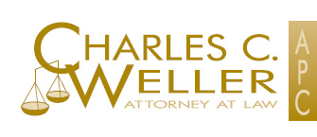
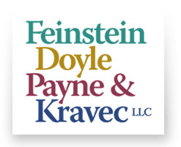
Know the enemy: law firms
BURSOR & FISHER, P.A.
EDELSON

Slide 8
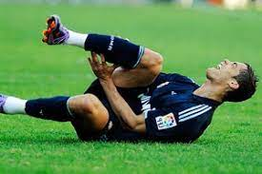
Know the enemy: claimants
Claimant/Plaintiff:
Identify Purchase(s);
Arbitration Clause;
Prior/Subsequent Purchases;
Relevant Social Media Postings;
Other Demand Letters;
Other Litigation; and
Ties to Current Counsel.

Slide 9
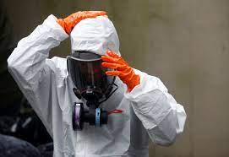
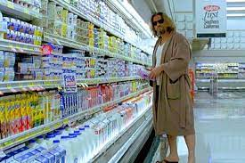
Know YOURSELF:
RISK TOLERANCE
Publicly-Filed Lawsuit;
Protracted/Limited/Avoid Litigation;
Adverse Adjudication;
Social Media // PR Tolerance;
Insurance;
Indemnification;

Slide 10
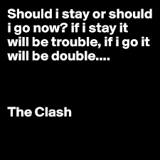
Responding . . . Or not
Respond:
Obtain Additional Information About Claims.
Avoid Catalyst?
Ken’s Dressing
Scare them off?
Avoid Additional Penalties?
Ignore?
Will they just go away?
Gain additional time?
What is to be gained?

Slide 11
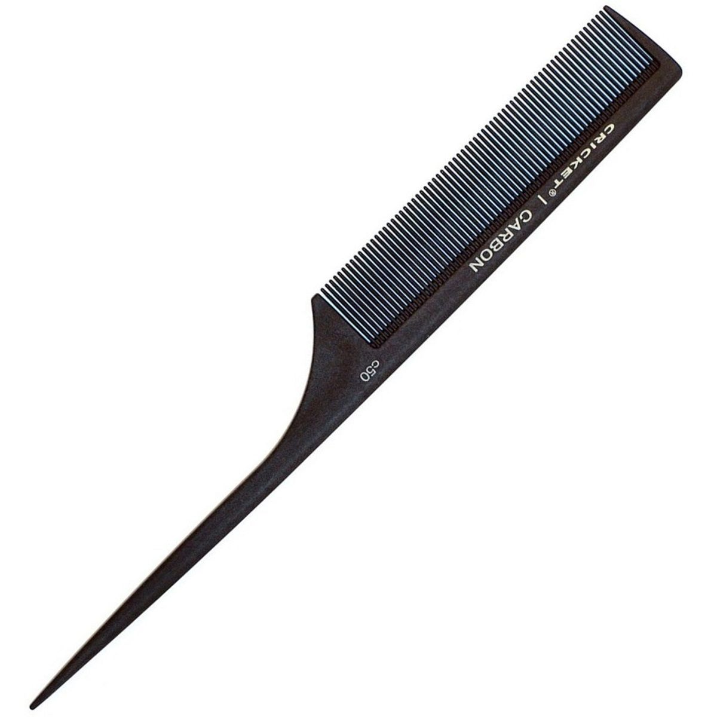
Avoiding Demand Letters

Slide 12
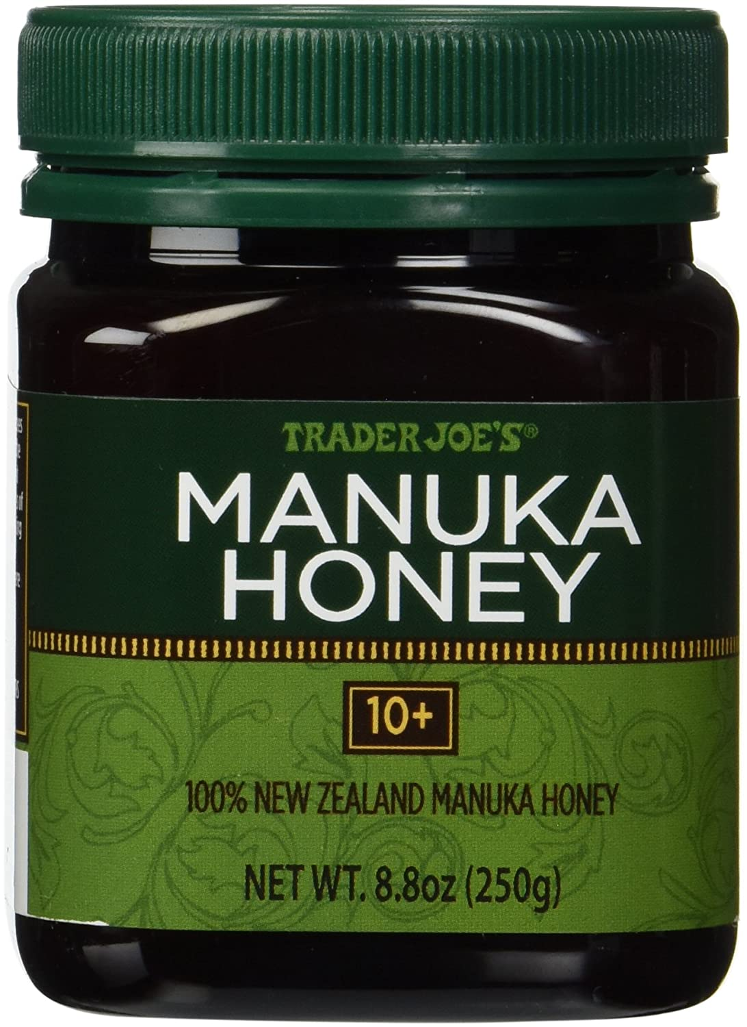
Key Legal Developments
Reasonable Consumer Standard

Slide 13
Reasonable Consumer Standard
Moore v. Trader Joe’s Co., No. 19-16618 (9th Cir. July 15, 2021).
“100%” in the “100% New Zealand Manuka Honey” label could be read in multiple ways: “100% could be a claim that the product was 100% Manuka honey, that its contents were 100% derived from the Manuka flower, or even that 100% of the honey was from New Zealand.”
In order to state a claim, plaintiffs must prove "more than a mere possibility that the seller's label might conceivably be misunderstood by some few consumers viewing it in an unreasonable manner. Rather, the reasonable consumer standard requires a probability that a significant portion of the general consuming public or of targeted consumers, acting reasonably in the circumstances, could be misled.“
The Court reinforced the importance of considering context:
(1) the impossibility of making a honey that is 100% derived from one floral source;
(2) the low price of Trader Joe’s Manuka Honey; and
(3) the presence of the “10+” on the label.

Slide 14
Reasonable Consumer Standard
Moore v. Trader Joe’s Co., No. 19-16618 (9th Cir. July 15, 2021).
Key Takeaways:
Consumers do not interpret labels to mean the impossible;
Consumers must consider all the information available to them, including context; and
FDA guidelines can support a “literally true” defense
“[W]here plaintiffs base deceptive advertising claims on unreasonable or fanciful interpretations of labels or other advertising, dismissal on the pleadings may well be justified.”

Slide 15
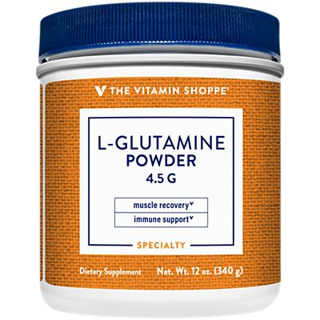
Structure Function Claims For Dietary Supplements

Slide 16
Structure/Function Claims
Greenberg v. Target Corp., No. 19-16699, 2021 WL 116537 (9th Cir. Jan. 13, 2021)
Allegation: “helps support healthy hair and skin” claim for biotin supplement misleading, because majority of population obtains enough biotin from diet
Ninth Circuit affirmed summary judgment in favor of defendant
Plaintiff did not dispute biotin supports healthy hair and skin
Similar to Dachauer, plaintiff cannot impose a higher standard on s/f claims
“Simply put, manufacturers may make structure/function claims about a nutrient’s general role on the human body without disclosing whether the product will provide a health benefit to each consumer”

Slide 17
Structure/Function Claims
Ferrari v. Vitamin Shoppe, Inc., USDC Mass
Plaintiffs did not contest that glutamine has been shown to produce the claimed benefits, but alleged that the dose of glutamine was insufficient to deliver the claimed benefits.
The Court held that a structure/function claim must be substantiated by evidence of the ingredient’s function in the body, and that it does not require evidence that the product produces the claimed benefits. Thus, Plaintiffs were preempted from claiming that the glutamine structure/function label claims were false and misleading.

Slide 18
New York Statutory Damages
Montera v. Premier Nutrition Corp., No. 3:16-cv-6980 (N.D. Cal.)
Glucosamine substantiation case
Brought in California under NY law
Jury awards actual damages of less than $1.5MM (full refund)
Consumers were made whole
Plaintiff moves for statutory penalties under NY GBL 349 and 350, which provide for statutory damages of the greater of actual damages or $50 and $500 per violation, respectively
$91MM in maximum statutory damages ($550 per sale)
Judge awards $8.3MM citing due process concerns with the $91MM figure
Plaintiff and Defendant have both indicated intention to appeal

Slide 19
Implied Preemption (Buckman)
Chong v. Kind (2/25/22)
Failure to provide %DV for Protein
Bootstrapped UCL claim based on violation of Sherman Act
FDCA preempts state-law claims (including UCL) that ultimately are dependent on the existence of violations of federal law.
To navigate the “narrow gap” for non-preempted claims, plaintiffs must “rely[] on traditional state tort law which had predated the federal enactments in question.”
Bubak v. Golo (8/28/22)
Implied disease claims
Bootstrapped UCL claim based on violation of Sherman Act
FDCA’s absence of a private remedy evidences Congress’s determination “that widely available state rights of action,” including California’s Sherman Law, “provided appropriate relief for injured consumers.”

Slide 20
TRENDS

Slide 21
TRENDS
PRODUCTS AND CLAIMS
Rise in cases, especially those implicating FD&C Act compliance
Even where labeling is compliant, claims may still be misleading
However, just because label violates federal or state regulation does not mean claim will succeed

Slide 22
TRENDS
Zahora v. Orgain – Northern District of Illinois:
“FDA product labeling regulations are not relevant in determining whether Zahora has stated a claim under the ICFA.”
“This case is about a reasonable consumer’s understanding of the labeling on Orgain protein shakes”
“Zahora’s case is not about the enforcement of FDA regulations – which, again, lies solely within the purview of the FDA.”

Slide 23
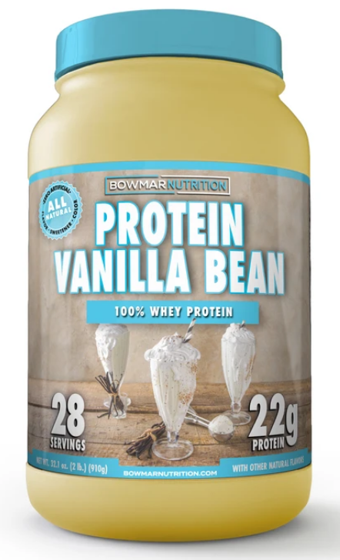
TRENDS
“Zero” and “No Added Sugar” claims
Challenges where label lacked mandatory disclosure that product is not a low-calorie food
No harm, no foul? Context may matter.
Recent Goldfish Cracker Case.
Protein claims
Challenges to protein content
Amino v. Protein in Calorie Counts
Based on use of nitrogen method grams vs. PDCAAS corrected grams; FDA regs allow both
%DV Claims

Slide 24
TRENDS
Other Nutrient Claims
FDA composite sampling requirements 21 C.F.R. 101.9(g)(2)
Pleading v. Proving
Natural Flavors // No Preservatives
Primary targets: malic acid, citric acid; added for technical function but may still affect flavor
Flavoring Cases / Fudge / Caramels (Sheehan, Inc.)
Complaints allege “vanilla” is misleading unless product complies with FDA’s standard of identity
Largely unsuccessful

Slide 25
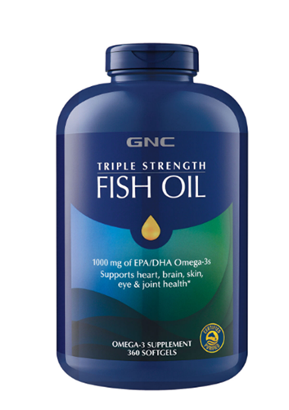
TRENDS
Trans-esterified “fish oil” not actually “fish oil”
“Irrevocably transformed”
Geographic origin claims
Continued focus on “green” claims
Keurig agrees to $10M settlement re coffee pods
FTC updates to Green Guides?
DSHEA Placement
Ex. Barnes v. Iovate Health Sciences U.S.A. Inc., No. 5:21-cv-04978 (N.D. Cal. June 28, 2021)
Slack-Fill was Dying . . .
Micro-Adulteration:
Benzene;
Titanium Dioxide;
Heavy Metals;

Slide 26
Thank You! Matthew Orr Matt@AminTalati.com 213.985.7219 William Cole William@AminTalati.com 213.985.7206

