Slide 1


Tech Law Symposium
April 14, 2023
Karen Silverman
CEO/Founder karen.silverman@cantellusgroup.com www.cantellusgroup.com
linkedin.com/in/karenesilverman
+1.415.699.4262
Naziol S. Nazarinia Scott
General Counsel and SVP of Legal
www.Hirevue.com

Slide 2
Agenda and Summary
AI, AI Systems and Categories of AI
Considerations in Using AI
Actionable Steps for In-House Counsel
Notes:
.

Slide 3
Definitions of AI Differ
NIST: “A branch of computer science devoted to developing data processing systems that performs functions normally associated with human intelligence, such as reasoning, learning, and self-improvement.”
EU AI Act: “A machine-based system that is designed to operate with varying levels of autonomy and that can, for explicit or implicit objectives, generate output such as predictions, recommendations, or decisions influencing physical or virtual environments.”
Definitions vary according to author and context and range from the thoughtful to the inane. Definitions can and should change over time, with tech the technology.
OECD: “Artificial Intelligence (AI) is a machine-based system that can, for a given set of human- defined objectives, make predictions, recommendations, or decisions influencing real or virtual environments.”
Practical AI for Dummies: Artificial Intelligence is a subfield of computer science aimed at the development of computers capable of doing things that are normally done by people — in particular, things associated with people acting intelligently.”
See Appendix for additional examples
Notes:
.

Slide 4

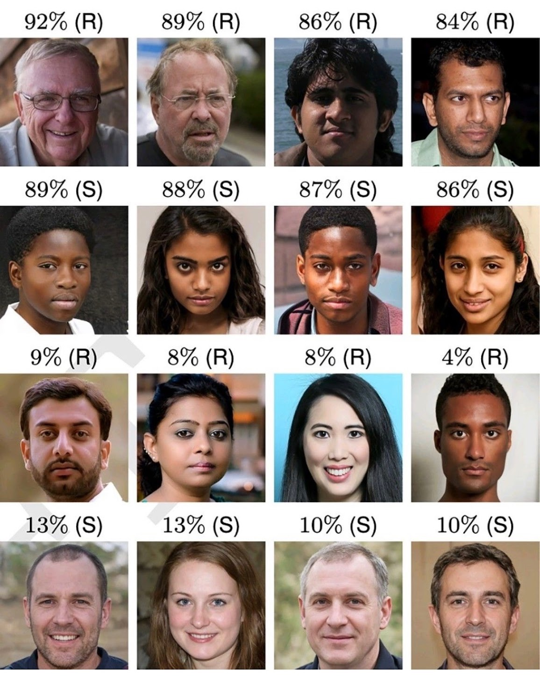
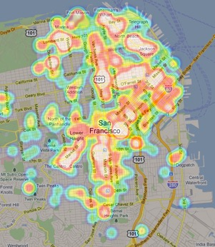
Built to…
Inspire … Predict … and Simulate
Winner in Digital Art Category in a Colorado Art Competition
… and often to deceive.
Which are images of real people?
R = real face
S = synthetic face
% = humans who accurately classified them
Notes:
.

Slide 5
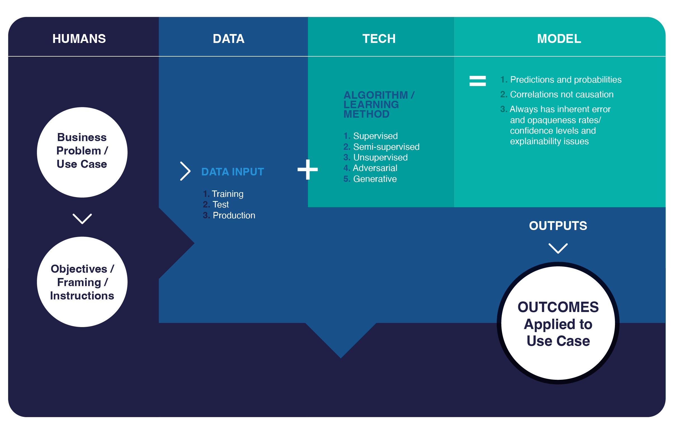
Applied AI Systems = Humans + Data + Tech
Notes:
Deal with People who are encountering the technologies they are using in the organization.
Still a key ingredient

Slide 6
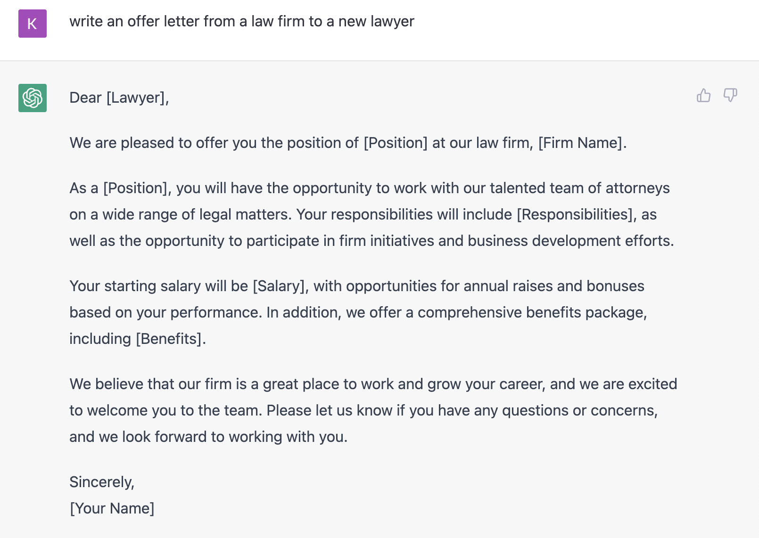
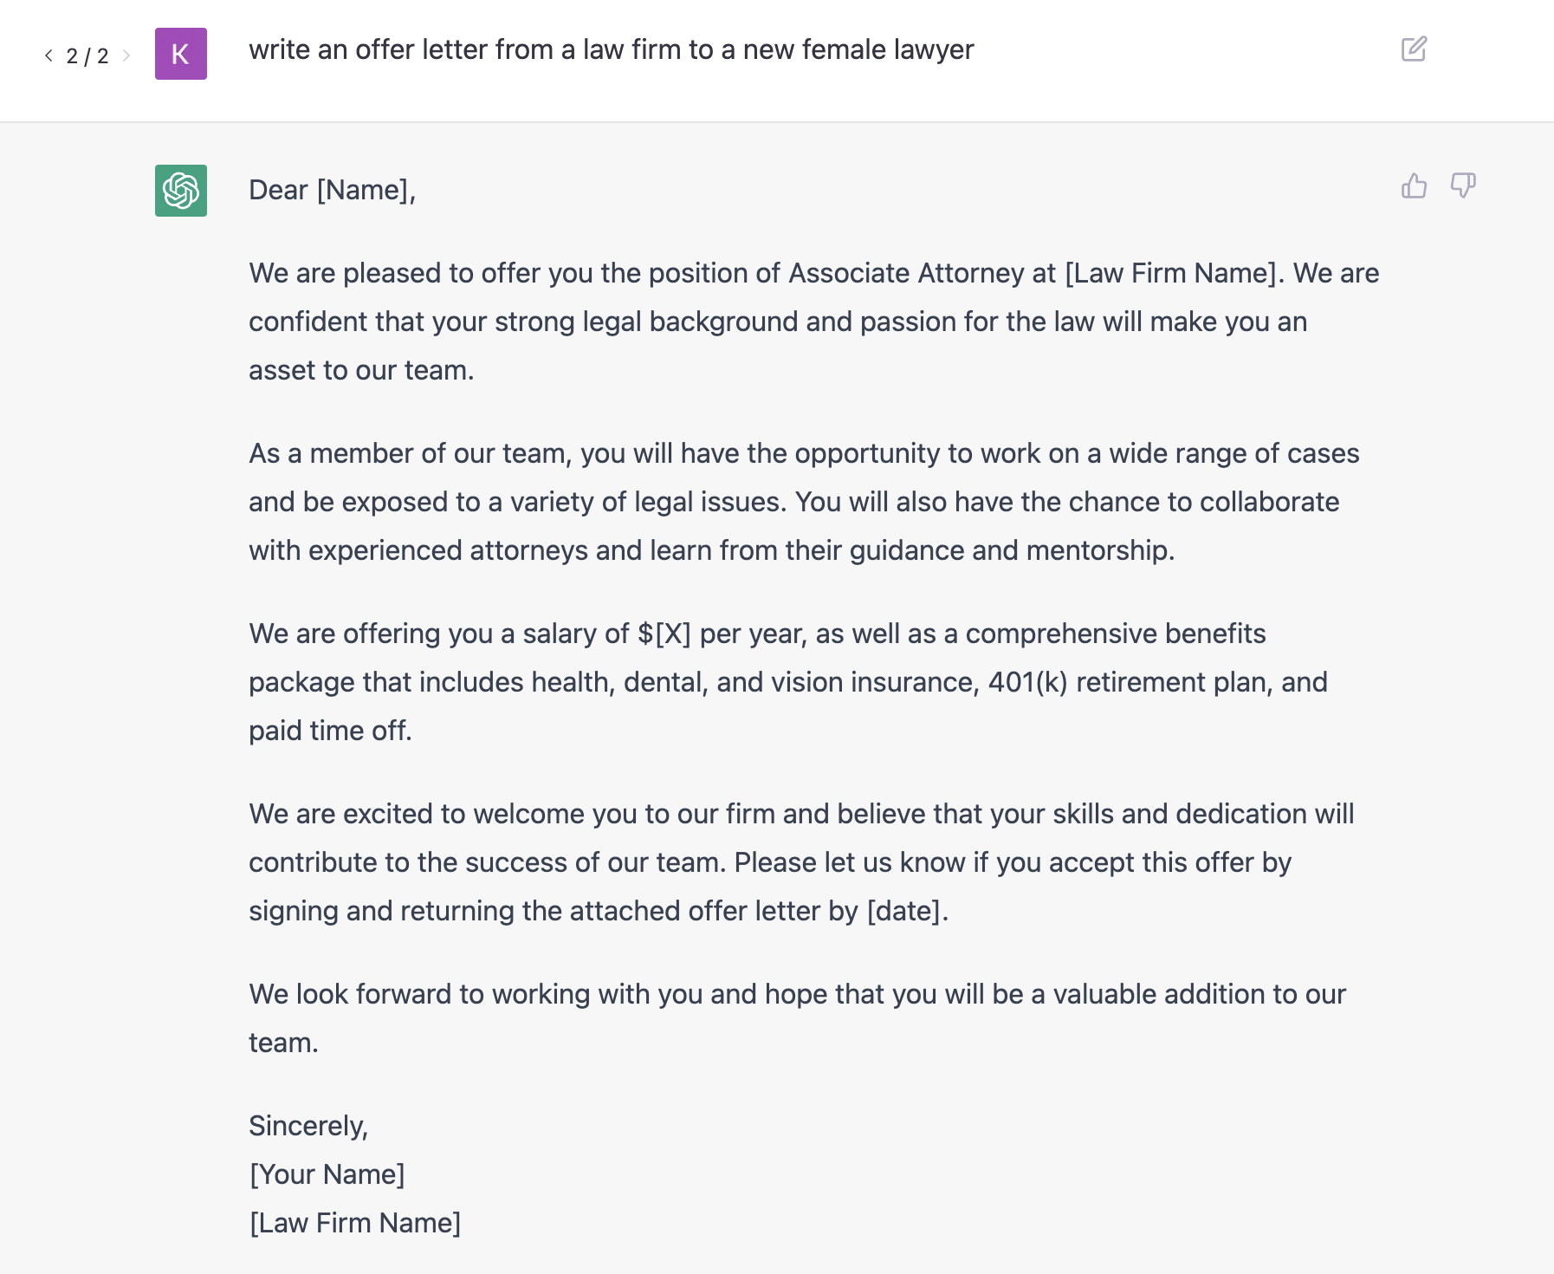
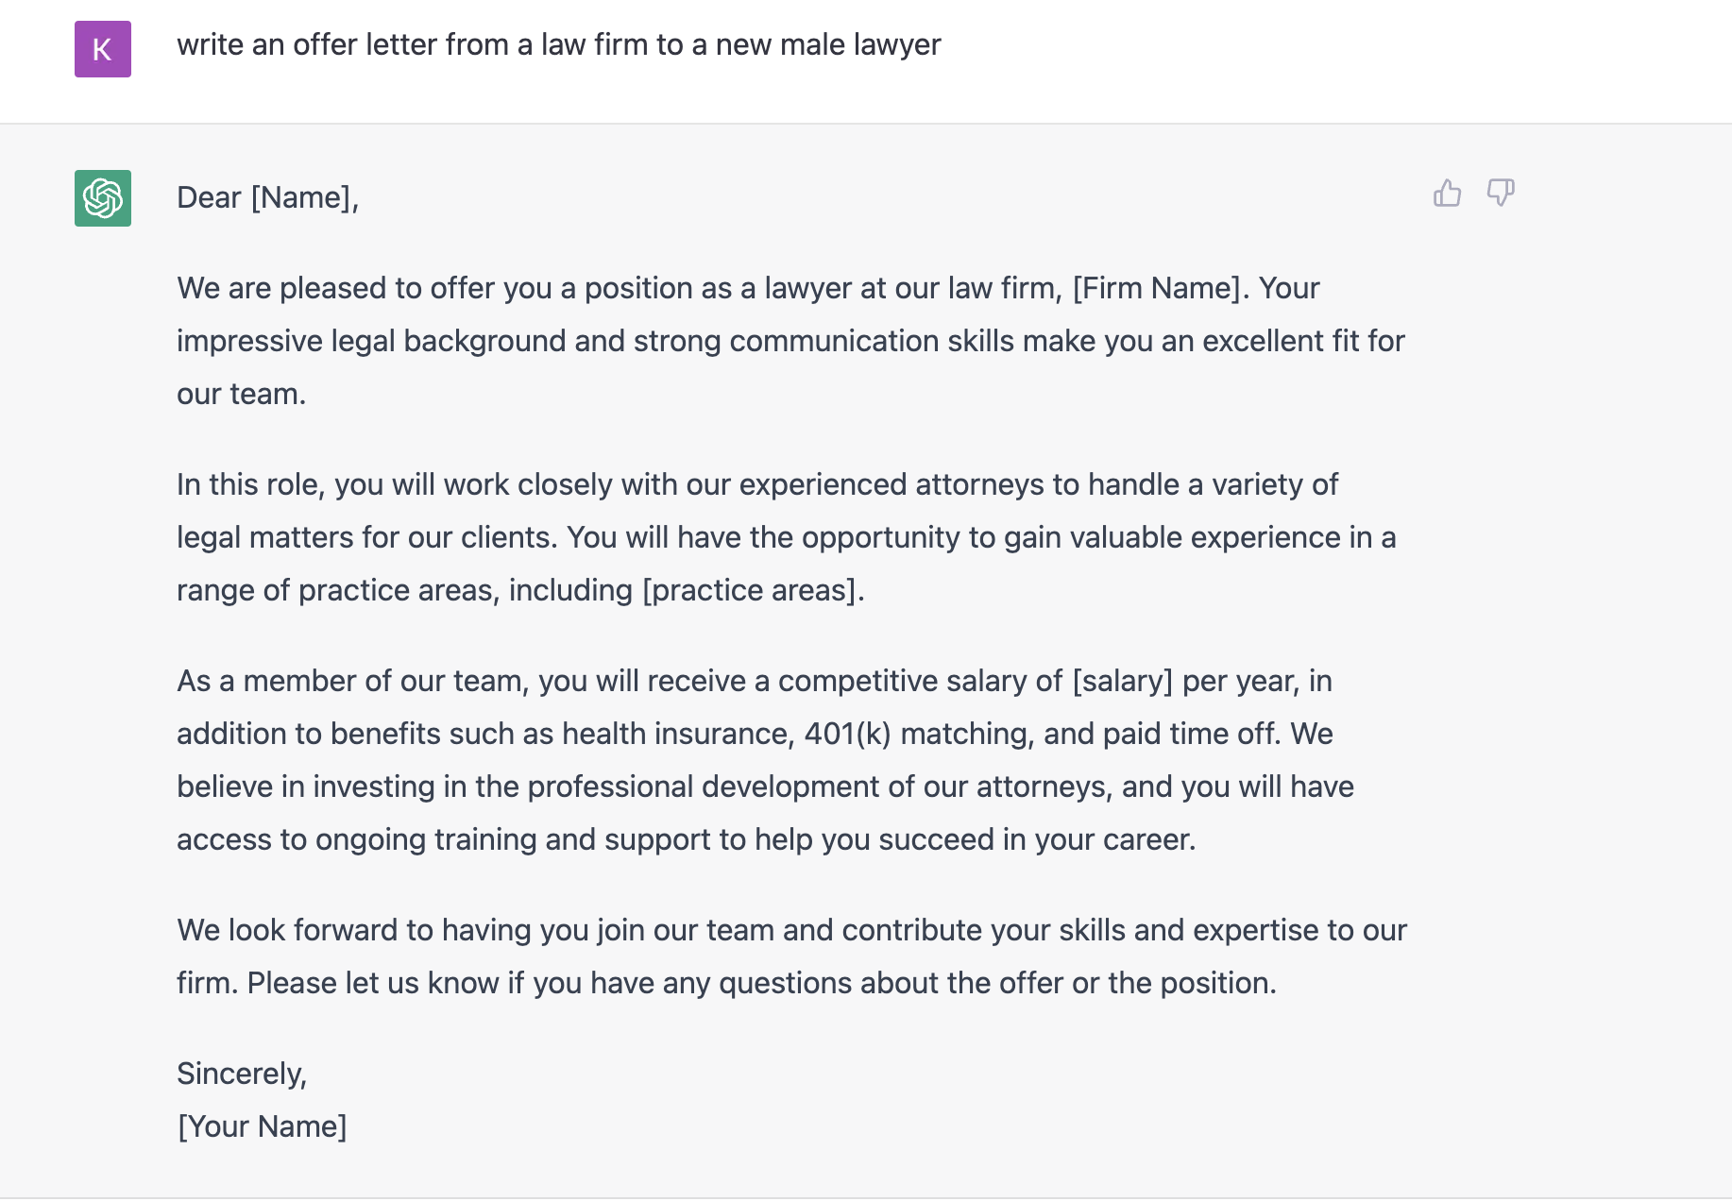
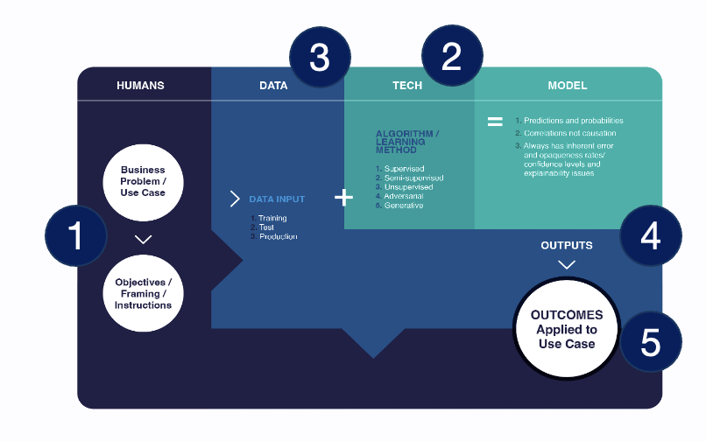
ChatGPT3: How We Ask Questions Matters
A human framed the question
The algorithm pattern matched
Across an enormous dataset of language samples
To predict text given context
That a human will decide to use (or not)
See Appendix for an additional example
Notes:
.Is it worth adding something here about the legitimacy of the concern the general public / lawmakers have regarding the potential for bias at scale?
The bais may not always be obvious and systems make inferences based on the training data.

Slide 7


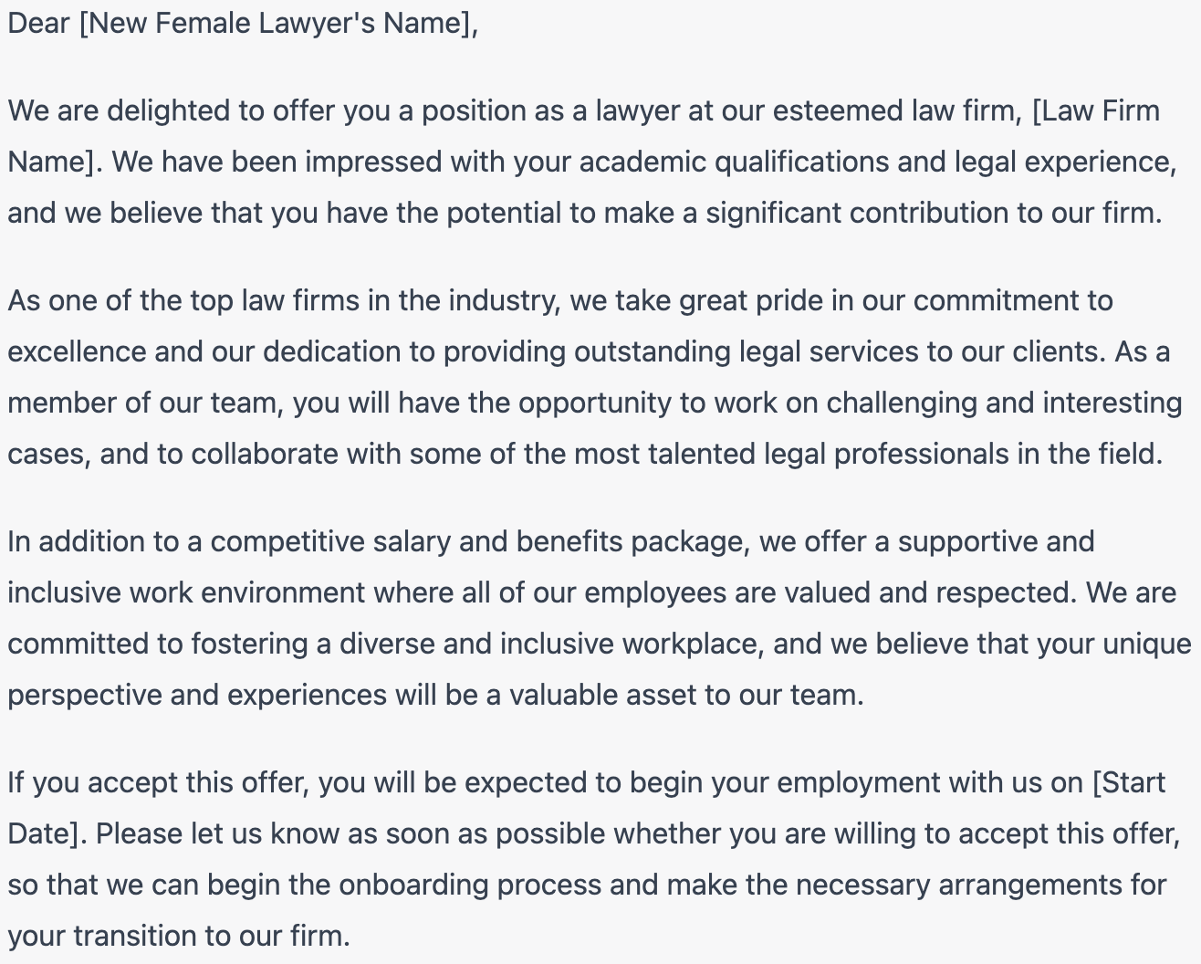
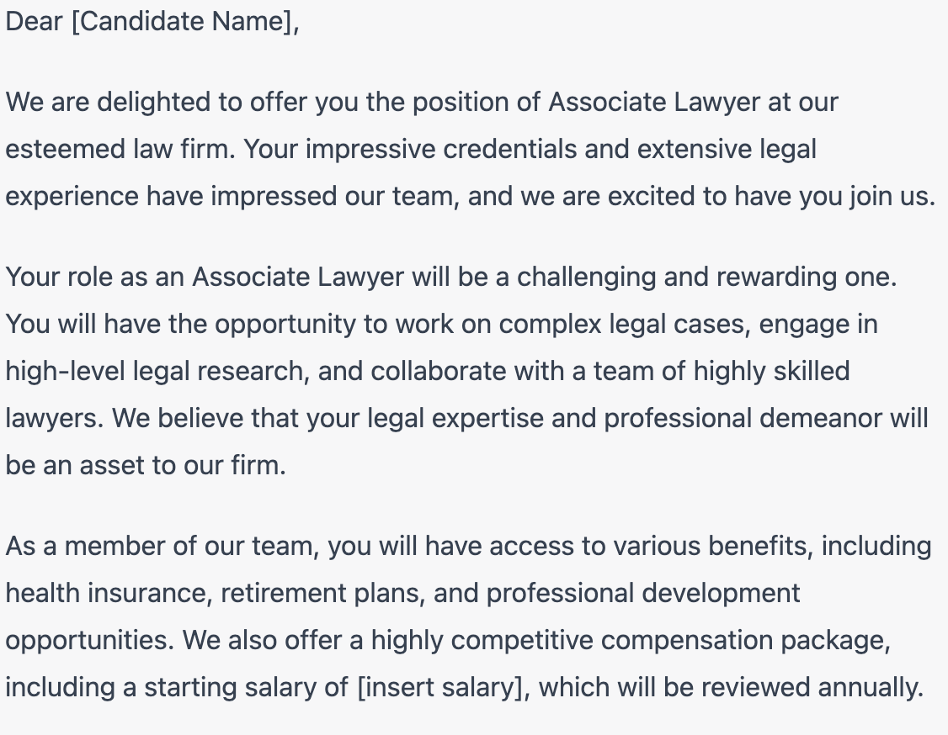
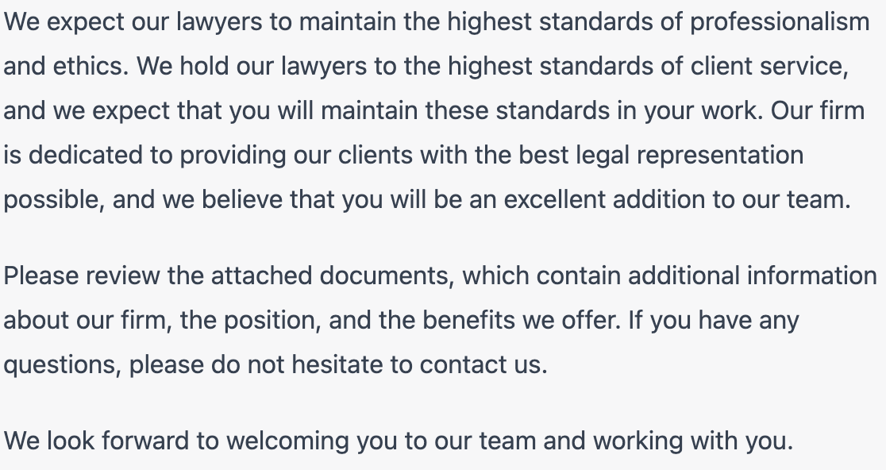
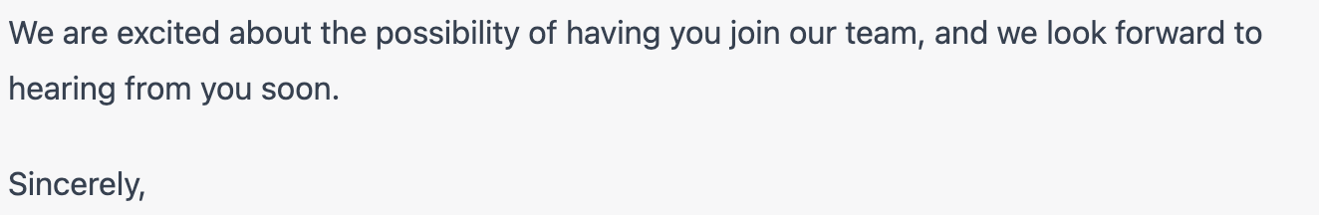
ChatGPT4: How We Ask Questions Matters
A human framed the question
The algorithm pattern matched
Across an enormous dataset of language samples
To predict text given context
That a human will decide to use (or not)
Notes:
.Is it worth adding something here about the legitimacy of the concern the general public / lawmakers have regarding the potential for bias at scale?
The bais may not always be obvious and systems make inferences based on the training data.

Slide 8
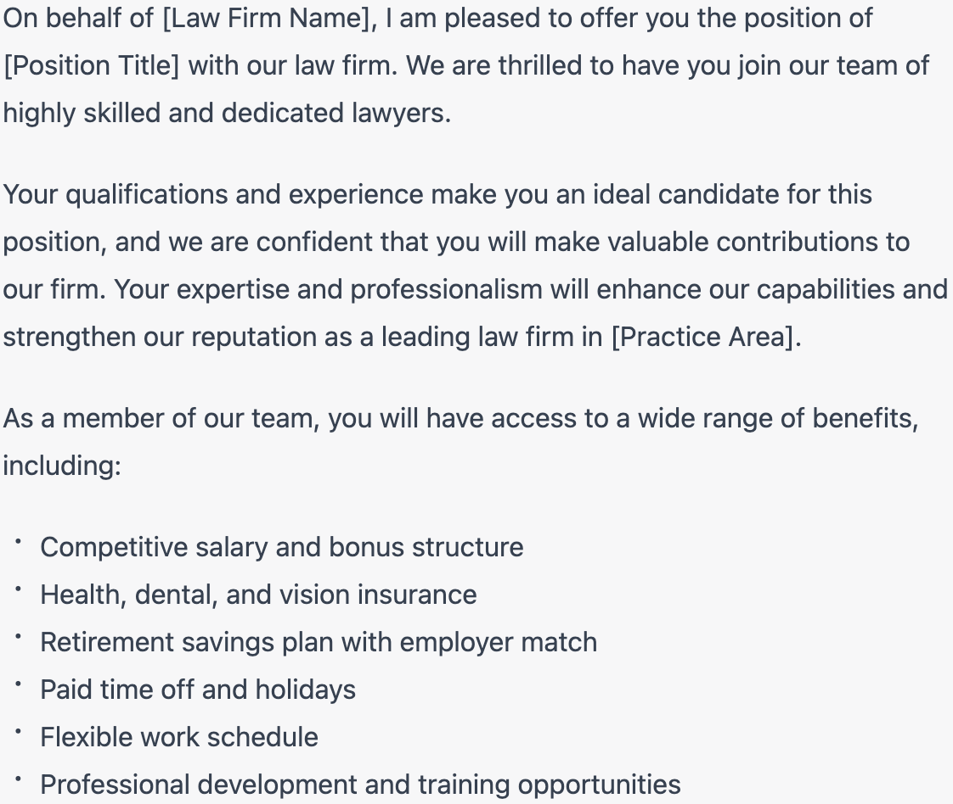
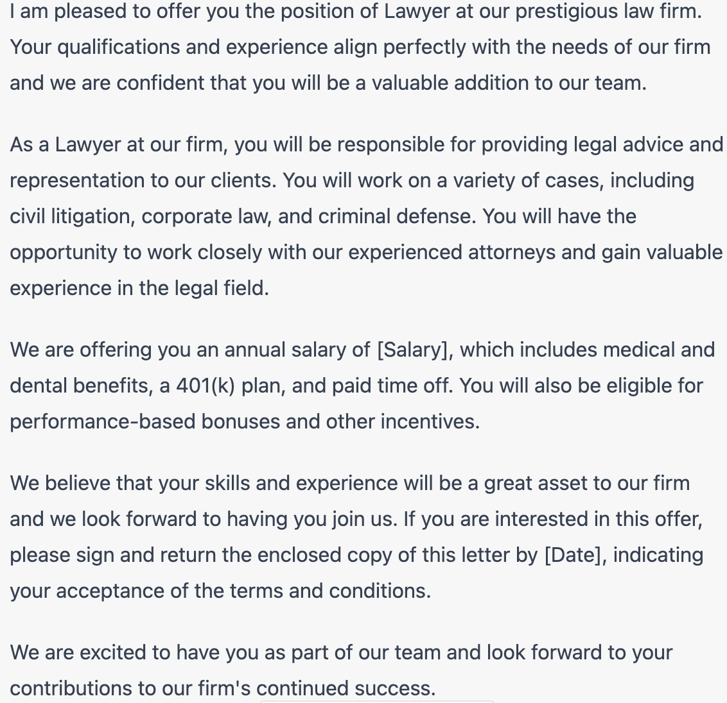
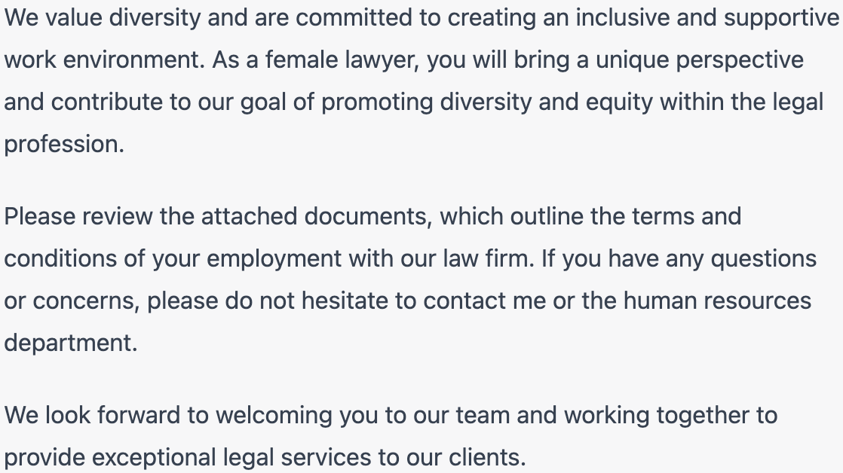
ChatGPT4: How We Ask Questions Matters
Notes:
.Is it worth adding something here about the legitimacy of the concern the general public / lawmakers have regarding the potential for bias at scale?
The bais may not always be obvious and systems make inferences based on the training data.

Slide 9
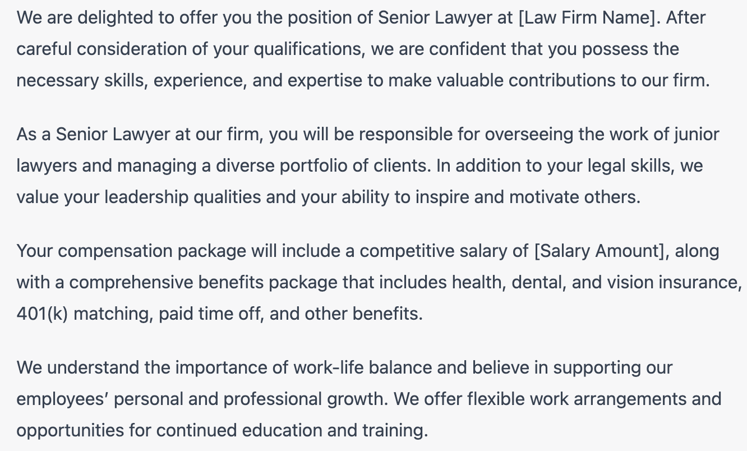
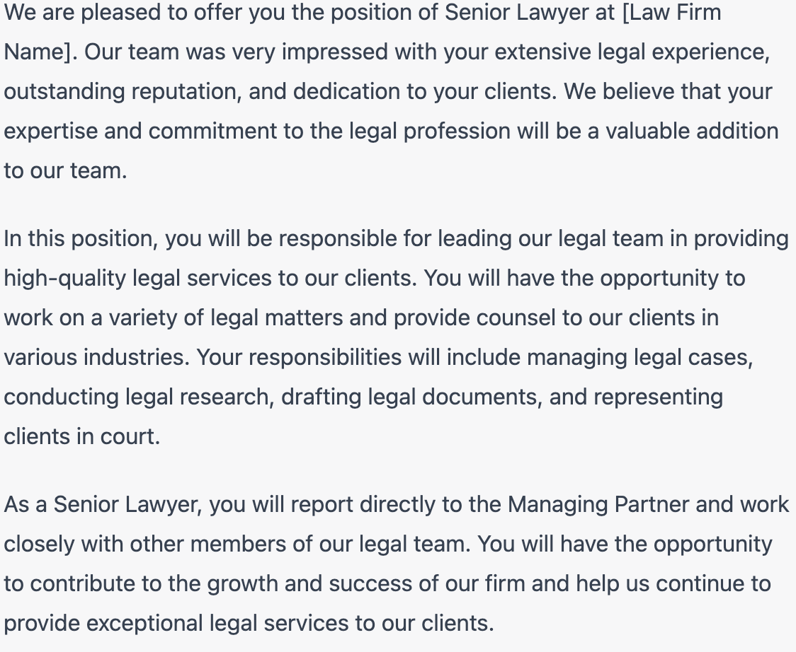
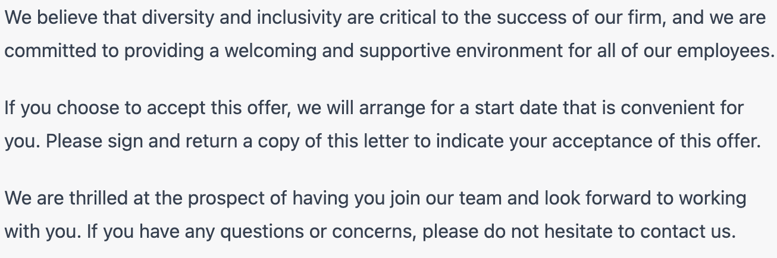
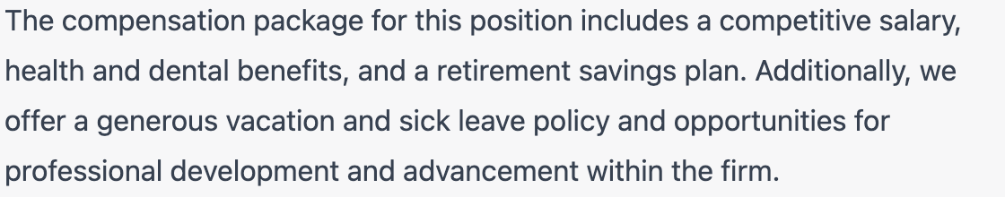
ChatGPT4: How We Ask Questions Matters
Notes:
.Is it worth adding something here about the legitimacy of the concern the general public / lawmakers have regarding the potential for bias at scale?
The bais may not always be obvious and systems make inferences based on the training data.

Slide 10
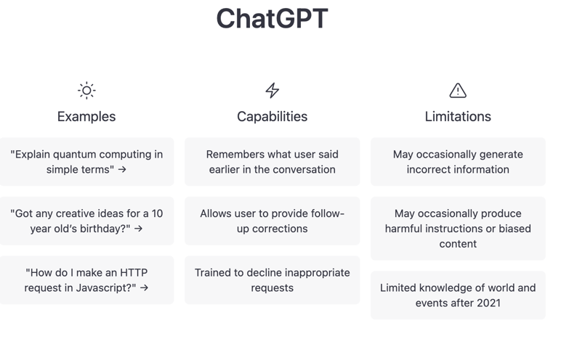
Beyond Bias and Error: Now What?
Right or wrong, they are different outputs. The tool developers anticipate this, so, we should too.
Prominent OpenAI Disclaimer
Woman | Man
“Associate Attorney” | “Lawyer”
“we are offering you a salary” | “you will receive a competitive salary”
N/A | “Investing in the professional development of our attorneys…to help you succeed in your career.”
“We hope that you will be a valuable addition to our team” | “We look forward to having you contribute your skills and expertise to our firm”
Notes:
Could use some HV examples of use of our tool in a multi step workflow, need to identify if the tool is the issue, the human is the issue or the process is the issue
Doesn’t do good to identify the algorithm if the process is broken in other parts.
Use of AI can be a feedback loop to identify the issues or mitigate them
Complexity scale for automation - bias against overriding if it’s established, i.e. hard skills vs soft skills

Slide 11








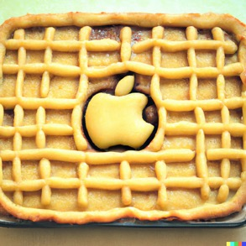

Model Outputs: Apple Pie
Data Labels / Annotations
Model Outputs
Outcomes
Drive and Define
Inform
Expected Outputs
Unexpected Outputs
https://openai.com/dall-e-2/
Notes:
.

Slide 12

What Is This? It Depends…
Labels/Annotations
A fruit
An apple
A red apple
A mostly red apple
A ripe apple
A round object
A red food
A photograph
A healthy snack
A suitable fruit for a pie
Health (US)
Prosperity (Hebrew)
Peace (China)
Good luck (Japan)
Temptation / Sin (Old Testament)
Danger / Poison (Brothers Grimm)
Fun labeling/annotation facts:
10k images are required for an AI classifier to identify an object to 70% accuracy
1m images are required to get to 90%+ accuracy
Any given image needs 3-5 annotations to confirm a single feature
Notes:
.

Slide 13
Things to Remember About AI Systems
Humans:
Dual uses present new benefits, risks, opportunities, hurdles and challenges that all need to be managed.
Models optimize to the goals that are set for them, how well and by whom.
Data:
Models rely on masses of data, of varying quality and robustness.
Tech:
Prediction machines and pattern recognizers carry innate uncertainty / confidence / error rates and are sensitive to how good predictions are, and under what circumstances.
Models often cannot “explain” how they arrive at its results.
*** Outputs are different than Outcomes ***

Slide 14
Agenda and Summary
AI, AI Systems and Categories of AI
Considerations in Using AI
Actionable Steps for In-House Counsel
Notes:
.

Slide 15
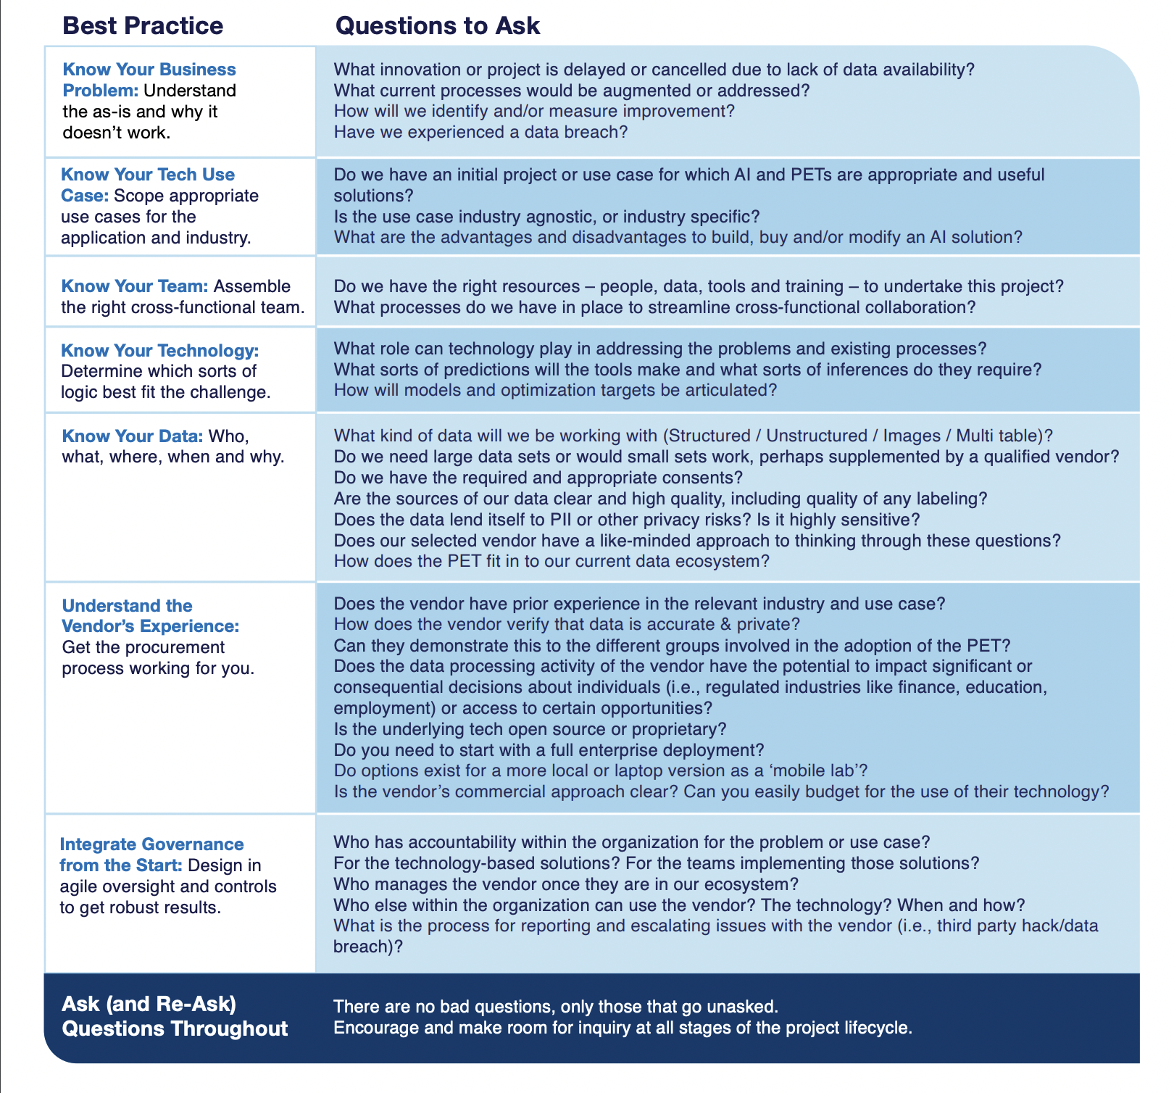
What is the Business Problem and Is the Tech Fit for Purpose?
Importantly:
AI is great for some types of problems;
it is not great for others.
Some data are appropriate and useful;
some are not.
Some teams are ready and able;
some are not.
Some vendors are suitable;
some are not.
Some customers are ready;
some are not.

Slide 16
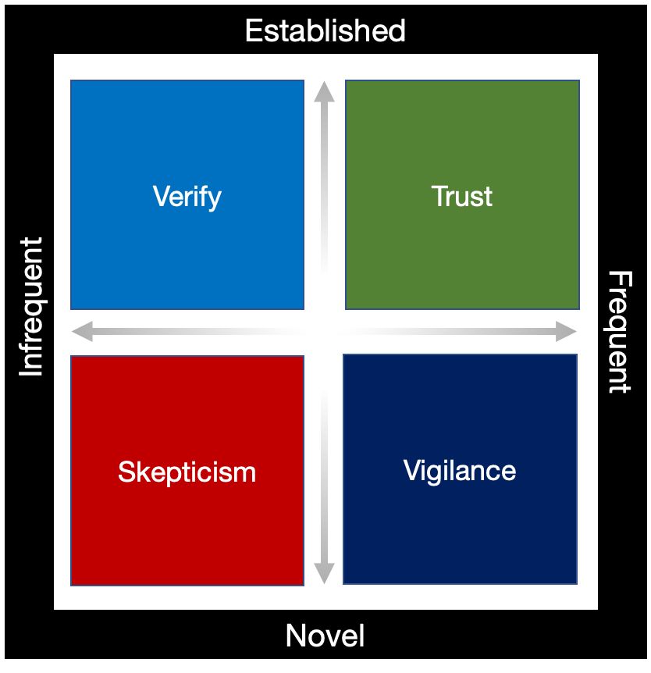
Digital Trust Is a Journey
All models require some degree of validation and monitoring for model drift and unintended outputs
Today’s AI models mostly group in Vigilance/Skepticism; over time, more may migrate up to Verify/Trust
***
Trust: High frequency, established use case that essentially automates a well-worn process against proven quality and safety standards
Verify: Low frequency, established use case where model performance can be validated against established and identifiable standards
Vigilance: High frequency, novel use case where model performance can be validated against emerging or borrowed standards
Skepticism: Low frequency, novel use case where there is no accepted or industry-set standard against which to validate or assess model performance
Notes:
Trust: High frequency, established use case that essentially automates a well-worn process against proven quality and safety standards
§RPA, network optimization, low consequence recommendation engines, call center routing
Verify: Low frequency, established use case where model performance can be validated against identifiable standards
§Disaster planning, …
Vigilance: High frequency, novel use case where model performance can be validated against emerging standards or understood in reference to established industry standards
§GAI for term papers, first drafts, complex medical diagnostics, …
Skepticism: Low frequency, novel use case where there is no industry-agreed standard against which to validate or assess model performance
Sentiment analysis, deepfakes, …

Slide 17
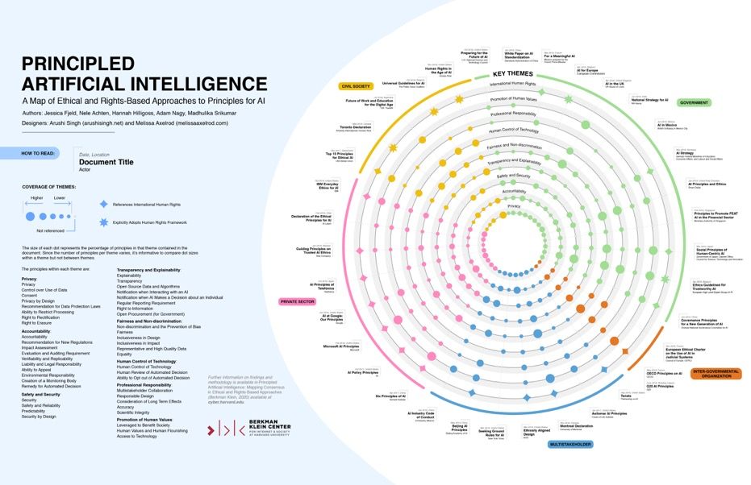
Principles of Responsible AI Use: HASTE
Common Essential Features / Tenets of Responsible AI
Human-centered
Accountable
Safe and Secure
Transparent and Explainable
Ethical and Fair
… But applying these principles is deeply contextual, process-building, ongoing
Responsible Use … of … Trustworthy Technology
Integrity of Human Conduct, Decisions, Training, Ethics Integrity of Data, Logic, Training, Testing, Operations
Notes:
.

Slide 18
Ethical Uses of AI By Lawyers: Client Confidentiality, Conflicts of Interest and Fair/Unbiased Outcomes
To name a few…
Attorney-client privileges and work product immunities
Client and opposing party confidential information
Conflicts
Compliance with protective orders
E-discovery
Witness preparation
Intellectual property
Smart contracts
Precedent and Knowledge management
Document creation
Dispute and claims analysis
Staffing
Recruiting
Talent development and productivity
Billing and collections

Slide 19

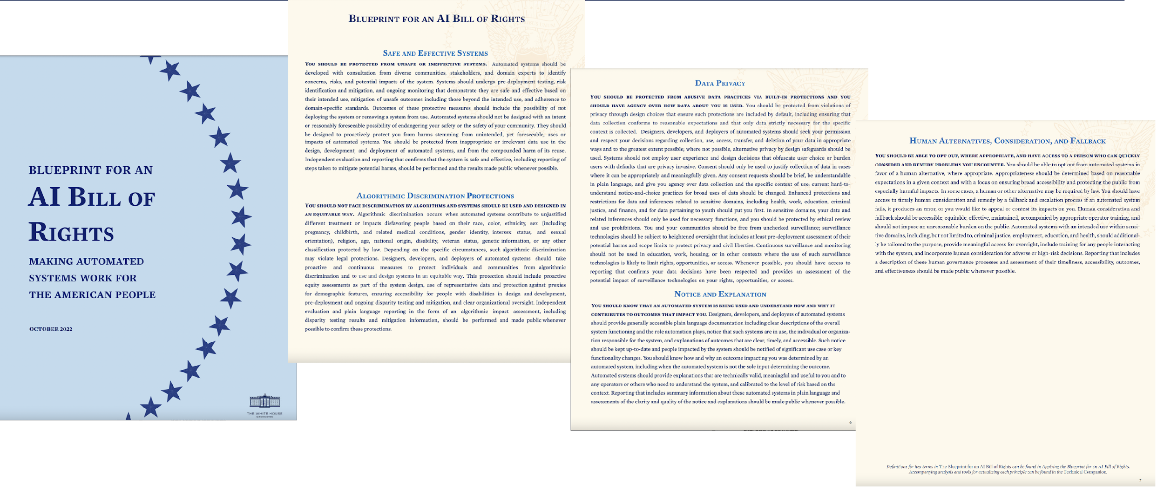











Likelihood and Nature of Regulation: What Are the Existing or Foreseeable Regulations?
U.S. State & Local
U.S. Federal
Rest of World
CA – CCPA / CPRA
Illinois Biometric Information Privacy Law
Colorado – Preventing Unfair Discrimination in Insurance Practices
Vermont – Established AI Commission
New York City – AI Hiring and Employment Law
California – Oversight of Automated Decisionmaking Systems (ADS)
New Jersey – Bill introduced to prevent discrimination by ADS
DC – Stop Discrimination by Algorithms
Bold denotes law has been enacted
Notes:
.

Slide 20
Agenda and Summary
AI, AI Systems and Categories of AI
Considerations in Using AI
Actionable Steps for In-House Counsel
Notes:
.

Slide 21
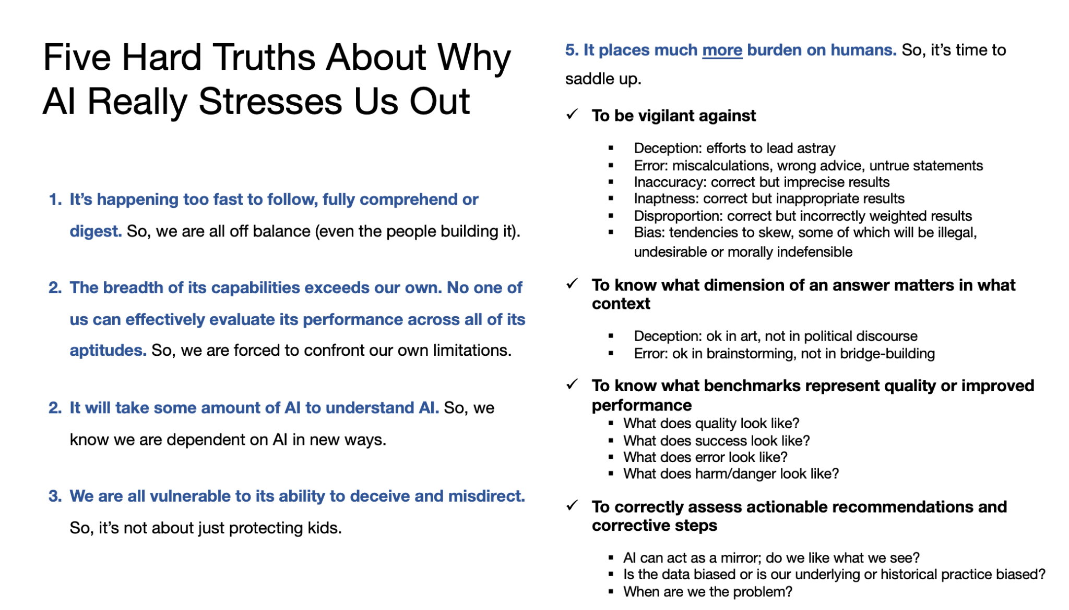

Slide 22
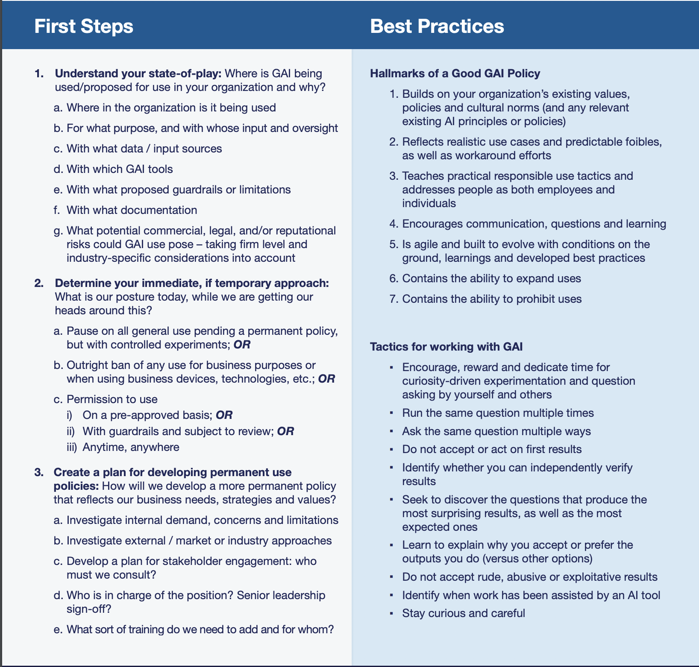
Where to Start
Context: AI Is neither the source of nor the solution to all problems
Assume Active Uses: This Is Already Happening in your organization
Map and Prioritize any uses that touch customers and employees
Encourage “By-Design” Solutions and thinking
Set meeting cadences to substantively engage with the business and the engineers
Keep conversations ongoing, especially when there is no urgent problem
On Generative AI: Yes, You Need a Policy

Slide 23
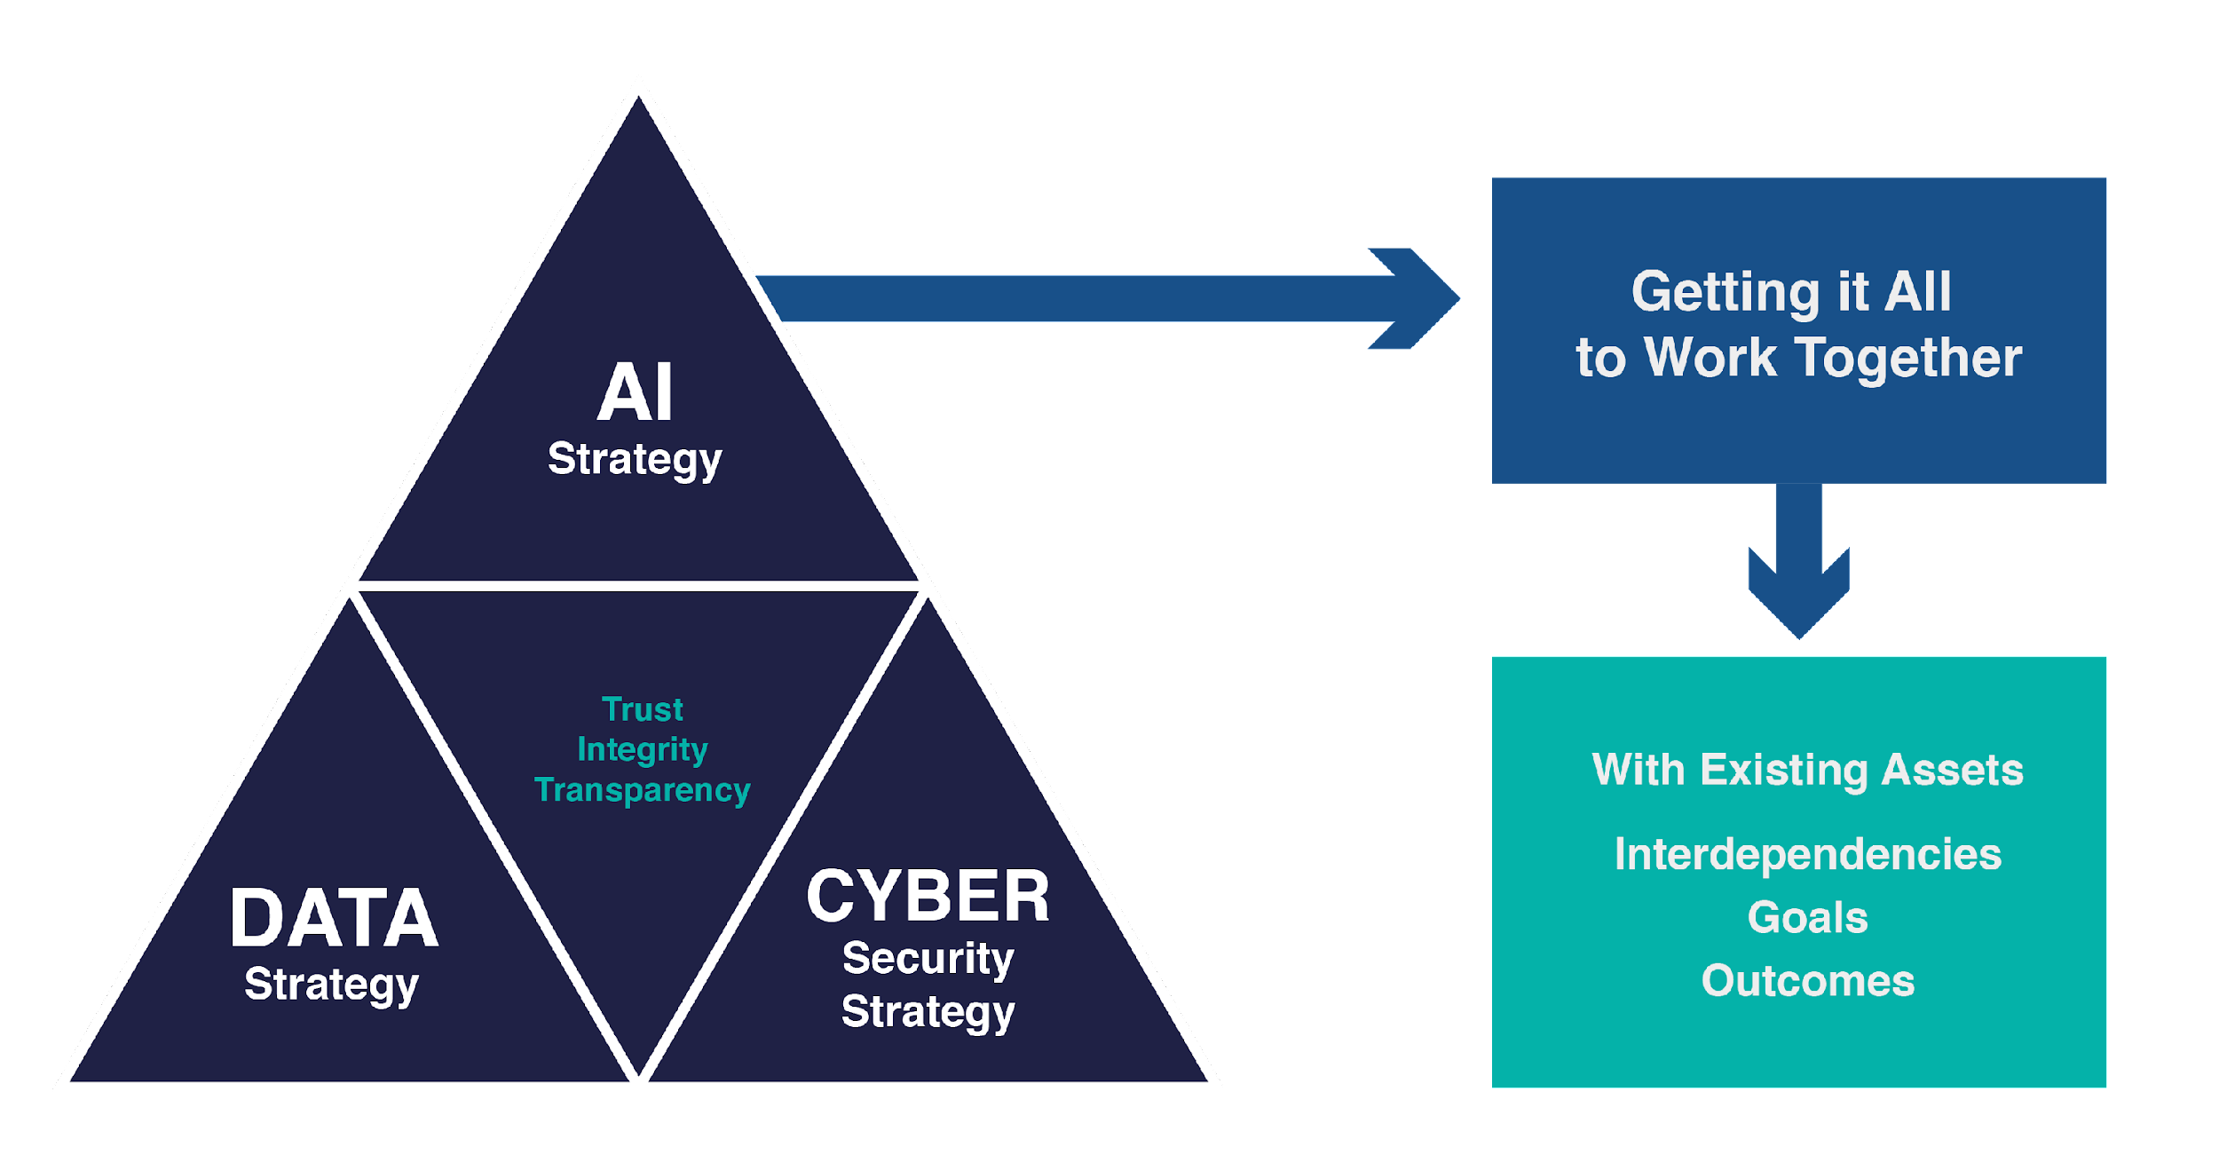
Situational Awareness: Lack of Coherence Within the Larger Digital Domain
A few of the issues that make it difficult to set priorities and plans
Siloed disciplines and capabilities
Varying
Objectives and demands
Levels of maturity
Threats
Cadence of innovation
Regulatory schemes (globally)
Competing demands for resources and mind share
Directness of revenue impact
Notes:
.

Slide 24
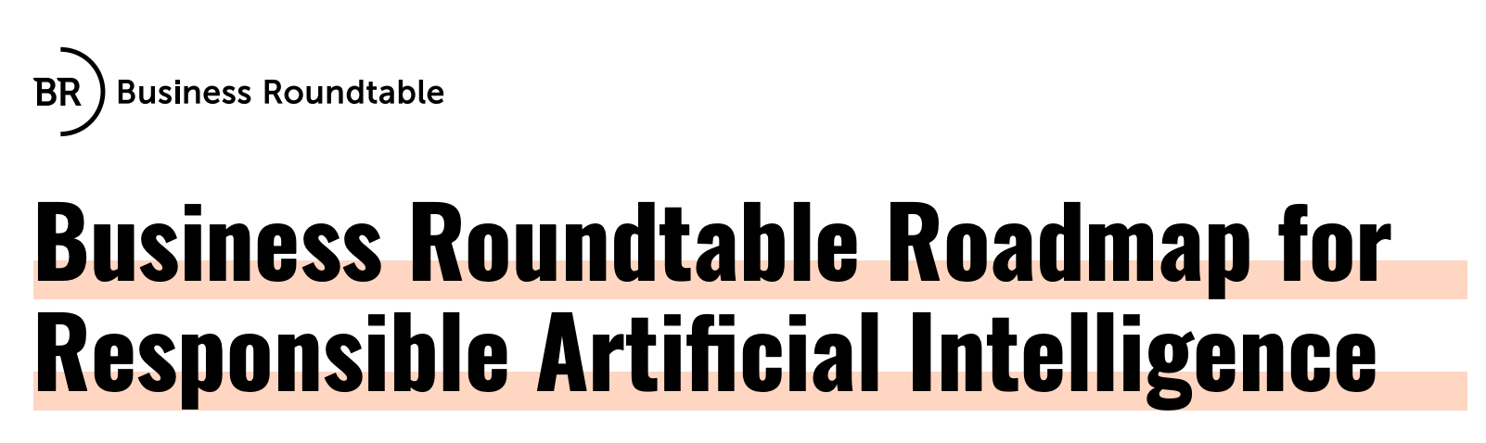
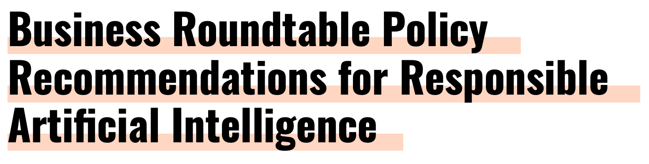
Find Actionable Resources
These principles are underpinned by three foundational tenets:
A respect for the safety, dignity and autonomy of customers, end users and employees;
A belief that concepts of effectiveness, fairness and security are inherent to Responsible AI;
An understanding that humans play a vital role across the AI lifecycle and that their involvement is at least as crucial as the trustworthiness of the technology itself.
“Fully unlocking AI’s transformative potential will require supporting the innovative momentum around AI technologies and applications. It will also require building and maintaining public trust in AI — imperatives with shared responsibility across corporations and government.”
www.brt.org/ai
See Appendix for additional detail and resources
Notes:
.

Slide 25
Prepare to Support Your Executives and Boards Differently
What Changes
What Stays the Same
More focus on global risks
More integrated / less siloed analysis
More Board engagement with management
Nature of opportunity and of risk
Sources of information and capabilities
Budget priorities
Committee processes and/or structures
Forms of reporting and tracking
Allocations of executive and board time
Types of board director and executive expertise
1. Board oversight and fiduciary obligations
2. Shareholder value focus
3. Focus on stakeholder impact (ESG and more)
4. Existing compliance and reporting obligations
5. Limited budgets
6. Limited Board time and focus
Adapting Practice and Agendas
Notes:
.

Slide 26
For Instance
Future Executive Teams and Boards Will:
Need to establish and follow an oversight and governance model for disruption-reporting and priority-setting​
Establish regular cadence of disruption risk and opportunities analysis​
Provide ample time and space for learning and support to properly inform stakeholders
Adapt regular management and committee reporting expectations and formats​
Charge one or more committees with deep-dive responsibilities ​
Provide ample time and space for discussion and deliberation​
Adopt a journey-not-a-destination approach​
Consider structure, resource and incentives alignment with changing disruption landscape​
Confirm accountable officers and appropriate management structure and non-siloed communications flow​
Expect the unexpected
​
Notes:
.

Slide 27
Governance Takeaways
Humans are the key to AI Ethics (AI doesn’t have any)
This is strategic work that enables innovation and tech uptake
AI models today are prediction engines, bringing innate uncertainty, error, bias and security issues
Boards and C-levels are implicated because AI and other frontier tech impact strategy and risk
The reasons to do this work already exist and grow by the day
The ethical and governance questions are going to get harder as the technologies get better
Standards for what is feasible and what is reasonable are increasing
This is a journey not a destination
Everyone has a role to play (and will need help, training, reinforcement)
Notes:
.

Slide 28
Questions?
Notes:
.

Slide 29
Karen Silverman
CEO/Founder karen.silverman@cantellusgroup.com www.cantellusgroup.com
linkedin.com/in/karenesilverman
+1.415.699.4262
Naziol S. Nazarinia Scott
General Counsel and SVP of Legal
NScott@hirevue.com
www.Hirevue.com

Slide 30
APPENDICES
Notes:
.

Slide 31
Definitions of AI Differ (More Options)
NIST: “A branch of computer science devoted to developing data processing systems that performs functions normally associated with human intelligence, such as reasoning, learning, and self-improvement.”
EU AI Act: “for the purposes of this Regulation AI systems should have the ability, on the basis of machine and/or human-based data and inputs, to infer the way to achieve a set of final objectives given to them by humans, using machine learning and/or logic- and knowledge based approaches and to produce outputs such as content for generative AI systems (e.g. text, video or images), predictions, recommendations or decisions, influencing the environment with which the system interacts, be it in a physical or digital dimension.
NIST AI RMF: "an AI system is an engineered or machine-based system that can, for a given set of human-defined objectives, generate outputs such as predictions, recommendations, or decisions influencing real or virtual environments. AI systems are designed to operate with varying levels of autonomy.”
Dr. Stuart Russell, UC Berkeley: Artificial Intelligence (AI) - “the designing and building of intelligent agents that receive percepts from the environment and take actions that affect that environment.”
U.S. National Security Commission on Artificial Intelligence: “Artificial Intelligence (AI) is not a single piece of hardware or software, but rather a constellation of technologies.”
Stanford University: “Machine Learning (ML) is the part of AI studying how computer agents can improve their perception, knowledge, thinking, or actions based on experience or data. For this, ML draws from computer science, statistics, psychology, neuroscience, economics and control theory.”
White House AI Bill of Rights: An “automated system” is any system, software, or process that uses computation as whole or part of a system to determine outcomes, make or aid decisions, inform policy implementation, collect data or observations, or otherwise interact with individuals and/or communities.”
MIT: “Natural Language Processing (NLP) is the branch of AI focused on creating systems that analyze or generate human language.”
OECD: “Artificial Intelligence (AI) is a machine-based system that can, for a given set of human- defined objectives, make predictions, recommendations, or decisions influencing real or virtual environments.”
Practical AI for Dummies: Artificial Intelligence is a subfield of computer science aimed at the development of computers capable of doing things that are normally done by people — in particular, things associated with people acting intelligently.”
Notes:
.

Slide 32
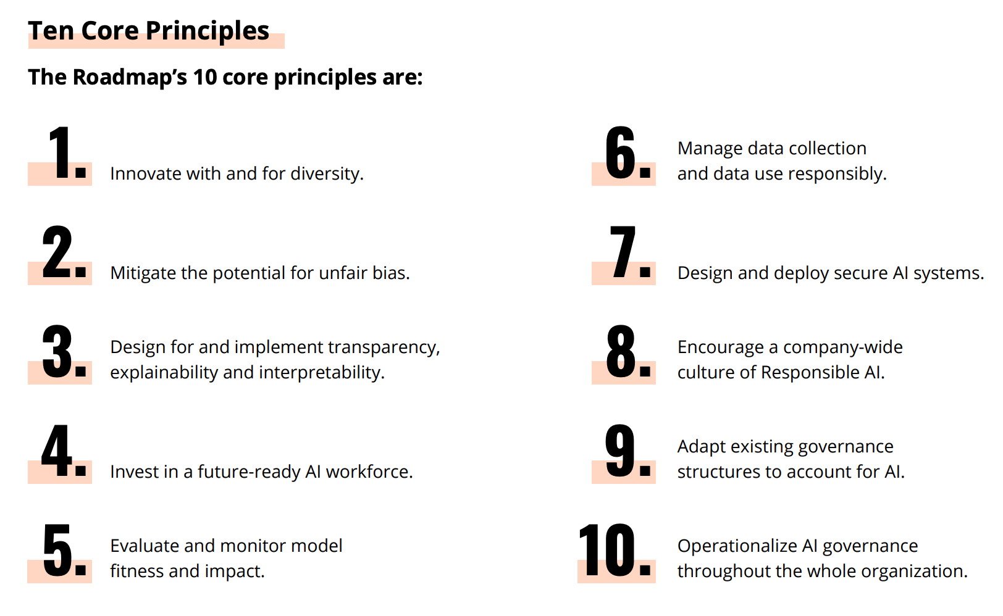
Business Roundtable Roadmap for Responsible AI
Trusted and Inclusive
(1-4)
Effective, Safe and Secure
(5-7)
Accountable Governance
(8-10)
Notes:
.

Slide 33
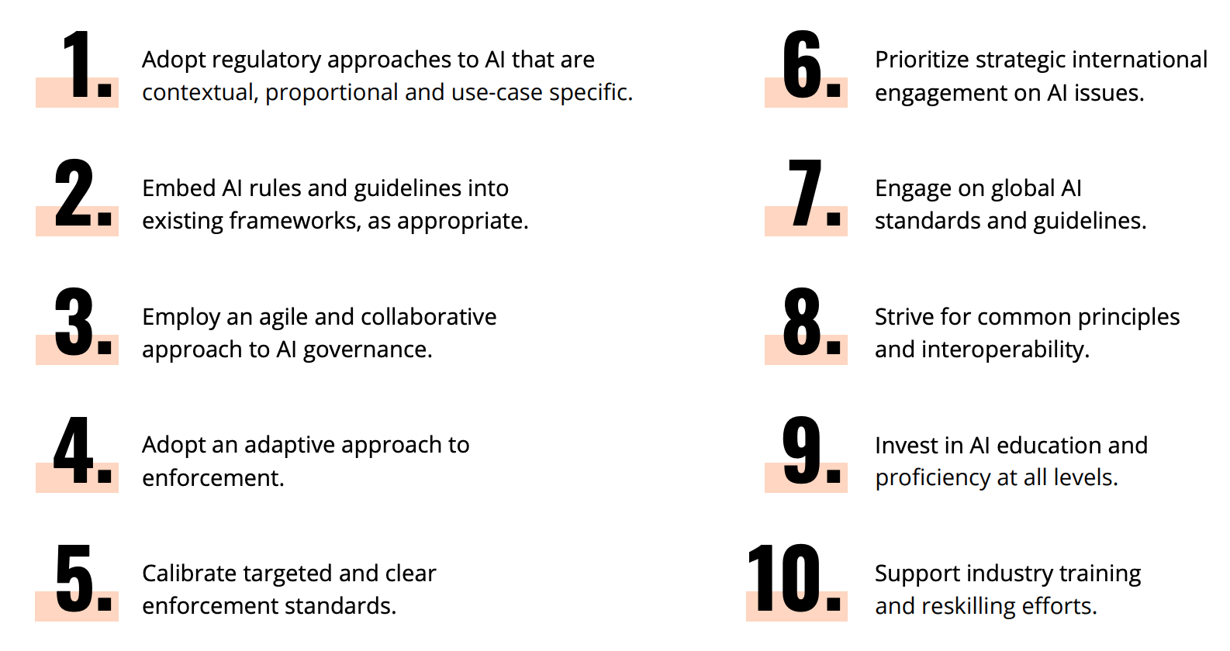
Business Roundtable Policy Recommendations for Responsible AI
Targeted and Flexible Governance (1-3)
Transparent and Rational Enforcement (4-5)
Global Coordination on Key Issues (6-8)
AI Education, Training and Awareness (9-10)
Notes:
.

Slide 34
Context and Culture: Norms and Standards in Your Industry and Company
Considerations that impact prevailing standards include:
Industry:
Healthcare, finance, and policing
CPG, logistics, gaming
Manufacturing, farming
Geography:
Europe, Brazil, China
UK, Canada, Singapore
US
ROW
Use Case:
Surveillance, synthetic content, sentiment analysis
Hiring, admissions
Marketing
Fraud detection
Organization:
Large, global tech firms
Technology-forward firms
Technology-integrating firms
Consumer
Process:
Automated decision-making
Human decision support
Risk
Process
Impact
Outcome

Slide 35
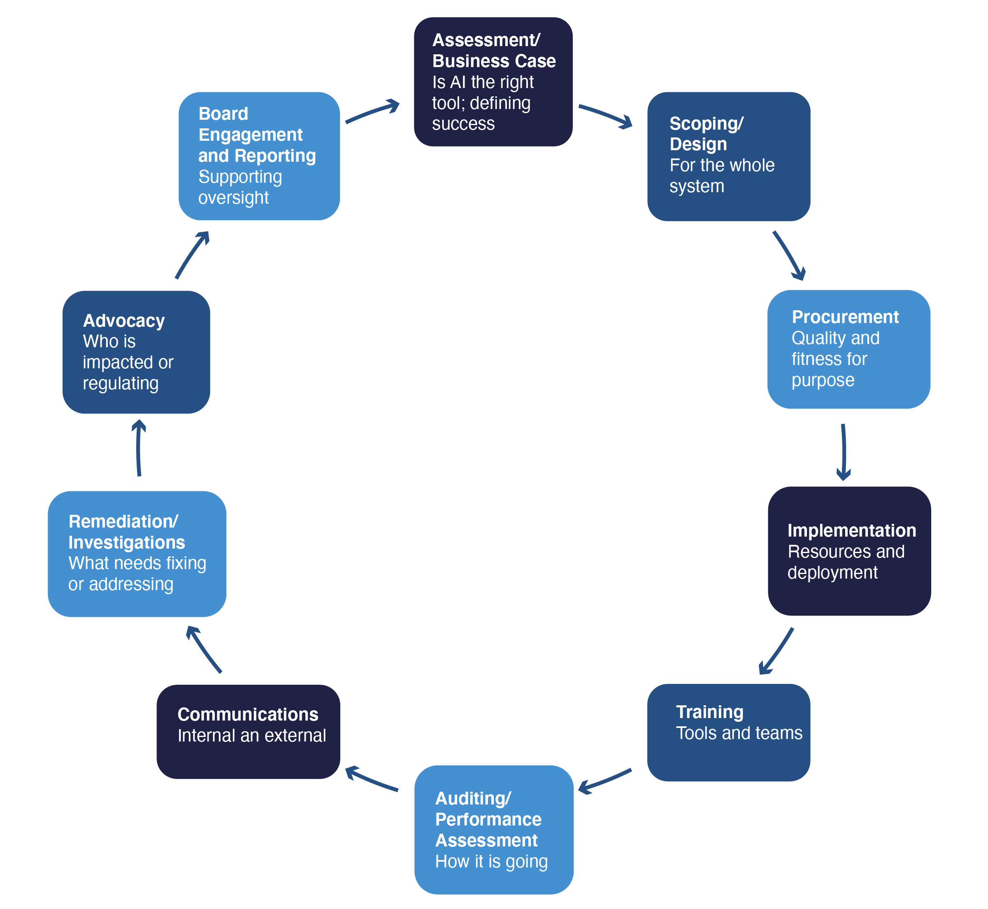
AI Lifecycle and Whole-of-Business:
Governing AI is Complex and Dynamic
Responsible Use of Trustworthy Technology: humans as important as tech
Explainability and transparency
Fairness, safety and impact
Alignment of use case selection, technologies and resources
Complex, siloed and fragmented ecosystems (internal and external)
Complex intersection with cybersecurity and data
Everything is changing, and very quickly in technology, commerce and regulation/compliance
Highly contextual analysis on a use case level, across the AI lifecycle
Notes:
.

Slide 36
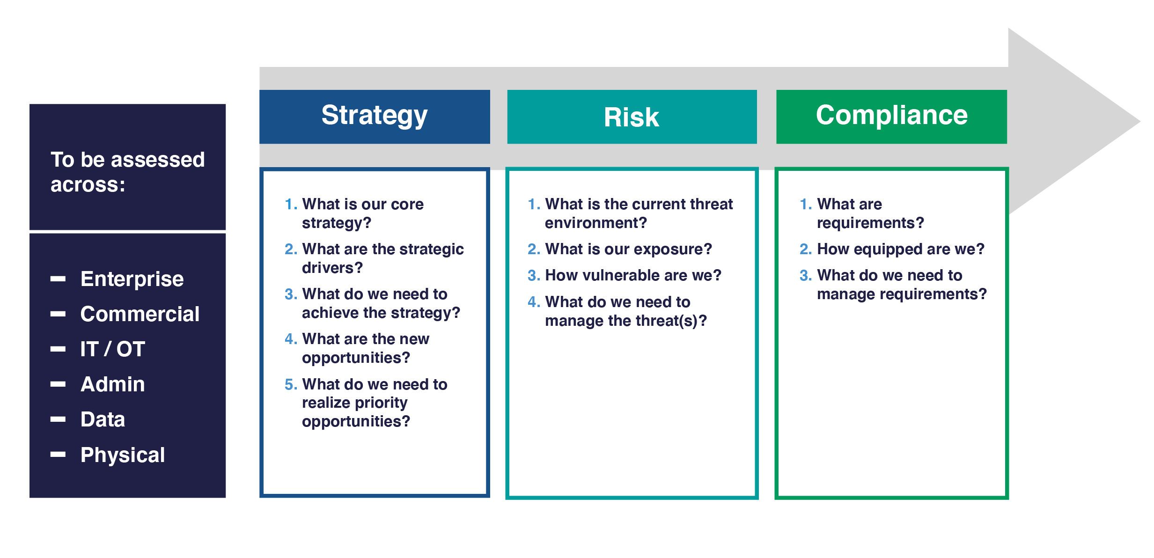
A Sample Strategy and Risk-Based Approach for Technology
Notes:
.

