Slide 1


sons
Luke Tapp, Partner & Head of Middle East Employment
Emma Davies, Chief People and Culture Officer, Masafi
Liz Williamson, Senior Legal Counsel, Accenture
Philipp von Zitzewitz, Managing Director, Sesam Immigration
UAE LABOUR LAW AND
HR PRACTICE IN 2022

Slide 2


Introducing ACC MENA

Slide 3
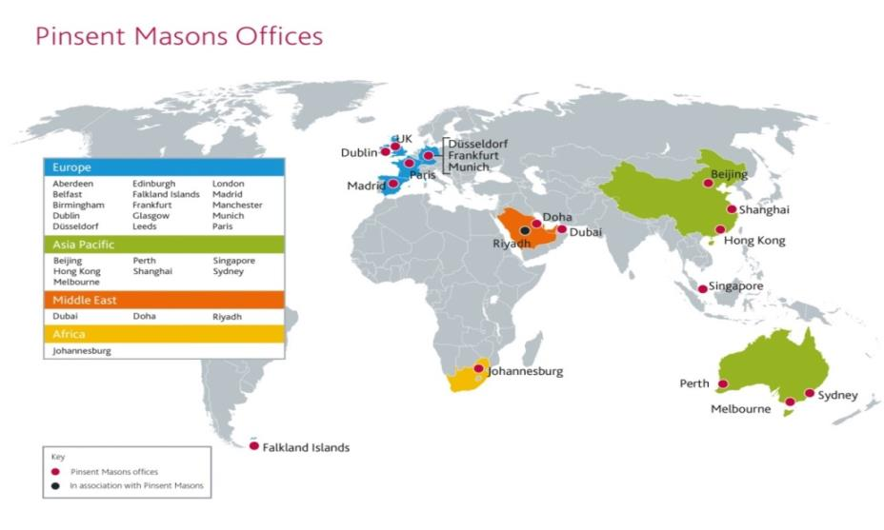
Introducing Pinsent Masons sons

Slide 4



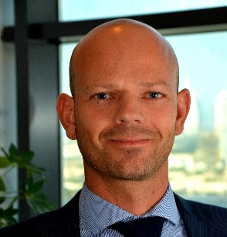
Introducing Our Panel
Luke Tapp
Partner & Head of the Middle East Employment Practice
E: luke.tapp@pinsentmasons.com
Liz Williamson
Senior Legal Counsel
Accenture
ACC MENA Board Director
Emma Davies
Chief People and Culture Officer
Masafi
Philipp von Zitzewitz
Managing Director
Sesam Immigration

Slide 5
Agenda
HIRING IN THE UAE
FLEXIBLE RESOURCING OPTIONS
EMIRATISATION
THE GREAT RESIGNATION

Slide 6
Hiring in the UAE
Job advertisements:
  Be aware of anti-discrimination provisions
  Ensure job description is accurate
Offer letter:
  Conditions of employment commencing

Slide 7
Hiring in the UAE
Employment Contract
  Probationary period
  Continuous service
  Post termination restrictive covenants
  IT security and access to company property
  Governing law and jurisdiction

Slide 8
Hiring in the UAE
New UAE Labour Law requirements:
  All contracts for up to a fixed period of 3-years
  Can be renewed or extended
  Continuity of service
  One year transitional period i.e. 1 February 2023

Slide 9

Panel Discussion

Slide 10
Flexible Resourcing Options
New Labour Law introduced six work models:
Full-time: Working for one employer for a full workday.
Remote work: The scheme enables full-time and part-time employees to work completely or partially outside the office should the nature of their work allow it.
Shared job model: Splitting job responsibilities and pay among more than one employee based on an agreement with the employer. The employees’ contracts under this model are governed by part-time job regulations.
Notes:
The amended labour laws, which were first outlined by the government in November 2021, provide options that were not available before, strengthening employees' rights. Diverse work models provide flexibility that meets different needs and attracts talents from all over the world
Dr Abdulrahman Al Awar, Minister of Human Resources and Emiratisation
An example of one of the new permits includes one granted to juveniles aged between 15 and 18 to allow them to work at an establishment registered at the ministry.

Slide 11
Flexible Resourcing Options
Part-time: Working for one or more employers for a specified number of hours or days.
Temporary work: A contract for a specific period of time or for one project that ends with the job’s completion.
Flexible work: Giving employees the freedom to work at different times depending on the conditions and requirements of the job based on a contract that covers hours, days and duties required.

Slide 12

Panel Discussion

Slide 13
Emiratisation
MOHRE Resolution and the new requirements..
Apply to all employers who fall under the jurisdiction of the MoHRE
Private sector companies with 50 or more employees are required to increase their Emirati workforce in excess of their current quota through a 2% year on year increase until they reach 10% in 2026.
Number of Emiratis required will be calculated according to the overall number of skilled workers
Existing Emirati employees pre-January 2023 will be disregarded when calculating the quota
Fines for non-compliance with the quotas: AED 6,000 per month per Emirati employee falling short of the quota. This fine will be increased by AED 1,000 per month per year.
Notes:
Emiratisation was and continues to be one of the hot topics in the UAE
Recently, MoHRE issued a new Ministerial Decision issued in relation to Emiratisation in the UAE.
Another factor to consider is that within the five skillset categories (5 being the lowest) skill set category 4 is now a level which requires certification; an example of a role which falls within category 4 is security guard.
In order for Emirati nationals to be counted against the quota, employers need to ensure that they comply with all labour regulations, and that they have furnished each UAE national with a work permit and employment contract, registered them with the applicable pension authority, and paid them through the Wages Protection System.
In addition to the new Emiratisation requirements, the Ministry of Human Resources & Emiratisation has announced amended conditions for the Platinum membership of the Tawteen Partners Club. To receive the Platinum membership, employers must now increase their Emiratisation quota by at least three times the prescribed annual ratio (if the number of Emirati employees is at least 30) or participate in the Nafis programme and train at least 500 Emirati nationals per year.

Slide 14
Emiratisation - NAFIS
Nafis program was launched as part of the UAE’s ‘Projects of the 50,’ and aims to support Emirati nationals to pursue their professional careers in the private sector.
Eleven initiatives have been announced:
  Career counselling
  Apprentice program: 12 months vocational training with private sector employer + training allowance
  Recruitment portal: unified job posting platform - Emirati nationals are connected with private sector employers
Notes:
Ambitious target of creating 75,000 jobs in the private sector by 2025
The new requirement to increase Emiratisation quota by 2% annually will challenge many employers. Not only because any existing Emirati employee population will not be taken into account, but also because it remains a challenge to attract and retain Emirati talent. Companies may wish to consider introducing a variety of measures to tackle the achievement of these targets including, short term and long term incentive programmes, training schemes and international secondment initiatives
NAFIS has a number of different strands by way of support to Emirati nationals seeking either to enter the workplace or to develop their career
It is also open to private sector employers to partner with the UAE Government to facilitate employment opportunities and to increase the number of UAE nationals in their organisation.

Slide 15
Emiratisation - NAFIS
  Salary subsidies
    Emirati salary support scheme: top up payment of AED 5,000 a month for up to 5 years + a payment of AED 8,000 a month to new graduates on training programs in the first year of employment.
    Additional top up payment for certain professions (nursing, accountancy, auditors, lawyers, financial analysts, coders)
  Pension subsidy: Government will pay state pension contributions for newly employed Emiratis for the first five years if they earn less than AED 20,000 a month
Notes:
Career assistance
Career counselling: Emirati nationals will be given career advice and coaching in order to enable them to direct their careers.
Apprentice program: This consists of twelve months vocational training with a private sector employer whereby the individual will receive a training allowance (and this also assists the employer to provide these programs).
Healthcare professionals: This program aims to develop 100,000 Emirati healthcare workers in the next five years.
Recruitment portal: This initiative consists of a unified job posting platform whereby Emirati nationals are connected with private sector employers who have signed agreements with Nafis to take part in their various initiatives.
Salary subsidies
Emirati salary support scheme: This initiative has two main provisions: a) a top up payment of AED 5,000 a month for those already in employment (potentially payable for a total period of five years); or b) a payment of AED 8,000 a month to new graduates on training programs in the first year of employment.
Merit program: This initiative is open to specific professions being nursing, accountancy, financial auditors, lawyers, financial analysts and coders) with a top up payment per month linked to individual earnings as follows (up to max earnings of 50k)

Slide 16

Panel Discussion

Slide 17
The Great Resignation
Ways in which clients are engaging employees:
  Agile working arrangements
  Enhanced statutory benefits
  Career progression
  Values and culture
  Mindful business charter
  Employee empowerment
  Long term incentive plans

Slide 18
The Great Resignation
Managing exits under the new Labour Law:
  Probationary period resignations
  Notice periods
  Garden leave
  Restrictive covenants:
    Non compete
    Non poach
    Non solicitation

Slide 19

Panel Discussion

Slide 20

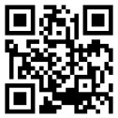
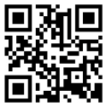
Pinsent Masons LLP is a limited liability partnership registered in England & Wales (registered number: OC333653) authorised and regulated by the Solicitors Regulation Authority, and by the appropriate regulatory body in the other jurisdictions in which it operates. The word 'partner', used in relation to the LLP, refers to a member of the LLP or an employee or consultant of the LLP or any affiliated firm of equivalent standing. A list of the members of the LLP, and of those non-members who are designated as partners, is displayed at the LLP's registered office: 30 Crown Place, London EC2A 4ES, United Kingdom. We use 'Pinsent Masons' to refer to Pinsent Masons LLP, its subsidiaries and any affiliates which it or its partners operate as separate businesses for regulatory or other reasons. Reference to 'Pinsent Masons' is to Pinsent Masons LLP and/or one or more of those subsidiaries or affiliates as the context requires. © Pinsent Masons LLP 2016
For a full list of our locations around the globe please visit our websites:
www.pinsentmasons.com
www.Out-Law.com

