Slide 1

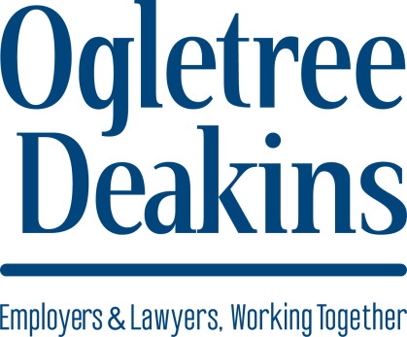
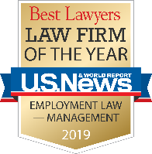
Resolving the Tough Ones: Effective Strategies for Settling Disputes Through Mediation
Association of Corporate Counsel – SFBA
San Jose – May 16, 2019
.
© 2019, Ogletree, Deakins, Nash, Smoak & Stewart, P.C.

Slide 2
Speakers
Yusuf Mohamed, Deputy General Counsel, Employment & Immigration
Tesla, Inc., Palo Alto
Marc Eisenhart, Partner
Gates Eisenhart Dawson, San Jose
Michael Westheimer, Partner
Ogletree Deakins, San Francisco
2

Slide 3
Planning for Mediation
  Determining when to conduct mediation
  Learning the facts
  Considering what success looks like
3

Slide 4
Attending Mediation
  Mediation privilege
  Attending joint sessions
  Leveraging strengths and weaknesses
  Reassessing your position in light of new facts
  Using tools such as mediator’s proposals and brackets
  Maximizing the role and skills of the mediator
4

Slide 5
Deal or No Deal
  Deal:
    Best practices for capturing the terms
    Evaluating the deal in light of expectations
5

Slide 6
Deal or No Deal
  No Deal:
    Determining when to walk away
    Mediator’s role in post-mediation negotiations
6

Slide 7
Questions?

