Slide 1
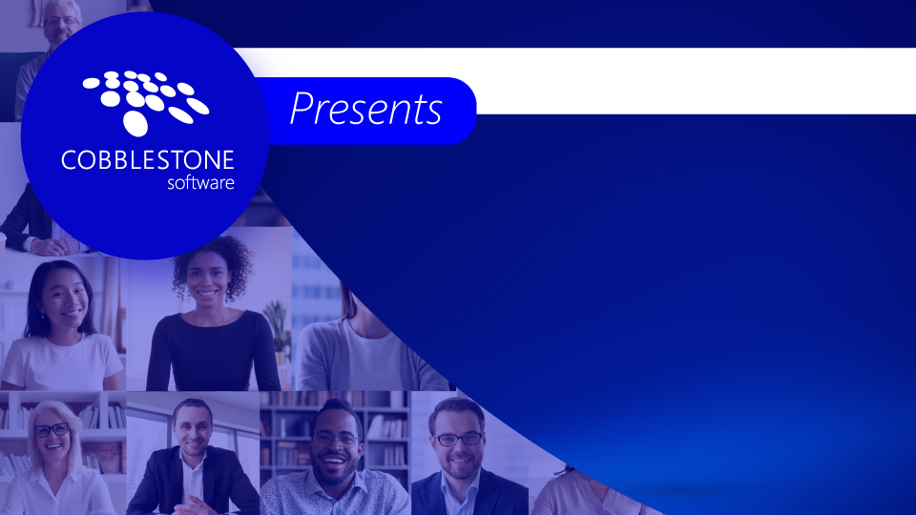

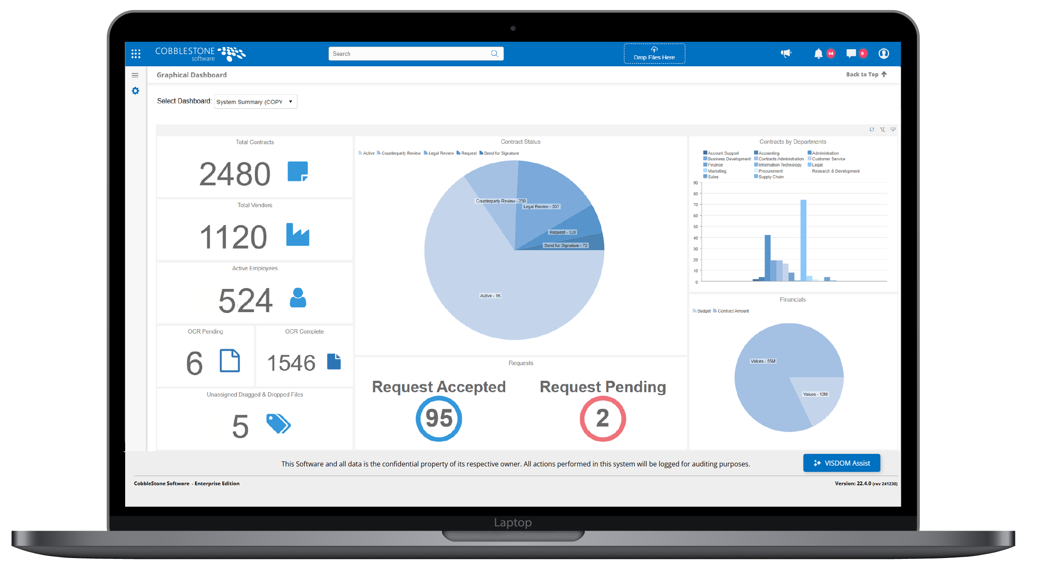
Drafting Smarter, Redlining Faster: Your AI Guide to Contract Negotiation

Slide 2
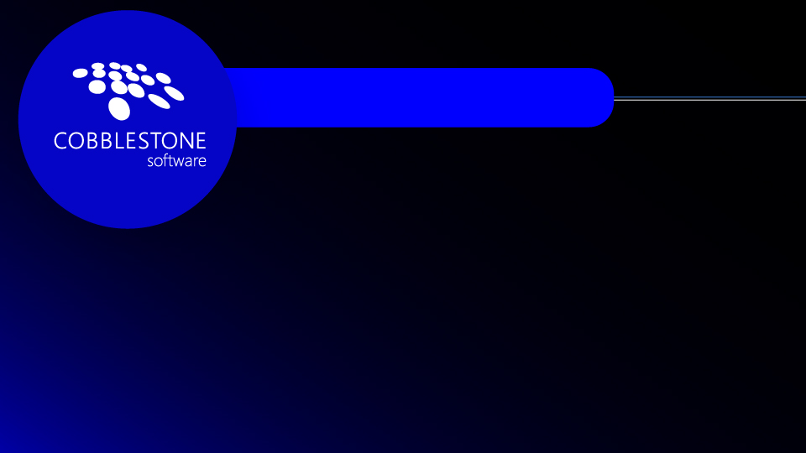




Register, Win, Donate
Copyright CobbleStone Software
Confidential: Please do not distribute

Slide 3
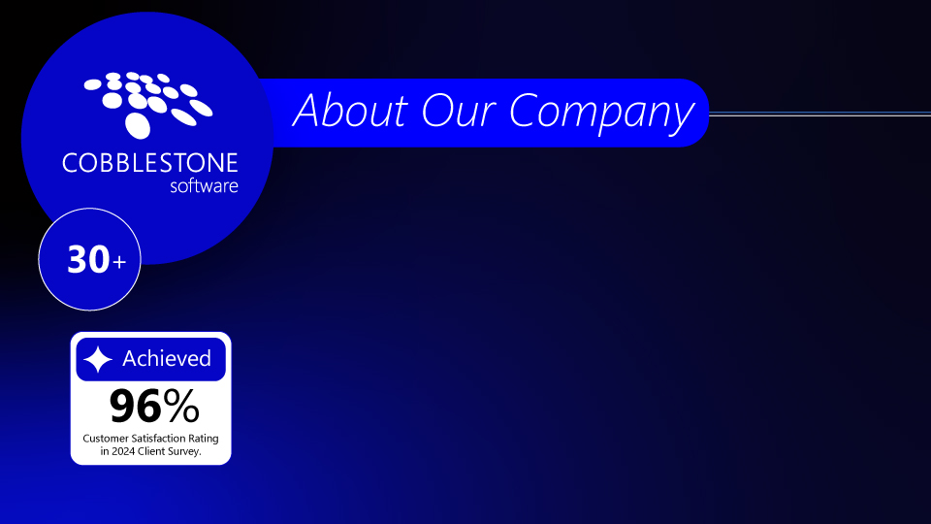
Industry Leading Contract Management Software (CLM)
One of the first companies to release a contract software product in 1995
Selected by over 1000 clients and thousands of users
Over 4 million records managed by the CobbleStone platform
User-friendly and flexible features.
99.9% SLA
Enhanced with VISDOM® artificial intelligence
Copyright CobbleStone Software
Confidential: Please do not distribute

Slide 4
Poll Question
Which aspect of AI-powered contract negotiation excites you the most?
Speed: Accelerating drafting and review cycles
Accuracy: Reducing errors and ensuring compliance
Insights: Uncovering hidden risks with advanced analytics
Collaboration: Streamlining stakeholder input and approvals
Innovation: Exploring new possibilities with AI-driven tools
Copyright CobbleStone Software
Confidential: Please do not distribute

Slide 5

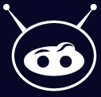

CobbleStone’s
VISDOM® AI
Machine Learning & Natural Language Processing
IntelliXtract Data Extraction
OCR, Data Identification, & Capture
Contract Auto-redlining
Clause Comparison
Risk Mitigation
Statistical Data Analysis
Proactive Recommendations Based On Real-Time Data
Copyright CobbleStone Software
Confidential: Please do not distribute

Slide 6
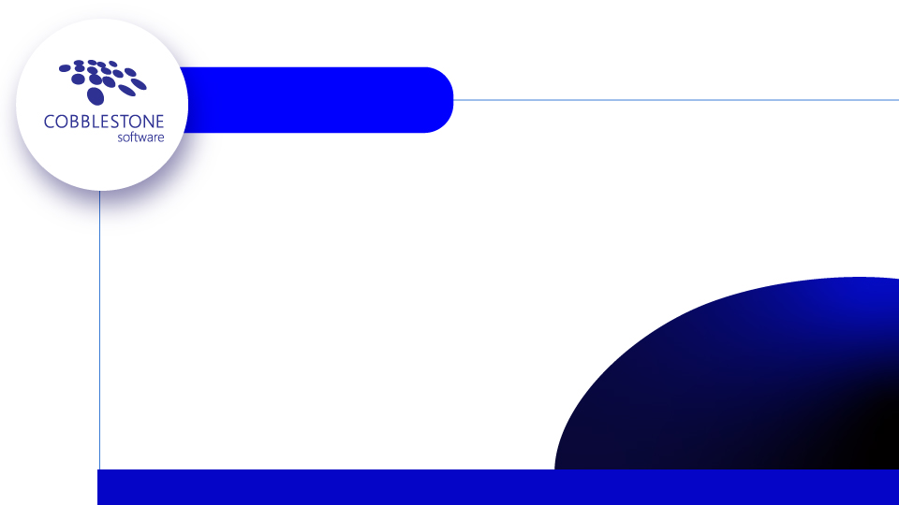




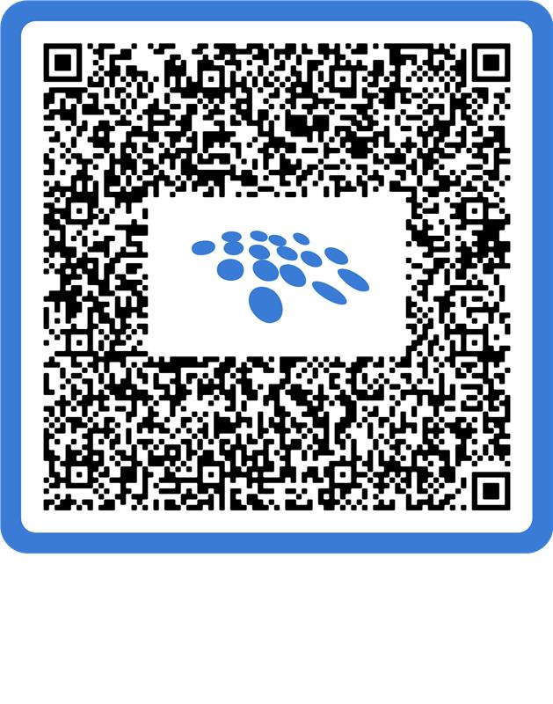
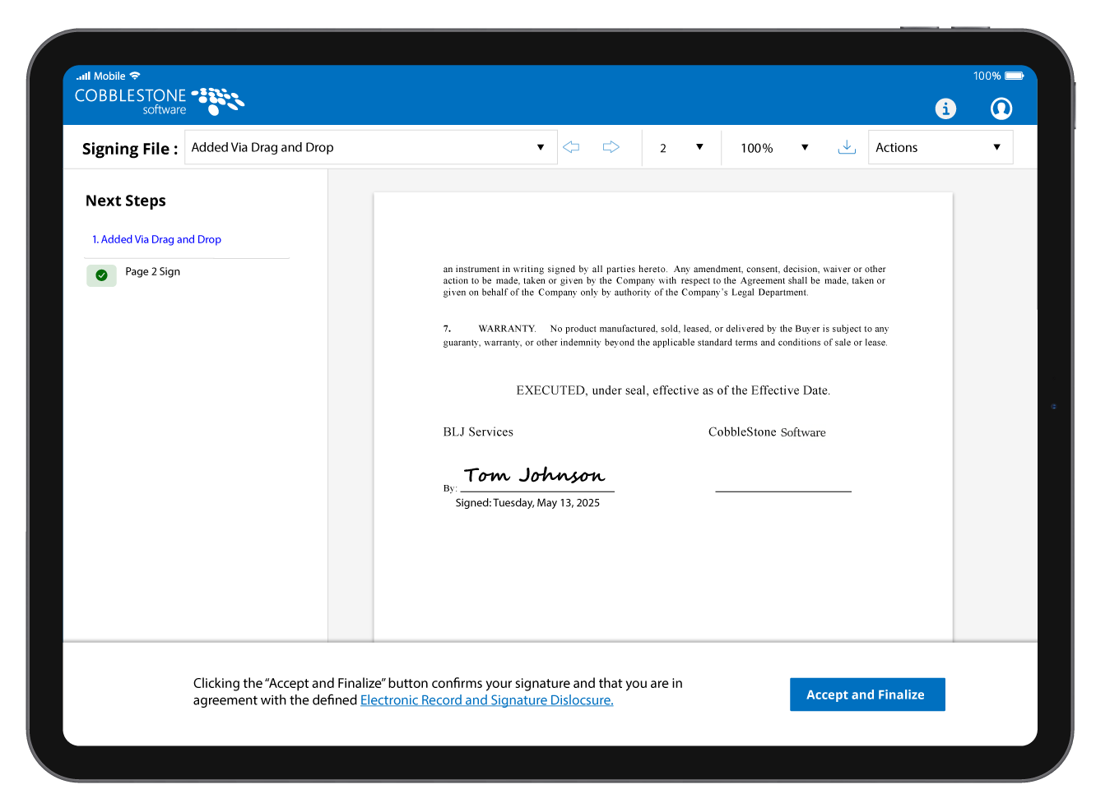
Closing
1-866-330-0056
www.CobbleStoneSoftware.com
Sales@CobbleStoneSoftware.com
Scan For a Customized Demo!
And win a prize!
Copyright CobbleStone Software
Confidential: Please do not distribute

