Slide 1

Doing Business in Europe: Common Pitfalls and How to Avoid Them
A&L Goodbody – ACC Austin CLE Panel
Thursday January 10 2019

Slide 2



Panellists
Gina Conheady
Partner, Corporate
San Francisco
gconheady@algoodbody.com
+1 415 767 5261
John Whelan
Partner, Commercial and Technology
Dublin
jwhelan@algoodbody.com
+353 1 649 2234
Rachael Evans
Senior Associate, Employment & Immigration
San Francisco
revans@algoodbody.com
+1 415 767 5260

Slide 3
Introduction & Overview
1
Choosing the right corporate structure
2
Privacy and regulation of personal data
3
Employment and immigration

Slide 4
Structuring Your EU Business: Choosing the Optimum Corporate Structure
Options when entering a new international market for the first time:
  Form a new subsidiary
  Register a branch
  Enter the market directly
Tax considerations will frequently be the driver
Keep in mind impact of Brexit if you need an EU entity or branch

Slide 5
Choosing the Optimum Corporate Structure – relevant factors
 | Subsidiary | Branch | Direct Entry
Separate legal personality | Yes | No | No
Ongoing corporate disclosure requirements | Yes | Yes | No
Business registration requirements | Yes | Yes | Not under EU law unless amounts to a branch - but Member State requirements may vary
Mandatory laws (GDPR, employment laws etc.) | Yes | Yes | Yes

Slide 6
GDPR
Privacy & Regulation of Personal Data
What is GDPR?
Why is it being introduced?
Who does it impact?
Increased compliance burden
Enhanced individual rights
Greater sanctions for non-compliance
A new regulatory environment

Slide 7

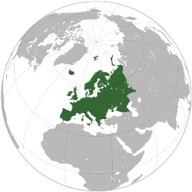
GDPR – a European Law with Global Reach
EU established controllers & processors
Non EU companies that target or monitor EU data subjects
Availability of “one stop shop” regulation:
  lead authority in place of main establishment
  “concerned” authorities can also be involved
  EDPB decides if authorities cannot
Jurisdiction

Slide 8
Data Protection – The Basics
What is Personal Data?
data relating to identified or identifiable individuals
“Data Controller”
a person who controls the use of personal data
“Data Processor”
a person who processes personal data on behalf of a data controller
“Sub-Processor”
a third party engaged by a data processor to carry out processing on behalf of the data controller
What is “processing”?
– almost anything you could conceivably do with personal data, including:
    collecting, organising, altering or adapting the data
    obtaining, recording, keeping or backing up the data
    transferring or disclosing the data

Slide 9
Compliance…
…being able to demonstrate compliance with the DP principles:
Lawfulness
Fairness and Transparency
Data
Minimisation
Storage
Limitation
Purpose
Limitation
Accuracy
Integrity
and
Confidentiality

Slide 10
Accountability
Article 5(2): The Controller shall be responsible for, and be able to demonstrate compliance with, paragraph 1 (“accountability”)
“Responsibility can be delegated,
accountability cannot…”

Slide 11





Accountability is shaping Compliance
Amazon fare badly in
Personal Data test
The Big Data
Responsibility
ACCOUNTABILITY
EU privacy regulators
increase pressure on Whatsapp
Tesco concerned about
GDPR impact on Clubcard
BMW Feeling Pressure To
Hand Over Connected Car Data
Facebook under pressure as EU
urge probe of data practices
Notes:
Amazon fare badly in
Personal Data test

Slide 12





GDPR - New Customer Rights
“data access right”:- right to provision of a copy of all held data, for free, within a month
“portability right”:- right to be provided data in a structured, commonly used and machine readable format, and right to transmission to another without hindrance
  “no profiling right”:- right not to be subject to automated decisions which produce legal effects, unless explicit consent given
“right to be forgotten”:- right to erasure, blocking
or rectification of data without delay, but within one month

Slide 13

GDPR - New Obligations
Accountability: - “the controller shall be responsible for, and be able to demonstrate compliance with..” – evidence will be required
Information:- significant increase in information to be
provided to data subjects (e.g. see Privacy Notice on next slide)
Consent:- higher degree of consent required: “freely given, specific, informed and unambiguous indication of the data subject's agreement… such as by a written statement or by clear affirmative action”
Data Protection Officer:- appoint a DPO where core activities involve large scale (i) regular and systematic monitoring of individuals or (ii) processing of special/criminal data
Privacy by Design and Default:- e.g. Privacy Impact Assessments (PIAs)
Reporting:- security breaches to be reported within 72 hours, and individuals notified where at risk – includes Cyber Attacks
Board of Directors – need to understand and make decisions about level of data privacy risk

Slide 14
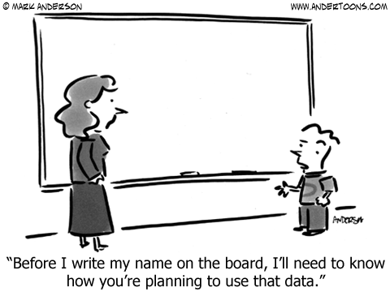
GDPR Information– Privacy Notices
NEW!
  Contact details of DPO
  Legal basis
  Legitimate Interests
  Data retention period
  Individuals’ rights
  Right to withdraw consent
  Details of any transfers out of the EEA
  Right to complain to the ODPC
  Existence of profiling & logic/purpose
  Whether data requested is necessary for the contract or required by law
Absolute obligation

Slide 15


GDPR New Controller - to - Processor relationship
Processors currently have limited exposure
Processors will have a new risk profile under GDPR
Data processors liable to fines, damages, and have new shared responsibility and liability with data controller
Written agreements to be put in place with lengthy list of mandatory contractual obligations
Controller to processor contracts being renegotiated

Slide 16
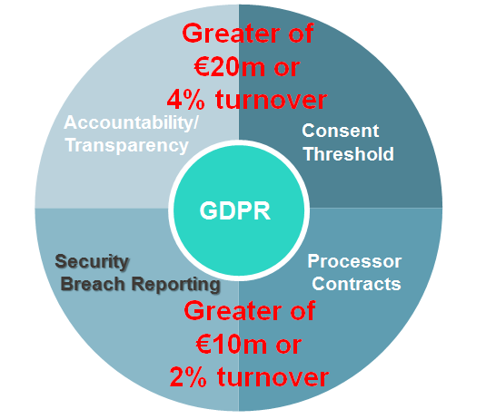



GDPR Breach – the Pitfalls
Consent Threshold
Accountability/ Transparency
GDPR
Security
Breach Reporting
Processor Contracts
…regulatory dawn raids and audits
…and new data subject actions

Slide 17
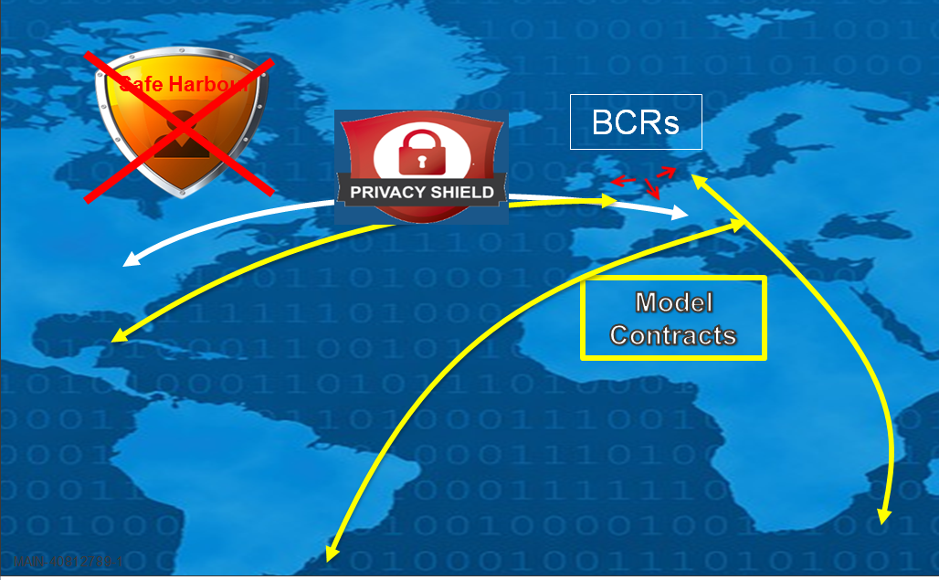
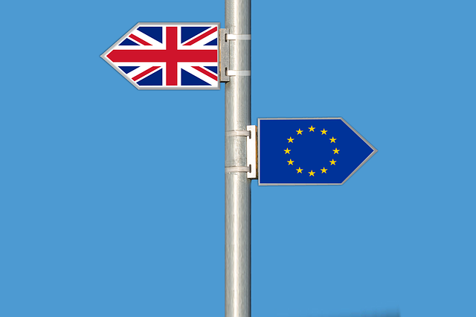
International Data Transfers
Brexit
EDPB
One Stop Shop

Slide 18


Employment and Immigration Matters
Differences within EU Member States
Common law or civil law jurisdiction?
EU Directives
Statutory entitlements
Immigration policies

Slide 19
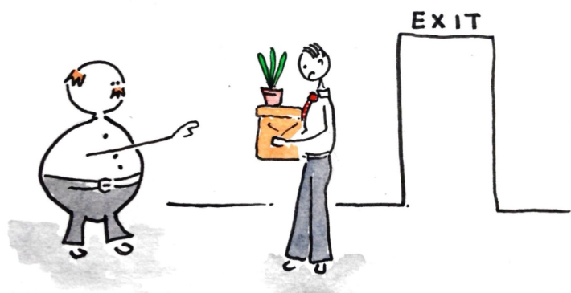

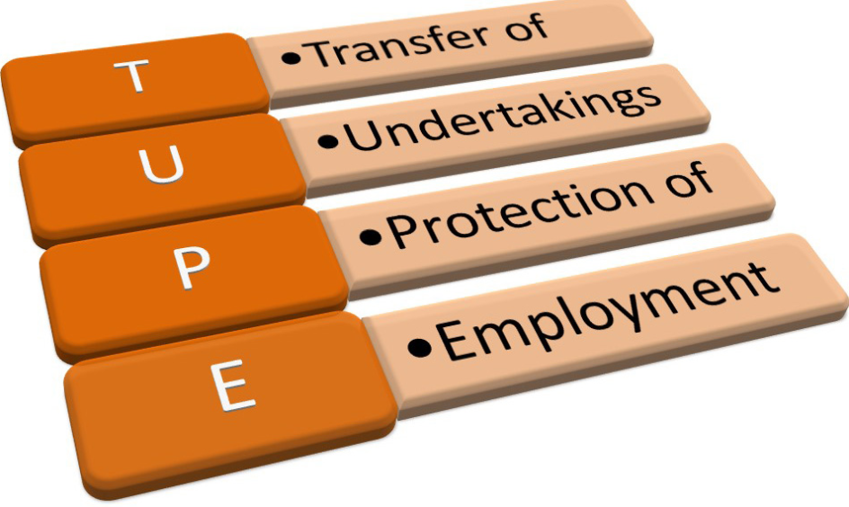

Common Employment Law Pitfalls: Overview
Statutory Protections
Dismissals
Benefits
Trade unions/works councils
Collective redundancies
TUPE
Immigration matters

Slide 20


Employment Pitfall No. 1: Statutory Protections
Unfair Dismissals
Employment Equality
Redundancy Payments
Protected Disclosures

Slide 21

Employment Pitfall No.2: Dismissals
No concept of “employment at will”
Employee may seek to “injunct” the dismissal

Slide 22


Employment Pitfall No.3: Workplace Benefits
European Union law base-line
Annual leave (PTO) – 20 days
Maternity Leave – 26 weeks + 16 weeks
Paternity leave – 2 weeks
Parental Leave – 18 weeks
Sick pay – no statutory entitlement
Health insurance
Pension

Slide 23


Employment Pitfall No.4:
Trade Unions / Works Councils
Workplace representation – Ireland outside the EU norm
No requirement to recognise/engage with Trade Union
No significant collective agreements
Works Councils are uncommon but may be more common following Brexit

Slide 24

Employment Pitfall No.5: Collective Redundancies
Collective Redundancies Directive 98/59/EC
Numerical Threshold
Information/consultation with employee reps – 30 days
Employers prevented by statute from terminating during the consultation period
Statutory obligation to inform relevant Minister in writing

Slide 25

Employment Pitfall No.6: Transfer of Undertakings
Transfer of Undertakings Directive 2001/23/EC
Asset sale – is TUPE triggered?
Automatic transfer to “new” employer by operation of law
Same terms and conditions of employment (pensions exception)
Information and Consultation obligations – 30 days

Slide 26

Employment Pitfall No.7: Immigration matters
Free movement of workers within the EU however US nationals require an employment permit for full time employment
Senior executives, professionals and technically skilled workers favoured
Salary and qualification criteria
Ireland: example
Straightforward application process and fast turnaround time
Trusted Partner Initiative: fast-track process for “Trusted Partner” companies

Slide 27
Final thoughts
1
Country-by-country analysis hard to avoid
2
Engage with tax advisors early
3
Hire carefully – no employment at will!
4
“Landing team” helps to set culture
5
Work with experienced local advisors!

Slide 28

Questions?
MAIN-43441524-1

