Slide 1
Copyright and Trademark Statutory and Practice Updates
April 13, 2023
Anthony Brooks
John McIlvaine

Slide 2
Table of Contents
Firm Background
Speaker Introductions
Copyrights
US Trademark Practice Updates

Slide 3
The Webb Law Firm
IP Focus
Patent, Trademark, & Copyright Law
Attorneys
Dual degrees in sciences/engineering and law with USPTO registration
Firm History
Founded in 1845
Headquartered in downtown Pittsburgh, with broad international presence
50+ patent attorneys/agents
Backgrounds include: electrical engineering, computer science & engineering, astrophysics, biology, neuroscience, chemical engineering, mechanical engineering, etc.

Slide 4
Anthony W. Brooks
Practices patent, copyright, trademark, and trade secret law
Focus on patent and trademark litigation and enforcement
International trademark and domain portfolio management and enforcement
Advises clients in acquiring, protecting, and licensing their intellectual property
Certifications, Admissions & Licensure:
Pennsylvania
United States District Court for the Western District of PA
United States District Court for the Eastern District of TX
United States Court of Federal Claims
United States Court of Appeals for the Federal Circuit
United States Patent and Trademark Office

Slide 5
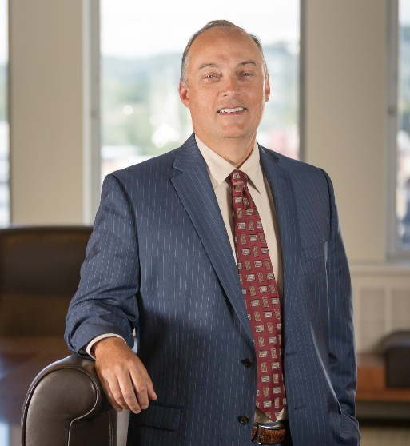
John W. McIlvaine
Practices patent procurement and enforcement, trademark registration and enforcement, licensing, litigation and mediation
Focuses on international IP law clients
Has experience with IP programs and initiatives
Advises a range of clients from individual inventors to Fortune 500 companies
Certifications, Admissions & Licensure:
Pennsylvania
United States Court of Appeals, Federal Circuit
United States District Court for the Western District of PA
United States District Court for the Middle District of PA
Certified Arbitrator and Neutral Evaluator, U.S. District Court for the Western District of Pennsylvania
United States Patent and Trademark Office

Slide 6
Copyrights

Slide 7
Copyrights
What is a copyright?
17 U.S.C. § 102
(1) Original works of authorship
(2) Fixed in a tangible medium
(3) Must not be an “idea, procedure, process, system, method of operation, concept, principle, or discovery,” regardless of form or embodiment

Slide 8
Works of Authorship
Literary works
Musical works, including any accompanying words
Dramatic works, including any accompanying music
Pantomimes and choreographic works
Pictorial, graphic, and sculptural works
Motion pictures and other audiovisual works
Sound recordings
Architectural works

Slide 9
Authorship
Copyright original vests in the author of a work
Works Made For Hire
1) a work prepared by an employee within the scope of his/her employment; and
Many works prepared by you and coworkers on a day to day basis
2) a specially ordered or commissioned work.
Ownership ≠ Authorship
Assignment?

Slide 10
Registration
By fixing a work in an original work in a tangible medium of expression
Creation acts to generate the work and the copyright protection afforded to the work
Registration not required
But see 17 U.S. Code § 411

Slide 11
17 U.S. Code § 411 - Registration and civil infringement actions
17 U.S. Code § 411(a)
“[N]o civil action for infringement of the copyright in any United States work shall be instituted until preregistration or registration of the copyright claim has been made in accordance with this title. In any case, however, where the deposit, application, and fee required for registration have been delivered to the Copyright Office in proper form and registration has been refused, the applicant is entitled to institute a civil action for infringement if notice thereof, with a copy of the complaint, is served on the Register of Copyrights. . . .”
Fourth Estate Public Benefit Corp. v. Wall-Street.com, LLC, et al., 139 S. Ct. 881, 887 (2019)
Held: A copyright claimant may only commence suit once a copyright is registered or refused registration. Filing of copyright registration is not enough.

Slide 12
17 U.S. Code § 412 - Registration as prerequisite to certain remedies for infringement
In any action under this title, other than [a few exceptions] . . . , no award of statutory damages or of attorney’s fees, as provided by sections 504 and 505, shall be made for—
(1)any infringement of copyright in an unpublished work commenced before the effective date of its registration; or
(2)any infringement of copyright commenced after first publication of the work and before the effective date of its registration, unless such registration is made within three months after the first publication of the work.

Slide 13
Registration
Title
Type of Work
Author
Natural person or work made-for-hire
Transfer Statement
Written agreement / assignment
Inheritance
Deposit Copies
Best Edition

Slide 14
17 U.S. Code § 411 - Registration and civil infringement actions
17 U.S. Code § 411(b)
(1)A certificate of registration satisfies the requirements of this section and section 412, regardless of whether the certificate contains any inaccurate information, unless—
(A)the inaccurate information was included on the application for copyright registration with knowledge that it was inaccurate; and
(B)the inaccuracy of the information, if known, would have caused the Register of Copyrights to refuse registration.
Unicolors, Inc. v. H&M Hennes & Mauritz, L. P., 142 S.Ct. 941 (2022)
Held: Lack of either factual OR legal knowledge can excuse an inaccuracy in a copyright registration under § 411(b)(1)(A).

Slide 15
What Can You Do With a Copyright?
The copyright owner has the exclusive right to do and to authorize any of the following:
To reproduce the copyrighted work;
To prepare derivative works;
To distribute copies;
To display the work publicly;
In the case of sound recording, to perform the work publicly by means of a digital audio transmission.

Slide 16
Fair Use
Fair use is not infringement
Factors considered include:
The purpose and character of the use – commercial or non-profit?
The nature of the copyrighted work
The amount of substantiality of the portion used in relation to the copyrighted work as a whole
The effect of the use upon the potential market for or value of the copyrighted work.
Typical fair use situations include: reproducing a work for classroom teaching, news reporting, research situations and some artwork.

Slide 17
Andy Warhol Foundation for the Arts v. Goldsmith Oral Argument, Supreme Court Docket No. 21-869
Whether a work of art is “transformative” when it conveys a different meaning or message from its source material (as the Supreme Court, U.S. Court of Appeals for the 9th Circuit, and other courts of appeals have held), or whether a court is forbidden from considering the meaning of the accused work where it “recognizably deriv[es] from” its source material (as the U.S. Court of Appeals for the 2nd Circuit has held).

Slide 18
Campbell v. Acuff-Rose Music, 510 U.S. 569, 575-578 (1994)
The band 2 Live Crew sued for copyright infringement for use of Roy Orbinson’s “Pretty Woman”
Held: 2 Live Crew’s “Pretty Woman” was a parody that added transformative value to the original, and thus use of Orbinson’s “Pretty Woman” was fair use.
Transformative value is a consideration under Fair Use Factor 1 “purpose and character” of the use.
Does the new work “add[] something new, with a further purpose or different character, altering the first with new expression, meaning, or message”?

Slide 19
Andy Warhol Foundation for the Arts v. Goldsmith Oral Argument, Supreme Court Docket No. 21-869

Slide 20
Andy Warhol Foundation for the Arts v. Goldsmith Oral Argument, Supreme Court Docket No. 21-869
S.D.N.Y. 2019
Warhol Foundation sought a declaratory judgment that the “Prince Series” did not infringe Goldsmith’s copyright
Argued entire series was fair use of Goldsmith’s photo
Goldsmith counterclaimed for copyright infringement.
On Summary Judgment, S.D.N.Y. determined Warhol’s use of Goldsmith’s work was fair because it “transformed” Goldsmith’s original work.
Warhol added something new to the image of Prince by highlighting Prince as an icon or a larger-than-life figure, and Goldsmith’s photograph showed Prince as vulnerable and uncomfortable.
Warhol stripped away all but Prince’s head and neckline from Goldsmith’s image in the “Prince Series” works, finding that only a nonprotectable portion was used.

Slide 21
Andy Warhol Foundation for the Arts v. Goldsmith Oral Argument, Supreme Court Docket No. 21-869
Second Circuit, Andy Warhol Foundation for the Visual Arts v. Goldsmith, 11 F.4th 26, 41 (2d Cir. 2021)
Accused S.D.N.Y. of playing “art critic”
Held: “Orange Prince“ infringed Goldsmith’s rights because it retained the “essential elements of the Goldsmith photograph without significantly adding to or altering those elements.”
While acknowledging a new meaning or message could make a new work transformative, it distinguished the “Prince Series“ from other transformative works, noting that those works “have themselves been distinct works of art that draw from numerous sources, rather than works that simply alter or recast a single work with a new aesthetic.”
Also dismissed “intent of the artist or the meaning or impression that a critic—or for that matter, a judge—draws from the work” as a valid consideration.
Essentially, Warhol’s contribution was a mere change in aesthetics as opposed to substantive transformation protected as fair use.

Slide 22
Andy Warhol Foundation for the Arts v. Goldsmith Oral Argument, Supreme Court Docket No. 21-869

Slide 23
Copyright Claims Board (CCB)

Slide 24
The Problem
Small claimants fall victim to copyright infringement.
Copyright infringement is a federal claim.
Federal lawsuits cost a lot of money.
Not all costs of litigation are recoverable.

Slide 25
Frustrating Factors
“In any civil action under this title, the court in its discretion may allow the recovery of full costs.” 17 U.S.C. § 505
“In copyright cases, § 505's authorization for the award of ‘full costs’ therefore covers only the six categories specified in the general costs statute…” Rimini St., Inc. v. Oracle U.S., Inc., 139 S. Ct. 873 (2019)
28 U.S. Code § 1920 - Taxation of costs
(1)Fees of the clerk and marshal;
(2)Fees for printed or electronically recorded transcripts necessarily obtained for use in the case;
(3)Fees and disbursements for printing and witnesses;
(4)Fees for exemplification and the costs of making copies of any materials where the copies are necessarily obtained for use in the case;
(5)Docket fees under section 1923 of this title;
(6)Compensation of court appointed experts, compensation of interpreters, and salaries, fees, expenses, and costs of special interpretation services under section 1828 of this title.

Slide 26
Frustrating Factors
17 U.S.C. § 505
“...no civil action for infringement of the copyright in any United States work shall be instituted until … registration of the copyright claim has been made in accordance with this title.”

Slide 27
Copyright Claims Board (CCB) www.ccb.gov
Inter partes federal panel to hear small disputes outside of federal court.

Slide 28
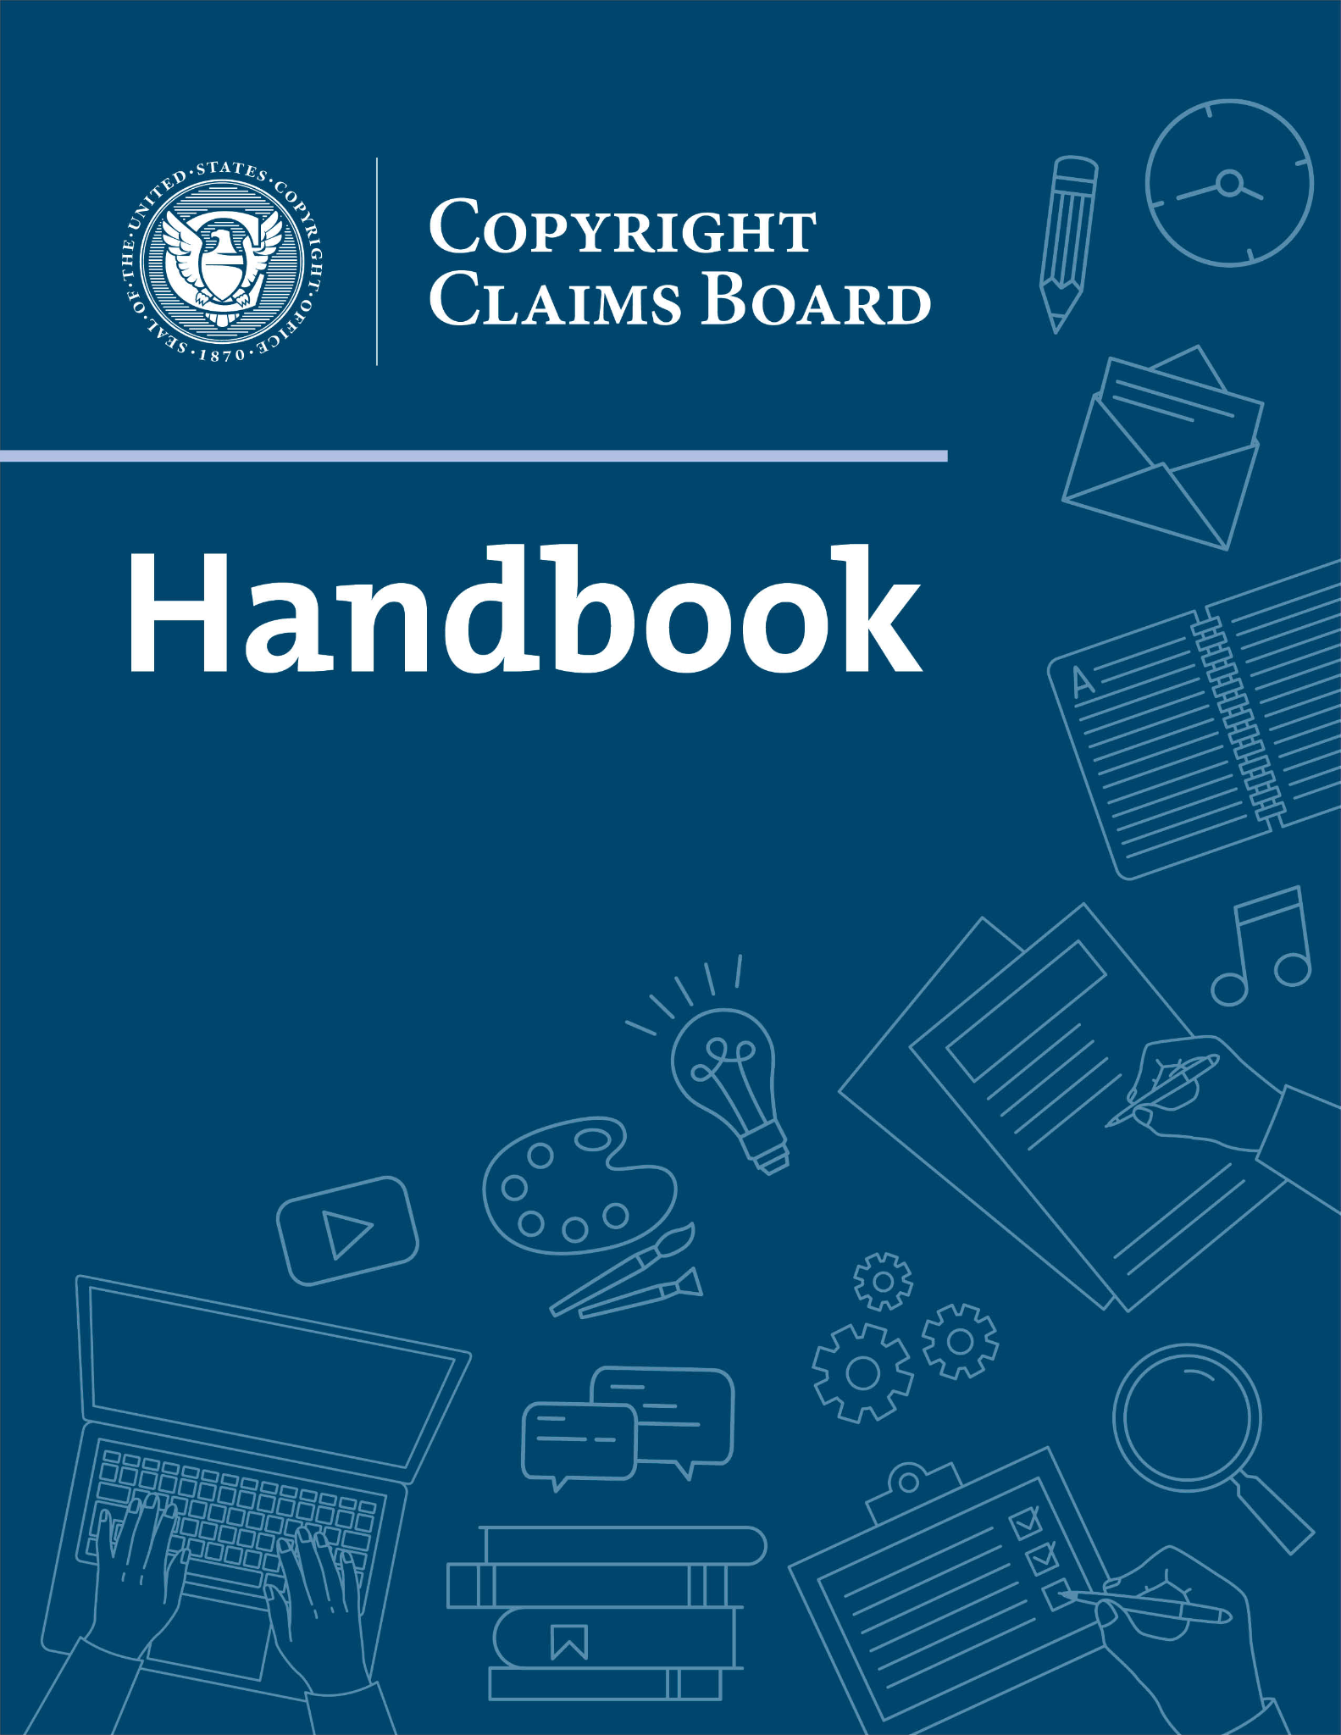
The official handbook is published in chapters, which may be updated from time to time: www.ccb.gov/handbook/

Slide 29
Key Features
Voluntary administrative dispute resolution process
Claimants send an opt-out notice to respondents
Adjudicators: three CCB Officers with mix of government, mediation, and litigation experience
Capped damages: $30,000* (with an option to cap at lower $5,000)
Streamlined discovery, rare if ever to admit expert testimony
Preclusion: resolution with CCB precludes later federal lawsuit
Award of attorney's fees capped**, and only for bad faith conduct

Slide 30
Interesting Features
Limited number of filings a year per claimant
Monetary penalties for bad faith conduct
Explicit carve-outs for law student representatives
Law school clinics and legal services can participate in Board-provided directory for pro bono representation
Libraries and archives may preemptively opt-out of all prospective Board proceedings
Everything is virtual – no in-person hearings or conferences

Slide 31
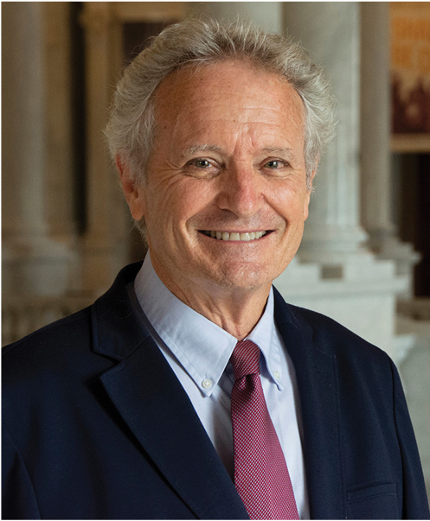
Meet the CCB Officers
David Carson
2014-2021: head of Copyright Policy Team at Ofﬁce of Policy and International Affairs, USPTO
2012-2014: Executive VP, Global Legal Policy at International Federation of the Phonographic Industry (IFPI)
1997-2012: general counsel at Copyright Office
Early career: attorney at copyright firms in NY & LA

Slide 32
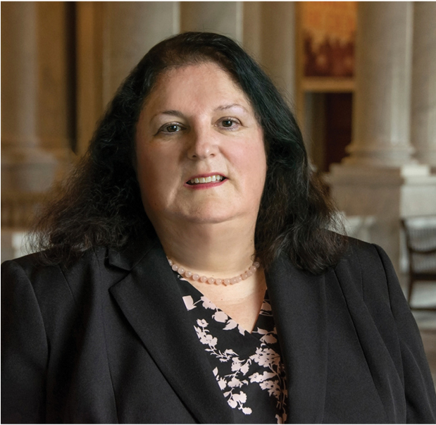
Meet the CCB Officers
Monica McCabe
2016-2021: Chair, IP Department at Phillips Nizer LLP
Veteran copyright litigator
2009-2016: Partner, Vandenberg & Feliu, LLP
1998-2009: Of Counsel, DLA Piper US LLP
1995-1998: Partner, Thelen Reid Brown Raysman & Steiner LLP
Experienced mediation panelist
International Trademark Association
Southern District of New York
New York State Supreme Court, Commercial Division

Slide 33
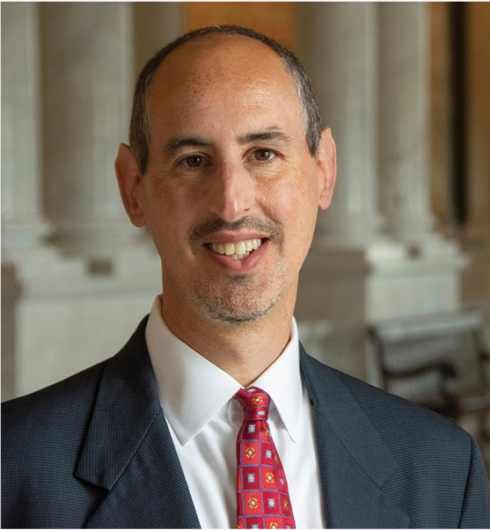
Meet the CCB Officers
Brad Newberg
Experienced litigator
2014-2021: Partner, McGuireWoods LLP
Led trademark & copyright litigation practice
2010-2014: Partner, Reed Smith LLP
2009-2010: Senior Counsel, Holland & Knight LLP
2005-2009: Partner, Newberg & Winters LLP

Slide 34
What you Need to File a Claim
Filed claims do not require an attorney, but representation is permitted
Businesses can self-represent through owner, partner, board member, or any authorized employee
You need a copyright registration to undertake “active” proceeding for infringement
But you can initiate the request with a pending application
Cost of filing claim: $100 ($40 to begin, $60 if respondent doesn’t opt out)
Cost to expedite subject pending application: $50

Slide 35
What Kind of Claims can be Filed?
The big three:
Copyright infringement
Declaration of non-infringement
Misrepresentation under the DMCA
Outside the big three:
Copyright-specific counterclaims and defenses
Tangential topics like contract disputes (e.g., licensing agreements) at CCB’s discretion
Non-copyright claims or counterclaims will be found “unsuitable” and case will be dismissed without prejudice

Slide 36
What’s in an Infringement Claim?
Copyright application/registration number and work information
Claimant identity and address
Respondent identity
What was the infringing activity?
When did infringement occur?
Where did infringement occur?
Optional election of “smaller claims” track
Harm suffered and relief sought
Optional evidence
Optional representation

Slide 37
Extra Steps for Online Service Providers
Section 512 of the Copyright Act: safe harbor for service providers
If bringing claim against an online service provider, you must first:
Send takedown notice to service provider
Check for “expeditious” removal or disabling of content
Only then, if they fail to do so, can you proceed with CCB

Slide 38
Initiation of CCB Proceeding
Review
90 days
Submit claim form
Board prepares initial notice
Claimant serves initial notice on respondent*
20 days
Board issues second notice after service
Respondent does not opt out
Board issues schedule
OR
Respondent opts out within 60 days
Dismissed without prejudice

Slide 39
CCB Proceeding
Board issues schedule
Respondent submits Response form
Respondent submits Counterclaim form
Board reviews Counterclaim for compliance
Claimant responds to Counterclaim

Slide 40
Phases
Discovery
Presentation of Evidence
Conferences
Hearing(s)
Final determination

Slide 41
(Even) Smaller Claims Track for Cases < $5000
Initial conference
Discovery
Merits conference
Proposed findings of fact
Final determination

Slide 42
Review of Final Determination
Request for Reconsideration
Board re-review, for a clear error of law or fact material to the outcome, or a technical mistake.
Review by the Register
Must file Request for Reconsideration first, and have that Request denied
Must identify an abuse of discretion in denying the Request for Reconsideration
Review by District Court
(1) final determination was due to fraud, corruption, misrepresentation, etc.
(2) CCB exceeded authority or failed to issue a final determination
(3) “excusable neglect” for default or failure to prosecute
The grounds for appeal are intentionally limited – otherwise, not a savings over litigation

Slide 43
How Can Attorneys Be of Service?
Update language of cease & desist letters and follow-up letters
Takedown notices to service providers can advise of potential CCB filing if not compiled with
CCB filing can be used as card to force settlement in view of more expensive litigation
Represent small claims clients
Bearing in mind attorneys’ fees only for bad faith opponent
Capped at $5000 for represented opponent / $2500 for pro se opponent
Counsel library and archive clients about preemptively opting out
Preempt copyright lawsuit threats with actual or potential CCB filing for declaratory judgment

Slide 44
Go to CCB.gov and set up your account today… or whenever this becomes relevant to you

Slide 45
What is a Trademark?

Slide 46
What is a Trademark?
A means of distinguishing the source of goods and/or services
Words
Phrases
Designs
Shapes
Sounds
Smells
Colors
Etc.
Goods
Services

Slide 47
Trademark Classification System
Trademark goods/services are grouped in classes
International (Nice) Classification
Goods: Classes 1-34
Services: Classes 35-45
Use Trademark ID Manual* to look up classifications

Slide 48
Class 25
Clothing, footwear, headwear

Slide 49
Class 9
Downloadable software
Class 42
Non-downloadable software

Slide 50
Class 5: nutritional beverages
Class 29: milk beverages
Class 30: coffee/tea beverages
Class 31: beverages for animals
Class 32: beer and other non-alcoholic beverages
Class 33: wine/spirits

Slide 51
Distinctiveness
Trademark concepts generally fall on a
Spectrum of Distinctiveness.
Generic
Weakest
Descriptive
Suggestive
Arbitrary
Fanciful
Strongest

Slide 52
Distinctiveness
Generic
Literal name of the goods/services
Incapable of distinguishing source
Cannot be registered
Examples:
Adhesive bandages
Flying disc

Slide 53
Distinctiveness
Generic
Immediately describe goods/services
Must acquire distinctiveness
Can be registered
Supplemental Register
Principal Register with showing of “acquired distinctiveness”
Examples:
American Airlines
Coca-Cola
Descriptive

Slide 54
Distinctiveness
Generic
Imaginative link to goods/services
Inherently distinctive
Can be registered
Principal Register
Examples:
Coppertone
Airbus
Descriptive
Suggestive

Slide 55
Distinctiveness
Generic
Existing concept, no link
Inherently distinctive
Can be registered
Principal Register
Examples:
Amazon
Apple
Descriptive
Suggestive
Arbitrary

Slide 56
Distinctiveness
Generic
Invented concept, no link
Inherently distinctive
Can be registered
Principal Register
Examples:
Kodak
Verizon
Descriptive
Suggestive
Arbitrary
Fanciful

Slide 57
Filing the Application
Filing Bases* for new U.S. application
Section 1(a): actual use in commerce
Section 1(b): intent-to-use in commerce
Applicant information
Domicile/mailing address
Email address
Business entity information
Goods/services information
Can’t be broadened later
Information about representative

Slide 58
§1(a) – Actual Use
Mark must be in use in commerce for all the goods/services listed as of application filing.
“Use in commerce”
Goods: sold or transported in interstate commerce
Services: rendered in more than one State, or domestic + abroad.
Requires specimen of use

Slide 59
§1(b) – Intent to Use
No use required, but bona fide intent to use mark in commerce
No specimen of use is required until mark is allowed
Registration will be withheld until you file a Statement of Use

Slide 60
Verified Statement
Person signing the application is verifying:
Section 1(a): belief that Applicant owns mark, is using it in commerce in connection with all goods/services as of filing
Section 1(b): belief that Applicant is entitled to use the mark in commerce and has bona fide intent to do so
Both 1(a) and 1(b): To the best of the signatory's knowledge and belief, no other persons have the right to use the mark in commerce, either in the identical form or in such near resemblance as to be likely, when used on or in connection with the goods/services of such other persons, to cause confusion or mistake, or to deceive.

Slide 61
This is the general process ~8.5 months to first Office Action ~14.5 months overall
Filing
Examination
Publication
Allowance
Registration

Slide 62
Office Actions
Non-U.S. applicants must be represented by U.S. attorney
U.S. applicants can self-represent, or appoint U.S. attorney
37 C.F.R. § 2.18(a)(2)
If an attorney is recognized as a representative pursuant to § 2.17(b)(1), the Office will correspond only with that attorney

Slide 63
Office Actions
Inform your client that they should not be contacted directly by USPTO
Scams are rampant in trademark practice
Promptly review and report out Office Actions
New response deadline: 3 months from OA date*
Response deadline extendible (3 mos.) with fee
37 C.F.R. §2.65
(a) If an applicant fails to respond, or to respond completely … the application shall be deemed abandoned

Slide 64
Office Action Checklist
Docket response dates
Make note of all objections and refusals
Promptly report options and deadlines to client
Three (3) month deadline (may affirmatively request another three (3) months)

Slide 65
Most Common Issues
Identification of goods/services indefinite/misclassified
Likelihood of confusion with prior-filed mark
Suspension of application if senior application
Refusal of application if senior registration
Mark is merely descriptive
May require a declaration of distinctiveness to be filed

Slide 66
Likelihood of Confusion Test
Weighted multi-factor test
Similarity of the marks
Relatedness of the goods/services
Similarity of trade channels
Nature of how goods are purchased (impulse vs. careful consumers)
Number of similar marks for similar goods
Existence of valid consent agreement
Sophistication of purchasers
Evidence of peaceful coexistence

Slide 67
Filing a Response
Respond completely and timely
Argument is helpful, evidence is powerful
Give the Examining Attorney a reason to change their mind beyond them making a mistake
Consider seeking coexistence/consent agreement for blocking marks

Slide 68
1st
OA
Final
OA
TTAB
Fed. Cir.
SCOTUS

Slide 69
Specimen Required for Registration
Filed with 1(a) application
Filed with Statement of Use* in 1(b) application
One specimen for each class of goods/services
All goods/services must be in use in commerce
Cannot be a rendering/mockup
Goods
Labels, packaging, POP displays associated with goods (shopping cart page)
Services
Advertising media

Slide 70
After Registration
Declaration of Use at 5 years
Only certain gaps in commercial use are excusable
Declaration of Use + Renewal every 10 years
Failure to renew results in cancellation for failure to renew
Opportunity to file Declaration of Incontestability
5 years of substantially exclusive, continuous use
Removes some grounds for having your mark cancelled

Slide 71
The Trademark Modernization Act of 2020 – Observations from Year One
Became law on December 27, 2020
Many of its provisions took effect in December 2021
A few remaining provisions became effective in December 2022
Two new ex parte proceedings to allow for cancellation of a trademark registration on the basis of nonuse

Slide 72
Expungement Proceedings
Codified at 15 U.S.C. § 1066a and provides a basis for cancellation of a trademark registration when the mark was never used in United States commerce for some or all of the goods and/or services listed in the registration
Applicable to all U.S. trademark registrations, regardless of their initial filing basis
Can be filed between 3 – 10 years following the date of registration of the challenged registration
There is a grace period in effect through December 27, 2023, during which the ten-year limitations period does not apply and registrations older than ten years can be challenged through that date

Slide 73
Reexamination Proceedings
Applies where the basis for cancellation is that the registered mark was not used in U.S. commerce on or before the “relevant date” for all or some of the goods or services listed in the registration
For use-based, relevant date=date of application
for intent-to-use, relevant date=deadline for filing a statement of use
applies only to applications that were filed under Section 1 of the Trademark Act
does not apply to applications under Section 44 or Madrid-based applications under Section 66
Reexamination petitions can be filed during the first five years following registration

Slide 74
Standing
Neither proceeding requires that the petitioner have standing or any particular interest in the proceeding, as opposed to cancellation actions in the TTAB
Petitioner may be a representative or law firm

Slide 75
First Year Results
Over two hundred petitions were filed
Nearly even split between expungement and reexamination petitions
Over 30 instituted petitions have been terminated
Around 50 were not instituted
The USPTO Director initiated 12 petitions

Slide 76
Petition Requirements
Must substantiate an in-depth, reasonable investigation into whether the challenged mark was in use at the relevant time
Supported by an itemized index of all evidence in support of the petition
Supporting evidence
Internet search results showing a lack of search results for the owner name and/or mark
Wayback Machine results to show nonuse as of a particular relevant date or date range
printouts of the registrant’s websites, showing that products under the mark are not available
corporate and/or regulatory records supporting an inference of nonuse of a mark
for reexamination proceedings, evidence showing that a specimen of use was likely digitally altered or emanated from a “specimen farm”

Slide 77
Registrant Response
Similar documentary evidence showing that the mark was in fact in use as of the relevant dates
Claim excusable nonuse in expungement proceedings for Section 44- and 66-based registrations
If registrant does not provide evidence of use for the challenged goods, the registration will be cancelled as to the challenged goods for which use was not proven
Sales invoices generally insufficient

Slide 78
Ex Parte
In contrast to TTAB cancellation proceedings, once a TMA petition has been instituted, the petitioner has no further involvement in the matter
Upon institution, an office action is issued to the registrant, requiring proof of use of the challenged goods or services
Costs of a contested TTAB proceeding that goes into discovery, motion practice, and trial will be far more significant to a petitioner than the minimal costs of following an ex parte proceeding following institution

Slide 79
Estoppel and Claim Preclusion
The determination of the USPTO Director to institute, not institute, sustain, or dismiss a petition is not preclusive
Except to the extent that, in cases where a registrant produces sufficient evidence of use as to certain challenged goods, subsequent petitioners may no longer challenge the registration as to those goods
No prohibition against successive filings where a petition was not instituted and a petitioner wants to take another bite at the apple
In contrast, TTAB decisions in cancellations can have preclusive effect where the elements of res judicata are otherwise met

Slide 80
Timing
Where a registrant contests an ex parte expungement or reexamination, the process takes around ten months
A contested TTAB cancellation, by contrast, can take several years and substantial expense to resolve

Slide 81
Shorter Office Action Response Periods
As of December 1, 2022, office actions are now being issued with a three-month response deadline instead of six months for Section 1- and 44-based applications
Madrid-based applications will continue to receive a six-month response period
Three-month deadline is extendible by three months upon payment of a $125 filing fee prior to the expiration of the three-month period
USPTO anticipates implementing the three-month response period for post-registration office actions in October 2023
For intent-to-use applications in particular, it may make sense for applicants to take advantage of the three-month extensions to respond

Slide 82
Letter of Protest Procedure Codified
TMA codified the Letter of Protest procedure
Letter of Protest allows any party to submit evidence for consideration and entry in the record of a trademark application that is relevant to a reasonable ground for refusal of the application
Filing fee is $50
Must include an itemized index of evidence
May be disregarded if they raise an issue already considered by the examining attorney
Carefully review the application file history before preparing and submitting a Letter of Protest
issues to raise
- applied-for term being generic or merely descriptive
- a likelihood of confusion with a prior registration, or a prior-pending application or later-filed application with an earlier priority claim (but not prior common law rights);
- issues with the identification of the goods, description of the mark
- veracity of a specimen
Expect to receive notification within 60 days whether a Letter of Protest was accepted or not
Decision final and non-reviewable

Slide 83
Conclusion
More important than ever to confirm actual use in commerce on all goods, when filing 1(a) application, SOU or Declaration of Continued Use
Practitioners and applicants should anticipate a new, faster cadence to trademark prosecution once an examiner has reviewed an application

