Slide 1
Tech talk: critical Communication & partnerships
Elise Selinger - Dexcom
Shayne Nelson - ebay
Phil Harris - holland & hart

Slide 2
WELCOME and overview

Slide 3

ENGINEERS/TECHNICAL EXPERTS
IN-HOUSE COUNSEL
OUTSIDE COUNSEL

Slide 4
OUR EXPERIENCE and motivation
ENGINEERS/TECHNICAL EXPERTS
IN-HOUSE COUNSEL
OUTSIDE COUNSEL

Slide 5
today and what’s next

Slide 6
Forming Effective Technical Partnerships
Elise J Selinger
DexCom
CONFIDENTIAL – NOT FOR DISTRIBUTION
Notes:
Paul – I’m not using the logo, but figured the company name was fine? Let me know if not – I can also change the color theme and put in any disclaimer you’d like to see.

Slide 7
Overview
Why we’re here
What we do
How are we doing?
How we can do it better
Q&A?
CONFIDENTIAL – NOT FOR DISTRIBUTION

Slide 8
Why we’re here
Talk to me.
CONFIDENTIAL – NOT FOR DISTRIBUTION

Slide 9
Why We’re Here
In-house + outside counsel working relationships
With their own tech folks
With clients’/OC tech folks
We work with OTHER HUMANS!
People are different
People have histories
Some people haven’t been around other people in 2 years
Strong relationships build trust →
Trust increases the odds of effective communication
Effective communication → effective processes + partnerships
Processes that nobody uses are wasted storage
CONFIDENTIAL – NOT FOR DISTRIBUTION

Slide 10
Why We’re Here (con’t)
If I want engineers (or anyone) to be able to approach me with:
Questions
Oopses
Near-misses
Anything else they need
Then they need to know that:
I won’t laugh at their question
I won’t ignore them
I won’t complain to their boss or others
And they will be more likely to approach me
Tl;dr: Be someone you’d want to work with
More on this later
CONFIDENTIAL – NOT FOR DISTRIBUTION
Notes:
E.g., things people were hesitant to tell legal in my engineering life

Slide 11
Why We’re Here (con’t)
Relationships are evolving
Changes in corporate structure
Corporate growth
Hybrid work environments
Even before the pandemic/distributed teams
Working with technology involves continuous learning of both LAW AND TECHNOLOGY
So we need to be able to communicate:
what we need and when we need it
and ideally why to encourage continued learning
And to understand what is communicated to us
CONFIDENTIAL – NOT FOR DISTRIBUTION
Notes:
Use overseas R&D examples from pre-pandemic, distributed teams because of uni partnering, etc.

Slide 12
Why We’re Here (con’t)
What are we currently doing to establish and maintain communication channels
And at what levels of leadership
Figure out who needs to be in the room
And if they’re able to be there
Career development opportunities
Depending upon your role, maybe.
What can we do better?
Who else should we ask?
CONFIDENTIAL – NOT FOR DISTRIBUTION

Slide 13
Practical Tips
Communication is an active process
Be present
Be approachable
Be open to feedback
Communication channels are evolving
Be willing to adapt as clients/companies add channels
This does not mean ICQ-levels of chat are required!
Rather: use these channels for watercooler moments
Technology can help or hurt your communication
So: look at the goal of the communication!
CONFIDENTIAL – NOT FOR DISTRIBUTION

Slide 14
What we do
Opportunities for Interaction
CONFIDENTIAL – NOT FOR DISTRIBUTION

Slide 15
Tech Practice Types
IP practice (patents/TM/©/trade dress/trade secrets)
Tech transfer/Licensing/M&A practice
Dispute practice (including or primarily IP)
Technology funding regulations/fundraising regs
Tech standards and regulation
Fintech
Safety/Environmental
Med/pharma
Electronics/consumer electronics
US and Abroad → all of the above
Other?
CONFIDENTIAL – NOT FOR DISTRIBUTION
Notes:
Note on dispute practice will be about someone who does construction expert witnessing bc they’re an engineer and to emphasize the importance of communication with your tech person in that particular situation

Slide 16
How We Interact?
ASK: How is your/client’s office configured?
In-office, remote, hybrid
Flexibility for interaction?
Culture of interaction?
ASK: How is collaboration achieved?
Technical meetings v. planning meetings
Introverts and Extroverts and everyone else
Meet people where they live
Read: fellow extroverts, don’t be scary.
CONFIDENTIAL – NOT FOR DISTRIBUTION

Slide 17
Visible v Invisible differences
Impacts communication and partnerships!
Examples of invisible differences:
Learning/neurodivergence
Family configurations (past or present)
Gender identity
Physical or mental abilities
Socioeconomics
Education
Cultural Background
Thinking style
Values, beliefs, religion
OTHERS?
CONFIDENTIAL – NOT FOR DISTRIBUTION

Slide 18
Visible v invisible differences (con’t)
Invisible and/or visible differences may impact things you see in a professional setting such as:
How someone learns
How they approach their day/act and react
How constructive feedback is processed
And how non-constructive feedback is processed!
How comfortable they are speaking up in different settings
How comfortable they are ASKING OTHERS to speak up “ “
And other aspects
CONFIDENTIAL – NOT FOR DISTRIBUTION

Slide 19
Knowing Your Audience
As much as you can considering your work configuration
Pay attention to hobbies and interests
Do these things for teambuilding/client interaction/holidays
Circles of interaction
Daily/weekly
Monthly
< Monthly
As-needed
What functional areas are upstream OR downstream from me?
What functional areas are associated with work I do?
CONFIDENTIAL – NOT FOR DISTRIBUTION

Slide 20
Knowing Your Audience (con’t)
Learn what the engineers ACTUALLY DO
Scope of their work
Discipline(s)
Interplay between disciplines
Undergraduate or graduate work
Product-to-Market processes
Including regulatory components (FCC, FDA, FTC, EPA, others?)
Understand all of their job and where you can best support
Funding approvals
Know how your clients’ work is funded
Especially true with university clients and startups
Partnering procedure/policies
CONFIDENTIAL – NOT FOR DISTRIBUTION

Slide 21
Letting Your Audience Know You
Lead with technical or personal background
Are you covering a technical meeting or leading training?
Ask about where they’re from/their work
Own your stuff.
Build confidence that you are someone who
Listens
Is confident in what you know
Understands the line where the above ends
Will give them credit
Teach them what they need to know at a high level
Terminology and hard dates
CONFIDENTIAL – NOT FOR DISTRIBUTION
Notes:
Owning your stuff is acknowledging whatever you don’t want the audience to be concerned about – tech degree differences, “are we in trouble because you’re a lawyer?” etc.

Slide 22
Technology-Specific Challenges
All tech
Crossover tech – not stumbling over yourself
Legacy tech – same here
Inventors who know things* about patent law
*may be incorrect things
Regulated tech
Fintech, defense, med dev/pharma
Evolving-regulation tech
Drones, cybercurrency, etc.
Patents
Varying levels of expertise used for different tasks
CONFIDENTIAL – NOT FOR DISTRIBUTION
Notes:
examples about things like AR/VR, palm pilots

Slide 23
Practical Tips
Know the players
Be aware of changes in the players or their management
Or business structure
Know the goal of the interaction
Know when it’s definitely you
Usually when you have other things going on
Know when it’s probably not
Be prepared to change course/receive feedback
Because maintaining partnerships is an ongoing process
CONFIDENTIAL – NOT FOR DISTRIBUTION

Slide 24
How are we doing?
Opportunities for Improvement
CONFIDENTIAL – NOT FOR DISTRIBUTION

Slide 25
How Are We Doing?
Employee advancement and retention
(usually → HR in industry)
+ incentive programs related to engineering/science functions
Engagement in activities to advance the business
Acquisitions, external funding, internal IP generation;
Quality, volume, origination, other factors?
Surveys of the actual humans we work with
(also usually → HR)
Ask someone you take advice from for criticism
But never the other way around*
*teenage sibling exception
CONFIDENTIAL – NOT FOR DISTRIBUTION
Notes:
I have an intern example here related to prepping interns using feedback from teenage siblings (it worked)

Slide 26
How Are We Doing? (con’t)
Examples in industry:
Highest level: you are treated like a part of a team outside of your reporting structure
Also good: you’re invited to key meetings and/or sent relevant updates
SOS: You are out of the loop, a lot.
In private practice:
Do the non-lawyers at your firm come to you when they spot an issue?
Technical or non-technical folks?
Returning business/Referrals from inventors
Inventors sending work/referrals from a new employer
Client feedback (routine……sometimes)
CONFIDENTIAL – NOT FOR DISTRIBUTION
Notes:
examples of being invited to client’s and other practice group and functional group’s events/meetings, so yes some Dexcom examples but vague and about jam and happy hour.

Slide 27
Nailed it!
The inventor who still tries to hire me
On a group text with his wife
The IHC who helped me figure out where to live
The professor who offered to find me grants for a PhD
Wedding invitations
Department heads/heads of other firm offices who include me in teambuilding
CONFIDENTIAL – NOT FOR DISTRIBUTION

Slide 28
Less Than Nailed It
The Professor who didn’t know his own research
Grad student revolving door
The client’s inventor who took 6 weeks of vacation
With short notice/through EOY
Effectively killing an entire group’s filing goals
Inventors who don’t speak up
Ask why?
Remember our differences/pandemic effect
The client’s inventor who insisted on a chemical’s existing
Nope.

Slide 29
Practical Tips
Set metrics for engagement/improvement of engagement depending upon what you do
Meeting attendance
Training attendance
Draft feedback/other feedback quality and consistency
Submissions via internal systems
Agreements, ideas, legal questions (open matters)
Responsiveness, submission quality, outcome, etc.
CONFIDENTIAL – NOT FOR DISTRIBUTION

Slide 30
How can we improve?
Plan for Improvement
CONFIDENTIAL – NOT FOR DISTRIBUTION

Slide 31
Be a Better Partner
Be somebody you’d want to work with
Create spaces where questions are encouraged.
Private practice? Ask your tech advisors/agents.
Acknowledge your mistakes
Provide education on what you do + why you need their help
Be a partner, not a speedbump
And ask them to provide the same education
Remember lunch n learns?
CONFIDENTIAL – NOT FOR DISTRIBUTION
Notes:
Paul – likely notes here on differences in doing this with giant, institutional clients as opposed to smaller/startup clients

Slide 32
Be a Better Partner (con’t)
Create a communication channel to and from you
And then actually use it
Being unresponsive erodes trust
Understand what you cannot control
Especially when it’s your client
Show up. I mean this literally.
When invited to meetings
When you ask a question, listen to the answer
And repeat it back, especially if you’re punching up technically
Contribute/demonstrate an understanding of their work/goals
CONFIDENTIAL – NOT FOR DISTRIBUTION
Notes:
the examples here are about unresponsive clients and how to work with in-house counsel so that doesn’t happen

Slide 33
Be a Better Partner (con’t)
Understand the technical folks’ work
As it relates to the work you are doing
And to the overall business plan of the client
As it relates to other work your firm or that inventor has done at the company
Check in with in-house counsel for team updates
Read: Make sure that new folks are invited to your meetings
Be proactive in finding out how your clients’ groups are configured
Ask clients about their processes and business
Relay this understanding to the tech folks (e.g., at your firm or vendors)
CONFIDENTIAL – NOT FOR DISTRIBUTION
Notes:
lots of examples here from consumer electronics and universities

Slide 34
Practical tips:
Tie what you do to what they do in a way that makes sense
Relate their processes/goals to yours/related agencies
Ask them to give a presentation to you/your team
Think of your docket as a resources-needed identifier
So that you can be efficient in your communication
Respect their time: Ask key folks about availability:
Statutory bar dates;
Dispute deadlines;
Regulatory filing deadlines;
Know what you don’t know about their tech/work
CONFIDENTIAL – NOT FOR DISTRIBUTION
Notes:
the examples here are things like “we are anticipating CCPA/GDPR and want to protect our tech XXX”

Slide 35
Practical Tips (con’t)
Respect everyone’s time
Have virtual office hours
Use agendas for meetings >3 people
Always leave room for them to open/close the meeting
Host a social event and include the client’s technical folks
Know when it’s not you
Some people are just harder to work with than others
But be prepared to deal with it anyway
Be the solution even if you’re not the problem
CONFIDENTIAL – NOT FOR DISTRIBUTION

Slide 36
Q&A
Thank you!
CONFIDENTIAL – NOT FOR DISTRIBUTION

Slide 37
More building blocks

Slide 38

Avoiding disaster
Motivation – Knowledge/Info is power
Requirement – Know the lay of the land
Anticipate the path
Understand processes
Engineering process (for IC and OC)
Development Duration
Product Staging
Change Management Procedure
Legal Processes (for ENG, IC, and OC)
Technical
Security
Loss Prevention
Business Processes (for ENG, IC, and OC)
Strategic Growth Plan
Vendors/3rd Parties/Joint Ventures
Intersection

Slide 39

Avoiding disaster
Anticipate the path
Know the culture and objectives
Vastly different internal procedures
Between Engineering and Business Groups (ENG, IC, OC)
Between Technical Teams (OC, IC)
Between Companies (OC)
If you don’t know, then ask (coming next)
Influence the culture and objectives
Communication procedures
Educating others about sharing
Procedures for sharing (or not)
Privilege

Slide 40

Avoiding disaster
Anticipate the path
Time and Timing
Perhaps the most critical resource we must manage
Perspective
What matters to engineering
What matters to the company
What matters to the law/externally
Techniques

Slide 41

Avoiding disaster
Ask the correct questions
Evaluate internal dynamics
Distill the important points
Ask the questions → then follow up
Be A Team—Row Together
EX: Cryptography software licensing
EX: Invention Disclosure

Slide 42


Education and evolution
Motivation – Build relationships
Requirement – Ensure alignment
Education
Teaching results in communication
Informed questions
Creating communication leverage
EX: Trade secrets vs. Protection vs. Litigation
Flexibility and Evolution
Different people
Different projects
Different issues
VS.

Slide 43
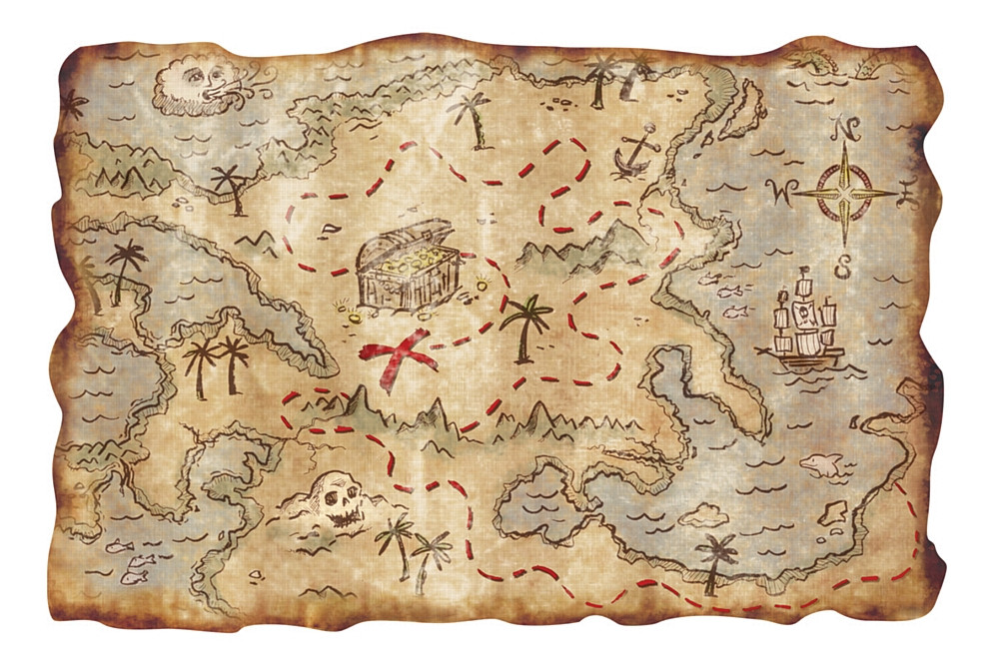
Playing nice with others
Motivation – True Partnership
Requirement – Continually Manage & Adapt
Treat others as equals → Adapt
As the expert
As the novice
Treat clients as clients
Treat external teams as clients
Treat internal teams as clients
EX: The Busy Attorney/Paralegal
EX: The Busy Engineer
EX: Be a translator

Slide 44
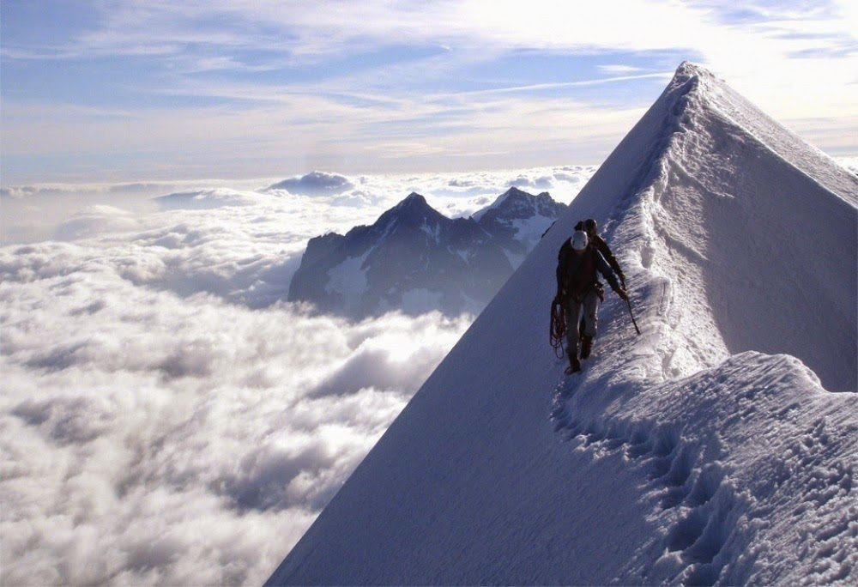
Context is key
Motivation – Navigate the mountain as easily as possible
Requirement – Providing key information to allow for easy access is critical
“I didn't have time to write a short letter, so I wrote a long one instead.” – Mark Twain
EX: Long email vs. short email vs. meeting → Triggers/Thresholds
Tailored communication
Account for relative (not absolute) horsepower
EX: The Top-Tier Engineer

Slide 45

WFH and the new norm
Have you learned from remote work & COVID
Building relationships
Have you learned from the “Great Resignation”
Building relationships
Techniques for balance between flexible + rigid
EX: The Hybrid Model & Key Talent

Slide 46


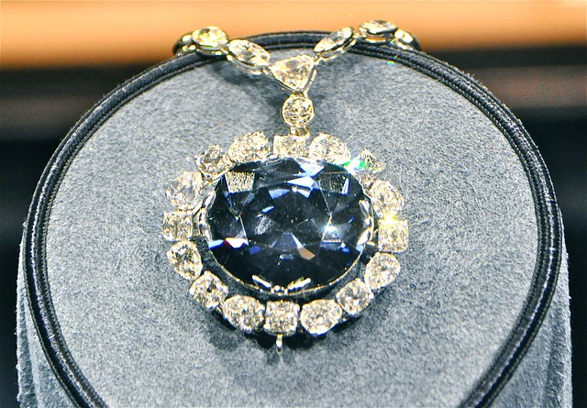

Lastly - Partnership
Remember – This is their baby
Balance macro-level with micro-level management
Vision and looking forward
Build trust
Solidify relationships
Advice vs. Counsel
Clear distinctions
Contingent or saying “No” – don’t be afraid
EX: Standard-Essential Patent Engineers

Slide 47
Summary & Key takeaways

Slide 48
questions

Slide 49
Thank You
Elise Selinger
DexCom, Inc.
Shayne Nelson
eBay, Inc.
Phil Harris
Holland & Hart LLP
pwharris@hollandhart.com

Slide 50
Resources
Workplace Strategies for Technology Lawyers, By David Sclar

