Slide 1
Pay Transparency: The Good, the Bad & the Legal Implications
Mariah L. Passarelli
mpassarelli@cozen.com

Slide 2
The Basics

Slide 3
Pay Equity vs. Pay Transparency
Equity
Transparency
The concept of compensating employees who have similar job functions with comparably equal pay, regardless of their gender, race, ethnicity, or other legally protected status.
The practice of openly displaying employee salary information to existing employees and candidates.

Slide 4
What is old is new again
Pay Equity laws have long existed at both the federal and state levels (with the federal Equal Pay Act (“EPA”) having passed into law in 1963)
Expansion/revision of the concepts within the EPA has occurred in many states over the past several decades
Pay Transparency is the comparatively new frontier, but is really based upon the same core concept – employees and job candidates should know that they are being paid equitably

Slide 5
Federal Law: The Equal Pay Act of 1963
Equal Pay for Equal Work: prohibits employers from paying different wages to men and women who work in jobs that require substantially equal skills, effort, and responsibility and are performed under similar working conditions within the same establishment.
“Equal" work does not mean identical jobs; rather, the jobs must be "substantially equal" in overall job content, even if the position titles are different.
Establishment is a distinct physical place of business rather than an entire business or enterprise consisting of several places of business.
Four affirmative defenses: (1) seniority system, (2) merit system, (3) a system that measures earnings by quantity or by quality of production, or (4) any factor other than sex.
No exhaustion of administrative remedies.
Notes:
NOTES
Protects both men and women
Skill: Measured by factors such as the experience, ability, education, and training required to perform the job. The issue is what skills are required for the job, not what skills the individual employees may have.
Effort: The amount of physical or mental exertion needed to perform a job.
Responsibility: The degree of accountability required to perform the job.
Working Conditions: This encompasses two factors: (1) physical surroundings like temperature, fumes, and ventilation; and (2) hazards.
Establishment: The prohibition against compensation discrimination under the EPA applies only to jobs within an establishment. An establishment is a distinct physical place of business rather than an entire business or enterprise consisting of several places of business. In some circumstances, physically separate places of business may be treated as one establishment. For example, if a central administrative unit hires employees, sets their compensation, and assigns them to separate work locations, the separate work sites can be considered part of one establishment.
"Equal" work does not mean identical jobs; rather, they must be "substantially equal" in overall job content, even if the position titles are different. In order to be considered substantially equal, the job duties must be "closely related" or "very much alike." Thus, minor differences in the job duties, or the skill, effort, or responsibility required for the jobs will not render the work unequal. An agency may have a defense if compensation is based on a seniority system, merit system, systems which measure earnings by quantity or quality of production, or any factor other than sex.

Slide 6
Other Federal Laws
Since passing the EPA, Congress has expanded federal protection against compensation discrimination through a variety of additional laws:
Title VII of the Civil Rights Act of 1964
Age Discrimination in Employment Act of 1967
Section 501 of the Rehabilitation Act of 1973
Lily Ledbetter Fair Pay Act of 2009:
Each paycheck that contains discriminatory compensation is a separate violation regardless of when the discrimination began.
Overturned the Supreme Court's decision in Ledbetter v. Goodyear Tire & Rubber Co., Inc., 550 U.S. 618 (2007), which severely restricted the time period for filing complaints of employment discrimination concerning compensation.
Notes:
NOTES
EPA signed in 1963 by President Kennedy.
These laws also prohibit compensation discrimination on the bases of race, color, national origin, religion, sex (including pregnancy, childbirth and related medical conditions, transgender status, gender identity, sexual orientation and sex stereotyping), age (over 40), marital status, political affiliation and disability. However, these laws have different filing deadlines and standards of proof from the Equal Pay Act, and may not grant Equal Employment Opportunity Commission (EEOC) appeal rights in some cases.
On January 29, 2009, President Obama signed the first piece of legislation of his Administration: the Lilly Ledbetter Fair Pay Act of 2009 ("Act"). This law overturned the Supreme Court's decision in Ledbetter v. Goodyear Tire & Rubber Co., Inc., 550 U.S. 618 (2007), which severely restricted the time period for filing complaints of employment discrimination concerning compensation.

Slide 7
State Law: Pay Transparency
So far, eight (8) states have pay transparency laws on the books:
California
Colorado
Connecticut
Maryland
New York
Nevada
Rhode Island
Washington

Slide 8
Challenges
With a lack of uniformity and widely varying requirements from state-to-state (as well as based on local/municipal laws) complying with pay transparency requirements is a growing challenge for employers
Many of these laws impose requirements for job postings if the candidate in question can work (including remotely) from the state

Slide 9
Key State and Local Laws

Slide 10
California
Effective: January 1, 2023
Applies to: Employers with 15 or more employees, with at least 1 working in California
Requires: Employers must (1) disclose salary range in all job postings, including for jobs that can be done remotely from the state, and (2) disclose position’s salary range to current employees upon request

Slide 11
Colorado
Effective: January 1, 2021
Applies to: Employers with at least 1 employee working in Colorado
Requires: Employers must disclose in all job postings, including for jobs that can be done remotely from the state (1) a salary range, (2) a general description of any bonuses, commissions, or other forms of compensation, and (3) a general description of all benefits

Slide 12
Connecticut
Effective: October 1, 2021
Applies to: Employers with at least 1 employee working in Connecticut
Requires: Employers must provide wage range information to an applicant upon the earliest of (1) the applicant’s request, or (2) prior to or at the time the applicant is made an offer of compensation. Also requires that employers provide an employee the wage range for the employee’s position upon hiring, a change in position, or upon the employee’s request.

Slide 13
Maryland
Effective: October 1, 2020
Applies to: Any employer engaged in business in the state of Maryland
Requires: Employers must provide the wage range to applicants upon request.

Slide 14
Nevada
Effective: October 1, 2021
Applies to: Any employer in Nevada
Requires: Employers must (1) provide applicants who have completed an interview for a position the wage or salary range or rate for the position, (2) provide the wage or salary range or rate for a promotion or transfer to a new position if an employee has (a) applied for the promotion/transfer, (b) completed an interview for the promotion/transfer or been offered the promotion/transfer, or (c) requested the wage or salary range or rate for the promotion/transfer.

Slide 15
New York State
Effective: September 17, 2023
Applies to: Employers with 4 or more employees
Requirements: Employers must (1) disclose the compensation or a range of compensation in any job advertisement, as well as in the context of any promotion or transfer opportunity, and (2) provide the job description for such job, promotion, or transfer opportunity, if such a description exists

Slide 16
New York City
Effective: November 1, 2022
Applies to: Employers with 4 or more employees, with at least one employee in NYC
Requires: Employers must (1) disclose a minimum and maximum annual salary or hourly wage in any advertisement for a job role that will or may be filled in NYC, including for jobs that can be done in the field or remotely from the city, and (2) disclose a minimum and maximum salary range in any posting for internal promotions or transfer opportunities

Slide 17
Rhode Island
Effective: January 1, 2023
Applies to: Rhode Island employers with 1 or more employees in the state
Requires: Employers must disclose (1) the wage range upon applicant’s request and prior to discussing compensation, (2) the wage range for the employee’s position, both at the time of hire and when the employee moves into a new position, and (3) the wage range during the course of employment, upon request by an employee

Slide 18
Washington
Effective: January 1, 2023
Applies to: Employers with 15 or more employees, if they have 1 or more Washington-based employees or if they engage in business in Washington or recruit for jobs that could be filled by a Washington-based employee, including remote jobs
Requires: Employers must disclose (1) the wage scale or salary range and a general description of all the benefits and other compensation in each posting, including for jobs that can be done remotely from the state, and (2) the wage scale or salary range for the employee’s new position, upon request of an employee offered an internal transfer to a new position or promotion.

Slide 19
Closer to Home

Slide 20
Cincinnati and Toledo, Ohio
Effective: March 13 and June 25, 2020, respectively
Applies to: Employers with more than 15 employees in Cincinnati/Toledo
Requires: Employers must provide a salary range upon a candidate’s request after conditional offer of employment is made

Slide 21
Pennsylvania Pay Transparency?
On March 13, 2023, the General Assembly of Pennsylvania proposed HB356. If passed:
Will apply to: Employers with 15 or more employees (unclear whether these individuals must be working in PA)
Requires: Employers must (1) include salary range in all job postings, (2) provide current employees with the salary range for their current role, as well as for jobs within the employer’s business that are substantially similar to the skill, effort, and responsibility required to perform their job.

Slide 22
West Virginia?
Proposed Pay Transparency legislation was briefly considered in West Virginia, but did not pass. Keep an eye out for this to be reintroduced in future sessions.

Slide 23
Pros, Cons, and Legal Implications

Slide 24
Benefits of Pay Transparency
The impact of pay transparency policies on employees and employers has not yet been adequately studied.
Theoretically, pay transparency should increase employee satisfaction because employees generally value clear and open communication with their employers. To be sure, however, this will only be true if employees like what they see!
Pay Transparency could also be a very helpful tool in assisting (read: motivating) employers to close unlawful pay gaps

Slide 25
Drawbacks of Pay Transparency
Transparent pay may make it more difficult for employers to attract and retain talent in an already tight job market
Pay transparency could pit employees against each other
Pay differences may be taken out of context by employees
If unlawful pay practices are revealed through pay transparency (particularly for existing employees), EPA and Title VII litigation may follow

Slide 26
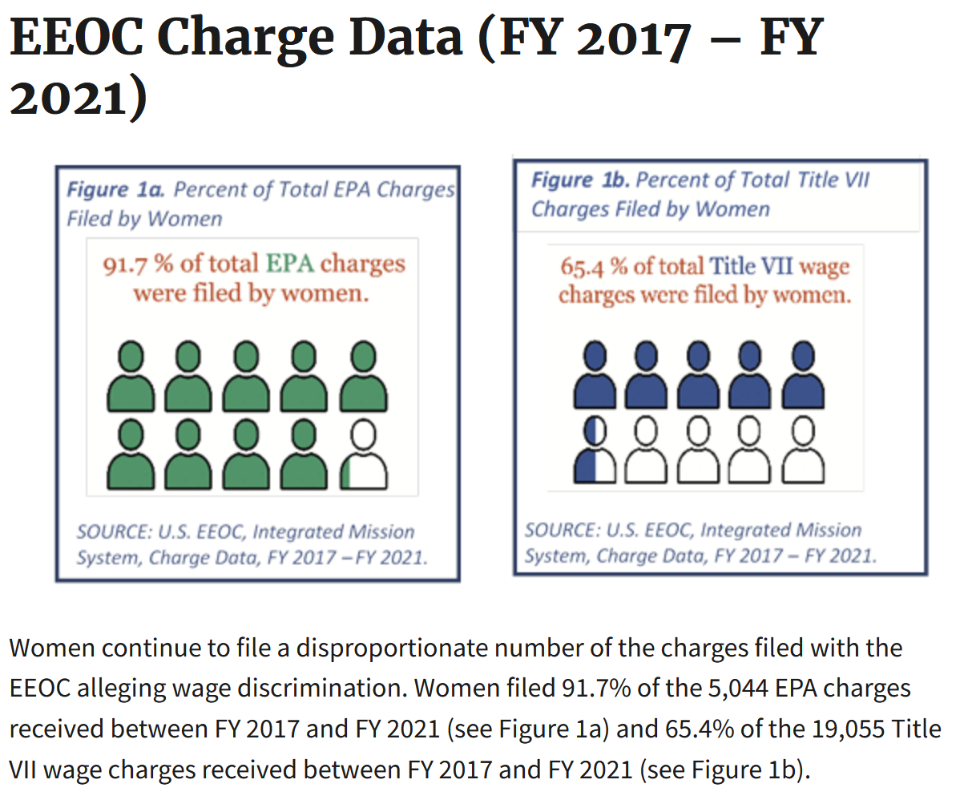
EEOC Charge Data
Source: The Continuing Impact of Pay Discrimination in the United States. Office of Enterprise Data and Analytics (OEDA) Data Highlight No. 1. U.S. Equal Employment Opportunity Commission (EEOC), Washington, DC, March 2022.
Notes:
Nike:
1. Is the California Equal Pay Act new?
No, for decades now, the California Equal Pay Act has prohibited an employer from paying its employees less than employees of the opposite sex for equal work. However, in 2015, Governor Brown signed the California Fair Pay Act, which strengthened the Equal Pay Act in a number of ways and signaled California’s commitment to achieving real gender pay equity.
A group of female employees suing Nike Inc. for alleged systemic sex discrimination in pay and promotions won’t get the chance to review internal pay equity studies the company compiled with the assistance of outside counsel, the District of Oregon ruled.
The documents are all shielded under the attorney-client privilege and litigation work-product doctrine, the court said.
Kelly Cahill and a proposed class of 500 or more female employees at the company’s Beaverton headquarters sought production of pay equity analyses that Nike first began compiling in 2016.
They allege in the August 2018 lawsuit that they were harmed by bias that included the use of salary history to set starting pay and other unlawful practices that marginalize the performance of women at Nike HQ and stunt their career growth.
Nike retained Seyfarth Shaw LLP and human resources experts for legal advice to develop statistical models to analyze its pay and promotion practices and to validate those models to identify factors that might explain differences in pay, the U.S. District Court for the District of Oregon said. The advice was sought to help Nike’s internal legal team remediate risk arising from or relating to pay or promotion discrepancies affecting protected-class workers, the court said.
The company also established that it implemented privilege protocols and guidelines for maintaining attorney-client privilege in developing and distributing the pay analyses and related correspondence, Magistrate Judge Jolie E. Russo said.
That Nike also had a business purpose for compiling the analyses didn’t waive the attorney-client privilege, the judge said. The documents were prepared for a primarily legal purpose, she said.
The company also demonstrated that the documents compiled by Seyfarth, as well as those created by Mercer, a consulting firm, and law firm Willis Towers Watson, fall under the work-product shield, the court said.
The pay studies were spurred by Nike’s receipt of Equal Employment Opportunity Commission charges alleging pay bias and internal complaints and litigation demand letters, the court said. Nike sought Seyfarth’s and the HR experts’ advice “to address potential legal liabilities for pay inequities,” Russo said, in denying the women’s motion to compel discovery.
The court rejected the women’s argument that any privilege was waived because Nike is using the pay analyses both as a shield, to insulate the documents from discovery, and as a sword, to thwart the women’s claims by offering the studies as a defense.
It isn’t clear yet what support the company will offer to back its affirmative defenses, Russo said in the Oct. 9 ruling.
The women were also wrong that Nike waived privilege by not serving privilege logs earlier in the litigation, Russo said. The “magnitude” of the discovery undertaken and exchanged by the parties to date justified any delay by Nike, she said.

Slide 27
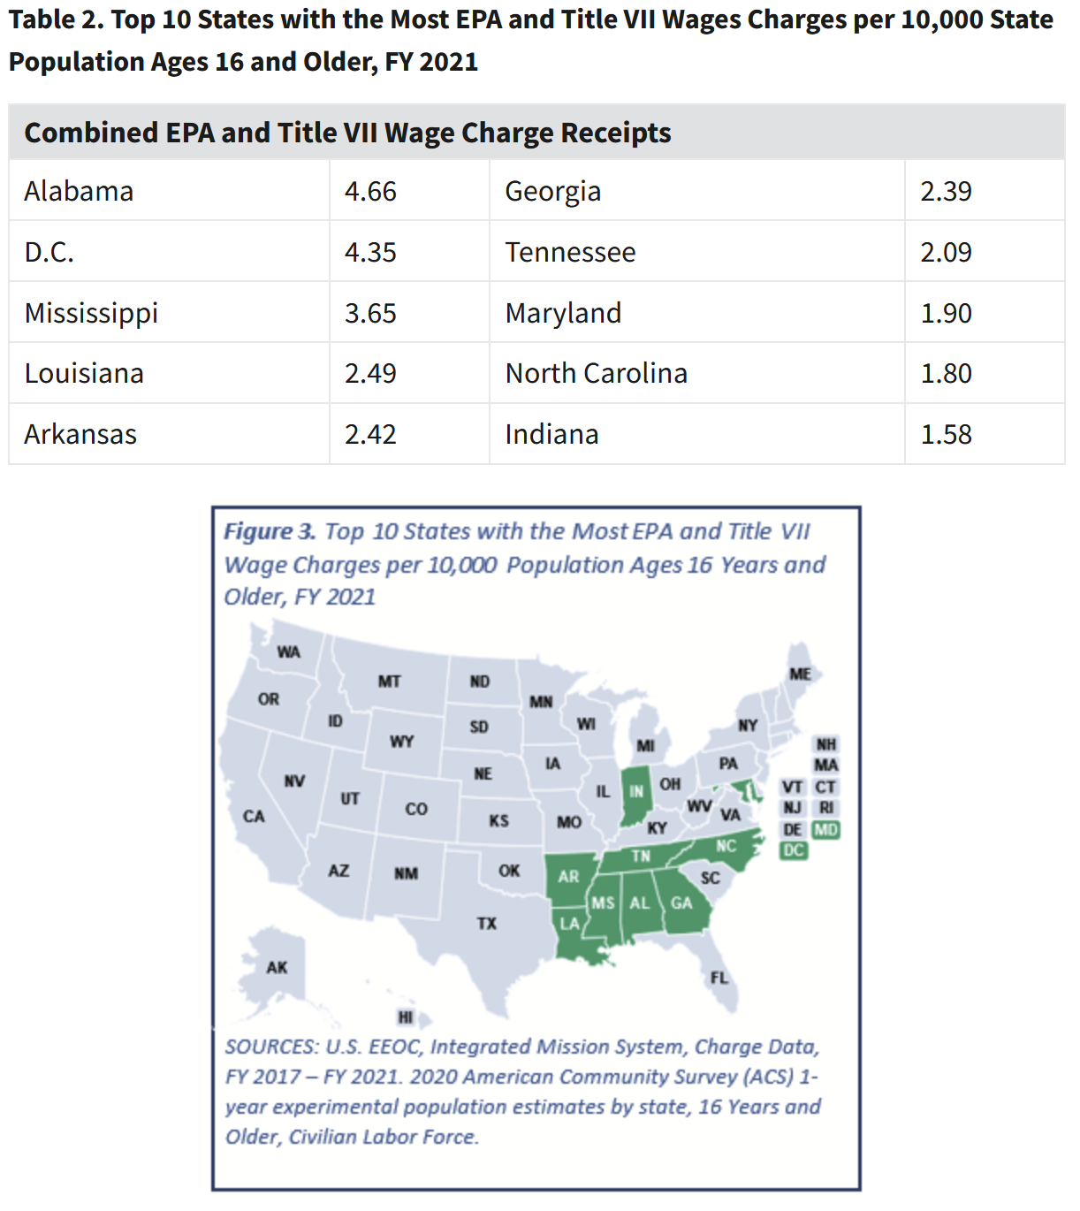
EEOC Charge Data (cont’d)
Source: The Continuing Impact of Pay Discrimination in the United States. Office of Enterprise Data and Analytics (OEDA) Data Highlight No. 1. U.S. Equal Employment Opportunity Commission (EEOC), Washington, DC, March 2022.
Notes:
Nike:
1. Is the California Equal Pay Act new?
No, for decades now, the California Equal Pay Act has prohibited an employer from paying its employees less than employees of the opposite sex for equal work. However, in 2015, Governor Brown signed the California Fair Pay Act, which strengthened the Equal Pay Act in a number of ways and signaled California’s commitment to achieving real gender pay equity.
A group of female employees suing Nike Inc. for alleged systemic sex discrimination in pay and promotions won’t get the chance to review internal pay equity studies the company compiled with the assistance of outside counsel, the District of Oregon ruled.
The documents are all shielded under the attorney-client privilege and litigation work-product doctrine, the court said.
Kelly Cahill and a proposed class of 500 or more female employees at the company’s Beaverton headquarters sought production of pay equity analyses that Nike first began compiling in 2016.
They allege in the August 2018 lawsuit that they were harmed by bias that included the use of salary history to set starting pay and other unlawful practices that marginalize the performance of women at Nike HQ and stunt their career growth.
Nike retained Seyfarth Shaw LLP and human resources experts for legal advice to develop statistical models to analyze its pay and promotion practices and to validate those models to identify factors that might explain differences in pay, the U.S. District Court for the District of Oregon said. The advice was sought to help Nike’s internal legal team remediate risk arising from or relating to pay or promotion discrepancies affecting protected-class workers, the court said.
The company also established that it implemented privilege protocols and guidelines for maintaining attorney-client privilege in developing and distributing the pay analyses and related correspondence, Magistrate Judge Jolie E. Russo said.
That Nike also had a business purpose for compiling the analyses didn’t waive the attorney-client privilege, the judge said. The documents were prepared for a primarily legal purpose, she said.
The company also demonstrated that the documents compiled by Seyfarth, as well as those created by Mercer, a consulting firm, and law firm Willis Towers Watson, fall under the work-product shield, the court said.
The pay studies were spurred by Nike’s receipt of Equal Employment Opportunity Commission charges alleging pay bias and internal complaints and litigation demand letters, the court said. Nike sought Seyfarth’s and the HR experts’ advice “to address potential legal liabilities for pay inequities,” Russo said, in denying the women’s motion to compel discovery.
The court rejected the women’s argument that any privilege was waived because Nike is using the pay analyses both as a shield, to insulate the documents from discovery, and as a sword, to thwart the women’s claims by offering the studies as a defense.
It isn’t clear yet what support the company will offer to back its affirmative defenses, Russo said in the Oct. 9 ruling.
The women were also wrong that Nike waived privilege by not serving privilege logs earlier in the litigation, Russo said. The “magnitude” of the discovery undertaken and exchanged by the parties to date justified any delay by Nike, she said.

Slide 28
What can you do?
Determine whether your company is operating in a state or municipality with a pay transparency law. Be sure to consider whether you are advertising positions that may be filled by individuals who will be working from these locations.
Create a check-list of disclosure requirements and review each job posting (including, if applicable, promotion/transfer posting) for compliance.
Establish a method of clear reporting and communication with employees in jurisdictions where this information must be provided to existing employees.
Enlist the help of legal counsel if you are unsure of how to proceed.

