Slide 1
PRIVACY, SECURITY & RISK VISIBILITY 2024
ACC Mountain West Chapter 2024 Tech Law Symposium
March 1, 2024

Slide 2
INTRODUCTION
“Ripped from the Headlines” –
Top Security Threats
Legal and Regulatory Update Alphabet Soup
Third Party Risk
In Search of . . . “Reasonableness”
Evolution of Reasonable Security
Do Your SOCs Match Your Outfit?
Do as I Say, Not As I Do
Where Do I Start?

Slide 3
SECURITY V. PRIVACY
Security
Protection of data and sensitive information against unauthorized access, disclosure, and use.
Data is reliable and accurate
Data is available for use when it is needed
Privacy
Right to control how your information is collected, stored, shared, and used.
Notice, transparency, and consent.
Access, use, and sharing of personal information in authorized manner
Protection of
personal information
Source: http://www.healthtechsydney.com.au/blog/2016/03/07/privacy-as-a-strategic-advantage-for-healthcare-products-services/

Slide 4
FORBES 5 TOP SECURITY THREATS 2023
Business Email Compromise (BEC)
Experts are particularly concerned with accounting departments. There is an uptick in attackers requesting a direct deposit change.
While this use to target higher paid employees, lately the focus has been mid-level employees.
Malware & Ransomware Attacks
Experts believe attacks will increase for US government contractors or other entities whose goods or services are aiding Ukraine in the war because of Russia’s state-sponsored organized crime team.
Crypto Scams & ‘Pig Butchering’
Individuals have a new threat referred to as ‘pig butchering.’ Attackers online are convincing others to invest in crypto with very large initial returns in hopes of obtaining further investments. Once the investments are suitable, the hacker drains the account.
Innovation in the Cybercrime Cash-out Process
Cybercriminals in the crypto space using “crypto mixing services” by taking in traceable ‘dirty’ money, cleaning it, and providing gift cards since they are not traceable.
Cybercrime & Scamming as a Service
Underground virtual marketplaces are providing end-to end services that enable low-skill threat actors to procure stolen credentials, credit card numbers, phishing kits and more. This is increasing the number of attackers.

Slide 5
FORBES TOP 7 SECURITY THREATS 2024
State Sponsored Attacks
Ransomware Double Extortion
Supply Chain Attacks
Internet of Things (IoT)
Quantum Computing
CISO Burnout
Insider Threats

Slide 6
2023 IAPP Year End STATE LAW Recap
In Effect - 2023
California
Colorado
Connecticut
Utah
Virginia

Slide 7
IAPP Comprehensive Privacy LAW Map

Slide 8
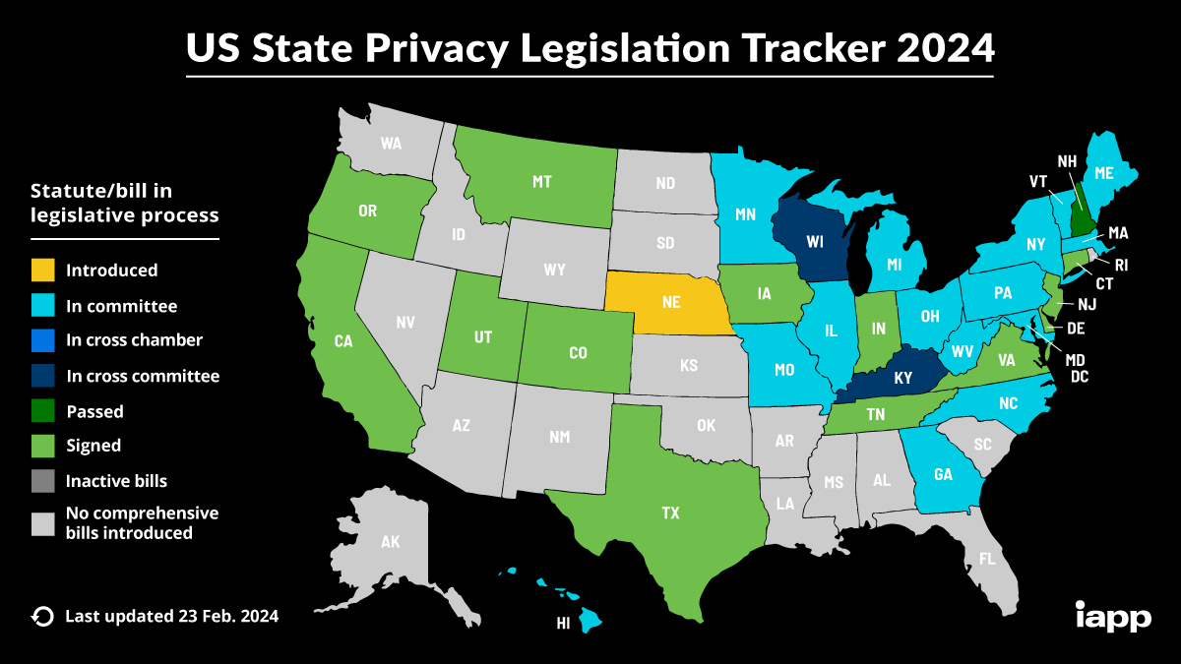
IAPP Comprehensive Privacy LAW Map

Slide 9
ALPHABET SOUP OF COMPLIANCE
Cable Act
COPPA
Dodd – Frank Act
FERPA
FTC ACT (Section 5)
GLBA
GDPR
HIPAA
NYFDS Cybersecurity Regulations
Privacy Act
PCI-DSS
SEC Rule Cybersecurity Risk Management, Strategy, Governance, and Incident Disclosure
SOX
TCPA
VPPA

Slide 10
AI Updates
EU AI Act:
The four-column document with 892 pages was leaked online
The timeline to agree on a final text remains tight as parliamentary elections take place this June
In general, the AI Act would enter into force on the 20th day after publication in the EU Official Journal and enter into application 24 months after entry into force, except for specific provisions.
Politics: AI-generated Biden robocall urges Democrats not to vote
McAfee unveils AI-powered deepfake audio detection

Slide 11
DATA SPRAWL

Slide 12
THIRD PARTY RISK
Third Party and Nth party breaches are likely underreported. Only 35% of study respondents say they are monitoring third party data handling practices with Nth parties.
59% of organizations have experienced a data breach caused by a third-party provider.
61% of organizations say they do not have a comprehensive inventory of third parties with whom they share information.
-The 2022 Data Risk in the Third-Party Ecosystem Study, Ponemon Institute, LLC, September, 2022

Slide 13
The MOAB- Mother of all Breaches
Researchers from Security Discovery and CyberNews, discovered 12 terabytes in size (26 billion records) database of leaked data
The database was found on an open storage instance
The compromised data includes more than just login credentials, much of it is “sensitive,” making it “valuable for malicious actors” per Cybernews
Dropbox, LinkedIn, Twitter already named, and the researchers also say that records from an assortment of U.S. and other government organizations can be found

Slide 14
IN SEARCH OF . . . REASONABLENESS
EVOLUTION OF REASONABLE SECURITY

Slide 15
Reasonable Security Evolution
GLBA (1999)
Safeguards Rule (2003)-For Financial Institutions:
(a) Information Security Program. You shall develop, implement, and maintain a comprehensive information security program that is written in one or more readily accessible parts and contains administrative, technical, and physical safeguards that are appropriate to your size and complexity, the nature and scope of your activities, and the sensitivity of any customer information at issue. The information security program shall include the elements set forth in § 314.4 and shall be reasonably designed to achieve the objectives of this part, as set forth in paragraph (b) of this section.
(b) Objectives. The objectives of section 501(b) of the Act, and of this part, are to:
(1) Insure the security and confidentiality of customer information;
(2) Protect against any anticipated threats or hazards to the security or integrity of such information; and
(3) Protect against unauthorized access to or use of such information that could result in substantial harm or inconvenience to any customer.

Slide 16
Reasonable Security Evolution
201 CMR 17.00: STANDARDS FOR THE PROTECTION OF PERSONAL INFORMATION OF RESIDENTS OF THE COMMONWEALTH
(1) Every person that owns or licenses personal information about a resident of the Commonwealth shall develop, implement, and maintain a comprehensive information security program that is written in one or more readily accessible parts and contains administrative, technical, and physical safeguards that are appropriate to: (a) the size, scope and type of business of the person obligated to safeguard the personal information under such comprehensive information security program; (b) the amount of resources available to such person; (c) the amount of stored data; and (d) the need for security and confidentiality of both consumer and employee information. The safeguards contained in such program must be consistent with the safeguards for protection of personal information and information of a similar character set forth in any state or federal regulations by which the person who owns or licenses such information may be regulated.

Slide 17
Reasonable Security Evolution
Art. 32 GDPR (25 May 2018)
1. Taking into account the state of the art, the costs of implementation and the nature, scope, context and purposes of processing as well as the risk of varying likelihood and severity for the rights and freedoms of natural persons, the controller and the processor shall implement appropriate technical and organisational measures to ensure a level of security appropriate to the risk, including inter alia as appropriate:
the pseudonymisation and encryption of personal data;
the ability to ensure the ongoing confidentiality, integrity, availability and resilience of processing systems and services;
the ability to restore the availability and access to personal data in a timely manner in the event of a physical or technical incident;
a process for regularly testing, assessing and evaluating the effectiveness of technical and organisational measures for ensuring the security of the processing.

Slide 18
Reasonable Security Evolution
2016 California Data Breach Report, Kamala D. Harris, Attorney General
“Securing data is no doubt challenging, with sophisticated cyber criminals – including some nation states – waging an escalating battle. But many of the breaches reported to us could have been prevented by taking reasonable security measures, and an organization that voluntarily chooses to collect and retain personal information takes on a legal obligation to adopt appropriate security controls.”

Slide 19
Reasonable Security Evolution
The 20 controls in the Center for Internet Security’s Critical Security Controls identify a minimum level of information security that all organizations that collect or maintain personal information should meet. The failure to implement all the Controls that apply to an organization’s environment constitutes a lack of reasonable security.
Organizations should make multi-factor authentication available on consumer-facing online accounts that contain sensitive personal information. This stronger procedure would provide greater protection than just the username-and-password combination for personal accounts such as online shopping accounts, health care websites and patient portals, and web-based email accounts.
Organizations should consistently use strong encryption to protect personal information on laptops and other portable devices, and should consider it for desktop computers. This is a particular imperative for health care, which appears to be lagging behind other sectors in this regard.

Slide 20
Reasonable Security Evolution
FTC enforcement action examples in determining “reasonable security”:
Includes yearly employee training, access controls, monitoring systems for data security incidents, patch management systems, and encryption
Assessors should identify evidence to support conclusions on security, including independent sampling, employee interviews, and document review
Companies are required to present their Board or similar governing body with a WISP and have senior management provide annual certifications of compliance.
This forces senior managers to gather detailed information about a company’s information security program and be knowledgeable about the program

Slide 21
IN SEARCH OF . . . REASONABLENESS
DO YOUR SOCS MATCH YOUR OUTFIT?

Slide 22
NIST CYBERSECURITY FRAMEWORK

Slide 23
CIS 18 CRITICAL SECURITY CONTROLS

Slide 24
Do Your SOCs Match Your Outfit?
Compliance and Audits
What security methodology and standards do you or they follow?
SOC 1, 2, 3
ISO/IEC 27000/27001
PCI-DSS
NIST Cybersecurity Framework
How do you or they verify/audit compliance?
How frequently do you or they audit?
Do you or they have certification?
What is the scope of the audit?

Slide 25
IN SEARCH OF . . . REASONABLENESS
Do as I say, not as I do

Slide 26
SOLAR WINDS
SEC charged SolarWinds and its CISO (Timothy Brown) with fraud and internal control failures
The SEC alleges SolarWinds misled investors about its cybersecurity practices leading up to the Sunburst attack discovered in December 2020.
The SEC alleges SolarWinds overstated its cybersecurity practices and failed to disclose known risks when the company went public (2018-Attack).
CISO Tim Brown is said to have ignored repeated red flags.
The SEC is seeking:
permanent injunctive relief,
disgorgement with prejudgment interest, civil penalties, and
to bar Brown from serving as an officer or director.

Slide 27
Solar Winds
SolarWinds promoted SolarWinds with (false) public statements about its security practices.
Similarly, SolarWinds made false statements about their cybersecurity practices in SEC filings.
SolarWinds also didn’t disclose “red flags” that led up to the SUNBURST attack.
They didn’t fully disclose the impact of the SUNBURST attack once it happened.
SolarWinds had multiple internal control failures.

Slide 28
SOLAR WINDS
By: Ryan McGheehan

Slide 29
And more
SOLAR WINDS
By: Ryan McGheehan

Slide 30
Gurbir Grewal,
SEC - Director of the Enforcement Division
-----------------------------------------------------------------
“Rather than address these vulnerabilities, SolarWinds and Brown engaged in a campaign to paint a false picture of the company’s cyber control environment, thereby depriving investors of accurate material information”
------------------------------------------------------------------

Slide 31
SOLAR WINDS
Risk management and disclosure are key complaints by the SEC
It’s vital that if you have a stated policy, you follow that policy.
Learn from the mistakes that others are making
“The bottom line is not to be a SolarWinds — look at your own failings and ensure that you are honest with yourself, your customers, and more importantly your investors.”
-Source: “The SEC action against SolarWinds highlights how tough it can get for CISOs”, csoonline.com, Dec. 12, 2023.

Slide 32
Solar Winds – Moving Forward
SOLAR WINDS
Review & revise cybersecurity policies, procedures & playbooks.
Maintain a detailed risk register & document to whom, how and when you communicate risks.
Delineate what is current practice & what is aspirational.
Avoid the use of superlatives or all-encompassing words such as “all” or “every,” unless there’s clear evidence to support it.
Encourage formal documentation & shorten retention of informal conversations.
If required to file Item 1.05 of Form 8-K, work with your legal and cybersecurity team(s) to ensure it is accurate & comprehensive.
Summer Fowler – IANS Faculty

Slide 33
IN SEARCH OF . . . REASONABLENESS
Ok then, where do I start?

Slide 34
KNOW YOUR DATA/ASSETS

Slide 35
EFFORT LEVEL IS DETERMINED BY RISK
Diligence effort should be tied to RISK that data exposes you to, which includes
Harm to customers, employees, consumers
Harm to reputation
Business and distraction value
Breach investigation, notification, remediation
Criminal and/or civil lawsuits
Regulatory action, fines, penalties

Slide 36
LAYERED SECURITY CONCEPTS
A layered security model works by implementing multiple security measures at different layers or levels of a system or network. Each layer of security provides a unique form of protection, and attackers must bypass multiple layers to gain access to sensitive information or systems. Here’s how a layered security model typically works:
Physical Security: The first layer of security is often physical security measures, such as locks, access control systems, and security cameras. This layer is designed to prevent unauthorized physical access to the facility or data center.
Network Security: This layer is designed to protect against network-based attacks and prevent unauthorized access to the network through the use of firewalls, intrusion detection systems, and antivirus software.
Application Security: The third layer of security is application security, which includes measures such as secure coding practices, penetration testing, and vulnerability assessments. This layer is designed to protect against application-level attacks, such as cross-site scripting or SQL injection.
Data Security: The fourth layer of security is data security, which includes measures such as encryption, access controls, and backup and recovery procedures. This layer is designed to protect against theft and loss of data, or unauthorized access to sensitive information.
User Education: The final layer of security is user education, which involves educating employees on best security practices, such as strong password management, phishing awareness, and social engineering awareness. This layer is designed to mitigate the risk of human error, which is a major contributing factor to security breaches.
See source: https://identitymanagementinstitute.org/layered-security-model

Slide 37
THIRD PARTY RISK MITIGATION

Slide 38
Reasonable Security Measures
Encryption
Encrypt data at rest and during transit.
WISP
Implement and maintain a comprehensive written information security program.
Employee and Agent controls
Implement and maintain policies, processes, and controls to ensure that employees and agents only access, process, and retain data that is pertinent to their duties, especially for sensitive data.
Terminated employees and agents should have access terminated immediately upon termination.
Personnel training for security incidents and reporting a security incident.
Vendors/Third Parties
Reasonable due diligence to select and ensure that vendors/third parties have security to protect data shared with the vendor/third party.
Contractually require vendors/third parties to only process data for the purposes given to those vendors/third parties.
Security Incident/Data Breach
Implement and maintain an Incident Response Plan for security incidents and data breaches.
Perform periodic table top exercises.
Retention of information
Only retain information for as long as needed or as required by law.
Securely dispose of information no longer needed.
Review controls
Periodically review all security controls, processes, and policies to ensure they are still adequate in light of changes to technology, the types of data being held, and the uses of the data.
Self audit and/or third party audit the safeguards and repair any material deficiencies.

Slide 39
PROACTIVE MEASURES
Adopt and continuously review and optimize your cybersecurity program;
Conduct regular risk assessments and actually follow up on key areas of concern;
Manage third party risks; make sure you are covered in your agreements with third parties, service providers, contractors for the risks they may bring and ensure to conduct due diligence such that you’re contracting with others who have proper cybersecurity response plans in place;
Train all of your employees – not just top management
In a study conducted about what companies are the most subject to data breaches, a direct link was found between a company’s privacy posture and the likelihood of publicly reported breach in the past 15 years.
Why is this? A company that truly focuses on privacy tends to have a culture of privacy within the organization, preventing something as small as a phishing email from being clicked, it has limited amounts of data that is shared with its third-party vendors, and it updates its privacy practices to adapt to new technologies.
These practices seem straightforward, yet it's reported that 2 out of 3 data breaches are because of a third party.
Report: https://cdn.osano.com/hubfs/assets/marketing/white-papers/data-privacy-and-data-breach-link.pdf

Slide 40
NACD 5 KEY OVERSIGHT STEPS
Understand and approach cybersecurity as an enterprise-wide risk management issue, not just an IT issue
Understand the legal implications of cyber security risks as they relate to their company’s specific circumstances
Board members and management should have adequate access to cybersecurity expertise, and discussions about cyber-risk management should be given regular and adequate time on the meeting agenda
Set the expectation that management will establish an enterprise-wide cyber-risk management framework with adequate staffing and budget
Discussions of cyber-risk should include identification of what risks to avoid, accept, mitigate, or transfer through insurance, as well as specific plans associated with each approach

Slide 41
Reasonable Security
No One Size Fits All
Reasonableness of Security = size and complexity of company & sensitivity of data held
Can Be Tied to General Industry Norms or Laws
Gramm Leach Bliley Act
Reasonable administrative, technical, and physical safeguards to protect the security, confidentiality, and integrity of customer information
CCPA and other state breach statutes
CCPA Law - [a]ny consumer whose nonencrypted and nonredacted personal information . . . is subject to unauthorized access and exfiltration, theft or disclosure as a result of the business’s violation of the duty to implement and maintain reasonable security procedures and practices appropriate to the nature of the information to protect the personal information
ISO/NIST standards
Improvement vs Finalized Process
Process does not need to be perfect right away, but steps should be taken to continually improve process to get it to where it needs to be.

Slide 42
Thank you – any questions?

