Slide 1
THE WIRELESS BARBARIANS: AI, CYBERSECURITY THREATS, DATA PRIVACY & PROTECTION
April 24, 2025
presented by:
Ron Schuler, Esq., Member, Spilman Thomas & Battle PLLC
Julian Neiser, Esq., Member, Spilman Thomas & Battle, PLLC

Slide 2

Ronald W. Schuler, Esq.
Ron is the Managing Member of the Pittsburgh Spilman office, and serves as Chair of the Firm’s Securities Law Practice and Co-Chair of its Mergers and Acquisitions Practice Group.
He is a corporate, securities and commercial transactions lawyer with extensive experience in mergers and acquisitions, public offerings, private placement financings, and numerous types of contracts for clients within the energy, software, cryptocurrency, biotechnology and technology industries.
www.spilmanlaw.com
West Virginia | North Carolina
Pennsylvania | Virginia | Florida

Slide 3
Julian Neiser, Esq.
Julian is Chair of the firm’s Litigation Department and Co-Chair of its Construction Practices Group. As a commercial trial lawyer, he has litigated numerous cases to verdict in state/federal courts and private arbitration panels. He regularly counsels clients on risk management and litigation avoidance through effective contracting and project management. He also is a member of the firm’s AI committee and advises clients on cybersecurity and data privacy.
www.spilmanlaw.com
West Virginia | North Carolina
Pennsylvania | Virginia | Florida

Slide 4
Why Data Privacy Matters for Businesses
Regulatory Compliance: Avoiding legal penalties
Reputation and Trust: Protecting brand value
Competitive Advantage: Gaining customer trust
Risk Mitigation: Reducing potential for breaches and lawsuits
www.spilmanlaw.com
West Virginia | North Carolina
Pennsylvania | Virginia | Florida

Slide 5
Key Data Protection & Privacy Challenges
Global Compliance: Navigating GDPR, CCPA, and other regulations
Cross-Border Data Flows: Handling international data transfers
Emerging Technologies: AI, IoT, data analytics
Data Breaches: Cyberattacks and insider threats
www.spilmanlaw.com
West Virginia | North Carolina
Pennsylvania | Virginia | Florida

Slide 6
Overview of Data Privacy Laws
GDPR (EU): General Data Protection Regulation
Applies to businesses handling EU citizen data
Strict requirements on consent, data access, and security
CCPA (California): California Consumer Privacy Act
Focuses on data access, deletion, and consumer rights
Other Regulations and Standards: HIPAA (healthcare), FTCA, PCI DSS, etc.
www.spilmanlaw.com
West Virginia | North Carolina
Pennsylvania | Virginia | Florida

Slide 7
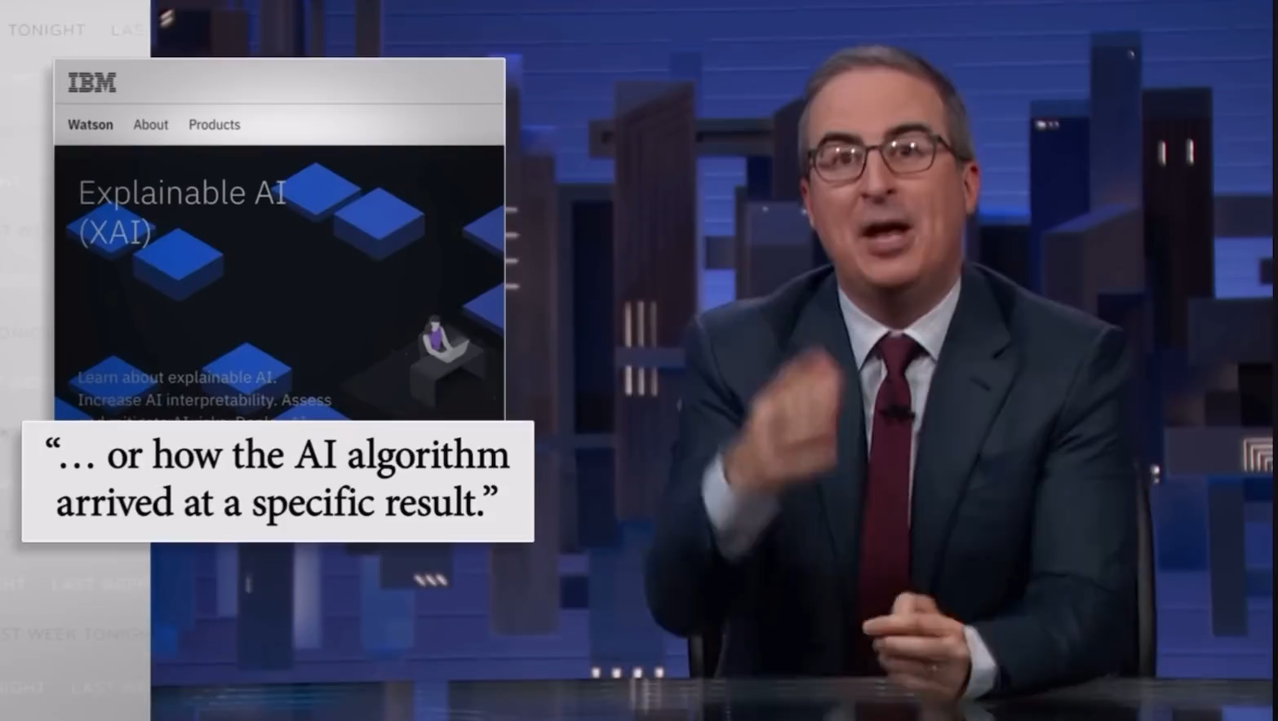
AI: The “Black Box Problem”
The "black box problem" refers to the challenge of understanding how complex AI models, particularly deep learning algorithms, arrive at their decisions or predictions.
www.spilmanlaw.com
West Virginia | North Carolina
Pennsylvania | Virginia | Florida

Slide 8
Results of the “Black Box Problem”
Lack of Transparency:
The internal workings of AI systems can be opaque, making it hard to see how inputs are transformed into outputs.
Accountability Issues:
If decisions made by AI lead to negative outcomes (e.g., biased hiring practices, unfair credit scoring), it can be challenging to determine who is responsible.
Regulatory and Ethical Concerns:
Many industries are considering regulations that require transparency and accountability in AI, which complicates the deployment of such systems.
Trust and Adoption:
Users may be hesitant to trust and adopt AI solutions if they don't understand how they work or why they make certain decisions.
www.spilmanlaw.com
West Virginia | North Carolina
Pennsylvania | Virginia | Florida

Slide 9
Legal Risks of AI and the “Black Box Problem”
AI as Intellectual Property
Ownership, Fair Use, and AI-assisted Creations
Commercial Transactions Involving AI
AI in the Courtroom
www.spilmanlaw.com
West Virginia | North Carolina
Pennsylvania | Virginia | Florida

Slide 10
Best Practice
Key Principles:
Proactive not reactive
Privacy as the DEFAULT setting
Full lifecycle protection
Business Benefits: reduces compliance risks and costs
www.spilmanlaw.com
West Virginia | North Carolina
Pennsylvania | Virginia | Florida

Slide 11
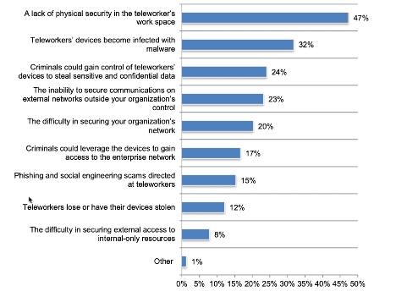
Cybersecurity Threats Continue to Rise
Humans are the weakest link
70% of office workers use work devices for personal tasks (Source).
37% of office workers use their personal computers to access work applications (Source).
57% of data breaches could have been prevented by installing an available patch.
www.spilmanlaw.com
West Virginia | North Carolina
Pennsylvania | Virginia | Florida
Source: https://www.ninjaone.com/blog/smb-cybersecurity-statistics/

Slide 12
Cybersecurity Threats Continue to Rise
Hackers can infiltrate 93% of business networks
30% of small businesses view phishing as their biggest cyber threat.
83% of small and medium-sized businesses are not prepared to recover from the financial damages of a cyber attack.
91% of small businesses have not purchased cyber liability insurance, despite an awareness of risk and the likelihood that they would be unable to recover from an attack.
www.spilmanlaw.com
West Virginia | North Carolina
Pennsylvania | Virginia | Florida
Source: https://www.ninjaone.com/blog/smb-cybersecurity-statistics/

Slide 13
Cybersecurity Threats Continue to Rise
The simplicity and efficacy of ransomware continue to make it a preferred choice for hackers
Malware increased by 358% and ransomware increased by 435% in 2020.
Worldwide ransomware damages and ransom payments added up to over $20 billion in 2021. This number is expected to increase to more than $265 billion by 2031.
Research on known ransomware victims shows that while 32% pay the ransom, they only get an average of 65% of their data back.
Only 57% of ransomware attacks have been successfully mitigated by restoring backups.
www.spilmanlaw.com
West Virginia | North Carolina
Pennsylvania | Virginia | Florida
Source: https://www.ninjaone.com/blog/smb-cybersecurity-statistics/

Slide 14
Cybersecurity Threats Continue to Rise
Takeaways
Cloud attacks are on the rise.
Third party attacks are on the rise.
It isn’t a matter of if you will be attacked, it’s when.
www.spilmanlaw.com
West Virginia | North Carolina
Pennsylvania | Virginia | Florida
Source: https://www.ninjaone.com/blog/smb-cybersecurity-statistics/

Slide 15
COPYRIGHT OWNERSHIP
Since AI lacks personhood, authorship and ownership become contentious. Does it belong to the programmer, the user, or is it public domain?
www.spilmanlaw.com
West Virginia | North Carolina
Pennsylvania | Virginia | Florida

Slide 16
Copyright Ownership Issues
Presented by AI
Input Issues
Copyrighted material may be infringed if used while training the AI.
Use in this context may fall within the fair use exception to infringement.
Output Issues
New content generated may also infringe on original work if exact copy or “substantially similar.”
Creates copyrightability questions.
www.spilmanlaw.com
West Virginia | North Carolina
Pennsylvania | Virginia | Florida
Source: https://www.ninjaone.com/blog/smb-cybersecurity-statistics/

Slide 17
Copyright Ownership Issues
Presented by AI
Infringement Case Examples
Author’s guild v. Google, Inc.
New York Times v. OpenAI
Andersen v. Stability AI Ltd.
www.spilmanlaw.com
West Virginia | North Carolina
Pennsylvania | Virginia | Florida
Source: https://www.ninjaone.com/blog/smb-cybersecurity-statistics/

Slide 18
Copyright Ownership Issues
Presented by AI
Fair Use
Always a case-by-case analysis.
Four Factors:
Purpose and character of use.
Nature of the copyrighted work.
Amount or substantiality of the portion used.
Effect of the use on the market/value of the work.
www.spilmanlaw.com
West Virginia | North Carolina
Pennsylvania | Virginia | Florida
Source: https://www.ninjaone.com/blog/smb-cybersecurity-statistics/

Slide 19
Copyright Ownership Issues
Presented by AI
Registration Case Examples
Thaler v. Perlmutter
Kashtanova’s “Zarya of the Dawn”
www.spilmanlaw.com
West Virginia | North Carolina
Pennsylvania | Virginia | Florida
Source: https://www.ninjaone.com/blog/smb-cybersecurity-statistics/

Slide 20
Copyright Ownership Issues
Presented by AI
Copyrightability of AI Generated Works
Authors of copyrightable works must be human under U.S. copyright law.
Works generated purely by AI without human involvement = NOT copyrightable.
Most works will fall on a spectrum.
Was AI used to brainstorm? To create components? To create whole works?
The more AI is relied upon, the more the author may have to disclaim.
www.spilmanlaw.com
West Virginia | North Carolina
Pennsylvania | Virginia | Florida
Source: https://www.ninjaone.com/blog/smb-cybersecurity-statistics/

Slide 21
Best Practices
Data Encryption: Protect sensitive data in transit and at rest
Access Control: Limit access to data on a need-to-know basis
Regular Audits: Monitor compliance and detect vulnerabilities
Incident Response Plans: Prepare for potential breaches
Employee Training: Build a security-first culture
Contract and Policy Review: Regular review by counsel
www.spilmanlaw.com
West Virginia | North Carolina
Pennsylvania | Virginia | Florida

Slide 22
THE WIRELESS BARBARIANS: AI, CYBERSECURITY THREATS, DATA PRIVACY & PROTECTION
April 24, 2025
presented by:
Ron Schuler, Esq., Member, Spilman Thomas & Battle PLLC
Julian Neiser, Esq., Member, Spilman Thomas & Battle, PLLC

