Slide 1


Navigating Cross-Border Transactions
Lessons Learned from a Landmark U.S.-China Deal
Prepared for:
December 6, 2024

Slide 2
AGENDA
Introduction
1
2
Item 1
Item 2
3
Item 3
4
5
Item 4
2

Slide 3

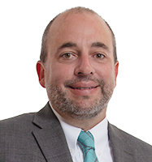
Introduction
NICK TAYLOR
J.B. Evans
Partner
Boise
+1 (208) 617-2540
taylor.nick@dorsey.com
Associate
Boise
+1 (208) 617-2528
evans.jb@dorsey.com
3

Slide 4




Firm Snapshot
575+
70+
Lawyers Firm Wide
Practice Areas
Founded in 1912, Dorsey is an international firm with over 575 lawyers in the United States, Canada, Europe and Asia. Many of the world’s most successful companies rely on Dorsey to help them prosper in a highly competitive world.
21
15
Global Offices
U.S. Offices

Slide 5
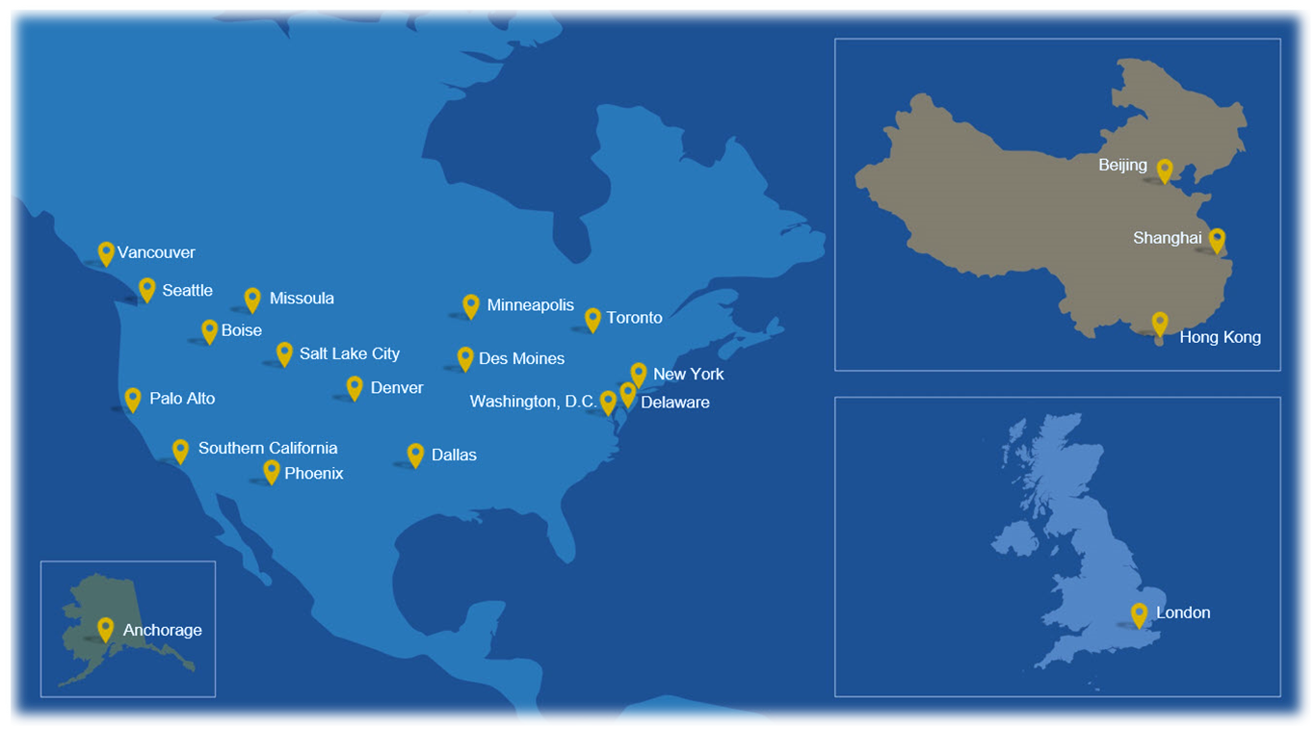
Our Footprint

Slide 6

Cross-border M&A totaled over $950 billion in 2023, comprising 33% of global deal value.
(Source: XBMA Annual Review for 2023.)
Why This Matters:
Increasing complexity in global transactions.
Significant opportunities and risks for businesses.
6

Slide 7
US – China Deal
US Seller owns a Chinese battery business.
VRB manufactures and sells vanadium redux flow batteries. All manufacturing is in China and sales to date have only been in China and other Asian countries.
Problem – nobody in the US will invest in VRB because it is in China. Nobody in China will invest in VRB because it is owned by the US. After AI, battery technology is probably the second most fought over technology in the world.
Solution – duplicate the VRB IP in the US, sell 51% of VRB China to a Chinese buyer, and use the capital to scale VRB USA pursuant to the terms of a cooperation agreement between VRB China and VRB USA.

Slide 8
US Seller
China Buyer
VRB Cayman
51%
49%
100%
VRB China
IP
VRB USA
Cooperation
Agreement

Slide 9
Sell-Side
Ivanhoe Electric Inc.
VRB Cayman
VRB China
Dorsey: Boise, Salt Lake, and Beijing

Slide 10
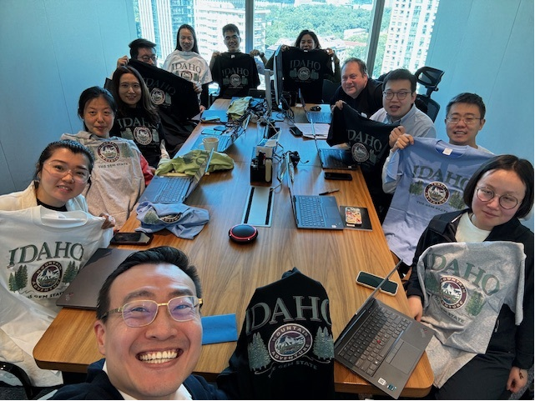

Slide 11
Buy-Side
Lubao Group
Shanxi Red Sun
King & Wood Mallesons: Beijing

Slide 12
Challenges & Lessons

Slide 13
Time Zones
The term sheet was negotiated and finalized on September 23, 2024.
China Buyer scheduled a signing ceremony for October 15, 2024.
The parties were located in Beijing, Singapore, Australia, Vancouver, Boise, Phoenix, and the Cayman Islands.

Slide 14


Slide 15
Parties’ Motivations
US Buyer is ultimately owned by a US public company with SEC reporting obligations to its shareholders. There was a desire to sell VRB, but not unless the terms of the deal allowed for VRB USA to scale and preserved US Buyer’s flexibility to divest its interests in VRB China and VRB USA.
China Buyer is a subsidiary of a large, Chinese public company. There were some unique family dynamics and counsel relationships. China Buyer needed to deploy their capital and go public with the new company by November.

Slide 16
Unforeseen Hurdles
IP Reorganization - The parties needed to complete the IP reorganization by the signing date. The definition of “complete” was heavily fought over.
Cooperation Agreement – One of the definitive agreements was a Cooperation Agreement between VRB China and VRB USA, which would give VRB USA the support needed to scale and allocate geographical territories between the parties. The term sheet provided for a subsequent term sheet regarding the terms of the Cooperation Agreement.
Paid vs. Unpaid Capital – VRB China is a Chinese limited liability company, but there is a concept of paid vs. unpaid registered capital. Also, the PRC had recently passed a law requiring companies to fully pay their registered capital or reduce their registered capital to only the paid portion. This wasn’t a problem until it was time to sell a portion of the interests to the China Buyer.
Authorized Signatories – VRB China had no officers or directors. Instead, there was only one “executive”, which was a man by the name of Bruce Li. And the AMR has only one signature on file for VRB China.
Share Pledge/Escrow – the term sheet required the China Buyer to pledge a portion of its equity as collateral for its payment obligations (the purchase price was paid over time). But there is no such concept in China of a share pledge or escrow arrangement (at least not as we understand those concepts). We had to use a “mutual account” approach with a local bank.

Slide 17
Chinese Regulatory Challenges
AMR - The transaction needed to be approved by the PRC’s Administration for Market Regulation (AMR). You communicate with the AMR via local “agents”. The requirements of the AMR are still a mystery to me.
Currency – the transaction needed to occur in renminbi (RMB), but also need to result in the US Buyer receiving dollars (USD). VRB China’s capital was only capable of being expressed, from the AMR’s perspective, as RMB. And there were specific requirements of each bank involved regarding whether they would accept deposits or process withdrawals in a specific currency type.
Taxation – after the transaction was approved by the AMR, we were not closed until the PRC’s taxation authorities had determined and received payment of the applicable taxes and duties.

Slide 18
Translation
Negotiations – in the negotiations some of the parties only spoke English, some only spoke Mandarin, and some spoke both. The negotiations were often simultaneous.
Documents – the documents were drafted and negotiated in English, but they needed to be translated into Mandarin for the China Buyer’s review. And the governing language was Mandarin. We had different views on how to best translate the documents.

Slide 19
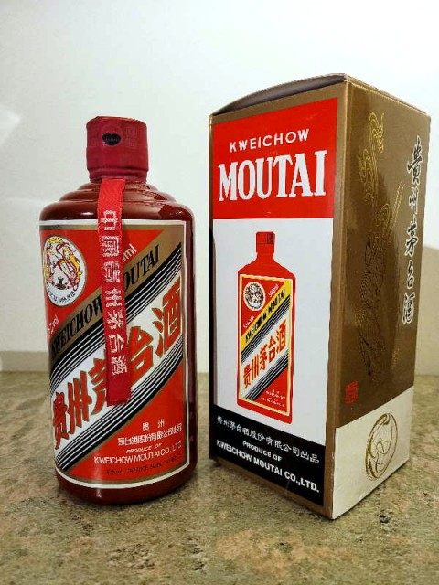
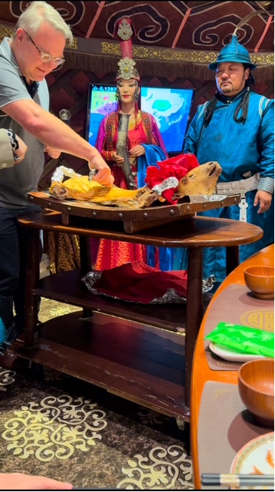
Celebration and Drinking
The importance in Chinese culture of celebrations

Slide 20
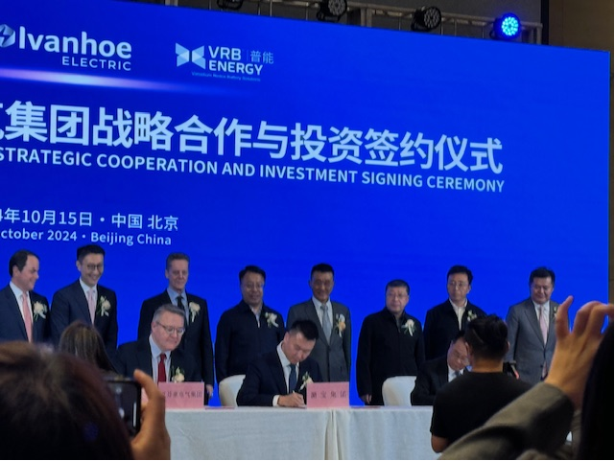
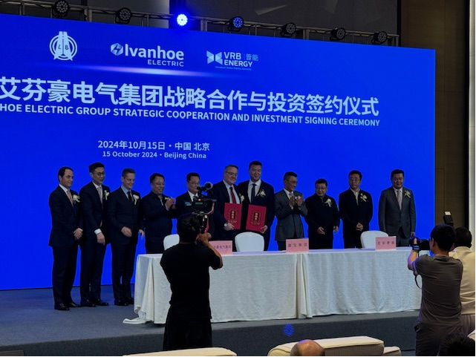

Slide 21
Trends and Challenges for Corporate Counsel in 2025

Slide 22

Elephant in the Room
Regardless of your political beliefs, the elephant
in the room will be the GOP and what it does with
control of Congress and the White House
POLITICS→
POLICY →
CHANGES IN LAW →
COUNSEL MUST PREPARE AND ADAPT

Slide 23

What’s on the Horizon?

Slide 24


How Will Change Impact Corporate Counsel?

Slide 25
Key Issues and Trends in 2025
THE ISSUE OR TREND
THE STATUS
THE POTENTIAL IMPACT

Slide 26

Deal Activity

Slide 27
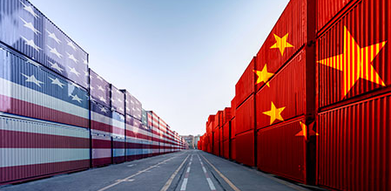
Tariffs

Slide 28

Inflation and Monetary Policy

Slide 29
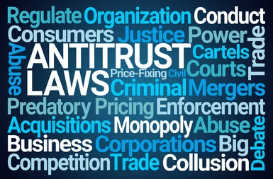
DOJ and Anti-Trust

Slide 30
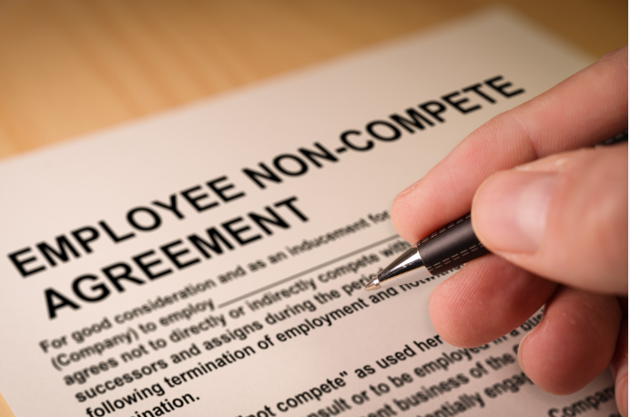
FTC and Noncompetes

Slide 31

Artificial Intelligence

Slide 32

Rep and Warranty Insurance

Slide 33
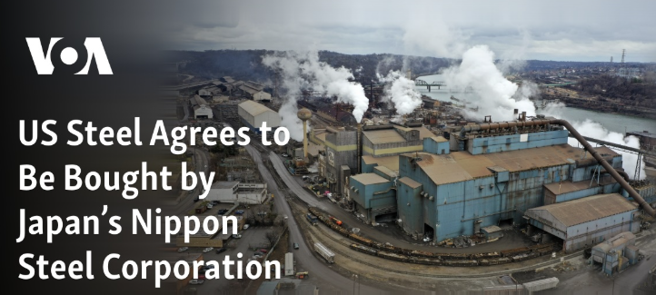
Political Issues: America First

Slide 34

Thank You and Good Luck!

