Slide 1
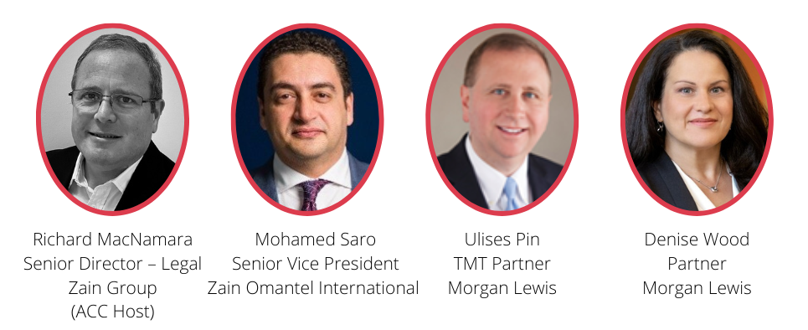

Telecoms Roundtable:
Demystifying Subsea Cable Projects
IN COLLABORATION WITH:
June 20, 4PM AST / 5PM GST

Slide 2
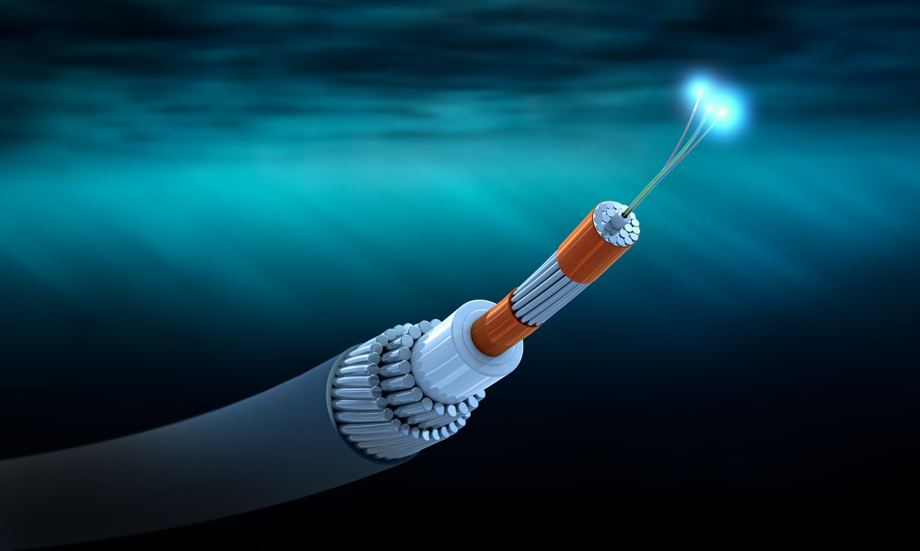
AGENDA
1
A Brief History of Modern Submarine Fiber Optic Cables
2
Technical Introduction
3
Building a Submarine Cable System
4
International Regulation of Submarine Cable Systems & Middle East Challenges

Slide 3
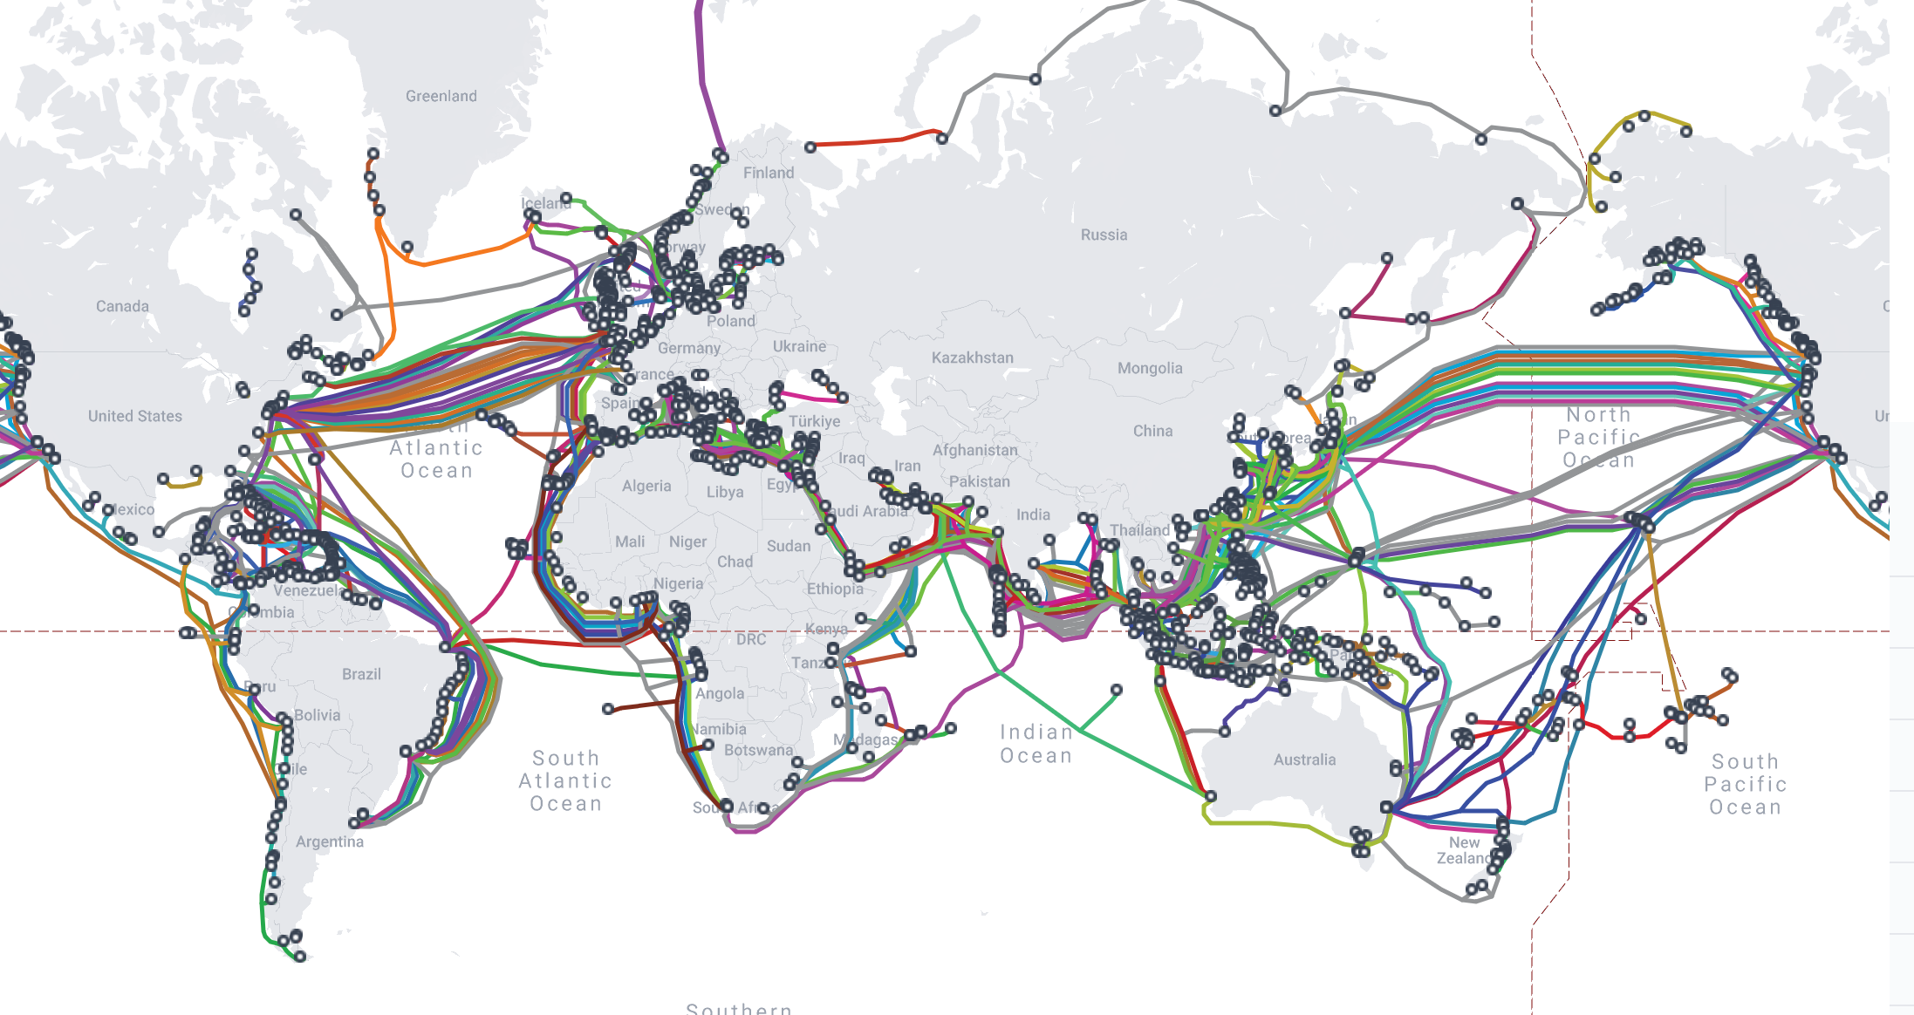
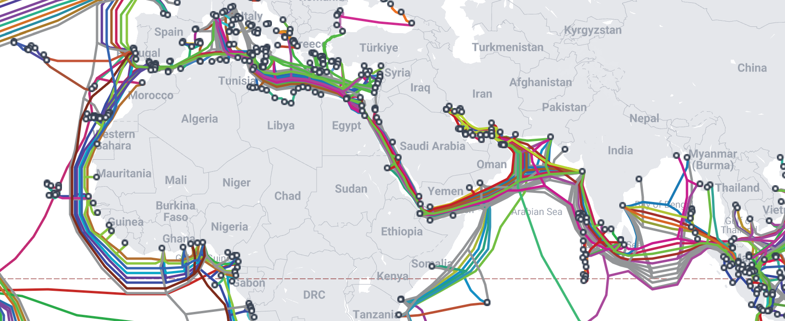
Introduction
History:
  1858: 1st transatlantic cable laid between Ireland and Newfoundland by Great Eastern. This failed after 26 days.
  1866: The first permanently successful transatlantic cable was laid.
  Today: In total, there are ~450 submarine cable systems in-service around the world, which together span over 1.35 million kilometers and form a critical part of the internet's infrastructure.
Ownership:
  Private, Consortium Or Hybrid
  Hyperscalers are major investors in new cable. The amount of capacity deployed by private network operators – like these content providers – has outpaced internet backbone operators in recent years.
Regions:
  Intercontinental cables the world is divided into four main regions:
    Transpacific
    Transatlantic
    Asia-Pacific
    Asia to Europe (Mainly through ME)

Slide 4
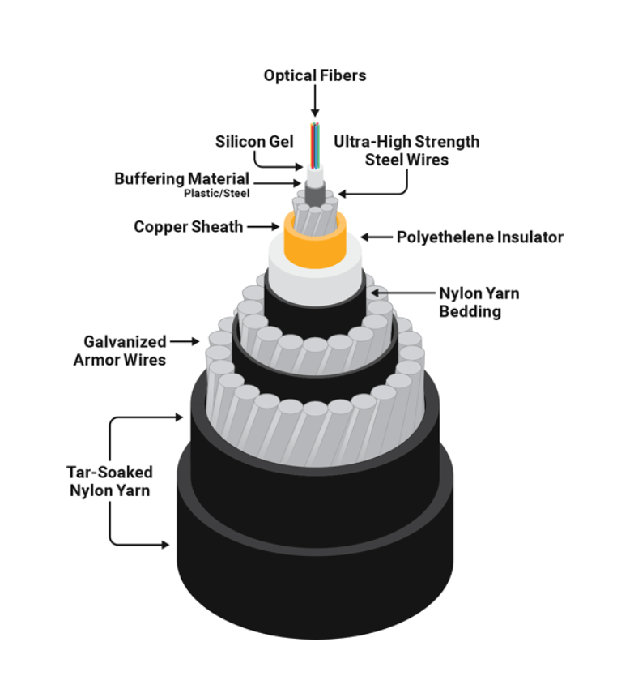
Introduction (Cont’d)
Subsea Cable Project useful lifetime is 20-25 years
Cables Coverage:
  Regional
  Transoceanic
Types:
  Repeatered (Max 24 Fiber Pair with Today’s technology)
  Unrepeated (Mainly Regional)
Capacity:
  To be defined based on the design and the length of the cable Modern cables are carrying 16-24Tb per Fiber pair
  New technologies are evolving to carry more capacity per fiber pair
Capacity Allocation Models:
  Modern Cables are Spectrum/Fiber based which is either a fraction of a fiber of full fiber
Cable Landing Stations of Data Centers:
  Most of subsea cables are trying to have open access at the ends of the cable to attract more customers/Users for the cable that is why recently most of submarine cables push to land in open access/Carrier neutral Data Centers in most/all of the landing points

Slide 5
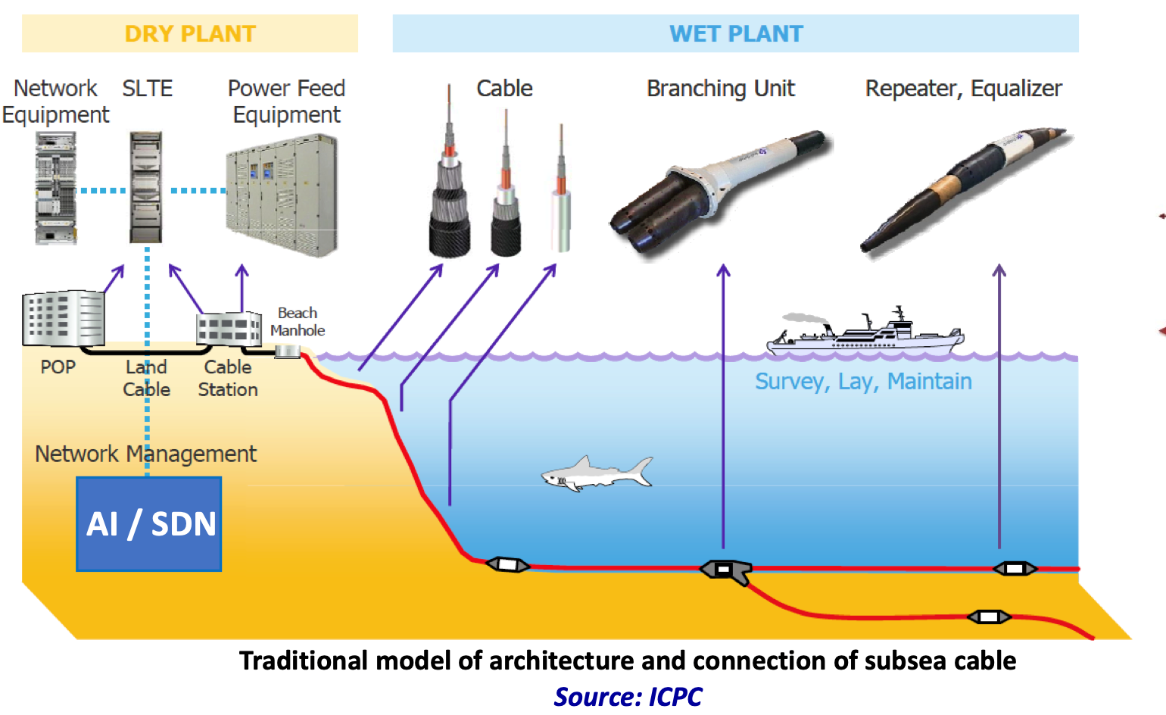

Slide 6
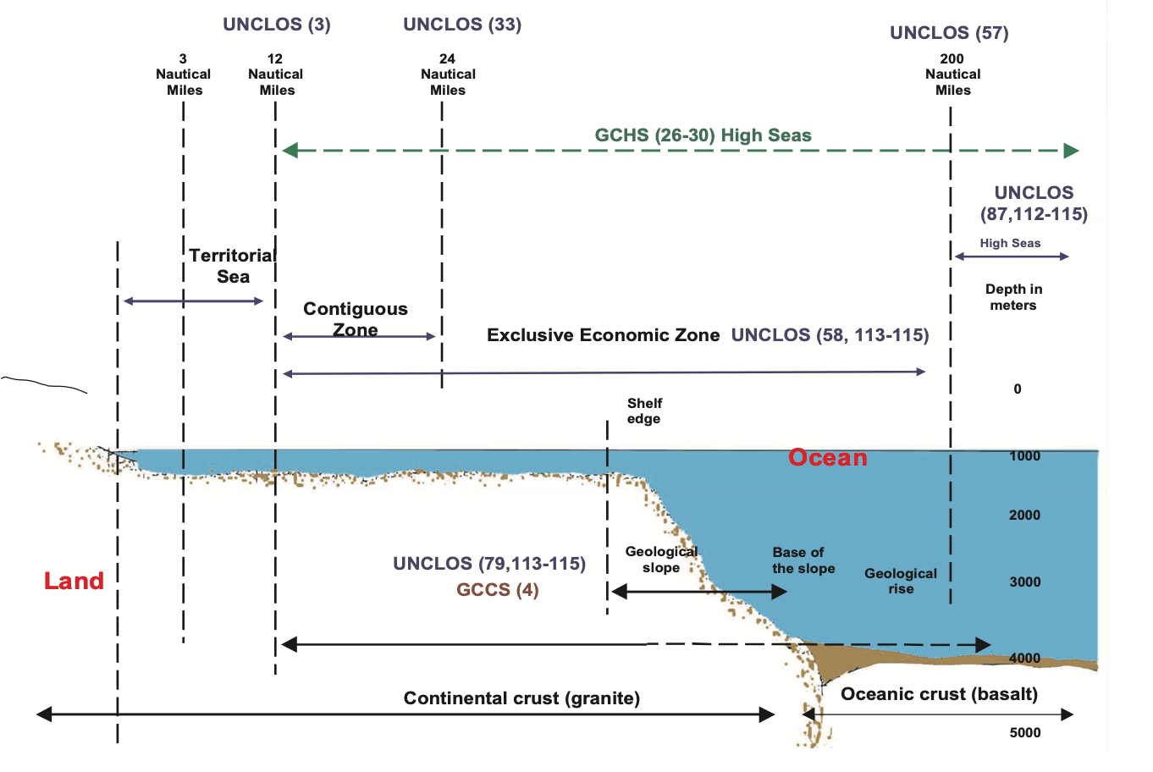
Legal Aspects of Subsea Cable Projects
Legal considerations involved in subsea cable projects:
  National law: Examining domestic regulations, permits, and licensing requirements.
  Foreign investment regulations: Understanding restrictions and requirements for international investors.
  Security and data protection: Addressing concerns related to cybersecurity, data privacy, and national security.
  Landing rights and permits: Navigating the process of obtaining necessary permissions from host countries.
  Interconnection agreements: Drafting and negotiating agreements with local telecommunication providers.
  Dispute resolution: Exploring potential conflicts and mechanisms for resolving disputes, including arbitration and litigation.

Slide 7
Building a Submarine Cable System

Slide 8
Building a Submarine Cable System
Consortium and
Private Cables
Corporate and Tax Structuring
Financing
Project Documents
Regulatory and Permitting
Development Challenges

Slide 9
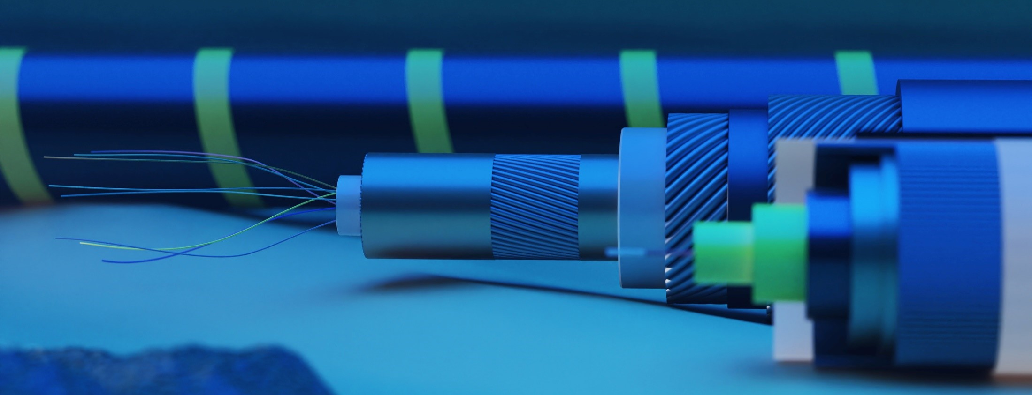
Building a Submarine Cable System:
Consortium and Private Cables
Consortium Cables
  “Club cables” formed by incumbent carriers
    All members participate in major decisions
    One member leads development and day-to-day construction, operation, and management
  Generally internally funded
  Members own and use all capacity
    Sales to third parties limited
    Members control landings in their countries
    Access to CLS/backhaul common point of contention

Slide 10

Building a Submarine Cable System:
Consortium and Private Cables (2)
Private Cables
  Built by carriers or non-carriers
  Use variety of financing tools
  Carriers’ carrier financial model
    IRU sales/leases -- dark fiber, lit fiber, wavelengths -- to hyperscalers, carriers and service providers
    Large closed networks for multinational corporations
    Landing and backhaul often problematic
New “truly private” cables (e.g., Google’s Curie or Firmina systems)

Slide 11
Building a Submarine Cable System:
Corporate and Tax Structuring
Major Considerations when building a business plan:
  Planned use of cable
    Most private cables rely on pre-sales to hyperscalers/carriers/large users to secure funding and become viable
    Low latency systems (particular interest for financial community and high-frequency traders)
  Requirements of lenders and financial sponsors
  Tax efficiency
    Goal is to push as much revenue as possible offshore
    Legacy offshore jurisdictions no longer used due to new Minimum Global Tax obligations
    No taxation of revenues in High Seas (i.e., international waters)

Slide 12
Building a Submarine Cable System:
Financing
Jurisdictional Considerations
  Historically formed in Bermuda, now moving to Ireland or Singapore due to favorable tax regimes
Consortium cables: Generally self-funded by members
Hybrid systems: Some members of consortium are carriers/hyperscalers with an independent developer
Private cables: Equity and debt financing
  Project finance structure: senior secured, non-recourse debt, payable from cash flows
    *As noted prior, truly Private systems are self-funded by hyperscalers*
  Vendor financing common in all structures
  Venture capital/private equity back in telecom industry
Funding from multilateral organizations has been important for projects in less-developed countries
Investors in general more conservative and demand additional protections
Having significant pre-sales or capacity commitments is a condition for funding

Slide 13
Building a Submarine Cable System:
Project Documents – C&MA vs. JBA and Maintenance
Construction and Maintenance Agreement (“C&MA”)
Joint Build Agreement (“JBA”) & Maintenance Agreement
  Ownership of segments and capacity
  Management and governance
  Management/payment of capital costs
  Management/payment of O&M costs
  Access to cable landing stations and backhaul
  Limits on use/assignment/resale of capacity
  Upgrades
  Generally governed by English or New York law
Joint Build Agreement (“JBA”)
  New Generation of C&MA created by hyperscalers
  Independent Fiber Pair Ownership and Upgrades
  More flexibility to transfer fiber pairs or half fiber pairs
  Open cable landing stations and access by competitive backhaul providers (i.e., elimination of toll booths)
Maintenance Agreements
  Marine maintenance generally subcontracted to special organization

Slide 14
Building a Submarine Cable System:
Project Documents – Supply Contract
Tender process/RFP typically used
  Same major vendors build most systems: Subcom, Alcatel Submarine Networks, NEC, HMN (Huawei Marine (subject to US trade restrictions)
Typically done on turnkey basis: Vendor handles subsea and terrestrial construction
  Construction schedule and penalties for non-performance biggest issues
Vendor obtains construction permits; developer handles telecom and landing permits
Vendor financing
Nowadays terminal equipment generally not part of original Supply Contract (i.e., ability for parties to purchase SLTE from other equipment manufacturers)

Slide 15

Building a Submarine Cable System:
Development Challenges – Regulatory
Coordination of licensing and permitting with construction activities is important
  Telecommunications license
  Landing license
  Other permits
    Environmental Defense
    Vessel Importation
    Local construction and land use

Slide 16
Building a Submarine Cable System:
Development Challenges – Regulatory (2)
Licensing and permitting typically more difficult in emerging markets
  Less developed legal and regulatory regimes
  More red tape
  Less transparency
  “Localization” rules – requirement to use local professionals
National Security considerations have become more prevalent in past few years
  This will be addressed later in the presentation
“Political” considerations
  Fishermen unions, other seabed users
  Political risk insurance and other mitigation mechanisms

Slide 17
Building a Submarine Cable System:
Development Challenges (3)
Cable Landing Stations
  Access to Land and ROW
    Beach access normally not problematic
      Handled at national level
    Beach manhole to CLS often difficult
      Municipalities impose onerous permitting processes and high costs for use of ROW
Backhaul faces similar issues
Newer systems are foregoing CLS near the coast and placing terminal equipment at a PoP inland
Avoiding South China Sea
Crossing of third country territorial waters

Slide 18
International Regulation of Submarine Cable Systems

Slide 19
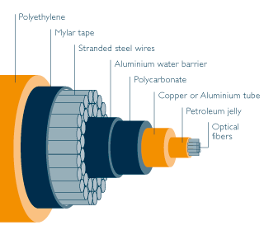
International Regulation of Submarine Cables
Varying regulatory frameworks governing cable landings
  Some countries require a “carrier” or “facilities-based” telecommunications license (e.g., Australia, Hong Kong, Singapore)
  Other countries regulate submarine cables in the same fashion as terrestrial networks. (e.g., EU)
  A third category of countries (mostly countries with legacy monopoly operators) have a cable landing license independent from telecom services.

Slide 20
International Regulation of Submarine Cables
Many countries consider subsea cables as critical infrastructure that require mandatory National Security/Foreign Investment reviews
  United States has targeted subsea cables that have potential Chinese connections.
  European countries are in the process of implementing more robust foreign direct investment regimes, with some already requiring foreign direct investment reviews of communications infrastructure because of national security concerns
Countries are also revoking the use of telecommunications equipment based on country of origin.
  U.S., Australia, Canada and the U.K. have banned Chinese-origin equipment from their networks.
  The European Union has called for additional restrictions in this area.

Slide 21
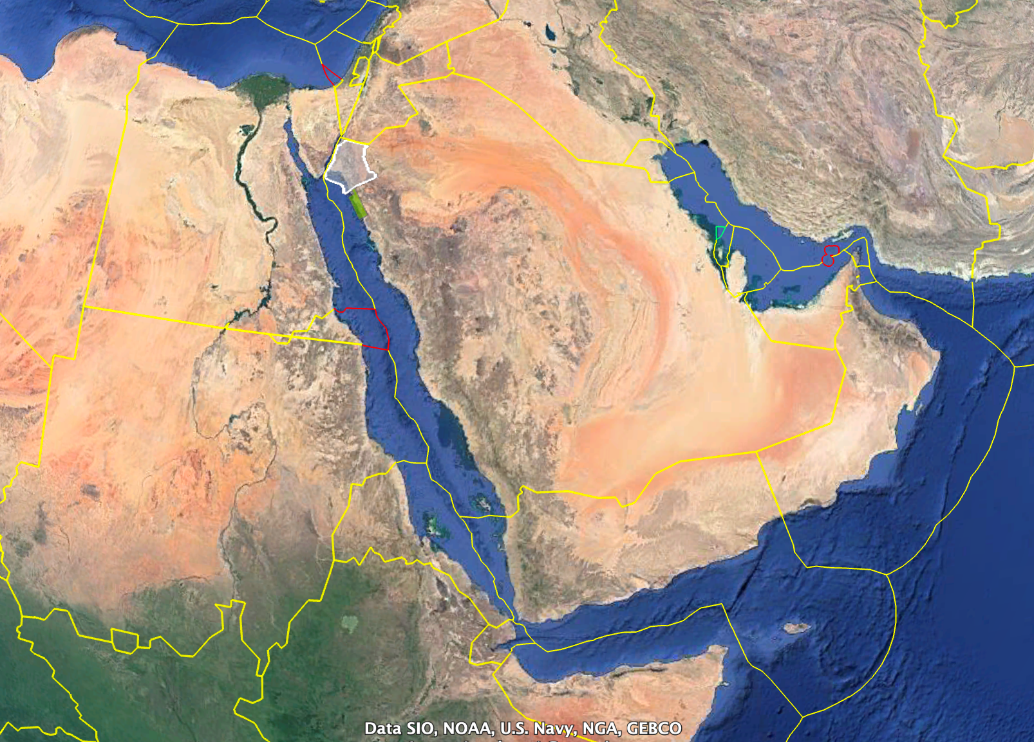
Middle East Challenges
  Egypt is the main corridor between Red and Med Seas for Subsea cables resulted in a major concentration for the global traffic through Egypt
  Entry of the Red sea is becoming a choke point
    Yemeni Permits
    Eritrean Permits
  Red Sea additional permits/approvals/Coordination with New Economic Zones/Cities
  Situation in Sudan
  Gulf of Aqaba is very Narrow for many cables to be laid
  Arabian gulf is very shallow and full of pipelines and Oil exploration activities
  Geo-Political Aspect:
    Vendor Selection and certain Customer Segments Sensitivity EU/US/Asian vs Chinese
    Cable/Capacity routing during political issues
    Investment Decisions

Slide 22

Thank you

