Slide 1

ACC Western Pennsylvania Chapter 2026 Draft-ing Day AI-Generated and AI-Assisted Works: A Touchdown or Fumble for Intellectual Property Protection?
April 10, 2026
Lauren B. Sabol
Partner
412.394.5568
lsabol@foxrothschild.com

Slide 2
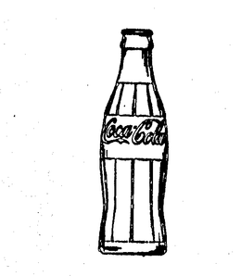

Intellectual Property
Patent
Copyright
Trademark
Trade Secret

Slide 3


Patent

Slide 4
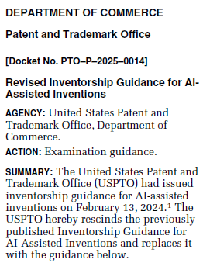
Inventorship
November 2025 Revised Inventorship Guidance for AI-Assisted Inventions
Rescinded prior guidance
AI cannot be named as an inventor, only natural persons can be inventors
AI = lab equipment
Analysis focuses on conception
“the formation in the mind of the inventor, of a definite and permanent idea of the complete and operative invention, as it is hereafter to be applied in practice”
Foreign priority

Slide 5
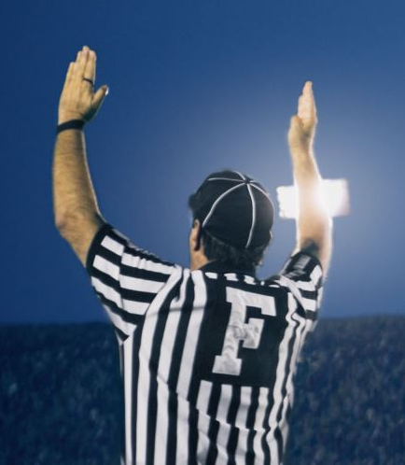
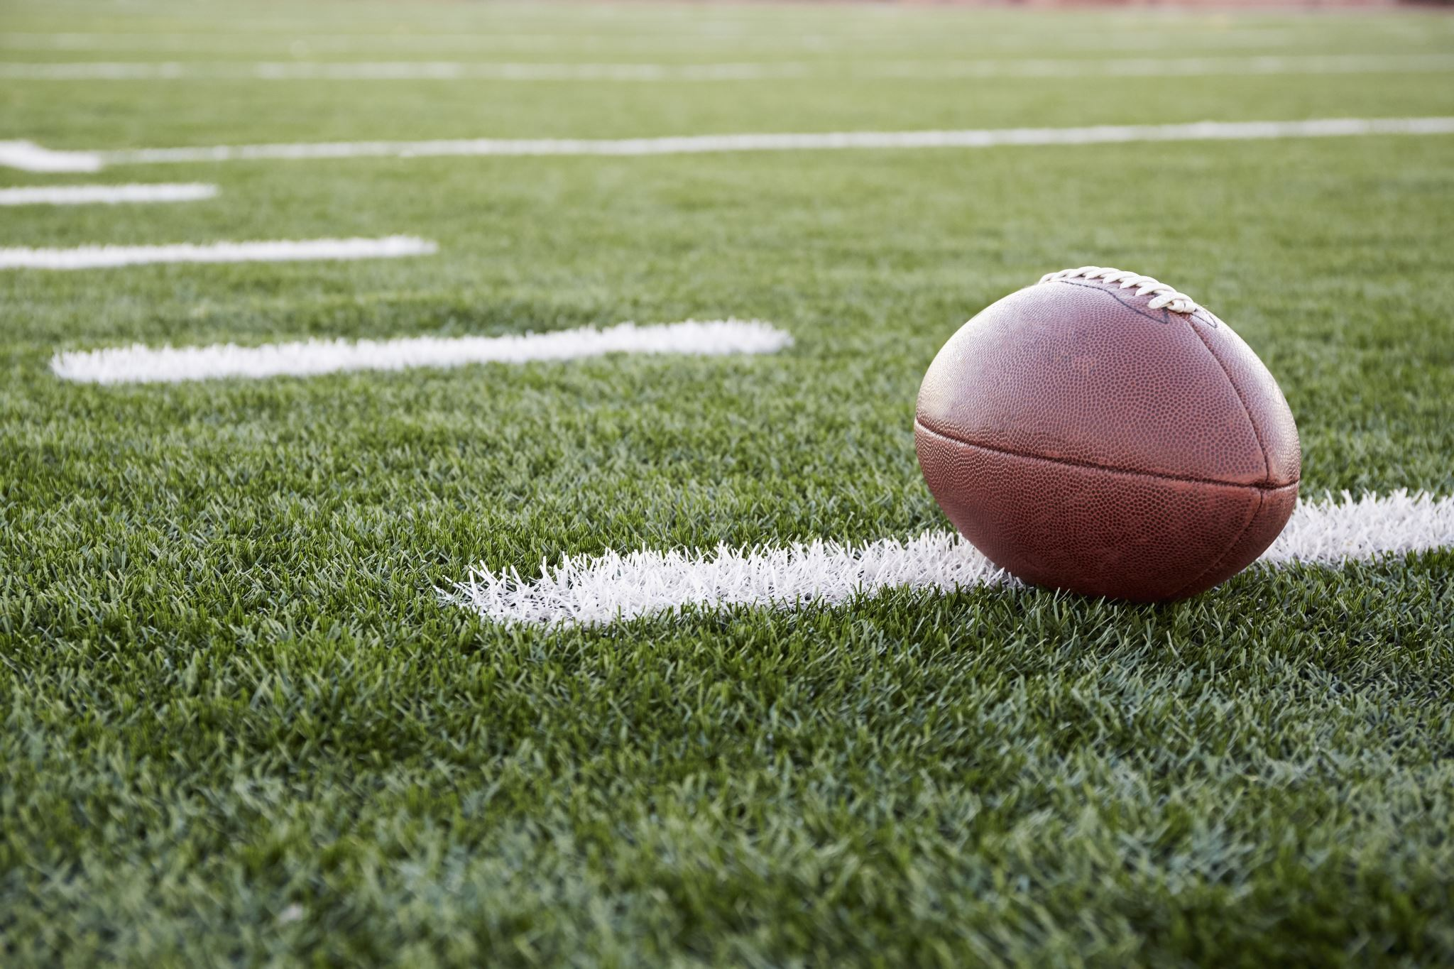
Patentability
2024 Guidance with new AI-specific examples
Abstract idea, law of nature, natural phenomenon are not patentable
Hardware configuration implementing AI model
TOUCHDOWN - Physical machine, no abstract ideas or mental processes
Method of receiving data, training on the data, and using the trained AI to detect anomalies in a new data set
FUMBLE - Abstract idea (process performed by the human mind), not integrated into a practical application
Method of training AI to detect an anomaly in network traffic and drop malicious network packets in real time/block future traffic from the source
TOUCHDOWN - Abstract idea, but integrates into a practical application by improving the computer and technological field (network security)

Slide 6
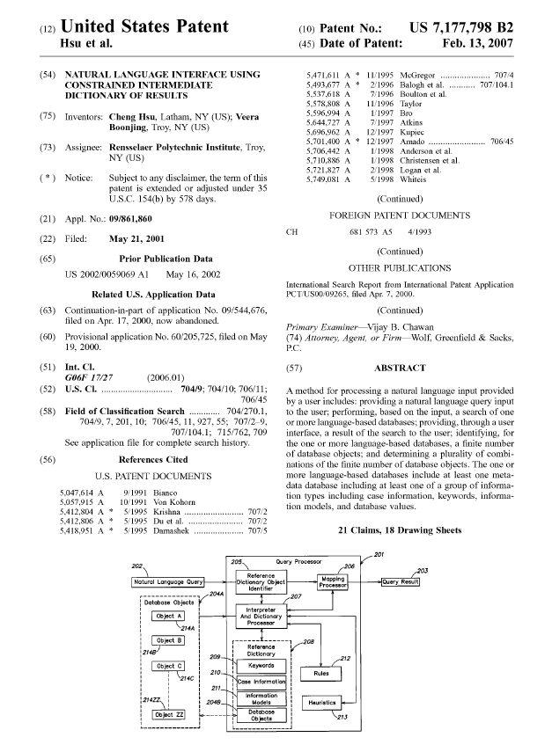
Patentability
Rensselaer Polytechnic Institute, CF v. Amazon.com, Inc., 2026 WL 506661 (Fed. Cir. Feb. 24, 2026)
Rensselaer sued Amazon for patent infringement
Patent disclosed “method for processing a natural language input provided by a user”
Case-based reasoning, which is a type of machine learning
FUMBLE - District court granted summary judgment for Amazon because patent was directed to ineligible subject matter
FUMBLE - Federal Circuit affirmed
Technological improvement to computer capabilities vs. using computer to implement abstract idea
“Generic use of AI without other parameters, such as ‘improving the mathematical algorithm or making machine learning better,’ is abstract.” Id. at *3.
“[T]he use of AI in a novel field is not an inventive concept.” Id. at *4

Slide 7

Copyright

Slide 8
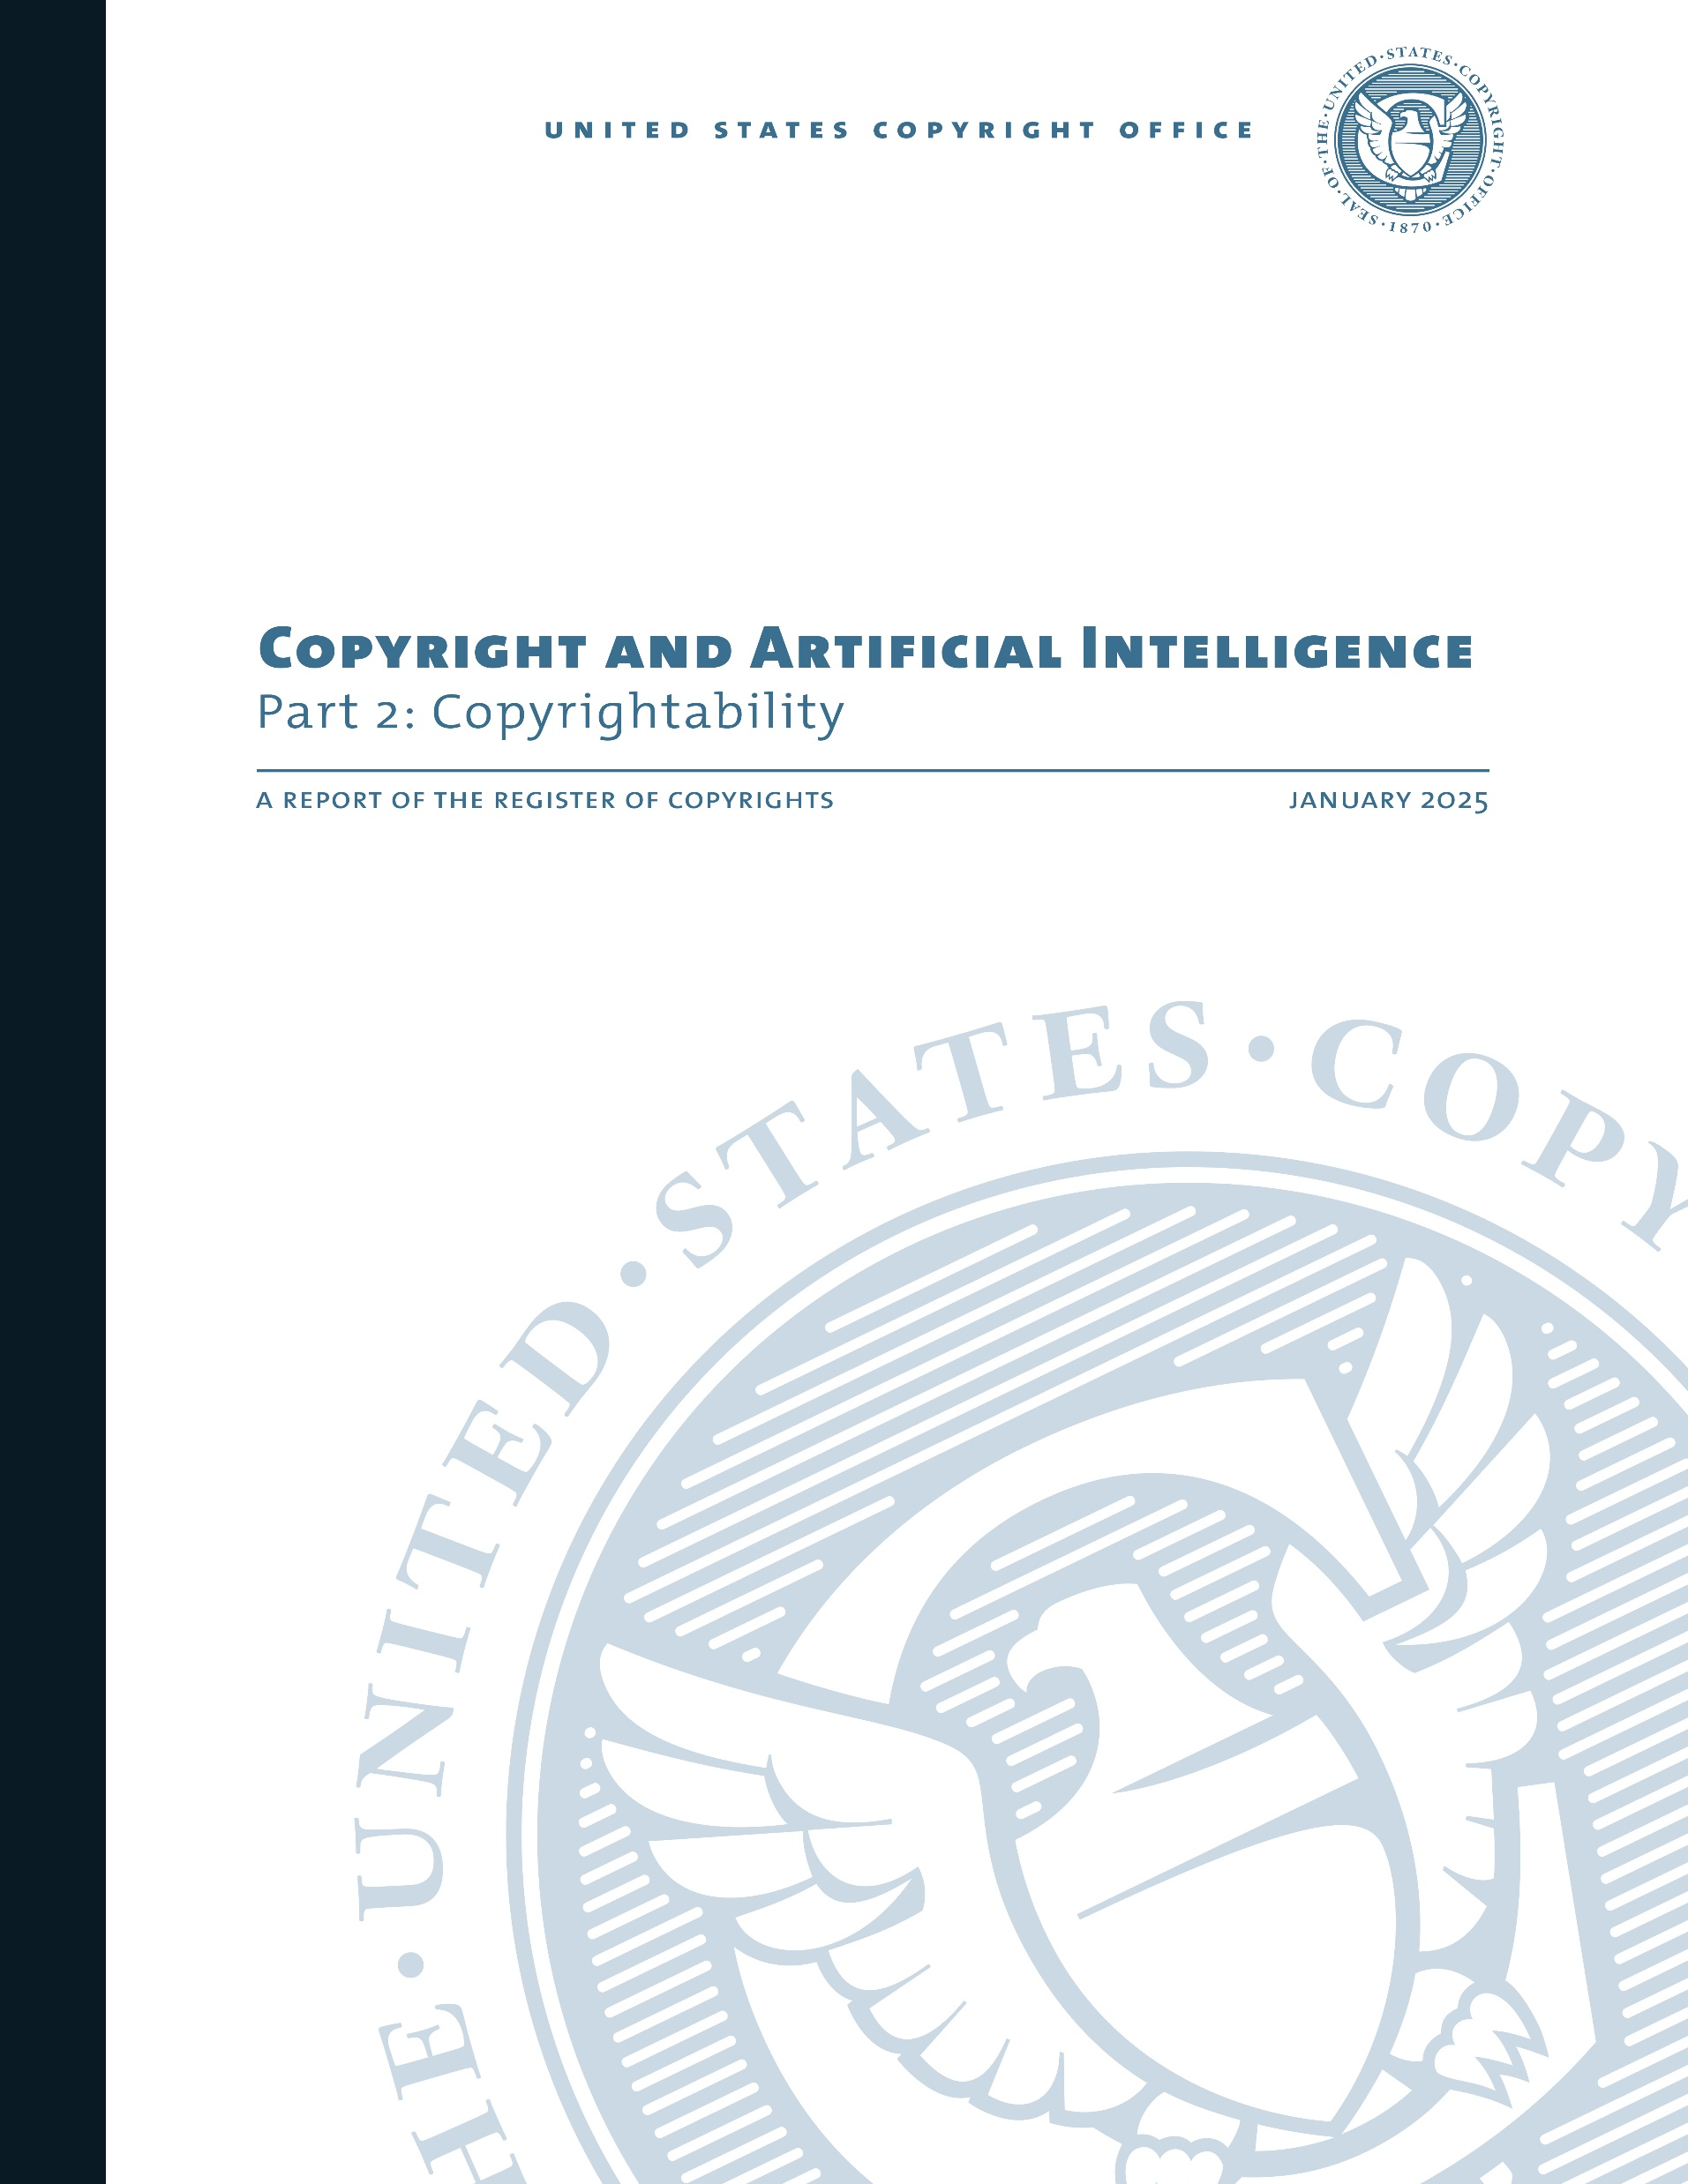
U.S. Copyright Office
Report on Copyright and Artificial Intelligence
Part 1 – Digital Replicas (July 31, 2024)
Part 2 – Copyrightability of Generative AI Outputs (January 29, 2025)
Part 3 – Generative AI Training (May 9, 2025 pre-publication version)
Final version expected to be published without substantive changes

Slide 9


Copyrightability
Prompts
Prompts themselves vs. Output
Prompts may be copyrightable if sufficiently creative
Prompts alone do not provide sufficient human control over how the idea is expressed for authorship of the output
FUMBLE
Same prompt can generate different outputs
AI systems may evolve to allow sufficient human control

Slide 10
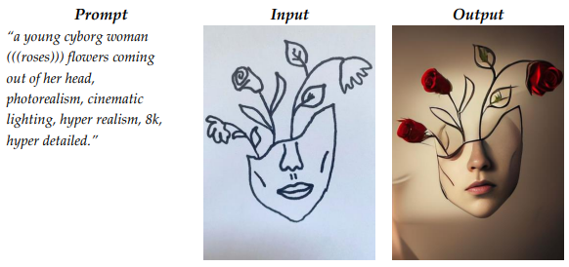

Copyrightability
Expressive Inputs
Drawing, original writing, etc.
Output may be copyrightable
TOUCHDOWN?
Expressive inputs limit the outputs, providing sufficient human contribution
Analogous to derivative works
Protecting only the author’s creative expression
Disclaim any non-human expression
Expressive elements must be clearly perceptible in the output

Slide 11
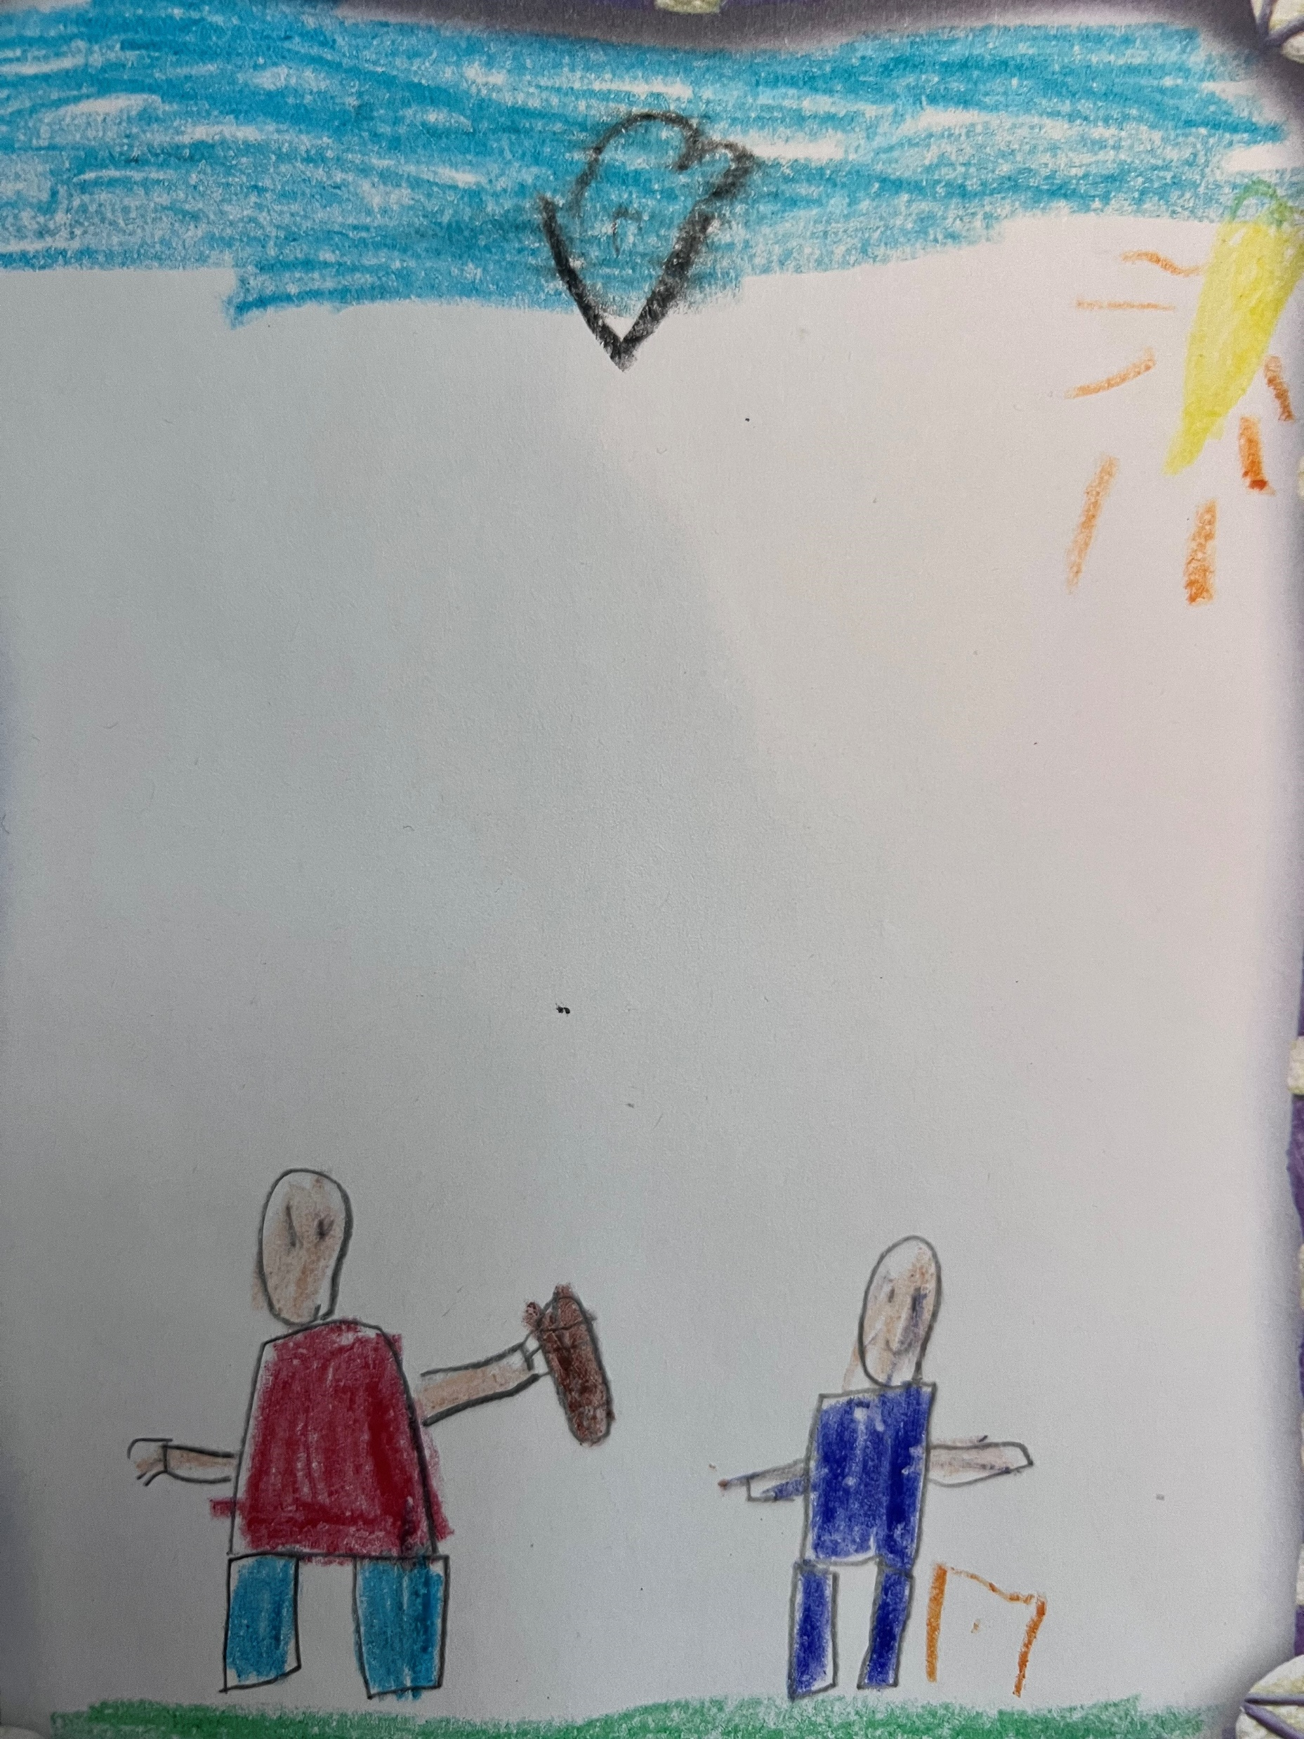
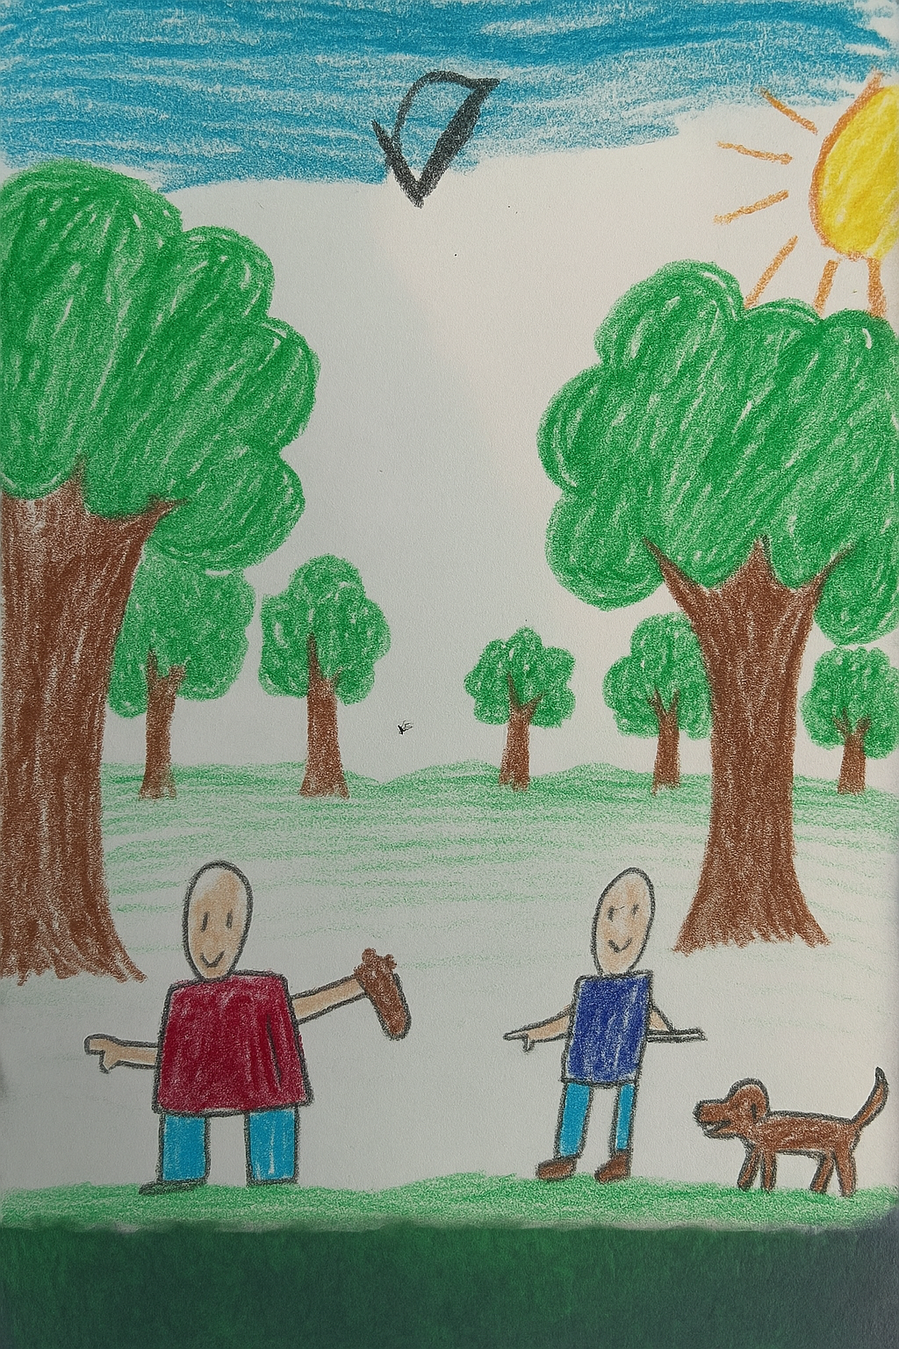
Copyrightability
Prompt Input Output
“add trees in the background and a dog”

Slide 12

Copyrightability
Modifying or Arranging AI-Generated Content
TOUCHDOWN?
May be copyrightable
Selection or arrangement of AI-generated material
Sufficiently modifying AI output
Similar to derivative work, protecting only human contribution and not underlying AI-generated content
Case by case assessment
Inclusion of AI-generated content in a larger human-authored work (e.g. AI-generated special effects) does not affect copyrightability of larger work

Slide 13


Copyrightability
Thaler v. Perlmutter, 130 F.4th 1039 (D.C. Cir. 2025)
Computer scientist created generative AI named the “Creativity Machine”
The Creativity Machine made a picture titled, “A Recent Entrance to Paradise,” which was submitted to the Copyright Office for Registration
FUMBLE – Copyright Office denied application, scientist sought review in federal court
FUMBLE - DC Circuit held that a non-human machine cannot be an author under the Copyright Act
FUMBLE - Supreme Court declined cert on March 2, 2026

Slide 14
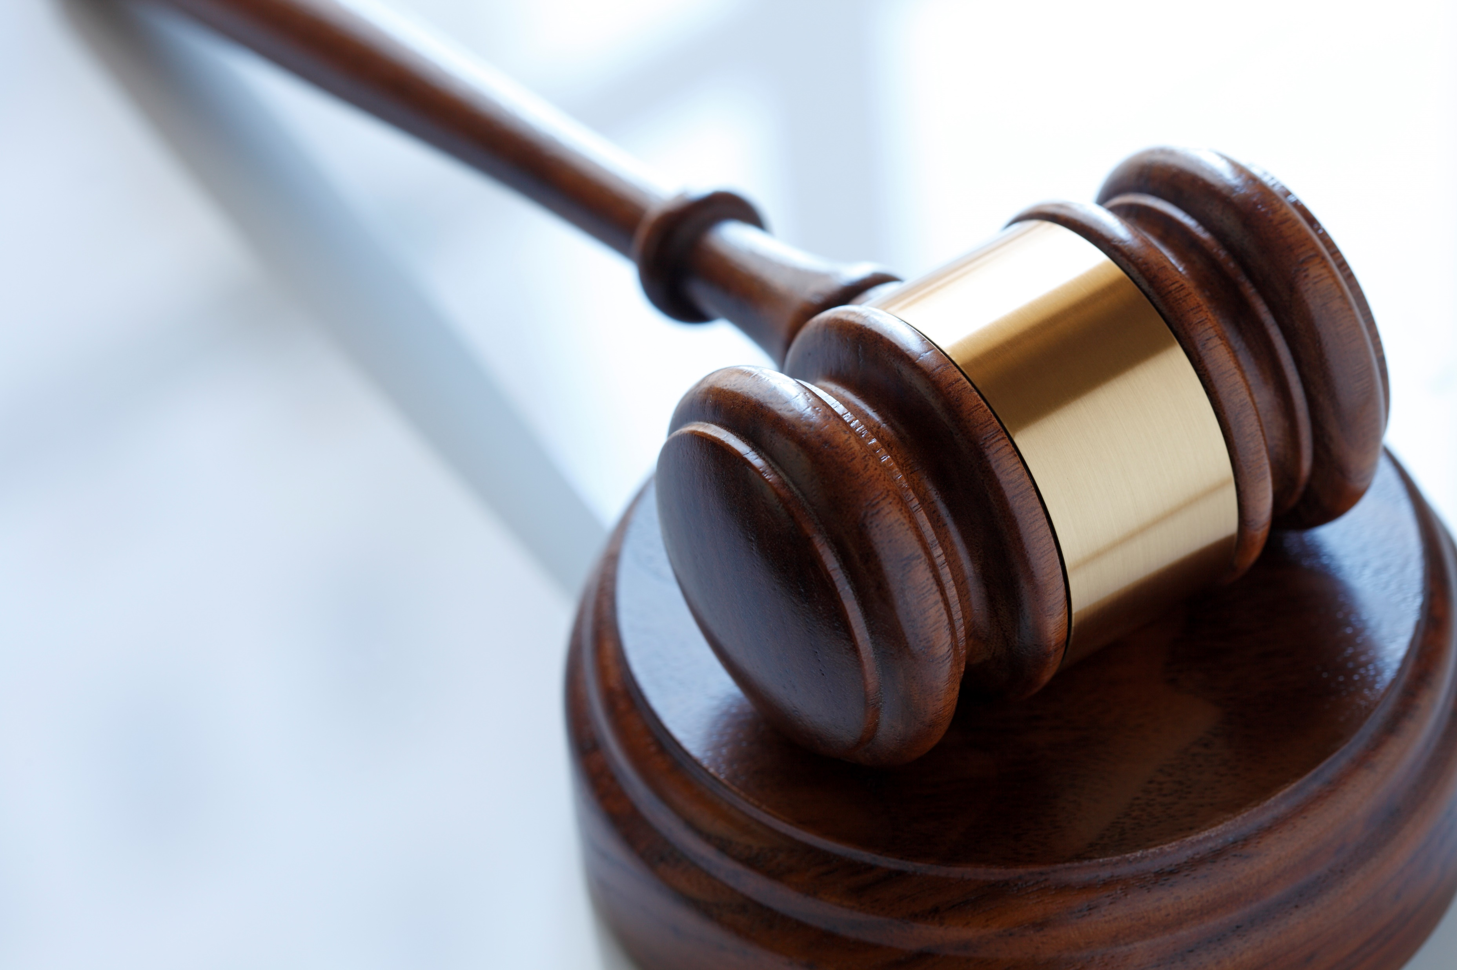
Liability

Slide 15
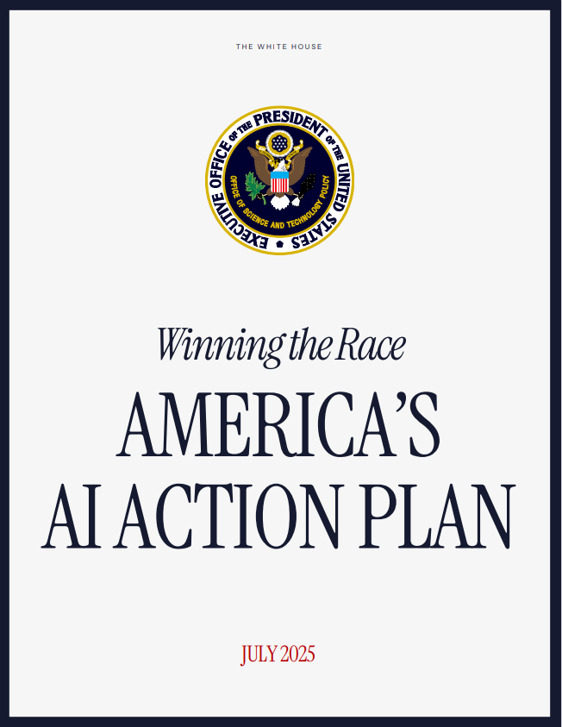
Intellectual Property Protection
America’s AI Action Plan, July 2025
“Maintaining American leadership in AI necessitates that the U.S. government work closely with industry to appropriately balance the dissemination of cutting-edge AI technologies with national security concerns. It is also essential for the U.S. government to effectively address security risks to American AI companies, talent, intellectual property, and systems.”

Slide 16
Potential Copyright Liability From AI Training
Exclusive right to reproduce copyrighted works, 17 U.S.C. § 106(1), and to prepare derivative works based upon copyrighted work,17 U.S.C. § 106(2)
Fair use exception
Fair Use
The use’s purpose and character, including whether it is commercial or nonprofit
The copyrighted work’s nature
How much of the work was used and how substantial a part it was relative to the copyrighted work’s whole, and
The effect of the use upon the potential market for or value of the copyrighted work
Justification for why copying is reasonably necessary to achieve new purpose is relevant to fair use. Andy Warhol Found. For the Visual Arts, Inc. v. Goldsmith, 598 U.S. 508, 532 (2023)

Slide 17
Potential Copyright Liability From AI Training
Part 3 – Generative AI Training (May 9, 2025 pre-publication version)
Balance competing interests
Training → Right of Reproduction
Outputs → Rights of Reproduction, to Prepare Derivative Works, Public Display, Public Performance
Using copyrighted material to train generative AI systems may not always be protected by fair use
Separate analysis for training and outputs
Training can be transformative, which can justify mass copying
Consideration of potential lost sales, market dilution, lost licensing opportunities

Slide 18
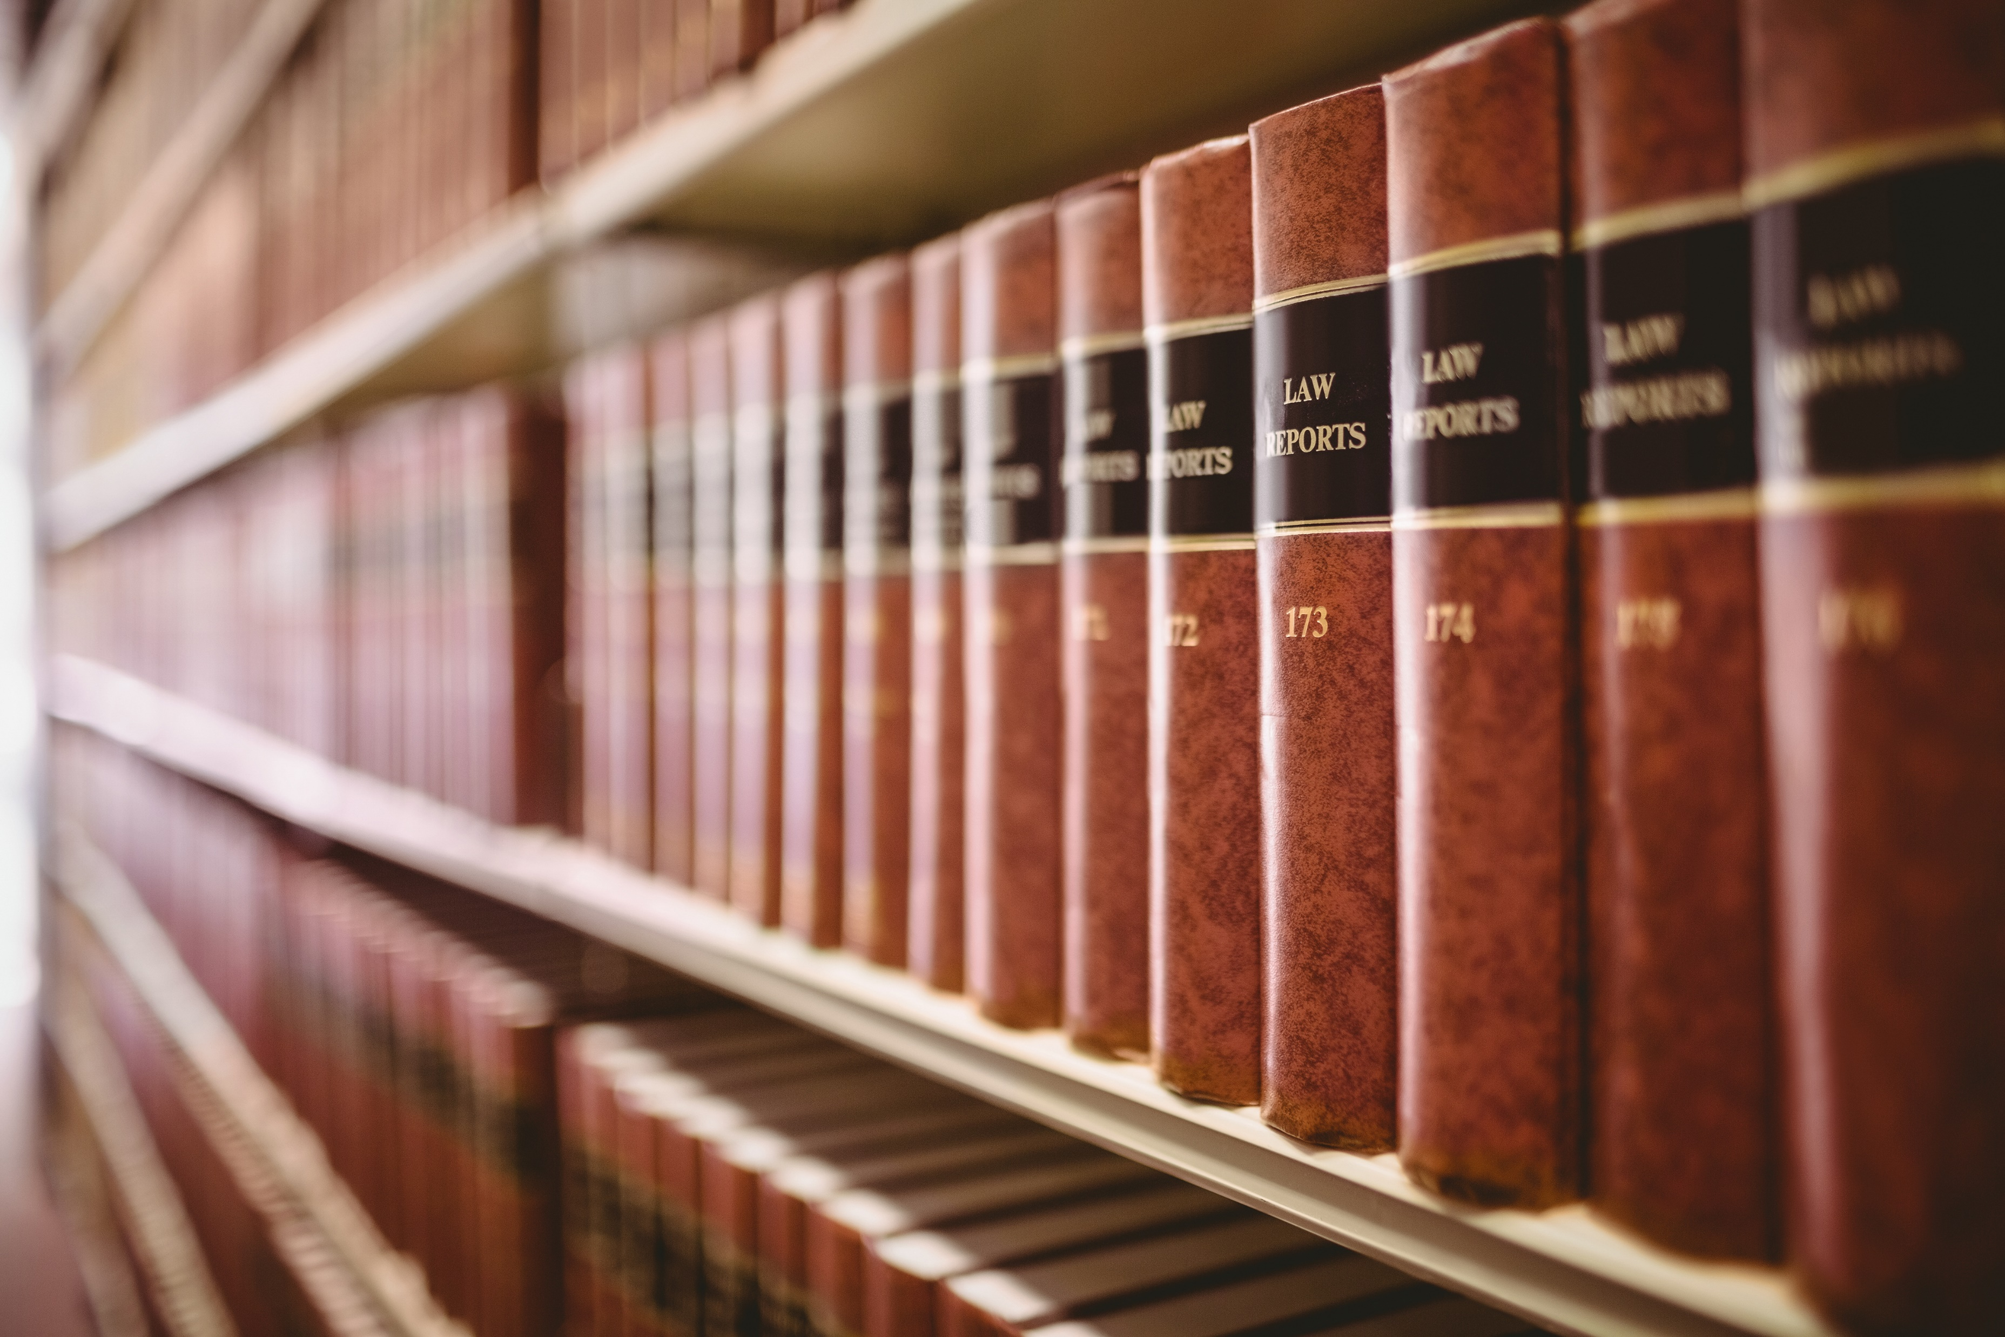
Potential Copyright Liability From AI Training
Thomson Reuters Enterp. Centre GmbH v. Ross Intelligence Inc., No. 1:20-cv-00613 (D. Del.)
Ross trained its AI on LegalEase’s Bulk Memos, which are lawyer compilations of legal questions with good and bad answers made using Westlaw headnotes
Partial summary judgment in favor of Thomson Reuters, including on fair use
Certified interlocutory appeal 25-8018, 25-2153 (3d Cir.) on:
Whether the West headnotes and West Key Number System are original, and
Whether Ross’s use of the headnotes was fair use
Fully briefed, 25 amicus

Slide 19

Potential Copyright Liability From AI Training
Bartz v. Anthropic PBC, 787 F. Supp. 3d 1007 (N.D. Cal. 2025)
Authors of copyrighted books sued Anthropic for copyright infringement
Works were copied to train large language model, Claude (Inputs)
Digitization of purchased books
Downloading of 7 million+ pirated copies
Central library created
Outputs did not include copyrighted material
Anthropic moved for summary judgment on fair use
Split fair use analysis
Using works to train LLM was “spectacularly” transformative, “most transformative many of us will see in our lifetimes”
TOUCHDOWN – SJ for Anthropic. Digitizing purchased copies of the works was transformative, amount used was reasonable, purchased copy destroyed, no redistribution
FUMBLE – SJ denied, headed to trial. Pirated dataset was not transformative, amount used was unreasonable, retained forever even if not being used

Slide 20

Potential Trademark Liability from AI Usage
Generative AI can create logos, slogans, brand names, marketing campaigns, etc.
FUMBLE - Potential for infringement
Confusingly similar
Taking inspiration from others
FUMBLE - Dilution risks
Use or association with a famous mark

Slide 21
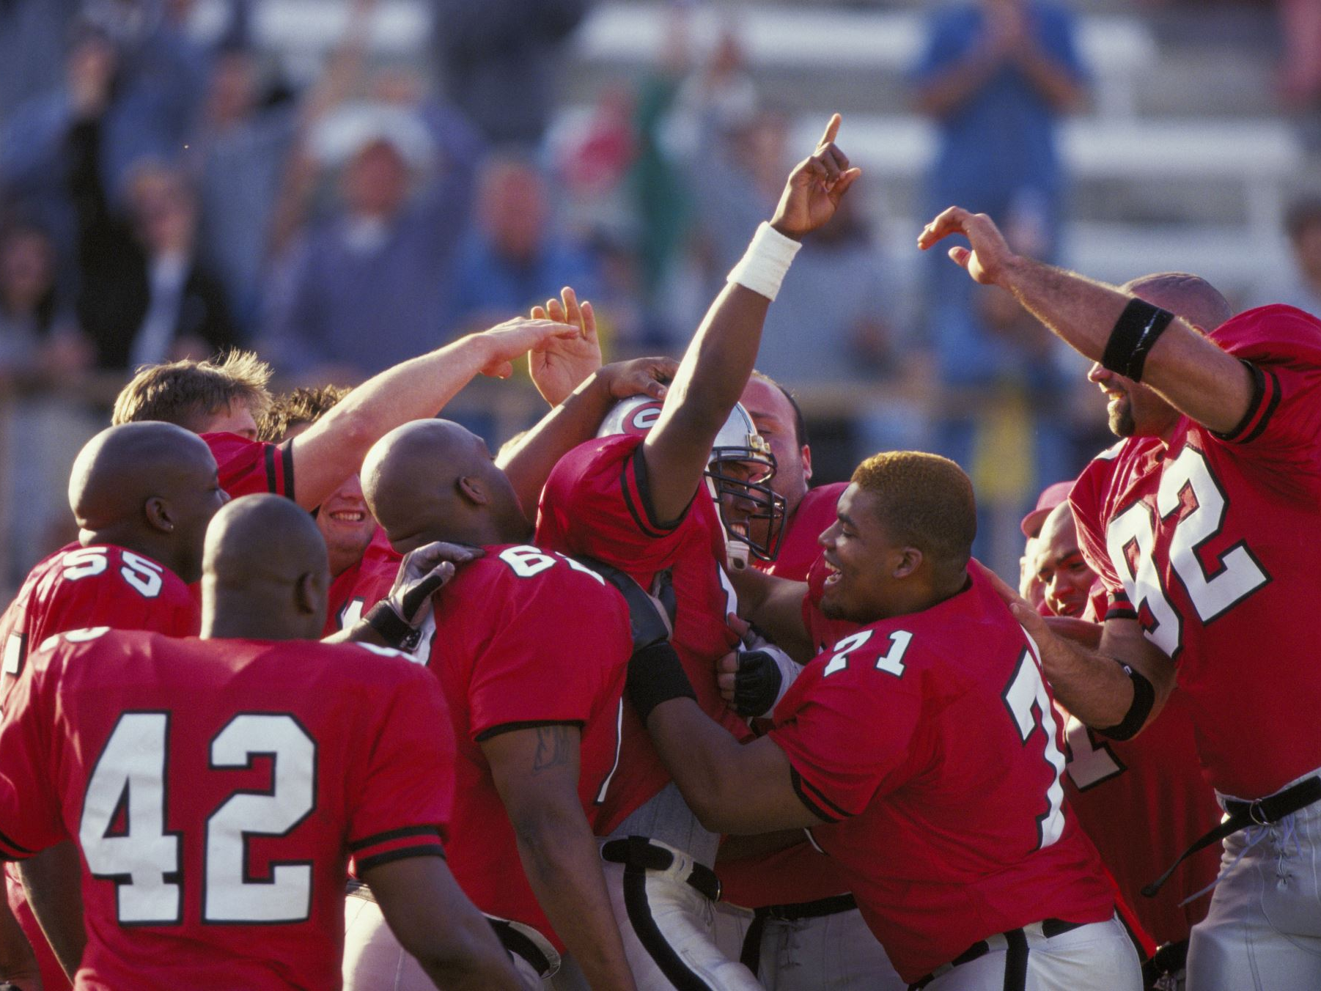
Considerations for a Winning Strategy
Ownership
Human contribution
Scope of protection
Trade secret protection
Potential Liability
AI-generated works (output)
AI Training (input)
Statute of limitations (3 years)
Development guardrails, source checks
Documentation of R&D/design process
Responsible AI usage
Contractual Updates
Indemnification provisions
AI-related use restrictions in NDAs, vendor agreements, outside counsel
Output safeguards
Licensing

Slide 22
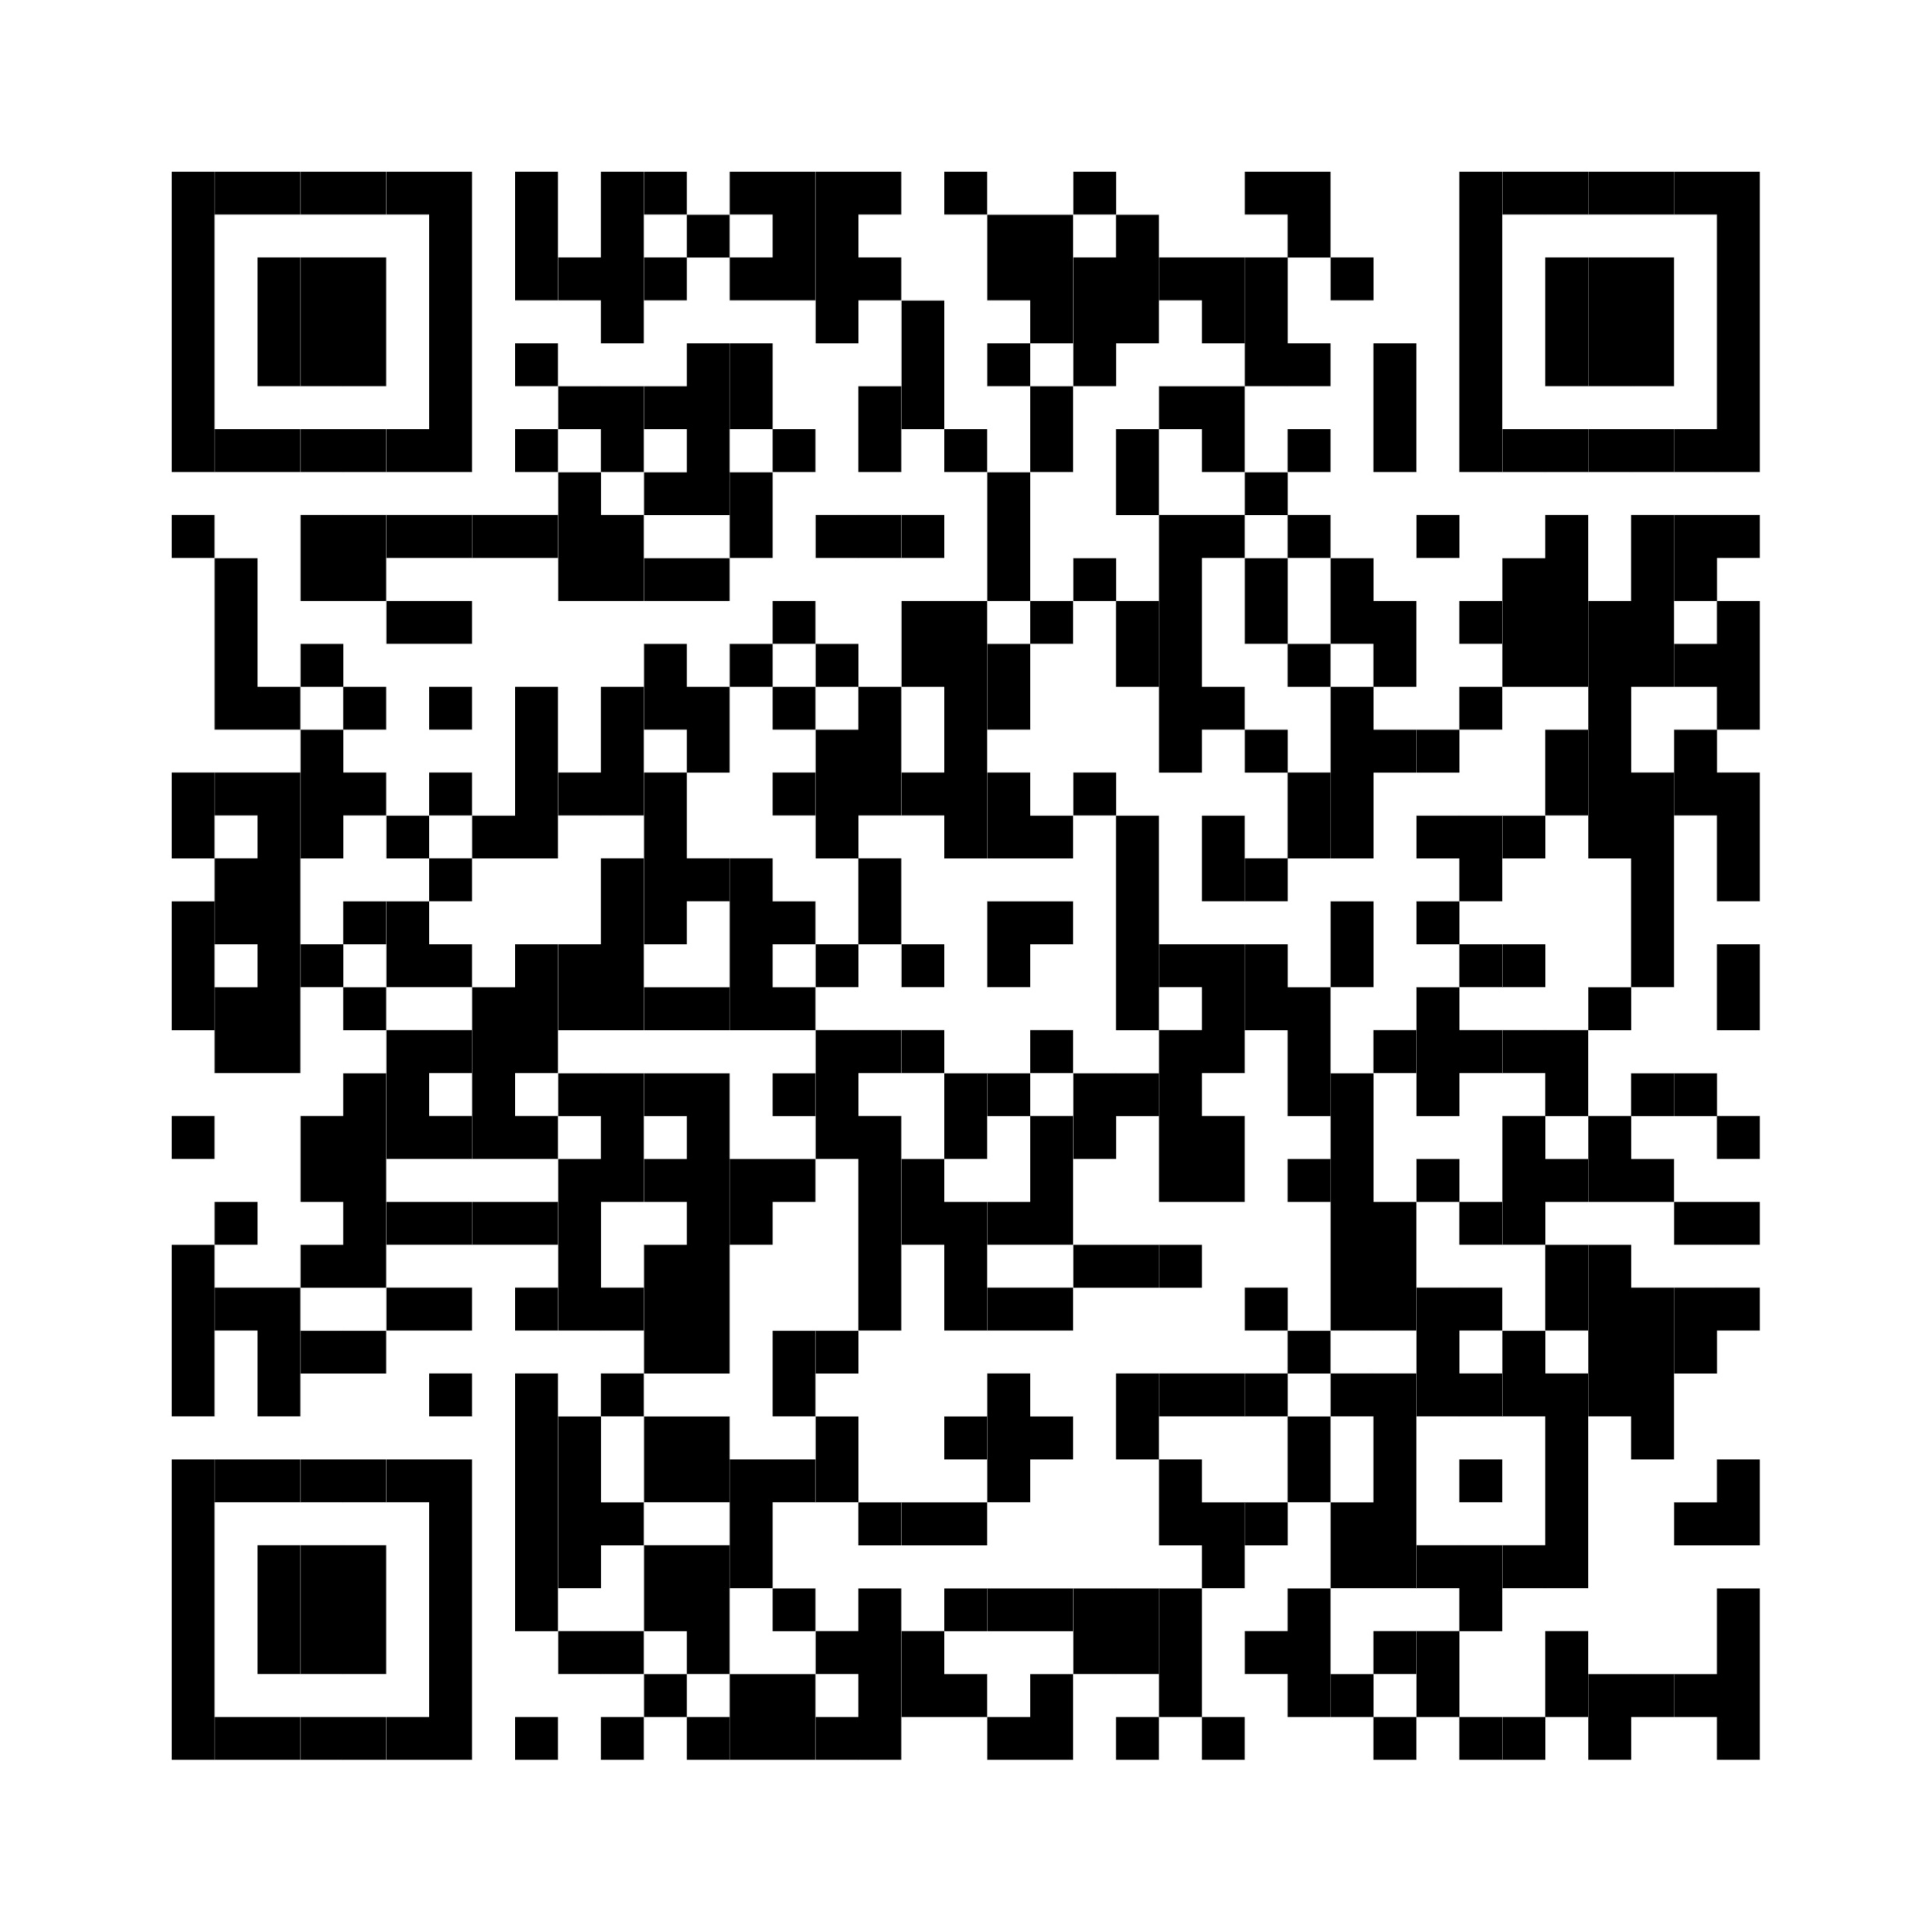
Trump Administration Initiatives & Executive Orders
The Trump administration is making sweeping changes in federal policy that directly impact businesses and individuals, including relating to AI.
Our Trump Administration Initiatives & Executive Orders webpage is a go-to source for up-to-date legal insights on federal policy changes — helping you understand how these developments may affect you and what actions you can take.
https://www.foxrothschild.com/trump-administration-initiatives-executive-orders

Slide 23

Stay Informed
Fox’s Oval Office Update on LinkedIn promotes our attorneys’ latest insights on Trump Administration Initiatives & Executive Orders. Subscribe to our newsletter to stay informed about the many policy changes coming from the White House.
To subscribe, visit:
https://www.linkedin.com/newsletters/oval-office-update-7295167083024146433/

Slide 24

Questions?
Lauren Sabol
Partner
412.394.5568
lsabol@foxrothschild.com

