Slide 1


When the Franchise Is on the Line: Strategies for Workplace Crisis Management
Presenters:
Brian Balonick, Fisher Phillips
Robert Frankhouser, Essential Utilities

Slide 2

Agenda
I. Defining Workplace Crises
Why crisis management matters
What qualifies as a “crisis”
Early warning signs and escalation triggers
II. Immediate Response Strategy
Organizational objectives in a crisis
Acting quickly while maintaining credibility
Key decision-makers and roles
Preserving legal privilege
IV. Conducting the Investigation
The arc of an internal investigation
Planning and information gathering
Interviewing witnesses (including high-risk witnesses)
V. Applied Case Study

Slide 3
Phase 1: Initial Considerations

Slide 4

Why Effective Crisis Management Matters
Speed of escalation: Workplace issues can become legal claims or public controversies in hours—not days
High-stakes exposure: Potential liability includes litigation, regulatory action, and reputational harm
Decision-making under pressure: Leadership must act quickly with incomplete information
Compounding risk: Missteps in the first 24–48 hours often create greater liability than the underlying issue
Workplace impact: Employee morale, trust, and retention are directly affected
Long-term consequences: How a company responds can shape culture, brand, and future claims

Slide 5
What Qualifies as a “Crisis”?
Three Elements Common to a Crisis Situation:
A Threat to the Organization
Potential impact on leadership, operations, or brand viability
Often involves systemic issues or institutional failure, not isolated conduct
Risk extends beyond the immediate incident to long-term consequences
The Element of Surprise
Issue emerges unexpectedly or without full context
Information is incomplete, evolving, or unreliable
Organization is reacting—not controlling—the narrative
A Short Decision Window
Need for immediate action with imperfect information
Delayed response can magnify liability and reputational harm
Requires rapid coordination across legal, HR, and leadership

Slide 6

Not All Crises Start as Crises
Most crises originate as routine workplace issues viewed through a narrow, short-term lens
Common Early Warning Signs
Repeat complaints involving the same individual or department
Patterns of behavior that emerge only when viewed collectively
“Open secret” dynamics where misconduct is informally known
Inconsistent responses to similar issues
Where Organizations Go Wrong
Failure to “connect the dots” across complaints
Allowing high performers or senior leaders to avoid scrutiny
Inadequate documentation or superficial investigations
Failure to escalate issues beyond HR or mid-level management

Slide 7

Crisis or Not?
Which of the following hypotheticals qualifies as a crisis?
Scenario 1: An employee files a single internal complaint alleging a supervisor made an inappropriate comment during a team meeting.
Scenario 2: Over several years, multiple employees report that senior leadership was aware of ongoing harassment by a high-level executive but failed to act. A reporter contacts the company for comment.
Scenario 3: A former employee posts a viral social media thread alleging discrimination, and several current employees publicly corroborate the claims.

Slide 8

Crisis or Not?
Scenario 1: Not a Crisis. Standing alone, this is not a crisis. It is an internal issue that requires a prompt and appropriate investigation, but it does not yet reflect a systemic problem, implicate senior leadership, or create external risk.
Scenario 2: Crisis. This is no longer just an allegation of misconduct—it is a potential institutional failure. The involvement of senior leadership, combined with prior notice and inaction, creates significant legal exposure and reputational risk. External scrutiny means the organization has likely lost control of the narrative, and its response will be judged as much as the underlying conduct.
Scenario 3: Emerging Crisis. The public nature of the allegations, combined with real-time amplification and internal corroboration, creates immediate reputational risk and puts the organization in a reactive posture. Even if the underlying facts are still being investigated, the combination of visibility, credibility, and speed of dissemination can independently trigger crisis conditions. At that point, the organization must respond not only as an investigator, but as an institution under scrutiny.

Slide 9
Escalation Triggers
When an Issue Must Be Elevated
Senior Leadership Involvement
Allegations involving executives or key decision-makers
Heightened risk of conflict of interest and reputational harm
Pattern or Repeat Conduct
Multiple complaints over time
Similar allegations across individuals or departments
Prior Notice / Failure to Act
Evidence the organization was aware of concerns
Prior complaints closed without meaningful resolution
Severity of Allegations
Harassment, discrimination, retaliation
Safety risks or potential harm to employees
External Exposure Risk
Media inquiries or social media activity

Slide 10

Organizational Objectives in a Crisis
Protect People
Ensure immediate physical and psychological safety of employees
Separate involved individuals where necessary
Maintain a stable and functional work environment
Prevent retaliation or further harm
Minimize Legal and Business Risk
Comply with legal obligations (e.g., reporting, investigation duties)
Avoid inconsistent or damaging internal communications
Limit liability exposure and avoid creating new risk
Preserve Organizational Integrity
Demonstrate fairness, neutrality, and accountability
Apply policies consistently—regardless of position or performance
Reinforce organizational values and expectations
Position the organization for long-term trust and defensibility

Slide 11

Act Quickly, But Credibly
Balancing Act:
Acting too slowly can cause management to lose control of the situation and increase the organization’s exposure to risk
Acting too aggressively risks poor or rash decision making and damaging the organization’s credibility
Do:
Take interim measures necessary to stabilize the situation and prevent harm or escalation
Ensure decisions are fact-driven and consistent with policy
Avoid:
Public statements that outpace the facts
Inconsistent or poorly documented decisions

Slide 12

Who Should Be in the Room?
Core Decision-Making Group
Legal (In-House and/or Outside Counsel
Direct the investigation strategy
Preserve privilege and manage legal risk
Advise on regulatory and litigation exposure
HR Leadership
Provide factual and historical context on policies, past complaints, and personnel history
Coordinate internal logistics and employee communications
Help implement interim and corrective actions
Executive Leadership
Provide operational insight and authority
Must be Excluded when necessary:
Reporting relationships to accused
Personal involvement
Conflicts of interest

Slide 13

Preserving Privilege
Why Privilege Matters
Protects internal legal communications and investigative work from disclosure
Allows candid assessment of risk, exposure, and strategy
Prevents internal documents from becoming evidence in litigation or regulatory review
Risks to Privilege
Including PR or communications teams can jeopardize privilege if not structured carefully
Sharing investigation findings too broadly
Use of third parties without safeguards

Slide 14

Managing Communications
Internal Communications
Limit to need-to-know audiences
Avoid unnecessary dissemination of sensitive information
Provide measured, factual updates
Avoid speculation or premature conclusions
Ensure consistency across leadership messaging
External Communications
Centralize messaging through a single point of contact
Use neutral, controlled statements

Slide 15

Executive Misconduct: Special Risks
Conflicts of Interest
Independence & Credibility Concerns
Reputational & Business Risk
Executive misconduct attracts media attention quickly
Can trigger shareholder actions, regulatory scrutiny, and loss of key personnel
Best Practices in Executive Cases
Escalate the issue to Board oversight immediately
Consider an Independent Investigation
In any event, maintain tight control over communications and information flow

Slide 16
Phase 2: Investigation

Slide 17
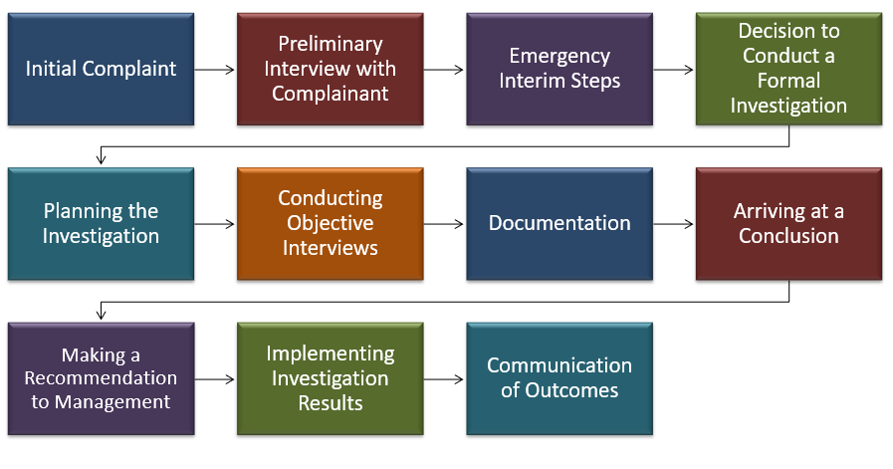
Arc of an Internal Investigation

Slide 18

Each investigation has unique facts and circumstances. Every investigation should be handled promptly. Every investigation demands fairness and respect for participants. Every investigation deserves a thoughtful, logical process and clear execution and follow-through. Every investigator should operate with objectivity and limit personal biases. So, what is different about *this* investigation and what does this situation demand?
Preliminary Question: What does this investigation demand?

Slide 19

Step 1 – Planning
Clearly articulate what question you are trying to answer.
What laws or policies might be implicated?
Identify documents and files you should review and study.
Org charts, job descriptions, relevant emails or texts, personnel files, attendance records, handbook policies, corporate codes of conduct, etc.
Identify people to interview.
Put interview subjects in rank order based on importance.
Coordinate calendars and schedule promptly and close together.
Begin to outline questions/issues to address.
Refine your outline as you become more familiar with the facts.

Slide 20

Step 2 – Gathering and Studying
Become an expert on the record.
Know the actors, dates, and facts.
Formalize the outline of topics you want to cover.
“Brain dump” the questions that come to mind.
Revise and edit this list as you study the record.
Organize your topics and questions into clusters.
Identify your potential biases for a particular outcome.
Revisit these often.

Slide 21
Step 3 – Interviewing (and maybe re-interviewing)
Start with the conversations of key people.
Start conversations with broad questions and move to narrow, specific questions.
Assess when to revisit certain conversations. Do two people conflict with each other?
Determine when you have done enough.

Slide 22
Tips for Conducting an Interview:
Practice active listening skills. Listen, repeat back. Do not cling to your outline of questions without considering the context of the larger investigation.
Start with open-ended questions.
“Tell me about X.”
“Tell me more about X, why you think that?”
“Can you explain X to me? What happened?”
“Tell me more about why you think X.”
Set parameters, when appropriate and helpful.
“In 2-3 sentences, tell me X.”
“In 1 minute or less, tell me about X.”

Slide 23
Tips for Conducting an Interview: (Continued)
Consider “test” questions, to which you know the answer, to lay groundwork.
Remember important topics to conclude with.
Admonitions about retaliation.
Tell the subject to reach out to you if they think of anything else.
Let the subject know you may have more questions.
Jot down your impressions immediately after the interview (keeping in mind they are part of the record).

Slide 24

Handling High-Risk Witnesses
Reluctant or Fearful Witnesses
Address retaliation concerns directly
Reinforce protections and expectations
Build trust through tone and process
Inconsistent Witnesses
Re-interview strategically
Clarify discrepancies
Document remaining inconsistencies clearly
Hostile or Defensive Witnesses
Maintain neutrality
Avoid confrontation
Stick to facts and documentation

Slide 25

Step 4 – Evaluating
The “ride home” thinking.
The “next day” thinking.
Seek pushback or input from others (confidentiality caution).
Assess credibility.
Detail?
Corroboration?
Demeanor?
Omissions?
Prior incidents?
Motive?
Plausibility?
Identify material facts.

Slide 26

Step 5 – Documenting
Begin with the written complaint (or notes about the complaint), interview notes, and copies of relevant documents to draft an outline of your report, citing to relevant laws or policies.
Refine your draft with citations to the record, including dates and times of interviews, what documents or evidence were considered, and your conclusions.
Focus on materiality.
Avoid legal conclusions. You are the fact-finder.
The circumstances and risks of each investigation drive how detailed your report needs to be.
Imagine your report being used in a court of law.
Create an investigation file for saving your notes and all related documentation. Keep the file secure, with other confidential files. Better to save than pitch.

Slide 27
HYPO Exercise: “The Executive Problem”

Slide 28
Hypo: “The Executive Problem”
The company’s Senior HR Manager receives a complaint involving the company’s Chief Operating Officer. According to the complaint, the COO has engaged in a pattern of inappropriate conduct toward multiple employees over the past two years. The allegations include late-night messages to subordinates that cross professional boundaries, invitations to private dinners tied—implicitly or explicitly—to career advancement, and repeated comments about employees’ appearance and personal lives. One employee has alleged that she was passed over for a promotion after declining the COO’s advances.
As you begin to review the file, additional concerns surface. There were two prior complaints involving the COO within the last 18 months, both of which were closed as “unsubstantiated.” Internal emails suggest that at least some members of leadership were aware of concerns about the COO’s behavior but chose not to escalate them. Informal Slack messages among employees refer to the COO’s conduct as an “open secret.”
At the same time, pressure is mounting. The CEO asks for a quick resolution, citing operational concerns. The Board has not yet been informed. Then, an email arrives from a reporter stating that they are “looking into allegations of executive misconduct” at the company and requesting comment.

Slide 29
“The Executive Problem” Discussion
1. Planning
What is the core question you are trying to answer?
What policies and legal risks are implicated by this situation?
2. Gathering & Studying
What additional documents or data do you need?
Are there gaps in the record you must fill before proceeding?
3. Interviewing
Who do you interview—and in what order?
How do you handle inconsistent witness accounts?
4. Evaluating
How do you assess credibility here?
5. Documenting
What facts must be clearly documented to make your findings defensible?
What level of detail is appropriate given the risk?

Slide 30

QUESTIONS?

Slide 31

THANK YOU

