Slide 1
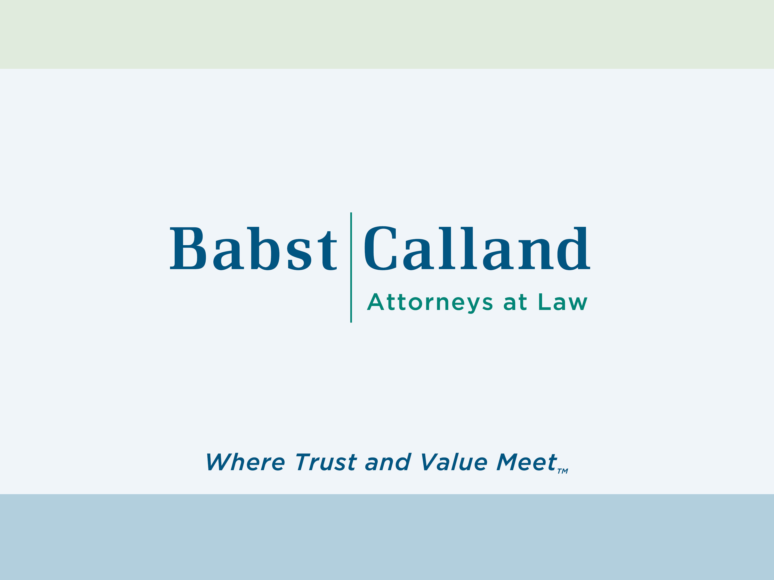

Slide 2
Strategizing Artificial Intelligence
in Legal Practice
April 10, 2026
Donald C. Bluedorn II, Esq.
Ethan F. Johnson, Esq.

Slide 3
Agenda
Introduction
Where Are We?
Basic Guidelines for Using GenAI
A Few Practical Examples
Responsible Use of AI Tools
Q & A

Slide 4
Where Are We?
Extractive AI vs. Generative AI
General Industry – yes and no
Usage is way up
Problems with implementation
Legal Industry – not a bubble, but AI products are consolidating - advancements in products occurring at a dizzyingly fast pace
Movement from “cost reduction” to “growth and innovation”

Slide 5
Bar Associations Have “Weighed In”
ABA Formal Opinion 512 – July 29, 2024
ABA Model Rules
Pennsylvania Bar Association and Philadelphia Bar Association Joint Formal Opinion 2024-200 – May 22, 2024
New York City Bar Association Formal Opinion 2025-6
Common Foundations:
Competence & Supervision – Rules 1.1, 5.1, and 5.3
Confidentiality – Rule 1.6
Communication – Rule 1.4
Reasonable Fees – Rule 1.5
Integrity – Rules 3.1, 3.3, and 8.4

Slide 6
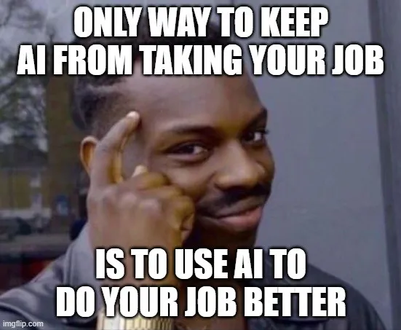
Where Are We - The Good . . .

Slide 7
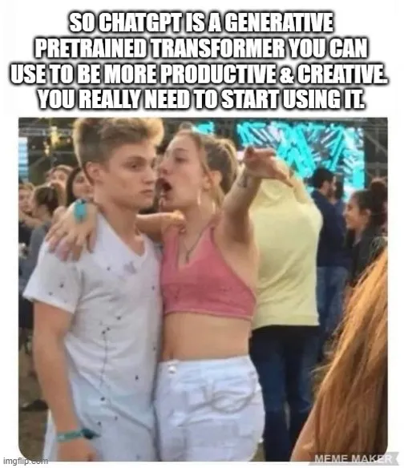
The Bad . . .

Slide 8
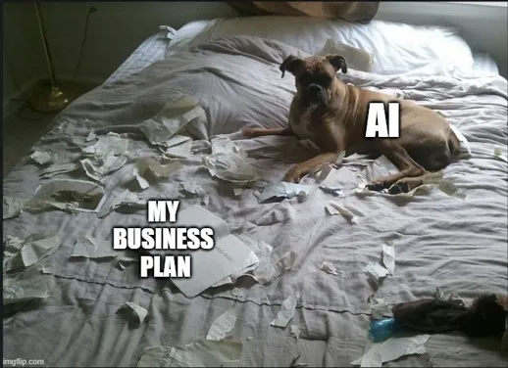
And the Ugly . . .

Slide 9
Basic GenAI Guidelines – Our Firm’s Approach
No. 1 – Understand the Technology and its Limitations
No. 2 – Adhere to Existing Rules on Use
No. 3 – Use Technology as a Complement, not a Substitute
No. 4 – Maintain Client Confidentiality and Attorney-Client Privilege
No. 5 – Inform Clients (including internal clients) and Assume Responsibility
No. 6 – Billing and Timekeeping

Slide 10
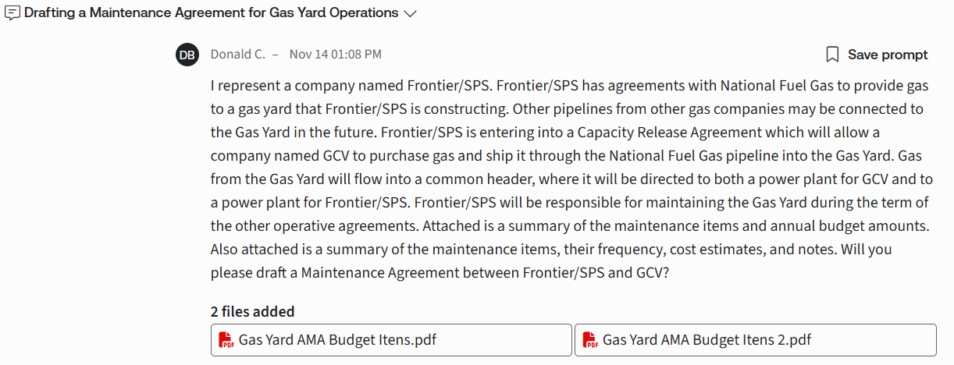
Example 1 – Draft an Agreement Using a “Secure” LLM

Slide 11
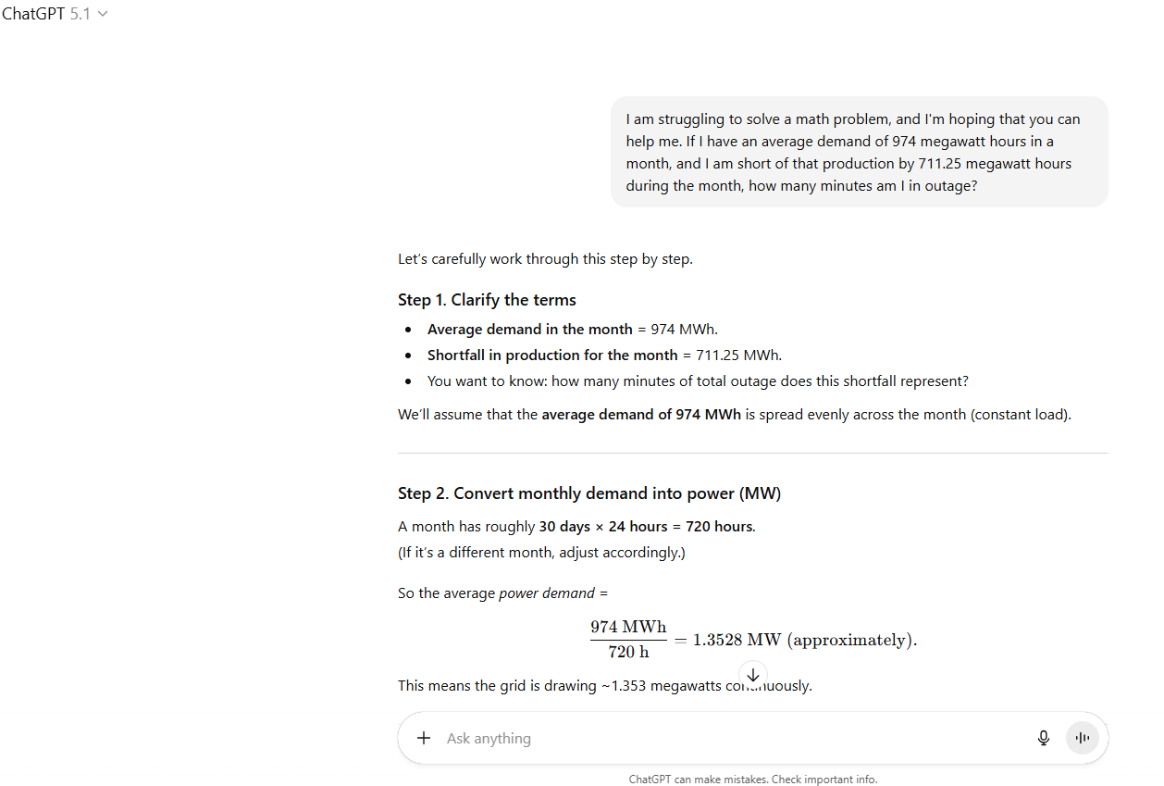
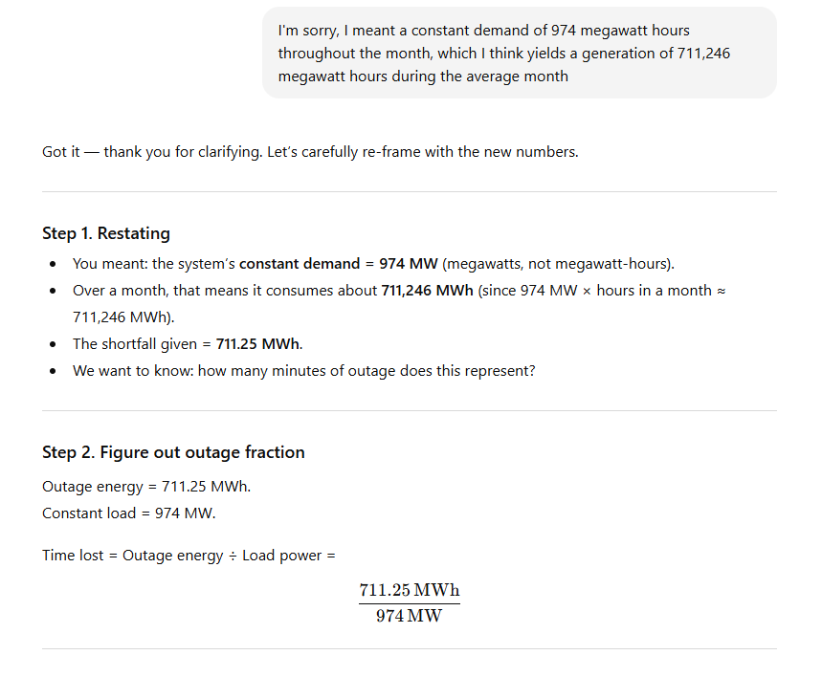
Example 2 – Perform a Calculation Using a “Non-Secure” LLM

Slide 12
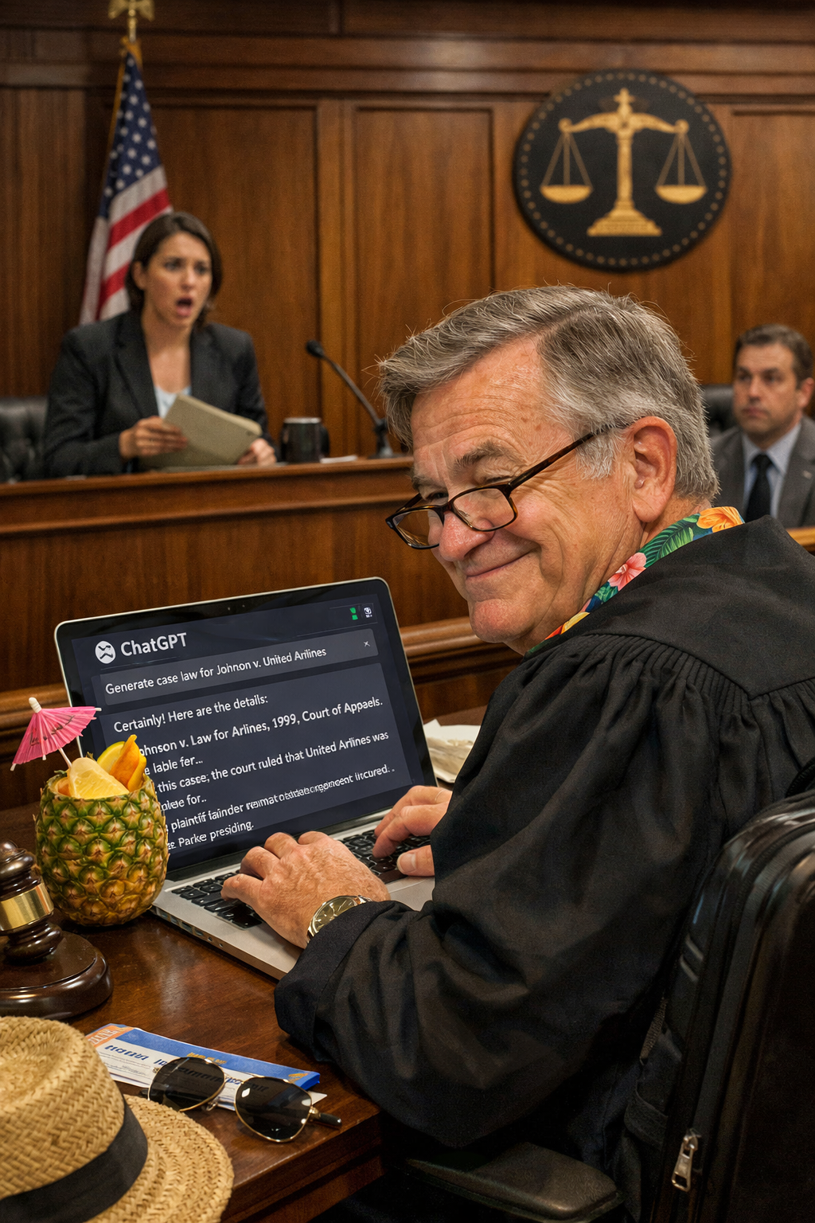
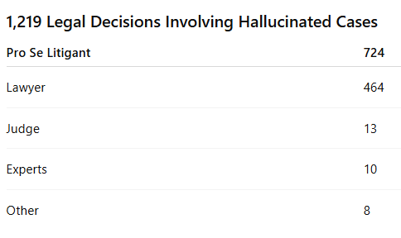
The Charlotin List
Notes:
Charlotin List: A French lawyer Damien Charlotin took it upon himself to keep track of every time a legal professional got in trouble for using a hallucinated case/bad citation in filings.
Chatgpt prompt: generate a picture of a judge inappropriately using chatgpt hallucinated cases so they can start a vacation early
Point out that 13 judges are listed and there is no mention of law clerks. But willing to bet a few law clerks had some explaining to do on those 13 cases. Make sure all admin and staff are using AI tools responsibly.

Slide 13
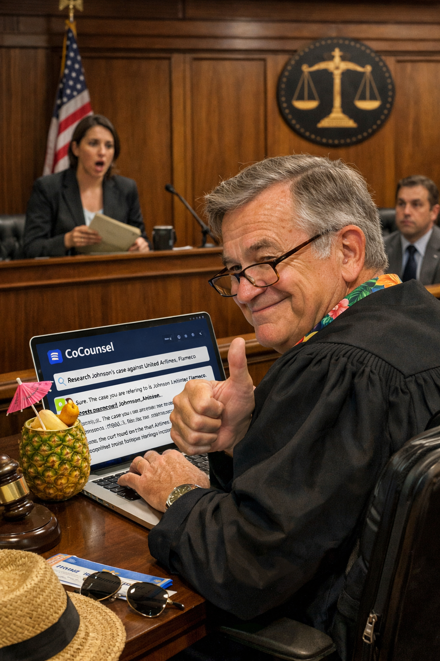
How to Stay Off The Charlotin List…
Do not use ChatGPT for Legal Research
Use CoCounsel for Legal Research
Use ChatGPT for facts, math, database searching, images, etc.
Notes:
Chatgpt prompt: change the picture to the same judge using cocounsel for legal research and doing a thumbs up

Slide 14
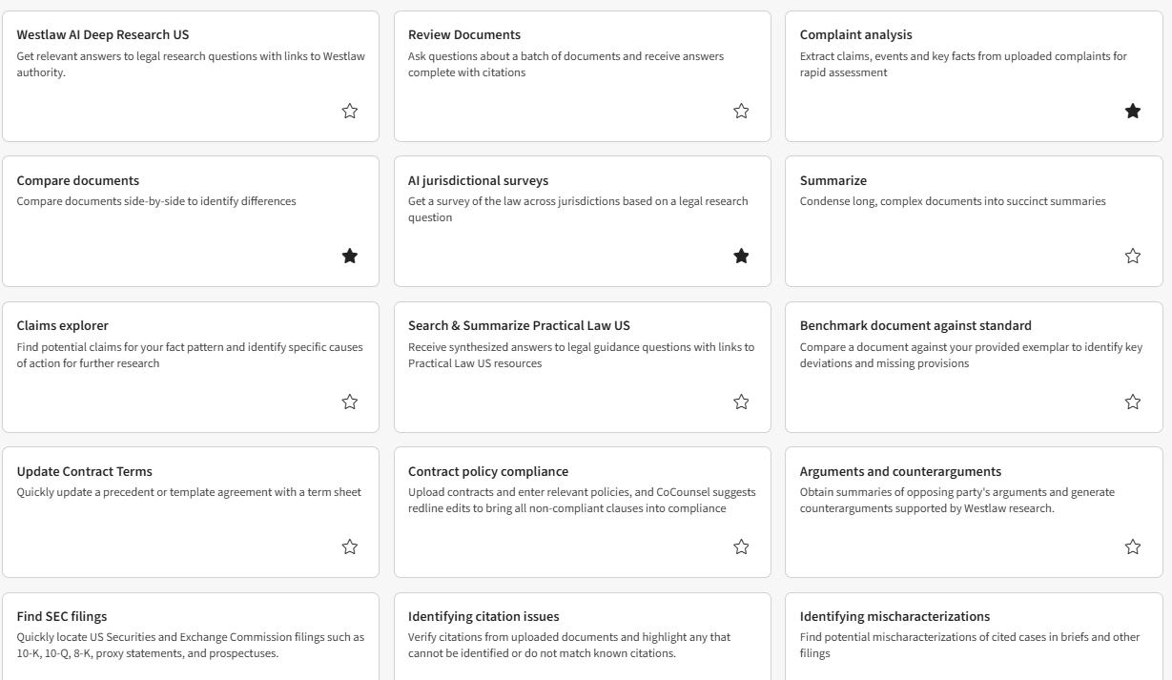
CoCounsel Examples
Notes:
Needed the identifying mischaracterizations tool when I was a law clerk

Slide 15
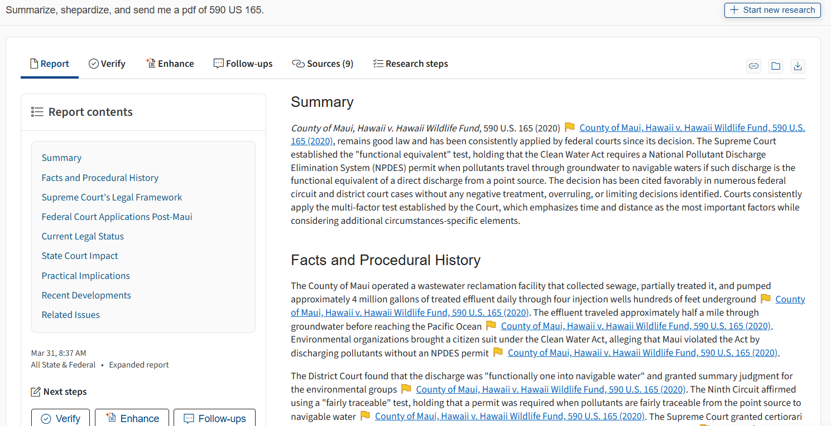
Deep Research Skill
Notes:
If you include shepardize in the prompt, cocounsel will identify and summarize negative treatment and you can easily review those cases.
Verify tool is key in Deep Research Task Bar
Deep Research skill will not hallucinate cases but it will generate questionable conclusory statements you should verify as necessary

Slide 16
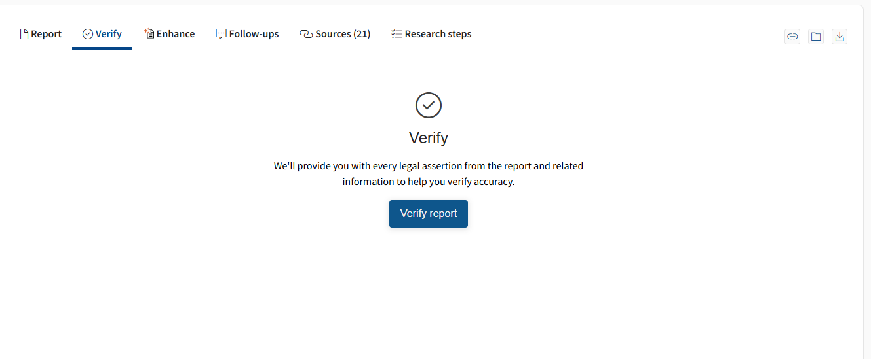
Deep Research Skill
Notes:
Verify tool is key in Deep Research Task Bar
Deep Research skill will not hallucinate cases but it will generate questionable conclusory statements you should verify as necessary

Slide 17
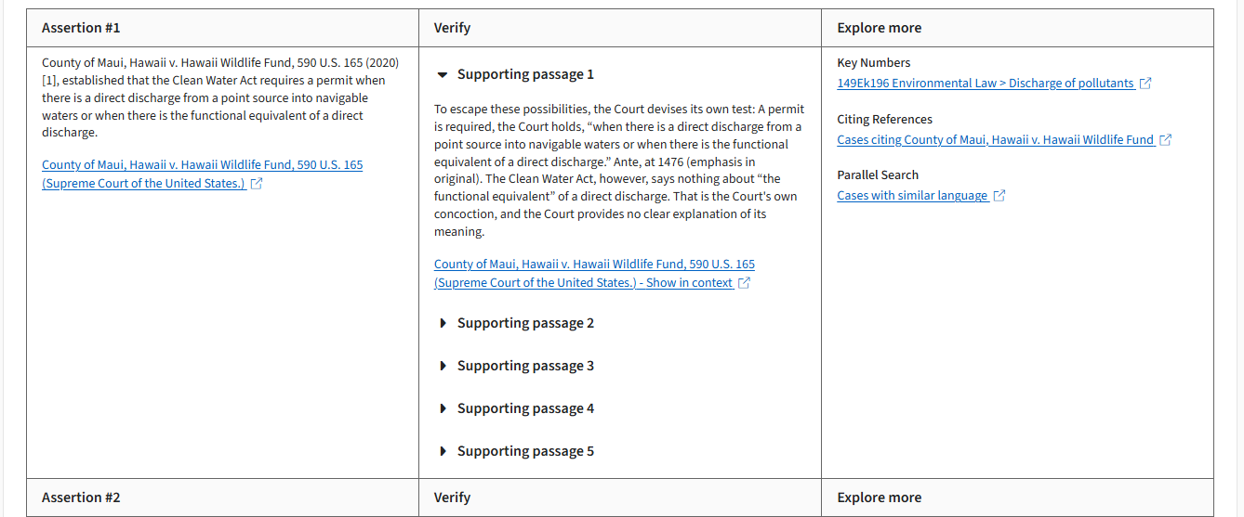
Deep Research Skill
Notes:
Identify any assertion you see as too strong or questionable and review the support

Slide 18
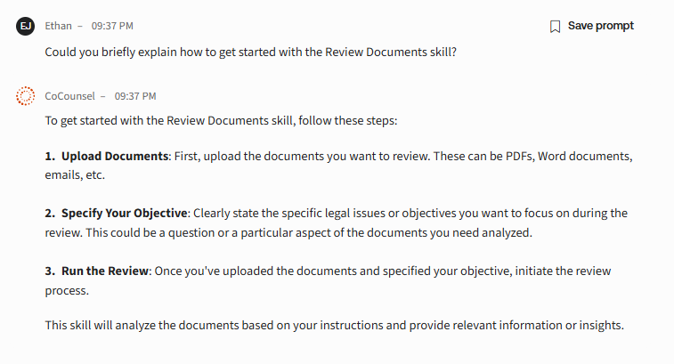
Review Documents Skill
Notes:
E.g. Upload four deposition transcripts and prompt: “Review these deposition transcripts and provide citations to any mention of…”

Slide 19
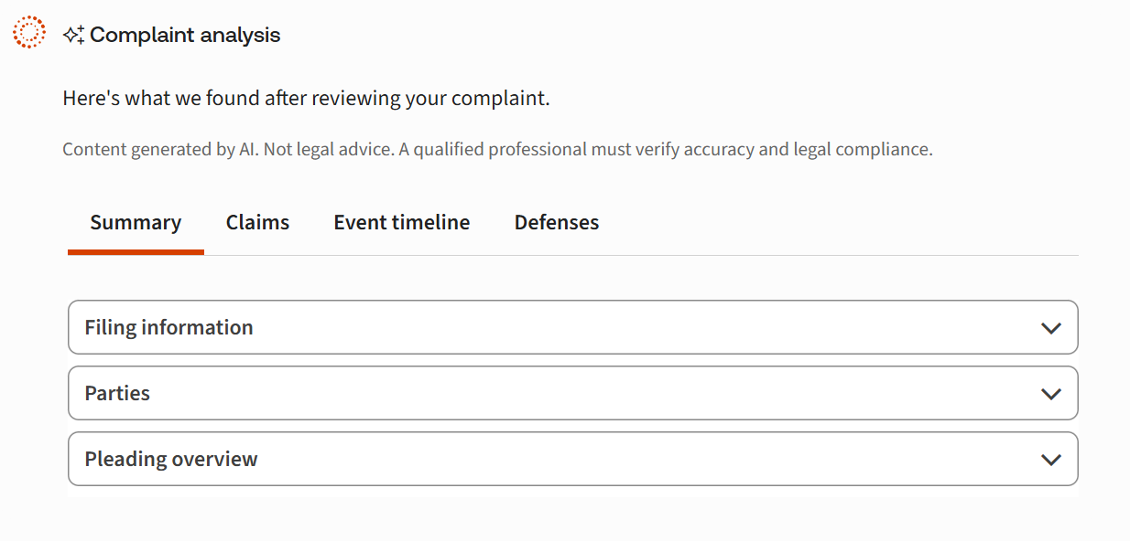
Complaint Analysis Skill
Notes:
Upload Complaint and use summary to draft outline to response

Slide 20
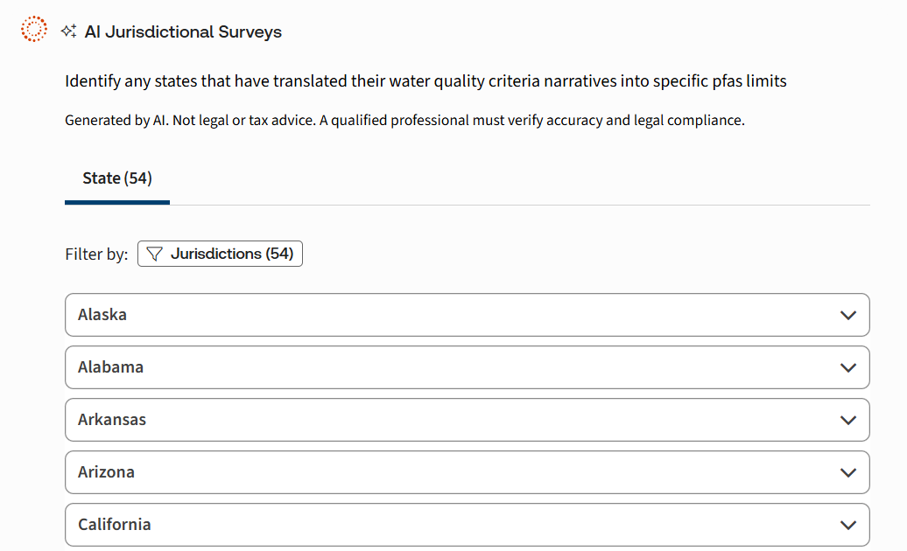
Jurisdictional Survey Skill
Notes:
CoCounsel Prompt: Identify any states that have translated their water quality criteria narratives into specific PFAS limits

Slide 21
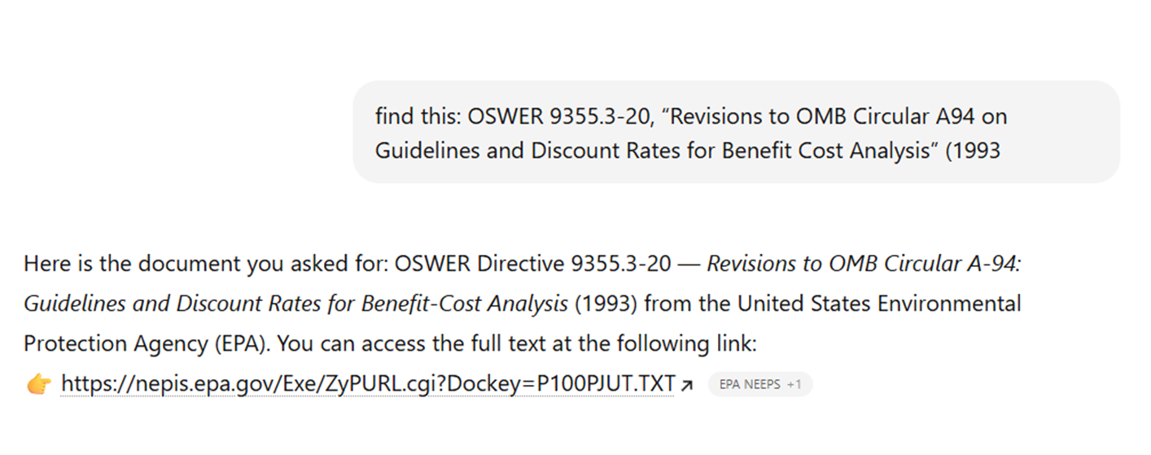
ChatGPT Examples
Notes:
Disclaimer: the use of chatgpt poses a risk to the confidentiality and privilege of any information you enter into it! Do not enter confidential and privileged information.
Make ChatGPT search clunky government databases instead of you

Slide 22
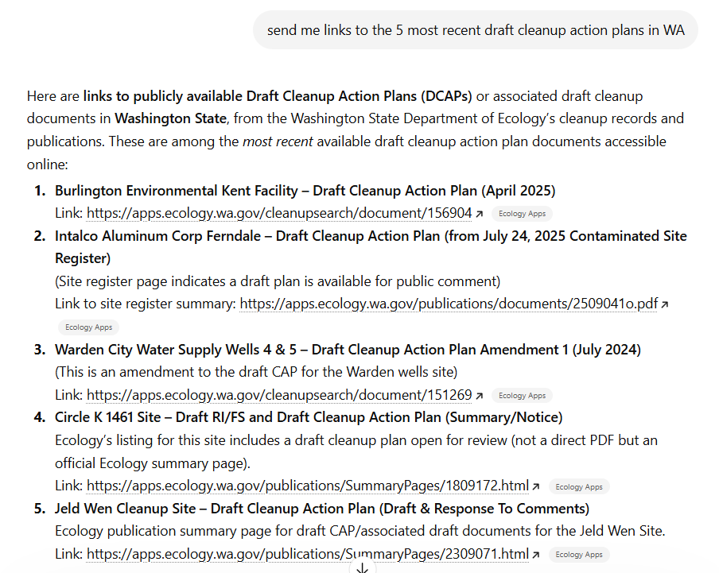
ChatGPT Examples
Notes:
Make ChatGPT search clunky government databases instead of you
Maybe I should start saying please and thank you like Don in case of any I Robot/Ex Machina situations…

Slide 23

ChatGPT Examples
Fact Research
“Diligent Investigation”
Corporate history
Notes:
Cautionary tale: Corporate client searched hard copy records on hand and decided it did not operate during certain timeframe in any capacity…30 second double check on chatgpt proved them wrong; make sure your “diligent investigations” during discovery are at least as good as a few minutes asking chatgpt

Slide 24
Rules of Thumb
Bookend Approach
CoCounsel/Westlaw AI for Legal Research
ChatGPT for facts, math, images, visuals, etc.
Always Verify; do not trust any quotes or citations from ChatGPT
Protect Confidentiality & Privilege
Notes:
Bookend Approach: Use AI at the beginning or end of projects. It can help orient you at the start and can alert you of things you may have missed at the end.

Slide 25
Q & A

