Slide 1
ACC Back to School 2025 Lawyering In a Crisis
Daniel McLane, Jessica Priselac, and Joseph Walsh,
Duane Morris LLP

Slide 2
Overview
Three Stages of a Crisis
Pre-Incident
Immediate Aftermath
Investigation/Legal Response
Ethical Implications
PA Rules
ABA Model Rules

Slide 3

Precedent Events
BP Macondo
Valdez
PG&E San Bruno
Torrance
Halliburton

Slide 4

Being Prepared - Pre-Incident
Establish Clear Priorities
Incident Command System
Scalability & Flexibility

Slide 5
Being Prepared - Pre-Incident
Who is your client?
ABA Model Rule and PA Rule 1.13
Organization as Client
Individual Employees
Joint Ventures
Emerging Growth Companies

Slide 6

Immediate Aftermath
Questions
What was the emergency event?
What was the extent of the damage?
What caused the incident?
Who is responsible?
How are you going to fix it?
Are you going to pay claims?

Slide 7

Immediate Aftermath
Guiding Principles
BE CREDIBLE Understand the facts
BE DISCIPLINED & FOCUSED Centralize communication and preserve evidence
BE COOPERATIVE Cooperative but firm
BE ENGAGED Empathy (vs. apathy) with all stakeholders
BE STRATEGIC Preserve claims against responsible parties

Slide 8
Immediate Aftermath
Providing and Obtaining Advice
ABA Model Rule and PA Rule 2.1
Advisor
Consideration of “moral, economic, social and political factors, that may be relevant to the client's situation.”
ABA Model Rule and PA Rule 1.1
Competence
Emergency Carveout
Multijurisdictional Issues

Slide 9
Immediate Aftermath
Communicating with the Public
ABA Model Rule and PA Rule 4.1
Truthfulness in Statements to Others
ABA Model Rule and PA Rule 4.3
Contact with Unrepresented Persons/Dealing with Unrepresented Person

Slide 10
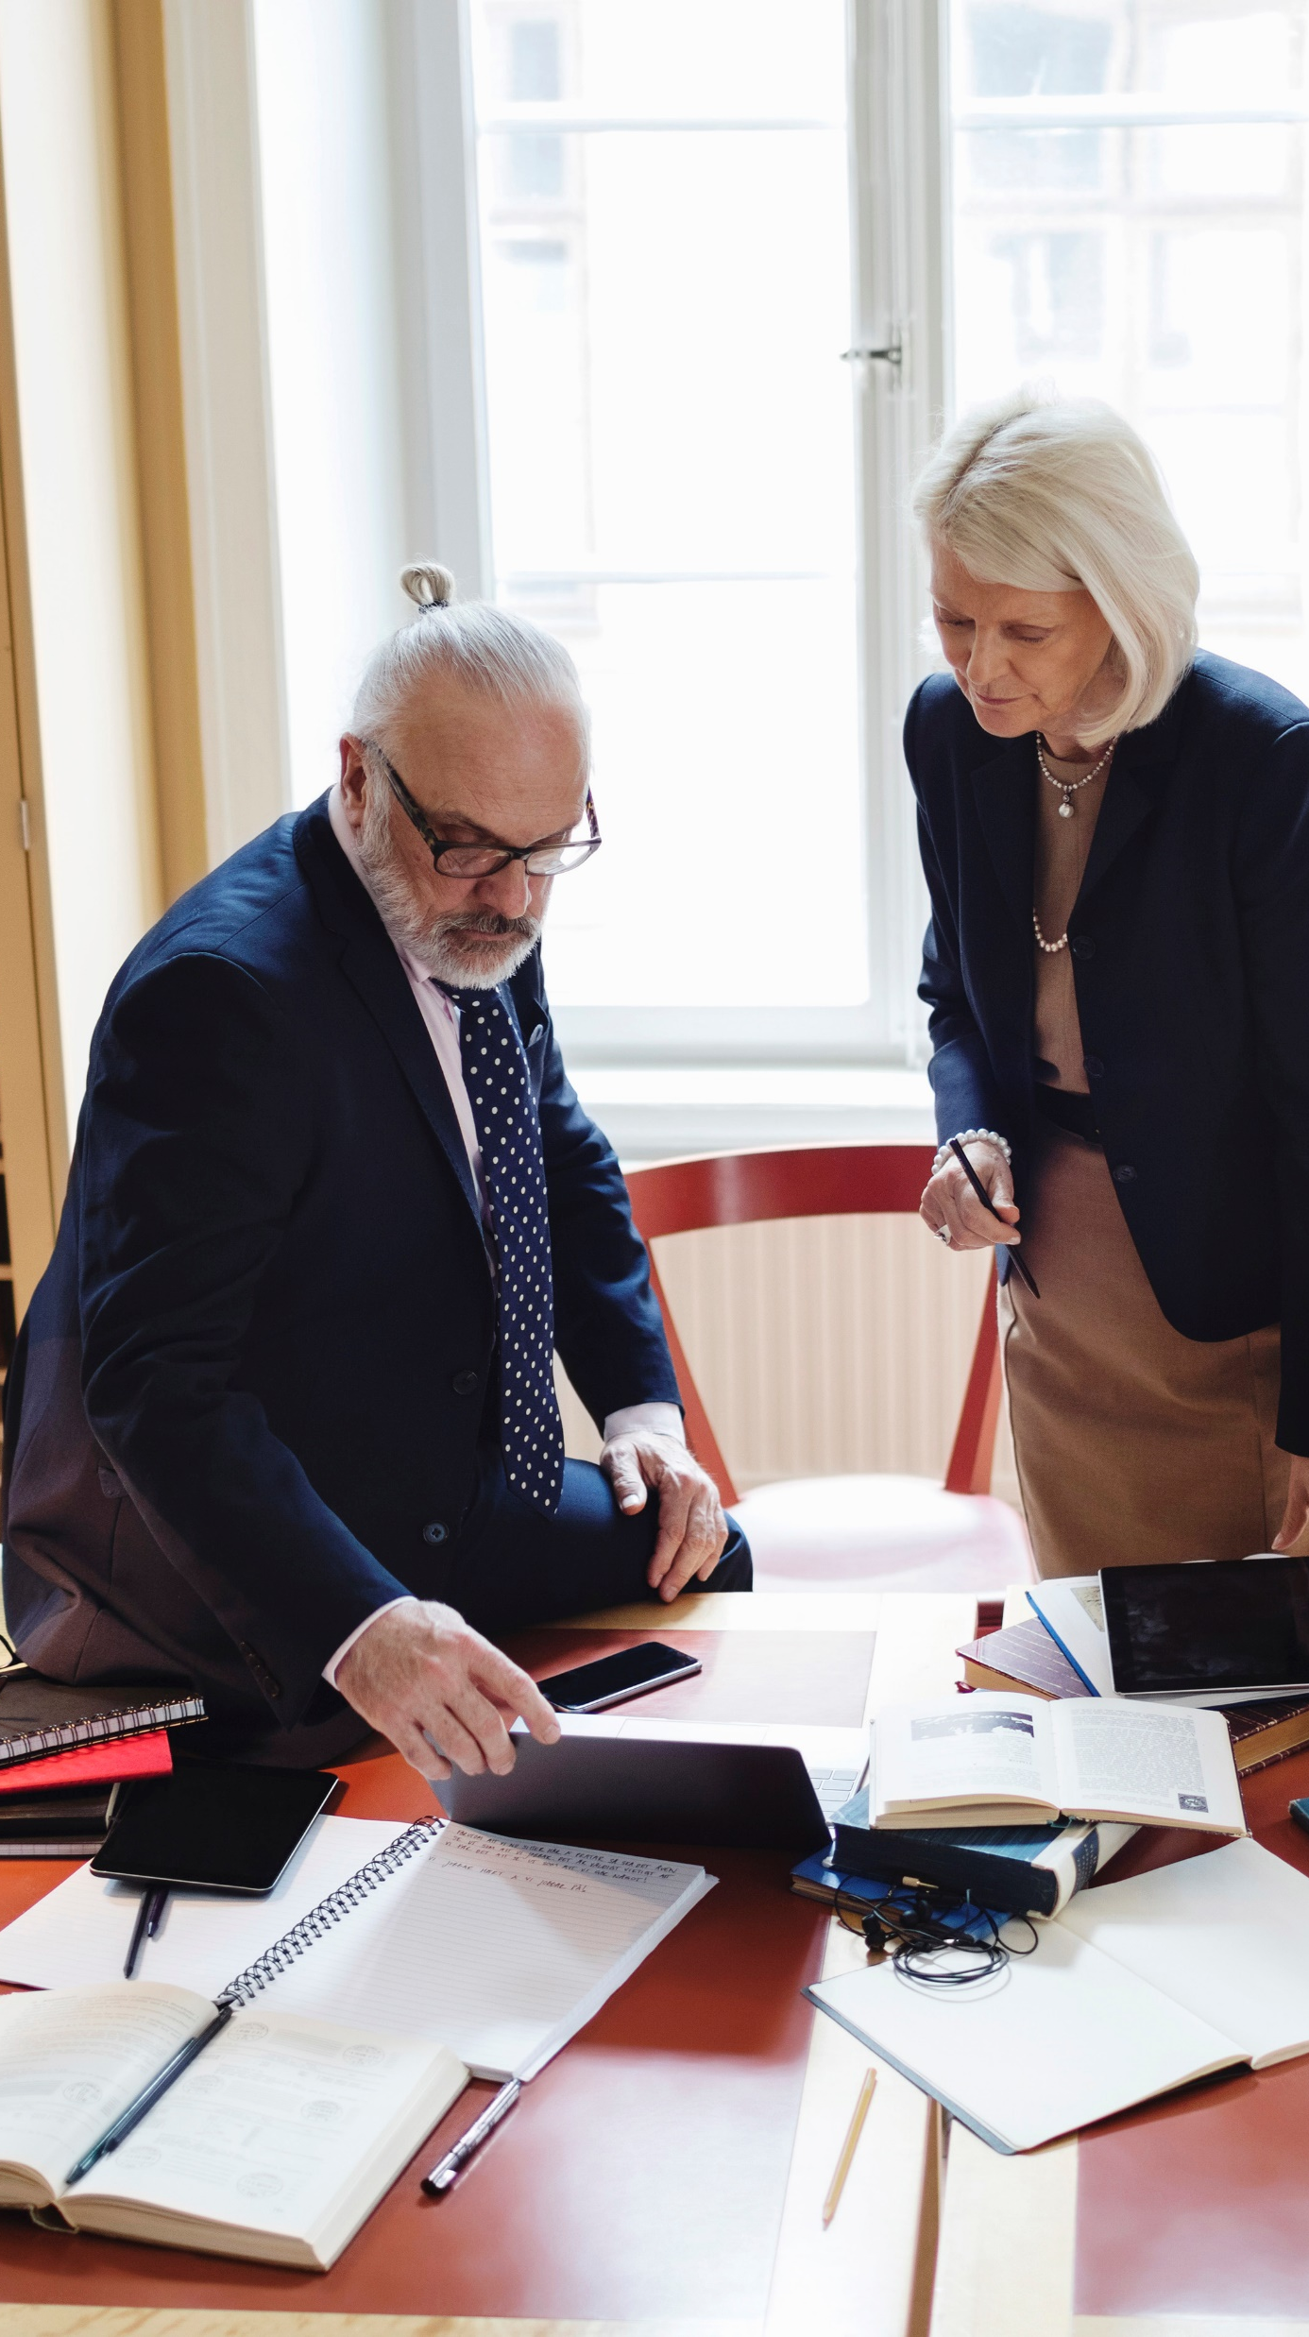
Investigation and Legal Response
EARLY CONSIDERATIONS
Type of harm: natural resources, property, personal injury, etc.
Communication protocol
Document/data retention policies
Affirmative claims
Reputation/brand risks
GOVERNMENT REGULATORS
Top priority: establish credibility with government agencies, civil and criminal.
Open communication
Accurate information
Early notifications

Slide 11
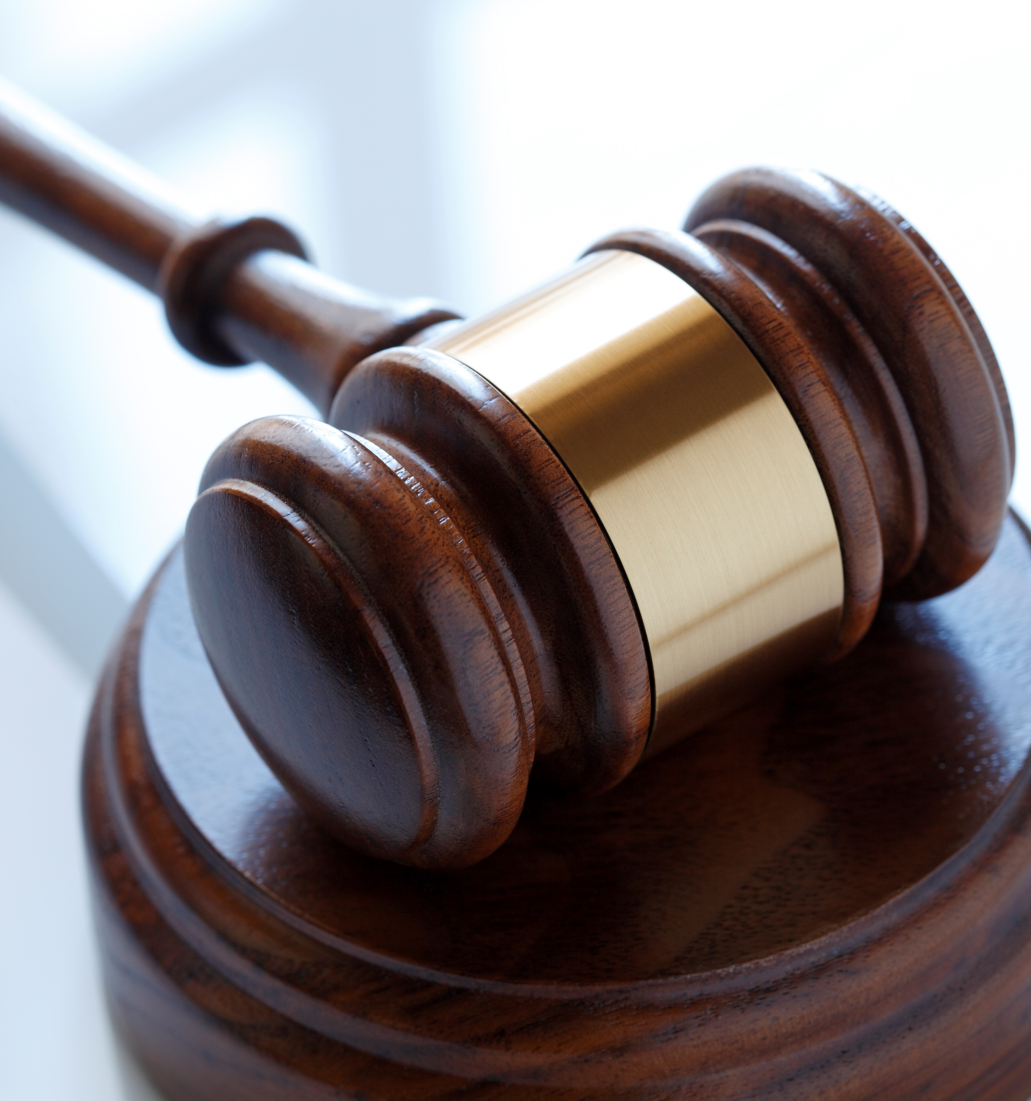
Investigation and Legal Response
CIVIL & CLAIMS PROCESS
Retain control
Standard: legitimate claims caused by the incident
Various types of potential suits
CRIMINAL ISSUES
Federal, state, and local authorities
Individual accountability
Corporate collective knowledge
CONGRESSIONAL HEARINGS
Political climate and motives

Slide 12
Investigation and Legal Response
Who is your client?
Ongoing Investigations
Discipline in Upjohn Warnings
Communicating with the Public
ABA Model Rule and PA Rule 3.6
Trial/Investigation Publicity

Slide 13
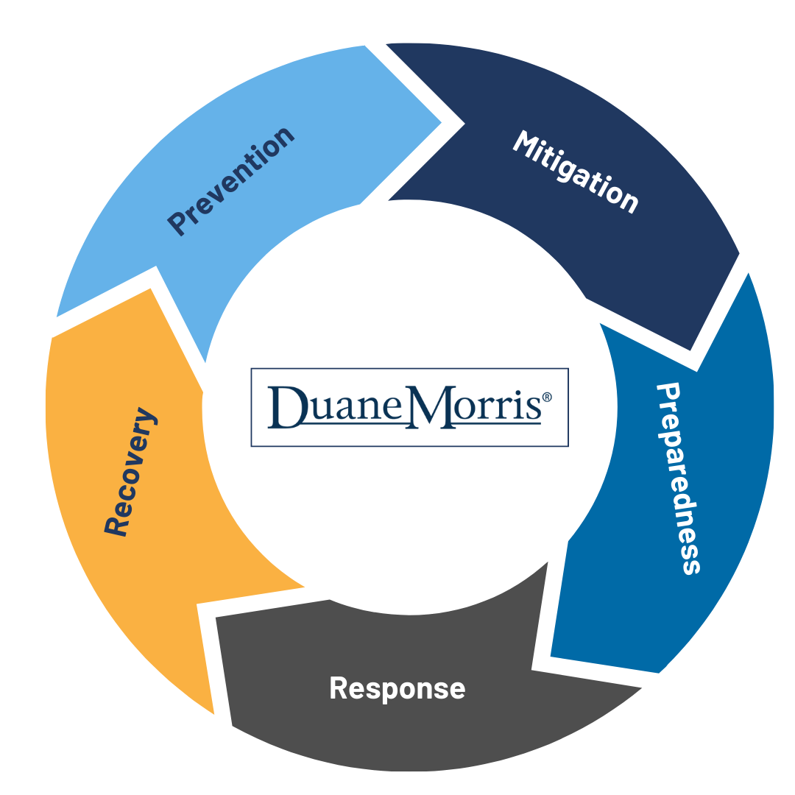
Questions?
Thank you!

