Slide 1


How the U.S. Supreme Court is Reshaping
Federal Labor & Employment Law
J.T. Holt
Partner
jholt@fisherphillips.com
(412) 822-6634

Slide 2

Agenda
Trump v. CASA, Inc.
Stanley v. City of Sanford, Florida
Ames v. Ohio Department of Youth Services
Garcia v. Fuentes Restaurant Management Services, Inc. (applying Morgan v. Sundance)
Loper Bright Enterprises v. Raimondo
Humphrey’s Executor v. United States

Slide 3
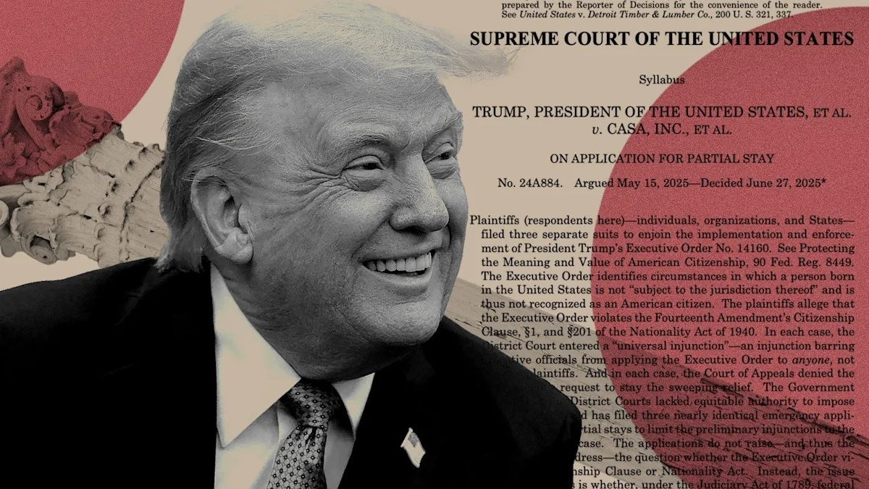
Trump v. CASA, Inc.

Slide 4

Background and Issue
Background:
  President Trump issued an executive order, redefining the circumstances under which a person born in the United States is considered a citizen.
  Individuals, organizations, and states filed suit, arguing that the executive order violated the Fourteenth Amendment’s Citizenship Clause and the Nationality Act of 1940.
  District courts issued universal preliminary injunctions, barring enforcement of the executive order.
  The Government challenged the universal injunctions, arguing that they should be limited to the named plaintiffs.
Issue: Whether federal courts have authority to issue nationwide injunctions.

Slide 5

Decision and Reasoning
Decision: (6-3) “Universal injunctions likely exceed the equitable authority that Congress has given to federal courts.”
  The Court granted the Government’s applications for a partial stay of the injunctions entered below, but only to the extent that the injunctions are broader than necessary to provide complete relief to each plaintiff with standing to sue.
Majority Reasoning:
  Issuance of a universal injunction can be justified only as an exercise of equitable authority.
  Congress did not expressly authorize federal courts to provide such a remedy.
  There is no precedent for issuing universal injunctions in courts of equity (in the U.S. or in England).
  Universal injunctions are rarely needed to grant “complete relief” to plaintiffs.

Slide 6

Practical Impact
It has become a common occurrence to challenge regulations and rules promulgated by federal agencies by seeking universal injunctions
  Recent example: In April 2024, the FTC issued its “non-compete ban” rule. Months later, the USDC for N.D. Tex. issued a nationwide injunction preventing the FTC from enforcing the rule.
Under CASA, Inc., such nationwide injunctions generally are not permitted.
There may be increased litigation because unnamed parties must file their own suits and/or seek class certification under Rule 23 to get relief.
There may be increased legal uncertainty and/or inconsistency
  Some jurisdictions may be subject to a challenged rule while others are not.
  There may be “splits” among the district courts and/or circuit courts
  Multi-state employers may need to track federal regulations/injunctions like state and local laws

Slide 7

Stanley v. City of Sanford, Florida

Slide 8
Background and Issue
Background:
  Karyn Stanley worked as a firefighter for the City of Sanford, Florida.
  When hired in 1999, the City provided free health insurance until age 65 for employees who retired due to disability and/or after 25 years of services.
  In 2003, the City limited health insurance benefits for disability retirees to 24 months.
  Stanley retired in 2018 due to Parkinson’s disease.
  After retiring, Stanley sued the City, claiming it violate the Americans with Disabilities Act (ADA) by providing different health-insurance benefits to disability retirees.
  The District Court dismissed the ADA claim, holding that the alleged discrimination occurred after Stanley retired (i.e., she was no longer an employee), and the Eleventh Circuit affirmed.
  Issue: Does a former employee — who was qualified to perform her job and who earned post-employment benefits during her employment — lose her right to sue over discrimination with respect to those benefits solely because she no longer holds her job.

Slide 9
Decision and Reasoning
Decision: (8-1) The ADA does not permit suits by former employees who no longer hold or desire their job at the time of the alleged discrimination.
Majority Reasoning:
  A “qualified individual” is someone who “can perform the essential functions of the employment position that such individual holds or desires.”
  The present-tense verbs indicate that the ADA only protects employees who can do the job they hold or seek at the time of the alleged discrimination.
  A plaintiff must plead and prove that she held or desired a job, and could perform its essential functions with or without reasonable accommodation, at the time of an employer’s alleged act of disability-based discrimination.

Slide 10
Practical Impact
Resolved a circuit split on whether a retired employee is a “qualified individual” under the ADA
ADA plaintiffs can prevail, even if they are retired when they sue, so long as they “can plead and prove they were disabled and ‘qualified’ when their employer adopted a discriminatory retirement-benefits policy.” (Emphasis added)
ADA plaintiffs also can prevail, even if they were not qualified individual with a disability at the time of the alleged discriminatory act or at the time they suffered harm, if they plead and prove that they were a “qualified individual” with a disability when they became subject to the discriminatory policy.

Slide 11
Practical Impact
Open Questions:
Will plaintiffs be able to bring suits under a “regarded as” theory of disability discrimination? (In other words, whether a plaintiff was regarded as having a disability at the time they became subject to the discriminatory policy.)
Will this rationale apply under other federal discrimination laws (Title VII, ADEA, GINA)?

Slide 12

Ames v. Ohio Department of Youth Services

Slide 13
Background and Issue
Background:
  Ames, a heterosexual woman, worked as the program administrator for the Ohio Department of Youth Services, and a gay woman supervised her.
  In 2019, Ames applied for a new management position but lost it to a lesbian woman.
  Subsequently, the agency demoted Ames from her position as program administrator and promoted a gay man to that position.
  Ames filed a “reverse discrimination” suit against the agency, claiming it discriminated against her because of her sexual orientation.
  The District Court granted summary judgment to the agency, finding that Ames did not show “background circumstances” that support that the agency is that unusual employer that discriminates against the majority, and the Sixth Circuit affirmed.
  Issue: Whether, in a “reverse discrimination” case, a plaintiff has a heightened evidentiary burden to show “background circumstances suggesting that the defendant is the unusual employer who discriminates against the majority.”

Slide 14
Decision and Reasoning
Decision: (9-0) A plaintiff who is a member a majority group does not have a heightened burden of proving background circumstances to support that the defendant is that unusual employer who discriminates against the majority.
Reasoning:
  The plain language of Title VII prohibits discrimination against “any individual” because of a protected characteristic.
  The statute does not authorize different standards for different plaintiffs – regardless of membership in a majority or minority group.
  The “background circumstances” rule undermines the flexible evidentiary standard imposed by the McDonnell Douglas framework.

Slide 15
Practical Impact
The elimination of the “circuit split” sets a uniform standard nationwide.
More reverse discrimination claims may survive summary judgment, as there is no longer a heightened burden of proof under the “background circumstances” rule.
This clarification by SCOTUS – along with current politics – may spark an increase in “reverse discrimination” cases.
  This may be so especially in jurisdictions like the Sixth Circuit, where a “new” standard applies, and employee-side attorneys may counsel clients differently.
Beware of Retaliation: Employers need to be mindful of potential retaliation claims when an employee brings forward a “reverse discrimination” claim.

Slide 16
Justice Thomas’s Concurrence
In a concurrence, Thomas invited challenges to the McDonnell Douglas framework:
His introductory remarks, which he expanded on in his concurring opinion, stated:
I join the Court’s opinion in full. I write separately to highlight the problems that arise when judges create atextual legal rules and frameworks. Judge-made doctrines have a tendency to distort the underlying statutory text, impose unnecessary burdens on litigants, and cause confusion for courts. The “background circumstances” rule — correctly rejected by the Court today — is one example of this phenomenon. And, the decision below involves another example: The Sixth Circuit analyzed Ames’s Title VII claim under the three-step framework developed by this Court in McDonnell Douglas Corp. v. Green, 411 U. S. 792 (1973). As with the “background circumstances” rule, the McDonnell Douglas framework lacks any basis in the text of Title VII and has proved difficult for courts to apply. In a case where the parties ask us to do so, I would be willing to consider whether the McDonnell Douglas framework is a workable and useful evidentiary tool.
(Emphasis added)

Slide 17
Practical Impact
Challenges with the McDonnell Douglas framework:
  Requires courts to draw a distinction between direct and circumstantial evidence
  Different prima facie standards can apply depending on type of discrimination alleged
  Confuses judges and attorneys at all levels
  Can complicate analysis, and present defense challenges, under the summary judgment standard
Significance and Future impact:
  Overruling a standard that is over 50 years old
  What replaces it?
  Would the new standard favor plaintiffs or defendants?
  Would more cases survive summary judgment?
  Would a new standard lead to more unpredictability relative to jury verdicts?
  Will state courts follow federal lead when interpreting congruent state laws?

Slide 18

Garcia v. Fuentes Restaurant Management Services, Inc.

Slide 19
The Morgan v. Sundance Standard
Context: Waiver of arbitration defense
Garcia involved an appeal before the Fifth Circuit (LA, MS, and TX), applying a standard announced in Morgan v. Sundance, Inc. (SCOTUS decision in 2022)
Morgan v. Sundance involved failure-to-pay overtime claims under FLSA
  Defendant filed unsuccessful motion to dismiss, answered complaint (without invoking arbitration defense), and participated in mediation in a similar lawsuit in a different jurisdiction (also without invoking arbitration)
  When Defendant sought to compel arbitration (8 months after suit commenced), the District Court denied the motion based on Sundance’s participation in the litigation process.

Slide 20
The Morgan v. Sundance Standard
Prior to Morgan, common arbitration waiver test:
  Whether the party seeking arbitration substantially invoked the judicial process; and
  Whether doing so was to the detriment or prejudice of the other party
In Morgan, SCOTUS concluded (9-0 decision) that the Federal Arbitration Act (FAA) does not permit courts to create special procedural rules governing arbitration agreements – specifically, by conditioning a waiver of the right to arbitrate on a showing of prejudice.
There is no difference between an arbitration agreement and any other contract with respect to waiver.
The standard for waiver of arbitration is whether the party intentionally relinquished a known right.

Slide 21
Garcia: Background and Issue
Background:
  Garcia, a former server, filed suit against Fuentes Restaurant Management Services, claiming that it violated the Fair Labor Standards Act by failing to pay her minimum wage.
  The parties engaged in some litigation (i.e., filing an answer, discovery, mediation, and filing a joint status report stating neither party had any intent to arbitrate).
  Five months later, the restaurant moved to compel arbitration.
  The District Court denied the motion, finding that the restaurant waived the right to arbitrate by substantially invoking the litigative process.
Fifth Circuit’s Holding: Affirmed the District Court’s decision, finding that the restaurant waived the right to arbitrate by engaging in several overt acts that indicated a desire to resolve the dispute through litigation, including an explicit denial of its intent to arbitrate.

Slide 22
Practical Impact
In many ways, the elimination of the “prejudice” element makes it easier to prove waiver – or, stated differently, for defendants to waive arbitration.
There may be an increase in court litigation, at least where defendants do not act early to confirm whether the plaintiff entered an arbitration agreement and to invoke the arbitration defense in the first pleading (via a motion to compel or, at a minimum, expressly stating the affirmative defense in the answer and Rule 26 reports).
In Garcia, the restaurant claimed lack of knowledge over its own files. Since the restaurant’s lack of knowledge did not prevent waiver, employers should expect courts to impute knowledge of internal agreements, and employers should regularly conduct internal audits.

Slide 23




Loper Bright Enterprises v. Raimondo

Slide 24
Holding of Loper Bright
Overruled Chevron, which required courts to defer to agency interpretations of ambiguous statutes if those interpretations were reasonable and not “arbitrary or capricious.”
The Administrative Procedure Act requires courts to exercise their independent judgment in deciding whether an agency has acted within its statutory authority.
Independent judgment may sometimes include deference to agency interpretations, especially those contemporaneous with a statute or consistently maintained.
However, courts no longer need to defer to agency regulations/interpretations simply because a statute is ambiguous.
Loper Bright makes clear that courts are empowered to interpret statutes

Slide 25
Application in United National Foods, Inc. v. National Labor Relations Board
Court: Fifth Circuit
Context: United National Foods, Inc. (UNFI) filed an unfair labor practice (ULP) charge with the National Labor Relations Board (NLRB). The Acting General Counsel withdrew the complaint, which the Board adopted. UNFI appeal the decision of the NLRB.
Issue: Whether the NLRB acted within its statutory authority when it concluded that the Acting General Counsel's decision to withdraw a complaint is an exercise of prosecutorial discretion that is generally not subject to judicial review.
Holding: Yes, it did.
  The Fifth Circuit looked at the text, structure, and history of the NLRA to determine that “until a hearing begins, settlement or dismissal determinations are prosecutorial.”
  The Fifth Circuit made clear that it was following Loper Bright – reaching its decision through independent judgment, and stating it no longer grants deference to the NLRB.

Slide 26
Application in Zimmer Radio of Mid-Missouri v. FCC
Court: Eighth Circuit
Issue: Whether the Federal Communications Commission’s (FCC) definitions violate Section 202(h) of the Telecommunications Act, which instructs the FCC to consider the necessity of its rules "in the public interest as the result of competition.”
Holding: No
  The Court granted deference to the FCC, finding that the FCC is best positioned to define the meaning of “competition.”
  The Eighth Circuit relied on Loper Bright, stating “interpretations issued contemporaneously with the statute at issue, and which have remained consistent over time, may be especially useful in determining the statute's meaning.”

Slide 27
Practical Impact
Increased legal challenges to federal agency regulations. Examples:
  FTC’s rule banning non-compete agreements
  DOL’s 80/20 tip-credit rule
  OSHA’s new heat standard
  NLRB’s joint-employer rule
Potentially more instability and inconsistencies:
  Different administrations creating different rules, which may be interpreted differently by different courts.
  Another context whereby employers need to track standards and rule by jurisdiction, as they might do with different state laws and/or injunctions (discussed earlier)

Slide 28


Humphrey’s Executor v.
United States
(in modern times)

Slide 29
Holding of Humphrey’s Executor
  SCOTUS in 1935 - arose when President Roosevelt removed an Federal Trade Commission (FTC) commissioner, William Humphrey.
  Decision: The removal was unconstitutional
      Congress may enact limits on the President’s authority to remove officers of certain types of independent/non-executive agencies, such as the Federal Trade Commission (FTC).
      The president does not have unlimited power to remove members of independent/non-executive agencies who hold “quasi-legislative” and “quasi-judicial” power.

Slide 30
Application Today
    President Trump removed Cathy Harris from the Merit Systems Protection Board (MSPB) and Gwynne Wilcox from the National Labor Relations Board (NLRB) without notice or cause, as required by statute.
    Harris and Wilcox filed suit against President Trump, arguing that their roles are “quasi-legislative” and “quasi-judicial” – and, therefore, Congress can limit the President’s removal power.
    President Trump argues that Harris and Wilcox wield “substantial executive power,” including adjudicating disputes, issuing subpoenas, and making rules – therefore, their roles were executive in nature, and Congress cannot limit the President’s removal power.

Slide 31
What the Lower Courts Have to Say
    The District Court found the removal of Harris and Wilcox unlawful, citing Humphrey’s Executor.
      A three-judge panel, with two republicans, held that restrictions on the President’s power to remove officers of the executive branch are likely unconstitutional.
      The D.C. Circuit agreed with the District Court and ordered the reinstatement of Harris and Wilcox to their former positions.
      In May, SCOTUS issued a temporary stay, precluding immediate reinstatement of Harris and Wilcox.
        But not on the basis that it agreed with the lower courts’ decisions relative to Humphrey’s Executor

Slide 32

What’s Next?
SCOTUS to consider Wilcox and Harris cases under Humphrey’s Executor
Interpreting Humphrey’s Executor
  Confusion around “quasi-legislative,” “quasi-judicial,” and “purely executive”
  SCOTUS could potentially narrow its application to officers of the FTC
  SCOTUS could overturn Humphrey’s Executor entirely
Impact of overturning Humphrey’s Executor
  It is a 90-year-old precedent!
  Vesting unprecedented removal power in the president
  Shorter terms for certain agency heads (NLRB, MSPB) – “at the pleasure of the president”
  Increased political influence over agency decisions and composition
  Increased fluctuation in agency regulation and guidance

Slide 33
QUESTIONS?

Slide 34
THANKS
For Joining Fisher Phillips

