Slide 1

ACC Western Pennsylvania Chapter 2025 Back to School: An In-House Primer – Lessons from Constructive Termination Caselaw
August 8, 2025

Slide 2

Presenter
John R. Gotaskie, Jr.
Partner
412.394.5528
jgotaskie@foxrothschild.com

Slide 3

Constructive Termination (CT) Defined
Involves an allegation of termination outside of the express bases for default and termination under the agreement.
Going to examine CT through the lens of franchising.
Most often: Franchisee asserting a claim of CT.
Analogies can be made to employment and landlord-tenant law.
Assertion that franchisor has changed or modified something about the franchise system or the market such that its franchise rights and opportunities have effectively been terminated.

Slide 4
Constructive Termination and Relationship Laws
Relationship statutes matter:
Only about half the states have general franchise laws.
All have specific franchise and distribution laws (vehicles, equipment, petroleum products)
Wisconsin Fair Dealership Law (“WFDL”): No grantor “directly or through any officer, agent or employee, may terminate, cancel or substantially change the competitive circumstances of a dealership without good cause.” Wis. Stat. § 135.03.

Slide 5

Relationship Law Impact on CT Claims
“Good cause” under Wis. Stat. § 135.02(4):
A. “Failure by a dealer to comply substantially with essential and reasonable requirements imposed upon the dealer by the grantor, or sought to be imposed by the grantor, which requirements are not discriminatory as compared the requirements imposed on other similarly situated dealers either by their terms or in the manner of their enforcement; or
B. Bad faith by the dealer in carrying out the terms of the dealership.”

Slide 6

Constructive Termination Through Market Withdrawal or Market Termination
May-Som Gulf, Inc. v. Chevron USA, Inc. (1989): market withdrawal and assignment of rights to new company
Cedar Brook Service Station v. Chevron (1990): assignment of contracts and leases not a CT because New York law allowed for such assignment
Lesson: market withdrawal alone (without evidence of other deleterious effects) not likely to result in a finding of constructive termination
6

Slide 7

Constructive Termination Through Changes to Operations Manual
Little Oil Co. v. Atlantic Richfield Co. (1988): ARCO issued unilateral marketing changes in operations manual with its franchisees.
Held: Marketing changes were not material to operation of business because disruption to business was low.
Lesson: Courts set high bar for level of disruption to operations manual changes must have before they will consider them to be constructive termination.

Slide 8

Constructive Termination Through Product or Service Discontinuation
Robert Basil Motors, Inc. v. General Motors Corp. (2004): CT claim could be maintained where the dealer had managed to stay in business pending the “phase-out” of the Oldsmobile brand.

Slide 9
Constructive Termination By Foreclosing Access to Essentials Necessary to Do Business
Sandhu v. 7-Eleven, Inc. (2014):
Franchisee sued for injunctive relief pursuant to the Delaware Franchise Security Law (“FSL”).
Court found that the FSL permits a cause of action for constructive termination consistent with the statute’s general purpose.
To remedy the imbalance of power in the franchise relationship by “‘adding a few statutory pounds to the franchisee’s side of the scales.”

Slide 10

Constructive Termination By Foreclosing Access to Essentials Necessary to Do Business
Sandhu:
Franchisee must show “‘some probability’” that the franchisor is trying to terminate the “‘relationship in bad faith or without just cause for doing so.’”
“Some probability” not a “likelihood of success” standard -- franchisee only needs to show “bad faith”.
Court declined to issue injunctive relief because franchisee had hindered audit requirements.
10

Slide 11

Constructive Termination Through Lease Nonrenewal, Rent Increases, or Sale of Underlying Land
Duff v. Marathon Petroleum (1995): actions done in good faith in normal course of business cannot be pretext for nonrenewal.
Good faith precludes sham determinations from being used as an “artifice for nonrenewal.”
Normal course requires examination of franchisor’s normal decision-making process.
Marathon presented evidence of rent decisions done in good faith and in normal course.

Slide 12

Constructive Termination Through Lease Nonrenewal, Rent Increases, or Sale of Underlying Land
Patel v. Sun Refining & Marketing Co. (1989): Land sales question often comes down to whether the premises had been sold in good faith to a third party in the normal course of business.

Slide 13

Constructive Termination By Allowing a Competing Franchisee to Encroach
Maintainco, Inc. v. Mitsubishi Caterpillar Forklift (2009):
Court found that Mitsubishi took actions intended to constructively terminate plaintiff.
“Termination” under the NJFPA “includes constructive termination in accordance with traditional contract law principles.”

Slide 14

Constructive Termination By Allowing a Competing Franchisee to Encroach
The Maintainco Court was troubled by factors including:
placement of competing franchisee into same market
and
announcement that it would stop selling new forklifts and parts to plaintiff.

Slide 15

Constructive Termination By Allowing a Competing Franchisee to Encroach
Burger King Corp. v. Weaver (1999):
Two franchises on military bases in Montana.
Neither franchise agreement contained an exclusivity provision, and one of them explicitly stated it did “not in any way grant or imply an area, market, or territorial rights proprietary to” plaintiff.
Absence of exclusivity language was fatal to plaintiff’s claims.

Slide 16

Constructive Termination by Allowing the Franchisor to Distribute and Compete Directly
April Marketing & Distribution Corp. v. Diamond Shamrock Refining & Marketing Co. (1997):
Nothing in the agreement prohibited franchisor from “competing directly with April Marketing.”
No breach.

Slide 17

Constructive Termination by Establishing Alternative Methods of Distribution
Deutz Corp. v. Engine Distributors, Inc. (2017):
Concluded that NJFPA permitted a claim for constructive termination where a franchisor established a competitor in a current franchisee’s exclusive territory.
Builds on Maintainco.

Slide 18

Themes for Constructive Termination
Plaintiffs are likely to have a better chance at maintaining a case for CT where there are compelling state laws (i.e., WFDL, NJFPA, etc.) upon which they can rely.
Importance of contractual language cannot be overemphasized.

Slide 19

The Supreme Court Weighs In
Mac’s Shell Service, Inc. v. Shell Oil Products Co. (2010):
Group of Shell franchisees received rent subsidy from Shell based on gallons sold.
Subsidy renewed annually and was subject to termination, but Shell said something akin to: “would always exist.”

Slide 20

The Supreme Court Weighs In
Shell joined with other oil companies to create Motiva Enterprises, which promptly ended the subsidy and offered new franchise agreements.
After signing the renewal agreements, the franchisees pursued CT claim and asserted nonrenewal under the federal Petroleum Marketing Practices Act (PMPA).

Slide 21

The Supreme Court Weighs In
Holding: A franchisee cannot state a claim for constructive termination under the Petroleum Marketing Practices Act (“PMPA”) while it remains in business. Court did not want to convert ordinary breach cases into CT cases.

Slide 22

The Supreme Court Weighs In
Specific to the PMPA:
“[N]o franchisor . . . May . . . terminate any franchise,” except for an enumerated reason and after providing written notice.
“[T]he Act prohibits only unlawful ‘fail[ures] to renew’ a franchise relationship” (not renewal on unfavorable terms).

Slide 23

“General Understanding” of the Doctrine
SCOTUS required abandonment so as to be consistent with the “general understanding” of the constructive termination doctrine in analogous circumstances.
Analogies made to employment and landlord-tenant law.
“As generally understood in these and other contexts, a termination is deemed ‘constructive’ because it is the plaintiff, rather than the defendant, who formally puts an end to the particular legal relationship -- not because there is no end to the relationship at all.”

Slide 24
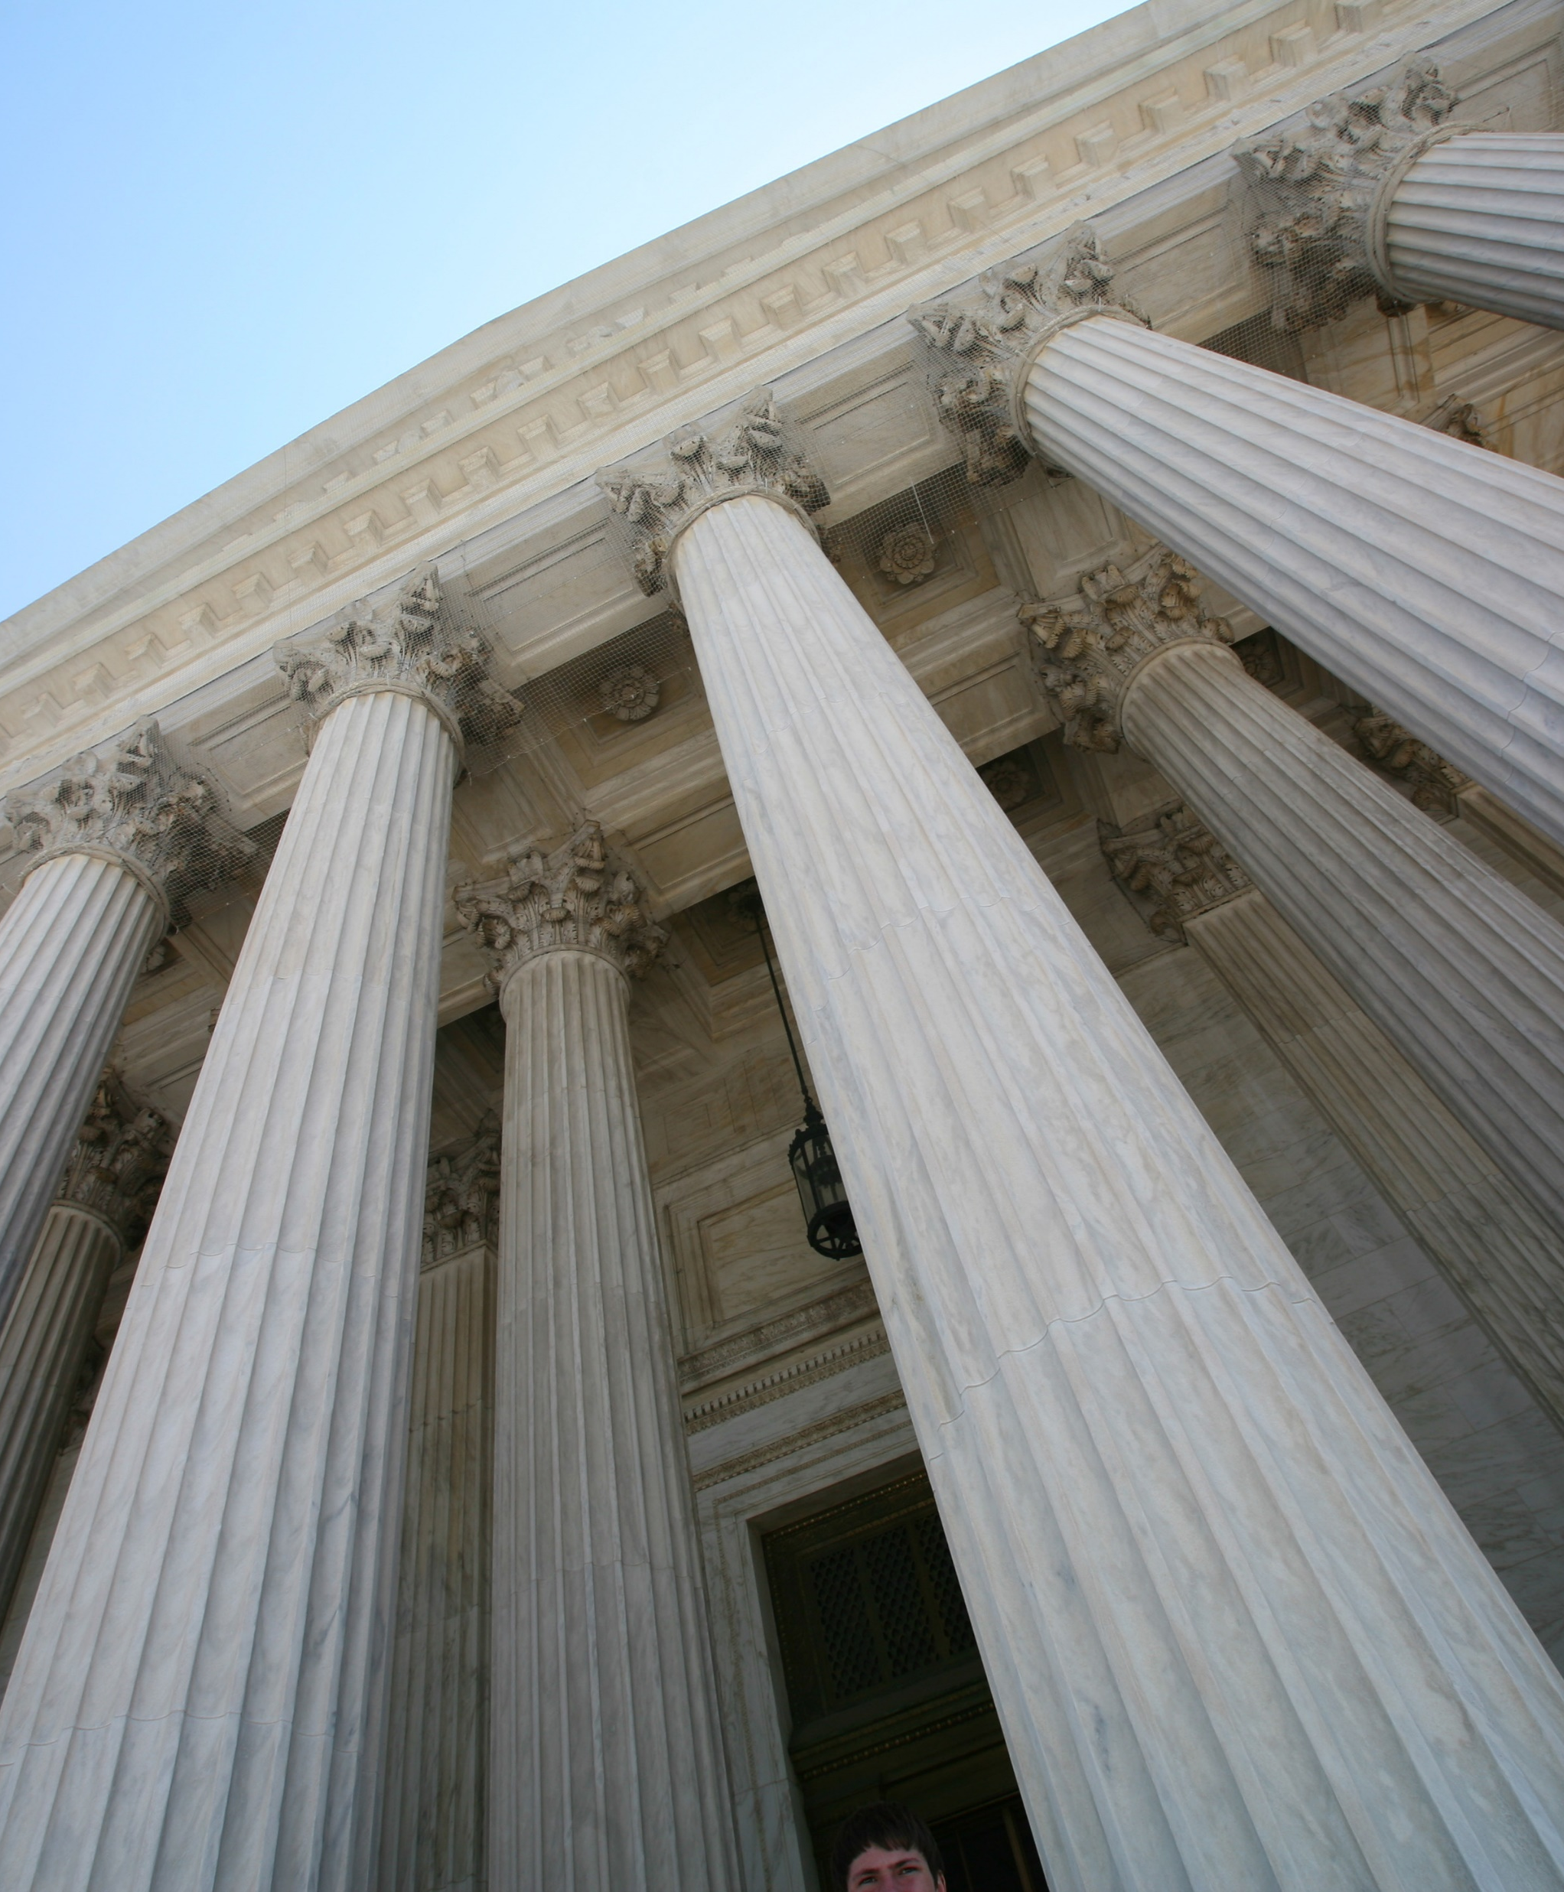
Decisions Since Mac’s Shell – PMPA Cases
Lock-Step with SCOTUS:
Duncan Services, Inc. v. ExxonMobil Oil Corp. (2010): Unsuccessfully challenged the assignment of franchise agreements that increased risk and pricing.
Hopkinton Friendly Services, Inc. v. Global Companies LLC (2019): Unsuccessfully challenged a notice of more than 5x rent increase.
But: state law claims often survive irrespective of PMPA claim disposition.

Slide 25
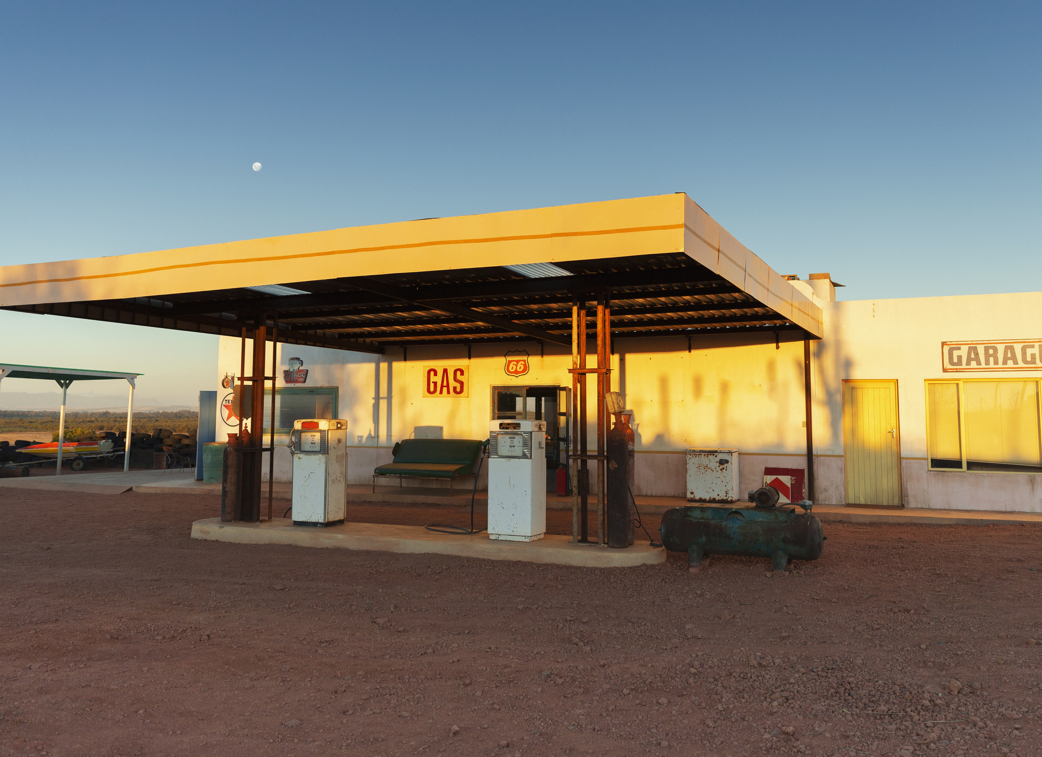
Decisions Since Mac’s Shell – Creative Pleading under the PMPA?
Poquez v. Suncor Holdings-COPII, LLC (2011):
Franchisee argued that selling the property underlying the station to an unfavorable developer was “an actual severance of the relevant legal relationship” and not a claim for constructive termination.
The Court: What counted was whether the defendants “actually terminated or failed to renew the franchise.”

Slide 26

Decisions Since Mac’s Shell – Preliminary Injunctions
Accessible under the PMPA when franchisees make strategic decisions with Mac’s Shell in mind.
In GTO Investments, Inc. v. Buchanan Energy (2012) franchisee refused to sign the renewal agreement – leading to the franchisor choosing not to renew.
Court entered a preliminary injunction.

Slide 27

Decisions Since Mac’s Shell – Preliminary Injunctions
Risk v. Reward
Close shop OR
Renew and seek state law remedies?
“If GTO loses its PMPA claim, however, it will also lose its franchise.”

Slide 28
Decisions Outside of the PMPA
Takiedine v. 7-Eleven, Inc. (2018):
Franchisee claimed hostile business conditions and financially burdensome requirements from 7-Eleven.
Court dismissed plaintiff’s claim due to Mac’s Shell: Takiedine could not raise a claim for constructive termination because he had not yet been terminated.

Slide 29

Decisions Outside of the PMPA
Tilstra v. Bou-Matic (2018):
Letter from Bou-Matic stating franchisor “was going to remove their entire trade territory if they did not agree to sell their assets and dealership to [a neighboring competing dealer].”
Decision to reassign territory was final, “with or without” Tilstra’s cooperation.
Tilstra sold at fire-sale prices.
Court looked to Mac’s Shell in concluding that Tilstra’s claim survived summary judgment, as Bou-Matic had terminated the agreement.

Slide 30
Decisions Outside of the PMPA
Many courts address constructive termination claims with no mention of Mac’s Shell or its reasoning.
Girl Scouts of Manitou Council, Inc. v. Girl Scouts of United States of America, Inc. (2011) – Transfer of all of plaintiff’s territory amounted to constructive termination under the WFDL.
No mention of Mac’s Shell.

Slide 31

Other Relationship Statutes and Mac’s Shell
Pai v. DRX Urgent Care, LLC (2014):
Acknowledged that a claim for constructive termination existed under the NJFPA.
Outlined its reasoning in accordance and referring to with the Mac’s Shell decision.
Still operating = no constructive termination.
Bell v. Bimbo Foods Bakeries Distribution, Inc. (2012):
“Effective termination” under Illinois Franchise Disclosure Act not enough after Mac’s Shell.

Slide 32

Other Relationship Statutes and Mac’s Shell
Hyundai Subaru of Nashville v. Hyundai Motor America, Inc. (2023):
Hyundai dealer alleged that Hyundai violated the Automobile Dealer’s Day in Court Act (“ADDCA”) by rejecting proposed new dealership sites and changing requirements mid-search.
Lesson: Broader protection statutes can equal broader constructive termination claims.

Slide 33

Other Relationship Statutes and Mac’s Shell
Court refused to adopt Hyundai’s arguments that the termination mandate in Mac’s Shell barred the plaintiff’s claims, because the ADDCA provided broader protection.
“Unlike the PMPA at issue in Mac’s Shell, [the ADDCA’s] focus is not solely on termination and allows recovery for a plaintiff that has been ‘injured by the defendant’s failure to act in good faith.’”

Slide 34

Reduction in Income – Niche Standards May Survive
Petereit v. S.B. Thomas, Inc. (1995):
CT under the Connecticut Franchise Act
Standard: “A substantial decline in franchisee net income. Such analysis will be strictly financial, except in close cases, where non-financial factors may have some bearing.”

Slide 35

Reduction in Income – Niche Standards May Survive
Grimes Buick-GMC Inc. v. GMAC, LLC (2013):
Decided months after Mac’s Shell
Denied a motion to dismiss under the Montana Motor Vehicle Dealer Act (“MMVDA”) and cited Petereit’s “reduction in value” standard.
Based on the MMVDA’s broad protections for franchisor’s that take “unfair advantage of its economic leverage”

Slide 36

The “Brass Tacks” of Litigating a CT Claim: Look to the Agreement First
What is authorized?
What is prohibited?
Mac’s Shell: breach of contract claim may still be a meaningful remedy absent constructive termination.
Maintainco: No exclusivity means trouble.

Slide 37

Must Assess the Laws Governing the Industry and Region
Relationship laws governing the applicable industry or market are key.
Duties of good faith and language or remedies to correct power imbalances – additional grants can expand a constructive termination claim beyond Mac’s Shell.

Slide 38

Must Assess the Laws Governing the Industry and Region
Example of The Wisconsin Fair Dealership Law:
“Dealers” and “Community of Interest”
Notice and Good Cause
Substantial Change in Competitive Circumstances

Slide 39

Remedies for Plaintiffs - Injunctions
Four-part test must typically be met:
Irreparable injury;
Threatened injury outweighs whatever damages the proposed injunction may cause;
Cannot be adverse to the public interest; and
Substantial likelihood that the movant will eventually prevail on the merits.

Slide 40
Remedies for Plaintiffs - Injunctions
There must be a looming threat of irreversible change.
Under the PMPA, the Supreme Court mandated that a preliminary injunction under the statute may only be sought after the franchisee has received a notice of termination from the franchisor.
Many regulatory schemes reduce the traditional injunction standard:
PMPA requires only “sufficiently serious questions going to the merits” that present “a fair ground for litigation” and the balance of hardships favors such relief.
WFDL presumes “irreparable harm.”

Slide 41

Remedies - Rescission
Intended to “restore the injured party to the position occupied before the transaction.”
Typical when accompanied by fraud; when a longstanding, profitable agreement, restitution or unjust enrichment may be more appropriate.
Rescission and constructive termination coincide where a franchisor takes actions inconsistent with its initial representations about:
Changes to rent;
Land ownership;
Territory; or
Marketing programs.

Slide 42

Remedies – Damages
Damages Available: Compensatory damages, loss of goodwill, consequential damages, harm to other active agreements.
Future Lost Profits: Which party terminates the relationship is more important than ever.
Meineke Car Care Centers, Inc. v. RLB Holdings, LLC (2011):
The “proximate cause” of the end of the relationship is responsible for future lost profits.
Does a CT claim risk responsibility for lost profits?

Slide 43
Defenses – Start with the Language of the Agreement
Agreements reign supreme, even in the context of constructive termination.
Strongest defense against a claim of constructive termination is that the plaintiff’s behavior was improper.
Constructive termination claims can be planned for in advance and included in the agreement.
Clearly spelling out and following key contract terms decreases the chances of being sued for breach of the agreement.

Slide 44
Moral of the Story
Mac’s Shell can serve as a shield for savvy defendants in those states and statutes that abide by its principles.
Declining to terminate (even where it is appropriate) could protect against constructive termination claim.

Slide 45
Moral of the Story
Contract always reigns supreme.
Likely wise for plaintiff to go out of business and assert CT claim at that point.
Whether to pursue an injunction fraught with complexity.
Damages analysis tied to how court defines the terminating event.

Slide 46
Questions?
John R. Gotaskie, Jr.
Partner
412.394.5528
jgotaskie@foxrothschild.com

Slide 47

Trump Administration Initiatives & Executive Orders
The Trump administration is making sweeping changes in federal policy that directly impact businesses and individuals.
Our Trump Administration Initiatives & Executive Orders webpage is a go-to source for up-to-date legal insights on federal policy changes — helping you understand how these developments may affect you and what actions you can take.
https://www.foxrothschild.com/trump-administration-initiatives-executive-orders

Slide 48

Stay Informed
Fox’s Oval Office Update on LinkedIn promotes our attorneys’ latest insights on Trump Administration Initiatives & Executive Orders. Subscribe to our newsletter to stay informed about the many policy changes coming from the White House.
To subscribe, visit: https://www.linkedin.com/newsletters/oval-office-update-7295167083024146433/

