Slide 2


Navigating the Evolving Data Privacy Landscape:
Strategic Legal and Operational Considerations
Susanna Bagdasarova
Kristen L. Petrina
August 8, 2025

Slide 3
Objectives and Roadmap
Four Areas of Focus:
  Status and Framework of Data Privacy Today
  Data Privacy Landscape in 2025
    U.S. Privacy Landscape
    Enforcement Trends & Risk Areas
    Impact on Corporate Governance and Operations
  Strategic Privacy Touchpoints Across Your Business
    Third-Party Risk & Contracting
    Employee & Internal Data Considerations
    M&A
  Building Strategic & Operational Resilience.
    Governance Frameworks & Cross-Functional Ownership
    Building Operational Resilience

Slide 4
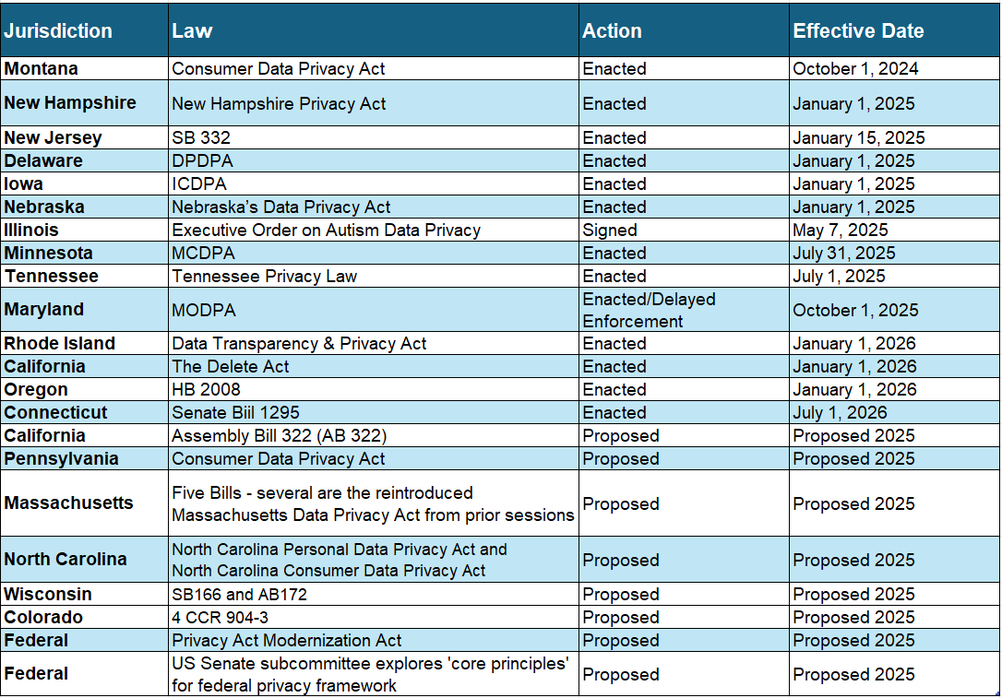
2025 Privacy Landscape

Slide 5
2025 Privacy Landscape
European Union
  GDPR, EU Data Act, and AI Act
Revisions or Expanded Provisions
  China - Regulations on Network Data Security Management
  Australia and Japan - New protections for children’s data, stricter rules for automated decision-making, and enhanced enforcement mechanism.
  Thailand - new provisions will be introduced in Thailand's Personal Data Protection Act to regulate the use of AI.
New Privacy Laws
  Indonesia - Personal Data Protection Law (PDPL)
  India - Digital Personal Data Protection Act – enacted no effective date yet
  Vietnam - Personal Data Protection Law (PDPL) – effective January 1, 2026

Slide 6
Data Privacy Framework
Data Privacy Framework is a set of rules and guidelines that U.S. organizations must follow to handle personal data from the EU, UK and Switzerland.
  Three Extensions: EU-US DPF, EU-US DFP – UK Extension, and Swiss-US DPF.
Replaces Privacy Shield Frameworks
Introduced in 2023 after the European Commission’s adequacy decision enabled transfers of personal data from the EU to the US without the use of Standard Contractual Clauses.

Slide 7
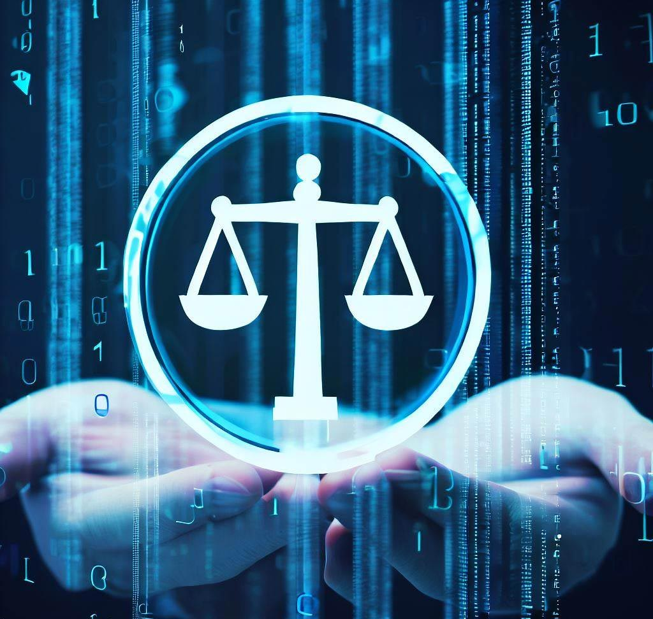
Data Privacy Framework
Legal Challenges
  Philippe Latombe v Commission (Case T‑553/23)
  NOYB / Max Schrems (“Schrems III”)
Legal Issues At Stake
  Surveillance Oversight
  Redress Mechanism
  Proportionality Standard
  Onward Transfers

Slide 8

Enforcement Trends & Risk Areas
Growing Number of Recent Enforcement Areas: Biometric Data, AI Profiling, Consent Violations, and Children’s Data
Increase in Class Action and Litigation Risk
Emerging Trends for Privacy Litigation

Slide 9




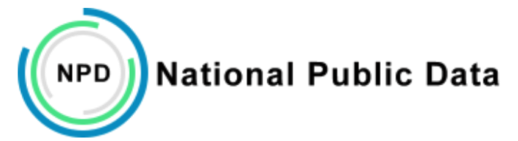


Privacy Enforcement and Fines

Slide 10
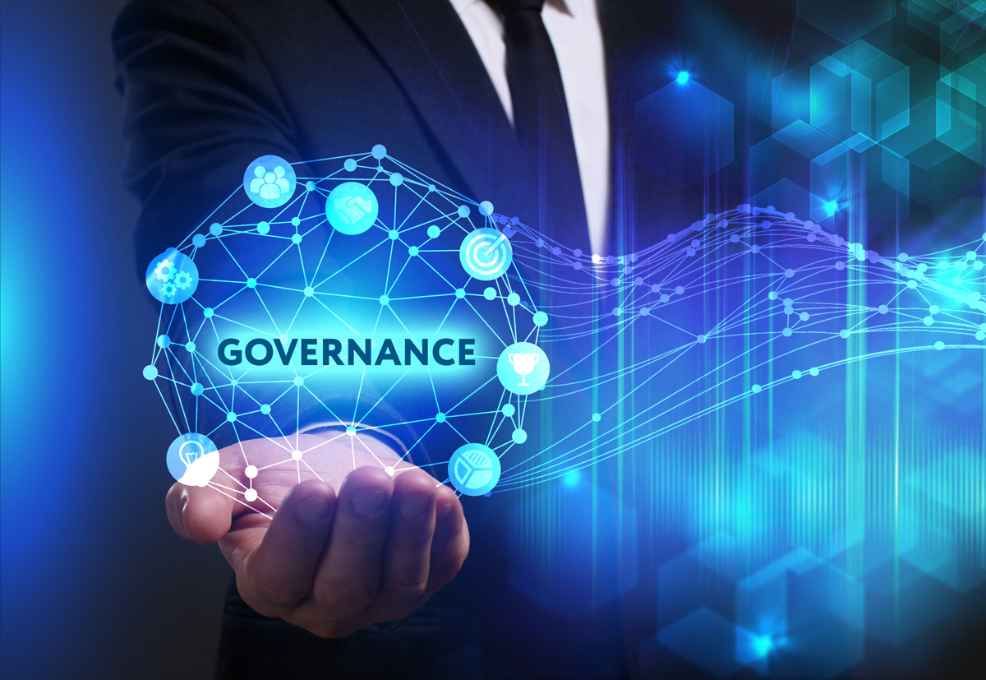
Impact on Corporate Governance and Operations
Leadership and Board Commitment
ESG and Reputational Risk Factors
Increasing Stakeholder Expectations From Consumers, Regulators and Employees:
  Transparency
  Choice
  Data Ethics

Slide 11
Third-Party Risk & Contracting
Vendors are Privacy Liabilities
Key DPA Clauses:
  Indemnity
  Data Minimization
  Subprocessors
  Audit Rights
  Breach Notifications
Ongoing Monitoring Beyond Onboarding
Emerging Trend: Data Transfer Risk Assessments Under GDPR

Slide 12
Employee and Internal Data
Remote Work and Global HR Data Transfer Risks
AI Tools Used for Productivity Surveillance and Profiling
Employee Transparency and Consent Obligations
Confirm DSAR Processing, Consent and Withdrawal Mechanisms, and Cross-border Transfer Compliance
Intersection with Labor Laws and Unions

Slide 13
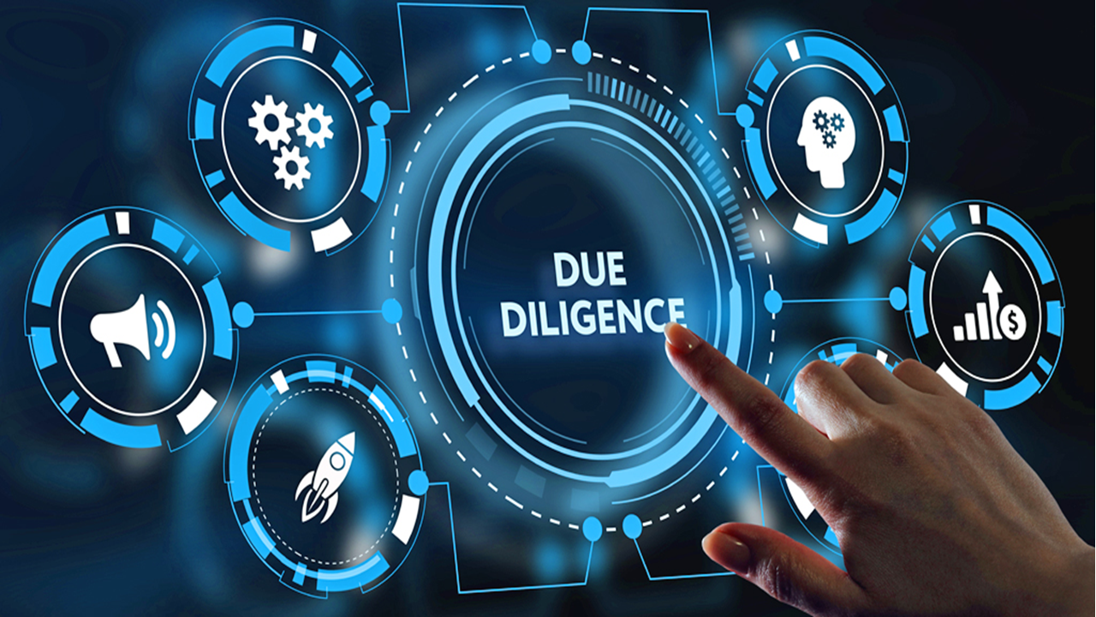
M&A
Privacy Due Diligence
  Legal Basis for Data Sharing
  Secure Data-Sharing
  NDAs with Limited Scope
    Limit Data-Usage
Post-Close Integration
  Data Mapping
  Notice Updates
  Legacy Storage Risk
  Obtain New or “Re-” Consent as Needed

Slide 14
Governance Framework
Governance Frameworks & Cross-Functional Ownership
  Privacy is a Cross-Functional Organizational Responsibility. Must Involve:
    Legal
    Compliance
    HR
    IT
    AI Integration
    Marketing
  Centralized vs. Federated Privacy Governance
  Role of the Data Protection Officer (or equivalent)

Slide 15
Building Operational Resilience
Key Tools
  Maintain RoPA/Data Inventory
  DPIA’s
  AI Impact Assessments
  Data Flow Mapping
  Manage Opt-Outs and Consents Across Systems
Building Internal Accountability
  Establish Metrics
  KPIs
  Internal Audits
  Periodic Training

Slide 16
What Is Next – How to Prepare
Track Data Localization Laws
Integrate Privacy, Ethics and AI Governance Frameworks
Develop Proactive Scenario Plans and Horizon Scanning Practices
Implement Continuous Updates, Proactive Compliance and Internal Culture Building

Slide 17
Questions?
Thank you!
Contact Info:
Susanna Bagdasarova
sbagdasarova@babstcalland.com
412-394-5434
Kristen Petrina
kpetrina@babstcalland.com
412-394-6966

