Slide 1

Your Employees Are Anxious.
Are You Making it Worse?
.
Presented for the American Corporate Counsel of Western PA
by: Maria Greco Danaher and John F. Greco
August 8, 2025

Slide 2
OBJECTIVES OF THIS SESSION
Understand the difference between anxiety and fear.
Discover the three basic strategies of Mindful Management.
Discuss how in-house lawyers can support change in this area.

Slide 3
FIRST, A QUIZ . . . .
When you think of the word “anxiety,” what adjectives come to mind?

Slide 4
WHAT IS ANXIETY?
American Psychological Association says anxiety is:
An emotion, characterized by worried thoughts
Often includes physical changes (i.e., increased blood pressure)
Future oriented
Includes a long-acting response (doesn’t fade)
Usually in response to a diffused threat
.

Slide 5
ANXIETY IS NOT THE SAME AS FEAR
Fear typically is:
Present oriented
Short-lived
More usually deemed “appropriate” by others
Response to a clearly identifiable threat

Slide 6
WHY DO WE CARE? BECAUSE. . .
To assist a fearful person, we can focus on the outward stimulus that is causing the fear.
Often, fear can be eliminated or put to rest.

Slide 7
BUT. . . .
Dealing with anxiety requires an entirely different skill set.
Anxiety rarely can be eliminated through the actions of someone else.

Slide 8
MANAGING MINDFULLY CAN HELP TO LESSEN OR AVOID ANXIETY IN THE WORKPLACE

Slide 9
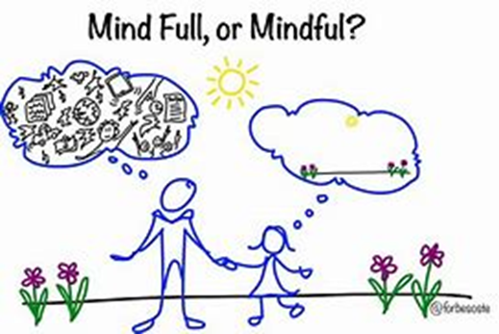
WHAT IS MINDFULNESS?
Being aware
Of the present moment
On purpose
Without judgment.

Slide 10
LET’S TALK ABOUT MANAGING MINDFULLY
Consider these three basic strategies:
1. Being aware of “anxiety traps”
2. Working to improve basic communication skills (ours and others’)
3. Understanding, teaching, and supporting coping skills

Slide 11
MANAGER-CREATED ANXIETY TRAPS
Not offering a clear path forward
Failing to provide “no update” updates
Anxious fixing
Not staying up-to-date on world events
Refusing to adjust expectations
Not understanding that engagement is needed

Slide 12
COMMUNICATION TECHNIQUES
Don’t react to the anger/frustration of others
Pay attention to your own word choices
Notice non-verbal cues (yours and others)
Work to change your “reactions” to “responses”
Consciously use silence as a tool (aka mindful listening) rather than a punishment

Slide 13
SUPPORTING OTHERS’ COPING SKILLS
Work to understand what is creating the anxiety. . . even if it’s you
Incorporate physical activity and/or mindfulness into the day, if possible
Respect the emotions of others, even if you don’t agree
Understand/share available resources (EAP, etc.)

Slide 14
CONSIDER THESE POINTS
Know and understand that people often don’t consider themselves “anxious.”
They may seem aggressive or disrespectful.
NOTE: Anxiety does not excuse dangerous or
threatening behavior.
An effective manager/HP person delivers that difficult message effectively.

Slide 15
IN-HOUSE ADVANTAGE
ACCESS!
Relationship building with managers
Being in the ‘business’ - knowledge
Understanding of the politics

Slide 16
REMEMBER
Three basic strategies for managing mindfully:
Be aware of manager-created “anxiety traps”
Work to improve basic communication skills
Understand, teach, and support coping skills

Slide 17

CAN YOU MAKE A DIFFERENCE?
Imagine a world
Where your every move matters.
Welcome to that world.

