Slide 1
Session Title
Thank you for combining all speakers’ decks & submitting to ACC by
August 22, 2025

Slide 2
Roadmap
What
Will
You
Discuss?

Slide 3
Content Slides
30 total slides for 60-minute session, 38 total slides for 75-minute session, 45 total slides for 90-minute session
  See “Course Materials” section in Speaker Service Center for more information
“5x5 Rule” - ≤ five lines per slide x ≤ five words per line
  It is impossible for an attendee to read long sentences and simultaneously pay attention to what the speaker is actually saying on stage. If what you plan to say can also be typed out just as effectively, are you really adding value as a speaker? (See what we mean about sentences on slide decks?)
2/3 of your total time
3-5 minutes per slide
Common pitfall: Poor time allocation

Slide 4

Content Slides
Images support messaging!

Slide 5
Engage the Audience
Live poll the audience
Host roundtable discussions
Plan tabletop exercise

Slide 6
For Ethics Credit
Clearly state the relevant rule(s) of professional conduct
Dedicate a reasonable amount of time to:
  Stating the relevant rule(s)
  Sharing practical considerations for corporate counsel
  Directing to more information
Include the answer and explanation to any hypotheticals

Slide 7
Key Takeaway(s)
What 1-2 things should they remember,
if nothing else?

Slide 8
Deeper Dive
Direct attendees to more info
  What program materials did you submit?
  Specific laws/regulations?
  Basics for those who need a refresher?
  Sponsor’s resources?

Slide 9
Q&A
1/3 of your time
  Plan Q&A start time
If none, discuss uncovered issues or under-developed points

Slide 10
Thank You!
Please ask attendees to provide session feedback

Slide 11
Polling the Audience
How to successfully incorporate polling into your presentation

Slide 12
How to Request Polling
Indicate this request in your Program Organizer Service Center or Speaker Service Center (under “A/V and Engagement Tools Request”).
Submit the poll questions and answer choices (if applicable) in the presentation slides by one month prior to presentation delivery, unless confirmed otherwise by your ACC liaison.
ACC sets up the poll(s) (final version; no edits after this point) for use during presentation.

Slide 13
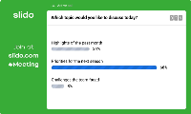
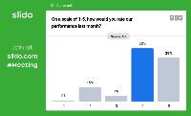
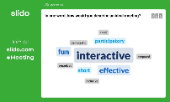
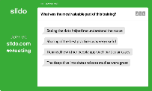

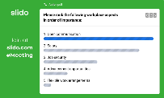
Engage the Audience – Polling How-to
Getting Started:
Identify your desired poll activity(ies)
  Multiple-choice polls: The audience chooses the answer they think is correct or that they agree with.
  Word cloud: The audience answers in one or two words.
  Quiz: This is a competition that you can set up where the person who answers the most questions correctly and/or quickly will be crowned the winner.
  Rating: Use a numeric scale or an agree/disagree scale to get your audience’s input on a topic.
  Open text: Get your audience members to submit a question or respond to your prompt in a few short words.
  Ranking: Have your audience move the answer choices into the order of relevance, importance, or agreement.

Slide 14
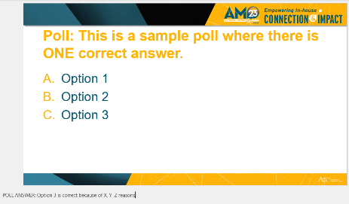
Engage the Audience – Polling How-to (Cont’d)
Insert your chosen poll activities and response options (if applicable) directly within your PowerPoint presentation.
    Each poll activity should appear on its own slide.
    For each poll question - include the ANSWER and any relevant EXPLANATION for the correct answer.
After submitting your final slides to ACC, we will take care of setting up your poll activities.
On the day of your presentation, simply proceed with your presentation as planned. ACC will ensure that all necessary polling technology has been activated.
We strongly suggest you provide simple instructions to the audience before kicking off your session presentation.

Slide 15
Introducing the Activity (Example)
Sample script
“Now I’m going to ask for your opinion. You’ll use your computer or mobile device to respond. You don’t need to download anything."
Explain what’s going to happen
“Let’s do a quick question now to get the hang of it…
If multiple choice --- “Have you been to this conference before? Visit this URL on the screen or scan the QR code, and select your answer.”
If word cloud --- “What do you like most about the Annual Meeting so far? Visit this URL on the screen or scan the QR code, and respond to the question in one or two words.”
Demo an icebreaker activity

Slide 16
Best Practices Checklist
Use this checklist to ensure a seamless polling experience, every time.
Give instructions upfront. Tell the audience they'll be asked to participate. Clear instructions set expectations and encourage participation.
Create and test a practice polling activity. Start your session with a practice poll — a simple, fun icebreaker question will do the trick.
Take it slow. Allow about 60-90 seconds for the practice round.
Mix it up. Deploy a poll every 10 to 15 minutes to bring wandering minds back into the fold. To keep things fresh, mix up the activity type.
Offer incentives. Many presenters turn polling into a game, offering prizes for participation, to keep energy levels high.
Please contact your ACC liaison if you have questions or need assistance

