Slide 1


Slide 2

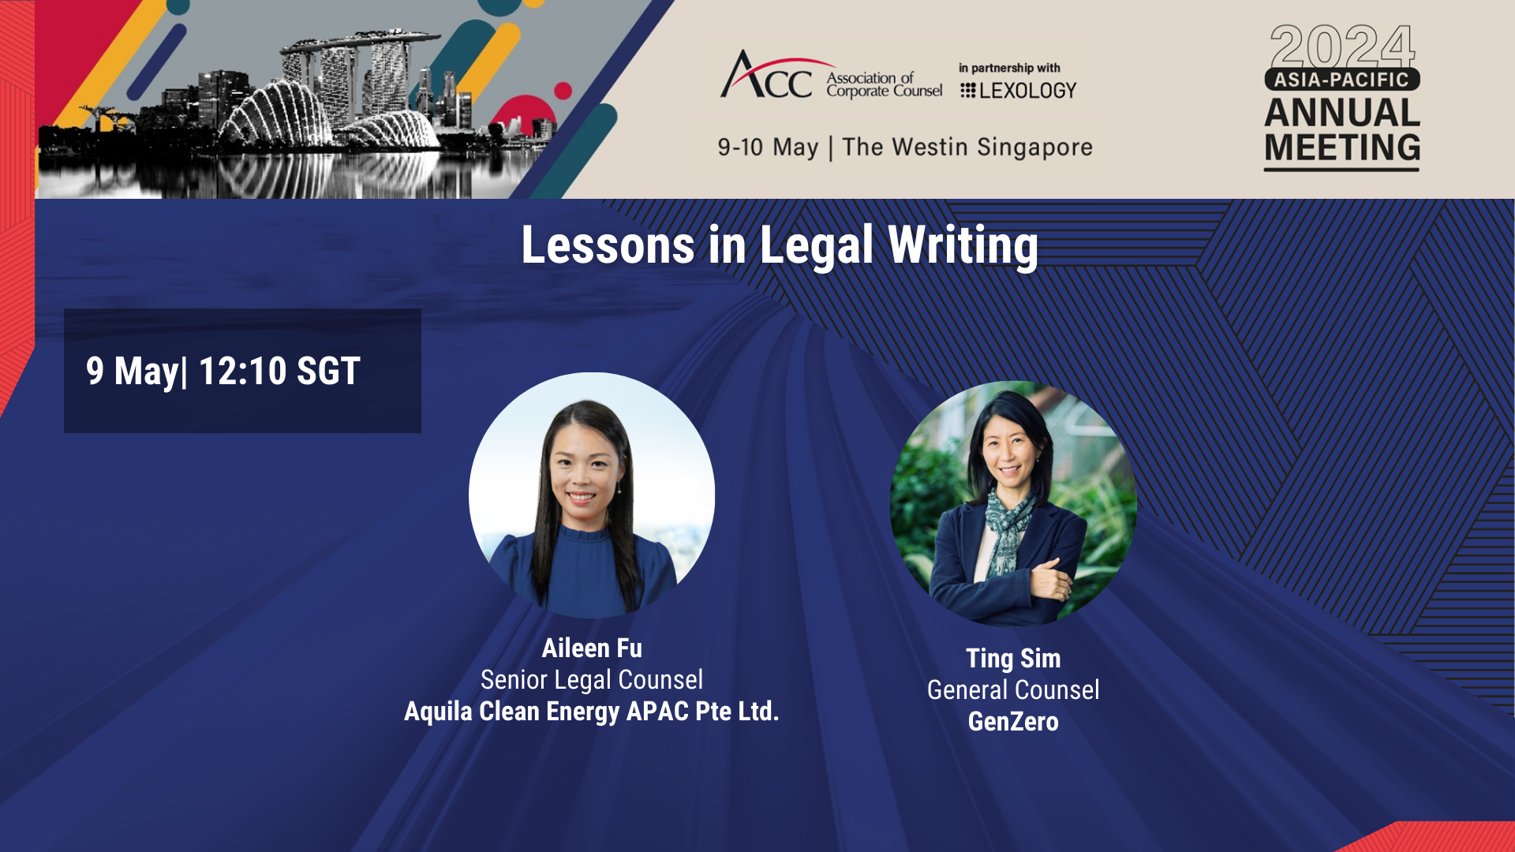





Lessons in Legal Writing in the Asia Pacific Region 1210 – 1310
SIM Ting
Managing Director
Head, Corporate Services Group and General Counsel
GenZero
Aileen Fu
Senior Legal Counsel
Aquila Clean Energy APAC

Slide 3
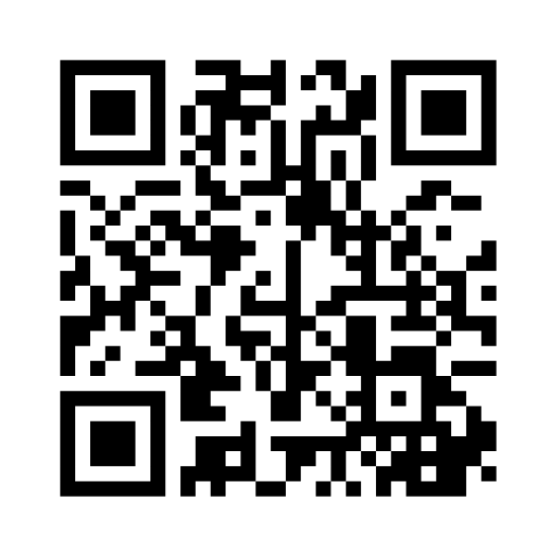
Ice Breaker
www.menti.com
enter the code:
5545 8334

Slide 4





Agenda
Welcome and introductions
Breakout sessions
Key lessons in legal writing
Key takeaways and closing remarks
Practical examples

Slide 5





Enhancing the client experience as in-house counsel
Pyramid communication
conclusion first
Next steps
call to action
Less is more
read, re-read and cut down
Make it easy on the eyes
tables, bold / italics, headings

Slide 6




Enhancing the client experience as in-house counsel
Know your audience
tailor to the crowd
Legalese
E.g. thereto, henceforth
Voice
Active Voice vs Passive Voice
Write Positively
Positive vs negative voice
Notes:
Passive voice : Examples of passive verbs:
was received,
is being considered,
has been selected.
Passive: The regulation [receiver] was written [verb] by the drafter [actor].
Active: The drafter [actor] wrote [verb] the regulation [receiver].
2. Use action verbs.
Avoid words like this:
DON'T SAY SAY
give consideration to consider
is applicable to applies to
make payment pay
give recognition to recognize
is concerned with concerns
Write positively. If you can accurately express an idea either positively or negatively, express it positively.
DON'T SAY: The Governor may not appoint persons other than those qualified by the Personnel Management Agency.
SAY: The Governor must appoint a person qualified by the Personnel Management
DON'T SAY: A demonstration project will not be approved unless all application requirements are met.
SAY: A demonstration project will be approved only if the applicant meets all requirements.
It's better to express even a negative in positive form.
DON'T SAY SAY
not honest dishonest
did not remember forgot
did not pay any attention to ignored
did not remain at the meeting left the meeting
did not comply with
or
failed to comply with violated
Avoid use of exceptions. If possible, state a rule or category directly rather than describing that rule or category by stating its exceptions.
DON'T SAY: All persons except those 18 years or older must...
SAY: Each person under 18 years of age must...

Slide 7
Practical Example 1 – Spot the Issue
To ensure legal compliance, it is advised that regular audits be conducted to uphold data protection standards under laws like GDPR and CCPA. Intellectual property associated with AI should be rigorously protected to prevent infringement claims.
Efforts must be made to address biases in AI algorithms to avoid discriminatory outcomes and potential liabilities. Additionally, clear liability clauses should be incorporated into user agreements to delineate responsibilities in case of AI failures, thus safeguarding the company's interests against legal challenges.

Slide 8
Practical Example 1 – Spot the Issue - Reference
For compliance with data protection laws such as GDPR and CCPA, conduct regular audits.
Protect intellectual property related to AI rigorously to avoid infringement claims.
Address biases in AI algorithms to prevent discriminatory outcomes and potential liabilities.
Include clear liability clauses in user agreements to set out responsibilities and protect the company in case of AI failures.
To ensure legal compliance, it is advised that regular audits be conducted to uphold data protection standards under laws like GDPR and CCPA. Intellectual property associated with AI should be rigorously protected to prevent infringement claims.
Efforts must be made to address biases in AI algorithms to avoid discriminatory outcomes and potential liabilities. Additionally, clear liability clauses should be incorporated into user agreements to delineate responsibilities in case of AI failures, thus safeguarding the company's interests against legal challenges.

Slide 9
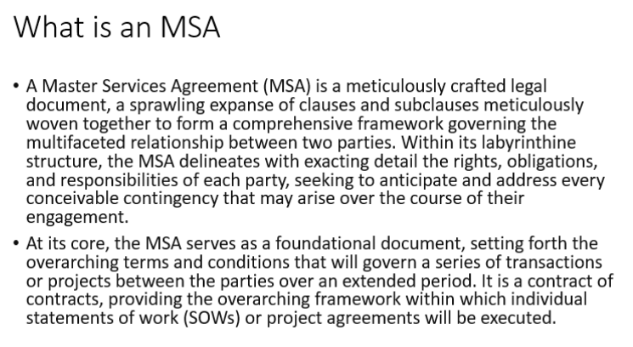
Practical Example 2 - PowerPoint
Example Slide

Slide 10
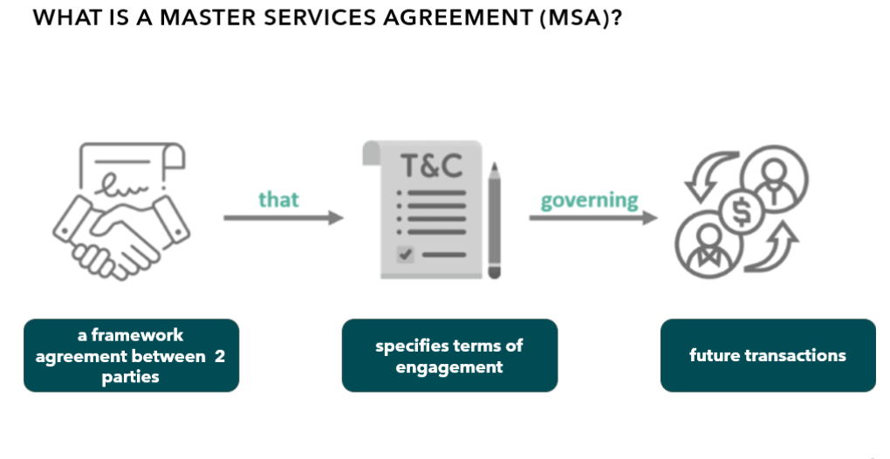
Practical Example 2 – PowerPoint cont’d
Example Slide

Slide 11
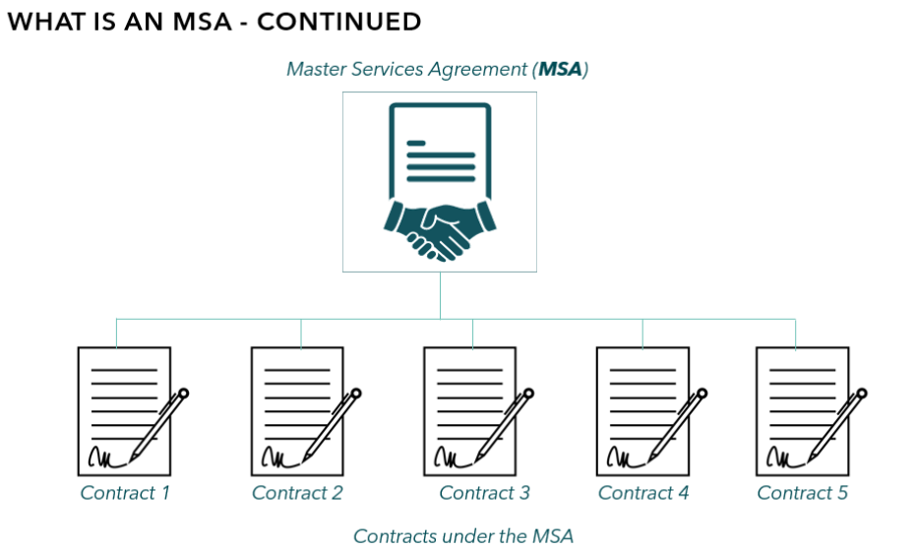
Master Services Agreement (MSA)
Practical Example 2 – PowerPoint cont’d
Example Slide

Slide 12
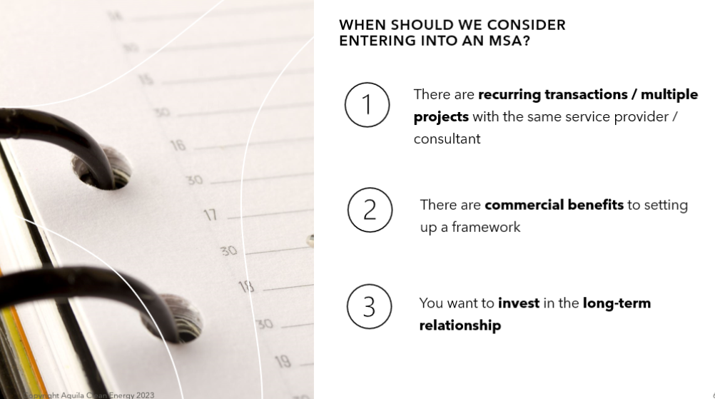
Practical Example 2 – PowerPoint cont’d
Example Slide

Slide 13



Breakout Session 1 – the million dollar comma
Can a party terminate the contract within five years of being signed?
  […This Agreement] shall be effective from the date it is made and shall continue in force for a period of five years from the date it is made, and thereafter for successive five-year terms, unless and until terminated by one-year prior notice in writing by either party.
Rogers Cable Communications Inc v Alliant Telecom Inc. CRTC 2006-45

Slide 14

What did the Commission think?
  […This Agreement] shall be effective from the date it is made and shall continue in force for a period of five years from the date it is made, and thereafter for successive five-year terms unless and until terminated by one-year prior notice in writing by either party.
Rogers Cable Communications Inc v Alliant Telecom Inc. CRTC 2006-45

Slide 15
How could I communicate the Commission's view to my internal clients?
  […This Agreement] shall be effective:
  from the date it is made and shall continue in force for a period of five years from the date it is made unless and until terminated by one-year prior notice in writing by either party; and
  thereafter for successive five-year terms unless and until terminated by one-year prior notice in writing by either party.

Slide 16


How can I make it even clearer to my internal clients?
Contract start
Successive periods
Contract can be terminated at any time with 1 year notice

Slide 17
How could we redraft the clause?
  (a) […This Agreement] shall be effective for a period of five years from the date it is executed.
  (b) The Agreement shall continue thereafter, for successive five-year terms unless and until terminated by one-year prior written notice by either party.

Slide 18
Breakout 2
Breakout Session 2 – an advice
How could we redraft advice to business on risks of AI?
Dear Business Team,
In accordance with our ongoing commitments and obligations under the pertinent legal frameworks, and due diligence requirements thereof, it is incumbent upon us to address a multifaceted array of legal risks associated with the implementation and operational deployment of Artificial Intelligence (AI) systems. Foremost among these considerations is the imperative to comply with a complex web of data protection statutes, including but not limited to the General Data Protection Regulation (GDPR) (EU) 2016/679, which mandates rigorous adherence to principles surrounding the processing of personal data, such as lawfulness, fairness, and transparency, along with specifications for data subject consent and the rights thereof.
Moreover, attention must also be directed towards the intellectual property regime, under which it is essential to ensure that all AI-driven creations, innovations, or enhancements are meticulously documented and registered where applicable, to safeguard our proprietary interests and preclude any potential infringement claims from third parties or competitors. Concurrently, the AI systems must be scrutinized for embedded biases which may precipitate discriminatory outcomes, thus exposing our company to legal challenges and reputational harm. This necessitates the implementation of stringent audit processes and remediation measures designed to ensure algorithmic fairness and neutrality, particularly in applications susceptible to high-stakes decision-making.
Furthermore, the delineation of liability, particularly in scenarios where AI systems fail or precipitate harm, must be clearly established through comprehensive contractual stipulations and indemnity clauses to mitigate exposures concerning consumer harm or other third-party liabilities. This involves a detailed analysis of end-user interactions and the operational environments in which the AI systems function.
In conclusion, it is advisable that we continuously monitor and adapt to the evolving legal landscape pertaining to AI, ensuring compliance with any new regulations or guidelines that may be promulgated in response to technological advancements. This will likely necessitate ongoing training for our teams, along with periodic reviews of our AI systems and practices to ensure they remain within the legal parameters set forth by applicable laws and regulations.

Slide 19
Breakout 2
Breakout Session 2 – an advice - Reference
Dear Business Team,
As we expand our use of AI technologies, it is crucial to mitigate legal risks through strategic actions. Below are key areas for focus and the recommended steps to ensure compliance and safeguard our operations:
1. Data Protection Compliance:
Action: Audit all AI systems to ensure they align with the GDPR and other relevant data privacy laws. Implement robust data encryption and anonymization techniques to secure personal data.
Recommendation: Develop and maintain comprehensive data handling policies and regularly train staff on these protocols to ensure ongoing compliance.
2. Intellectual Property Management:
Action: Conduct a thorough IP audit to identify and document all AI related innovations and data usage. Secure appropriate licenses for all third party tools and datasets.
Recommendation: Establish clear protocols for IP management and ensure all AI developments are properly registered and protected under these guidelines.

Slide 20
Breakout 2
Breakout Session 2 – an advice - Reference
3. Bias and Discrimination Prevention:
Action: Implement regular audits for algorithmic bias, particularly in AI applications affecting decision making in critical areas such as hiring and lending.
Recommendation: Develop an AI ethics policy and engage external consultants to validate and improve our AI systems' fairness and accuracy.
4. Liability Clarification:
Action: Update terms of service and user agreements to clearly define the scope of liability concerning AI malfunctions or failures.
Recommendation: Obtain comprehensive liability insurance that covers potential damages from AI related incidents to mitigate financial risks.
5. Regulatory Compliance Monitoring:
Action: Establish a dedicated compliance team to monitor evolving AI regulations and ensure all our AI applications adhere to new and existing laws.
Recommendation: Schedule regular compliance reviews and adjust AI operations as necessary to stay ahead of regulatory changes.
Notes:
Key takeaways :
clarity and focus on recommendation., providing all essential information in a more succinct format.
Linear approach vs pyramid or recommendation/action advice
- **Immediate Impact vs. Detailed Exploration**: Leading with the recommendation and conclusion provides immediate clarity and action points, which is effective for busy recipients or decision-makers who need to understand the bottom line quickly. This format prioritizes efficiency and impact over depth initially.
- **Information Flow**: The linear approach walks the reader through the entire thought process, from background through detailed analysis, before reaching a conclusion and recommendation. This method may be preferred for complex issues where understanding the context and nuanced analysis is crucial before arriving at a conclusion.

