Slide 1
CLASS ACTION DEFENSE: Trends, Recent Developments, Risks, and Opportunities
Kevin Allen, Michael Pest, Jessica Priselac

Slide 2
Overview
Settlement Trends/Data
Class Certification
Privacy Actions
Artificial Intelligence
Arbitration Issues
Questions

Slide 3
Class Action Settlements Reach Unprecedented Levels
Total amount of class action settlements in 2022-2023 exceeded $115 billion - largest aggregate settlement total over any two-year period
2022:
$66 billion in class action settlements
14 settlements exceeded $1 billion
2023:
$51.4 billion in class action settlements
10 settlements exceeded $1 billion

Slide 4
Highest Aggregate Settlement Values by Case Type (2023)
$25.82 Billion – Products liability class actions and mass tort
$11.74 Billion – Antitrust class actions
$5.4 Billion – Securities fraud class actions
$3.29 Billion – Consumer fraud class actions
$1.32 Billion – Privacy class actions
$762.2 Million – Discrimination class actions
$742.5 Million – Wage & hour class and collective actions

Slide 5
Highest Aggregate Settlement Values (Continued)
$643.15 Million – Civil rights class actions
$580.5 Million – ERISA class actions
$515.75 Million – Data breach class actions
$263.58 Million – Government enforcement actions
$139.67 Million – Labor class actions
$103.45 Million – TCPA class actions
$100.15 Million – Fair Credit Reporting Act class actions

Slide 6
Class Certification Trends
2022
335 motions to grant or to deny class certification
74% Success Rate
2023
451 motions to grant or to deny class certification
72% Success Rate

Slide 7
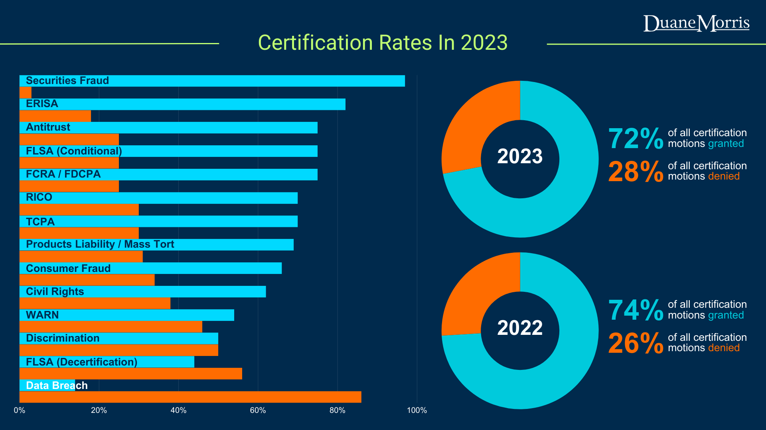

Slide 8
FLSA Certification – 2023
Certification rulings in FLSA collective actions
183 rulings
165 addressed first-stage motions
18 addressed second-stage motions

Slide 9
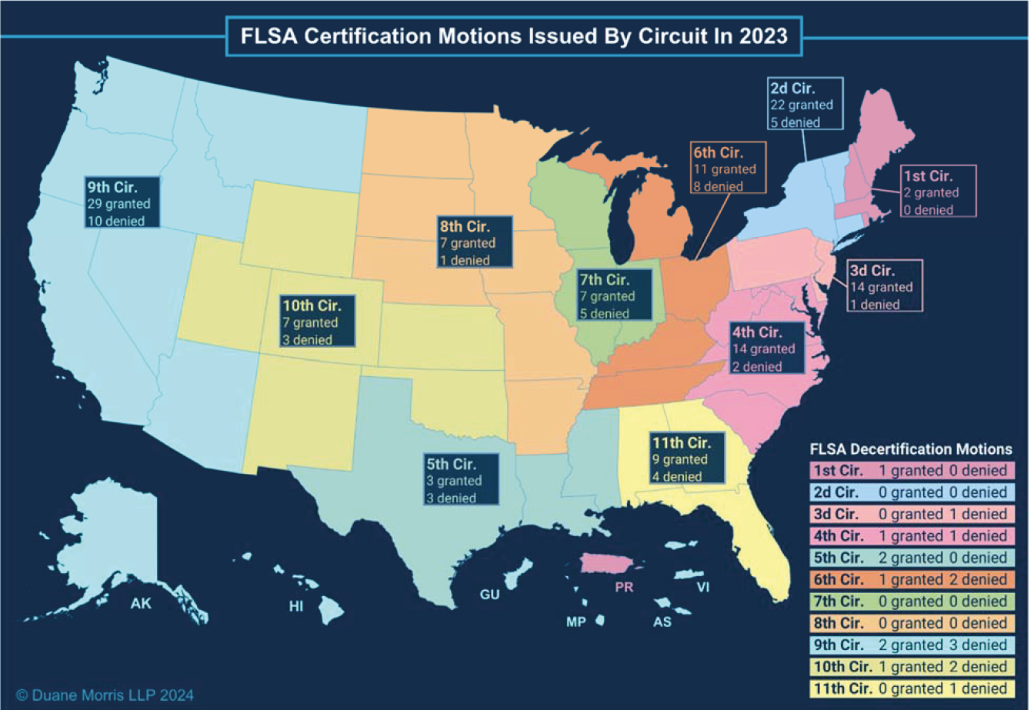

Slide 10
Opportunities to Challenge Certification
FLSA – One Step v. Two Step
Standing
Ascertainability
Personal Jurisdiction

Slide 11
Privacy Class Actions
Video Privacy Protection Act, 18 U.S.C. § 2710 (“VPPA”)
Enacted in 1988 to prevent wrongful disclosure of video tape sale and rental records – the “Bork Bill”
Prohibits “video tape service providers” from knowingly disclosing personally identifiable information concerning any consumer of such provider
“Personally identifiable information” includes “information which identifies a person as having requested or obtained specific video materials or services from a video tape service provider”
Statutory damages of up to $2,500 per violation

Slide 12
Video Privacy Protection Act
First wave of lawsuits in late 2000s
Lane v. Facebook, Inc., No. 08-cv-3845, 2010 WL 9013059 (N.D. Cal. Mar. 17, 2010) aff’d. 696 F.3d 811 (9th Cir. 2012)
Doe v. Netflix, Inc., No. 09-cv-5903 (N.D. Cal. Dec. 17, 2009)
Surge of VPPA lawsuits since 2020:

Slide 13
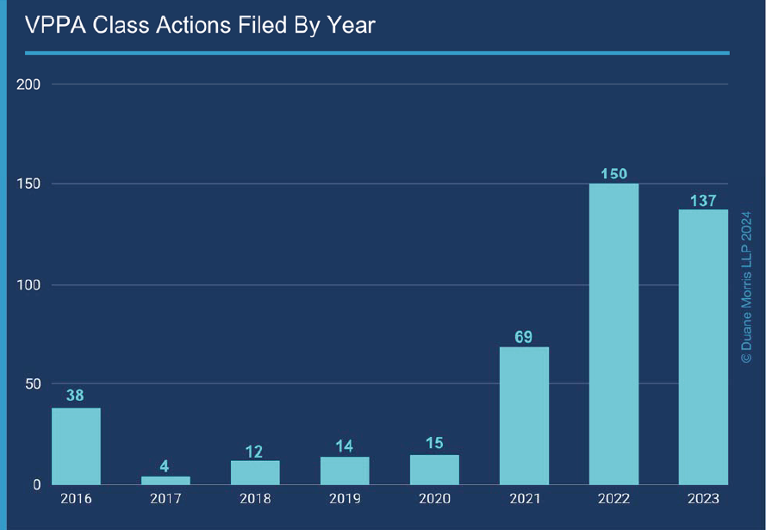

Slide 14
Video Privacy Protection Act
Key Issues/Defenses
Who qualifies as “video tape service provider?”
Cantu v. Tapestry, Inc., __ F. Supp. 3d __, 2023 WL 6451109 (S.D. Cal. 2023)
Carroll v. General Mills, Inc., No. 23-cv-1746, 2023 WL 4361093 (C.D. Cal. June 26, 2023)
Who qualifies as a “consumer?”
Gardner v. MeTV, No. 22-cv-5963, 2024 WL 779728 (N.D. Ill. Feb. 15, 2024)
Salazar v. Nat’l Basketball Assoc., __ F. Supp. 3d __, 2023 WL 5016968 (S.D.N.Y. 2023)
What constitutes “personally identifiable information?”
Saunders v. Hearst Television, Inc., __ F. Supp. 3d __, 2024 WL 126186 (D. Mass. 2024)
In re Nickelodeon Consumer Privacy Litig., 827 F.3d 262 (3d Cir. 2016)

Slide 15
Wiretapping Statutes
Pennsylvania Wiretapping and Electronic Surveillance Control Act, 18 Pa. C.S. § 5701(“WESCA”)
Prohibits the interception, disclosure, or use of any wire, electronic, or oral communication
At least 20 class actions filed in Pennsylvania state and federal courts under WESCA since 2022
Recent wave of lawsuits targets use of tracking cookies, session replay software

Slide 16
WESCA
Key Issues/Defenses
Article III Standing
Smidga v. Spirit Airlines, Inc., 2024 WL 1485853 (W.D. Pa. Apr. 5, 2024)
Cook v. GameStop, Inc., __ F. Supp. 3d __, 2023 WL 4429772 (W.D. Pa. 2023)
How and where does “interception” occur?
Popa v. Harriet Carter Gifts, Inc., 52 F.4th 121 (3d Cir. 2022)
Personal Jurisdiction
Schnur v. Papa John’s Int’l, No. 2:22-cv-1620, 2023 WL 5529775 (W.D. Pa. Aug. 28, 2023)
Hasson v. FullStory, Inc., No. 22-1246, 2023 WL 4745961 (W.D. Pa. July 25, 2023)

Slide 17
Artificial Intelligence
AI-Based Class Claims
AI Washing
D'Agostino v. Innodata, Inc., et al., No. 24-cv-00971 (D.N.J. Feb 21, 2024)
AI-Based Decisionmaking
Kisting-Leung, et al. v. Cigna Corp., Case No. 23-CV-01477 (E.D. Cal. 2023)
Use of Protected IP
Andersen, et al. v. Stability AI, Ltd., Case No. 23-CV-00201 (N.D. Cal. Oct. 20, 2023)

Slide 18
Artificial Intelligence
Using AI to Mitigate Litigation Costs
Document review tools and protocols
Machine learning
Analyzing large data sets
Reducing Administration Costs

Slide 19
Artificial Intelligence
Utilization of AI by Plaintiffs
Participation in claims-made settlements
Generally within the range of 15% to 35%
Locating potential class members
Developing claims
Third-party firms utilized by claimants

Slide 20
Rulings On Motions To Compel Arbitration in 2023

Slide 21
Federal Arbitration Act
First . . .
Read the Act.
Federal Arbitration Act, 9 U.S.C. §§ 1 et seq.

Slide 22
Federal Arbitration Act
Select Provisions
§1 – Exceptions to Operations of Title.
§2 – Contracts to arbitrate are valid and enforceable.
§16 – Right to immediate appeal from denials under §3 or §4.
No interlocutory appeal from a grant of a stay under §3 or an order compelling arbitration under §4.

Slide 23
Transportation Worker Exemption
9 U.S. Code § 1
… Nothing herein contained shall apply to contracts of employment of … any other class of workers engaged in foreign or interstate commerce.
Southwest Airlines Co. v. Saxon, 596 U.S. 450 (2022)
Bissonnette v. LePage Bakeries, No. 23-51, 601 U.S. ___, 2024 WL 1588708 (April 12, 2024)

Slide 24
Ending Forced Arbitration Act
9 U.S.C. § § 401-402 (emphasis added)
(a) In General. – . . . no predispute arbitration agreement or predispute joint-action waiver shall be valid or enforceable with respect to a case which is filed under Federal, Tribal, or State law and relates to [a] sexual assault dispute or [a] sexual harassment dispute.

Slide 25
Stay Pending Appeal
9 U.S.C. § 16 (right to immediate appeal)
Coinbase, Inc. v. Bielski, 143 S. Ct. 1915 (2023)

Slide 26
Waiver
Morgan v. Sundance, 596 U.S. 411 (2022) (showing of prejudice not necessary)
White v. Samsung, 61 F.4th 344 (3d Cir. 2023) (waiver if party acted inconsistently with an intent to assert right to arbitrate)

Slide 27
QUESTIONS?
Phone: +1 412 497 1046
Phone: +1 412 497 1046
Phone: +1 412 497 1046
Phone: +1 412 497 1046
Jessica Priselac
jpriselac@duanemorris.com; 412.497.1046
Michael P. Pest
mppest@duanemorris.com; 412.497.1035
Kevin P. Allen
kpallen@duanemorris.com; 412.497.1037

