Slide 1
Building Strong Foundations Developing Leadership Capabilities in the Workplace (And why lawyers can be strong leaders)
Erin Gibson Allen
Of Counsel, Fisher Phillips
eallen@fisherphillips.com
Friday, April 26, 2024

Slide 2
Agenda
Leading a complex project
Goal Identification
Personal Strength Assessment
Team Building
Seeking and Accepting Feedback
Meeting Management
Responding to the Unexpected

Slide 3
Disclaimer
The information in this presentation is provided for informational purposes only.
It does not necessarily represent the position or opinions of the firm or its partners or attorneys collectively and does not constitute legal advice or the establishment of an attorney-client relationship.

Slide 4
1) Goal Identification
You’ve been asked to lead something. When panic passes:
Define success.
Articulate your task.
Identify and refine your timeline.
Specify organizational needs.
Review the bylaws/rules.
Understand the contingency plans.
Leadership succession.
Public relations.
Other risks? Insurance audit?
How are emergency decisions made?
Remote voting authorized?

Slide 5
Recommended Reading
“Organizational psychologist Adam Grant examines the critical art of rethinking: learning to rethink your opinions and open other people’s minds, which can position you for excellence at work and wisdom in life.”
Grant examines:
Individual Rethinking – Updating Our Own Views.
Interpersonal Rethinking – Opening Other People’s Minds.
“Brilliant . . . guaranteed to make you rethink your opinions and your most important decisions.” -- Nobel Prize winner Daniel Kahneman

Slide 6
2) Personal Strength Assessment
First things first:
Articulate your strengths.
Where do you excel?
Do you have relevant experience?
Are you ready learn new subject matter?
What are the best ways for you to learn?
What can you read or listen to?
Consider taking a skills assessment.

Slide 7
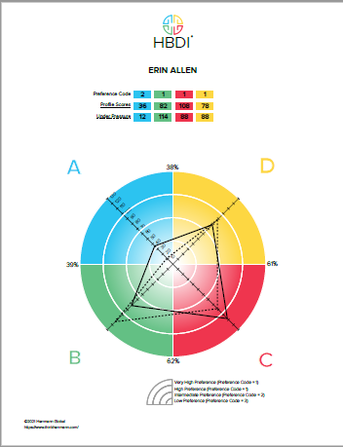
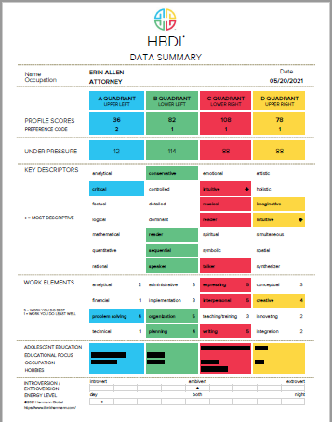

Slide 8
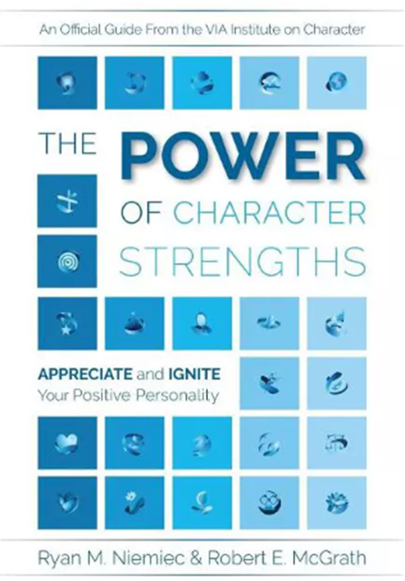
Recommended Reading
“Recent research shows that when you understand and active your positive personality traits, you become more resilient, manage stress better, and find greater fulfillment in life.”
www.viacharacter.org
VIA Institute on Character – a non-profit based in Cincinnati, Ohio, dedicated to the science of character strengths.

Slide 9
3) Team Building
Who will help in your efforts?
Who is assigned to your team? Who can you add?
Who cares about the project and will give time and helpful feedback?
Who has complementary skills?
Who has other assets, like specific experience and a network?
Who is on your executive committee?
Develop a personal board of directors.

Slide 10
Recommended Reading
The Culture Code “unlocks the secrets of highly successful groups and provides tomorrow’s leaders with the tools to build a cohesive, motivated culture.”
Coyle focuses on three skills:
Building safety
Sharing vulnerability
Establishing purpose
“Daniel Coyle has produced a truly brilliant, mesmerizing book that demystifies the magic of great groups.” Adam Grant

Slide 11
4) Seeking and Accepting Feedback
Before and during your project:
Start by meeting with stakeholders. Have open conversations. What is on their minds?
What is on the minds of others?
Can others contribute to the goal? If so, how?
What areas do they think need to be improved?
Keep checking in and engage in active listening.
Consider virtual surveys to guide direction of the group.

Slide 12
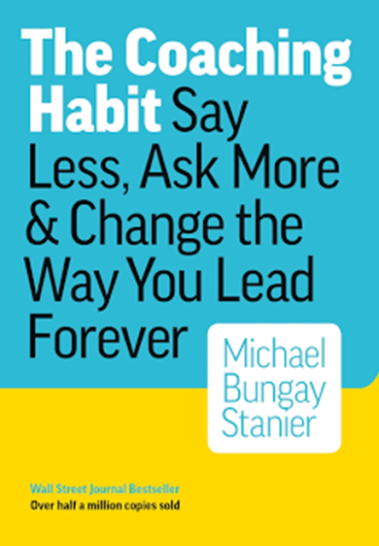
Recommended Reading
“This book gives you seven questions and the tools to make them an everyday way to work less hard and have more impact.”
Stanier examines a way of asking questions that works with customers, suppliers, colleagues, and bosses.
“This book is full of practical, useful and interesting questions, ideas and tools that will guide any leader trying to be better.” Dave Ulrich

Slide 13
5) Meeting Management
The best use of everyone’s time.
Start with place setting and appreciation.
Manage the clock to stay on schedule.
Engage others.
Use lawyering skills. Ask for opposing views. Ask someone to make an argument for an unpopular position.
Repeat back what you are hearing and offer context.

Slide 14
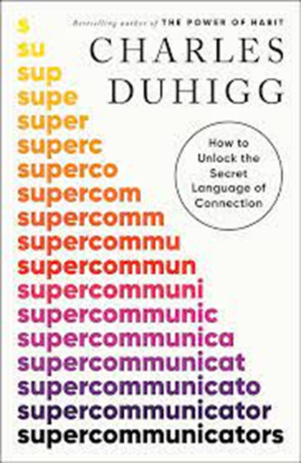
Recommended Reading
Duhigg has written “a fascinating exploration of what makes conversations work, and how we can all learn to be supercommunicators at work and in life.”
Duhigg examines three kinds of conversations: 1) What’s this really about, 2) How do we feel, and 3) Who are we?
“ [Duhigg] goes through a mountain of research—and some riveting stories—and unearths practical tactics to show that anyone can become a more effective listener, speaker, and even social media poster.” David Epstein

Slide 15
6) Responding to the Unexpected
Because something always happens.
Identify the interests at stake.
Check the bylaws/rules.
Refer to the contingency plans.
Check in with leadership (executive committee?) and get buy-in for a plan.
Leverage your network for support.
Stay calm.

Slide 16
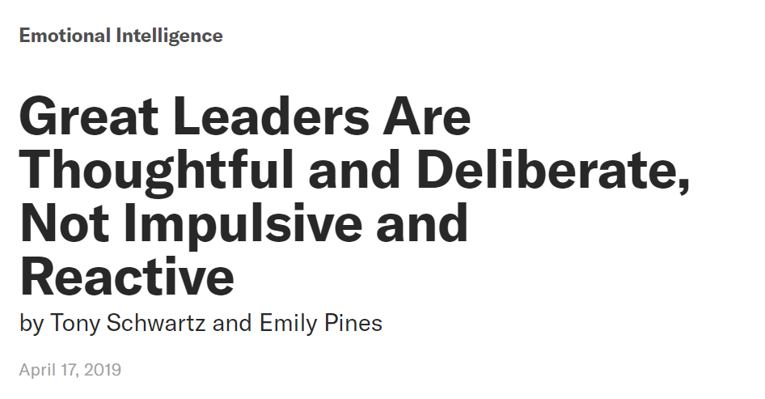
Recommended Reading

Slide 17
Questions?
Erin Gibson Allen
Of Counsel, Fisher Phillips
eallen@fisherphillips.com

Slide 18
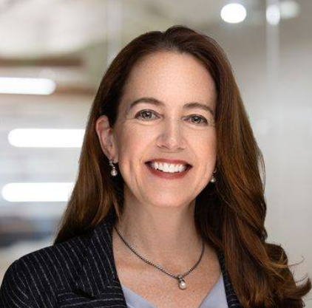
Thank You!

