Slide 2
Digital Law:
Navigating Artificial Intelligence in Legal Practice
Susanna Bagdasarova
April 26, 2024

Slide 3
Today’s Agenda
Basics of Artificial Intelligence
Recent Regulatory Developments
Ethical Considerations
AI-Enabled Legal Tools
AI Governance Best Practices

Slide 4
2023 The Year of AI

Slide 5
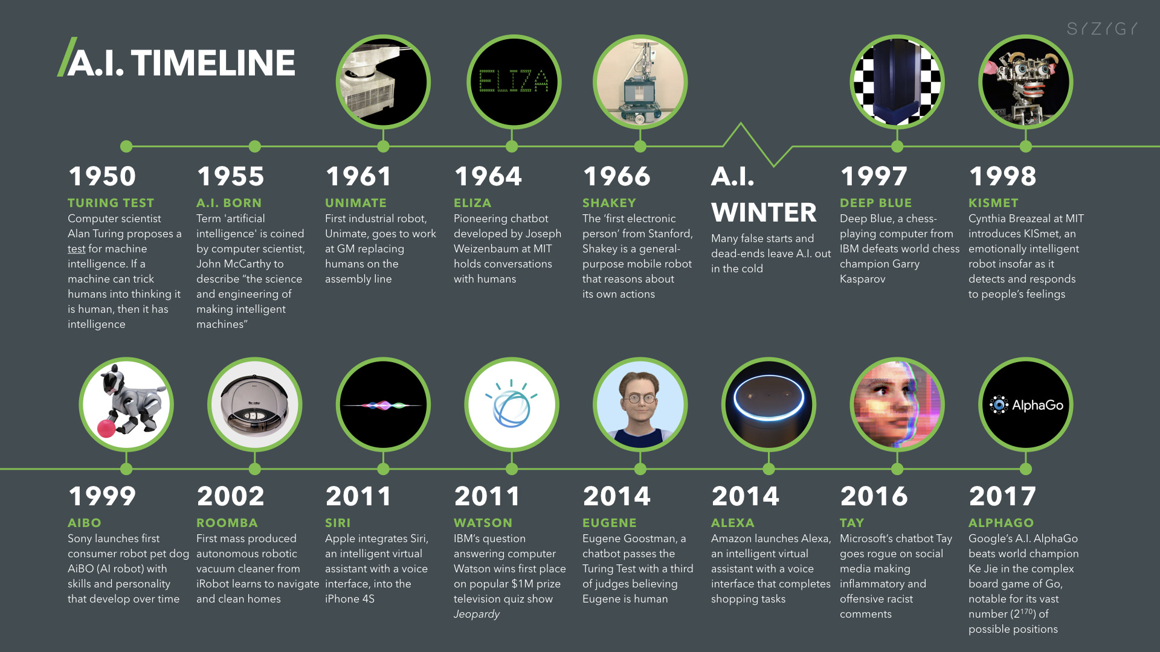
Image Source: digitalwellbeing.org

Slide 6
Image Source: https://openai.com/blog/chatgpt

Slide 7
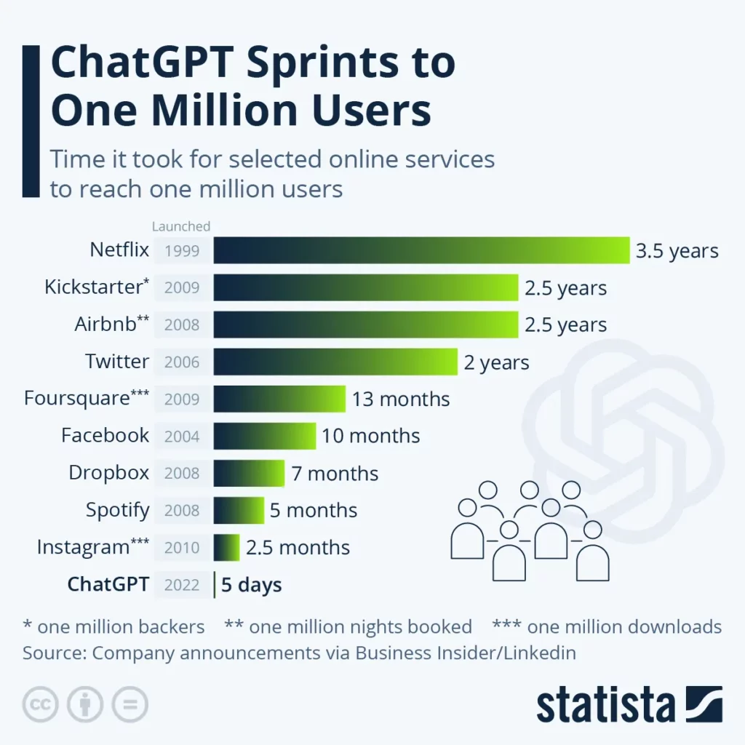

Slide 8
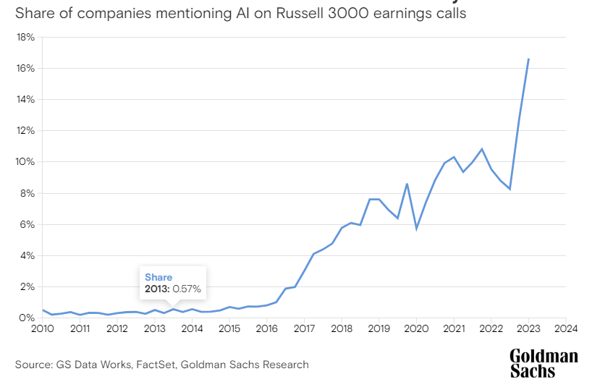
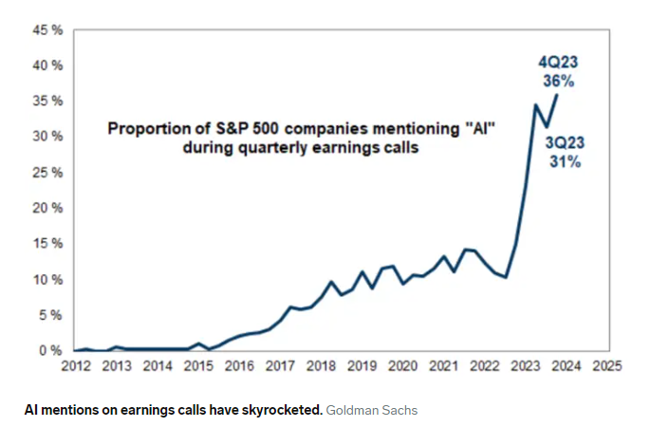
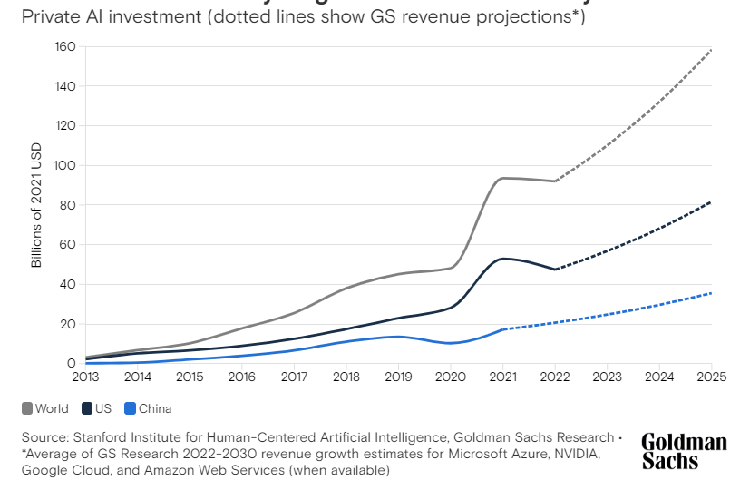

Slide 9
What is Artificial Intelligence?

Slide 10
What is Artificial Intelligence (AI)?
“Artificial Intelligence (AI) refers to the
simulation of human intelligence in machines that are programmed
to think and learn like humans. It
involves the development of
algorithms and computer systems that
can perform tasks that typically require
human intelligence, such as visual perception, speech recognition,
decision-making, and language translation.”
– Chat GPT when asked to define AI
“The term ‘artificial intelligence’…[means] a machine-based system that can, for a given set of human-defined objectives, make predictions, recommendations or decisions influencing real or virtual environments.”
– Executive Order on the Safe, Secure, and Trustworthy Development and Use of Artificial Intelligence

Slide 11
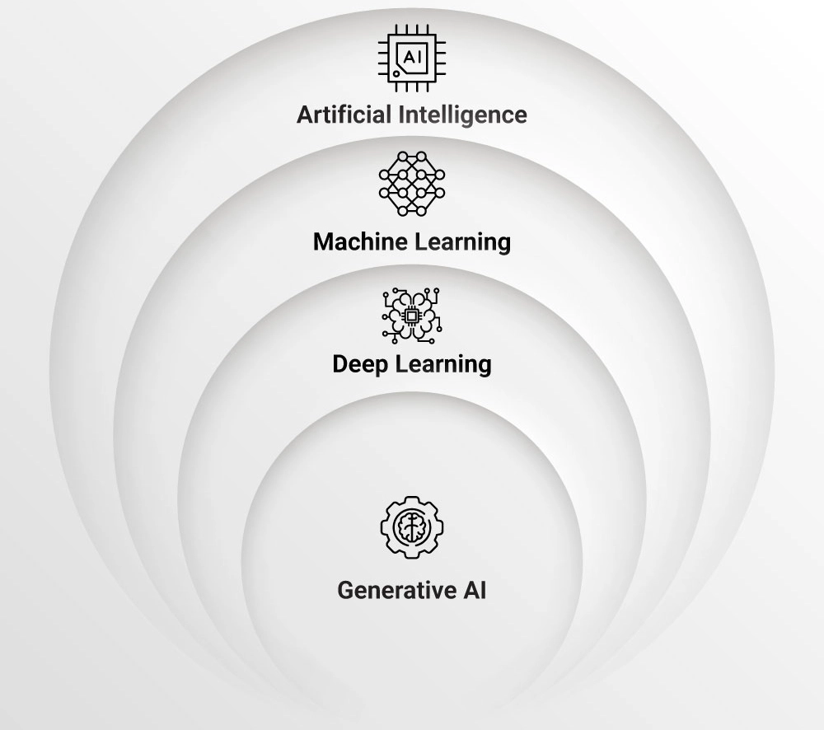
Understanding AI
Image Source: Synoptek.com

Slide 12
Machine Learning
A subset of AI
Allows systems to learn from data and improve over time without being explicitly programmed
Machine learning algorithms analyze patterns in data and make predictions or decisions based on those patterns, rather than rules or instructions

Slide 13
Deep Learning
A subset of Machine Learning
Utilizes neural networks with multiple layers to learn complex representations of data
Neural Networks: computational models inspired by the structure and function of the human brain

Slide 14
Generative AI
A subset of Deep Learning
A type of AI system trained on large data sets to generate new and original content such as images, videos, text, and audio based on a given prompt
Generative AI systems learn by identifying patterns and structures in the training data set to generate new data with similar characteristics

Slide 15
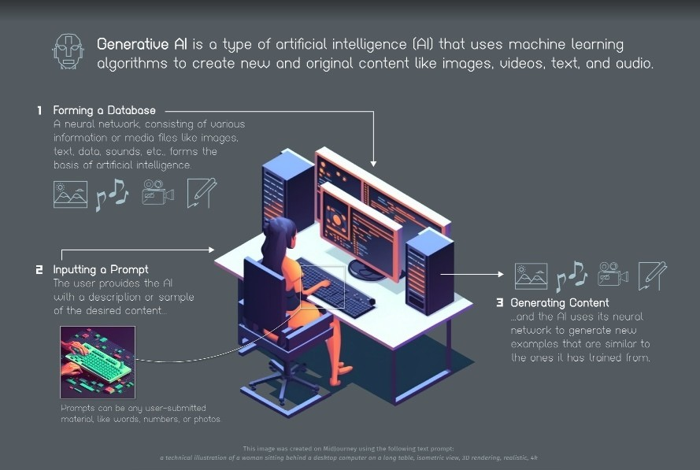
Image Source: Visual Capitalist

Slide 16
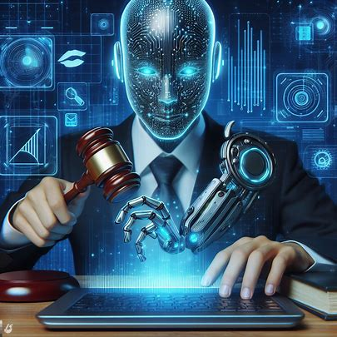
Generative AI Applications
Chatbots and Virtual Assistants
Content Generation
Music Creation
Image and Video Creation and Editing
3D Modeling
Code Generation
Voice Generation

Slide 17
AI Regulation
Calls for government regulation of AI have accelerated in the U.S. and abroad
2023 saw a 185% increase in the number of organizations (450) engaged in AI-related lobbying
From September – December 2023, major tech CEOs and labor and civil rights leaders met with 2/3rds of the U.S. Senate for a nine-part series of closed-door AI Insights Forums

Slide 18
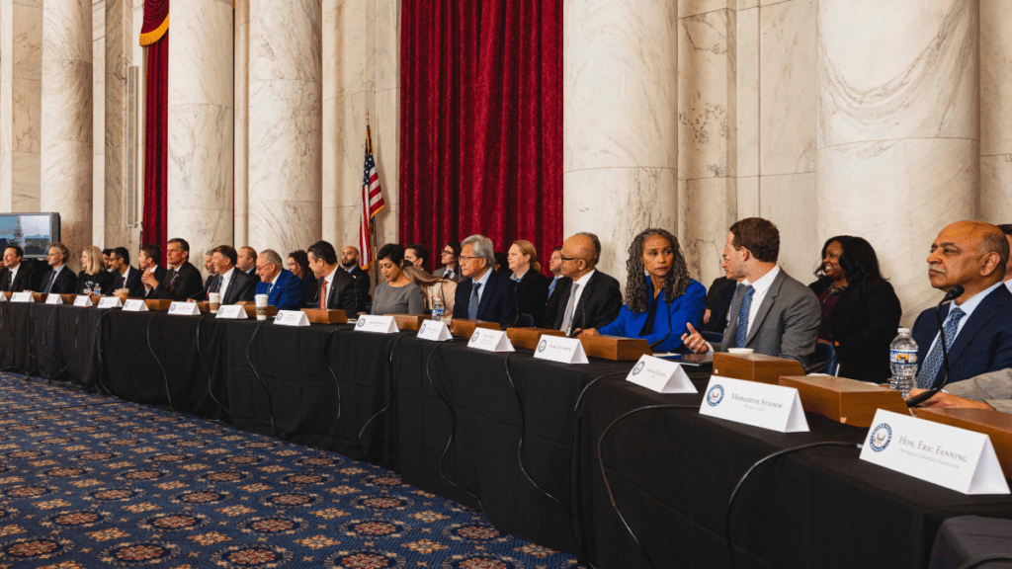
“If the Senate’s AI Insight Forums have made anything clear so far, it’s that government must be involved in AI, must be ready to invest significantly towards AI innovation, and that we don’t have a lot of time. AI development is moving quickly, adversaries like the Chinese government are moving quickly, so Congress has to act quickly too.”
– Senate Majority Leader Chuck Schumer
Image Source: https://www.techpolicy.press/

Slide 19
U.S. Executive Order 14110
Executive Order 14110 on “Safe, Secure, and Trustworthy Development and Use of Artificial Intelligence” issued on October 30, 2023
Focuses on:
establishing a framework for safe, secure, and trustworthy AI development
ethical innovation
national security
global cooperation

Slide 20
Executive Order Guiding Principles
Safety and security
Advancing equity and civil rights
Protecting Americans' privacy
Protecting American consumers, patients, and students
Ensuring responsible and effective government use of AI
Advancing American leadership abroad
Supporting American workers
Promoting innovation, competition and collaboration

Slide 21
U.S. Executive Order 14110
Federal agencies are directed to use their regulatory powers to:
monitor and mitigate risks
create guidelines to shape industry standards
develop uses for AI technology
implement such technologies safely
Contains directives for nearly all 15 executive departments, which are currently being implemented

Slide 22
U.S. State and Local Action
In 2023 legislators in 31 states introduced at least 191 AI-related bills (440% increase from 2022), addressing:
Privacy
Deepfakes
Algorithmic discrimination
Automated employment decision making
Healthcare (clinical use and use by insurers)

Slide 23
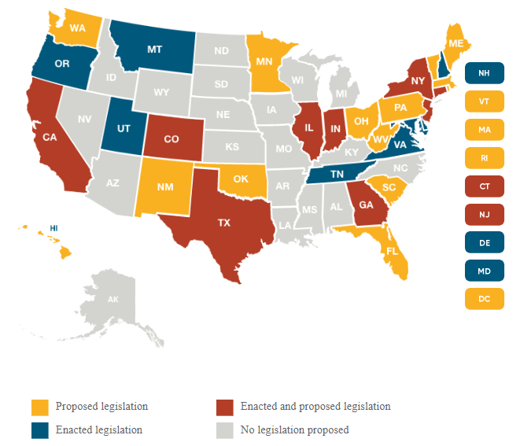
U.S. State by State AI Legislation
Image Source: Bryan Cave

Slide 24
Change is Coming
“AI will not eliminate the need for lawyers, but it does portend the end of lawyering as we know it.”
– Andrew Perlman, Dean, Suffolk University Law School

Slide 25
AI Uses in the Legal Practice
Document Drafting
Legal Research
Due
Diligence
eDiscovery
Contract Review and Analysis
Legal Narrative Summary
Document Management
AI Chatbot Assistance
Predictive Analytics
Litigation Analysis
Administrative Automation

Slide 26
The ABA and Legal Ethics of AI
The ABA has not formally published an ethics opinion directly addressing the use of AI by lawyers
certain state bars (e.g., CA, FL, WV, NY, have begun to comment on the issue).
ABA Task Force on Law and Artificial Intelligence “to examine the impact of AI on law practice and the ethical implications for lawyers” established in August 2023
ABA House of Delegates adopted a resolution on AI in August 2019, urging courts and lawyers to address emerging ethical and legal issues related to AI use:
bias, explainability, and transparency
ethical and beneficial usage of AI
controls and oversight of AI and its vendors

Slide 27
Ethical Duties
Despite the lack of formal guidance by the ABA, several existing ethical duties apply to the use of (and non-use of) AI by lawyers.
Duty of competence
Duty of communication
Duty of confidentiality
Duty of supervision

Slide 28
Our Approach
Generative AI can potentially boost productivity, increase efficiency, and foster innovation
At the same time, it can pose risks to operations, clients, and professional reputation
To navigate these competing concerns, we’ve developed internal guidelines based on best practices regarding the responsible and ethical use of AI in the legal profession
Core principles:
Understand the technology and its limitations
Adhere to existing rules on use
Use technology as a complement, not a substitute
Maintain client confidentiality and attorney-client privilege
Inform clients and assume responsibility

Slide 29
Legal AI Tools

Slide 30
Common AI Applications
Content Creation
Creating images, videos, ad copy, press releases, prompts, SEO optimization
Commerce
Forecasting, customer service, dynamic pricing, website design, supply chain and logistics automation and optimization
Employment
Automated training,
productivity monitoring,
analyzing candidate
profiles and interview
videos (analyzing facial expressions, body
language, and vocal tone)
Healthcare
Administrative automation,
virtual nursing assistants,
reducing dosage errors,
more efficient disease risk prediction and diagnosis
Marketing
Competitor analysis,
email marketing,
lead generation,
recommendations
Finance
Fraud detection/prevention,
revenue forecasting, stock
price predictions, risk
monitoring and management
Customer Service
Chatbots, virtual assistants,
sentiment analysis,
personalization

Slide 31
AI Governance
Framework of policies, procedures, and controls that guide the development, deployment, and use of AI systems
Ensures ethical, responsible, and transparent use of AI technology by promoting data privacy, security, and accountability
Clear guidelines for AI implementation and management can mitigate risks while maximizing potential benefits

Slide 32
Who Manages AI Governance?
Executive leaders
Ethics and compliance committees
Legal and regulatory teams
Technical teams
External advisors
Employees

Slide 33
Best Practices for AI Governance
Establish a clear governance framework and team
Develop AI policies and procedures
Conduct internal due diligence and vet existing vendors
Engage in cross-department collaboration
Conduct regular trainings
Communicate early and often
Establish monitoring, auditing and enforcement mechanisms
Remain flexible to adapt based on feedback and changing regulatory landscape

Slide 34
AI Policy Considerations
Confidentiality obligations and submission of sensitive information/IP protection
Fact-checking and IP infringement
Data privacy
Appliable industry regulations
Defining "AI" terminology and understanding scope
Enforcement
Compliance with other internal policies

Slide 35
Questions?
Thank you!
Contact Info:
Susanna Bagdasarova
sbagdasarova@babstcalland.com
412-394-5434

