Slide 1
Proven Results. Exceptional Client Service.

Slide 2
ABOUT O’HAGAN MEYER
A litigation firm with proven Results focused on exceptional client service.
O’Hagan Meyer’s lawyers understand that our clients want solutions to their legal problems. We have distinguished ourselves in the court room and in arbitrations handling a wide variety of litigation and employment related matters. But most importantly, the firm’s lawyers take pride in helping our clients solve tough legal problems.
Our mission:
O’Hagan Meyer’s mission is to provide practical, innovative, and exceptional litigation and advisory services to our clients.
A commitment to diversity.
O’Hagan Meyer embraces diversity as a core value, because we recognize the contribution a diverse workplace makes to the firm, our clients, the legal profession and to society as a whole. A diverse workplace includes and provides equal opportunity to persons with different characteristics, including race, religion, ethnicity, marital status, gender, sexual orientation, disability and age.

Slide 3
OUR REACH
States Where Our Attorneys Are Licensed
Arizona, California, Colorado, Connecticut, Delaware, District of Columbia, Florida, Georgia, Idaho, Illinois, Indiana, Iowa, Maryland, Massachusetts, Michigan, Missouri, Nevada, New Jersey, New York, North Carolina, Ohio, Oregon, Pennsylvania, South Carolina, Tennessee, Texas, Virginia, Washington, West Virginia, Wisconsin, and Wyoming.

Slide 4
OFFICES
Alexandria, VA
2560 Huntington Ave, Suite 204
Alexandria, VA 22303
Tel: 703-775-8600
Denver, CO
1331 17th St, Suite 350
Denver, CO 80202
Tel: 720-995-6910
New York City, NY
229 West 36th St, 8th Fl.
New York City, NY 10018
Tel: 212-377-5255
Richmond, VA
411 E. Franklin St, Suite 500
Richmond, VA 23219
Tel: 804-403-7100
Atlanta, GA
555 North Point Center East,
4th Floor
Alpharetta, GA 30022
Tel: 312-422-6100
Detroit, MI
21800 Haggerty Rd, Suite 106
Northville, MI 48167
Tel: 248-896-1800
Norfolk, VA
101 W. Main St, Suite 4900
Norfolk, VA 23510
Tel: 757-678-8680
Sacramento, CA
5325 Elkhorn Blvd, Suite 1013
Sacramento, CA 95842
Fresno, CA
8050 N. Palm Ave., Suite 300
Fresno, CA 93711
Orange County, CA
4695 MacArthur Court, Suite 900
Newport Beach, CA 92660
San Francisco, CA 1 Embarcadero Center, Suite 2100
San Francisco, CA 94111
Boston, MA
111 Huntington Ave, Suite 719
Boston, MA 02199
Tel: 617-843-6800
Hermosa Beach, CA
2615 East Pacific Coast Hwy, Suite 300
Hermosa Beach, CA 90254
Tel: 310-807-1100
Philadelphia, PA
1717 Arch St, Suite 3910
Philadelphia, PA 19103
Tel: 215-461-3300
Seattle, WA
600 1st Ave.,Suite 102, PMB 2256
Seattle, WA 98104
Charlotte, NC
1355 Greenwood Cliff Rd, Suite 100
Charlotte, NC 28204
Tel: 704-582-7900
Las Vegas, NV
300 South 4th Street, Suite 1250
Las Vegas, NV 89101
Tel: 725-485-4520
Pittsburgh, PA
102 Broadway St, Suite 200
Carnegie, PA 15106
Tel: 412-790-3020
Washington, D.C.
1629 K Street N.W., Suite 300
Washington, D.C. 20006
Tel: 703-775-8601
Chicago, IL
1 E. Wacker Dr, Suite 3400
Chicago, IL 60601
Tel: 312-422-6100
Los Angeles, CA
550 South Hope St, Suite 2400
Los Angeles, CA 90071
Los Angeles, CA
21650 Oxnard St, Suite 530
Woodland Hills, CA 91367
Tel: 213-306-1610
Portland, OR
805 SW Broadway, Suite 2280
Portland, OR 97205
Tel: 458-451-5904
Wilmington, DE
800 North King St, Plaza Suite 1
Wilmington, DE 19801
Tel: 302-492-2150
Columbia, MD
8115 Maple Lawn Blvd, Suite 350
Fulton, MD 20759
Tel: 312-422-6100
Princeton, NJ
116 Village Blvd, Suite 200
Princeton, NJ 08540
Tel: 215-461-3300

Slide 5
History and Background on DEI
Dean Falavolito – Partner | Alexandra Boyer – Associate

Slide 6
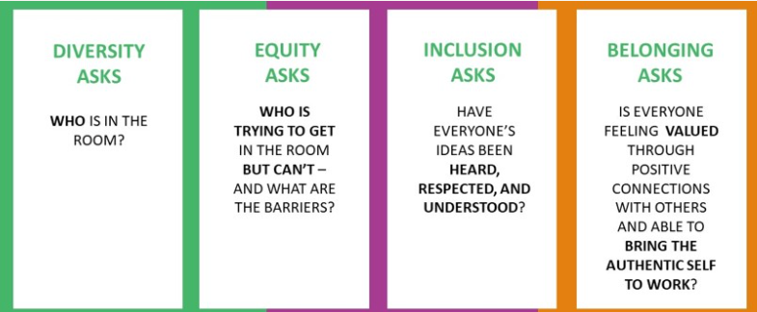
What Is Diversity, Equity and Inclusion?

Slide 7
Employment Data
EEO Employment Data
2014 Data
Job Patterns for Minorities and Women in Private Industry
By Race Ethnicity & Sex
2021 Data
Job Patterns for Minorities and Women in Private Industry
By Race Ethnicity & Sex

Slide 8
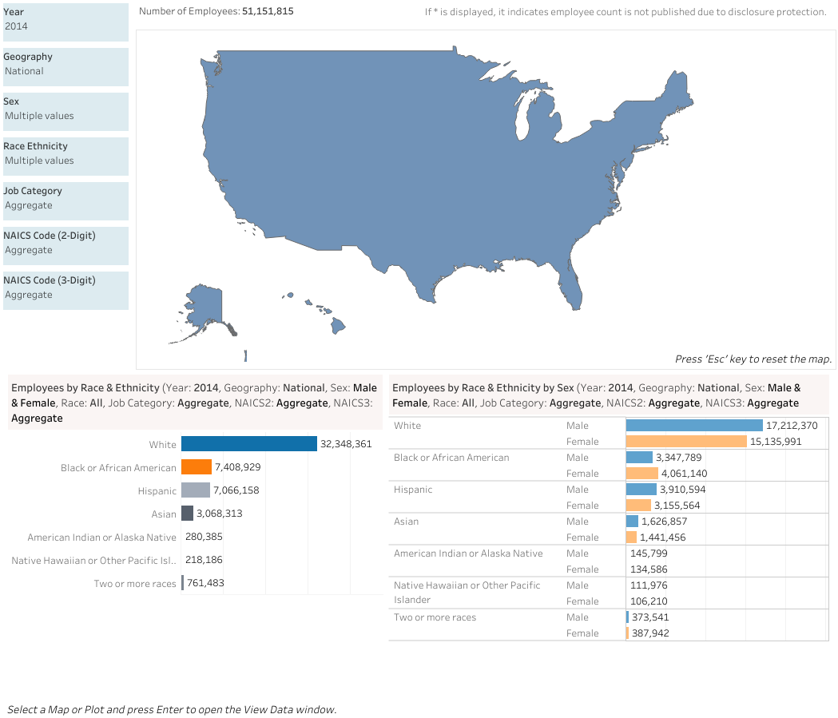
EEO Employment Data: Race & Ethnicity & Sex (2014)

Slide 9
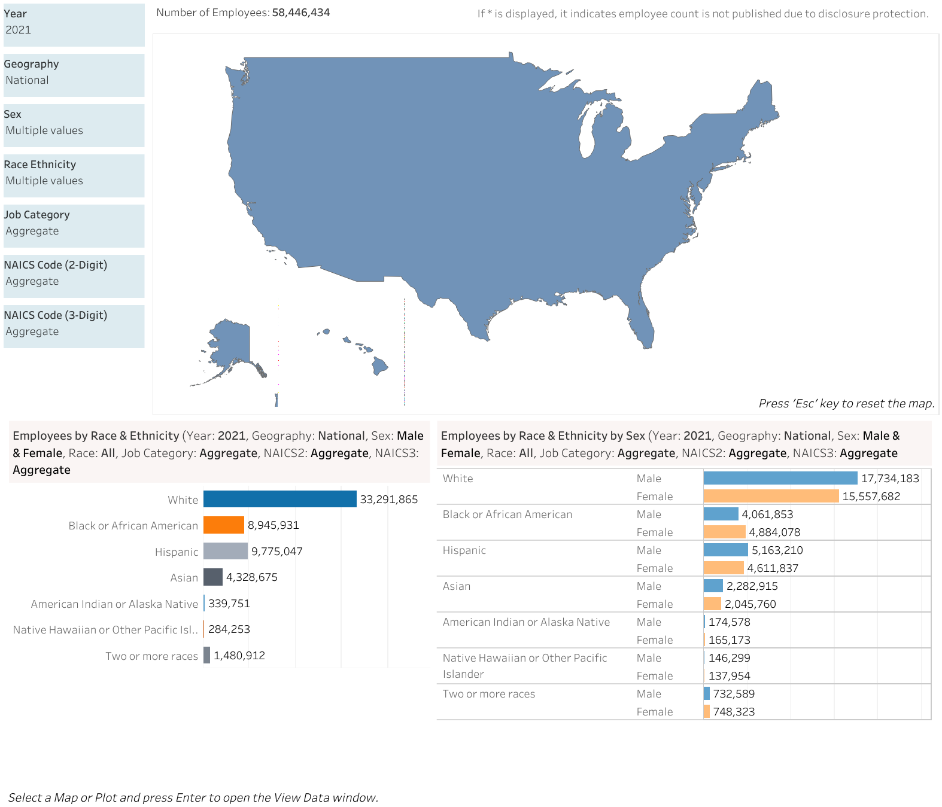
EEO Employment Data: Race & Ethnicity & Sex (2021)

Slide 10
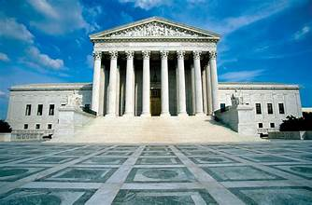
Supreme Court Decisions on DEI

Slide 11
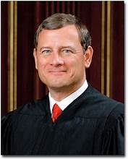
Students for Fair Admissions, Inc. v. President and Fellows of Harvard College, No. 20-1199, together with Students for Fair Admissions, Inc. v. Univ. of North Carolina, No. 21-707 (June 29, 2023)
SCOTUS - consideration of race in college affirmative action programs violated the Equal Protection Clause of the Fourteenth Amendment and Title VI
Equal Protection Clause does not permit distinctions based upon race
Noted that race-neutral programs are permissible
Expressed concern that Harvard and UNC used impermissible stereotypes which made assumptions that students of color would bring different experiences to a campus than white students
But - “nothing prohibits universities from considering an applicant’s discussion of how race affected the applicant’s life.” (Roberts)

Slide 12
SFFA – Rejected Defendant Arguments
Admissions policies’ goals were “commendable“ but “not sufficiently coherent for purposes of strict scrutiny.”
Rejected colleges’ arguments that the programs
Train future leaders in the public and private sectors
Prepare graduates to adapt to an increasingly pluralistic society
Better educate its students through diversity
Produce new knowledge stemming from diverse outlooks
Promote robust exchange of ideas
Broaden and refines understanding
Foster innovation and problem-solving
Prepare engaging and productive citizens and leaders
Enhance appreciation, respect, empathy and cross-racial understanding
Break down stereotypes.

Slide 13
SFFA – Application to Employer DE&I Initiatives
While the decision didn’t directly address Title VII, challengers of employer DE&I initiatives are applying the Court’s reasoning to the employer context, leading to:
Discrimination claims which allege DE&I measures are evidence of discrimination against white and/or male applicants/employees
Stakeholder actions that allege DE&I initiatives that attempt to increase opportunities for under-represented groups negatively affect majority groups
State legislation designed to challenge, weaken, or eliminate DE&I initiatives.
https://www.nytimes.com/2024/01/22/business/diversity-backlash-fortune-500-companies.html

Slide 14
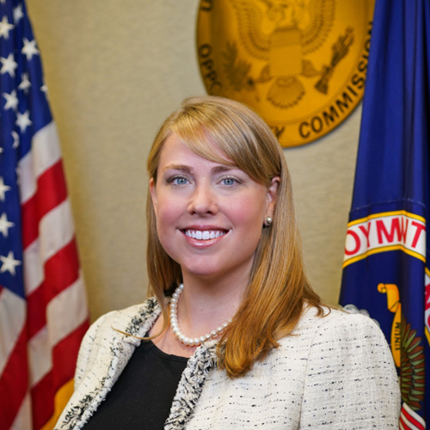
Equal Employment Opportunity Commission (EEOC) Commissioner Lucas
Commissioner Lucas on the SFFA decision:
Today’s Supreme Court decision rejects diversity interests as justifications for race-based university admissions decisions. This brings the rules governing higher education into closer parallel with the more restrictive standards of federal employment law. Employers generally are not permitted to take employment actions motivated by protected characteristics.
https://www.reuters.com/legal/legalindustry/with-supreme-court-affirmative-action-ruling-its-time-companies-take-hard-look-2023-06-29/

Slide 15
EEOC Commissioner Lucas
Since the 1970’s, employers could consider race and sex only in very limited circumstances as part of a voluntary, remedial affirmative action plan
Remedial plans must be temporary, narrowly tailored to the company or industry at issue, and justified by a “strong basis in evidence” that remedial action is necessary.
General interest in diversity or “equity” is not sufficient to allow race- or sex-motivated employment actions.
References to societal discrimination, or differences between the composition of a company's workforce and “society,” or the company's customer base also insufficient.
https://www.reuters.com/legal/legalindustry/with-supreme-court-affirmative-action-ruling-its-time-companies-take-hard-look-2023-06-29/

Slide 16
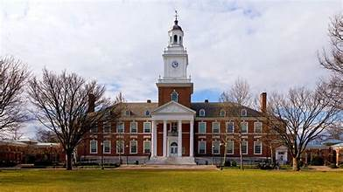
Post Harvard

Slide 17
Muldrow v. City of St. Louis
U.S. Supreme Court – April 17, 2024
To make out a 42 U.S.C.S. § 2000e-2(a)(1) discrimination claim, a transferee had to show some harm respecting an identifiable term or condition of employment, but did not have to show that the harm incurred was significant, serious, or substantial; [2]-The lower court erred in requiring a police sergeant to show that an allegedly discriminatory transfer produced a significant employment disadvantage. The allegations that she was moved from a plainclothes job in a prestigious specialized division with substantial responsibility over priority investigations and frequent opportunity to work with police commanders to a uniformed job supervising one district’s patrol officers with less involvement in high-visibility matters, primarily performing administrative work, a less regular schedule, and no take-home car were sufficient
Notes:
Hiring, firing, promotion, demotion and compensation
Typically, lateral transfers, schedule changes are not sufficient.

Slide 18
Washington Post - April 19, 2024
The Supreme Court’s unanimous decision this week in favor of a St. Louis police sergeant was almost universally cast as a win for workers, who now have a lower bar for proving discrimination claims. But it’s also being held up by conservative activists intent on dismantling diversity, equity and inclusion initiatives, who say it will give them added firepower to quash workplace programs reserved for minorities, women and other underrepresented groups.

Slide 19
Impact on Employers’ DE&I Initiatives
https://www.littler.com/files/2024_littler_csuite_survey_report.pdf

Slide 20
Legislative Action Against DEI

Slide 21
Legislative Actions Against DEI
Individual Freedom Act aka “Stop WOKE Act” (Wrongs to Our kids and Employees Act) – House Bill 7
Prohibits workplace training that teaches that individuals are “inherently racist, sexist, or oppressive;” that people are “privileged or oppressed based on race, gender, or national origin;” or that a person “bears personal responsibility for and must feel guilt, anguish, or other forms of psychological distress” over actions committed in the past by members of the same race, gender, or national origin.
Senate Bill 148 – Modifies Florida’s Civil Right Act’s definition of “unlawful employment practices” and “race discrimination” to include “subjecting an individual, as a condition of employment, membership, certification, licensing, credentialing, or passing an examination” to any “training, instruction, or any other required activity” that espouses, promotes, advances, inculcates, or compels an individual to believe” any of the 8 restrictions.

Slide 22
Anti-DEI Legislation in Education
More than 30 states have introduced anti-DEI legislation at public colleges
Alabama, Florida, Tennessee, Texas, and Utah have enacted legislation prohibiting diversity training, hiring and inclusion programs at universities and state government
Alabama – Senate Bill 129
Prohibits public colleges add universities from promoting, sponsoring’ or maintaining DEI offices and programs
Prohibits public institutions from affirming certain divisive concepts relating to race, sex, or religion

Slide 23
Anti-DEI Legislation in Education
Florida – Senate Bill 266 and House Bill 999
Prohibits state colleges and universities from using state and federal funds to promote, support, or maintain DEI programs; and from offering any general education course that “teaches identity politics, or is based on theories that systemic racism, sexism, oppression’ and privilege are inherent in the institutions of the United States”
Tennessee – Senate Bill 222
Prohibits public colleges from requiring DEI training and education to issue certain medical and health related degrees and from using state funds to endorse or promote “divisive concepts”

Slide 24
Anti-DEI Legislation in Education
Texas – Senate bill 17
Prohibits diversity equity and inclusion offices from public colleges and universities.
Prohibits higher education institutions from requiring anyone to provide DEI statements or participate in DEI training.
Utah – House Bill 261
Prohibits institutions of higher education, the public education system, and government employers from “taking certain actions and engaging in discriminatory practices,” including DEI programs.
Bans “requiring an individual, before, during, or after admission or employment, to provide certain submissions or attend certain training that promotes differential treatment.”

Slide 25
Current DEI Landscape

Slide 26
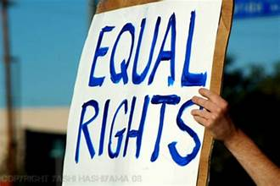
Claims Against Law Firms
American Alliance for Equal Rights (AAER) filed suit or sent notice of potential to suit to at least seven firms including Perkins Coie, Morrison Foerster, and Winston & Strawn
The Attorneys General for Arkansas, Iowa, Kansas, Kentucky, and Montana sent a letter to 100 of the nation’s largest law firms, relying on SFFA, and warning the firms that they “owe a duty to refrain from discriminating on the basis of race, whether under the label of ‘diversity, equity, and inclusion,’ or otherwise.”
That letter specifically took issue with certain firms’ sponsorship of “race-based fellowships and programs” as well other firms having “sought and achieved a certification under the so-called Mansfield Rule[.]”

Slide 27
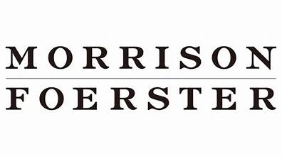
Claims Against Law Firms
Am. All. for Equal Rights v. Winston & Strawn; No. 23-4113; S.D. Tex.
Am. All. for Equal Rights v. Perkins Coie; No. 23-1877; N.D. Tex.
Am. All. for Equal Rights v. Morrison & Foerster; No. 23-23189; S.D. Fla.
Three firms opened their fellowships aimed at students of color to students of all races
A fourth firm ended its diversity fellowship
Some removed mentions of race or gender from the eligibility criteria of their diversity programs

Slide 28
Claims Against Law Firms: Are They Over?
AAER withdrew all three suits after the eligibility requires for the firms were modified
AAER has indicated that “[t]here’s nothing left for us to do in that space”
However, AAER still monitors the websites of forms looking for evidence of programs it views as illegal

Slide 29
Claims Against Businesses
America First Legal, a nonprofit backed by Stephen Miller, a former adviser to President Trump, has filed complaints or threatened action against NASCAR, MLB, Progressive Insurance, Activision Blizzard, Macy’s, Kellogg, and Nordstrom based on a range of DEI policies and practices
Phillips v. Starbucks Corp.; No. 19-19432, D.N.J.
Discrimination claim filed by a Caucasian plaintiff alleging race-based discrimination and retaliation
$2,736,755 in economic damages
$25,600,000 in punitive damages
$1,419,609 sought in attorneys’ fees
Settled while fee petition pending

Slide 30
Claims Against Businesses
Jonathan Bresser, Jr. v. The Chicago Bears Football Club, Inc., et al
Plaintiff
Caucasian male, first-year law student at DePaul University College of Law in Chicago, Illinois
2/1/2024: Charge of Discrimination alleging race and sex discrimination filed with the Illinois Department of Human Rights (“IDHR”) and the Equal Employment Opportunity Commission (“EEOC”)

Slide 31
Claims Against Businesses
Jonathan Bresser, Jr. v The Chicago Bears Football Club, Inc., et al
Lawsuit
Filed 3/11/2024 in The United States District Court for the Northern District of Illinois, Eastern Division
Chicago Bears job posting for a “Legal Diversity Fellow” which, among other things; (i.e. grades and experience), sought applicants who are “person[s] of color and/or female law student.”
Plaintiff applied but was denied. Alleges he was met all job qualifications other than being a person of color or female.
Alleges Defendants engaged in intentional race and sex discrimination when creating and circulating the job posting which by its very nature excludes Caucasian male as viable applicants.
Alleges defendants intentionally deprived him of his rights to contract on the basis of his race and/or sex.
Demands $600,000.

Slide 32
Football-less South?
The NAACP issued a call for Black student athletes in Florida to reconsider going to public colleges and universities in the state. That's because in Florida, spending on Diversity, Equity and Inclusion, or DEI, is prohibited under a state law signed last year by Governor Ron DeSantis.
Former University of Florida student and professional football player, Emmitt Smith urges Black athletes to fight for diversity programs at the University of Florida
Birmingham Mayor Randall Woodfin said he’d encourage Black athletes and their parents to avoid Alabama schools if state Republicans succeed in their push to ban DEI programs. He asked the leadership, athletic directors and coaches at University of Alabama Athletics, Auburn University and UAB — The University of Alabama at Birmingham: Do you support this prohibition of diversity and inclusion? To the parents of minority athletes who are helping their children decide if they want to play sports at those institutions: Would you be cool with your child playing at schools where diversity among staff is actively being discouraged? Although I’m the biggest Bama fan, I have no problem organizing Black parents and athletes to attend other institutions outside of the state where diversity and inclusion are prioritized.

Slide 33
What is ESG?
Environmental criteria consider how a company safeguards the environment, including corporate policies addressing climate change, for example.
Social aspects look at the company’s relationships with internal and external stakeholders. Social criteria examines how it manages relationships with employees, suppliers, customers, and the communities where it operates.
Governance standards ensure a company uses accurate and transparent accounting methods, pursues integrity and diversity in selecting its leadership, and is accountable to shareholders. This includes company’s leadership, executive pay, audits, internal controls and shareholder rights.
Source – Investopedia

Slide 34
Current DEI & ESG Lawsuit Landscape
National Center for Public Policy Research v. Starbucks
NCPPR filed suit alleging Starbucks diversity and inclusion initiatives were discriminatory and violated securities laws. Also, policies led to race-based decisions which violated federal and state civil rights laws.
The judge dismissed using Business Judgement Rule. He stated –
if the plaintiff doesn’t want to be invested in ‘woke’ corporate America, perhaps it should seek other investment opportunities rather than wasting the court’s time.”
Nat'l Ctr. for Pub. Policy Research v. Schultz, 2:22-CV-00267-SAB
(E.D. Wash. Mar. 21, 2023)

Slide 35
Current DEI & ESG Lawsuit Landscape
Spence v. American Airlines & American Airlines Employee Benefit Committee –
The Northern District of Texas denied the motion to dismiss in a lawsuit filed by an American Airlines pilot alleging that the airline and its employee benefits committee violated their fiduciary duties under ERISA to the company’s 401(k) plan participants in connection with selection and retention of funds whose managers allegedly pursue non-economic ESG objectives rather than maximizing plan participants’ financial benefits.
Court said – Taking allegations as true, Plaintiff plausibly alleges at this stage that Defendants violated the duty of loyalty by not acting with a “single eye” to the interest of participants and beneficiaries.
Spence v. Am. Airlines, Inc., Civil Action 4:23-cv-00552-O (N.D. Tex. Feb. 21, 2024)

Slide 36
Current DEI & ESG Lawsuit Landscape
Honeyfund.com, Inc., et al v. DeSantis, et al
Opponents of Florida’s STOP WOKE Act filed suit against the Governor, Attorney General and members of the Florida Commission on Human Relations challenging the Act. The Act prohibits employers from requiring employees to attend meetings where the company seemingly endorses concepts in programs and trainings that members of one race or sex are morally superior to others, are inherently racist or sexist, carry certain privileges, or should feel guilty about the past actions of their ancestors.
The district court granted a preliminary injunction prohibiting enforcement of the Act, reasoning that the mandatory-meeting provision is both unconstitutionally vague and an unlawful content- and viewpoint-based speech restriction. The U.S. Court of Appeals for the Eight Circuit upheld dismissal.
Honeyfund.com v. DeSantis, 622 F. Supp. 3d 1159 (N.D. Fla. 2022)

Slide 38
DEI Is Under Attack.
Here’s How Companies Can Mitigate the Legal Risks.
By Kenji Yoshini & David Glasgow - Harvard Business Review – January 5, 2024
What Makes DEI Risky?
A DEI program is most risky when it meets three criteria:
1. It confers a preference, meaning that some individuals are treated more favorably than others. 2. The preference is given to members of a legally protected group, such as groups defined by the categories protected in Title VII of the Civil Rights Act of 1964. These are race, color, religion, national origin, and sex (including sexual orientation and gender identity). 3. The preference relates to a palpable benefit, such as a job, a promotion, a pay raise, a work assignment, or access to training and development opportunities.

Slide 39
Identify Potential DEI Risk (Cont)
With these three criteria in mind, it is possible to identify risky DEI programs.
They include:
Hiring quotas (“Make sure at least 45% of our incoming associates are women”)
Tiebreaker decision-making (“If you’re choosing between two similarly strong candidates and one is white and the other is a person of color, pick the person of color”)
Group-specific internships and fellowships (“Let’s create an internship that limits eligibility to Black and Latino talent”)
Tying manager compensation to diversity goals (“You will get a bonus if you hire more women and people of color on your team”)

Slide 40
Reality
Reputation and retention – Diverse companies enhance recruitment, retention, talent development and can capture new market share
Groups formally seen as “minorities” may reach majority status by 2045
48% of Generation Z are racial or ethnic minorities
Three out of four job seekers and workers prefer diverse companies and coworkers

Slide 41
How Might DEI Risks Evolve
and Be Handled?

Slide 42
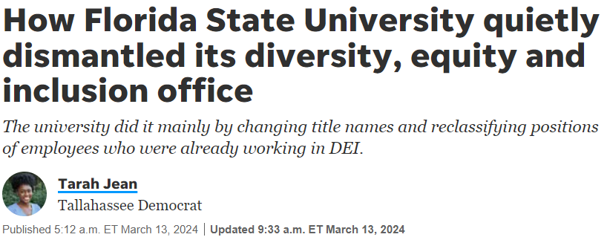
Results of DEI: Impact on Universities

Slide 43
Results of DEI: Impact on Universities
University of Florida
Closed its Equity, Diversity & Inclusion Office
No program administrators or employees lost their jobs – accomplished through title changes or reclassifying positions
Florida State University
Eliminated all Diversity, Equity and Inclusion employee positions
The change was announced in emailed, administrative memo
“[T]o comply with the Florida Board of Governor’s regulation 9.016 on prohibited expenditures, the University of Florida has closed the Office of Chief Diversity Officer, eliminated DEI positions and administrative appointments, and halted DEI-focused contracts with outside vendors.”
Florida A&M University
Never utilized a DEI office
“[I]t’s important to note that diversity, equity and inclusion are not integrated into our programs.”

Slide 44
Will Employers Change DE&I Initiatives?
Commissioner Lucas –
“[SFA] ruling only heightens those employers' practical risks by reemphasizing the Supreme Court's rejection of diversity, nebulous "equity" interests, or societal discrimination as justifying actions motivated — even in part — by race, sex, or other protected characteristics.”
Even in the limited contexts in which affirmative action currently is permitted, an employer still cannot use racial or sex-based quotas.
Companies also cannot take race-motivated actions to maintain a demographically "balanced" workforce.
https://www.reuters.com/legal/legalindustry/with-supreme-court-affirmative-action-ruling-its-time-companies-take-hard-look-2023-06-29/

Slide 45
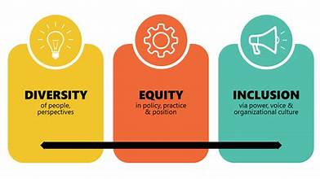
Inclusion, Equity and Diversity C-Suite Survey Report
January 2024 Littler survey of surveyed more than 300 C-suite executives across the United States
Chief Executive Officers (CEOs), Chief Legal Officers (CLOs) and Chief Diversity Officers (CDOs)
Diverse range of industries and company sizes
Employers remain committed to DE&I
57% increased efforts over the past year, yet 59% indicated an increase in backlash since SCOTUS decisions on affirmative action
91% indicated that SCOTUS decisions have not lessened DE&I prioritization.
https://www.littler.com/files/2024_littler_csuite_survey_report.pdf

Slide 46
Changes in DE&I Focus
Companies are re-examining DE&I initiatives
Some are opting for an “under the radar” approach
Reducing initiatives that attract public attention and instead focusing on lower-profile strategies, like diversity task forces that bring together leaders from different departments.
In another employer survey, 33% were concerned not only about the risk of lawsuits resulting from DE&I activities but also negative media and social media attention, damage to their culture and harm to their employer and corporate brand.
https://www.nytimes.com/2024/01/22/business/diversity-backlash-fortune-500-companies.html
https://hrexecutive.com/how-the-diversity-backlash-is-affecting-dei-efforts-in-theworkplace/#:~:text=Some%20companies%20(33%25)%20are,their%20employer%20and%20corporate%20brand
Notes:
Analyzed data from over 850 respondents in organizations of all sizes

Slide 47
Changes in DE&I Focus
HR initiatives, including DE&I, are under cost pressure
Layoffs, fewer DE&I job postings
Employers may scale back initiatives aimed at hiring, as they tend to be riskier
May also see fewer initiatives that have a demographic attribute in the title, such as internships for women
Will employers switch from a race/gender focus to a socio-economic focus?
https://hrexecutive.com/where-the-dei-pushback-leaves-employers-hr/?oly_enc_id=2137D1791101B4V
Notes:
Analyzed data from over 850 respondents in organizations of all sizes

Slide 48
Employer DE&I Initiatives

Slide 49
Comments/Questions?

