Slide 1

The Attorney Client Privilege Across Borders
March 7, 2024
Annual In-House Counsel Symposium
Omni Frisco
Jordan W. Cowman | cowmanj@gtlaw.com | +1.214.235.2223
Courtney York | courtney.york@gtlaw.com | +1 214.665.3779

Slide 2

Why a Presentation on Cross-Border Privilege?
Internal FCPA, AML and Antitrust investigations in 8 countries
In-house counsel in U.S., Australia, Brazil, Switzerland, China, Netherlands, Korea & Japan (outside counsel) involved
Highly sensitive communications
Detailed (and convicting) self-critical analysis
Privilege & data privacy strategies?
ABA MODEL RULES OF PROFESSIONAL CONDUCT 1.6 (more on this later)

Slide 3

Japan
Bengoshi (licensed member of the Bar ) v. Non-Bengoshi
The concept of privilege exists as an obligation not a privilege
Bengoshi have the right and statutory obligation to hold in confidence secret information obtained during the course of their professional duties
Confidential documents in lawyer’s hands are privileged, but documents in corporation’s hands are discoverable

Slide 4
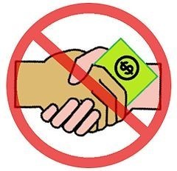

Hypothetical Cross-Border Antitrust & Anticorruption Issues
Anticorruption
Concern re: employee, consultant, sales agent, distributor possible bribery of government officials to obtain regulatory permits, patent applications and compliance approvals, rights and licenses
FCPA / Irish Criminal Justice (Corruption Offences) Act & similar laws
Alleged collusion, concerted activity and conspiracy to fix prices and to raise prices

Slide 5



Team Prep!
Team’s Mission - investigate, interview & opine
Observations re: govs’ enforcement agenda(s)
Strategy, WEAKNESSES, diagrams, flow charts
Witnesses names, admission statements, tons of privileged info
Exposure & Liability…doesn’t look good!
Digitize lots of boxes of documents

Slide 6


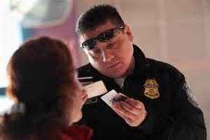


FUN AND ADVENTURE AWAIT! Let’s Travel to Those Romantic Hot Spots!

Slide 7




Home Sweet Home!!!

Slide 8

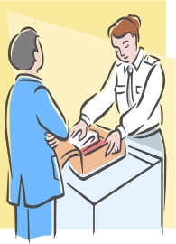
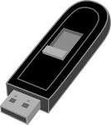
Bordering on Privilege Waiver!
Your laptop, flash drive, smart phone are…
…like locked suitcases…OPEN UP!
Hey, I’m a Big Shot Lawyer and I know I’ve got 4th Amendment Rights…(Right?)

Slide 9


Bordering on Waiver? BORDER SEARCH EXCEPTION
Suspicionless “virtual strip search”
Now in public domain?
"officials may share copies of the laptop's contents with other agencies and private entities for language translation, data decryption or other reasons."
Riley v. CA US SCT 2014– No warrantless search of mobile telephone (outside the border context)

Slide 10

Electronic Device Advisory
for Mid-Year Meeting Attendees

Slide 11
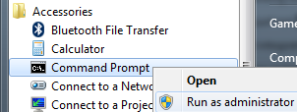
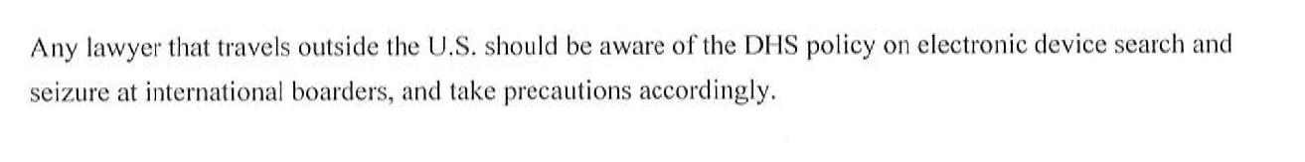
Don’t Be An Information Hoarder at the Border!

Slide 12
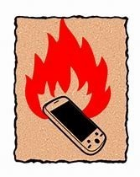
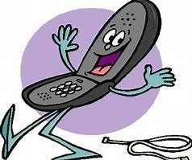

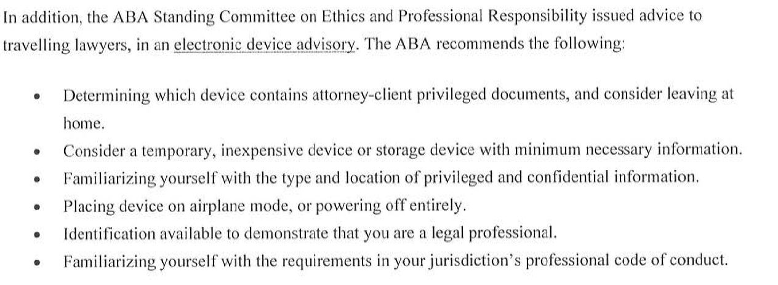
What’s A Traveling Lawyer To Do?

Slide 13

What Should I Do? Put Up A Fight.
“I am an attorney” – Bar Card / Business Card
“This electronic device contains privileged info”
“Is this a request or a demand?”
Do applicable ethics rules allow you to consent to request?

Slide 14
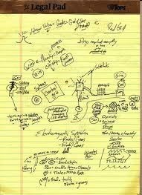

WHAT’S AN INTERNATIONAL ATTORNEY TO DO?
Take less with you…less to lose
Go low-tech – a legal pad with rather cryptic notes (Ha!)
Password & Encrypt information
Consider new tech equipment (NOT wiped clean existing hardware) in sensitive matters

Slide 15
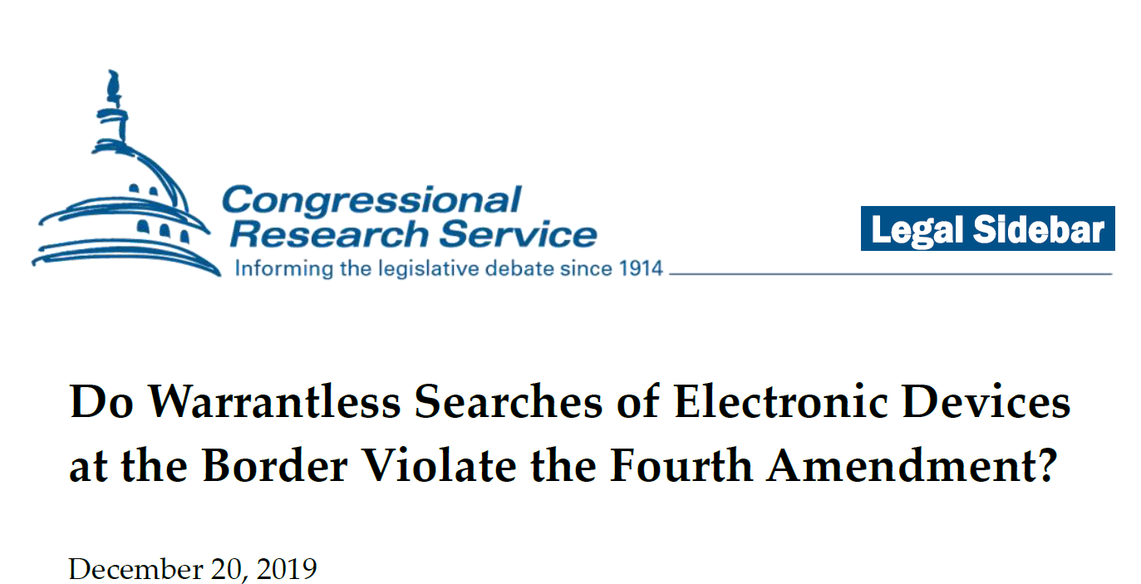
Is Help Coming From Congress?
Bipartisan bills introduced to place restrictions on searches and seizures of electronic devices at the border, e.g. Protecting Data at the Border Act

Slide 16
Who Wants Your Client’s Secrets and Privileged Information?
Competitors
Investigators
Regulators
Litigants

Slide 17

Is Our Legal Team in Compliance?
Who is supposed to protect your client’s secrets and privileged information?

Slide 18

ABA MODEL RULES OF PROFESSIONAL CONDUCT 1.6(a)
A lawyer
shall not reveal information
protected by the attorney-client privilege
under applicable law ….

Slide 19

Uhhhh…Which Law(s) Apply?
Note to self:
Ask this question BEFORE you inadvertently waive privilege

Slide 20

Spoken or Written Communication
Pick up the “#!*!#!*!#” telephone!
Do you really need to write it down?
Tip

Slide 21


Defining Attorney-Client Privilege
Know U.S. privilege law…much litigation is in the U.S.
Generally…
confidentiality of all forms of communication,
between a lawyer and the client,
for the purpose of the attorney rendering legal advice.

Slide 22
“Lawyers are Lawyers”
Often no equivalent of U.S. states’ bar membership in other jurisdictions
In-house counsel oftentimes are not eligible for bar membership
Remember Japan?

Slide 23

“Lawyers” in Sweden
There is no monopoly of legal services in Sweden
Any person may practice law, offering services to the public … no need for a law license
Any person may use the title “lawyer”
In-house counsel may not be bar members
Privilege only attaches to communications between clients & members of the bar

Slide 24
Who is the Client? Under Which Law(s)?
Parent
Subsidiary
Affiliate
Board of Directors
Shareholders
Directors
Officers
Board Committee
Control Group Test
Subject Matter Test

Slide 25
Are you rendering
business advice or legal advice?

Slide 26
Are You Rendering Legal Advice?
Press Release from Siemens
“The new worldwide general counsels will not just give legal advice.
They will have a formative role and decision-making function in business operations.
Their responsibilities in this key position will go considerably beyond merely identifying risks.”

Slide 27




Business or Legal Advice?
Communications with in-house counsel that seek business advice or that appear to be for informational purposes are not privileged
A corporation cannot insulate information from discovery simply by copying in-house counsel
What is your title? Email signature?
Having in-house counsel sit in on a meeting does not render privileged everything said at that meeting
“I’m not a potted plant!”

Slide 28
“We request legal advice on the following: ”

Slide 29
“In response to your
request for legal advice,….”

Slide 30

E a s y? Attorney-Client Privilege Across Borders
Works here, works there

Slide 31

Key Point #1
Protection of attorney-client privileged communications primarily
is a matter of each individual country’s law

Slide 32
Key Point #2
Identical information receives
different privilege status
in different jurisdictions

Slide 33

GOOD TEACHING
CASES

Slide 34

Case #1
John Deere 1984 - Germany

Slide 35
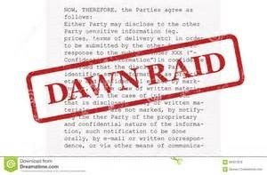
Tough Legal Times
Trapping the Unwary In-House Counsel
- Since 1802
John Deere Dawn Raided in Germany
-GC transferred from Illinois
-Internal investigations & self-critical analysis
-EC investigation of anti-competitive behavior
-Documents seized

Slide 36
Lawyer’s Writings Seized
“Privileged” documents used at trial
“…knowingly violated our law…”
“Their own lawyer wrote …”

Slide 37
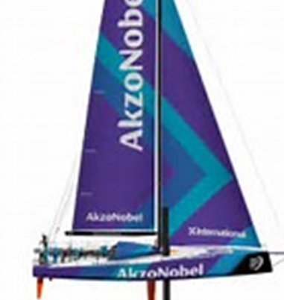
Case #2
Akzo Nobel Chemicals 2010 - UK

Slide 38





Common Law Jurisdictions
Similar to U.S., Ireland, Canada, Australia, England & Other Common Law Jurisdictions

Slide 39

Akzo learns from John Deere
Move to England where they have great privilege rules

Slide 40

Akzo
EC investigating industry for anti-competitive behaviors
Akzo’s General Counsel’s Office - fantastic source of evidence

Slide 41


EC Competition Authority
Dawn Raid

Slide 42


Akzo Nobel Chemicals
Documents seized from GC’s office
Two emails at issue
Netherlands-licensed in-house competition lawyer’s opinions on competition compliance program seized

Slide 43

Netherlands – Favorable Privilege Law
Trending Positive …!
Privilege for in-house lawyers
Privilege extends to privileged information in client’s possession

Slide 44

WSJ 29 April 2010:
“Bad Day For In-House Lawyers”
ECJ advisory opinion:
NO PRIVILEGE
for executive’s communications with
in-house counsel
One Key - Financial Remuneration

Slide 45

Holding reflects
“…a fundamental misunderstanding of both the role and responsibilities of in-house counsel, and the impact of financial remuneration on any lawyer retained by a client to represent the client’s legal interests.”

Slide 46

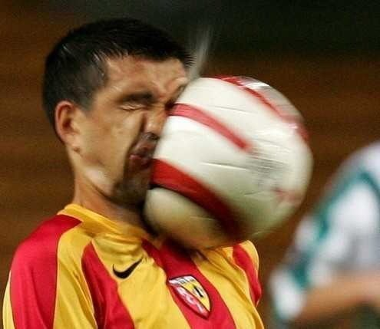
WSJ 14 September 2010
“Bad Day For In-House Lawyers Part Deux”
The ECJ Rejects Akzo’s arguments that its employees’ communications with internal lawyers should be covered by LPP

Slide 47
28 member states (Brexit)
European Union member countries are split on whether to recognize legal professional privilege for in-house counsel
Ireland, England, Greece, Poland, Netherlands
EU Law

Slide 48


High Impact of Akzo Nobel
The ruling has the perverse effect of undermining … corporate compliance in multinational companies
American corporations doing business outside U.S. are seriously adversely affected

Slide 49

Work in Switzerland
No In-House Counsel Privilege
Foreign-Licensed Lawyers Enjoy Privilege
No Work Product – Litigation Privilege
Privilege Does Not Extend to Documents in Client’s Hands

Slide 50


Training? Who needs training? Who’s got the button?
Dawn Raid training in one easy step!

Slide 51

Back to Key Point #2
A document created in one jurisdiction may not be where an arbitrator or court will decide whether that document is privileged…or discoverable

Slide 52

Case #3
December 2016 UK

Slide 53

RBS Rights Issue Litigation - UK
RBS investors who suffered losses sue in UK
RBS receives request for RBS’ U.S. & UK outside counsel notes
Seeking attorney notes from interviews with RBS employees and former employees from two investigations …
…conducted by OUTSIDE counsel!

Slide 54

Notes protected by Legal Advice Privilege/LPP/ACP
Lawyers’ work product
Apply the law of the jurisdiction (U.S.) where the engagement made / instructions given
U.S. law - privilege attaches
Upjohn (Subject Matter)

Slide 55
RBS Litigation in England - Lex Fori
Since 1859, privilege decided under Lex Fori
Privilege does not extend to communications with employees/former employees (± Control Group)
Privilege covers genuine analysis and legal advice
Privilege does not cover notes, train of inquiry…
FACTS are never privileged!

Slide 56

Take-Aways from RBS
U.S. v. UK law - identical information receives different privilege status in different jurisdictions (Key Point #2)
Lex Fori, privilege law of the forum
Are you creating discoverable documents?
Discoverable in other jurisdictions?
THINK AHEAD!
Develop powers of clairvoyance

Slide 57
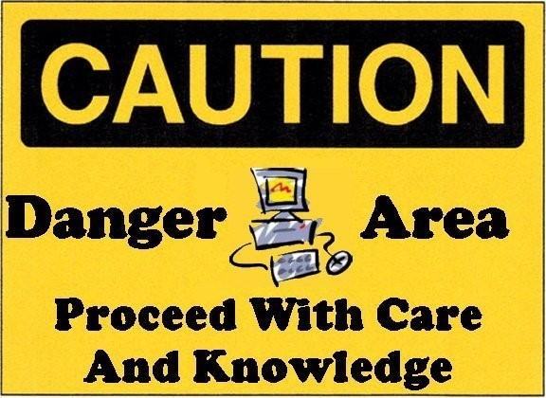
Cautionary Notes
Don’t assume documents created in corporate investigation are privileged…even w/outside counsel
Definition of client? …lawyer? … confidential?
What test? Subject matter? Control group? Other?
Which law applies? Model Rule 1.6
Withholding “privileged” documents will be closely scrutinized by court

Slide 58

Privilege:
Not just for litigation!

Slide 59


Business Combinations
M&A lawyers have nothing to worry about…RIGHT?
Antitrust due diligence & opinions
Recent example – Two US in-house lawyers caught in Dawn Raid in London

Slide 60

Government authorities have dawn raided business operations outside the U.S. and requested documents employees there can access from servers in U.S.,
including U.S. legal departments

Slide 62
I M P O R T A N T N O T E
This document, and any accompanying exhibits and/or oral presentation, provides general information as to selected issues.
IT IS NOT LEGAL ADVICE AND SHOULD NOT BE USED AS A SUBSTITUTE FOR REVIEW OF YOUR SPECIFIC SITUATION WITH LEGAL COUNSEL.
Efforts have been made to provide accurate information; however, we advise you to seek counsel and advice from a qualified lawyer regarding legal matters. Legal obligations may vary according to the facts and circumstances as well as the jurisdiction.

Slide 63

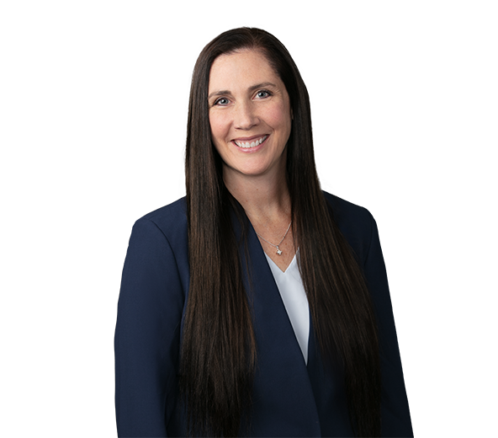
Thank You
Jordan W. Cowman
Shareholder
cowmanj@gtlaw.com
214.665.3652 (office)
214.235.2223 (mobile)
Courtney York
Shareholder
Courtney.York@gtlaw.com
214.665.3779 (office)

