Slide 1
Software License Agreements: the complete download
ACC Western Pennsylvania
8.29.2023
Presenter: Jim Singer, Fox Rothschild LLP

Slide 2

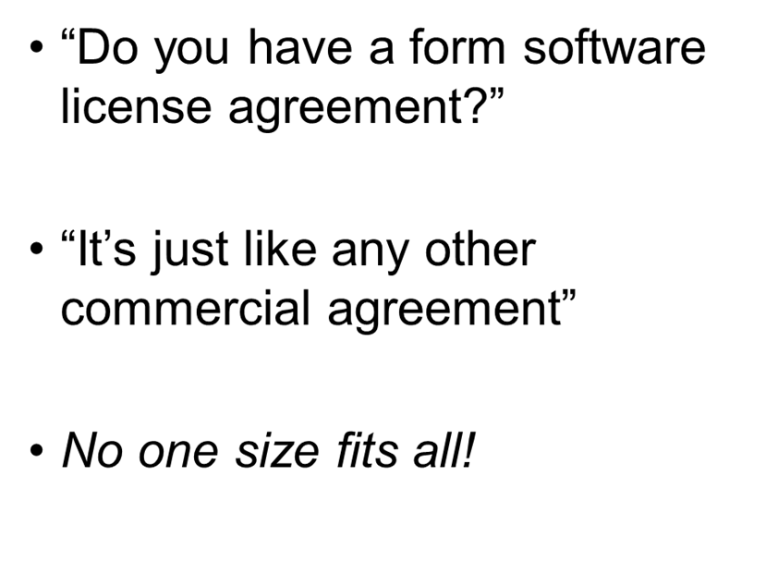
Why this discussion?

Slide 3
I/O
Types of software agreements
License vs SaaS
Service level agreements
Pricing models
Why attorneys need to review the scope of work
Open source code: when does it matter?
Data security
Licensing generative AI tools

Slide 4
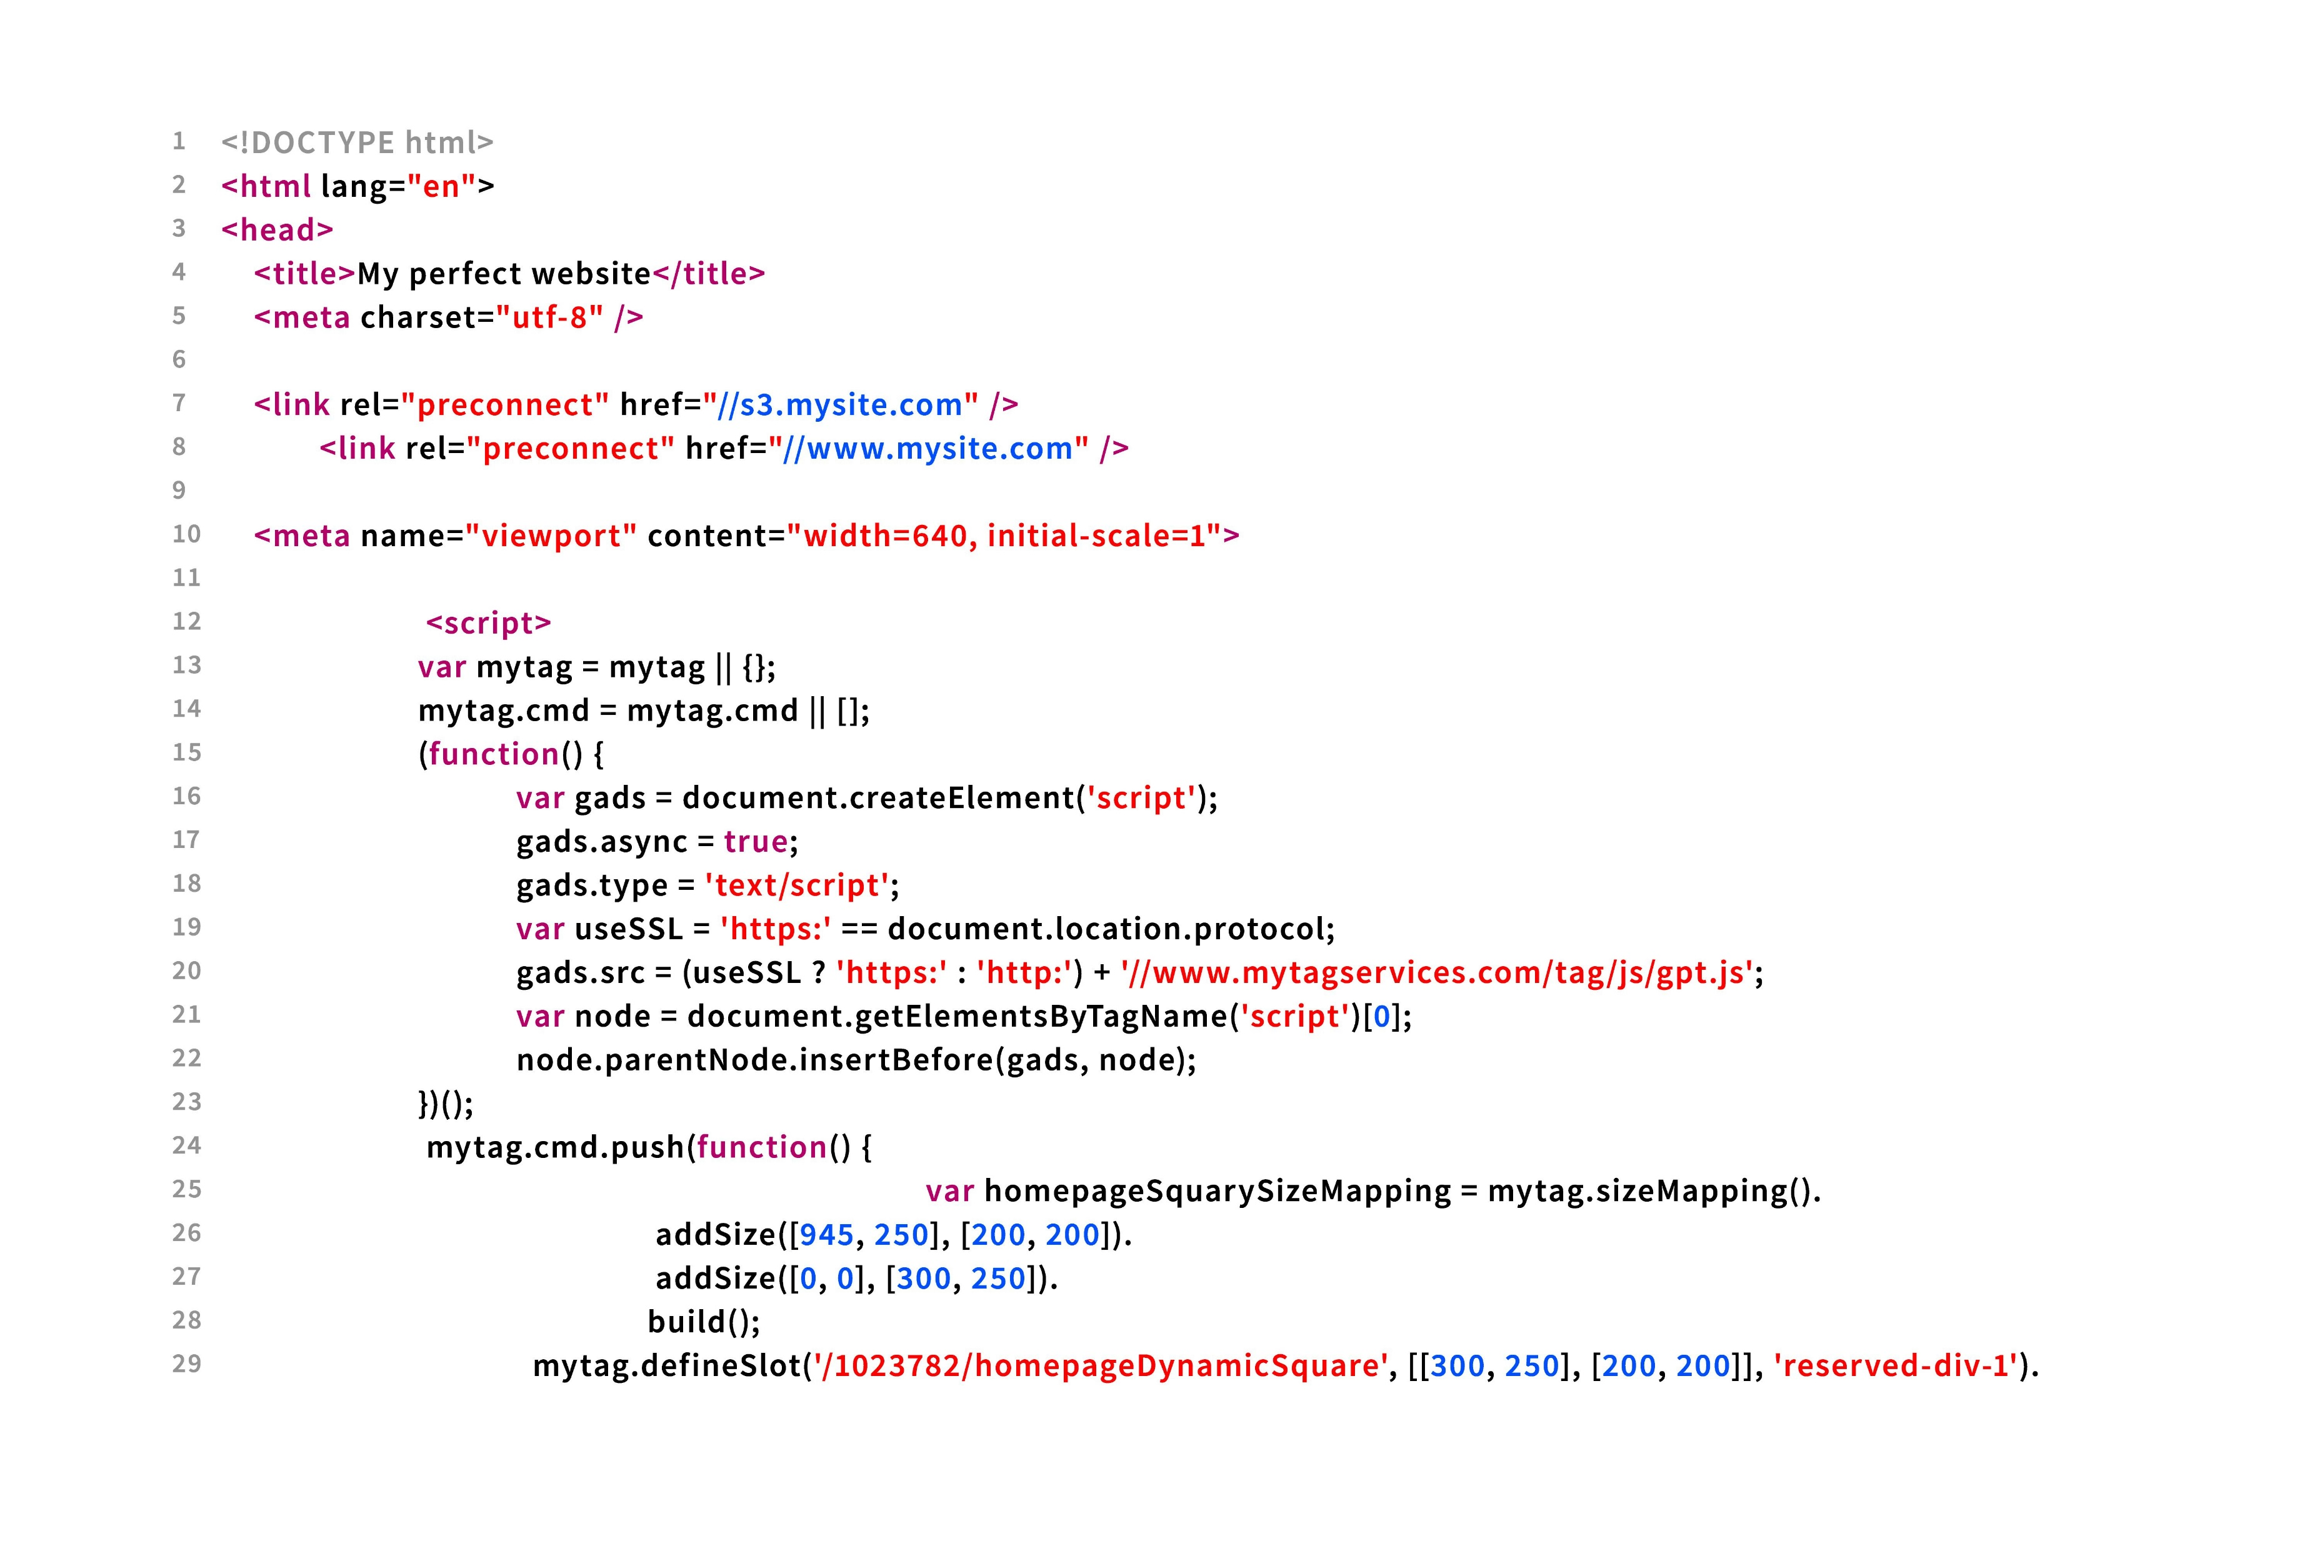
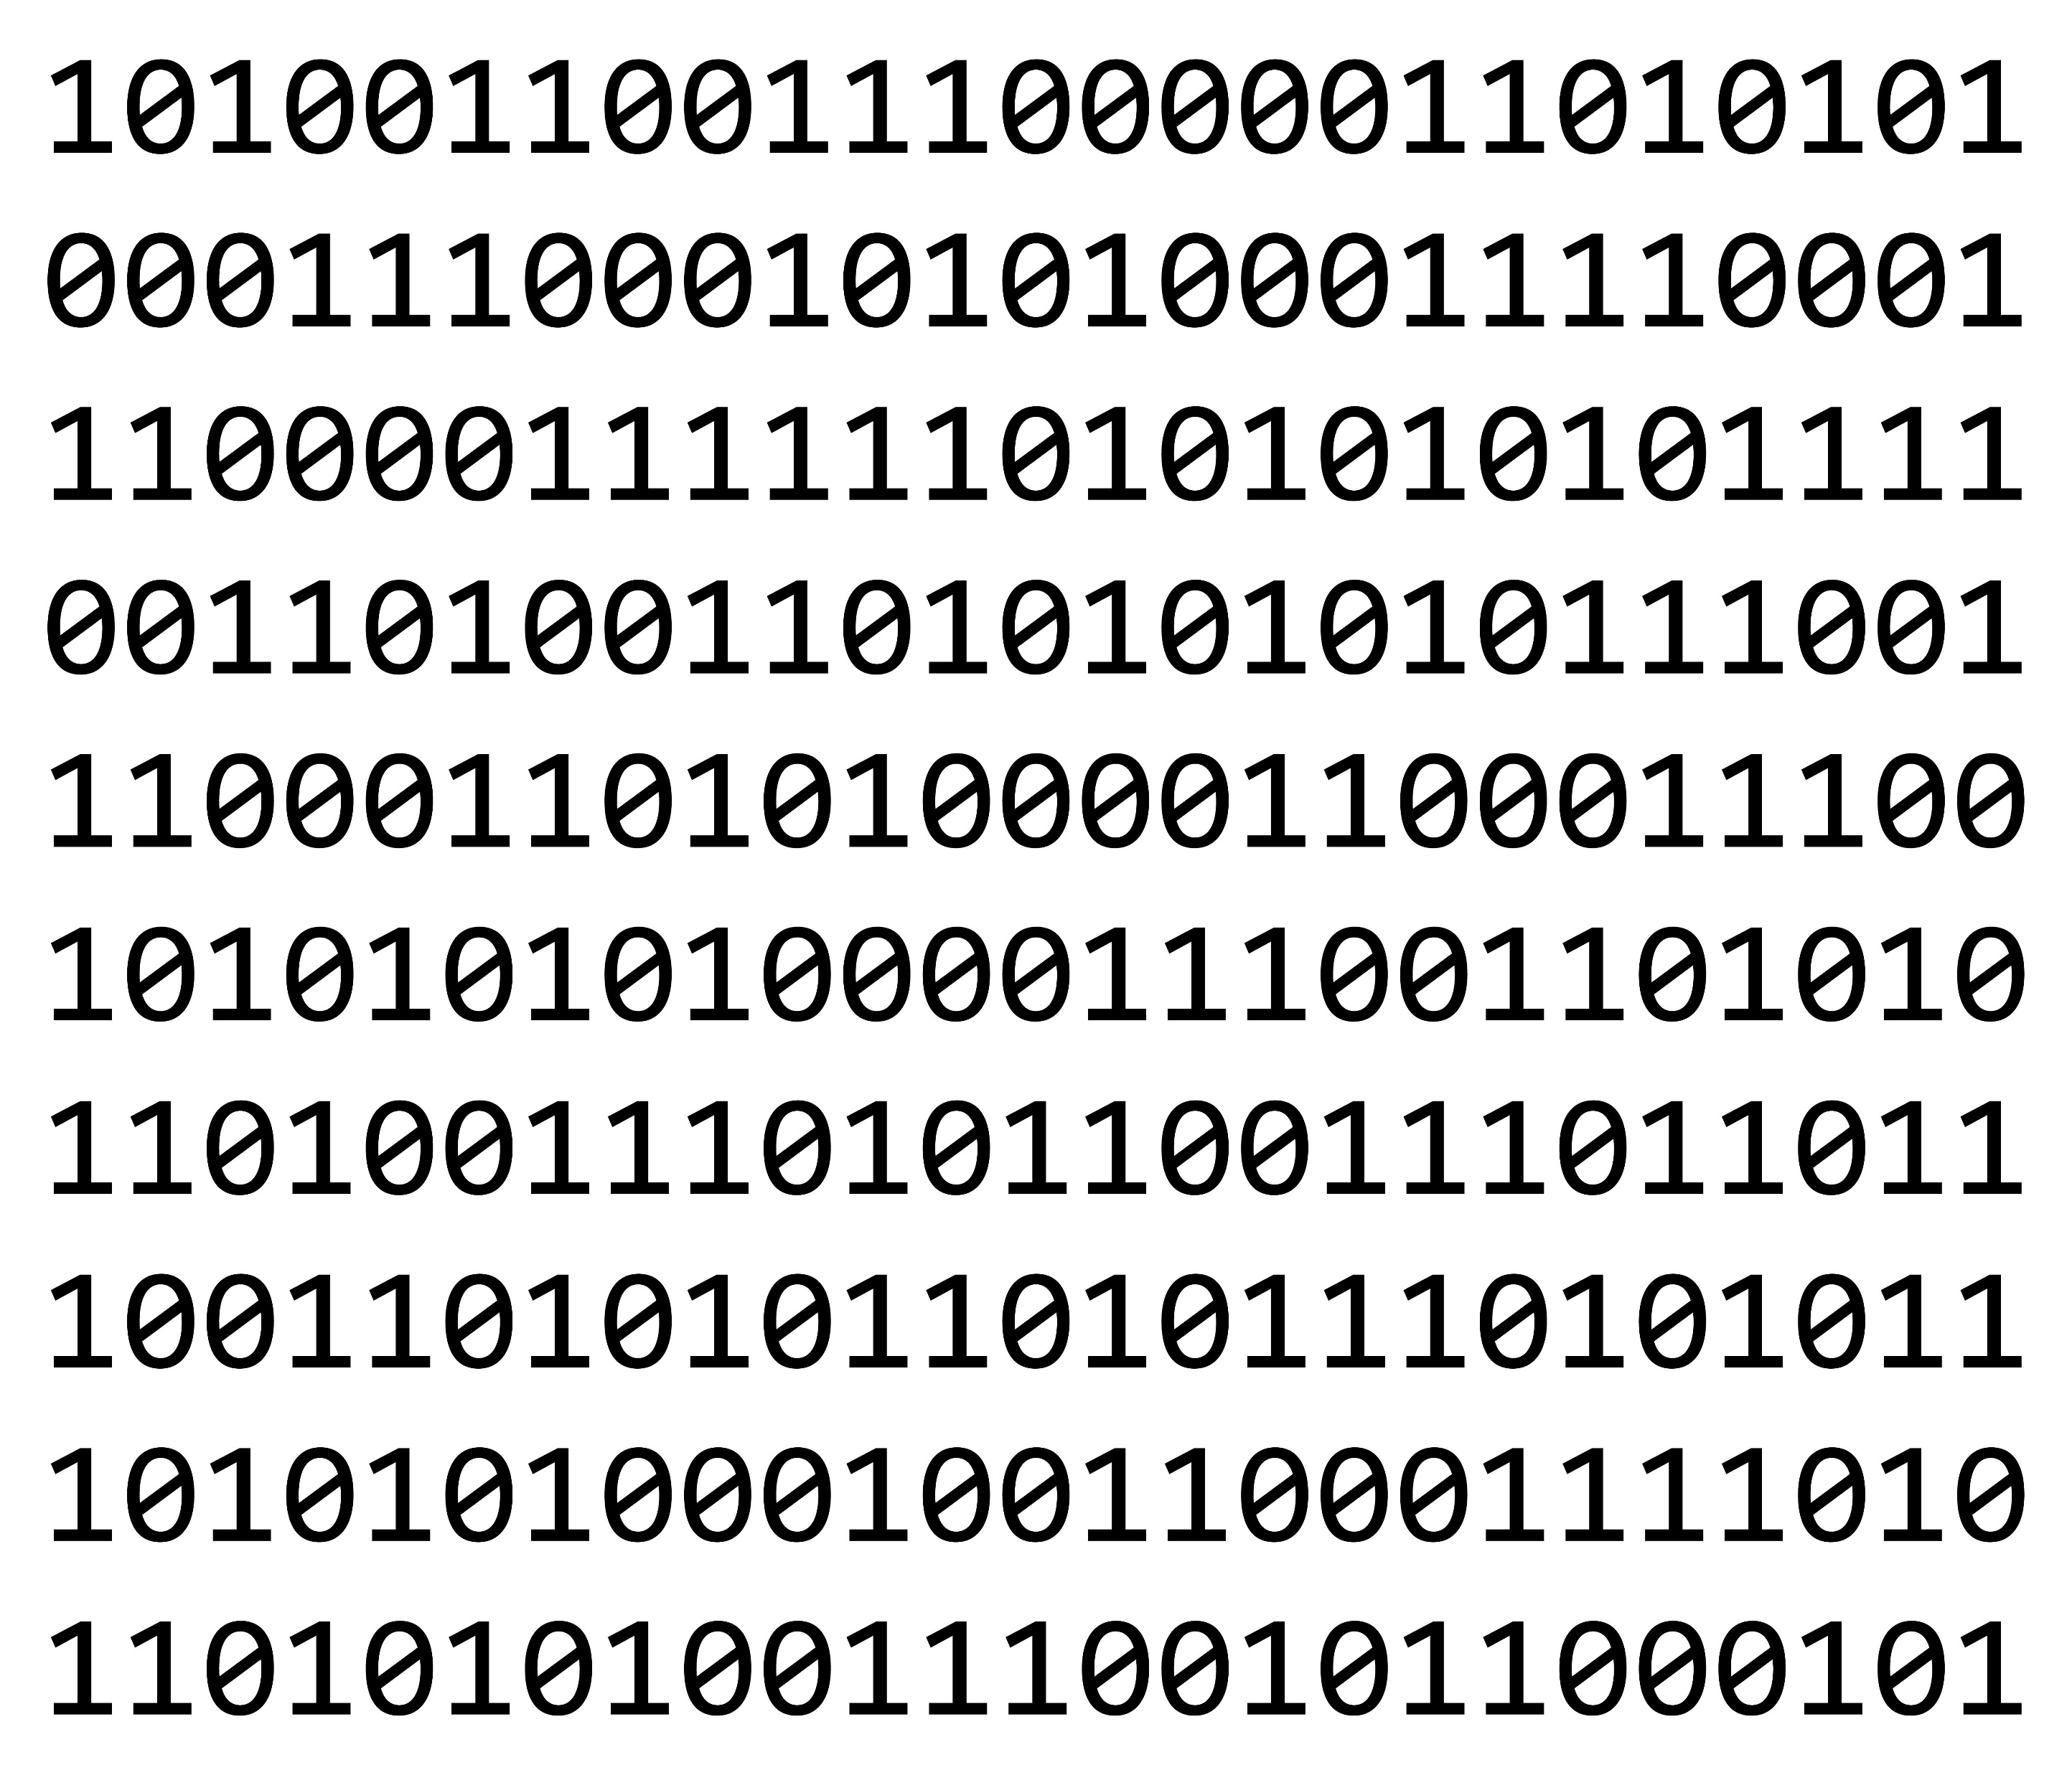
Technical terms
Source Code
Human-readable programming language
Often maintained as trade secret
Object Code
Binary code that is compiled from source code
Executable by computer processor

Slide 5
More technical terms
API = Application Programming Interface
Allows one party’s software to interface with another party’s software
Platform as a Service

Slide 6


Types of software agreements
License
License to installed copy
Software as a Service (SaaS)
License to access hosted service
Combination of the above

Slide 7

Additional services in software agreements
Custom development
Maintenance and support

Slide 8

Other software-related agreements
Data sets
Geographic data, marketing data, price data, event stats
Content licensing
Images, audio/video files, news feeds, documents
API licensing
API – application programming interface
Platform as a service
Open source

Slide 9

Anatomy of the agreement
License (installed software)
Customer = licensee
Code is installed on customer’s equipment
Term
Perpetual, or
Limited period, renewable
SaaS (hosted service)
Customer = subscriber
Customer gets no code (or minimal code)
Customer accesses service via web or app
Term
Subscription-based (monthly, annually, etc.)

Slide 10

Installed software licenses: key terms
What code does the customer get?
Source code, object code, or both?
Customization?
Optional modules and features?
May list in order form

Slide 11

Installed software licenses: more key terms
Updates = bug fixes / security updates
Should require customer to accept and install mandatory updates
Typically, free for a limited time
Upgrades = new features
Typically, not included – requires additional fee

Slide 12
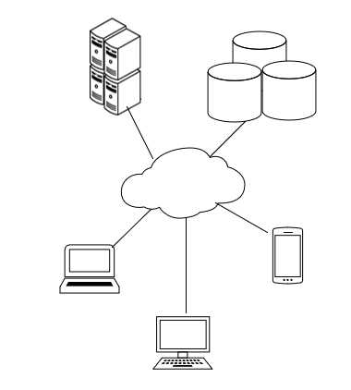
Hosted service agreements – key terms
Define the service
General description – benefits service provider
List specific functions – benefits customer
Describe it as right to access a service, not license to access / use software code
Customization?
Service Level Agreement (SLA)

Slide 13
Service Level Agreements (SLAs)
Define service categories and expected response time
Example:
Level 1 = system down, respond within 1 hour
Level 2 = some features down, respond within 4 hours
Level 3 = system functional but degraded, respond within 1 business day
Minimum required uptime (99+%)
Exclude scheduled maintenance
Consider: Does the service provider control uptime, or is it a third party such as AWS?
Consequence of failure to meet service levels / uptime

Slide 14
Common terms

Slide 15
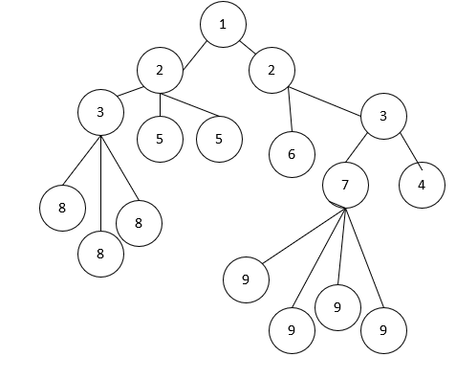
Usage rights
Who can use the software / service?
One end user
Specific # of end users (seats)
Number of devices
Enterprise-wide
Internal use only, or to provide services to others?
Consider EULAs, too

Slide 16

Restrictions on use
No assignment or sublicensing
(except as specifically permitted)
No copying / no modification / no derivative works
No reverse engineering / accessing source code
No redistribution of content

Slide 17

More restrictions on use
Security – no sharing of credentials
No unlawful use
No export
Optional:
N o competition with licensor
Additional restrictions if required by third party licensors

Slide 18

Pricing terms
Flat fee or subscription?
Enterprise, per-seat, or usage-based?
Tiered pricing?
Audit rights

Slide 19
Additional pricing terms
Custom development services
Installation and training
Service / support / maintenance fees
Updates typically included in subscription models;
Upgrades are typically not included
May include separate support / maintenance terms

Slide 20
Pause - questions

Slide 21

Confidentiality
Licensee’s obligations
Source code (if provided)
Third party data sets (if provided)
Other information accessed through the software
Provider’s obligations (maybe)
Information uploaded by licensee
Output generated for licensee
Customer’s usage data

Slide 22
Privacy policies are different!
Privacy policy
Legally required disclosure
Informs consumers what a service may do with the consumer’s personal information
NDA in license terms
Negotiated agreement
Outlines permissions and restrictions on use of certain types of information
Use may be permitted if not expressly restricted

Slide 23
Warranties / Limitations on Liability
Provider’s goals:
Software provided as is; strict limitations on liability
Customer will not violate restrictions on use
Preconditions (notice, opportunity to cure, replacement of code)
Customer’s goals:
Software will perform described functions in accordance with all documentation
Security of customer’s data and information
Compliance with laws
Non-infringement

Slide 24
Statements of Work / Exhibits
Provider–friendly:
Licensee may access the Acme Space Modulator software that Provider provides to Licensee
Licensee-friendly:
Provider will provide Licensee with full access to the Acme Space Modulator Software as described in the Proposal dated ### and the functional specification enclosed in Exhibit A

Slide 25

Things to look for in the SOW
Describe what will the software will do for the customer
Consider attaching proposal, if available
Custom development services
Pricing
Scope
Acceptance and testing
Intellectual property rights: ensure that agreement protects provider
Timelines and milestones

Slide 26

Things to avoid in the SOW
If representing provider:
Open-ended commitments
Unrealistic timelines
Obligations to do extra work without extra payment
If representing customer:
Vague descriptions of deliverables
No acceptance or testing
If representing either party:
Conflicts with the legal terms
Scaling back or expanding warranties

Slide 27
Pause - questions

Slide 28

Open-Source Code
What is it?
Free of charge
Still subject to license terms and conditions
When is it important?
If agreement includes custom development
If licensee will incorporate software into other software
Risks of “viral” open-source code

Slide 29

Source code escrow
Third party holds code for benefit of customer
Conditions of release
Breach, bankruptcy, failure to support
Must specify what customer can and cannot do with the code upon release
Consider:
Who pays for escrow service?
Required to update code in escrow?
Don’t rely on the escrow service’s terms of release and license terms!

Slide 30
Data security
PROVIDER WANTS
Provider may use Customer Data and data about Customer’s use of the Provider System to improve its product and service offerings.
Provider may use or disclose Customer’s usage data in aggregate form (without identifying Customer) for any purpose.
Provider may disclose Customer Data to a successor to its business that includes the Provider System or systems that are derived or that replace the Provider System.
CUSTOMER WANTS
Provider may use Customer Data solely for the purpose of providing the services to Customer under this Agreement.

Slide 31
Data security
PROVIDER WANTS
x
CUSTOMER WANTS
All Customer Data shall be stored on servers located within the United States. No Customer Data shall be exported outside of the United States.
Provider shall at all times maintain a written information security policy containing protections that are consistent with industry standards. Provider shall comply with the policy and provide Customer a copy of the policy upon request.
HIPAA or financial data – additional requirements

Slide 32
Data security
PROVIDER WANTS
Provider may, but is not obligated to, retain Customer Data after termination of this Agreement.
CUSTOMER WANTS
Provider will return all Customer Data to Customer in downloadable format upon request of Customer at any time, and also within five days of termination of this Agreement.

Slide 33

Making the license enforceable
Signed agreement
Click-through
Must allow user to access and download a copy

Slide 34






Generative AI tools

Slide 35
Considerations when using generative AI
Incorrect output
Bias of output
No copyright in AI-generated content
Not secure – be careful with information provided
Risk of IP infringement
Is output derivative of the training material?
Open-source code risks
(If used to generate software code)

Slide 36

Jim Singer
Partner – Intellectual Property
Co-Chair, Technology Practice
412.391.2486
jsinger@foxrothschild.com

