Slide 1
Mindful Negotiations: Getting the Most Out of Mediations
.
Presented by: Maria Greco Danaher
and John F. Greco
August 29, 2023

Slide 2
OBJECTIVES OF THIS SESSION
Addressing conflict ethically
Building toward collaboration
Communicating mindfully and effectively

Slide 3
PARAMETERS FOR THIS SESSION
CIVILITY – being respectful
CANDOR – addressing all issues honestly
NON-JUDGMENT – keeping an open mind
FORWARD THINKING – what matters?
(Jathan Janove)

Slide 4
WHEN WE THINK OF NEGOTIATION . . .
Persistent Pushing interests
Diligent Winning
Assertive Powerful

Slide 5
BUT WHAT IF WE USE THESE?
Wisdom Curiosity
Thoughtfulness Patience
Empathy
Willingness to Listen

Slide 6
HOW DO WE GET THERE?
Increasing our self-awareness
Willingness to adapting to change
Managing our own emotions
Becoming more ethically mindful

Slide 7
Ethical Duties During Negotiations
Client Lawyer Other Party
Legal Profession

Slide 8
Duties to the Client
Rule 1.2: Scope of Representation
(a) A lawyer shall abide by a client’s decisions concerning the objectives of the representation . . . and shall consult with the client as to the means by which they are to be pursued. . . .

Slide 9
Duties to the Client
Rule 1.2: Scope of Representation (cont’d)
A lawyer may take such action on behalf of the client as is impliedly authorized to carry out the representation. . . .
A lawyer shall abide by a client’s decision whether to accept an offer of settlement.

Slide 10
Duties to the Other Party
MR 3.4(a) Fairness to Opposing Party and Counsel:
A lawyer shall not unlawfully obstruct another party’s access to evidence or destroy or conceal a document or other material having potential evidentiary value. . . . [and]
A lawyer shall not counsel or assist another person to do any such act.

Slide 11
Duty to the Profession
Preamble to the Model Rules:
“As negotiator, a lawyer seeks a result advantageous to the client, but consistent with requirements of honest dealing with others.”

Slide 12
Duty to the Profession
MR 4.1 Truthfulness in Statements to Others
In the course of representing a client a lawyer shall not knowingly . . . (a) make a false statement of material fact or law to a third person . . . .

Slide 13
Duty to the Profession
M.R 4.1, Comment #1:
A misrepresentation can occur if the lawyer incorporates or affirms a statement of another person that the lawyer knows is false.
Misrepresentations also can occur by partially true but misleading statements or omissions that are the equivalent of affirmative false statements

Slide 14
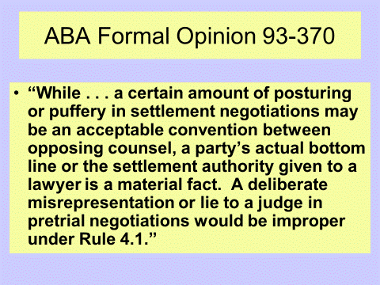

Slide 15
“A leader leads by example, not by force”
― Sun Tzu, The Art of War

Slide 16
Three Approaches
Cost ($) | Risk | Compromise
COLLABORATION
The action of working with someone to produce of create something
CONSENSUS
A general agreement
COMPETITION
Strive to gain or win something by defeating of establishing superiority over others who are trying to do the same

Slide 17
Additional Points
Individuals move fluidly among these three states (collaboration, consensus, competition)
The longer the team/group can stay in a collaborative state, the better the outcome
There is mutual gain and little loss when collaboration is reached

Slide 18
Pixar
Plussing
Criticize only if you can add to the idea, never take away only
”yes and ...” vs. “yes but …”
Make your partner look good
Separate the people from the problem

Slide 19
Pixar (cont’d)
Brain Trust
Do not become attached to your ideas – you are not your ideas
Do not judge the value of your own contribution by whether your ideas are adopted
Put all your attention on the problem. Keep your focus on whether the idea thread is advancing or stagnating.
Withhold quick judgement
As you wait to find a break in the banter in which to speak up and make your points, don’t stop listening to what is happening

Slide 20
Conclusion
EGO is a person’s sense of self-esteem or self-importance
EGO is the enemy of collaboration
Less EGO leads to increased possibility of a mutually acceptable result
Mindfulness decreases EGO

Slide 21
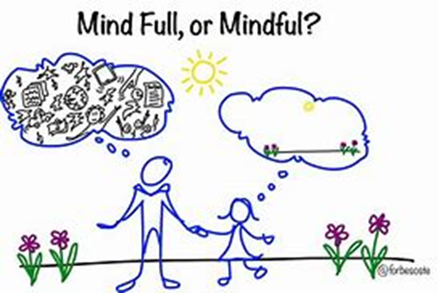
WHAT IS MINDFULNESS?
Purposely
Being aware of the present moment
With conscious attention
Without judgment

Slide 22
Effectively Listening to the Response
Work to understand the issues
Use silence as a tool
Ask questions to clarify and assist
Encourage factual (as opposed to emotional) negotiation

Slide 23
Mindfulness in Mediation
Maintain civility at all times
Pay attention to your word choice/tone
Acknowledge emotions in the room
Work toward collaboration

Slide 24
24

