Slide 2
Common Zoning Pitfalls in Real Estate Transactions
Kevin T. Wills
Alyssa E. Golfieri
Association of Corporate Counsel
August 29, 2023

Slide 3
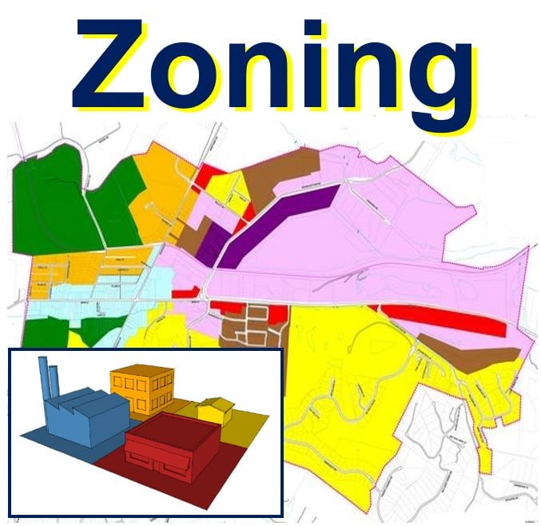
What is Zoning?
Established framework for use and development of land, typically regulated by the states, but dictated and enacted by local governments, based on the idea of separating incompatible uses by including them in different zoning districts.
Notes:
In Pennsylvania, the governing law is the Pennsylvania Municipalities Planning Code (53 P.S. 10101 et seq.)

Slide 4
Why Does Zoning Matter?
Costly “fixes” to abate violations or obtain missing permits and approvals.
Revocation of an occupancy permit, which results in a shut down of operations and use.
Costly litigation that has the potential of shutting down operations and use until resolution.
Notes:
The potential impacts and threats to a property’s use and operations are significant when zoning is ignored or isn’t properly evaluated and addressed.
Your lender likely cares – A LOT.
If you know the universe of issues, you can proactively address and develop a plan with Seller for addressing them.

Slide 5
What You Need to Ask
Zoning Harmony
Zoning District?
Use Permitted?
Bulk / Area Regulations?
Permits / approvals?
Legal Nonconformity?
Rebuild Rights?
Notes:
What zoning district is the property located?
Is the use currently permitted in the zoning district?
If so, what are the applicable bulk and area regulations and does the property or proposed development fit within the confines of the same?
If not, was it permitted and properly approved at its inception?
What is my threshold for rebuild?

Slide 6
Types of Zoning Approvals
Permitted by Right
Conditional Use
Special Exception
Variance
Notes:
In Pennsylvania….permitted by right, conditional use, special exception, variance
Other states generally take the same approach, but naming conventions may differ – for example, permitted by special permit

Slide 7
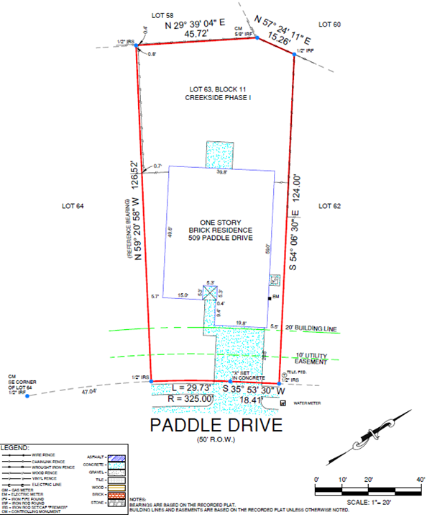
Bulk and Area Regulations
Setbacks
Lot Area
Lot Density
Parking
Landscape Buffers
Notes:
Best way to confirm is via an accurate survey.
Online tools –google aerial, GIS

Slide 8
Legal Nonconformities
A legal nonconforming use is a use that predates a prohibitory zoning regulation; it constitutes a vested, constitutional property right that may be continued unless the use is abandoned or extinguished.
Notes:
The law in in most states, including Pennsylvania, regulating legal nonconforming uses is well settled.
What it is and how it is protected:
A legal nonconforming use is a use that predates a prohibitory zoning regulation; it constitutes a vested, constitutional property right that may be continued unless the use is abandoned or extinguished by eminent domain or casualty (under certain circumstances).
EXAMPLE: an existing legal auto body shop does not have to move upon the adoption of a zoning ordinance that prohibits the shop in its present location. Rather, the shop can continue to operate as a nonconforming use.
Constitutionally protected right to expand. This right of natural expansion is not, however, unlimited.
Distinction between legal nonconforming and nonconforming
Burden of proving – on the property owner!
The burden of proving the existence of a nonconforming use falls upon the property owner. In order to establish a nonconforming use, a property owner must present objective evidence that the subject property was devoted to such use at the time the prohibitory zoning regulation was enacted.
How to prove a legal nonconformity
Permits and approvals, including approved site plans

Slide 9
Private Rights, Covenants, Conditions & Restrictions
What?
Where?
Same as Zoning?
How to Address
Notes:
What are Covenants, Conditions and Restrictions?
Where are they found?
Interplay between private land rights and zoning regulations
How to address?
Estoppels
Tile Policy Endorsement

Slide 10
Notes:
5 ways to protect yourself:
Don’t sign or commit to anything without first confirming ZONING!
Be proactive with your Purchase Agreement
Due Diligence – give zoning the attention it deserves
Understand the Universe of Inspections
Know your right to rebuild in the event of a casualty
Have a game plan for missing CofOs

Slide 11
Confirm Zoning FIRST!
DON’T
Sign an LOI
Spend time and money negotiating a PSA
Execute a lease
Expend money on an architect /engineer
Buy inventory or equipment
Take on the expense of moving
UNTIL
You confirm your use and development is permitted on the subject property.
Notes:
Most municipal ordinances are available online.

Slide 12
Be Proactive in Your Purchase Agreement
Representations and Warranties
Covenants
Conditions to Closing
Objection Process
Inspection Period/ Due Diligence
Notes:
PSAs don’t typically address zoning in much detail - - even longform template PSAs don’t address zoning in much detail.
Reasons:
Many Buyers don’t understand potential impact
Many Sellers don’t want to address it directly
Often treated as a due diligence item

Slide 13
Make the Most of Due Diligence
Include zoning records as part of seller’s required DD disclosures:
Previous zoning reports & verifications
Surveys
Permits
Approvals
Certificates of occupancy
Notices of violation & warning letters
Hire a third-party zoning consultant or land use attorney to prepare an independent zoning report
Utilize the state’s record disclosure law
Review online information
County or municipal assessment information
GIS
Zoning regulations
Analyze the records
Call the municipality
Notes:
PSA provision specifically articulating due diligence items requested related to zoning (e.g., previous zoning reports, surveys, permits and approvals)
Add a third-party zoning consultant or land use attorney to your DD team
Utilize the state’s RTKL
It is an easy, inexpensive process that can yield significant results.
Submit your requests immediately after executing your PSA because municipalities have a generous range of time for response. In PA, it’s 5 BD plus 30 calendar days.
Analyze the Records
Understand what permits and approvals exist for the property and use; analyze any conditions applicable, as approvals and permits will oftentimes contain ongoing conditions or obligations separate and apart from the Zoning Ordinance that as the property owner you must satisfy. Failure to comply can give rise to a violation and puts your certificate of occupancy (operation of the property) at risk.
Records to request and review:
conditional use approvals
special exception approvals
variances
special permits
land development/site plan approval
certificates of occupancy / compliance
business licenses
Call the municipality
Only after PSA executed and in Inspection Period.

Slide 14
Understand What Inspections Are Required / Triggered
Obtaining a Business License
Obtaining a missing Certificate of Occupancy
Transferring a Certificate of Occupancy
Conditions to previous zoning approvals
Mere changes in ownership
Notes:
In addition to your DD inspection, be cognizant of your municipality’s required inspections.
Some municipalities tie inspection requirements to business license registrations or renewals, some tie it to the transfer of a certificate of occupancy, some impose it as a condition to approval, and other stricter municipalities require it upon a mere change in ownership.
PSA provisions (including options for amendment)
Seller handles inspection and pays for all fixes
Seller handles inspection and pays for all fixes up to a certain amount, with buyer having the option to terminate if fix exceeds agreed upon amount and Seller elects not to fix
Escrow by Seller with Buyer fix post-closing

Slide 15
Understand Your Casualty Rebuild Rights
Notes:
Understand going in what, if any, legal nonconformities exist at the property.
Understand the applicable casualty provision
What is the threshold of destruction permitted before losing nonconforming status?
If the use is no longer permitted in the zoning district, or a legal nonconformity exists, continued use of the same post casualty is usually not guaranteed after 50% destruction.
Down Zoning

Slide 16
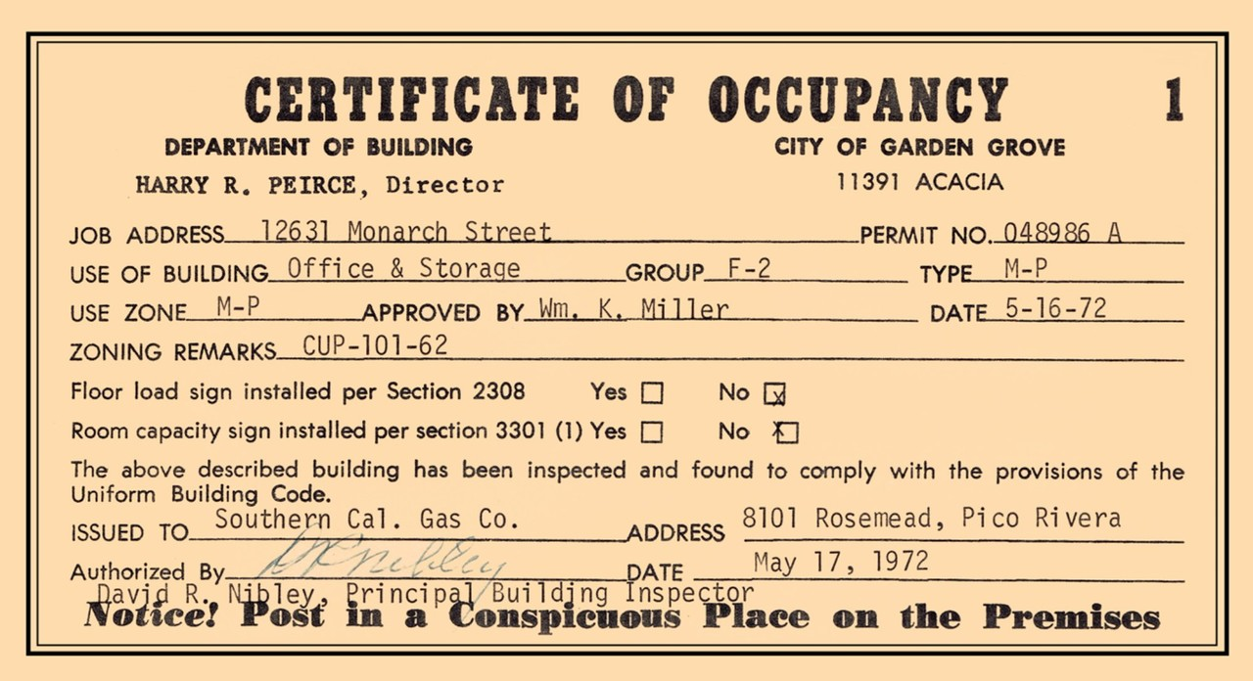
Plan for Missing Certificates of Occupancy
Notes:
There are several reasons a CofO could be unavailable:
Seller or its predecessor never obtained one
Seller and municipality are terrible records keepers
Municipality purges records after so many years
PSA provisions
Be prepared with a “no violation” statement – many lenders will require it.
Ask for retroactive compliance (future sale of property).

Slide 17
Thank You!

