Slide 1
Everything Lawyers Need to Know About AI (But Are Afraid to Ask ChatGPT)
Erica G. Wilson
Associate and Vice Chair, Artificial Intelligence Team
ewilson@fisherphillips.com

Slide 2
Agenda
What is artificial intelligence (AI)?
How is AI being used?
What are the risks associated with AI?
How is AI currently and expected to be regulated?
Q&A

Slide 3
What Is Artificial Intelligence?
Computers/algorithms mimicking human cognition by:
Making predictions
Making recommendations
Making decisions

Slide 4
Some AI Variations/Terminology
Data Analytics (descriptive, diagnostic, predictive, prescriptive)
Machine Learning (supervised, unsupervised, reinforcement)
Rule-based or expert systems
Generative AI

Slide 5
ChatGPT
Generative (generates text)
Pre-training (pre-trained on vast data set)
Transformer (architecture used to understand relationship between words)
What can it do?
• “write a cover letter for a junior social media marketing position”
• “outline a presentation to HR about PA medical marijuana laws”
• “explain how generative AI could be used by a legal assistant”

Slide 6
Generative AI: Text, Images, Sound…
ChatGPT prompt: Describe a visual representation of artificial intelligence that you would describe as cautiously optimistic and forward thinking

Slide 7
How Is AI Used?
You have been using AI-driven products for years:
Social media algorithms
Virtual personal assistants
Spam filters
Navigation/traffic prediction
Voice recognition
Predictive text
Search engines

Slide 8
AI at Work
Customer service chatbots
Supply chain optimization
Tailored marketing campaigns
Fraud detection
Data analytics for [insert literally anything here]

Slide 9
AI in HR
LinkedIn scrapers
Chat bot recruiters
Resume screeners
Candidate selection
Video interview reviewers

Slide 10
Examples of HR Data
Recruiting
Compensation
Demographics
Health data
Performance evaluations
Financial data
CRM data
Employee surveys
Job descriptions/ requirements
Unstructured data
Social media
Training/ Learning
Travel
Expenses
Production/ sales data
Absences
Mentoring programs
Exit interviews

Slide 11
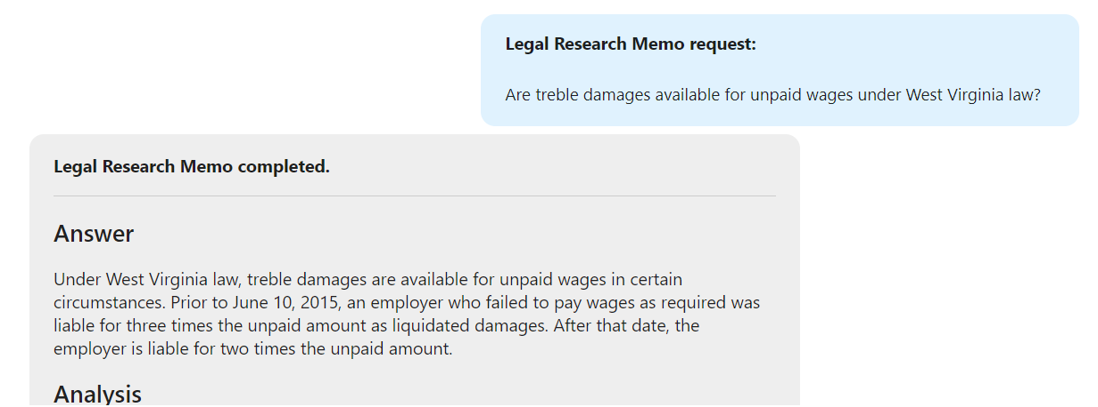
GenAI in Legal: CoCounsel by Casetext

Slide 13
What Are the Risks?

Slide 14
What Are the Risks?
Lack of understanding how the product works…or doesn’t:

Slide 15
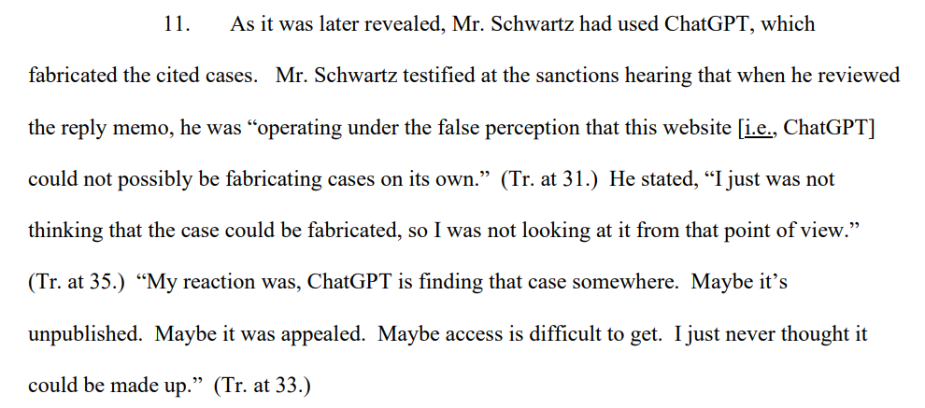

Slide 16
What Are the Risks?
Garbage In, Garbage Out
Inaccuracies/hallucinations
Deep fakes (trying to trick you)
“AI assisted” flaws (could trick you)
Bias (discrimination by algorithm)

Slide 17
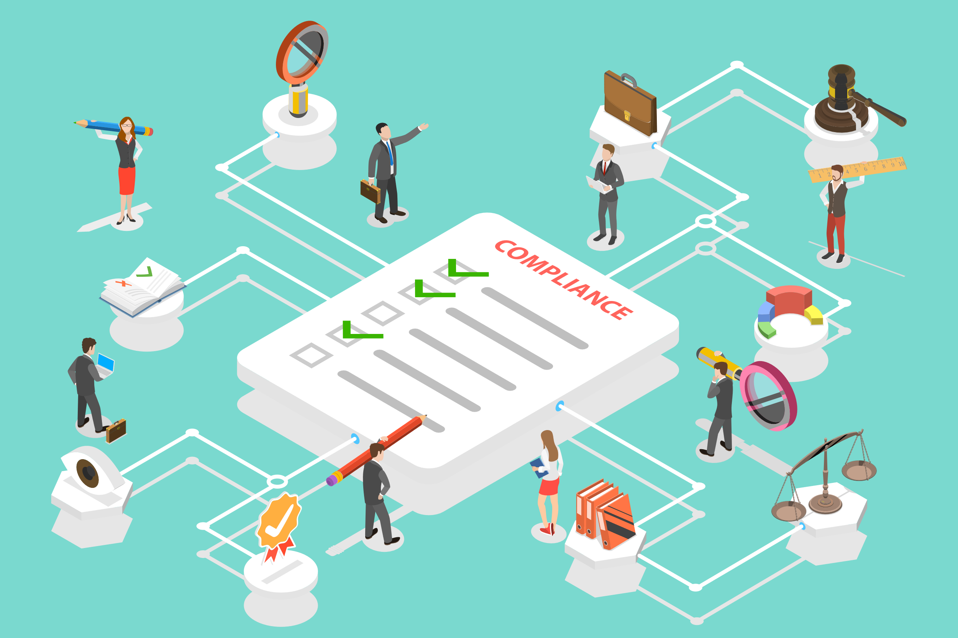
What Are the Risks?
Data privacy and security issues:
Vendor vetting
Need for disclosures or consent
Wiretapping claims

Slide 18
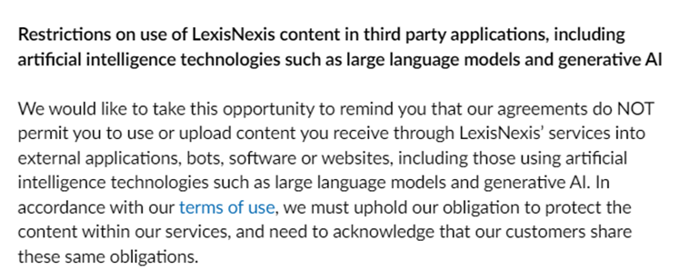
What Are the Risks?
Copyright infringement:
your company’s information, or someone else’s…

Slide 19
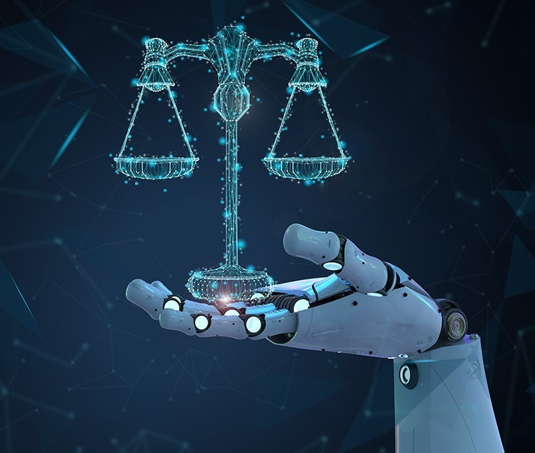
Legislative and Regulatory Outlook
State/local laws
Federal regulatory guidance
What’s coming

Slide 20
Illinois Artificial Intelligence Video Interview Act
Before asking for video interviews from applicants, must
Notify applicant that AI may be used to analyze their facial expressions
Explain how the AI works and what general characteristics it uses to evaluate applicants
Obtain applicant’s consent
Limitations on sharing videos
Destruction and reporting requirements

Slide 21
Colorado
Prohibits insurers from using any external consumer data, or algorithms or predictive models that use external consumer data, in a way that unfairly discriminates based on race, color, national or ethnic origin, religion, sex, sexual orientation, disability, gender identity or gender expression

Slide 22
New York City’s AEDT law
Applies to use of “automated employment decision tools” in hiring/promotions
Requires third-party bias audit to be conducted no more than one year before the AEDT is used
Requires publication of bias audit results and other disclosures

Slide 23
What is an AEDT?
Elements:
Computational process derived from machine learning, statistical modeling, data analytics, or artificial intelligence
Issues a simplified output – e.g., score, classification, or recommendation
Substantially assist or replace discretionary decision-making for employment decisions.
Area of Use: Limited to hiring and promotion process. E.g., determine which applicants are selected for an interview not just the applicants that are ultimately hired.

Slide 24
AI and Disparate/Adverse Impact
Refresher: facially neutral policy that has a disparate impact on a protected class
Evidence is on statistics, not motive
Some vendors promise “bias-free” assessments—but can they prove it?
Proxy discrimination

Slide 25
EEOC Guidance: ADA and AI
Does the algorithm (intentionally or unintentionally) screen out individuals with a disability even if they could perform the job with a reasonable accommodation?
Is the applicant provided a reasonable accommodation that will allow them to be rated fairly and accurately by the algorithm?
Does the software make pre-offer disability-related inquiries or ask for information that could qualify as a medical examination?

Slide 26
EEOC Guidance: Title VII and AI
Does the algorithm (intentionally or unintentionally) disproportionately screen out individuals based on their race, color, religion, sex, or national origin?
If it does, is the selection rationale job-related and consistent with business necessity?
Is a less discriminatory alternative available?
Employers are responsible for the use of algorithmic decision-making tools, even if they are designed by a software vendor.

Slide 27
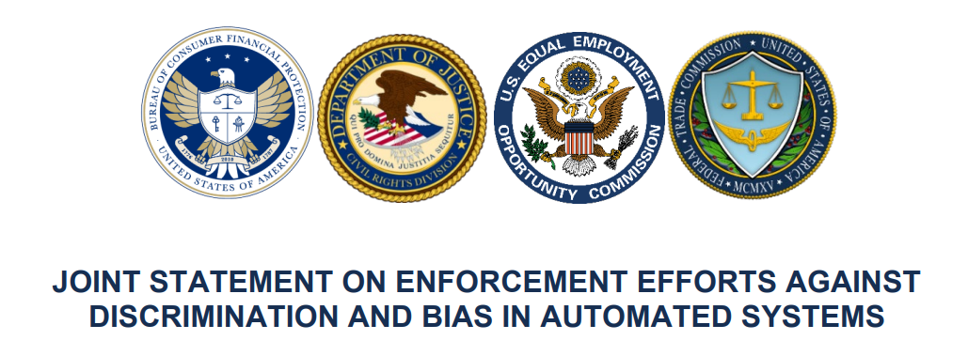
Other Agencies

Slide 28
Other Agencies
Expressed concerns regarding:
Data and datasets: unrepresentative/imbalanced data, incorporation of historical bias, discrimination by proxy
Model opacity/access: black box nature of data models/lack of transparency (sometimes even to the developer)
Design and use: design based on flawed presumptions or misunderstanding about how product will be used

Slide 29
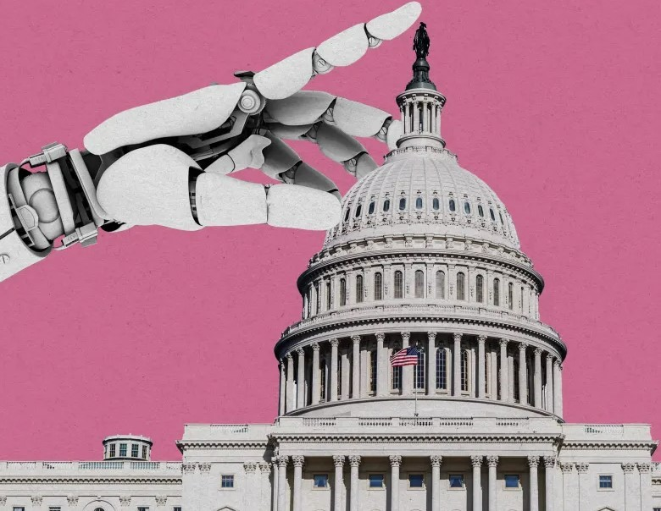
The White House’s AI Bill of Rights
People should:
Not face discrimination by algorithms;
Be safe from abusive data practices;
Be aware when an automated system is in use and how it impacts them;
Be able to opt out of systems where appropriate; and
Be protected from unsafe/ineffective systems.

Slide 30
Takeaways
The [robot] cat is out of the bag
Lawyers need to understand how AI products work to spot risks
Free AI tools are imperfect, but cool; employees will experiment at work
Laws on the books apply, and more are coming

Slide 31
Questions?
Erica G. Wilson
Associate and Vice Chair, Artificial Intelligence Team
ewilson@fisherphillips.com

