Slide 1


Emerging
Environmental Issues in Business Transactions

Slide 2

Funding

Slide 3


Environmental
Social &
Corporate
Governance

Slide 4

Environmental Justice

Slide 5
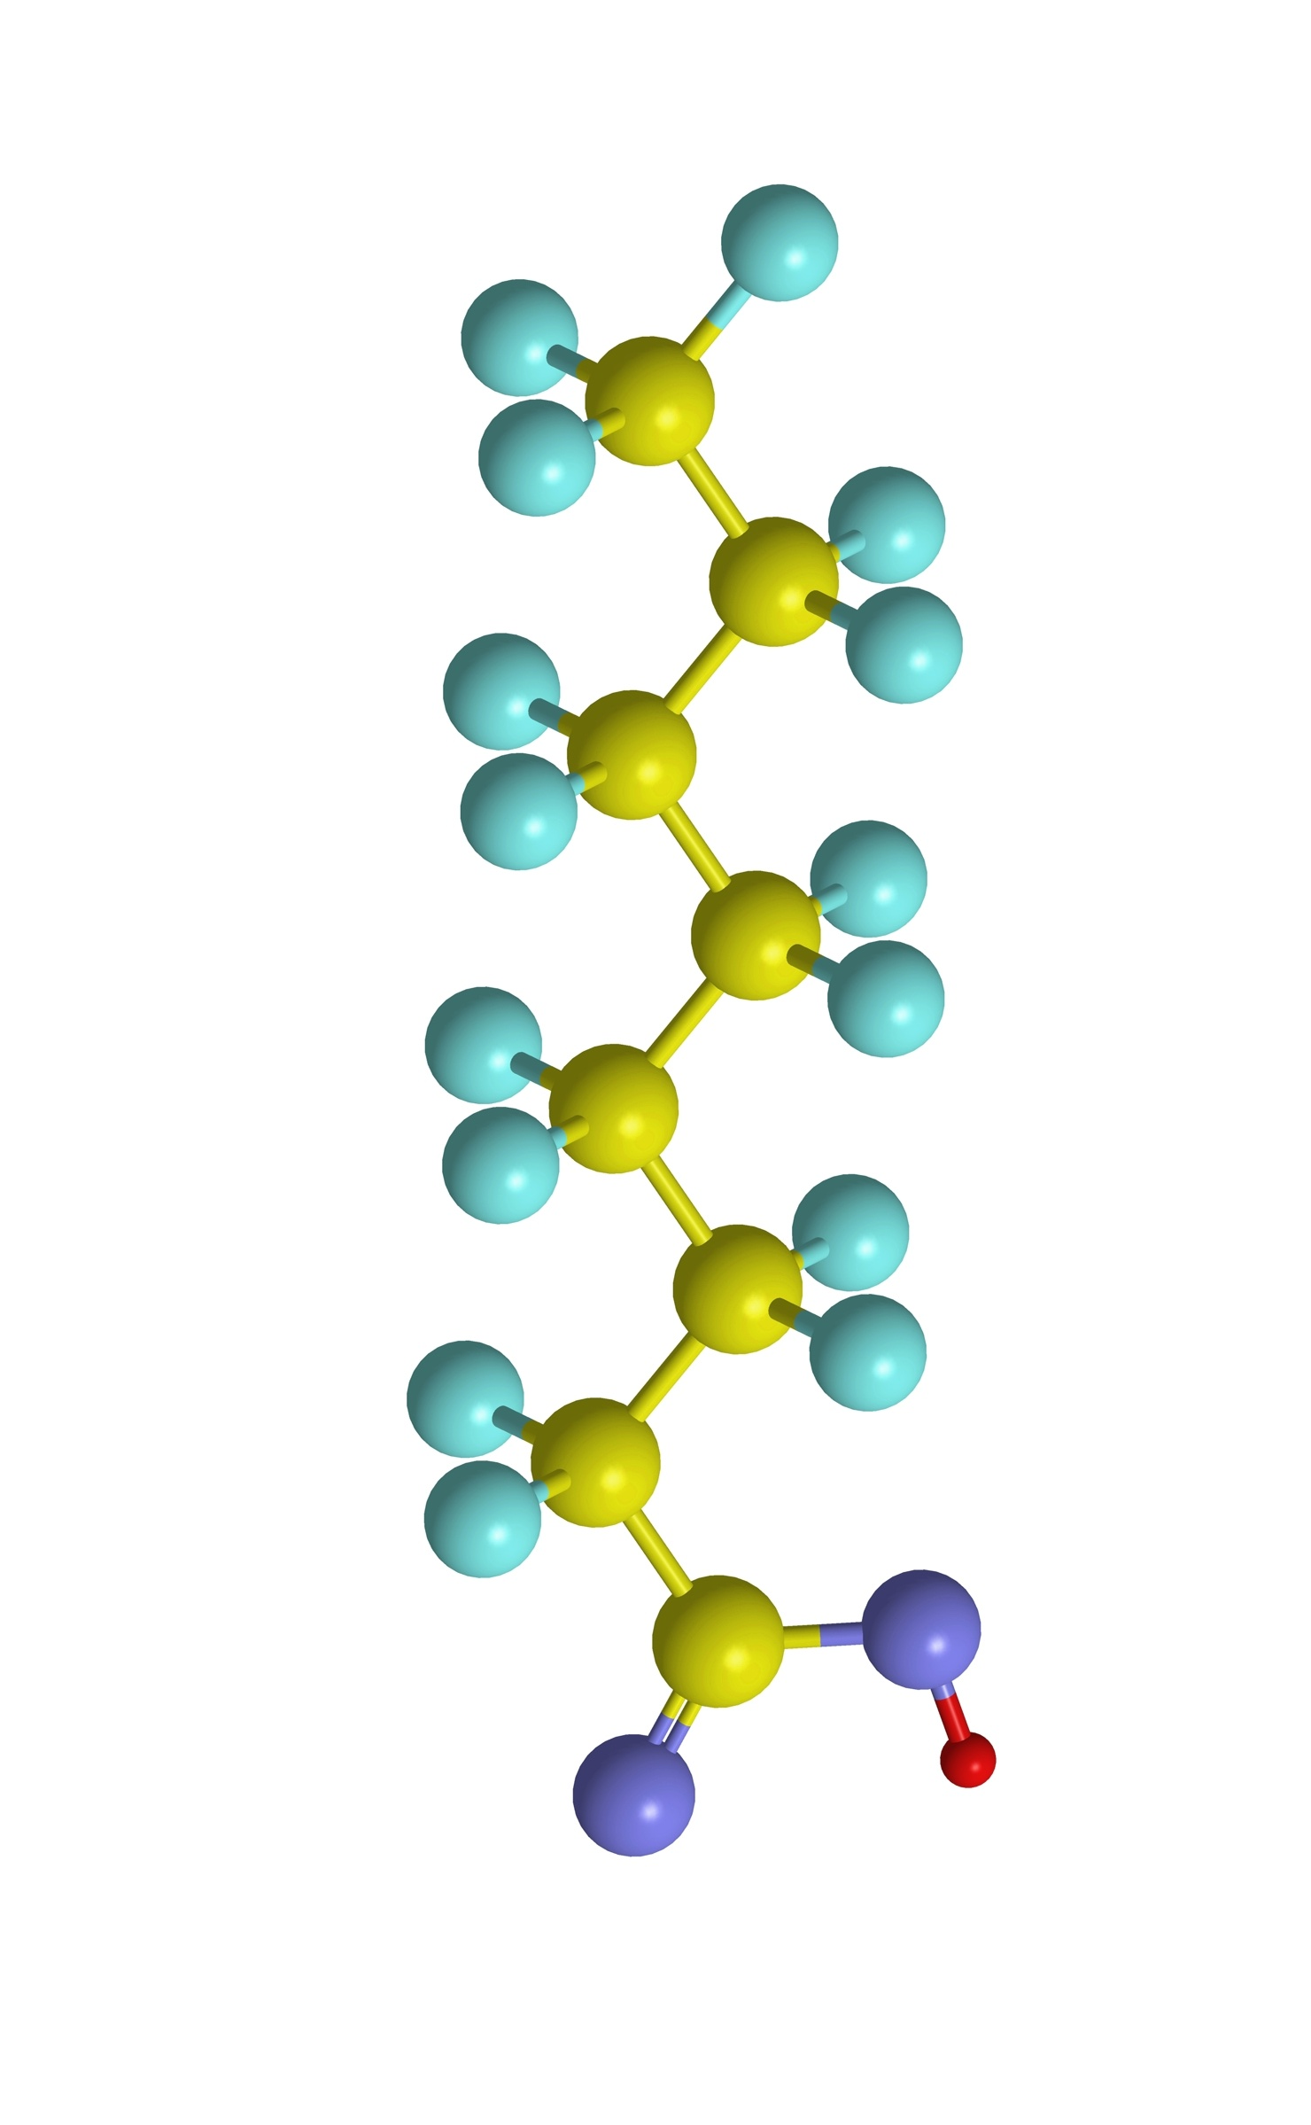
Emerging
Contaminants

Slide 6

ASTM
Due Diligence Standard

Slide 7
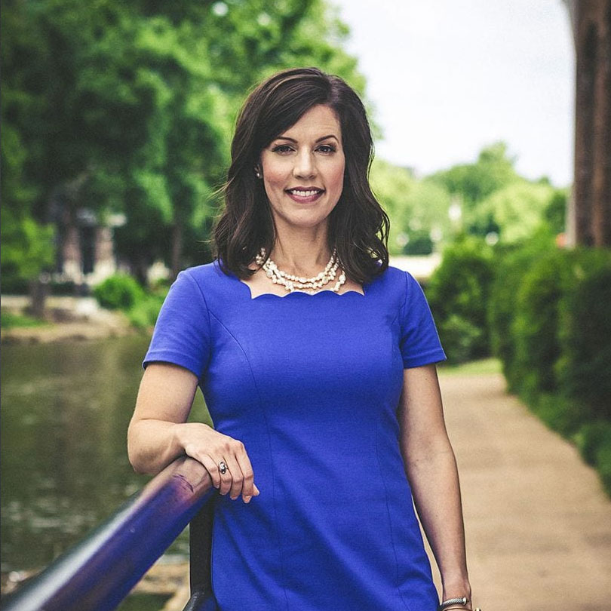


RITA BOLT BARKER
member Wyche, P.A
rbarker@wyche.com
864-242-8253
/ritaboltbarker

Slide 8
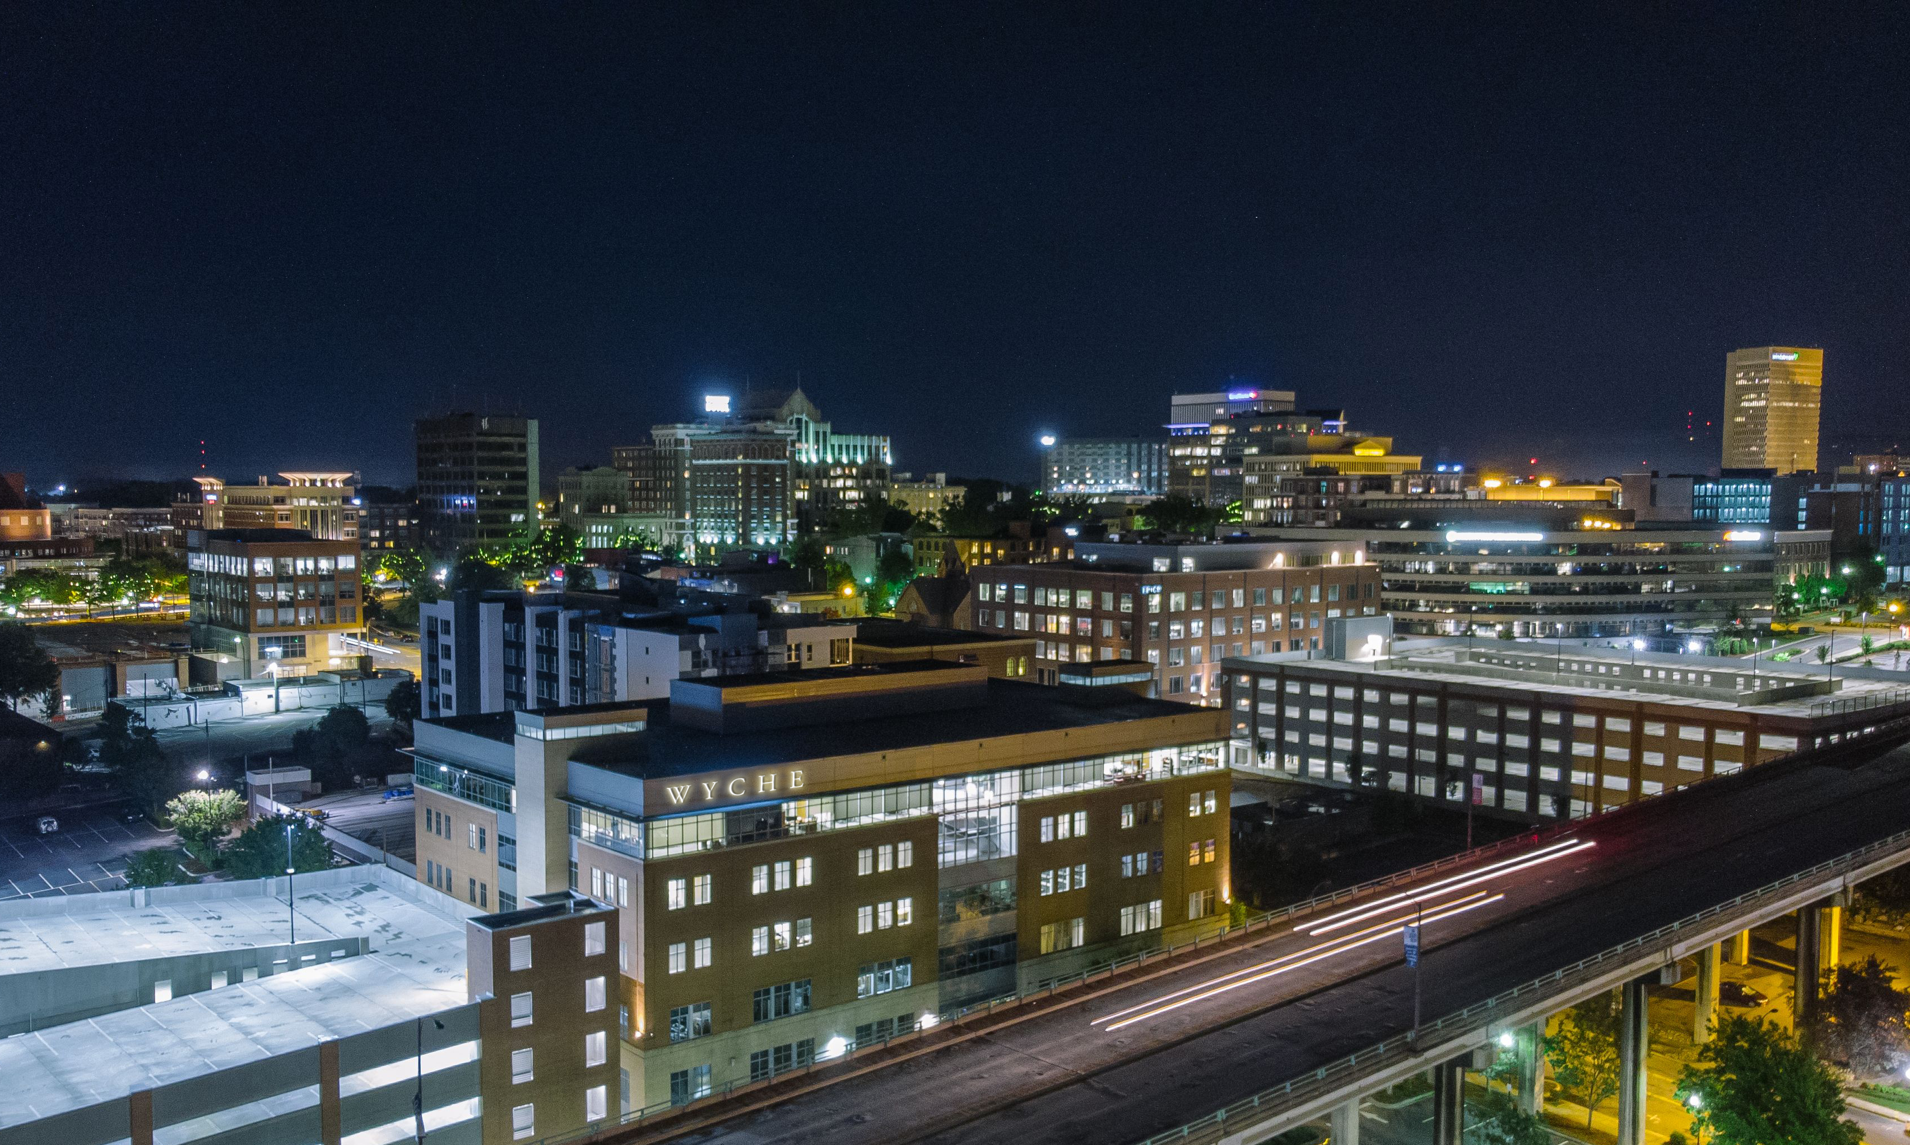

Follow us
Wyche, P.A.
Wyche, P.A.
@wychepa
Subscribe to Updates wyche.com/subscribe

